Slide 1
Theoretical Foundations for Copyright
Opening Up Copyright Instructional Module
Get ready to have a Hegel of a time!
Admit it: you Kant resist!
January 2019
Notes:
1. Hello and welcome to the University of Alberta’s Opening Up Copyright Instructional Module on Theoretical Foundations for Copyright.

Slide 2
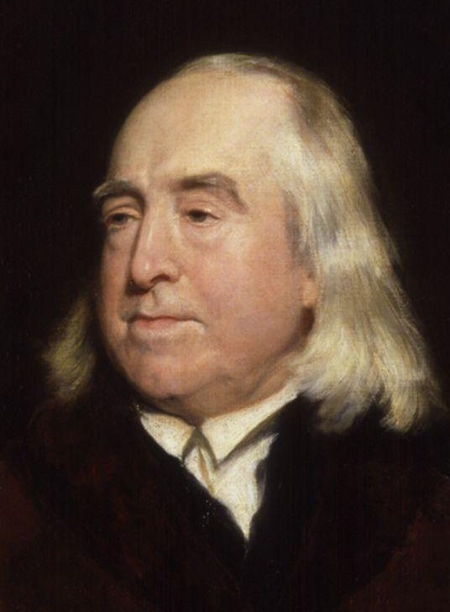
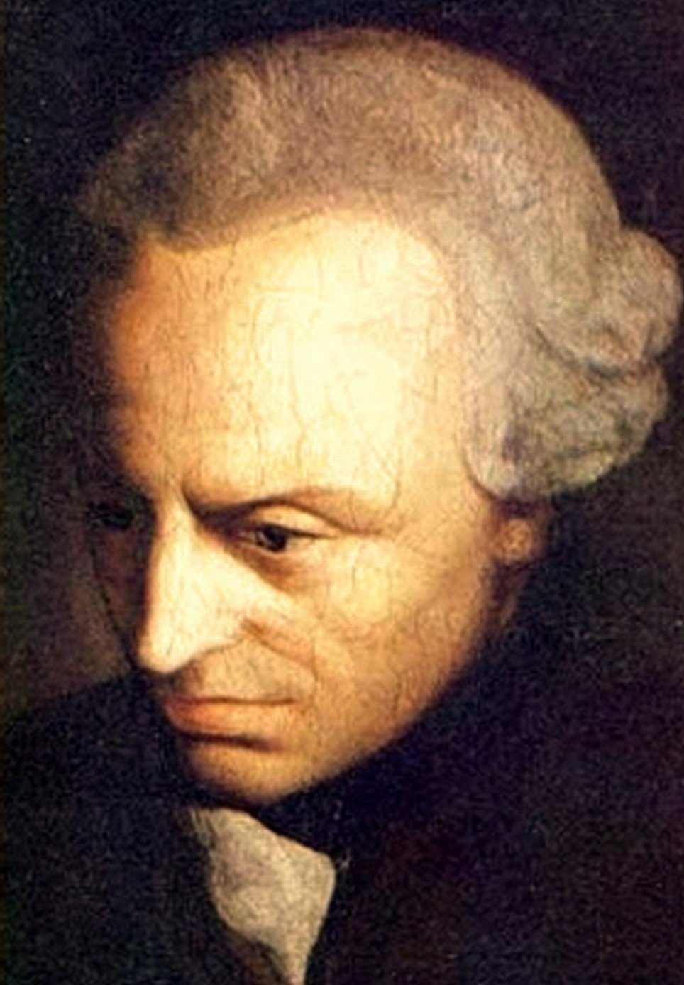
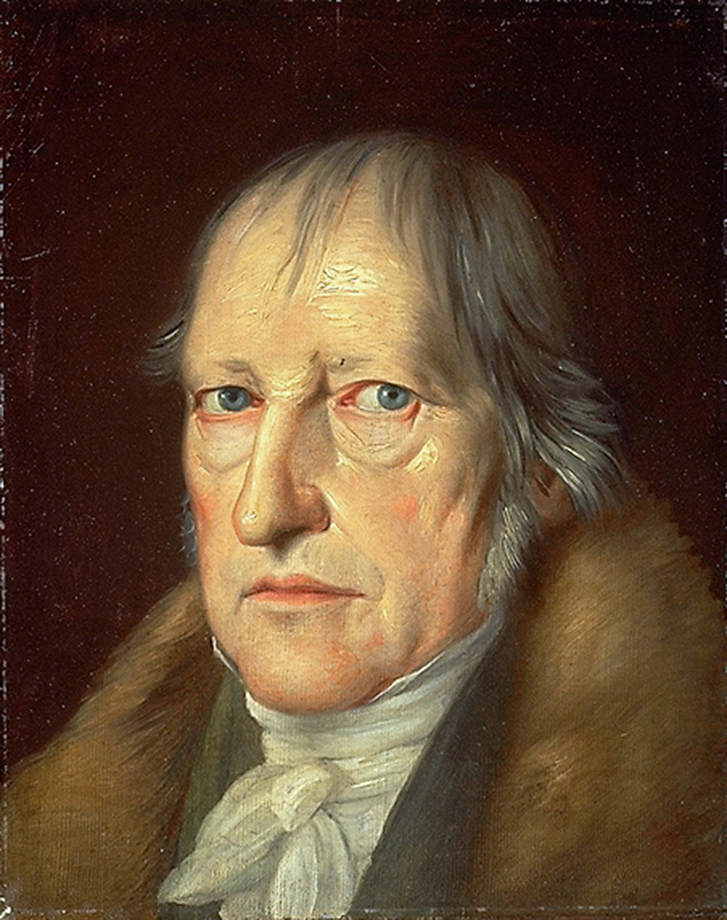
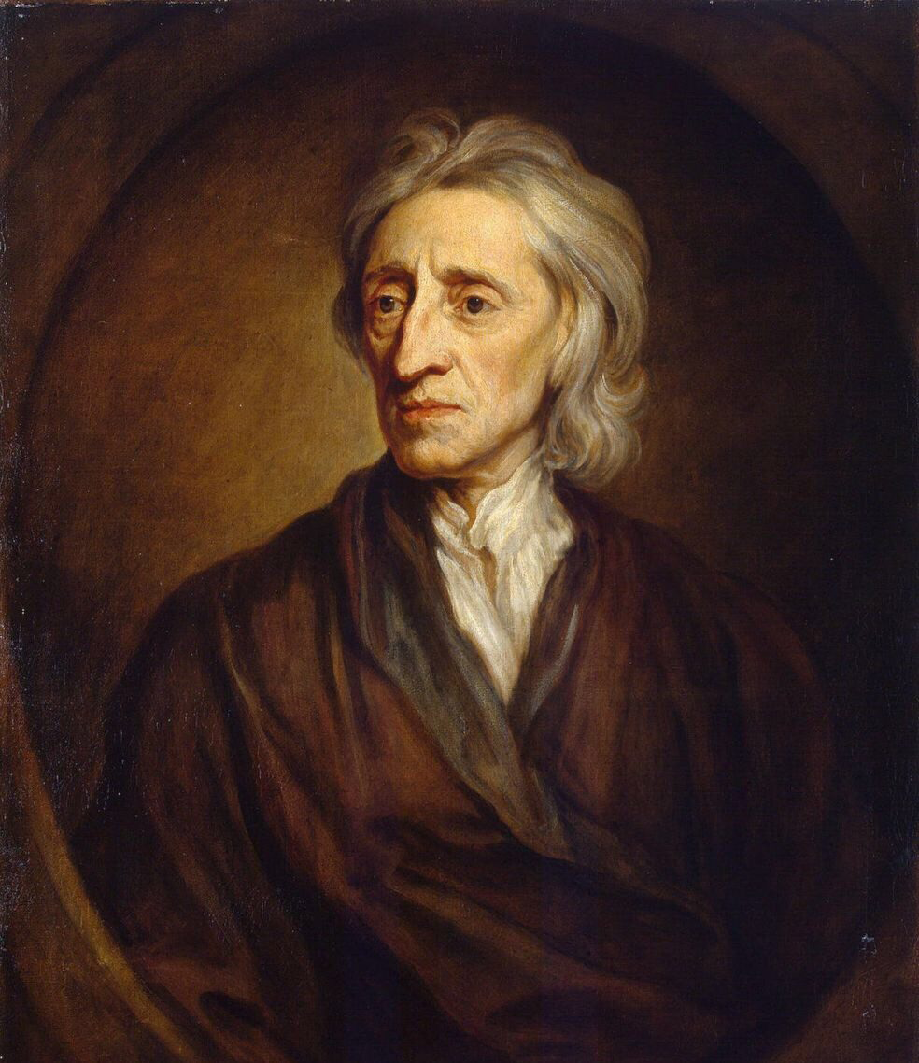
THREE APPROACHES
John Locke
Jeremy Bentham
Immanuel Kant
Georg WF Hegel
Notes:
3. In a western context there are three major approaches to the theories that justify copyright – the utilitarian/consequentialist approach, the natural rights approach and the personality-based approach.
4. Each approach to the argument for copyright is connected to the writings of one or two major philosophers - the utilitarian approach draws from the work of Bentham, the natural rights approach is developed from the writings of Locke, and the personality-based approach comes from the works of Kant and Hegel.

Slide 3
UTILITARIAN VIEW
“Of all the methods of exciting and rewarding industry, this [patenting] is the least burdensome, and the most exactly proportioned to the merit of invention.”
Encourage creative and inventive behaviour
Advance the arts and sciences
Improve society
Jeremy Bentham, The Works of Jeremy Bentham, vol. 2, John Bowring (ed.), (Edinburgh: Simpkin, Marshall and Co., 1843), 533.
Notes:
5. The utilitarian/consequentialist view of “intellectual property”, or “IP”, treats the temporary monopoly provided through IP rights as a mechanism for encouraging creative and inventive behaviour with the aim of advancing the arts and sciences and improving society as a whole. Specifically Bentham, the father of utilitarianism, viewed patents favourably arguing, “of all the methods of exciting and rewarding industry, this [patenting] is the least burdensome, and the most exactly proportioned to the merit of invention.” While he did not address copyrights specifically, Bentham's utilitarian argument for patents has been extended and applied as a justification for copyright.

Slide 4
THE US CONSTITUTION ON IP
promote the Progress of Science and useful Arts,
“To
by securing for limited Times to Authors and Inventors the exclusive Right to their respective Writings and Discoveries”
Article 1, Section 8, Clause 8
Notes:
6. This utilitarian justification is clearly present in the U.S. Constitution’s article 1, section 8, clause 8 where the explicit aim of copyright and patents are “to promote the progress of science and useful arts.” This has heavily influenced U.S. Supreme Court decisions in cases involving copyright.

Slide 5
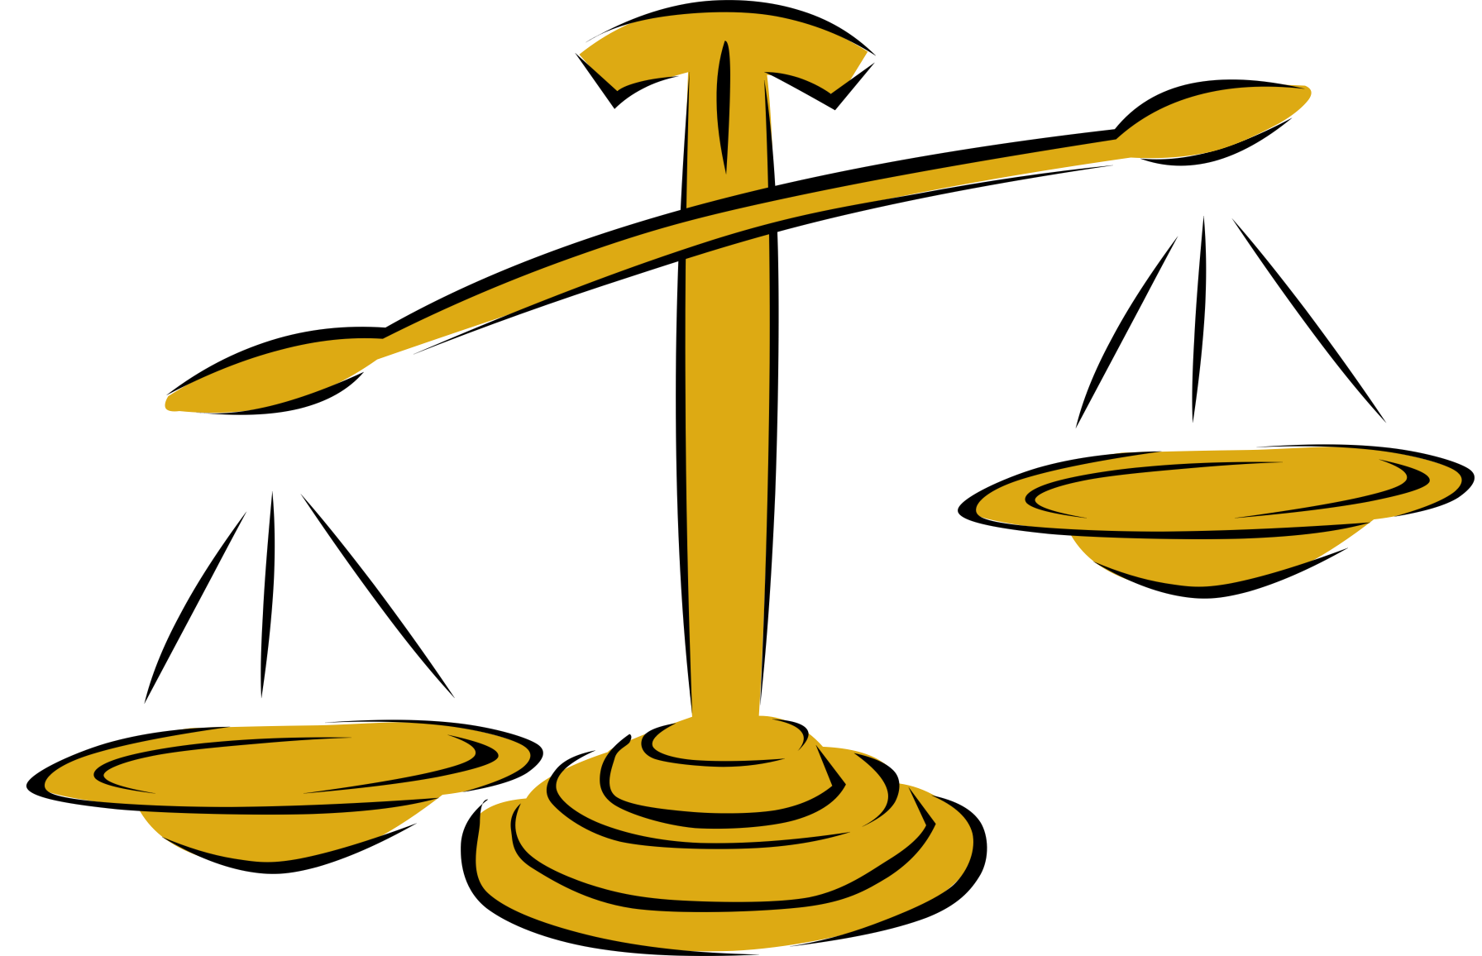
THE BALANCING ACT
Incentives
for
Creators
Creative
Behaviour
🏅
Inventive
Behaviour
Access
and
Intellectual
Good
Notes:
7. The policy goal in the utilitarian approach to copyright should be to find the optimal incentive level, which is the minimum level of incentive required to induce the greatest amount of creative and inventive behaviour. Complicating this balancing act is the fact that the greater the incentive provided to authors and creators, often through strict controls or limitations on use of works, there is a corresponding decrease in the general access to the works and the public and intellectual good arising from the broader use of those works.

Slide 6
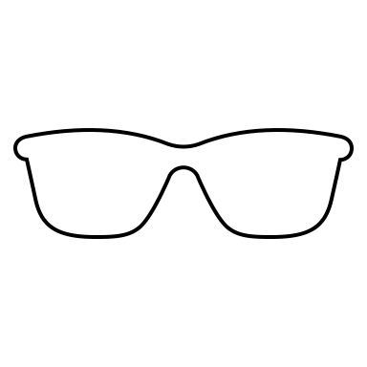
NATURAL RIGHTS APPROACH
Haha!
MINE!
Notes:
8. The natural rights based approach to copyright is drawn from the work of John Locke, specifically from his writings on the subject of common property in Two Treatises of Government, which have been extended to intellectual property. The Lockean justification is premised on the idea that when an individual mixes their own labour with something from nature, the result becomes the property of that individual.

Slide 7
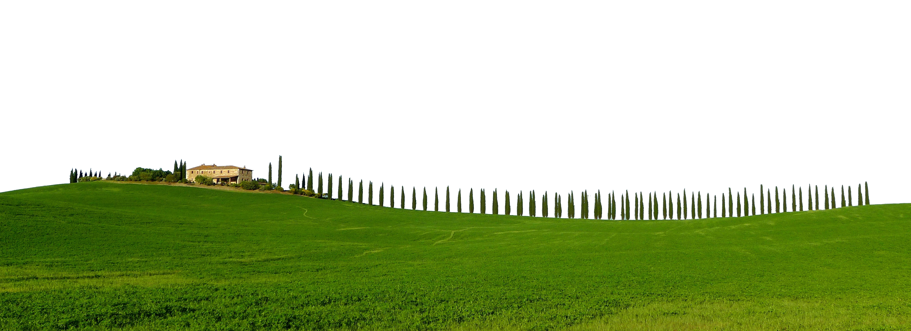
NATURAL RIGHTS APPROACH
Lockean Provisos
Increased value of common property
justifies taking ownership
Two conditions must be met:
Don’t take so much that you create spoilage
Leave “enough and as good” for others
Notes:
9. At the beginning of the process, there is some “common property”. An individual then makes an investment of his labour, and through that investment raises the value what was once common. This raising of value through the investment of individual labour is the justification for that individual’s deserving to take ownership in the product of that labour.
10. Locke indicates that there are two important conditions that must be met to justify the taking of common property – one should not take so much as to create spoilage, and one must leave “enough and as good” for others. Together these are known as the Lockean provisos.

Slide 8
NATURAL RIGHTS APPROACH
Limitations:
Intangible forms of property were not addressed
Copyright of ancient works condemned
Notes:
11. The natural rights based perspective does have limitations. In Two Treatises, Locke was not addressing intangible forms of common property, and Locke specifically wrote on the subject of copyright where he condemned providing copyright to ancient works and suggested that the term for copyright should be at most 70 years after death of the author.
12. Lockean justifications of copyright and other IP have always held a degree of appeal in Anglo-American debates, but have tended to take a secondary role to utilitarian justifications. However, the Lockean notion of a just reward for the creator is often used to supplement utilitarian arguments based on providing incentives.

Slide 9
THÉBERGE DECISION
“The Copyright Act is usually presented as a balance between promoting the public interest in the encouragement and dissemination of works of the arts and intellect and obtaining a just reward for the creator (or, more accurately, to prevent someone other than the creator from appropriating whatever benefits may be generated).”
Théberge v. Galerie d’Art du Petit Champlain Inc., 2002 SCC 34, at para. 30
Notes:
12 cont’d. The Canadian system reflects a blending of these approaches. For example, in the Théberge decision the Supreme Court of Canada noted:
The Copyright Act is usually presented as a balance between promoting the public interest in the encouragement and dissemination of works of the arts and intellect and obtaining a just reward for the creator (or, more accurately, to prevent someone other than the creator from appropriating whatever benefits may be generated). (para 30)

Slide 10
PERSONALITY-BASED APPROACH
Artistic creations are
a manifestation of
an individual’s personhood
Notes:
13. The personality-based approach of Kant and Hegel justify copyright and other IP based on the view that the artistic creations are a manifestation of an individual’s personhood and as such deserving of protection.

Slide 11
PERSONALITY-BASED APPROACH
Kant:
Condemned illegal book copying
Did not think copyright should extend to translations and derivative works
Notes:
14. Kant explicitly condemned the illegal copying of books. However, Kant’s focus on the importance of speech led him to conclude that copyright should not be extended to translations and derivative works.

Slide 12
PERSONALITY-BASED APPROACH
Hegel:
Property is essential
Authors should retain control of their intellectual property
“the author of the work or inventor of the apparatus remains the owner of the general method of multiplying such products”
Hegel, The Philosophy of Right, § 69.
Notes:
15. Hegel’s writings on intellectual property deal with both artistic works and invention. In Philosophy of Right, Hegel claims property is essential, noting that it is required to provide individuals freedom to interact with each other through mutually consenting contracts. Hegel specifically argues that inventors and authors should retain control of their intellectual property, noting, “the author of the work or inventor of the apparatus remains the owner of the general method of multiplying such products.”

Slide 13
PERSONALITY-BASED APPROACH
WHO OWNS THIS THING?
Director?
Leading actor?
Studio CEO?
Milton Bradley?
Special effects designer?
Notes:
16. While Kant’s and Hegel’s arguments may be better suited to works of individual creation by independent persons, this approach to justifying copyright presents some problems for works produced by a collective or under the scope of employment. Is the latest Hollywood movie a manifestation of the will of its director, the leading actor, or the studio’s CEO or primary shareholder?

Slide 14
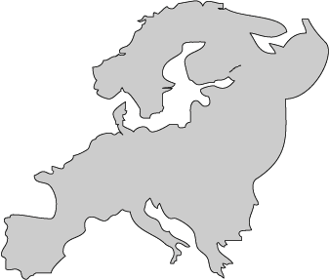
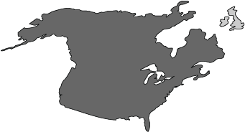
PERSONALITY-BASED APPROACH
Kant and Hegel approach creates the strongest justification for copyright and moral rights
Resonates more strongly in continental Europe
French copyright: moral rights are perpetual, inalienable, and imprescriptible
Britain and Canada have moral rights for authors but there is almost no grounds for this in U.S. copyright law
Notes:
17. Kant’s and Hegel’s personality based approaches to IP create what is arguably the strongest justification for copyright in general and for moral rights in particular. This approach has a much stronger resonance in continental Europe than in Anglo-American jurisdictions. Their influence is reflected in the 1957 French copyright law which designated moral rights as perpetual, inalienable and imprescriptible. In the Anglo-American context their influence has been muted. Though both Britain and Canada provide moral rights for authors, moral rights have almost no statutory grounds in U.S. copyright law.

Slide 15
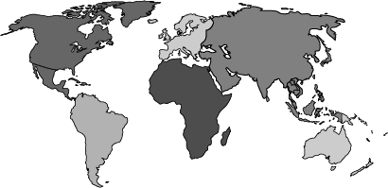
WESTERN IDEOLOGY
Notes:
Finally, it is important to recognize that all the major justificatory theories of copyright are from European authors and reflect that copyright itself is a Western concept.

Slide 16
LEARNING OBJECTIVES
You should now be able to:
Summarize the three main theories that serve as the foundation of copyright
Describe how these theories have influenced modern copyright concepts
Notes:
You should now be able to:
Summarize the three main theories that serve as the foundation of copyright
Describe how these theories have influenced modern copyright concepts

Slide 17
QUESTIONS
The natural rights approach to copyright posits that:
a) When labour is added to common property, the output should belong to the individual
b) John Locke invented lightbulbs
c) Copyright should do the most good for the most people
d) Creators should have control of their invented works forever
Under Kant and Hegel’s personality-based approach:
a) Creations exist for the benefit of everyone and don’t need protection
b) Creations are a manifestation of an individual’s personhood
c) Protection for creations should only last for 14 years
d) The concept of property is totally unimportant

Slide 18
QUESTIONS
The idea of moral rights is most strongly connected to:
a) Bentham’s utilitarian approach
b) Locke’s natural rights approach
c) Kant and Hegel’s personality-based approach
d) Rousseau’s social contract approach
Which philosopher would argue that copyright ownership should be perpetual?
a) Locke
b) Bentham
c) Kant
d) Hegel

Slide 19
REFERENCES AND RESOURCES
Bentham, J. (2000). The Works of Jeremy Bentham. Electronic edition. Colonies, Commerce, and Constitutional Law: Rid Yourselves of Ultramaria and other writings on Spain and Spanish America. (P. Schofield, Ed.). Charlottesville, Va.: InteLex Corporation.
Fischer, W. (2001). Theories of Intellectual Property. In S. R. Munzer (Ed.), New essays in the legal and political theory of property (pp. 169–194). Cambridge, UK ; New York: Cambridge University Press.
Hegel, G. W. F. (1952). Grundlinien der Philosophie des Rechts [The philosophy of right]. Chicago, IL: Encyclopedia Brittanica.
Kant, I. (1883). Die Unrechtmässigkeit des Büchenachdrucks. In R. Macfie (Ed.), Copyright and patents for inventions (Vol. 2, pp. 581–586). Edinburgh, UK: T. & T. Clark.
Locke, J. (2016). Two treatises of government. (L. Ward, Ed.). Indianapolis, Indiana: Focus.

Slide 20
CASES AND LEGISLATION
Théberge v. Galerie d’Art du Petit Champlain Inc., 2002 SCC 34
U.S. Const. art. I, § 8.

Slide 21
IMAGE AND SOUND REFERENCES
Images (in order of appearance):
Vectors Market. (n.d.) Devil Monster. The Noun Project. CC BY. https://thenounproject.com/term/devil-monster/1885152
Wikimedia Commons. (n.d.) Bentham: National Portrait Gallery. Wikimedia Commons. Public Domain. http://commons.wikimedia.org/
Godfrey Kneller. (n.d.) Locke. Wikimedia Commons. Public Domain. http://commons.wikimedia.org/
Wikimedia Commons. (n.d.) Kant. Wikimedia Commons. Public Domain. http://commons.wikimedia.org/
Jakob Schlesinger. (n.d.) Hegel. Wikimedia Commons. Public Domain. http://commons.wikimedia.org/

Slide 22
IMAGE AND SOUND REFERENCES
Clker-Free-Vector-Images. (n.d.) [Yellow balance scale]. Pixabay. CC0. https://pixabay.com/en/scales-yellow-weigh-justice-tool-30251/
Library of Congress. (n.d.) Two Treatises of Government. Wikimedia Commons. Public Domain. http://commons.wikimedia.org/
Martial Red. (n.d.) Lightning. The Noun Project. CC BY. https://thenounproject.com/term/lightning/1057044
evondue. (n.d.) [Toscana Cypress farmhouse]. Pixabay. CC0. https://pixabay.com/en/toscana-cypresses-farmhouse-scenic-2286630/
National Portrait Gallery. (n.d.) Philosophy of Right by Georg Wilhelm Friedrich Hegel [Digital scan of original work]. Wikimedia Commons. Public Domain. http://commons.wikimedia.org/

Slide 23
LICENSING AND ATTRIBUTION
Suggested Citation:
University of Alberta. 2018. “Theoretical Foundations for Copyright.” Opening Up Copyright Instructional Module. https://www.ualberta.ca/copyright/resources/opening-up-copyright-instructional-modules
For the project overview and complete list of modules please visit the project website at: https://www.ualberta.ca/copyright/resources/opening-up-copyright-instructional-modules
Questions, comments, and suggestions should be directed to the University of Alberta’s Copyright Office at: copyright@ualberta.ca
This module is made available and licensed under a Creative Commons Attribution 4.0 International Licence

Slide 24
CONTRIBUTORS
Copyright Office
Centre for Teaching and Learning
Technologies in Education
Adrian Sheppard
Amanda Wakaruk
Cosette Lemelin
Graeme Pate
Krysta McNutt
Anwen Burk
Jamie Stewart
Matt Cheung
University of Alberta Libraries
School of Library and Information Studies
Michelle Brailey
Jesse Carson
Toby Grant
Kris Joseph
Michael B. McNally

Slide 25
ACKNOWLEDGEMENT
Opening Up Copyright modules were initially funded through the University of Alberta, Centre for Teaching and Learning’s Teaching and Learning Enhancement Fund (TLEF) with in kind contributions from the Copyright Office and the School of Library and Information Studies.

