Slide 1
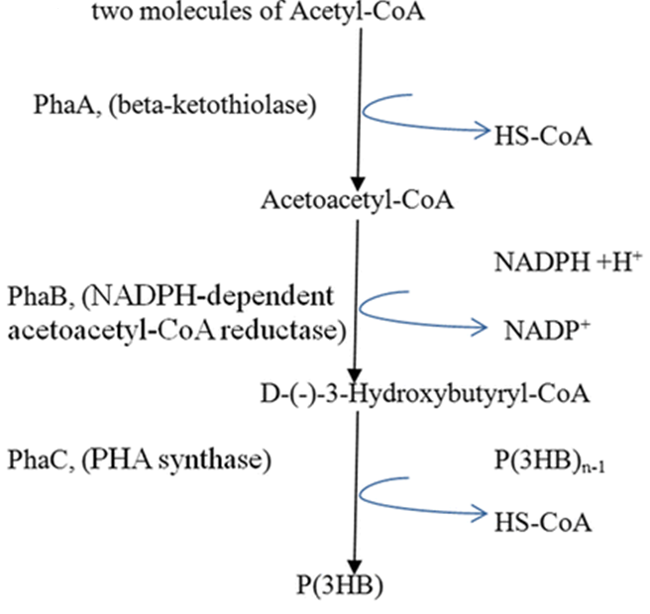
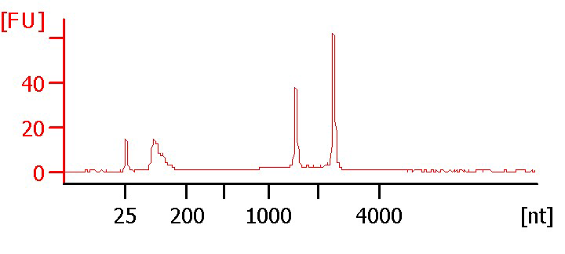
Optimizing biopolymer production by microorganisms using C1 substrates
*Catherine Tays, Albert Remus Rosana, Dominic Sauvageau, & Lisa Stein
University of Alberta, Edmonton AB, Canada
Background
Batch Culture
Transcriptomics and Future Work
ON METHANOTROPHS, PHB, SELF-CYCLING FERMENTATION, AND WHY YOU SHOULD CARE:
GROWTH CURVES UNDER VARIOUS CONDITIONS
Growth curves have been completed with both strains of interest under conditions of variable carbon and nitrogen source.
These conditions include either ammonia mineral salts (AMS) or nitrate mineral salts (NMS) media paired with either methane or methanol provided as a carbon source.
Growth estimates were completed by measuring optical density of cultures by spectrophotometer.
RNA EXTRACTION OF EACH GROWTH CONDITION
Total RNA (i.e. transcriptome) of each culture and condition above has been extracted using an optimized procedure during the log (exponential) phase of growth.
After extraction, the RNA sample is tested for quality using a BioAnalyzer to identify possible degradation or contamination and to quantify the sample.
Sequencing of the RNA extracted in the Stein lab will be accomplished by the US Department of Energy Joint Genome Institute using the Illumina platform.
Once the sequences are received, analysis of the resulting transcriptomes will commence.
Fig. 4. A representative BioAnalyzer trace of the M. trichosporium OB3b NMS-methane condition, showing a clean extraction without degradation.
FURTHER DIRECTIONS
Currently, this project is still in its initial stages, aimed at essential information gathering on the bacteria themselves and on the development of the self-cycling fermentation strategy to best suit the organisms.
The next steps will include interpretation of the transcriptome results in terms of regulation of carbon and nitrogen metabolic pathways and experimentation with PHB extraction protocols.
Methanotrophs are organisms that derive both their carbon source and energy from methane. These bacteria possess great potential for application as bioremediators and producers of industrially-relevant value-added products (Smith et al., 2010). Under certain conditions Alphaproteobacteria methanotrophs produce the biopolymer polyhydroxybutyrate (PHB), which is a precursor to biodegradable next-generation bioplastics (Khosravi-Darani et al., 3013).
Immense commercial and environmental value are inherent in such a product as methane is an inexpensive and polluting carbon source and a greenhouse gas that is emitted as industrial waste. Historically, the difficulty of PHB production was in economic viability – how to get enough product from the microorganism and extract it efficiently (Khosravi-Darani et al., 3013).
This project will show that the answer lies in an interdisciplinary approach that incorporates both the development and application of biotechnology and the analytical research used to examine the efficacy and effects of the biotechnology being developed.
Towards that end, this project will couple self-cycling fermentation (SCF) with transcriptomic analysis, pairing superior culturing with microbiological understanding and expertise. SCF has been shown to result in synchronization of cultures and generally results in greater product yield than traditional techniques (Brown, 2001). The potential for such a technique is staggering and its proper execution, supported by the data generated from this research, could result in production of materials that are useful to society, non-harmful to the environment, and profitable for those who would exploit them.
Fig. 1. Production of PHB from Acetyl-CoA (adapted from Vincenzini et al. 1999).
Fig. 2. Graph showing the growth curves of Methylosinus trichosporium OB3b under different media-carbon source conditions.
Goals and Methods
TerraVerdae Bioworks
OPTIMIZATION OF BIOPOLYMER PRODUCTION THROUGH INTEGRATION OF BIOLOGY AND ENGINEERING
Essentially, this research requires working at the interface of two different disciplines: biological sciences and chemical engineering, involving the analysis of the cellular regulation and pathways involved in producing PHB in alphaproteobacterial methanotrophs as well as the development of processing strategies to optimize this production.
The alphaproteobacterial methanotrophs chosen for this project are Methylosinus trichosporium strain OB3b and Methyocystis sp. strain Rockwell. M. trichosporium OB3b is a well-studied model methanotroph while Methylocystis sp. Rockwell is an as-of-yet unexplored strain.
PHB production will later be optimized by incorporating the strategies of self-cycling fermentation, exploiting pathways leading to PHB, and experimentation with more efficient methods of PHB extraction.
INDUSTRIAL RELEVANCE AND PARTNERSHIP
As well as being a true integration of microbiology and chemical engineering, this project demonstrates a direct applicability to industry and businesses who would harness the technology and methodology being researched.
TerraVerdae BioWorks is one such business; a company that seeks alternatives to fossil fuel-derived products through development of bioplastics and bio-chemicals. The development of PHB-producing and -harvesting technologies is currently being completed with their collaboration.
Literature Cited
Fig. 3. Graph showing the growth curves of Methylocystis sp. Strain Rockwell under different media-carbon source conditions.
Brown, W.A. (2001). “The self-cycling fermentor – development, applications, and future opportunities”. Recent Developments in Biotechnology & Bioengineering 4: 61-90.
Khosravi-Darani, K., Mokhtari, Z., Amai, T., & Tanaka K. (2013). “Microbial production of poly(hydroxybutyrate) from C1 sources”. Applied Microbiology and Biotechnology 97: 1407-1424.
Smith, T.J., Trotsenko, Y.A., & Murrell, J.C. (2010). Physiology and Biochemistry of the Aerobic Methane Oxidizing Bacteria. In K.N. Timmis (ed.), Handbook of Hydrocarbon and Lipid Microbiology (pp. 767-779).
Vincenzini M., & De Philippis, R. (1999) Polyhydroxyalkanoates. In: Chemicals from Microalgae, Cohen Z, London, Taylor and Francis, pp 292-352.
For both strains, growth curves demonstrated a nitrogen-carbon source preference of AMS-methane as indicated by shorter lag phases and higher cell densities at stationary phase.
These growth curves were used to assess culture growth in the following RNA extraction trials; cells were harvested at mid-log, according to comparison of culture turbidity to these growth curves.

