Slide 1

Open Educational Resources (OER): Background and Some Considerations
Michael B. McNally (mmcnally@ualberta.ca)
Assistant Professor, School of Library and Information Studies
University of Alberta

Slide 2
Outline
A – Introduction to Open Educational Resources (OER)
B – Role of Libraries in OERs
C – OER Considerations

Slide 3
A-I. What Are Open Educational Resources (OER)
Term “Open Educational Resources” coined at a 2002 UNESCO conference, which defined OER as
  the open provision of educational resources, enabled by information and communications technologies, for consultation, use and adaption by a community of users for non-commercial purposes
Alternatively the OECD in Giving Knowledge for Free (2007) defined OER as,
  digitised materials offered freely and openly for educators, students and self-learners to use and reuse for teaching, learning and research

Slide 4

A-II. Forms of OER
Primary forms of OER include
  Entire courses or course materials (open courseware)
  Textbooks
  Multimedia content
However, any learning object could be an OER
Also important to remember for OER to be successful it is necessary to have underlying technology, tools and implementation resources

Slide 5
A-III. Rising Openness
OER part of larger trend towards openness
Historical linkage between open movements and the academy
Teaching
Open Educational Resources
Research (Output) :
Open Access Publishing
Technology:
Open Source Software
Research (Input) :
Open Data

Slide 6
A-IV. OER Stakeholders
Several different parties with a vested interest in OERs
  Educators/teachers – as both OER creators and users
  Librarians – facilitators for OER, but also creators
  Students/learners – users, and potentially as creators
  Governments – as financial supporters of OER and OER policymakers
  The general public – as learners and financial backers of students

Slide 7
A-V. OER Barriers (OECD, 2007)
Institutional barriers
  Costs of developing and sustaining OER initiatives
  Fear that OER may undermine commercialization efforts
Individual barriers for creating OER
  Lack of institutional support including recognition of OER development in promotion and tenure considerations
  Fear of loss of control over one’s intellectual work
  Fear of criticism from peers or the broader community
  Confusion over copyright and licensing issues
Individual barrier for using OER
  Concerns of the quality of the content
  Lack of time and difficulty in locating content
  Confusion over copyright and licensing issues

Slide 8
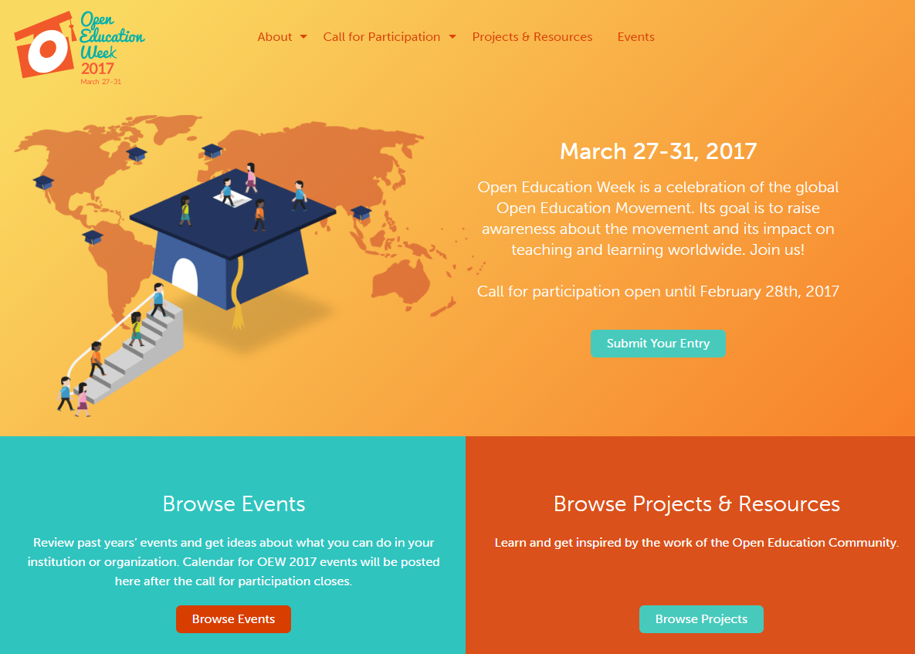
B-I. Role of Librarians: Advocacy and Promotion

Slide 9
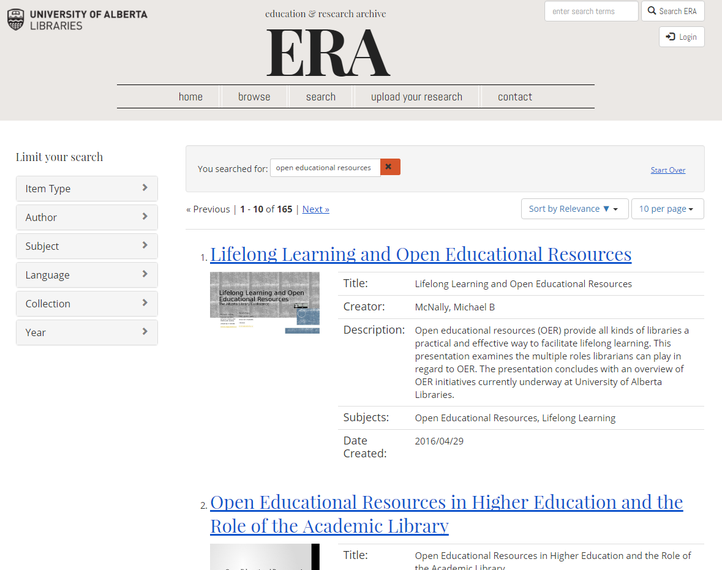
B-II. Role of Librarians: Facilitation of Dissemination

Slide 10
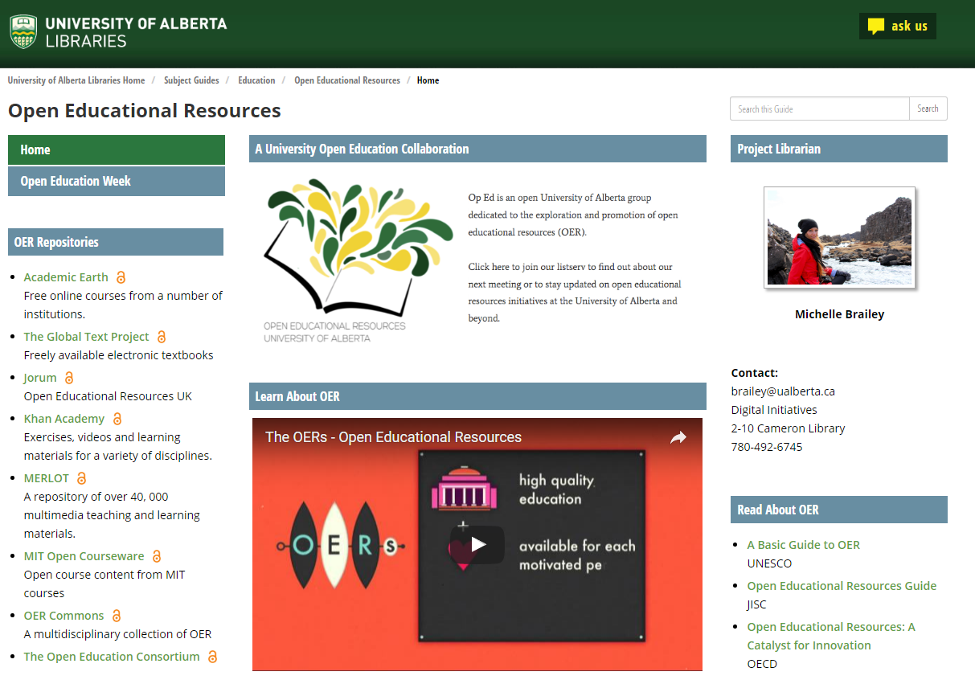
B-I. Role of Librarians:
Locating OER

Slide 11
B-I. Role of Librarians:
Copyright and Licensing Instruction

Slide 12

C-I. Creation Considerations
In creating OERs you need to align the openness of the file type with openness of the license
A permissively licensed (e.g. CC-BY or CC0) object with a restrictive file type (e.g. PDF) is a poor match
Ideally permissible licenses go with easily modifiable formats

Slide 13
C-II. For Whom is this Learning Object?
Creating materials for use in class or presentations to also serve as OERs makes sense
  However, considering of the needs of both leads to competing design needs
Need to consider primary and secondary audience (Smith and Ragan, 2005)
Secondary audience for OERs though include both learners and OER creators, arguably across the whole globe
  Only 20% of MIT’s users are educators looking to incorporate OER into their own teaching materials (MIT, 2016)

Slide 14
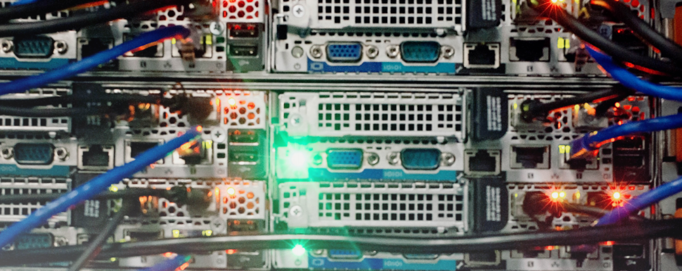
C-III. OERs Are Not Universal
Secondary audience should not be considered to be everyone on earth, despite rhetoric on the universal nature of OERs (see UNESCO, 2014).
Language divide – less that 500 million native English speakers (Ethnologue, 2015).
Digital divide – 15% of Canadians still do not use the internet (ITU, 2014)
Electrical Divide – estimated 20% of the global population doesn’t have access to electricity; 32% lack access in rural areas globally (IEA, 2012)

Slide 15
C-IV. Copyright Considerations
The Canadian Copyright Act provides numerous exceptions for educators
  Fair dealing (for the purposes of research, private study and education (among others)) (s. 29)
  Non-commercial user-generated content (s. 29.21)
  Educational exceptions (s. 29.4 to 30.04)
International users don’t benefit from the latter two, and fair dealing/use in other countries may be more restrictive
In general, to ensure broadest possible use of resources, one must rely on openly licensed materials

Slide 16
C-V. Considerations for Alternatively Abled Users
Ideally OERs should consider people with visual, hearing, physical, and cognitive disabilities (OECD, 2007)
These considerations include (among others):
  Easily readable text
  Descriptions for graphics and text
  Ensuring screen reader compatibility
  Captioning for audio
  Appropriate language level
  Explicit rather than embedded URLs

Slide 17
C-VI. Critical Considerations
OER can be seen as a form of neocolonialism in education (Weiland, 2015; Crissinger, 2015, Ameil, 2012)
OER does little to address major, structural changes in academic labour
  Still no evidence of OERs factoring into promotion and tenure concerns, and OERs do little for the expanding pool of precarious sessional instructors (Crissinger, 2015)
Major users still appear to be from more wealthy regions
  Of MIT OCW users only 4% from Latin and South America, 4% from Northern Africa, and 2% from Sub-Saharan Africa (MIT, 2016)

Slide 18
C-VII. Converging and Diverging Stakeholders
Cost
Awareness and discoverability
Quality

Slide 19
C-VII(ii). Converging and Diverging Stakeholders
In Alberta, Government is primarily concerned with cost:
  “The Open Educational Resource Initiative is a long-term strategy to help reduce, over time, the costs students face for a post-secondary education.” Government of Alberta (2014)
B.C.’s Open Textbook Project has also generally had a similar focus, though with greater demonstrable results (costs savings of between $1.1m and $1.4m) (Jhangiani et al. 2016)
Costs savings has also been a key driver for student interest in OER projects

Slide 20

C-VII(iii). Converging and Diverging Stakeholders
In a survey of almost 1000 BC post-secondary educators, the three most common barriers were:
  Finding suitable resources (58.2%)
  Finding resources of sufficiently high quality (56.1%)
  Knowing where to find resources (53.3%) (Jhangiani et al., 2016)
A recent U.S. study of over 3000 faculty members found that costs for students was among the most important factor for professors in selecting a resource (Allen and Seaman, 2016)
  However, they also concluded, “cost to the student is important, but only after content, relevance, quality and presentation have been considered.” (Allen and Seaman, 2016, p. 10)
More importantly Allen and Seaman (2016) note that overall OER still struggle from awareness problems with 58% of their respondents “Not Aware” of OER

Slide 21
Sources
Alberta. 2014. “Open Resources will Benefit Post-Secondary Students.” (8 Apr. 2014): http://www.alberta.ca/release.cfm?xID=361759413B5A0-D9D0-0BAB-223D46A8642B6F47
Allen, I Elaine, and Jeff Seaman. 2016. Opening the Textbook: Educational Resources in U.S. Higher Education, 2015-16. http://www.onlinelearningsurvey.com/reports/openingthetextbook2016.pdf
Ameil, Tel. 2012. “Identifying Barriers to the Remix of Translated Open Educational Resources.” International Review of Research in Open and Distance Learning, 14(1): p. 16-144.
Copyright Act. R.S.C., 1985, c. C-42. http://laws-lois.justice.gc.ca/eng/acts/C-42/FullText.html
Crissinger, Sarah. 2015. “A Critical Take on OER Practices: Interrogating, Commercialization, Colonialism and Content.” In the Library with the Lead Pipe, (Oct. 2015),: http://www.inthelibrarywiththeleadpipe.org/2015/a-critical-take-on-oer-practices-interrogating-commercialization-colonialism-and-content/
International Energy Agency (IEA). 2012. “Access to Electricity.” http://www.worldenergyoutlook.org/resources/energydevelopment/accesstoelectricity/
International Telecommunications Union (ITU). 2014. “Percentage of Individuals Using the Internet.” http://www.itu.int/en/ITU-D/Statistics/Pages/stat/default.aspx
Jhangiani, Rajiv S., Rebecca Pitt, Christina Hendricks, Jessie Key and Clint Lalonde. 2016. Explore Faculty Use of Open Educational Resources at British Columbia Post Secondary Institutions. https://bccampus.ca/files/2016/01/BCFacultyUseOfOER_final.pdf
Lewis, M. Paul, Gary F. Simons, and Charles D. Fennig (eds.). 2015.Ethnologue: Languages of the World, Eighteenth edition. Dallas, Texas: SIL International. Online version: http://www.ethnologue.com.
MIT. 2016. “MIT OpenCourseWare Site Statistics.” https://ocw.mit.edu/about/site-statistics/Organisation for Economic Cooperation and Development (OECD). 2007. Giving Knowledge for Free: The Emergence of Open Educational Resources. http://www.oecd.org/edu/ceri/givingknowledgeforfreetheemergenceofopeneducationalresources.htm
Smith, Patricia L., and Tillman J. Ragan. 2005. Instructional Design. 3rd Ed. Hoboken, NJ: Wiley.
United Nations Educational, Scientific and Cultural Organization. (UNESCO). 2014. “Open Educational
Weiland, Steven. 2015. “Open Educational Resources: American Ideals, Global Questions.” Global Education Review, 2(3): 4-22.

