Slide 1


PUBLIC DOMAIN
Opening Up Copyright Instructional Module
Mar. 2018

Slide 2
LEARNING OBJECTIVES
By the end of this module, you will be able to:
  Describe the public domain’s scope and relationship with copyright;
  Recognize the three categories of works in the public domain;
  Identify public domain works; and
  Contribute your own works to the public domain.

Slide 3

PUBLIC DOMAIN AND COPYRIGHT
Works protected by copyright in Canada
Universe of All Creative Works
Works where copyright protection has been waived
≠
Public domain
Publicly available
Public Domain
Works for which copyright protection has expired
Works not eligible for copyright protection

Slide 4
WORKS NOT ELIGIBLE FOR COPYRIGHT PROTECTION
Works protected by copyright in Canada
Universe of All Creative Works
Works where copyright protection has been waived
Works for which copyright protection has expired
Works not eligible for copyright protection

Slide 5

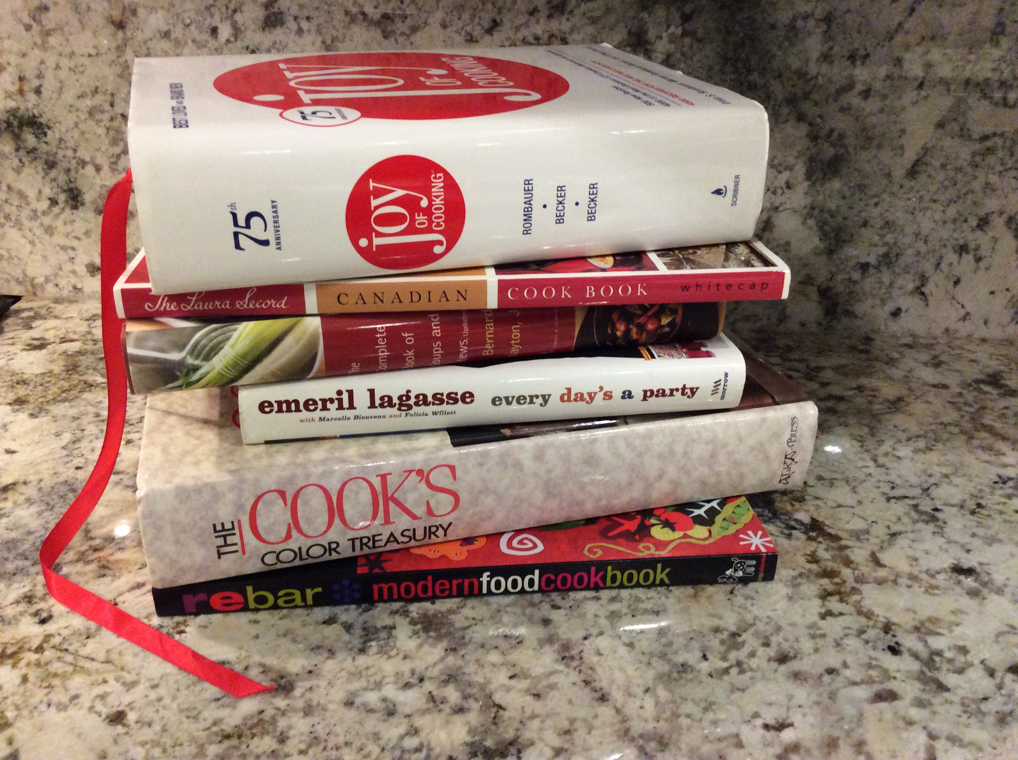
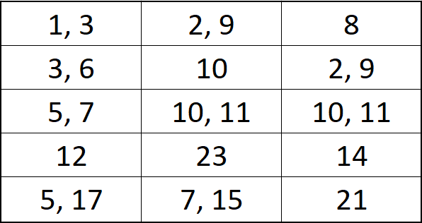
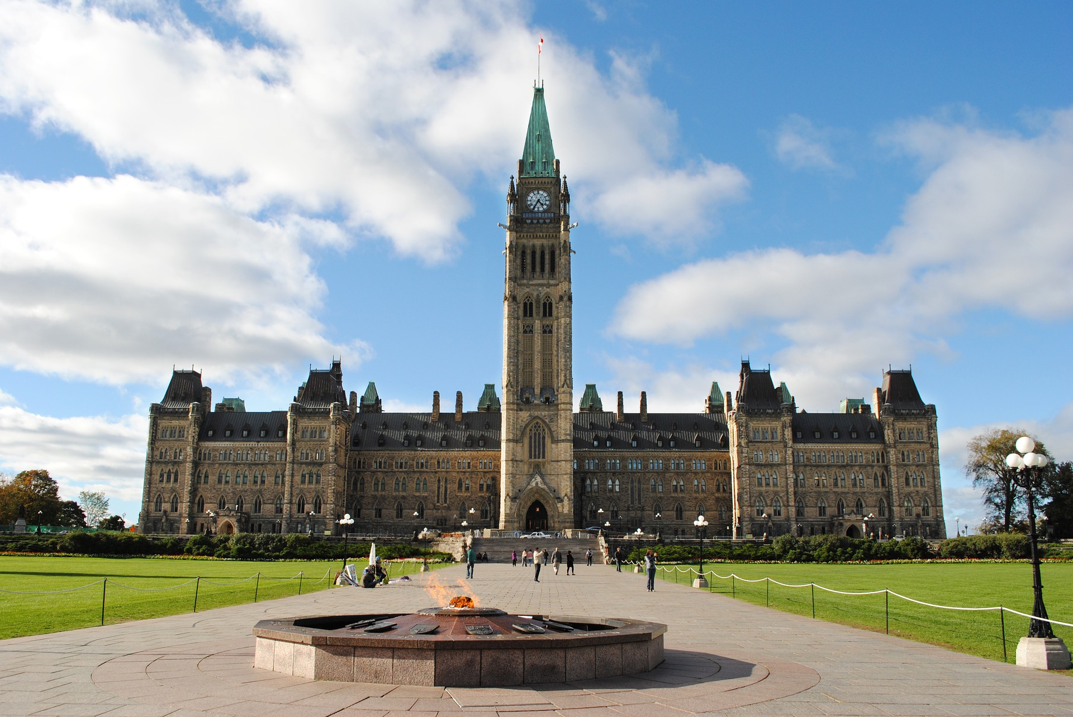
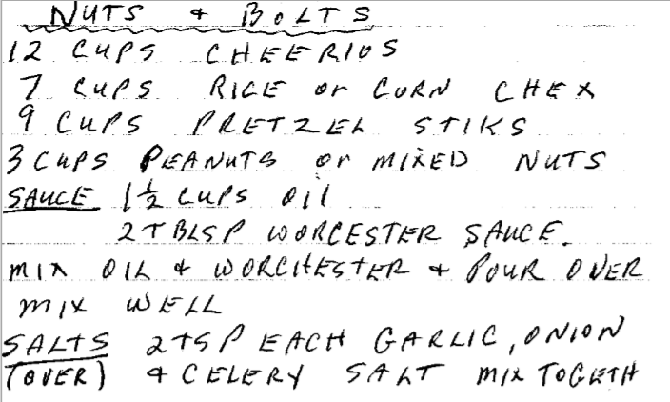
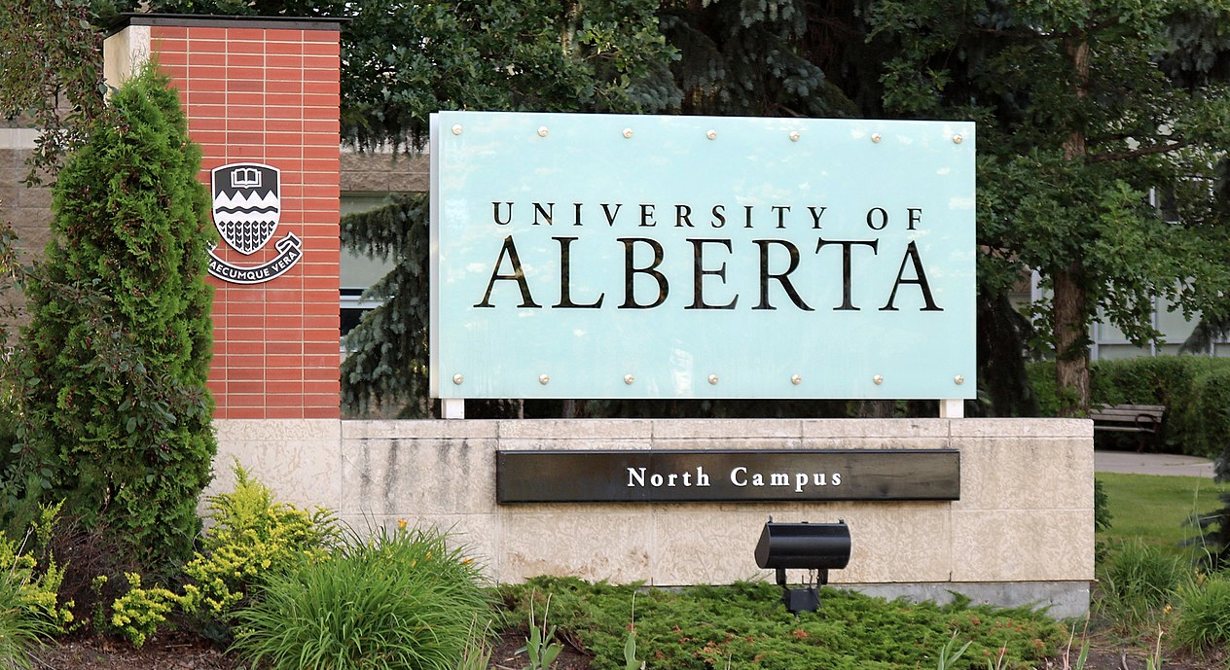
WORKS NOT ELIGIBLE FOR COPYRIGHT PROTECTION
Ursula Dawn Hall
Gary Peter Goodall
Larry Stevens
E=mc²
F=ma
e^{iπ} + 1 = 0
Ottawa:
The Capital of Canada
71 45 23
89 74 42
4 52 11
1 + 7 = 9
Festivio, 2013, CC0
Beall, 2017, CC-BY

Slide 6
WORKS FOR WHICH COPYRIGHT HAS EXPIRED
Works protected by copyright in Canada
Universe of All Creative Works
Works where copyright protection has been waived
Works for which copyright protection has expired
Works not eligible for copyright protection

Slide 7
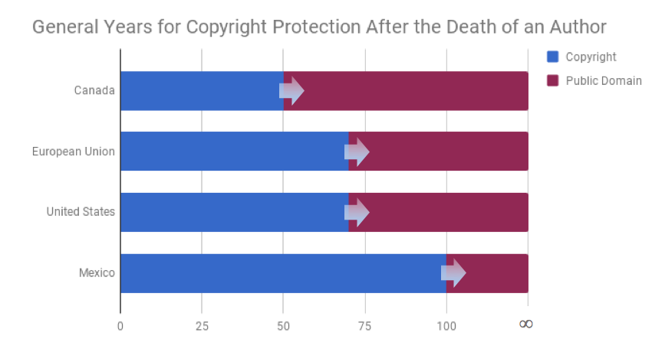
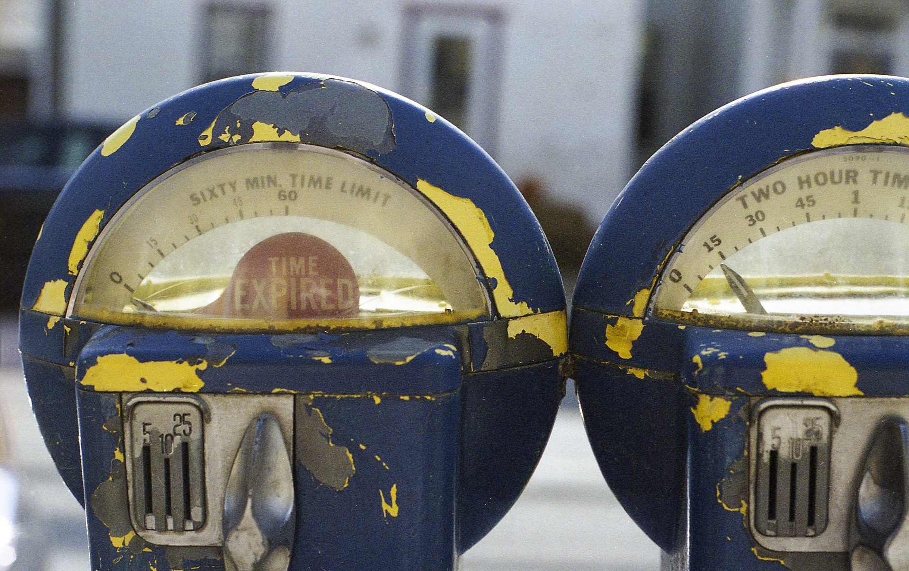
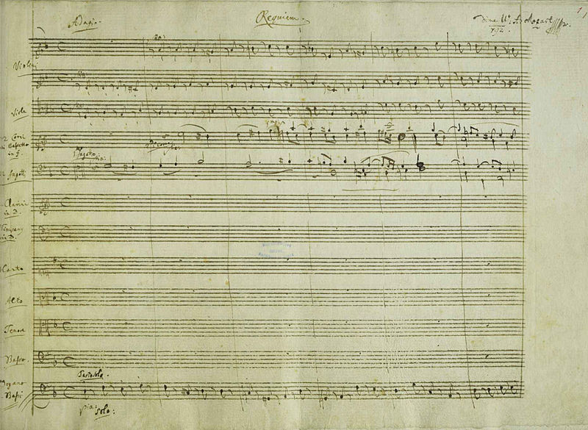
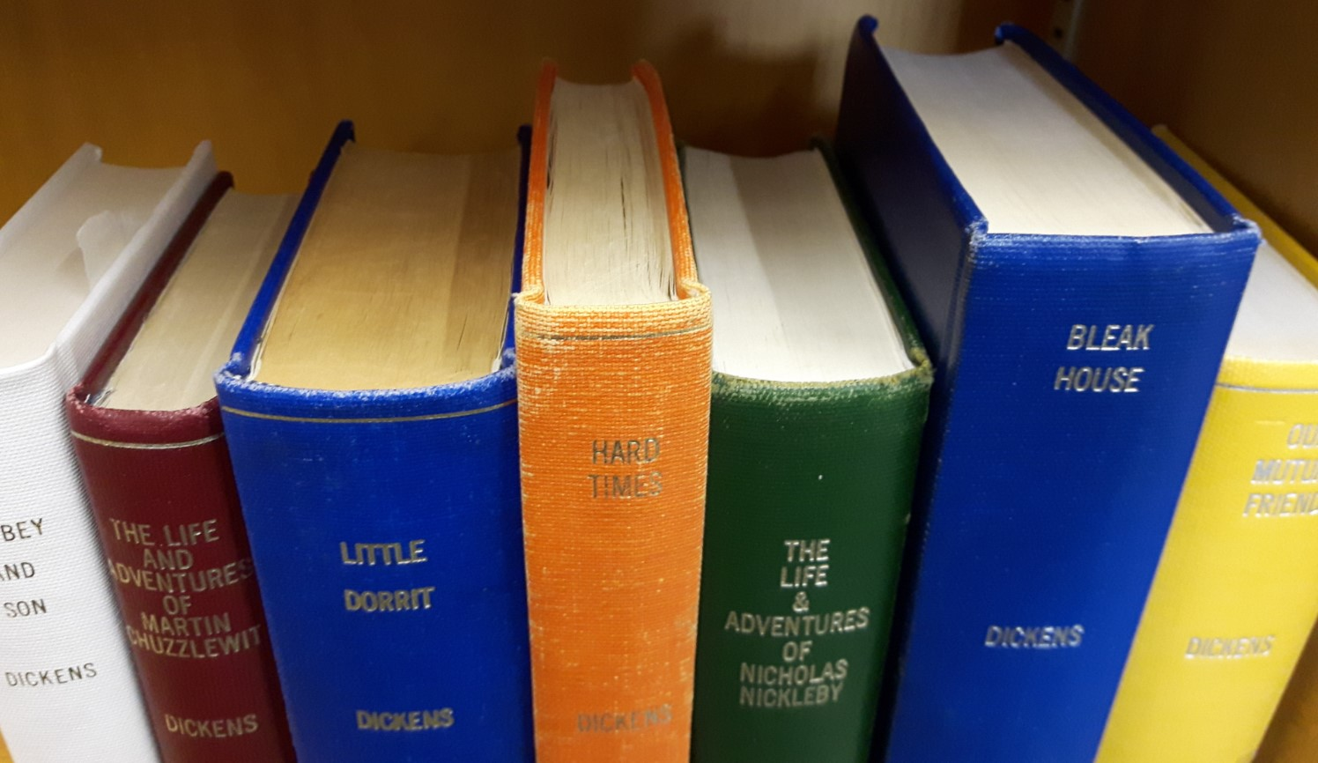
WORKS FOR WHICH COPYRIGHT HAS EXPIRED
Mozart
d. 1791
Dickens
d. 1870
In Canada, the copyright term normally expires 50 years after the end of the calendar year of the author’s death. The work becomes part of the public domain on January 1.
Mozart, 1791, PD
Free-Photos, 2015, CC0

Slide 8
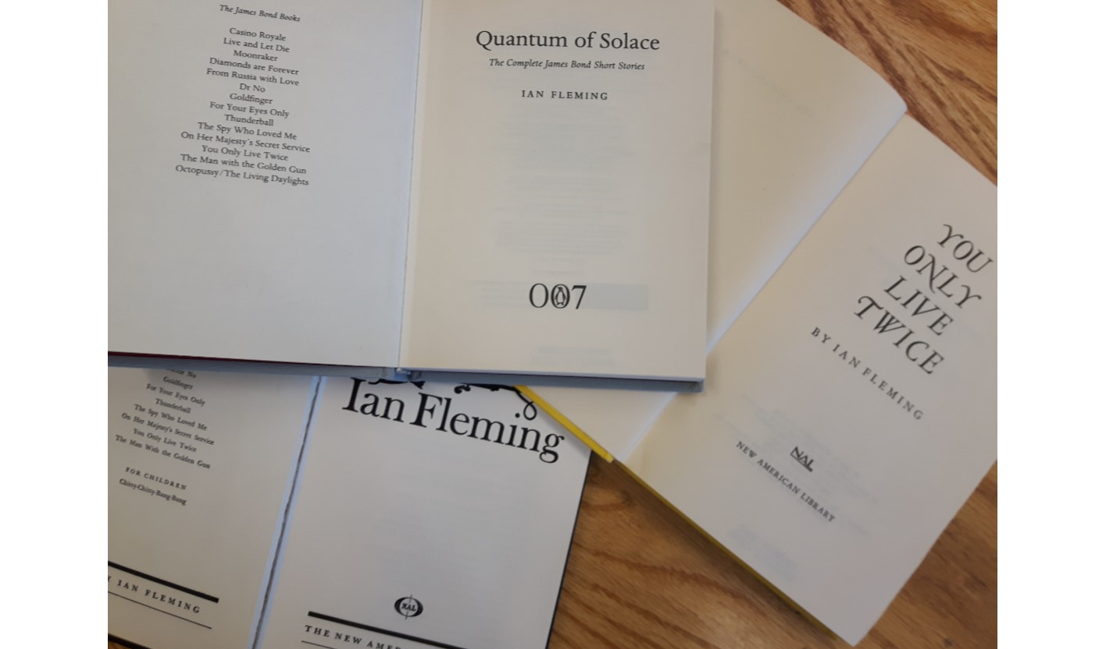
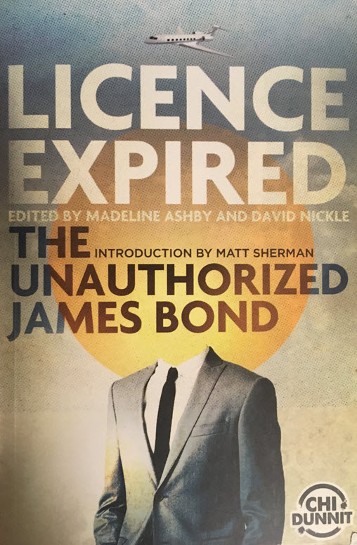
MATERIAL FOR WHICH COPYRIGHT HAS EXPIRED
Ian Fleming dies
Aug 12, 1964
2017
Jan 1, 2015
Ian Fleming’s novels enter the public domain in Canada

Slide 9
MATERIAL FOR WHICH COPYRIGHT PROTECTION HAS BEEN WAIVED
Works protected by copyright in Canada
Works where copyright protection has been waived
Works for which copyright protection has expired
Works not eligible for copyright protection

Slide 10
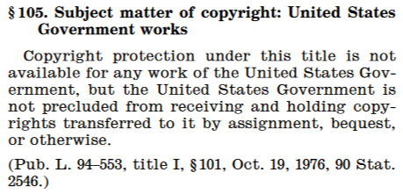
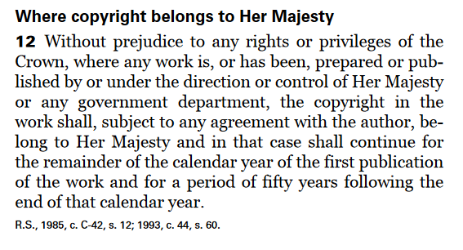
MATERIAL FOR WHICH COPYRIGHT PROTECTION HAS BEEN WAIVED
Canada’s Crown copyright (Copyright Act s.12)
U.S. Federal Government’s waiver of copyright (17 U.S.C. §105)

Slide 11

MATERIAL FOR WHICH COPYRIGHT PROTECTION HAS BEEN WAIVED
CC0
“No Rights Reserved”
Creative Commons Zero Designation
Example of a CC0 Waiver

Slide 12
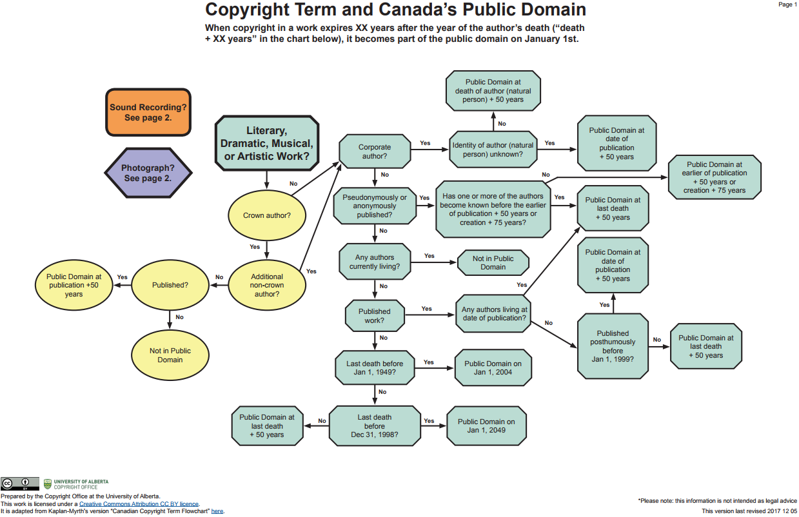
IDENTIFYING PUBLIC DOMAIN WORKS
Was the creator a corporation?
See the ‘References and Resources’ slide at the end for a link to the flowchart!
Published work?
When did the last co-creator die?

Slide 13
LEARNING OBJECTIVES
You should now be able to:
  Describe the public domain’s scope and relationship with copyright;
  Recognize the three categories of works in the public domain;
  Identify public domain works; and
  Contribute your own works to the public domain.

Slide 14
TEST QUESTIONS AND ANSWERS
Learning Objective: Describe the public domain’s scope and relationship with copyright
A work can be simultaneously in the public domain and protected by copyright in Canada:
True
False
Learning Objective: Recognize the three categories of works in the public domain
Which of the following works would not be in the public domain in Canada:
A work for which the term of copyright has expired
A work which was never protected by copyright
A work for which copyright protection has been waived
A Government of Canada report published in 1982

Slide 15
TEST QUESTIONS AND ANSWERS
Learning Objective: Identify public domain works
Select the factor that would be relevant for determining if a single-authored book is in the public domain:
The book has a Creative Commons Attribution (CC-BY) licence
The book was published in France
The author died in 1964
The author was Canadian
Learning Objective: Contribute your own works to the public domain
One way an author can place a work in the public domain is to:
Make it available on the public internet
Apply to the Copyright Board of Canada
Get approval from the Minister of Innovation
Assign a CC0 Licence

Slide 16
REFERENCES AND RESOURCES
Ashby, Madeline and David Nickle. (Eds.). Licence Expired: The Unauthorized James Bond. Toronto: ChiDunnit.
Boyle, James. The Public Domain. New Haven, CT: Yale University Press, 2008. http://thepublicdomain.org/thepublicdomain1.pdf
Craig, Carys J. "The Canadian Public Domain: What, Where, and to What End?." Canadian Journal of Law and Technology, 7 (2010): 221-241: https://works.bepress.com/carys_craig/27/
Public Domain Review’s Guide to Finding Interesting Public Domain Works on the Internet: https://publicdomainreview.org/guide-to-finding-interesting-public-domain-works-online/
University of Alberta Copyright Office – Public Domain Flowchart: https://cloudfront.ualberta.ca/-/media/ualberta/faculty-and-staff/copyright-office/public-domain-chart-v11-revised.pdf
Wikimedia Public Domain Images: https://commons.wikimedia.org/wiki/Commons:Free_media_resources/Photography

Slide 17
IMAGE AND SOUND REFERENCES
Image Credits (in order appearance):
  Festivio. “Parliament Hill.” Pixabay. 2013. https://pixabay.com/en/ottawa-parliament-canada-government-815375/
  Beall, Jeffrey. “University of Alberta Sign.” Wikimedia Commons. 2017. https://commons.wikimedia.org/wiki/File:University_of_Alberta_sign.JPG
  Mozart, Wolfgang Amadeus. “Requiem.” Wikimedia Commons. 1791 https://commons.wikimedia.org/wiki/File:K626_Requiem_Mozart.jpg
  Free Photos. “Parking Meter.” Pixabay. 2015. https://pixabay.com/en/parking-meter-parking-meter-street-828887/
Closing Slides Music: Rybak, Nazar. “Corporate Inspired.” HookSounds. N.d. http://www.hooksounds.com (used under a CC-BY 4.0 Licence)
Unattributed materials are contributions from the Opening Up Copyright Project Team and placed in the Public Domain.

Slide 18
LICENSING AND ATTRIBUTION
Suggested Citation:
  University of Alberta. 2018. “Public Domain.” Opening Up Copyright Instructional Module. https://www.ualberta.ca/copyright/resources/opening-up-copyright-instructional-modules
For the project overview and complete list of modules please visit the project website at: https://www.ualberta.ca/copyright/resources/opening-up-copyright-instructional-modules
Questions, comments, and suggestions should be directed to the University of Alberta’s Copyright Office at: copyright@ualberta.ca
This module is made available and licensed under a Creative Commons Attribution 4.0 International Licence

Slide 19
CONTRIBUTORS
Copyright Office
Centre for Teaching and Learning
Technologies in Education
Adrian Sheppard
Amanda Wakaruk
Cosette Lemelin
Graeme Pate
Krysta McNutt
Anwen Burk
Jamie Stewart
Matt Cheung
University of Alberta Libraries
School of Library and Information Studies
Michelle Brailey
Jesse Carson
Michael B. McNally

Slide 20

ACKNOWLEDGEMENT
Opening Up Copyright modules were initially funded through the University of Alberta, Centre for Teaching and Learning’s Teaching and Learning Enhancement Fund (TLEF) with in kind contributions from the Copyright Office and the School of Library and Information Studies.

