Slide 1
Public Domain
June 2019
Notes:
Welcome to the University of Alberta’s Opening Up Copyright Instructional Module on the Public Domain in Canada.

Slide 2

WHICH WORKS ARE PUBLIC?
Notes:
The public domain is significant in that its works can be used freely by anyone because those works are not protected by copyright. Unfortunately, sometimes it can be a challenge to determine which works are in the public domain.

Slide 3
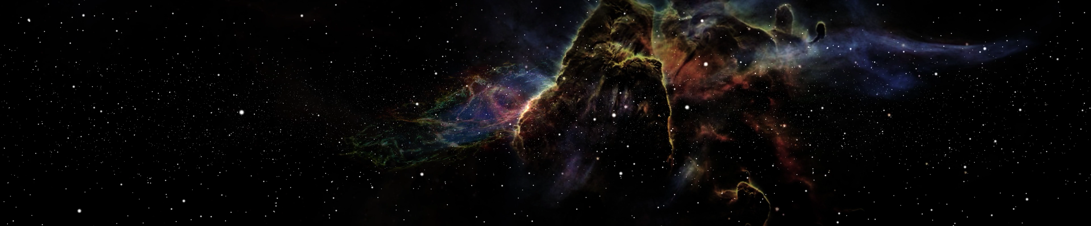
PUBLIC DOMAIN AND COPYRIGHT
PUBLIC DOMAIN
THE UNIVERSE
Of
ALL CREATIVE WORKS!
PUBLICLY AVAILABLE
Notes:
It is important to note that the [c] public domain should [c] not be confused with works that are [c] publicly available. Many publicly available works are [c] protected by copyright. [c] To understand how copyright-protected works and works in Canada’s public domain are related, let us consider [c] the universe of all creative works.

Slide 4



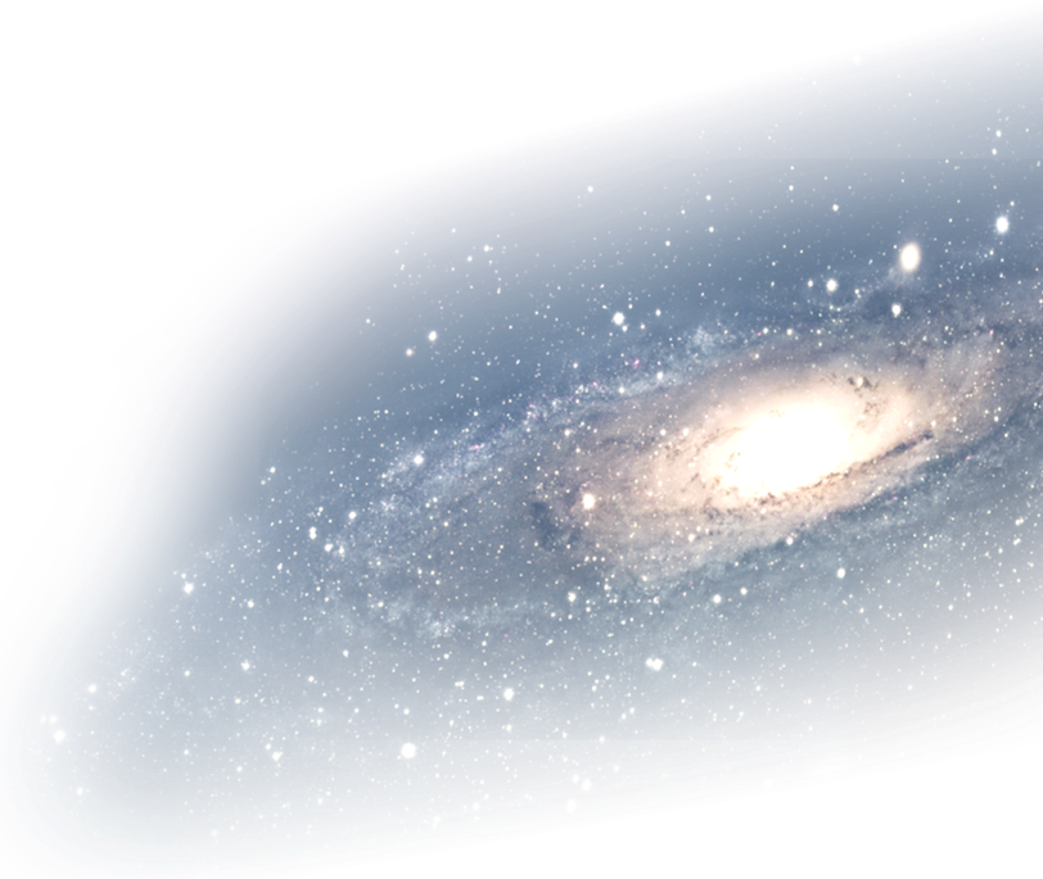
PUBLIC DOMAIN AND COPYRIGHT
Copyright expired
PUBLIC DOMAIN
Copyright ineligible
PUBLIC DOMAIN
Protected by copyright
Copyright waived
PUBLIC DOMAIN
Notes:
Within this universe there are [c] works protected by copyright.
Some creative works were once protected by copyright, [c] but the term of copyright has expired. These works are now in the [c] public domain.
There are also works that are eligible for copyright protection, but that protection has been [c] waived, such as through a CC0 designation. These works are also effectively in the [c] public domain.
Finally, all works that are [c] not eligible for copyright protection, (and, which are not eligible for any other form of intellectual property protection, like trademarks, patents, or industrial designs) [c] are in the public domain.
[c] The public domain is a key source of ideas and inspiration for all creators. It is everyone’s intellectual commons. Works that are in the public domain are not protected by copyright and can be used without restriction.

Slide 5
PUBLIC DOMAIN AND COPYRIGHT
Copyright expired
PUBLIC DOMAIN
Copyright protects expressions—not ideas
Facts and ideas are not protected by copyright
Copyright ineligible
PUBLIC DOMAIN
Protected by copyright
Copyright waived
PUBLIC DOMAIN
Notes:
Not all works are eligible for copyright protection. [c] Copyright protects expressions of ideas not the underlying ideas themselves. Because copyright protects expressions and requires some creative originality, [c] facts and ideas on their own are not protected by copyright.

Slide 6
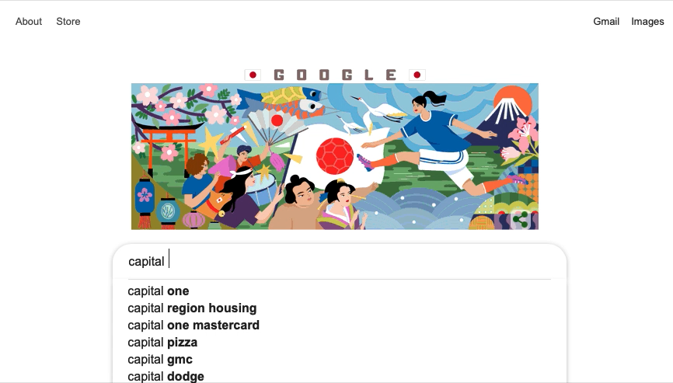
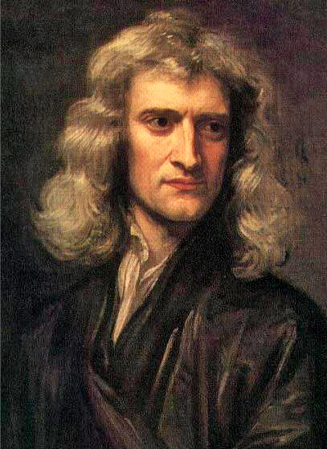
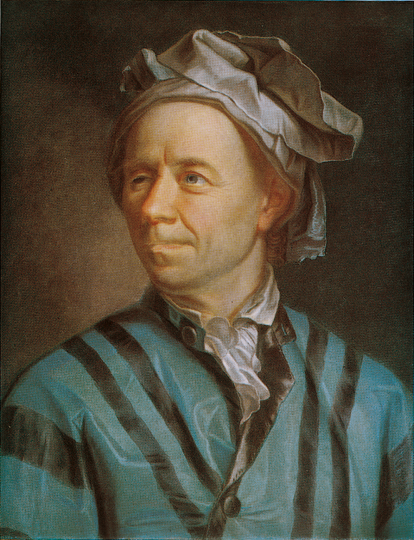
NOT ELIGIBLE FOR
COPYRIGHT PROTECTION
1 + 7 = 9
Euler’s identity
#FakeNews!
e^{iπ} + 1 = 0
TM
Edmonton Oilers
Oilers identity
wut?
Isaac Newton
Leonhardt Euler
Copyright ineligible
Facts
Mathematical expressions
Laws of nature
Names
Notes:
Facts such as ‘Ottawa is the capital of Canada’ are not protected by copyright.
[c] Laws of nature and mathematical expressions are also not subject to copyright. For example, there is no copyright protection for [c] Newton’s Second Law, or in [c] expressions like one plus seven equals nine, [c] or even in Euler’s identity.
[c] While most names aren’t protected by copyright, it is important to note that [c] some names can be protected by [c] trademark.

Slide 7

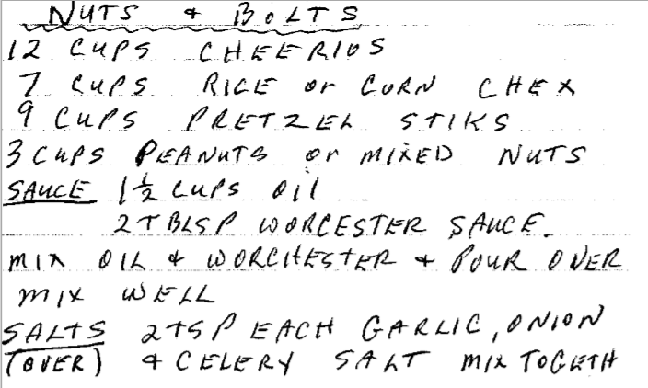
NOT ELIGIBLE FOR
COPYRIGHT PROTECTION
GPA Scores for Isaac Newton
Euler’s identity
3.6
3.9
3.0
2.8
4.0
4.0
Isaac Newton
Leonhardt Euler
3.5
3.9
3.8
4.0
3.7
TM
3.9
Edmonton Oilers
Oilers identity
Copyright ineligible
Facts
Mathematical expressions
Numerical data
Laws of nature
Names
Ingredients & instructions
Notes:
Numerical data on its own generally isn’t protected by copyright, but the [c] compilation and/or arrangement of data can be. In addition, works that are treated as research data (for example, images or [c] transcripts) are generally protected by copyright.
Similarly, the [c] bare list of ingredients and instructions that make up a recipe are not protected by copyright but the detailed descriptions, layout, accompanying photographs, illustrations, and arrangements of a recipe in a [c] cookbook may be protected by copyright.

Slide 8
COPYRIGHT EXPIRED
Copyright expired
PUBLIC DOMAIN
Protected by copyright
Copyright ineligible
Copyright waived
PUBLIC DOMAIN
Notes:
A second category of works which are not protected by copyright are [c] materials for which the term of copyright has expired.

Slide 9
MATERIAL FOR WHICH COPYRIGHT HAS EXPIRED
50 years
In Canada, copyright terms may vary for:
works by organizations
government works
anonymous works
sound recordings
Copyright expired
Death
∞
Notes:
In Canada the term of copyright protection is generally the life of the author plus an additional [c] 50 years after their death. It should be noted though, that for [c] works produced by an organization, [c] government works, [c] anonymous works, and [c] sound recordings the terms may differ. [c][c]

Slide 10
MATERIAL FOR WHICH COPYRIGHT HAS EXPIRED
International
minimum!
50 years
70 years
70 years
Copyright expired
100 years
Death
∞
Notes:
Canada’s copyright term is shorter than that of many other countries. in [c] Mexico the general term of protection is life of the author plus 100 years after their death, and in the [c] United States and the European Union member states, the term of protection is the life of the author plus 70 years. [c] Canada’s term of protection is as short as possible [c] under international copyright agreements. [c]

Slide 11
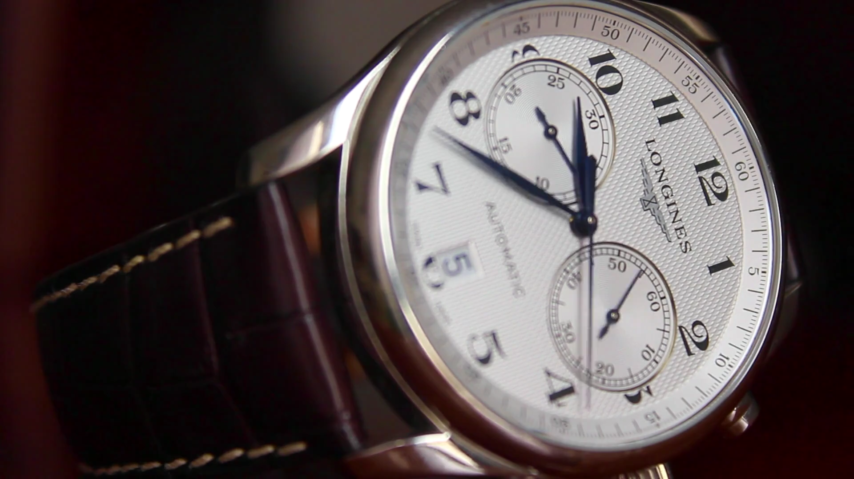
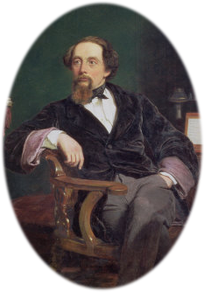
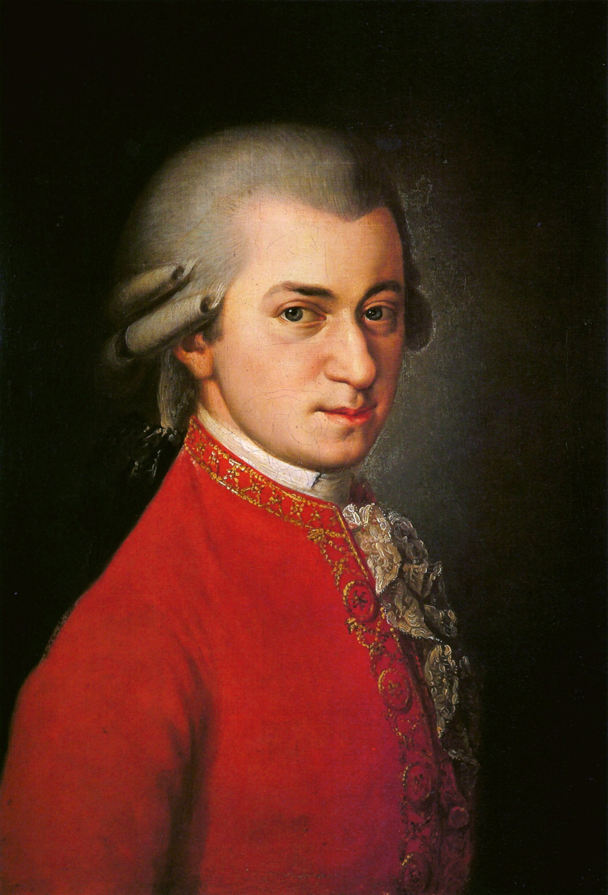
MATERIAL FOR WHICH COPYRIGHT HAS EXPIRED
WE BELONG TO THE PEOPLE NOW!
Copyright expired
OH GOODY
Notes:
Most works that are from before 1900 are already in the public domain. [c] The novels of Dickens and the music of [c] Mozart are examples of works that are no longer protected by copyright [c] because the terms have expired.

Slide 12
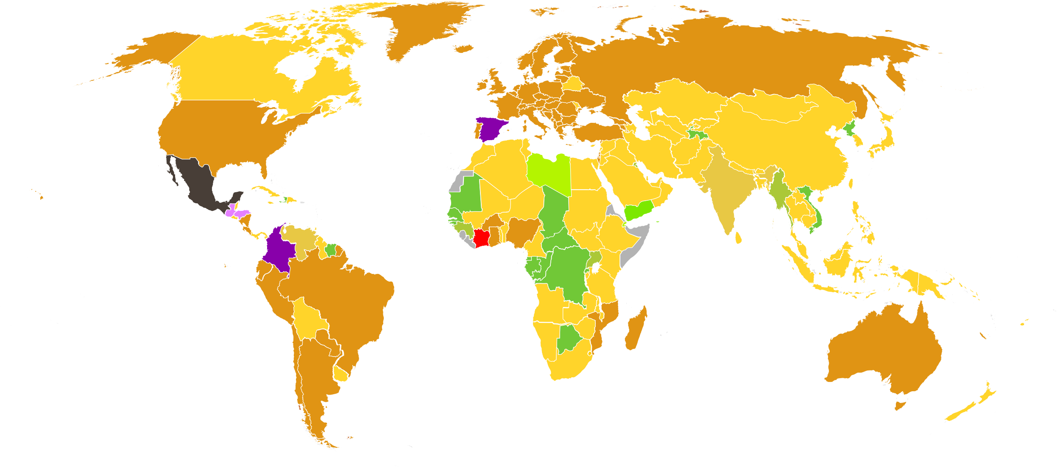
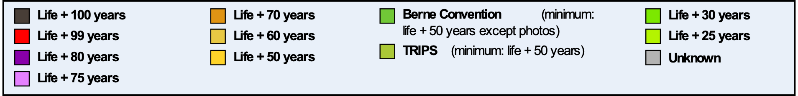
MATERIAL FOR WHICH COPYRIGHT HAS EXPIRED
Copyright Terms by Country (data from 2015)
Larger Public domain
Also big
Larger too
Big here
Not so much
So big
Not small
Copyright expired
Notes:
What is in the public domain is not the same set of works in all countries. Because of its shorter copyright term, Canada has a [c] larger public domain than many other countries. Works will enter the public domain earlier in Canada. Shorter copyright terms are advantageous because a [c] larger public domain allows for broader use of certain works.

Slide 13
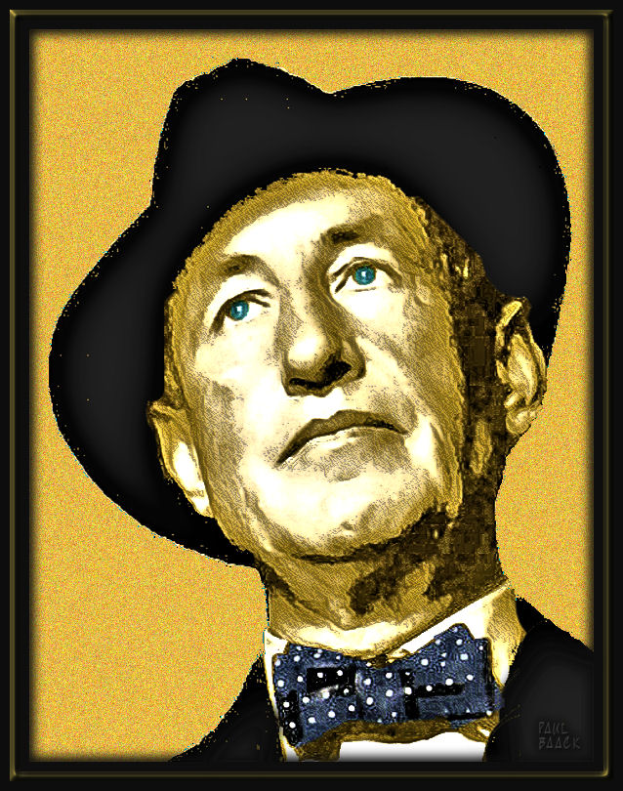
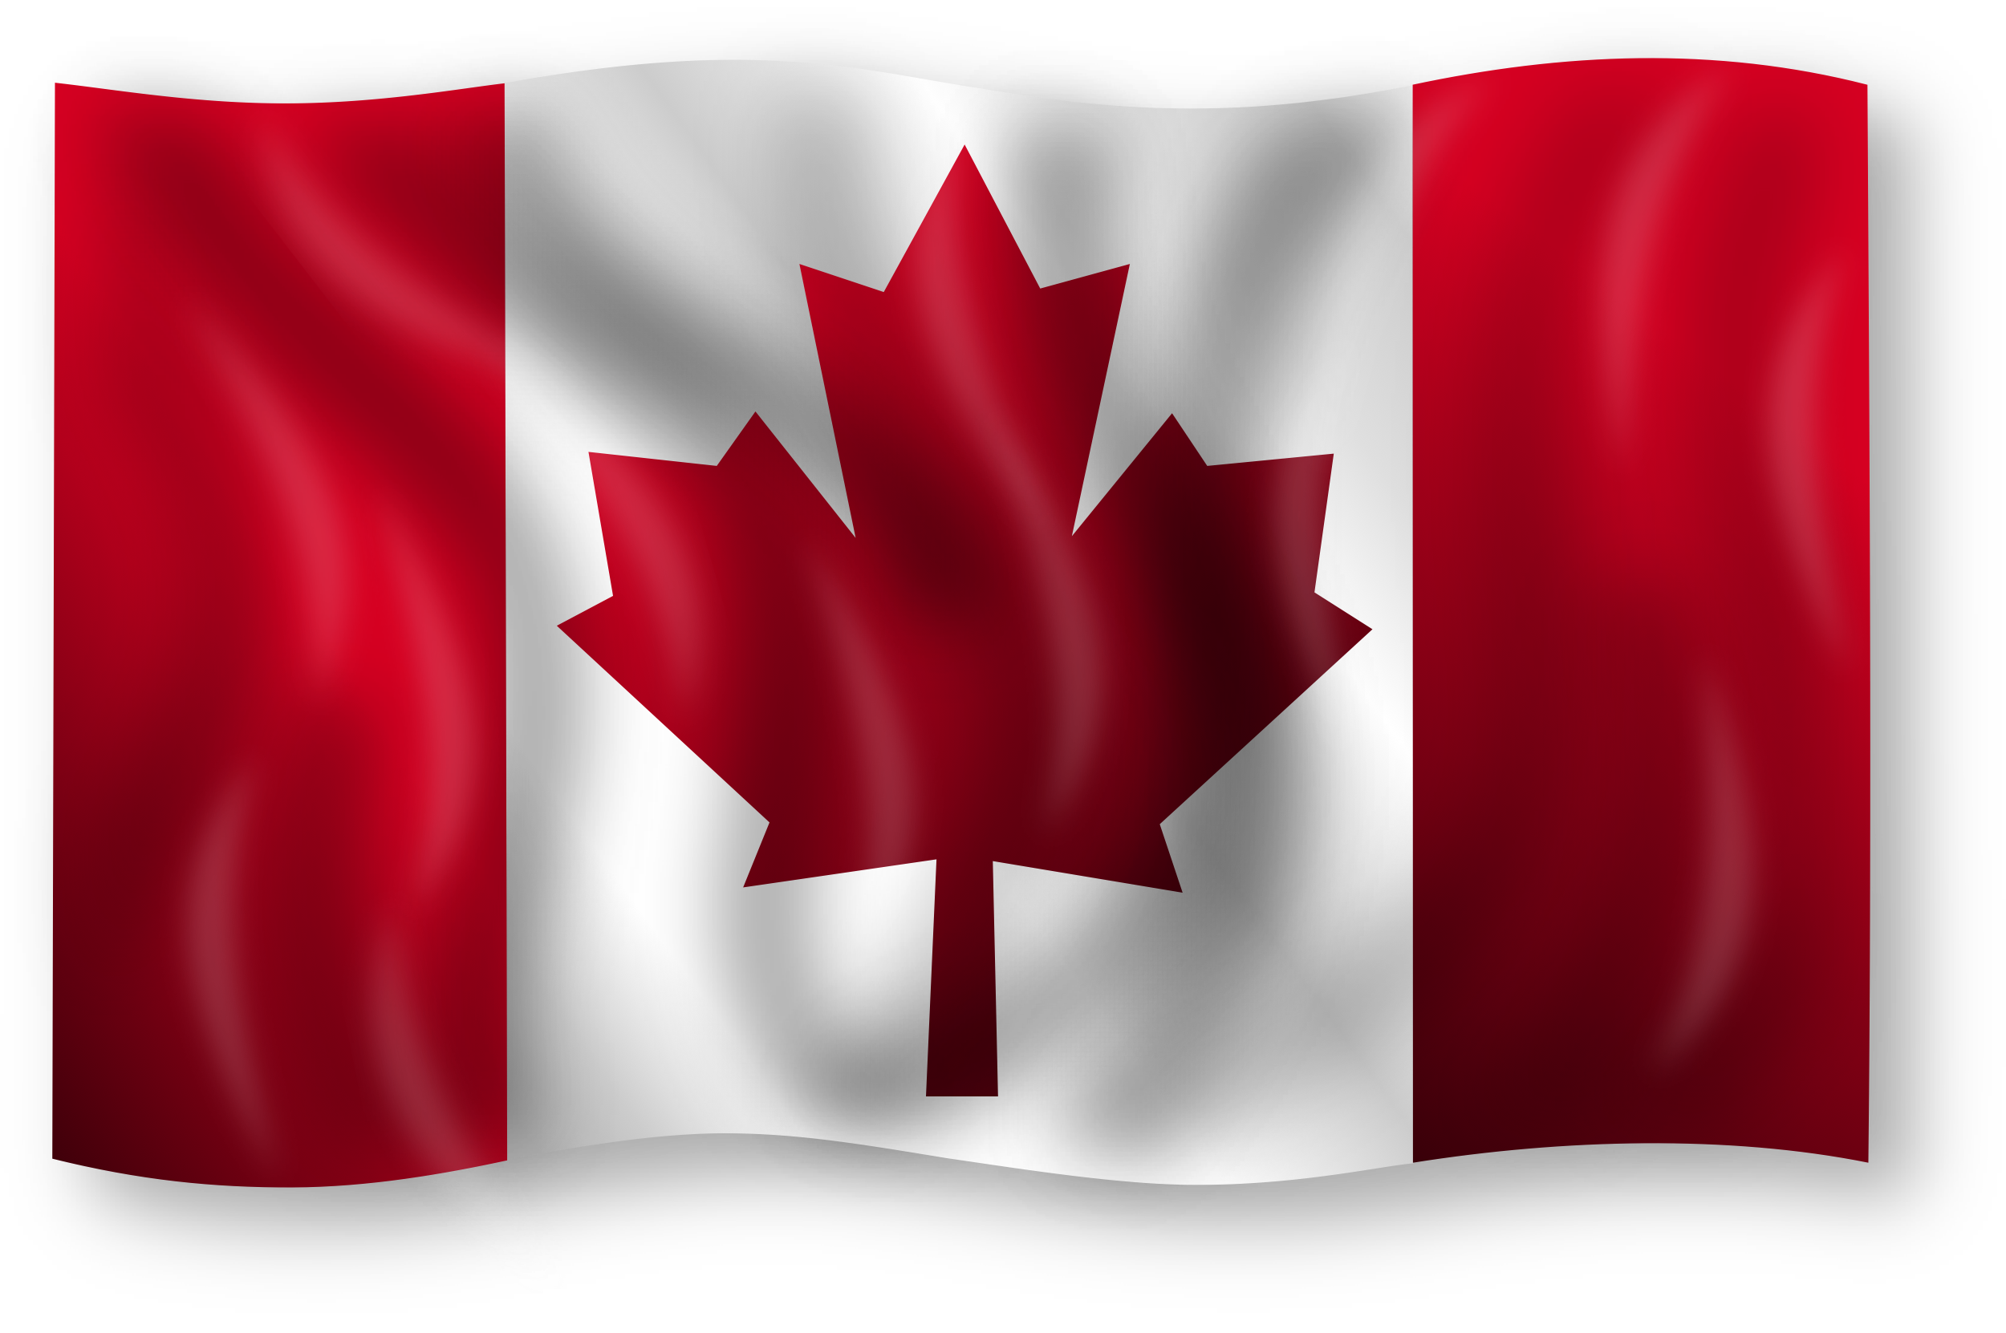
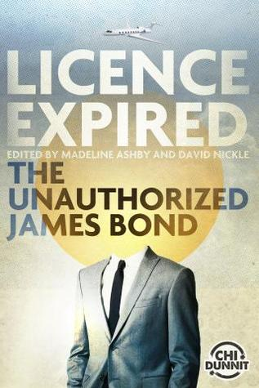
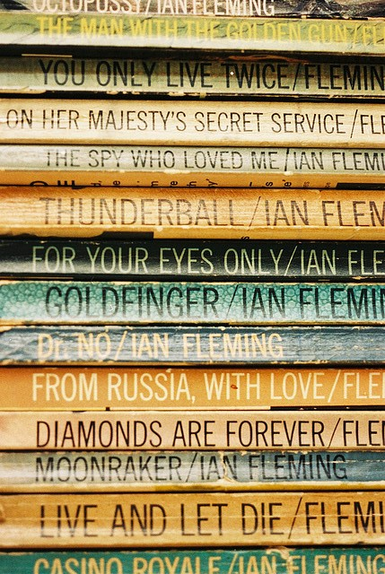


MATERIAL FOR WHICH COPYRIGHT HAS EXPIRED
#DED
Public domain
2017
1964
CANLIT FTW
Not so much
Copyright expired
Y’ALL CAN’T
COPYRIGHT
THE
PUBLIC
DOMAIN!
WE’RE FREE!
Not so much
2015
Notes:
For example, the [c] British author Ian Fleming died in 1964.[c]
That means his James Bond novels entered the [c] public domain in Canada on January 1, 2015.[c] Authors from across [c] Canada wrote a collection of short stories featuring the James Bond character. [c]
These were published in [c] 2017 under the title, “Licence Expired: The Unauthorized James Bond.” Because Fleming’s work had entered the public domain, publishing the book in Canada required no permission from Fleming’s estate.[c] Permission would have been required had it been published in [c] countries with a longer copyright term, which includes the [c] United Kingdom and the [c] United States. [c]

Slide 14
COPYRIGHT WAIVED
Copyright expired
PUBLIC DOMAIN
Copyright ineligible
PUBLIC DOMAIN
Protected by copyright
Copyright waived
PUBLIC DOMAIN
Notes:
The third category of materials in the public domain are works [c] where copyright protection has been waived. In general, this category can be more difficult to assess.

Slide 15
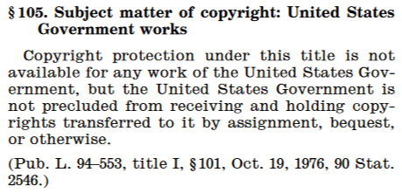
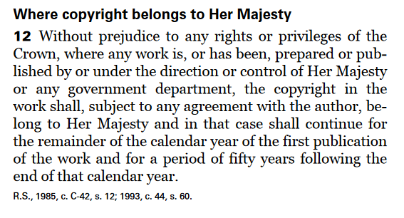
COPYRIGHT WAIVED
U.S. Federal Government’s waiver of copyright
(17 U.S.C. §105)
WE BELONG TO THE PEOPLE!
Canada’s Crown copyright (Copyright Act s.12)
Copyright waived
WE DON’T!
Notes:
Some countries waive copyright protection for some types of government works. [c] For example, most federal government materials in the United States are in the public domain.[c] However, all government works in [c] Canada are protected by Crown copyright until 50 years [c] past their year of publication.

Slide 16

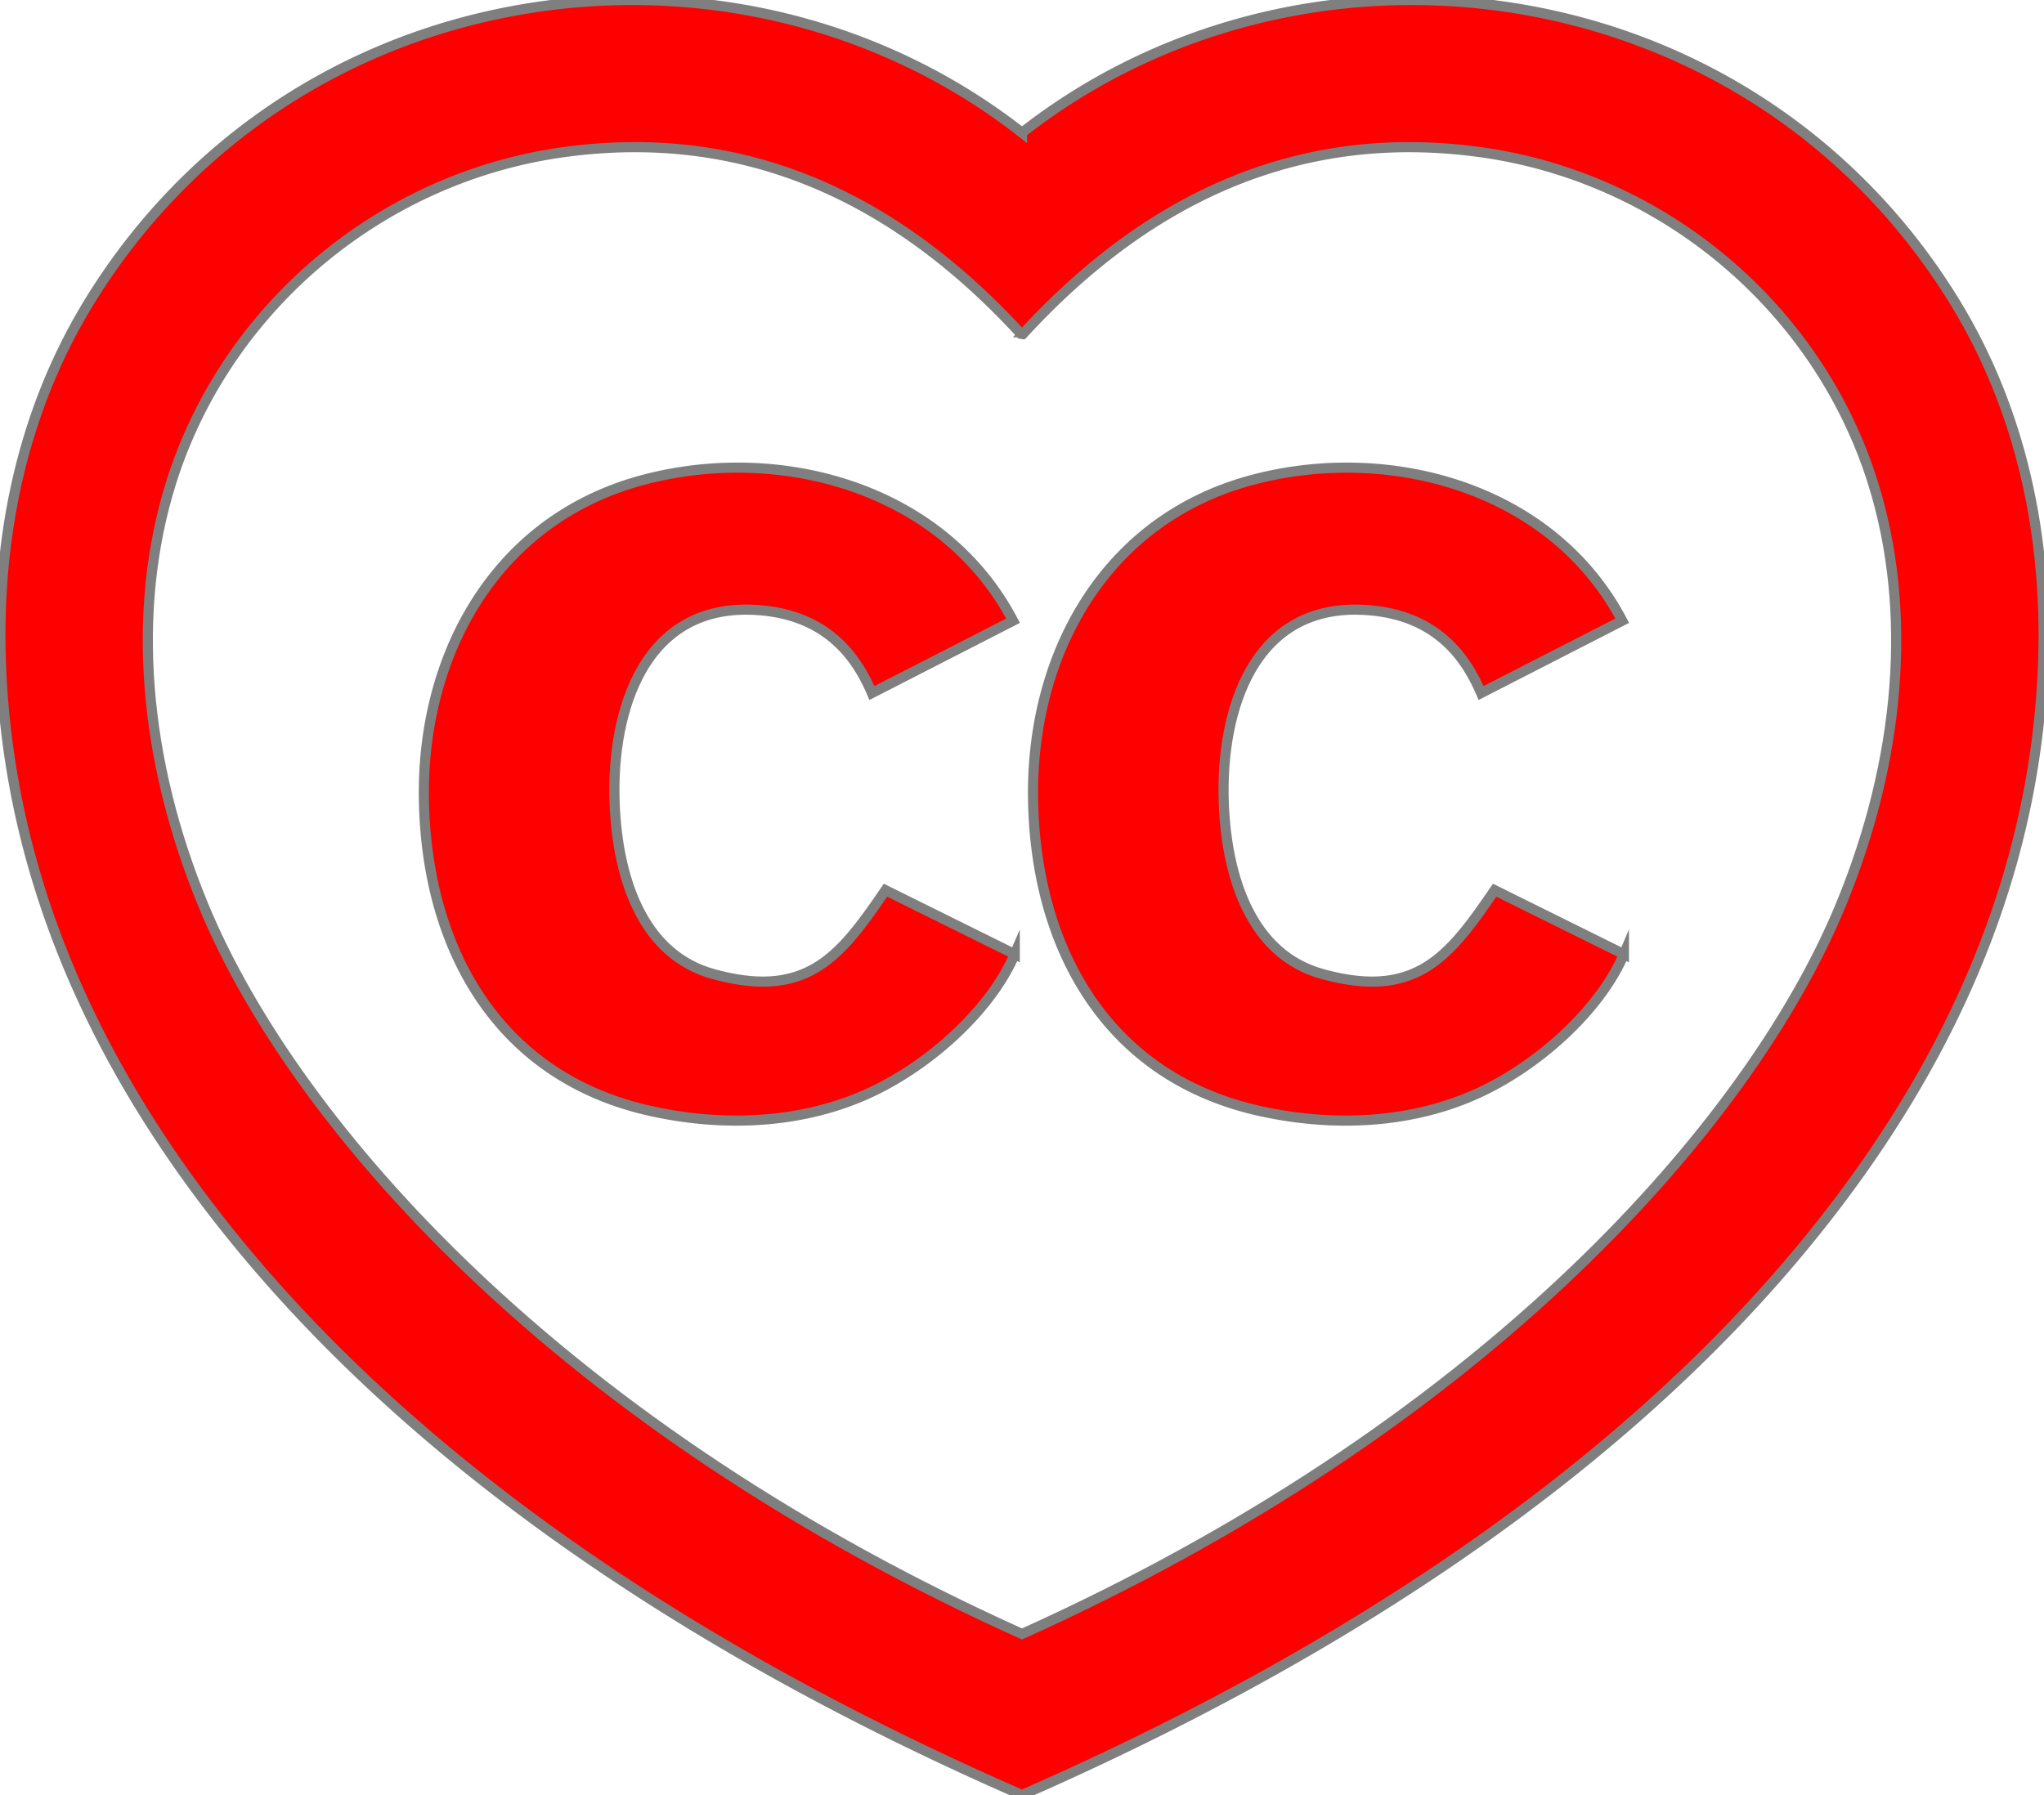

COPYRIGHT WAIVED
When you use the CC0 mark:
You surrender all rights
You do not have to be attributed as the creator
Copyright waived
Creative Commons Zero (CC0) Designation
Notes:
Rights holders can choose to waive their copyright in a work, in effect contributing it to the public domain. [c] The simplest way to do this is by using the Creative Commons Zero designation. If you see a [c] CC0 mark on a work, you are free to use the work without any restrictions. As a creator, it is important to note [c] that if you put a CC0 mark on your work, [c] you are surrendering all your rights in that work, including [c] the right to be attributed as the creator of the work.

Slide 17
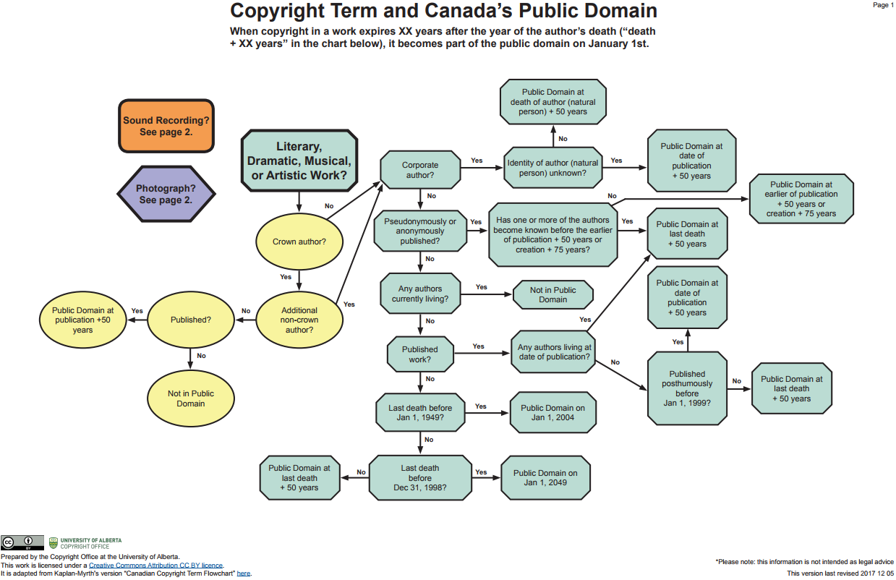
IDENTIFYING
PUBLIC DOMAIN WORKS
WAS THE CREATOR A CORPORATION?
OLD
#DED
FREE
WHEN DID THE LAST CO-CREATOR DIE?
WAS THE WORK PUBLISHED?
Copyright waived
Notes:
While it can be easy to identify [c] very old works, works with a [c] single known creator with a known date of death, or works that have a [c] CC0 designation as being in the public domain, for other works it can be challenging to determine whether the copyright term has expired.
[c] To make these determinations, you will need to know whether the [c] creator of the work was a corporation, and, if there were multiple or anonymous authors or composers, [c] when the last co-creator died. Whether or not a work was [c] published and when can also be important.
Tools like [c] this flowchart can help determine whether or not a copyright term in a work has expired.

Slide 18
LEARNING OBJECTIVES
You should now be able to:
  Describe the public domain’s scope and relationship with copyright
  Recognize the three categories of works in the public domain
  Identify public domain works
  Contribute your own works to the public domain
Notes:
You should now be able to:
[c] Describe the public domain’s scope and relationship with copyright
[c] Recognize the three categories of works in the public domain
[c] Identify public domain works
[c] Contribute your own works to the public domain

Slide 19
Notes:
To learn more about the public domain, please see the ‘Resources and References’ section at the end of the module. Thank you for your attention.

Slide 21
Ashby, Madeline and David Nickle. (Eds.). Licence Expired: The Unauthorized James Bond. Toronto: ChiDunnit.
Boyle, James. The Public Domain. New Haven, CT: Yale University Press, 2008. http://thepublicdomain.org/thepublicdomain1.pdf
The Public Domain Manifesto: https://publicdomainmanifesto.org/manifesto/
Craig, Carys J. "The Canadian Public Domain: What, Where, and to What End?." Canadian Journal of Law and Technology, 7 (2010): 221-241: https://works.bepress.com/carys_craig/27/
Public Domain Review’s Guide to Finding Interesting Public Domain Works on the Internet: https://publicdomainreview.org/guide-to-finding-interesting-public-domain-works-online/
University of Alberta Copyright Office – Public Domain Flowchart: https://cloudfront.ualberta.ca/-/media/ualberta/faculty-and-staff/copyright-office/public-domain-chart-v11-revised.pdf
Wikimedia Public Domain Images: https://commons.wikimedia.org/wiki/Commons:Free_media_resources/Photography

Slide 22
Mixmaster_Andy. (2017). Krupnyj Plan. Pixabay. Pixabay License. https://pixabay.com/videos/krupnyj-plan-books-choice-12802/
PNG All. (2016). Galaxy PNG Image. PNG All. CC BY-NC. http://www.pngall.com/?p=14390
PNG All. (2016). Galaxy PNG Clipart. PNG All. CC BY-NC. http://www.pngall.com/?p=14352
PNG All. (2016). Galaxy Transparent. PNG All. CC BY-NC. http://www.pngall.com/?p=14481
PNG All. (2016). Galaxy. PNG All. CC BY-NC. http://www.pngall.com/?p=14524
Barrington Bramley.(1992). Copy of Godfrey Kneller’s Isaac Newton portrait. Wikimedia. Public Domain. https://commons.wikimedia.org/wiki/File:GodfreyKneller-IsaacNewton-1689.jpg
Jakob Emmanuel Handmann. (1753). Portrait of Leonhardt Euler. Wikimedia. Public Domain. https://commons.wikimedia.org/wiki/File:Leonhard_Euler_by_Handmann.png
OpenClipart-Vectors. (2016). Book Cook Eat… Pixabay. Pixabay License. https://pixabay.com/images/id-1292854/

Slide 23
josemdelaa. (2016). Clock Quick Passage of Time… Pixabay. Pixabay License. https://pixabay.com/videos/id-3019/
William Powell Frith. (1859). Charles Dickens. Wikimedia. Public Domain. https://upload.wikimedia.org/wikipedia/commons/d/d5/Charles_Dickens_by_Frith_1859.png
Barbara Kraft. (1819). Wolfgang Amadeus Mozart. Wikimedia. Public Domain. https://upload.wikimedia.org/wikipedia/commons/1/1e/Wolfgang-amadeus-mozart_1.jpg
Balfour Smith. (2015). List of different countries and the length of their standard copyright in years. Wikimedia. CC BY. https://upload.wikimedia.org/wikipedia/commons/5/59/World_copyright_terms.svg
Paul Baack. (2009). The author was a spy. Flickr. CC BY. https://www.flickr.com/photos/paulbaack/3312630626
SchroCat. (2012). Fleming’s paperback Bonds. Wikimedia. Public Domain. https://upload.wikimedia.org/wikipedia/commons/f/f3/Fleming%27s_paperback_Bonds.jpg

Slide 24
OpenClipart-Vectors. (2013). Canada Flag… Pixabay. Pixabay License. https://pixabay.com/images/id-159585/
TheDigitalArtist. (2016). United Kingdom Flag… Pixabay. Pixabay License. https://pixabay.com/images/id-1332946/
TheDigitalArtist. (2016). United States Flag… Pixabay. Pixabay License. https://pixabay.com/images/id-1327120/
StockSnap. (2017). Laptop Computer Browser…. Pixabay. Pixabay License. https://pixabay.com/images/id-2562325/
University of Alberta. (2017). Canadian Copyright Term Flowchart. University of Alberta. CC BY. https://www.ualberta.ca/copyright/resources/tools
Closing Slides Music: Rybak, Nazar. (n.d.). Corporate Inspired. HookSounds. CC BY. http://www.hooksounds.com/
Unattributed materials are contributions from the Opening Up Copyright Project Team and placed in the Public Domain.

Slide 25
University of Alberta. 2019. “Public Domain.” Opening Up Copyright Instructional Module. https://sites.library.ualberta.ca/copyright/

