Slide 1

Other Types of IP
Opening Up Copyright Instructional Module
December 2018
Notes:
1. Hello and welcome to the University of Alberta’s Opening Up Copyright Instructional Module on how copyright relates to Other Types of Intellectual Property

Slide 2
TYPES OF INTELLECTUAL PROPERTY
Intellectual Property
?
?
?
?
Copyright
Patent?
Industrial Design?
Trademark?
Notes:
2. Did you know that copyright is only one type of intellectual property, and that there are about a dozen other forms of intellectual property protection? Often intellectual property (or IP) issues are discrete and deal with just a single category of IP. However, in some instances the lines can be blurred and what we might consider to be a copyright issue may also be a trademark, patent or industrial design issue.

Slide 3
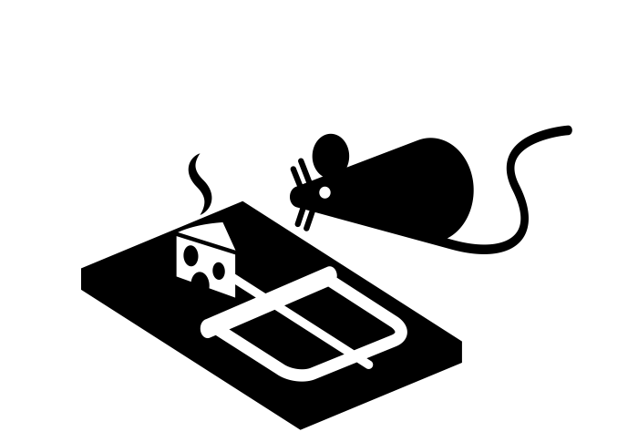
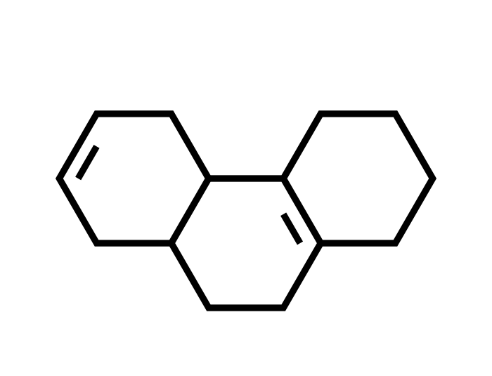

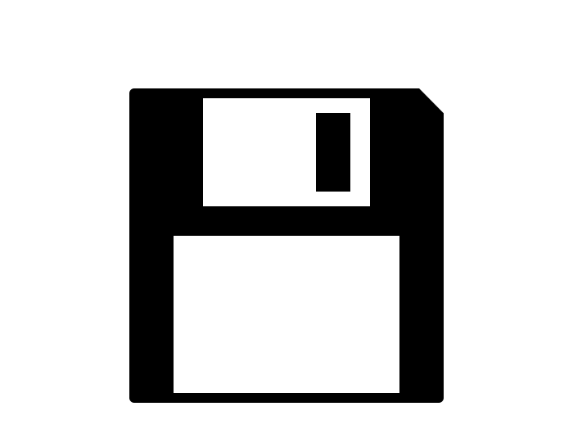

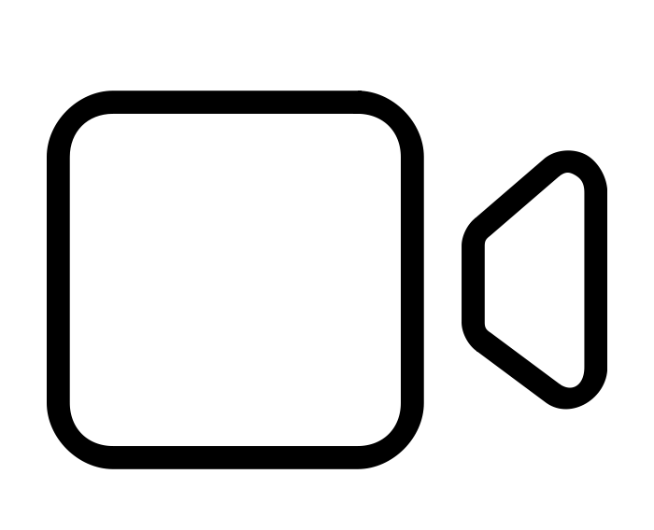
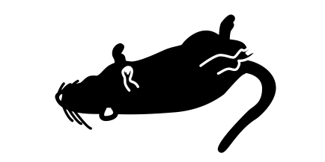
COPYRIGHT AND PATENT
Copyright
Patent
Creative Works
Inventive Works
Version 2.0! Now With Dead Mice!
Notes:
3. Copyright and patent tend to be the two best known forms of IP. Traditionally copyright has protected creative works - first written materials, and then other forms of creative expression like sound recordings, films and even software. Patents protect inventive works such as building a better mousetrap. Patents can also be issued for new chemical compositions, machines or processes for developing new and better products, or improvements to any of these. Compared to copyright, patents have shorter terms of protection, fewer exceptions for unauthorized use and are granted by a national patent office, whereas copyright protection is automatic. Patents are the oldest modern form in intellectual property with the first patent statute being passed by the city state of Venice in 1474.

Slide 4



COPYRIGHT OR PATENT?
print(“Hello, World!”)
Copyright
Patent
Notes:
4. While copyright and patents may seem distinct, there are circumstances where the question “is this a copyright or a patent issue” can be unclear. For example, the creation of software code can generate both patent and copyright issues. While code is considered a literary work and protected by copyright, it is also possible to patent business methods that are embodied in computer programs.

Slide 5


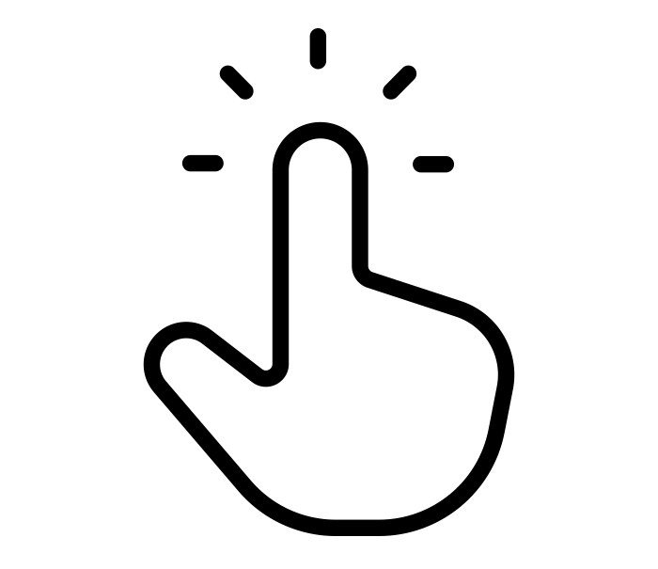
AMAZON
Jane Smith
116 St 85 Ave
Edmonton, AB
T6G 2R3
Notes:
5. A good example of the overlap between patent and copyright is Amazon’s “1-Click” checkout method, where your payment method and shipping address are loaded with a single click, based on your account. The underlying software that executes the 1-Click purchase is protected by copyright, but Amazon has also patented (contentiously in both Canada and the US) the business process of ‘1-Click’ purchasing.

Slide 6


TRADEMARKS
TM
TM
NEW!
Scamazon “1-Click”!
TM
TM
TM
Notes:
6. Amazon’s “1-Click” also illustrates copyright’s relation to another type of intellectual property protection: trademarks. While copyright protection will generally not apply to a name, a name can be protected as a trademark. Trademarks can protect a combination of words, sounds or designs used to distinguish goods and services from others in a market. In the case of “1-Click” it is the specific combination of one using the numeral combined with the word ‘click’ that is covered by the trademark. Trademark protection helps ensure that brands can protect themselves against counterfeiting and sabotage from rivals.

Slide 7
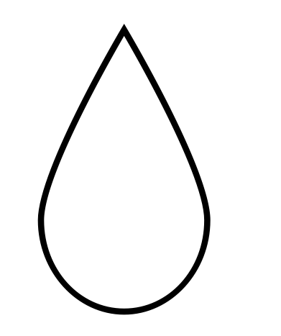

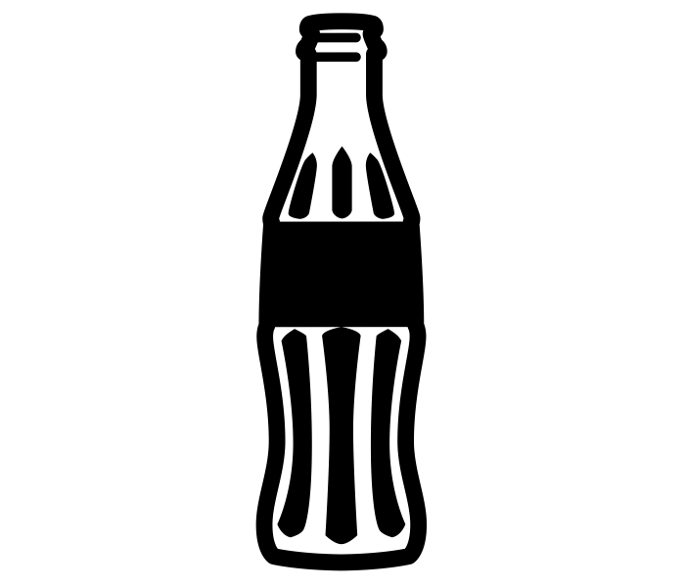
TRADEMARKS
Coke
Notes:
For example, Pepsi can’t put some noxious chemical solution in a can and market it as Coca-Cola because it would be infringing on Coke’s trademark, and likely a few other laws. Similarly, you can’t start your own beverage company and market your drinks as Coke/Pepsi just to increase sales.

Slide 8
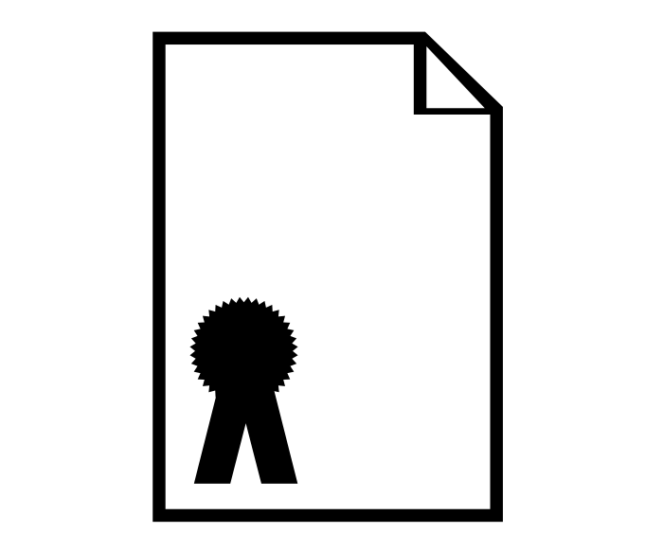

PURPOSES
Patent
TM
Reputation
Incentive for Distribution
Notes:
7. As you can tell from these examples, trademark protection is primarily about protecting reputation, whereas patents and copyright are primarily about providing creators or inventors with an incentive for distributing their works. These different justifications for IP protection help distinguish between trademarks on one hand and patents and copyrights on the other.

Slide 9
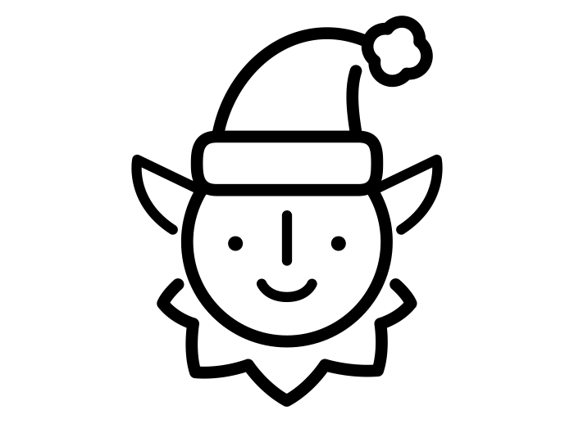
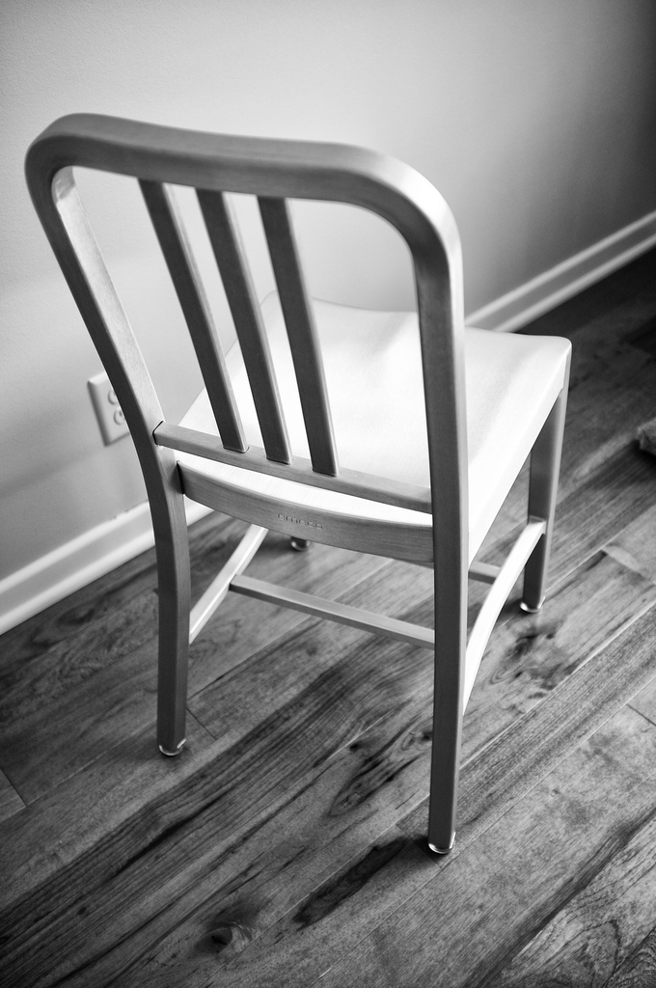
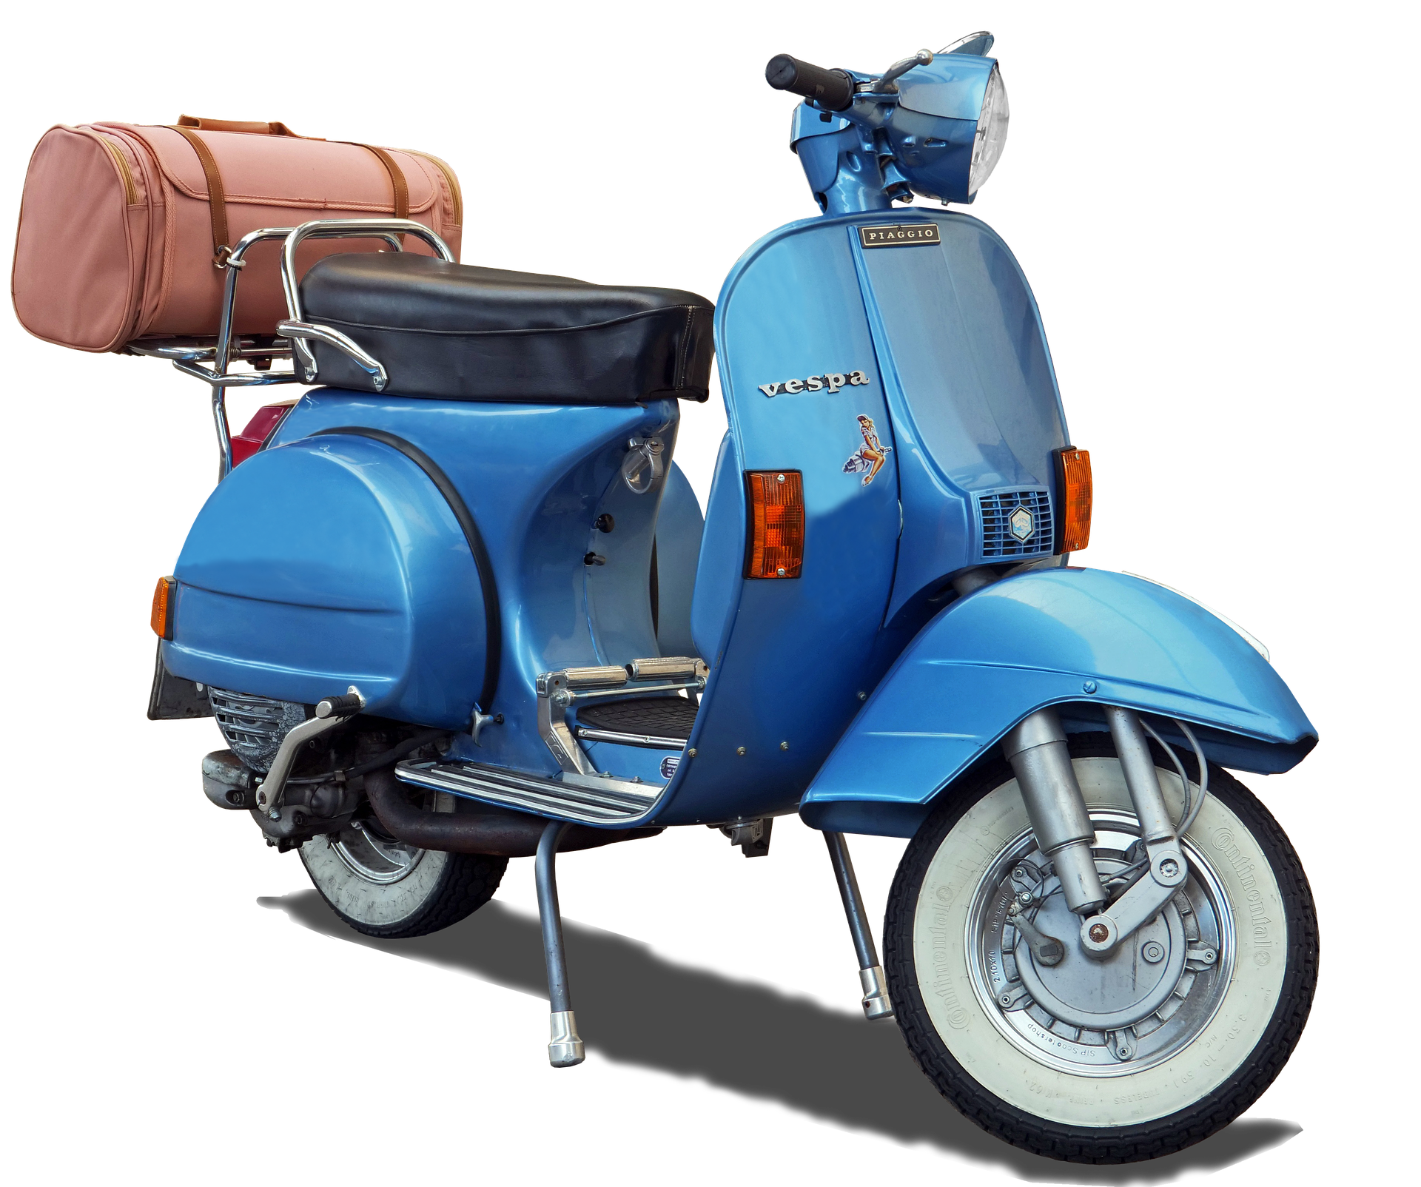
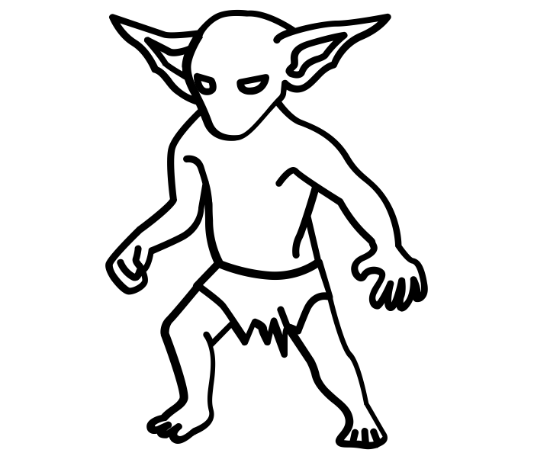
INDUSTRIAL DESIGN
Patent
Copyright
Trademark
Industrial Design
Vespa Scooter, created 1946
Emeco’s Navy Chair, created 1944
Notes:
8. In some cases, copyright issues may also intersect with industrial design. Industrial design protection is a long established form of IP. Industrial designs are similar to patents in that they require registration but rather than protecting inventiveness of a product or process they protect the visual features of shape, configuration, pattern or ornament or any combination of these applied to a finished product. Historically, industrial designs have been viewed as the poor cousin of the IP family and have generally attracted less attention than patents, copyrights and trademarks.

Slide 10
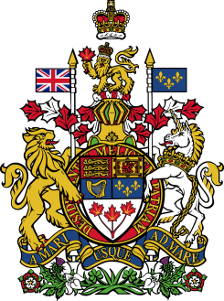
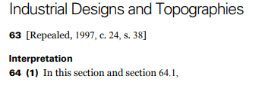
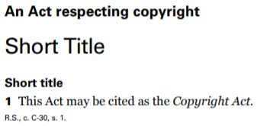

SECTION 64
…
…
Quantities of 50 copies or more
Notes:
9. The interaction between copyright and industrial design is covered in s. 64 of the Copyright Act, which may be the most poorly-written section of the entire act. In short, when a creative object is manufactured in quantities of 50 copies or more, one should consider whether industrial design protections are indicated.

Slide 11
COPYRIGHT OVERLAP
TM
Patent
Notes:
10. In the Canadian context, copyright issues sometimes overlap with patent, trademark, and industrial design concerns. In other jurisdictions, there might be more IP overlap to consider

Slide 12

SUI GENERIS
19th Century
TM
Patent
Notes:
Over the past century, several new forms of IP protection have come into being in certain jurisdictions, covering a range of intellectual works. These new forms of IP are often called sui generis forms of protection. Some of these newer forms of IP have broader international adoption, while other new IP mechanisms are more regional in the scope of their protection.
For example, in the European Union sui generis protection for databases was included in the 1996 Database Directive. This differs from the Canadian context where the arrangement of data may be protected by copyright, but the underlying data is not.

Slide 13
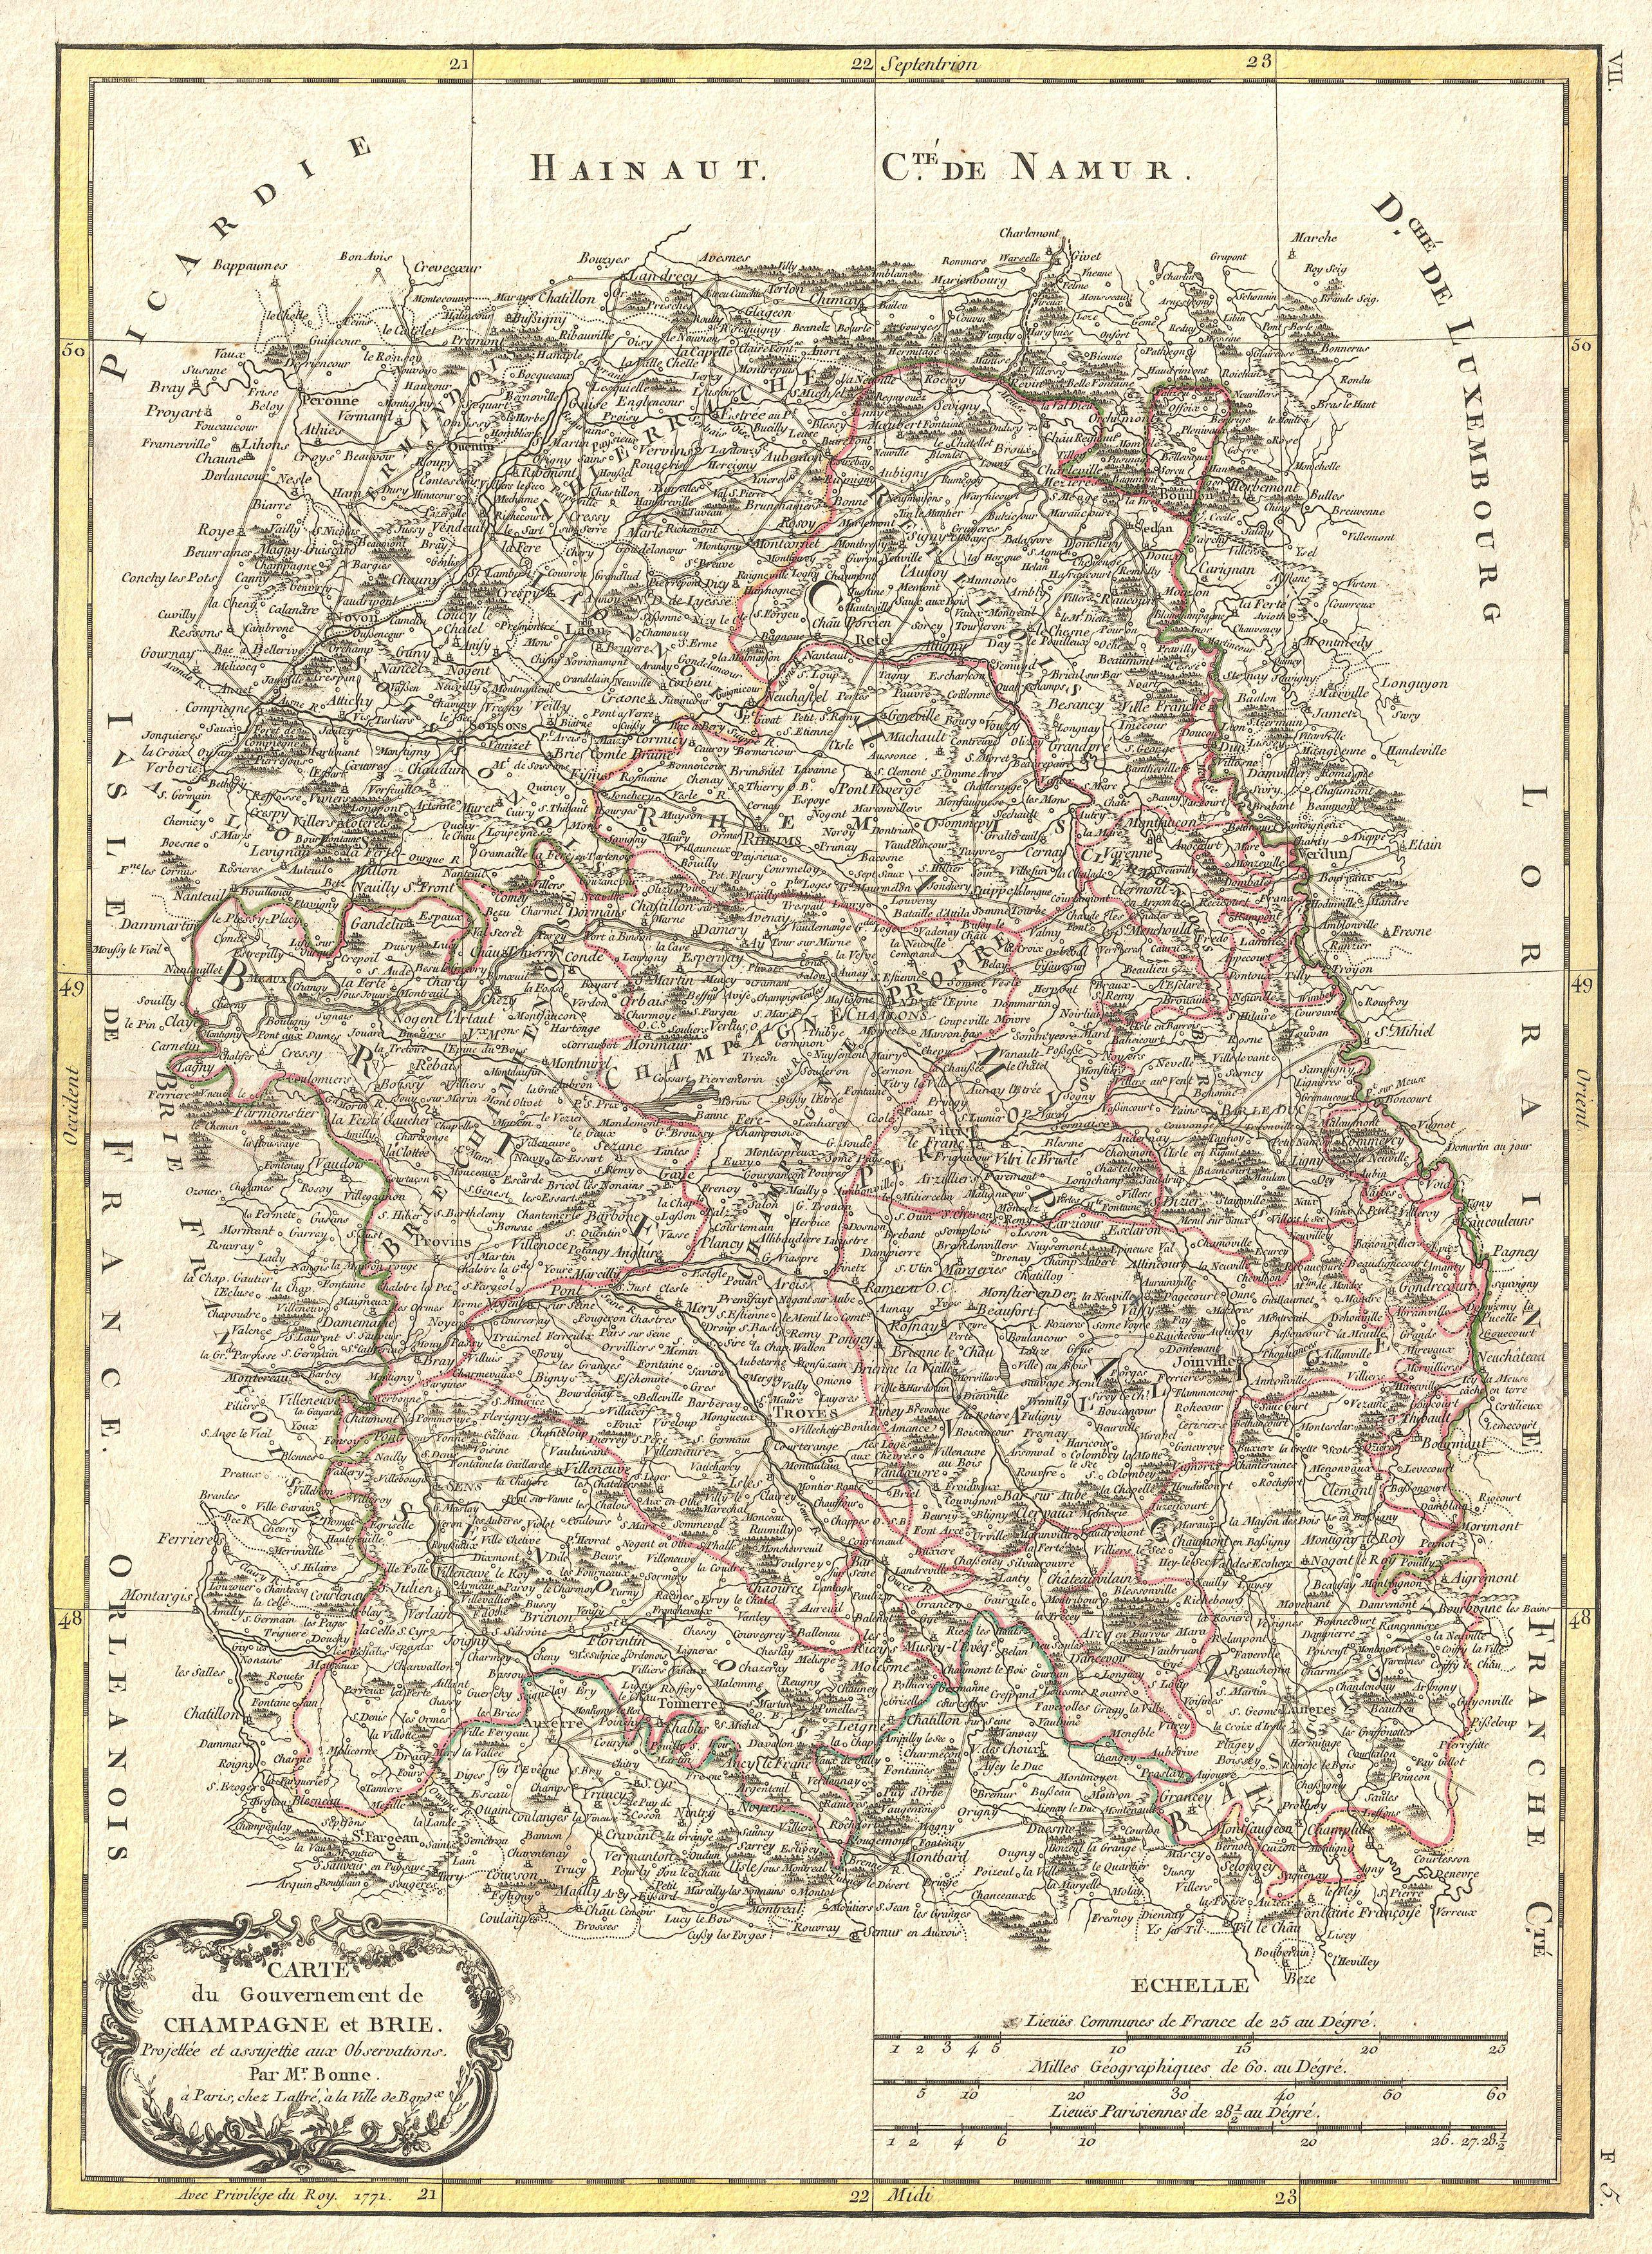
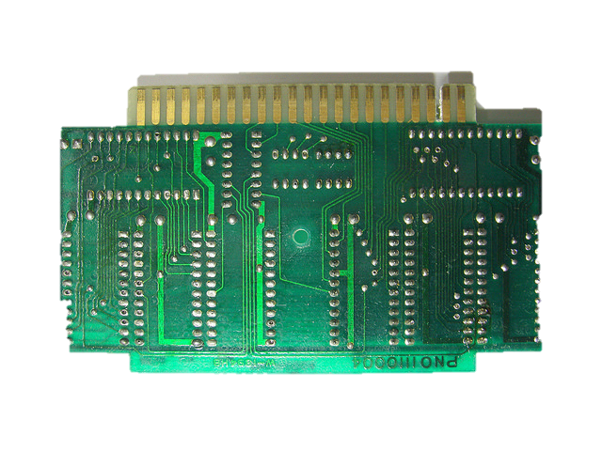
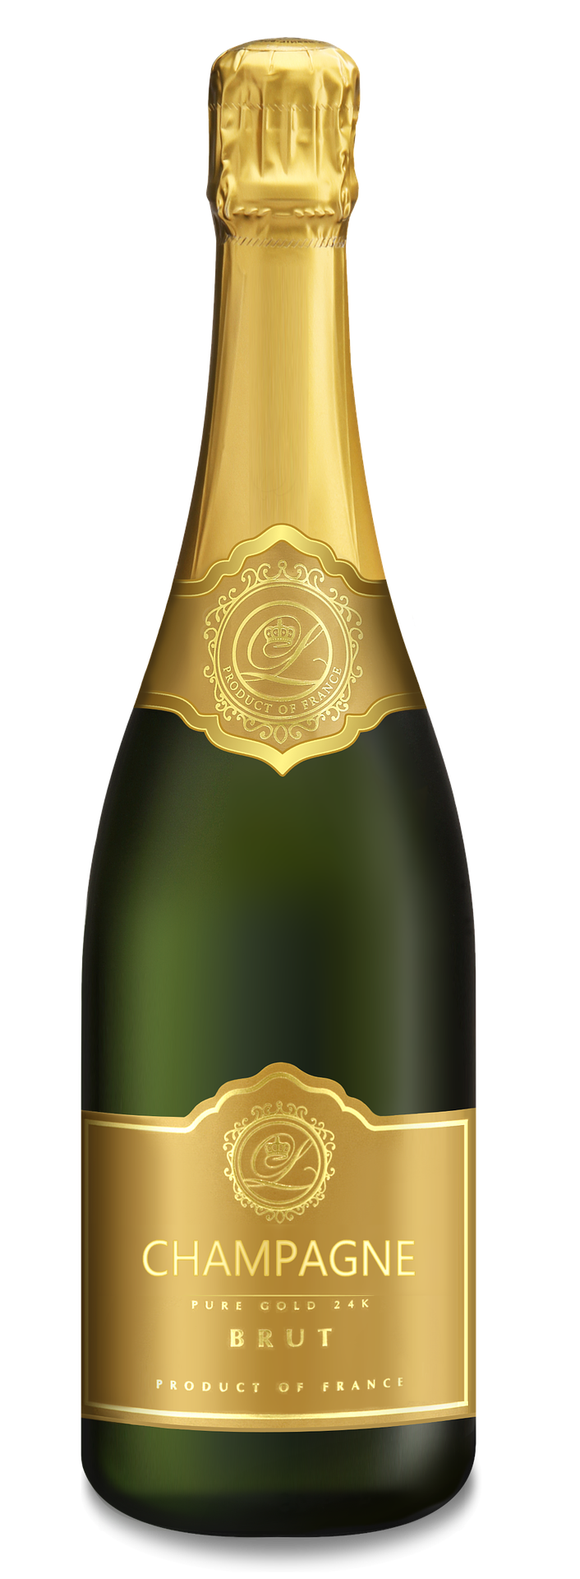
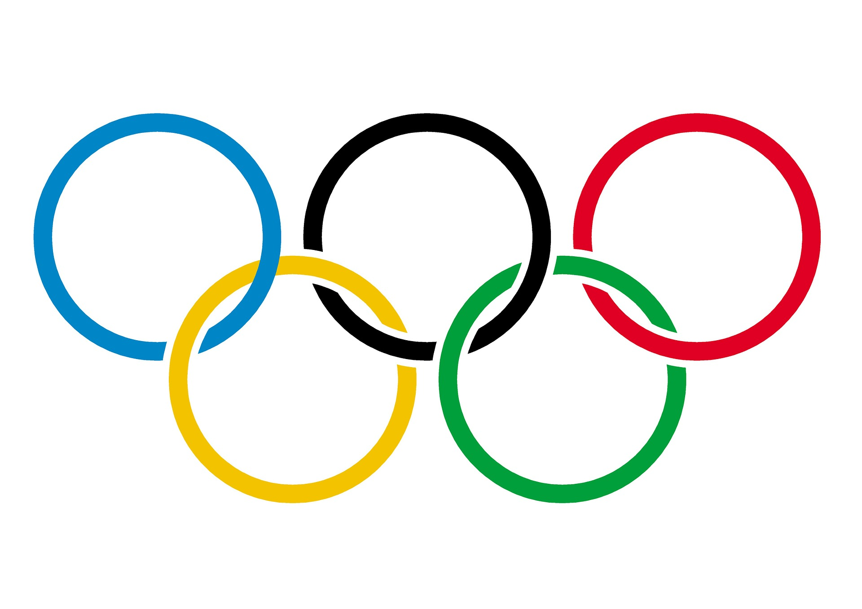
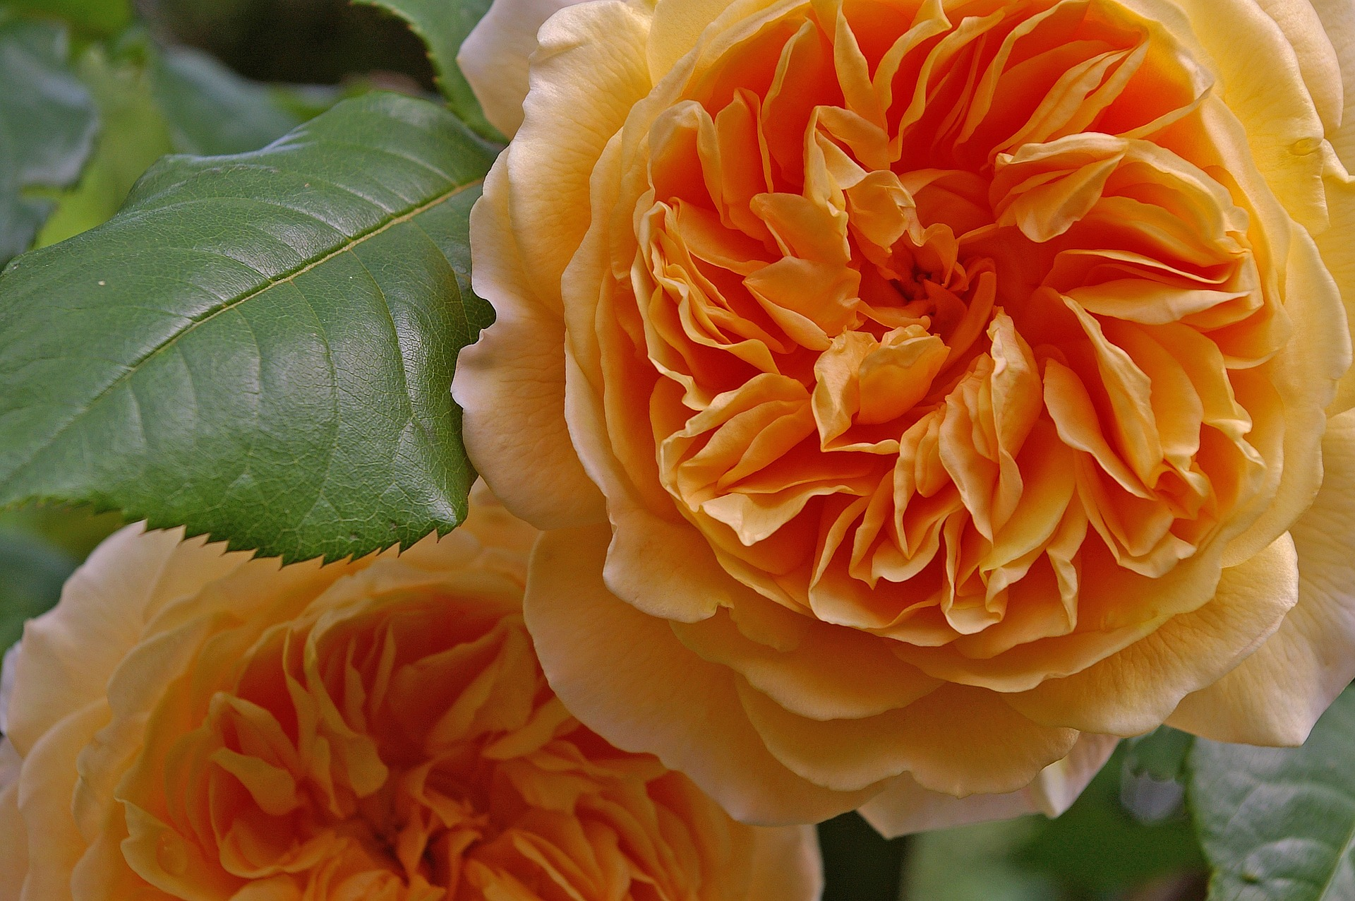
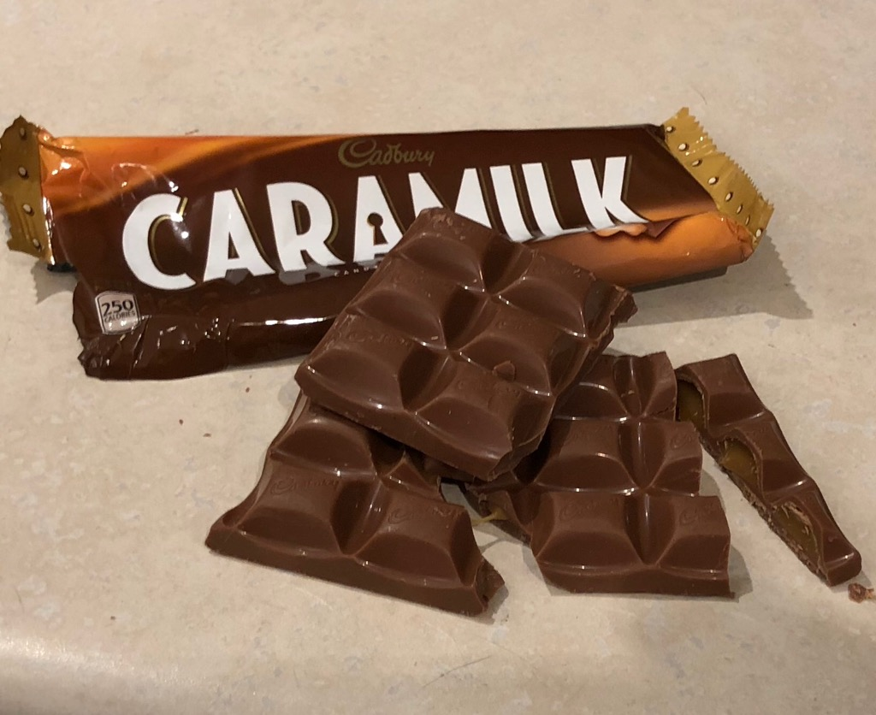
SUI GENERIS
20th Century
Semiconductor layouts
Geographical indicators
Plant varieties
Trade secrets
Notes:
11. Finally, there are several other forms of IP that exist that don’t have much of a relation to copyright. These include the protection of: plant breeders rights for new species and varieties of plants, semiconductor layouts, domain names, ship hull designs, and even the Olympic Rings, which are protected by their own international treaty.

Slide 14
LEARNING OBJECTIVES
You should now be able to:
Understand the relationship among copyright and other intellectual properties.
Identify where a copyright issue or concern may involve trademark, patent or industrial design issues.
List the type of intellectual property protection in Canada.
Notes:
12. You should now be able to:
Understand the relationship between copyright and other Intellectual Property.
Identify where a copyright issue or concern may also involve trademark, patent or industrial design issues
List the types of Intellectual Property protection in Canada

Slide 15
TEST QUESTIONS AND ANSWERS
Which of the following types of IP is not sui generis?
Plant Variety Protection
Geographical Indicators
Industrial Design Protection
Database Protection
Trademarks are different from patent and copyrights because trademarks protect reputation, while patents and copyrights:
Haven’t been heavily exploited by Amazon
Are an incentive for the distribution of works
Are the poor cousins of the IP family
Only protect the reputations of celebrities

Slide 16
TEST QUESTIONS AND ANSWERS
Section 64 of the Copyright Act, which describes the relationship between copyrights and industrial designs, is:
Clear, well written, concise and engaging
Allows people to make up to 50,000 copies of an item without implicating industrial design protection concerns
Allows people to make up to 50 copies of an item without implicating industrial design protection concerns
Patent and copyright protections and concerns may overlap with regard to:
Software, specifically business methods embodied in software processes
Copying of genetic information
Protecting dramatic works
Leather shoes

Slide 17
REFERENCES AND RESOURCES
Gutierrez, E. 2005. "Geographical indicators: A unique european perspective on intellectual property." Hastings International and Comparative Law Review, 29(1). 29-50.
Trosow, S. E. 2005. "Sui generis database legislation: A critical analysis." Yale Journal of Law and Technology, 7(2): 534-642.
Vaver, D. 2011. Intellectual property law: Copyright, patents and trademarks. 2nd Ed. Toronto: Irwin Law.
Wells, M. G. 2001. "Internet Business Method Patent Policy." Virginia Law Review, 87(4). 729-780.
Notes:
14. You should now be able to: [learning objectives]

Slide 18
IMAGE REFERENCES
Image Credits (in order of appearance)
Viral faisfalovers. (n.d.). chemical. The Noun Project. CC BY https://thenounproject.com/icon/1862149/
Atif Arshad. (n.d). Gramophone. The Noun Project. CC BY https://thenounproject.com/icon/1306170/
Stonehub. (n.d.) Record. The Noun Project. CC BY https://thenounproject.com/icon/1113096/
Andrea Mazzini. (n.d.) Floppy Disk. The Noun Project. CC BY https://thenounproject.com/icon/209186/
chris dawson (n.d.) Mousetrap. The Noun Project. CC BY https://thenounproject.com/icon/153422/
Stewart Lamb Cromar. (n.d). Rat. The Noun Project. CC BY. https://thenounproject.com/icon/104731
Enshia. (n.d.). Book. The Noun Project. CC BY https://thenounproject.com/icon/1787402/
Viktor Ostrovsky. (n.d.). Tap. The Noun Project. CC BY https://thenounproject.com/icon/1094252/
Blair Adams. (n.d.) debit card. The Noun Project. CC BY https://thenounproject.com/icon/1783833/
popcornarts.(n.d). process. The Noun Project. CC BY https://thenounproject.com/term/process/1057868
Silsor. (15 January 2006). Whmis Class D. Wikimedia Commons. CC0 https://commons.wikimedia.org/wiki/File:WHMIS_Class_D-1.svg
Assiya Dauyek. (n.d.). Water. The Noun Project. CC BY https://thenounproject.com/icon/637525
Effach. (n.d.) Sode Bottle. The Noun Project. CC BY. https://thenounproject.com/icon/715021
Unattributed materials are contributions from the Opening Up Copyright Project Team and are placed in the Public Domain

Slide 19
IMAGE REFERENCES
Image Credits (in order of appearance)
parkjisun. (n.d). Goblin. The Noun Project. CC BY https://thenounproject.com/icon/1005005
Imogen Oh. (n.d.) Elf. The Noun Project. CC BY https://thenounproject.com/icon/744495
James Christopher. (n.d). Patent. The Noun Project. CC BY. https://thenounproject.com/icon/4467
ProSymbols (n.d.) copyright. The Noun Project. CC BY https://thenounproject.com/term/copyright/793324
Emeco Navy Chair - Maggie Osterberg, https://www.flickr.com/photos/27128268@N00/7028427889/
Emslichter (n.d). Motor Scooter. Pixabay. CC0 https://pixabay.com/en/motor-scooter-vespa-jewel-3655011/
Verdy et al. (n.d). Flag of Europe. Wikimedia Commons. CC0. https://en.wikipedia.org/wiki/Flag_of_Europe
Bradley Neil. (6 February 2018). Commodore. Flickr. CC BY https://www.flickr.com/photos/145201475@N08/28347194379
maciej326 (14 November 2016) Champagne. Pixabay. CC0 https://pixabay.com/en/champagne-bottle-of-champagne-glass-1814988/
Rigobert Bonne. (1771). Carte du Gouvernement de Champagne et Brie. Wikimedia Commons. CC0 https://commons.wikimedia.org/wiki/File:1771_Bonne_Map_of_Brie_and_Champagne,_France_-_Geographicus_-_Champagne-bonne-1771.jpg
Kriemer. (20 June 2015) Crown Princess Margareta. Pixabay. CC0 https://pixabay.com/en/rose-crown-princess-margareta-818723/
PublicDomainPictures. (15 February 2013). Competition Colors. Pixabay. CC0 https://pixabay.com/en/blue-colors-competition-event-five-81847/
Unattributed materials are contributions from the Opening Up Copyright Project Team and are placed in the Public Domain

Slide 20
LICENSING AND ATTRIBUTION
Suggested Citation:
  University of Alberta. (2018). “Other Types of IP.” Opening Up Copyright Instructional Module. https://www.ualberta.ca/copyright/resources/opening-up-copyright-instructional-modules
For the project overview and complete list of modules please visit the project website at: https://www.ualberta.ca/copyright/resources/opening-up-copyright-instructional-modules
Questions, comments, and suggestions should be directed to the University of Alberta’s Copyright Office at: copyright@ualberta.ca
This module is made available and licensed under a Creative Commons Attribution 4.0 International Licence

Slide 21
CONTRIBUTORS
Copyright Office
Centre for Teaching and Learning
Technologies in Education
Adrian Sheppard
Amanda Wakaruk
Cosette Lemelin
Graeme Pate
Krysta McNutt
Anwen Burk
Jamie Stewart
Matt Cheung
University of Alberta Libraries
School of Library and Information Studies
Michelle Brailey
Jesse Carson
Toby Grant
Kris Joseph
Michael B. McNally

Slide 22

ACKNOWLEDGEMENT
Opening Up Copyright modules were initially funded through the University of Alberta, Centre for Teaching and Learning’s Teaching and Learning Enhancement Fund (TLEF) with in kind contributions from the Copyright Office and the School of Library and Information Studies.

