Slide 1
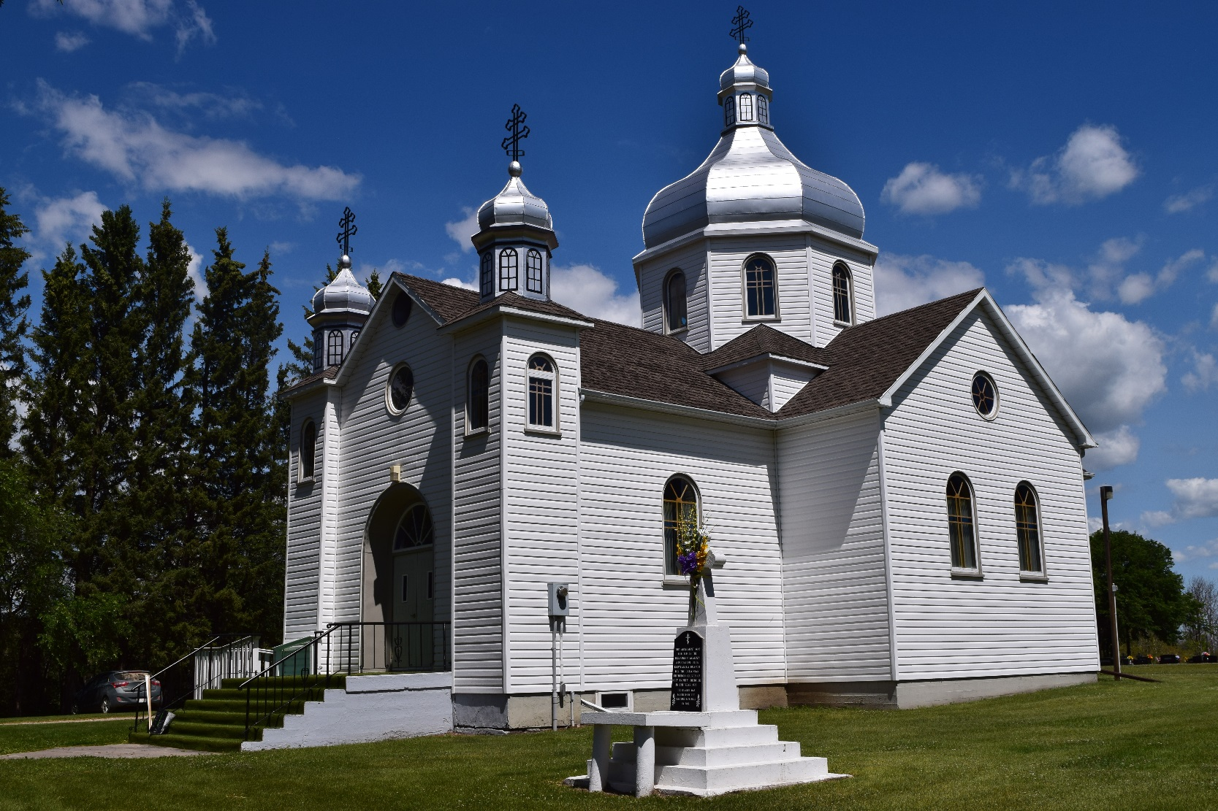
Stories of the Unquiet Dead: Ukrainian Graveyards as the Place of Change
Natalie Kononenko
Kule Chair in Ukrainian Ethnography
University of Alberta

Slide 2
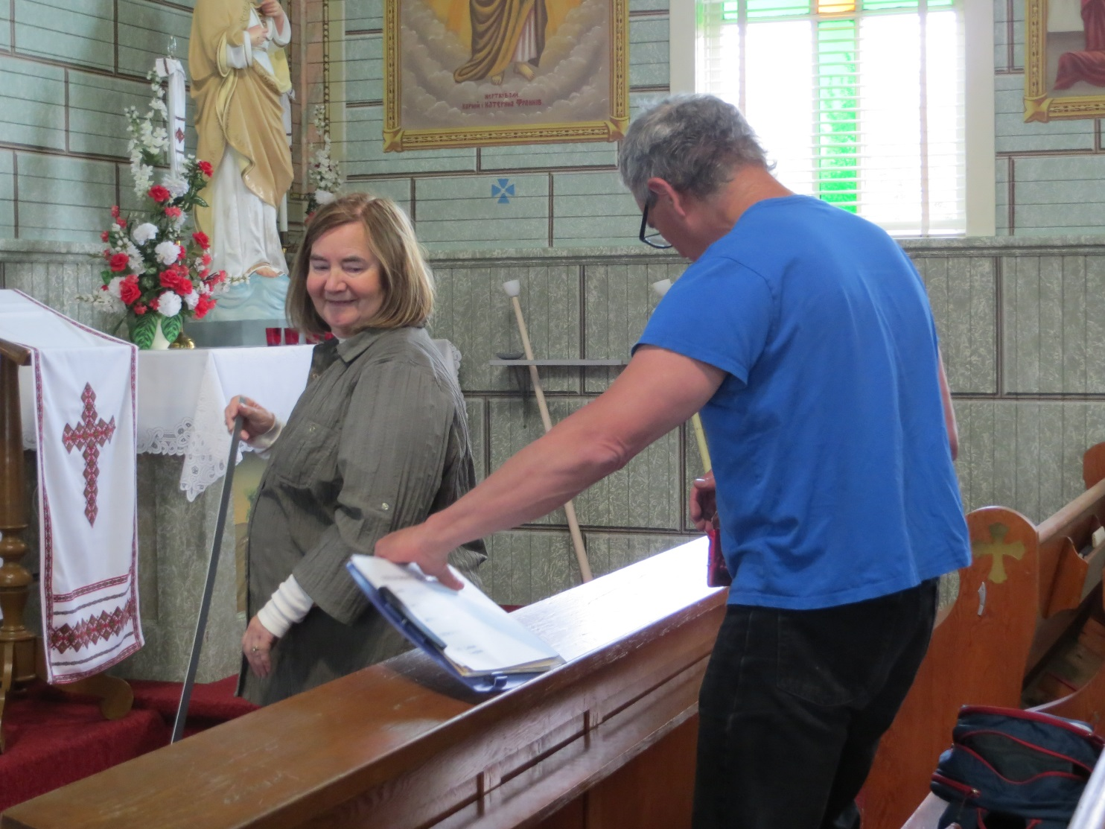
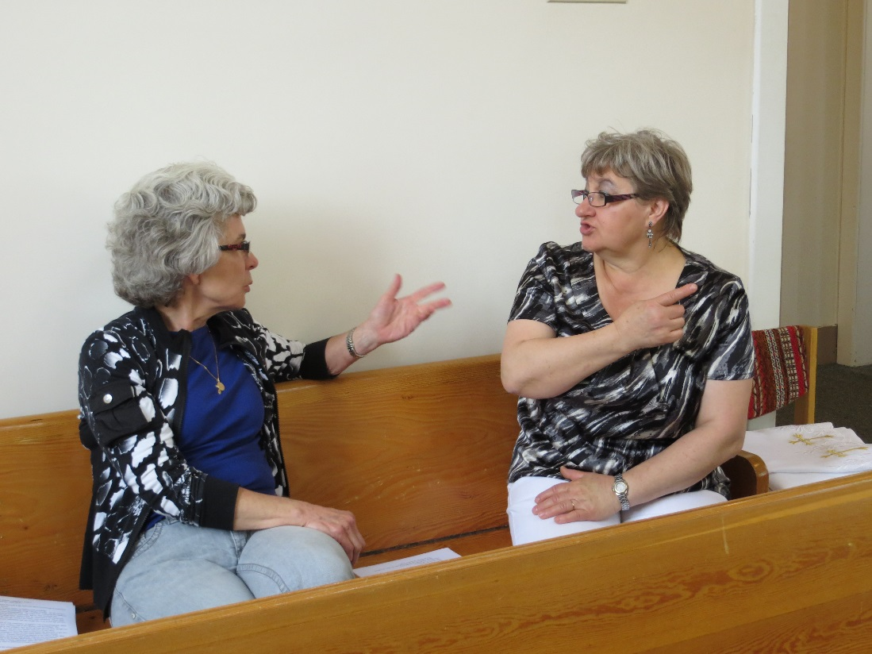
The Sanctuary project: Our team
John-Paul Himka
Frances Swyripa
Me – Natalie Kononenko
Photo documentation of the church exterior and interior, including photographing all ritual objects
Interviews about ritual practices connected to the church

Slide 3
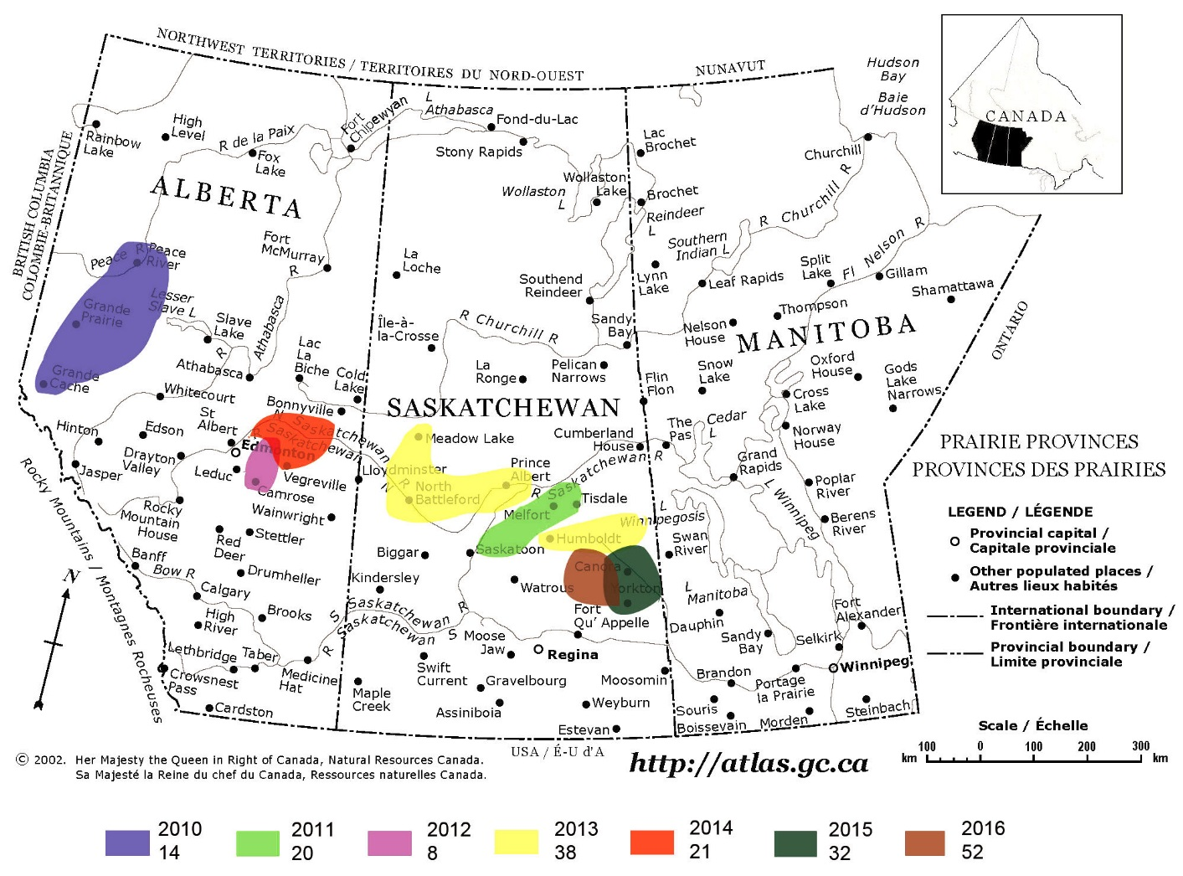
The areas where we have worked

Slide 4
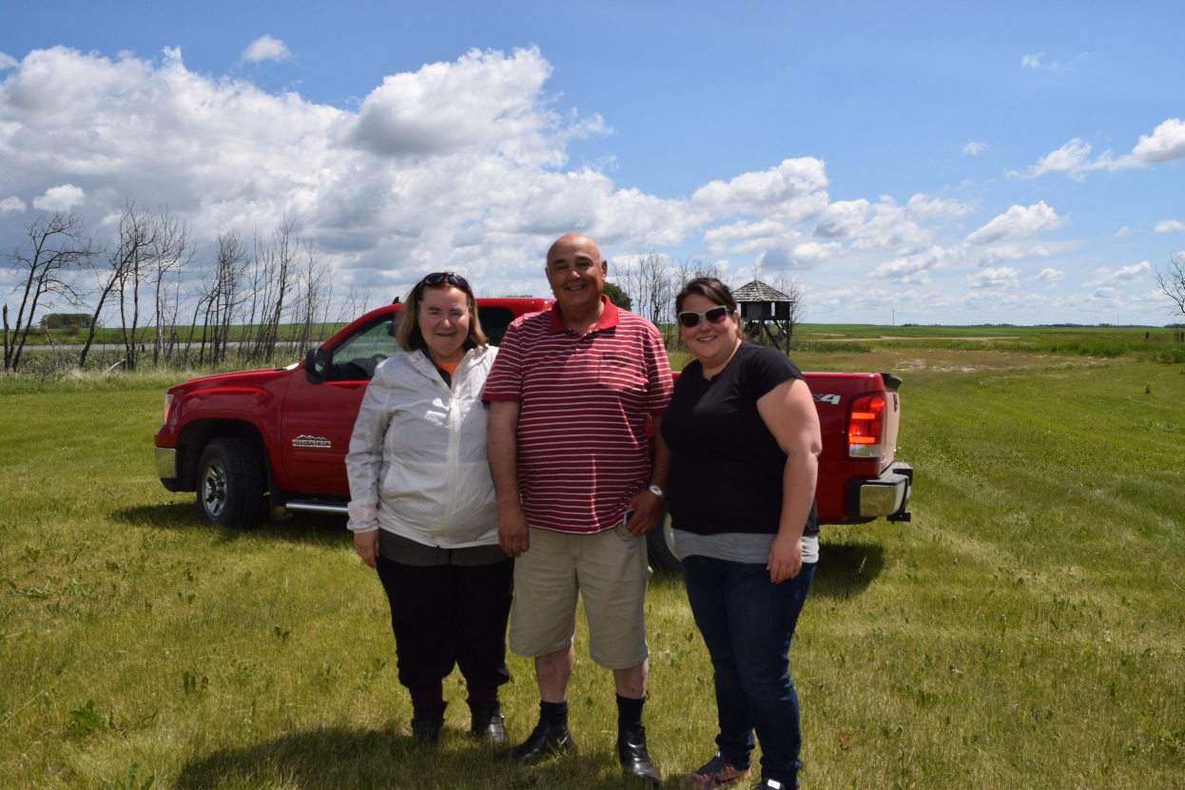
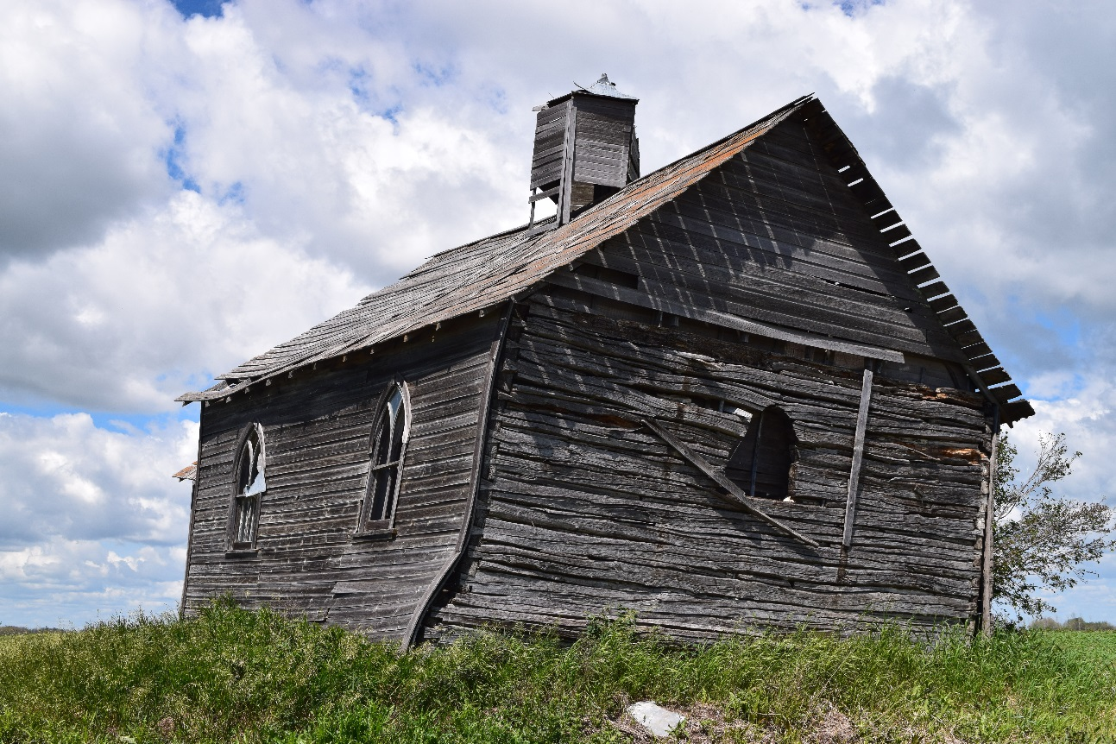
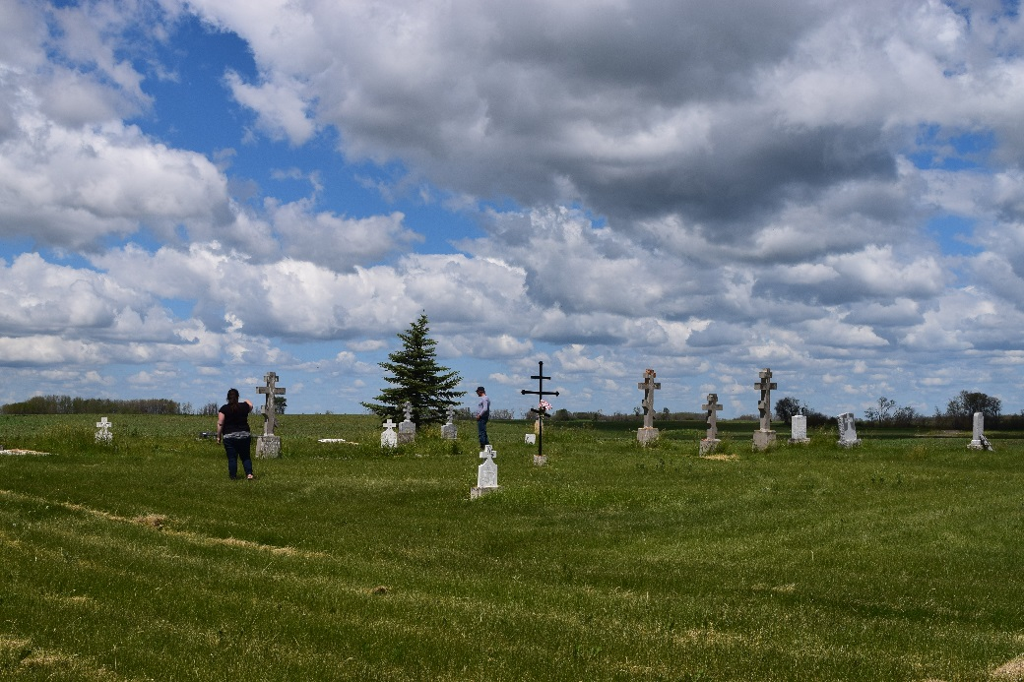
Why we do it
The church of the direct descendants of one of the first Ukrainian families to come to Canada; the cemetery

Slide 5
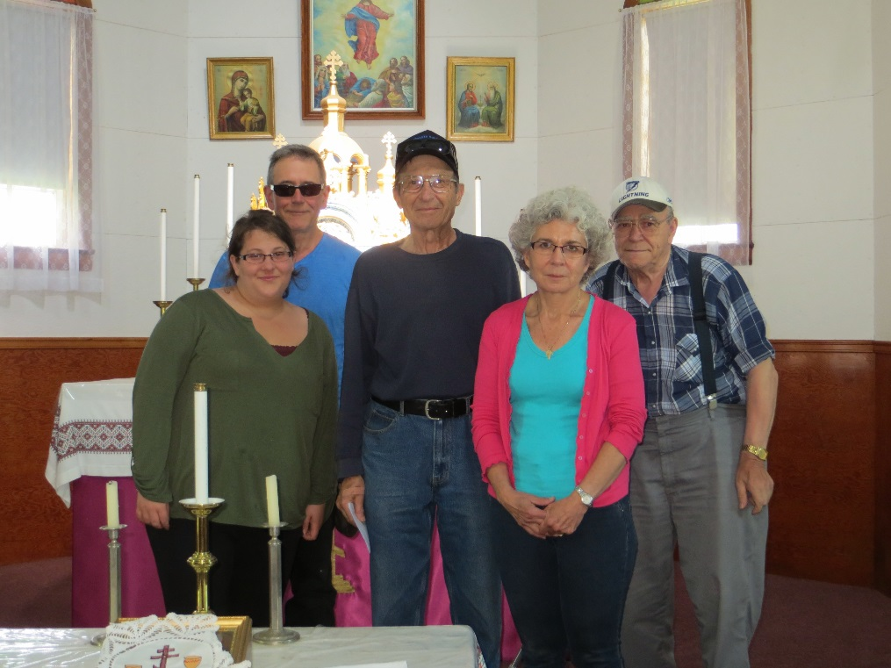
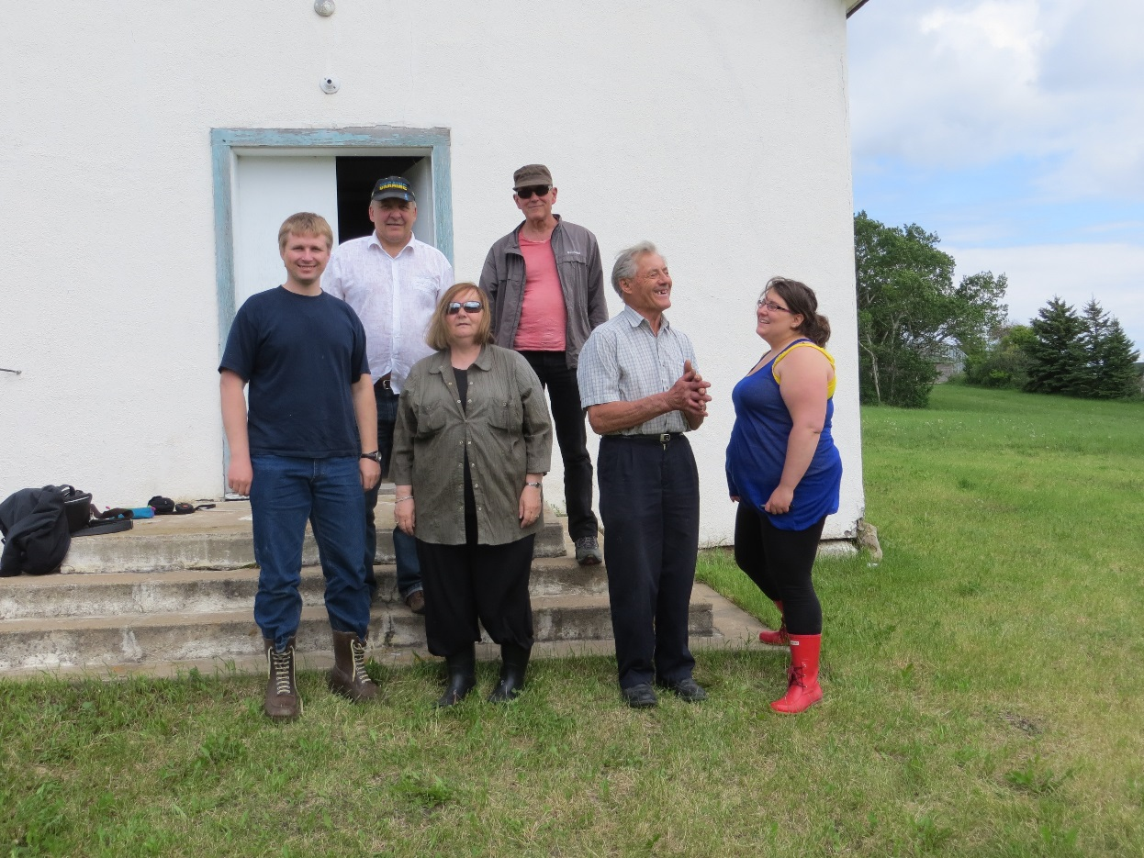
Demographic change
Mechanization allows smaller number of people to work more land – people move to cities
Churches amalgamated into larger and larger districts – number of services decrease
Smaller churches are closed
Services decrease further: one per month, then several per year – big holidays only
Last stage is Khram/Praznyk only – day of the saint after whom the church is named

Slide 6
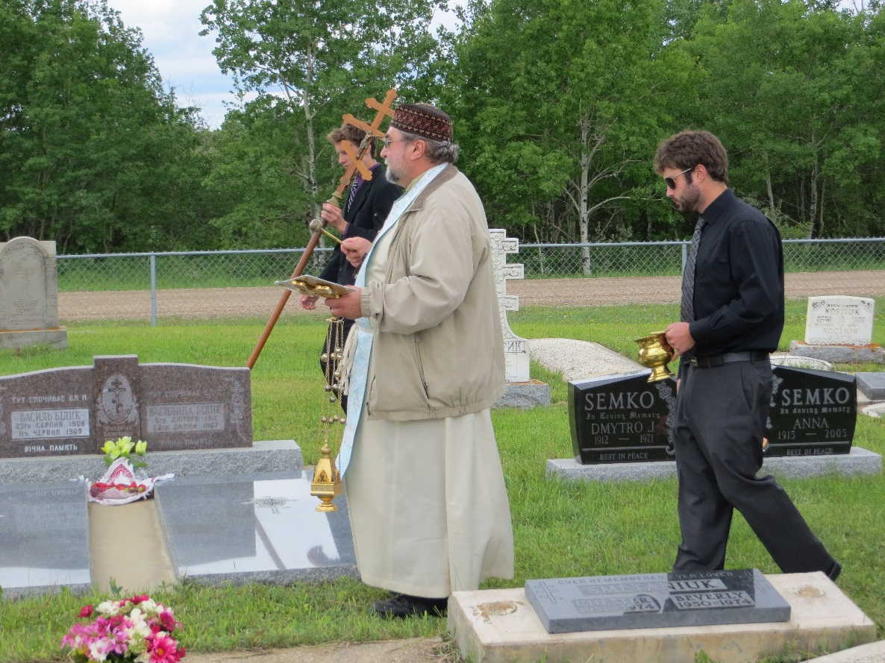
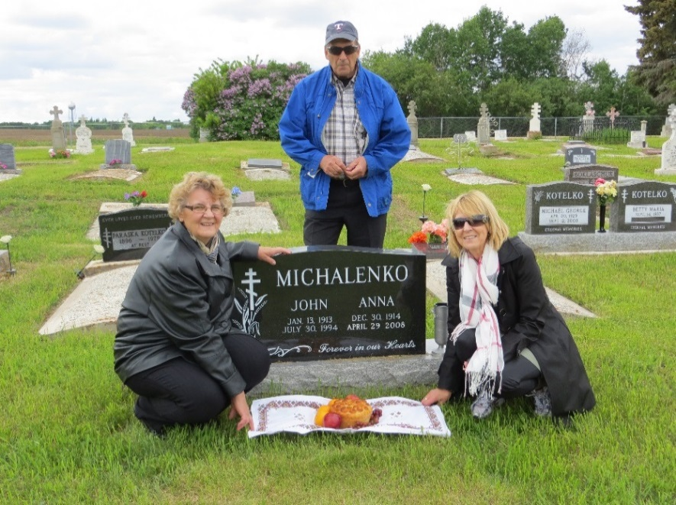
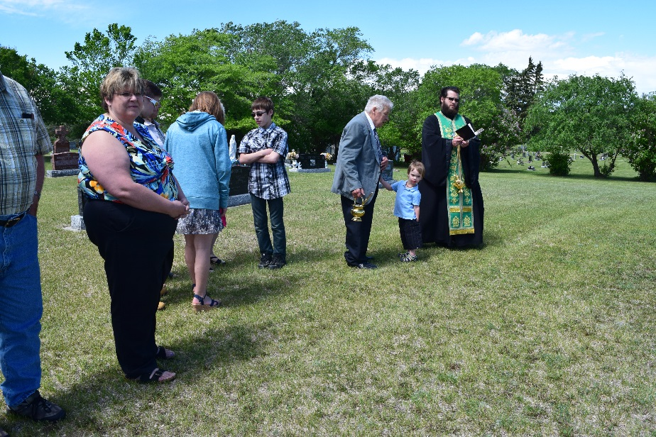
Grave blessings
Obligatory part of Khram or Praznyk
So important they “live on” even after church closes
Celebrated in conjunction with a Khram or Praznyk at a nearby larger church; grave blessings at larger church are followed by grave blessings at all of the regional churches which have closed
In the cases of closed churches, oftentimes no building – graves only

Slide 7
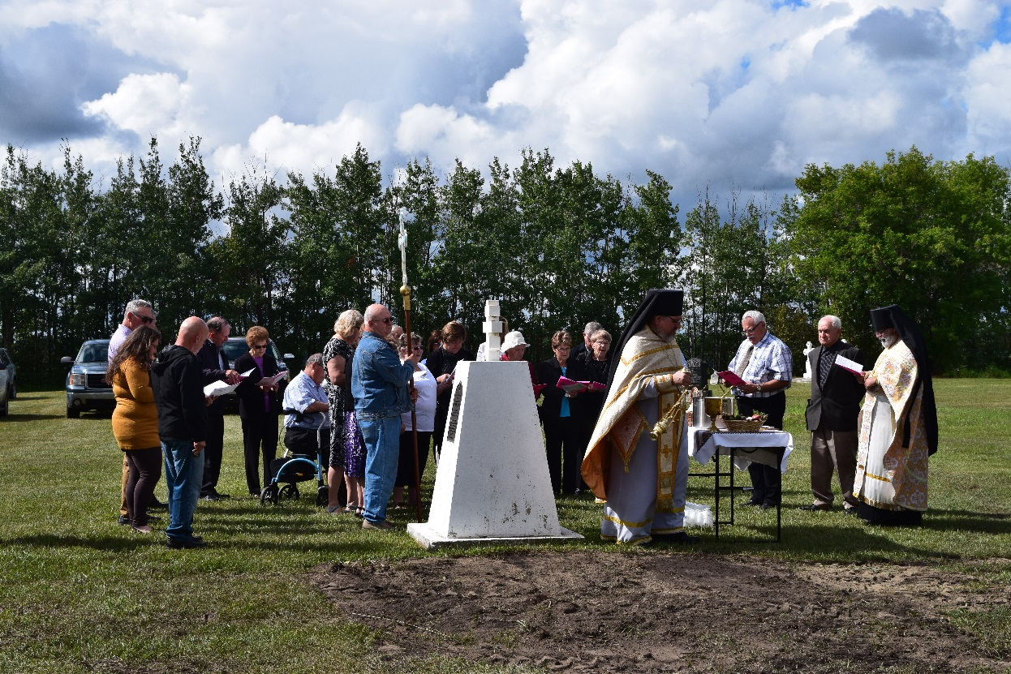
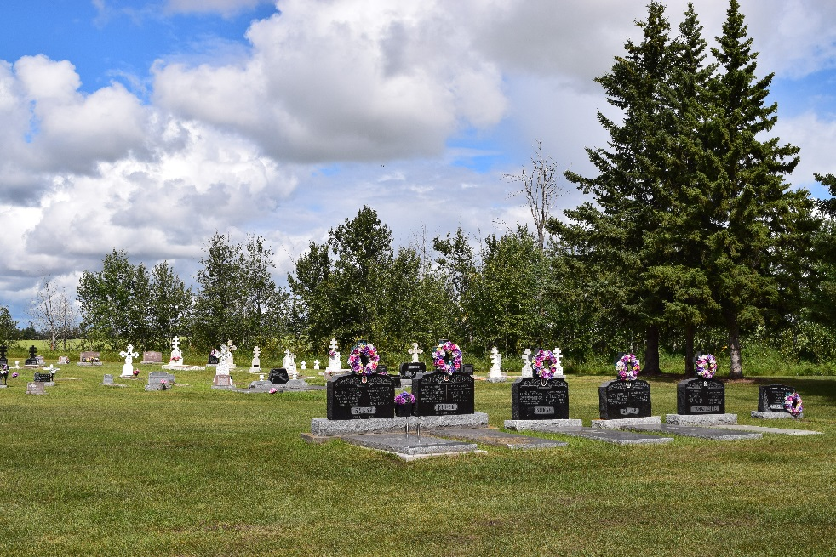
The importance of graves – liminality supreme
Burying ancestors = planting one’s family – and one’s roots – in the soil
Point of transition between life and death, this world and the next
Interviews indicate that graveyards are also the point where other transitions are negotiated and enacted
Beliefs brought from Ukraine; demands of life in Canada
Church doctrine, civil society, and changing attitudes

Slide 8
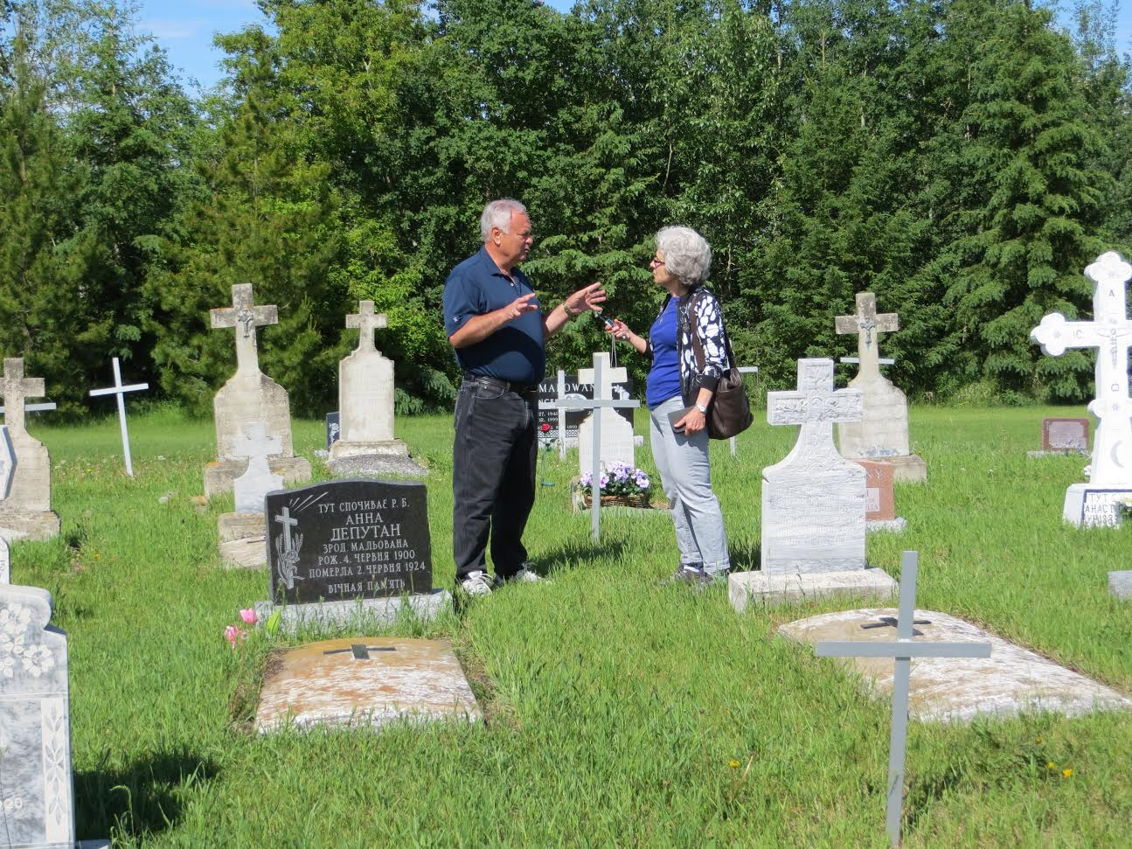
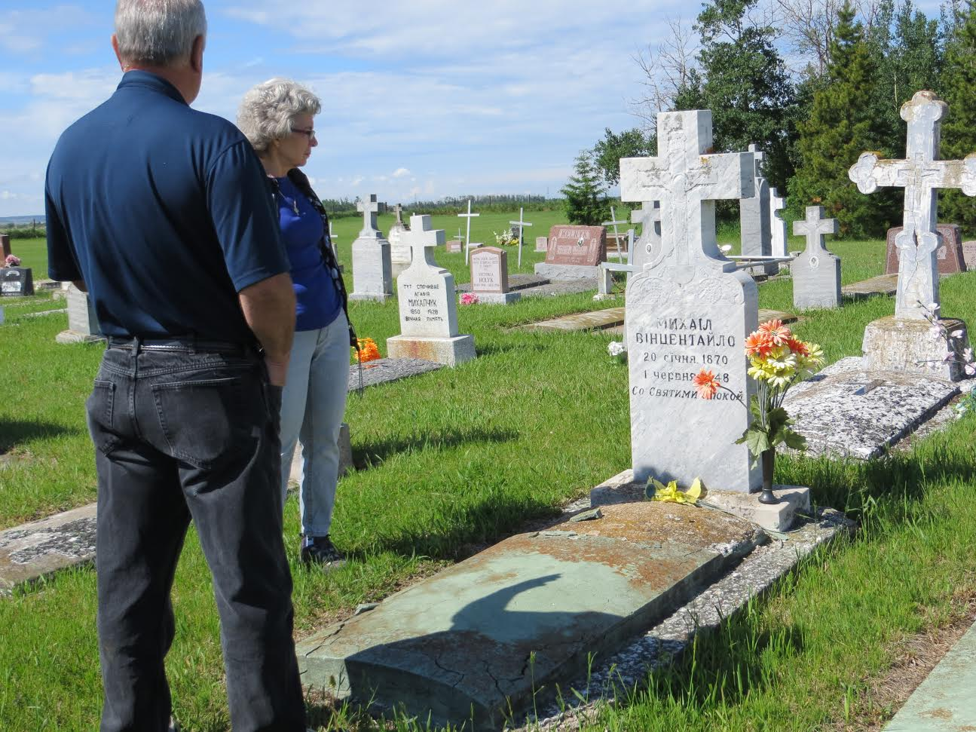
Stories of the unquiet dead
Told to me in secret – often in the graveyard
They are important and people feel a great compulsion to tell me
I do not ask for these stories – they are volunteered or even insisted upon

Slide 9
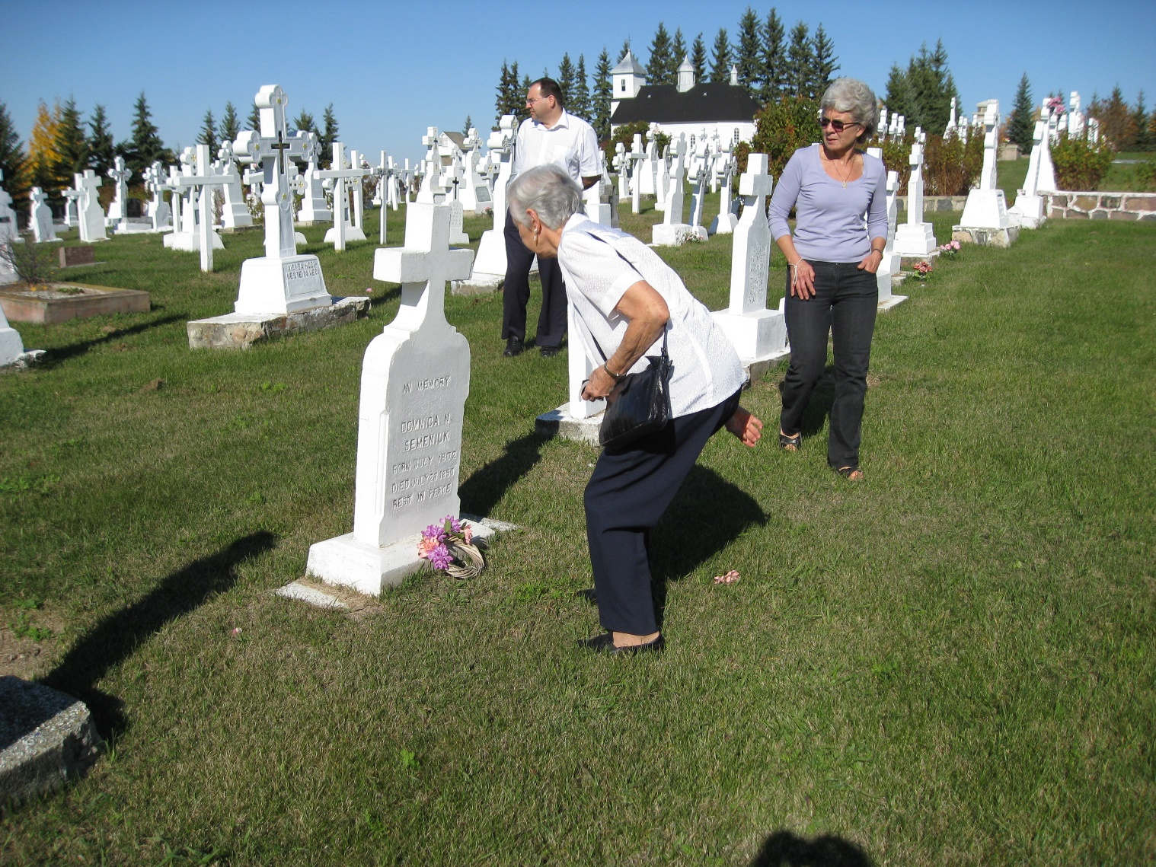
What are these stories and how do they develop over time – the process of negotiation
Secret stories of uncomfortable situations – step 1
Lead to/are followed by more public stories and individual protests against old ways of doing things – step 2
Step 3 is group action that is public and available for the recording
Some stories seem to come back – perhaps to start the process anew or to negotiate a new, but related, issue
Or stories come back because issues remain unresolved

Slide 10
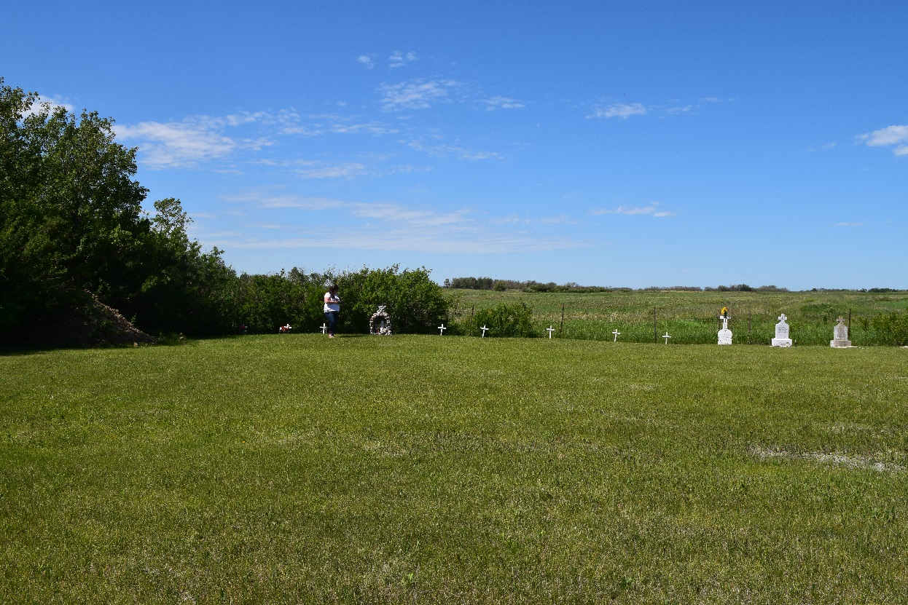
Unbaptised infants as unquiet dead
Traditional restrictions on burial in consecrated ground = the church cemetery
Restricted to baptized Christians who died a natural death
Implication – stillborn and other unbaptised infants cannot be buried
Unbaptised infants buried to the side, near the trees, or outside the fence
First step – stories of people cleaning the cemetery and hearing crying babies in the bush
The graves of the unbaptised separated from the main cemetery – Rama SK

Slide 11
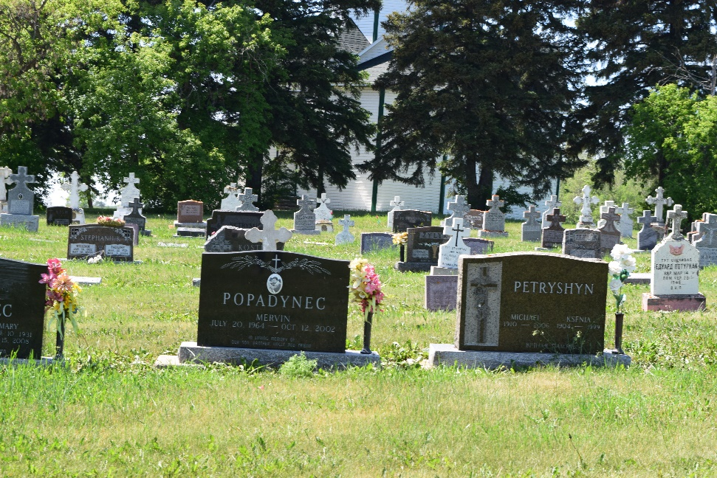
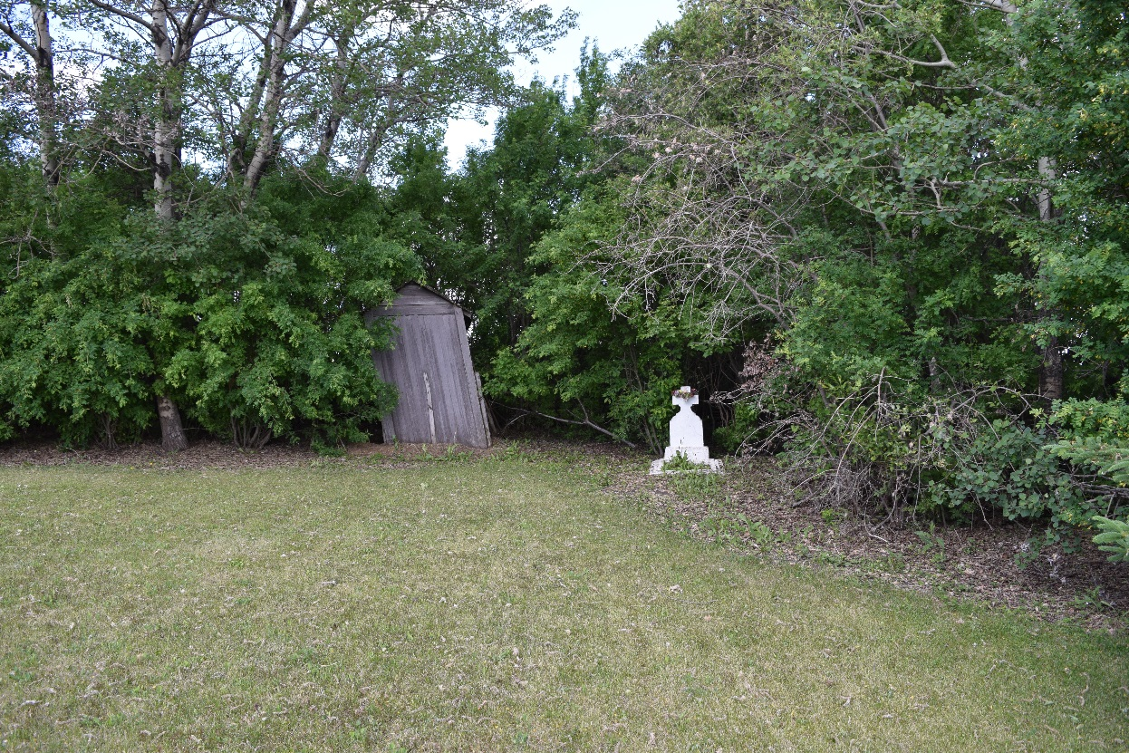
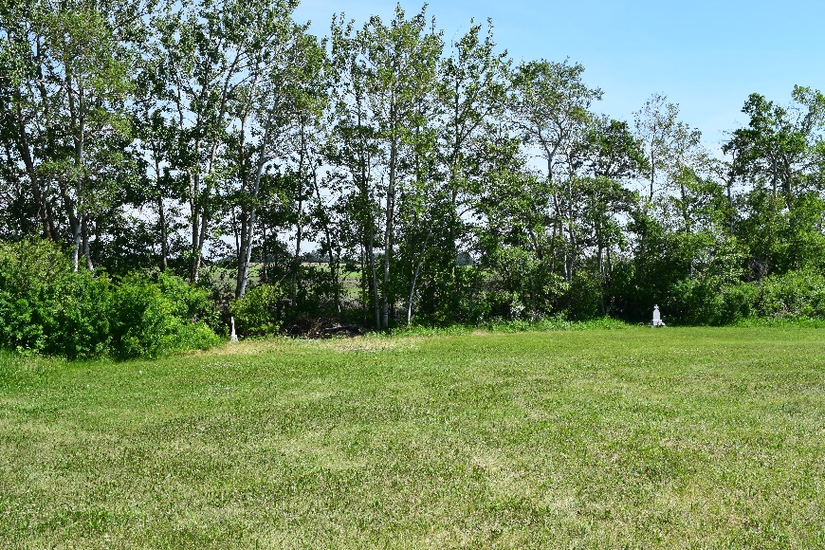
Change in belief says that children are innocent and should be honored and buried with everyone else
St. Michael’s cemetery, SK
Unbaptised graves near the bush
Extreme case of separate burial – unbaptised child next to outhouse – Tufnell SK

Slide 12
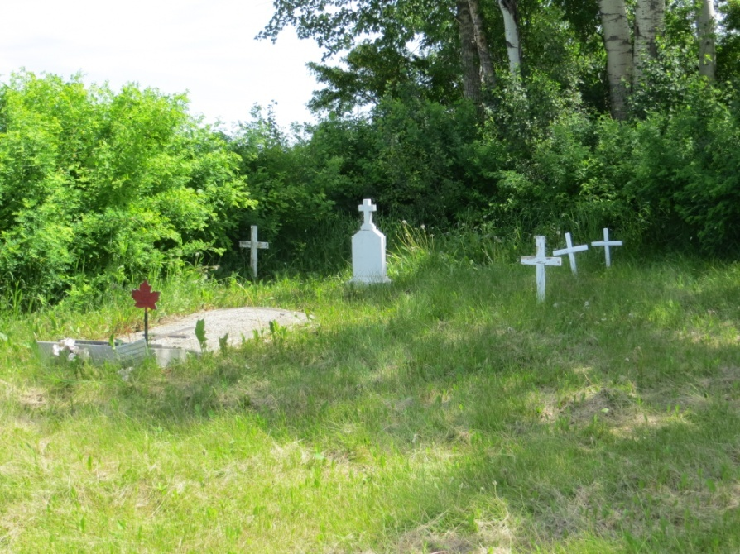
Individual protests against denial of burial in cemetery
War veteran dad – dies of old age; buried with son and other unbaptised babies rather than in normal cemetery
Other protests take form of stories told to the interviewer – me
These are stories about crying infants wanting baptism or other acknowledgement; they are stories about the courageous dad

Slide 13
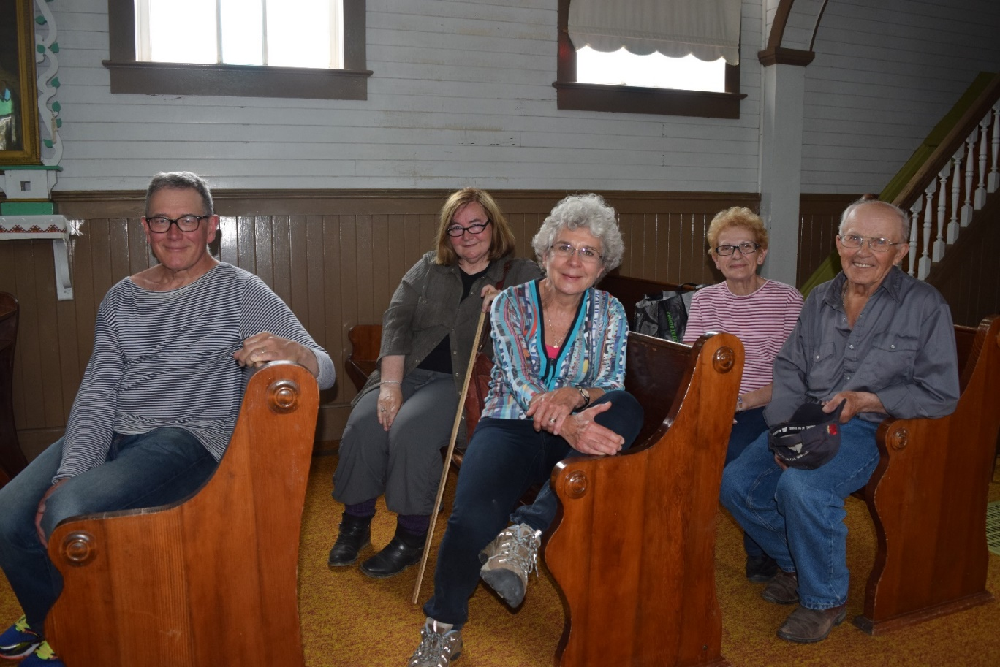
Moving on to group action
Couple in Model Farm who started looking up names of infants; they initiated moving the cemetery fence so that unbaptized infant graves would now be in the cemetery proper
Mike and Gerardine Woitas
She was given the name of a brother who died at birth
He was not buried in the cemetery
But parents wanted his memory to live on and gave the next born child the same name – feminine version
Possible influence of hospital births and naming infants in civic record
This change recognized by church:
Father Kushko blesses the graves

Slide 14
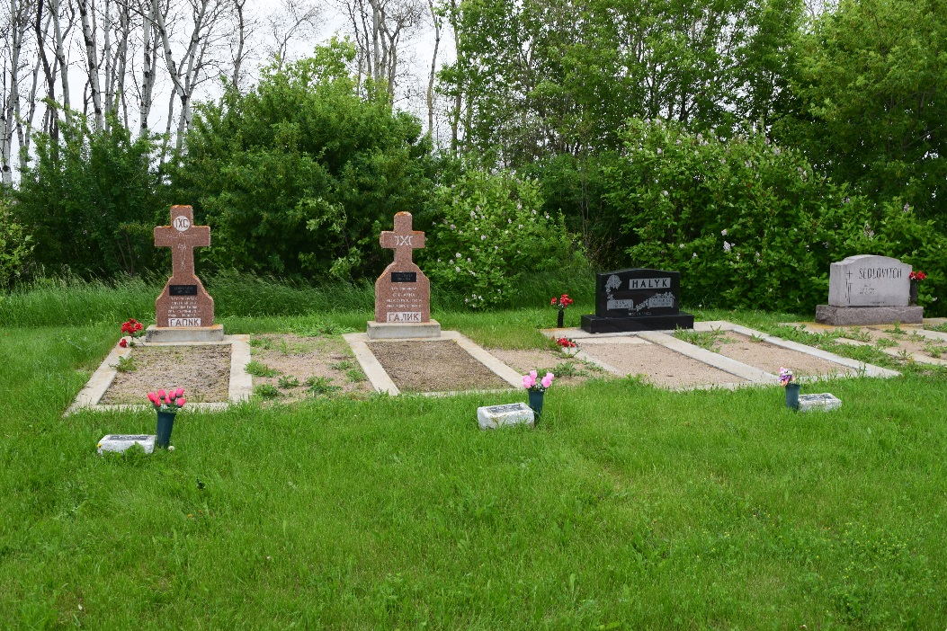
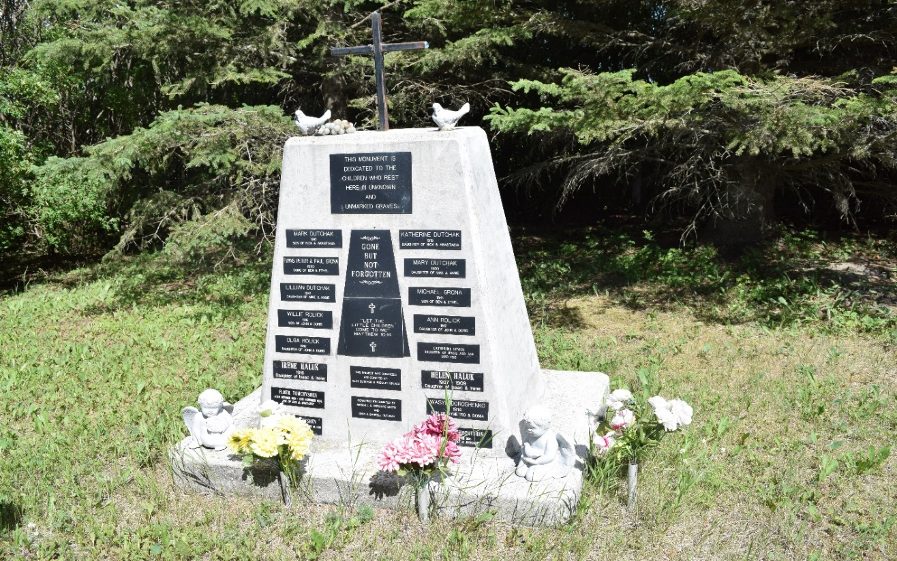
From stories to group action
Fence moved to include infant burial sites in Model Farm
Small markers next to graves of parents (Birmingham) – in the cemetery proper
Names of unbaptised children recovered from civic records and cenotaph erected – Kuziw near Rama SK; plaque dedicated to children in unmarked graves in MacNutt

Slide 15
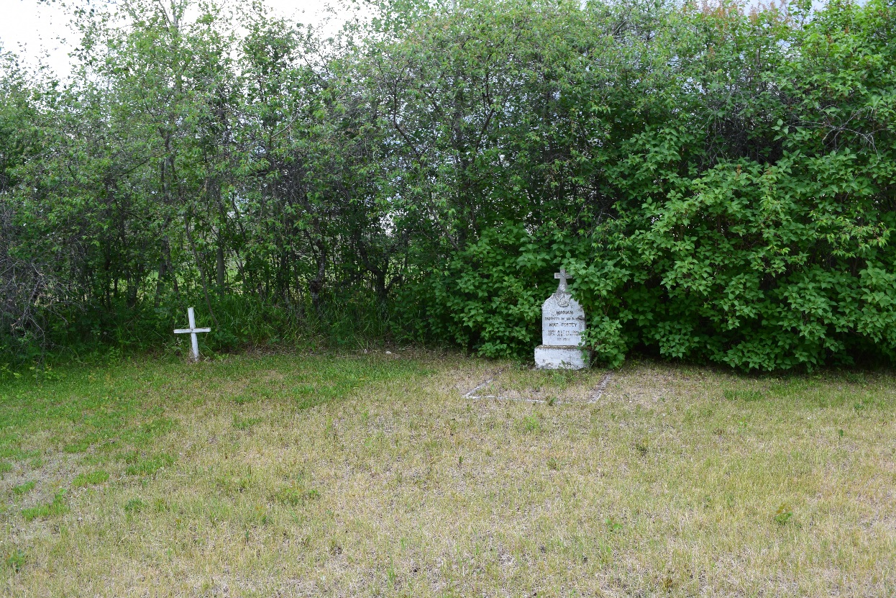
Suicides pose the same problem
Died unnatural death – cannot be buried in the regular cemetery
Grave of unbaptized child and suicide, Gorlitz SK
The stories
Suicides who come in dreams and ask for proper burial
Individual action – wife is buried next to suicide husband rather than in cemetery proper

Slide 16
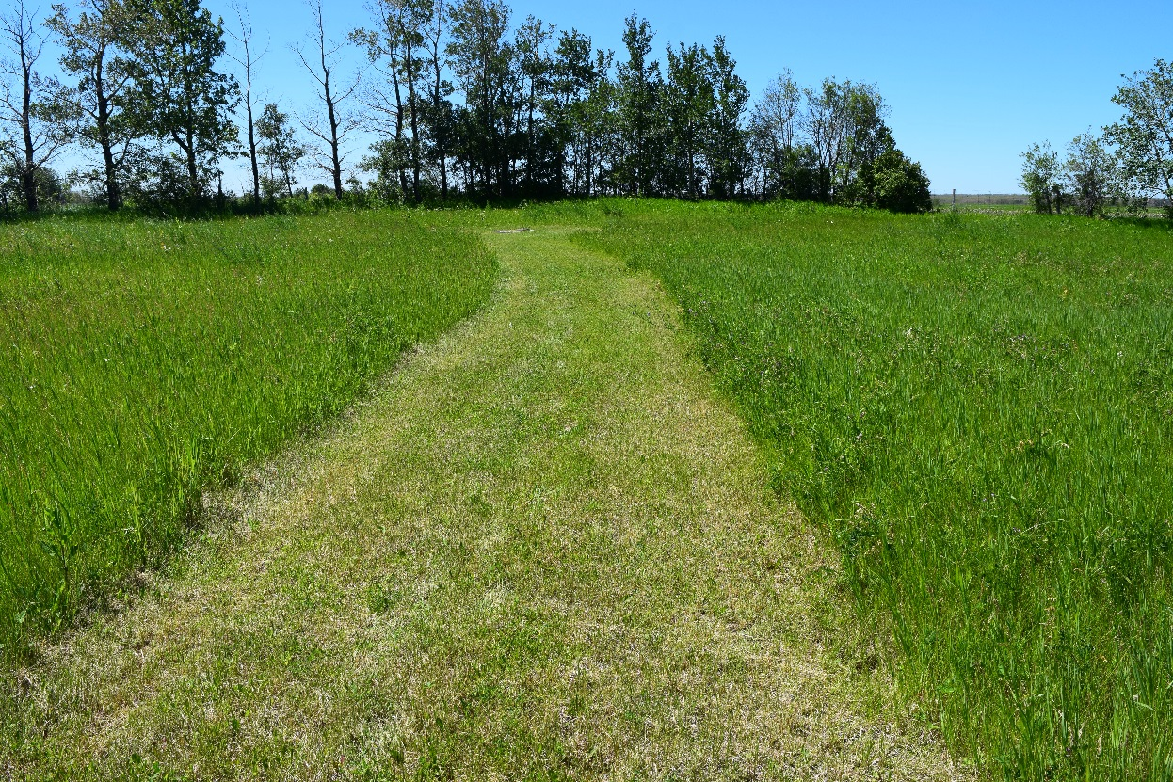
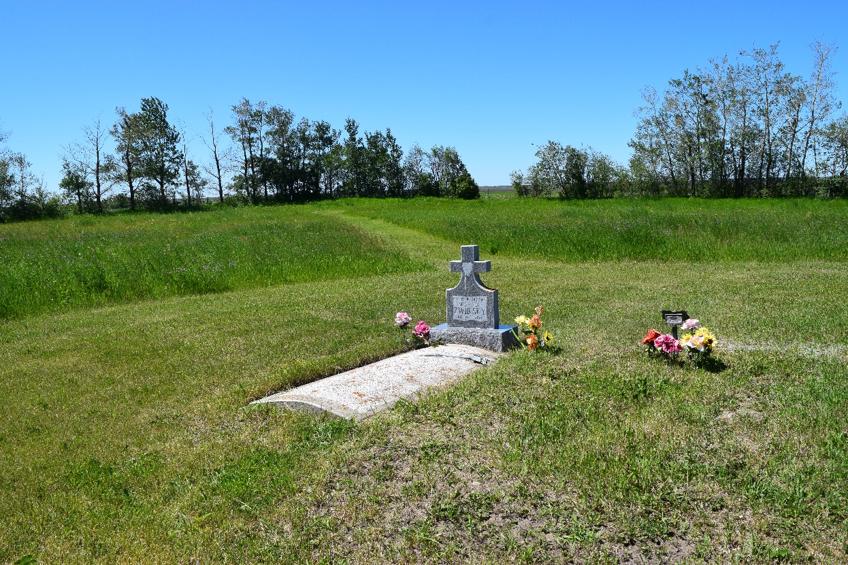
Group or open action with suicides more problematic, but does exist
Path mowed to the grave of a suicide, located away from the main cemetery
Grave of suicide now clearly evident – no longer hidden behind tall grass or at bottom of a hill

Slide 17
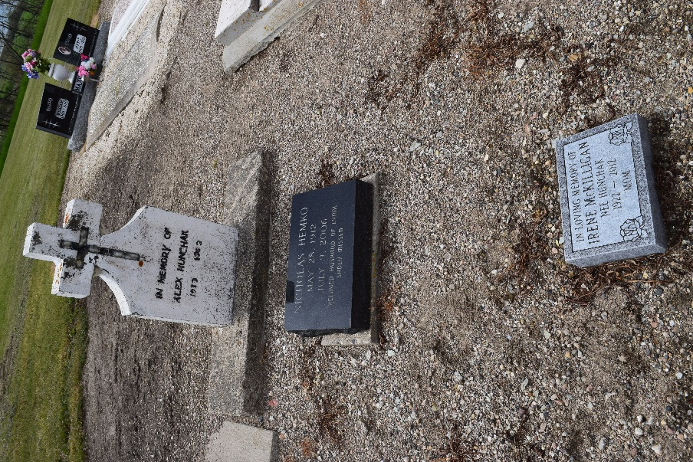
Cremation – body must be whole at the Last Judgement
Problem – people who die far from where they were born
Want to be buried “at home”
Cannot afford shipping of whole body
Elect to be shipped in cremated form – and are denied sacraments
Relatives protest and bury cremated remains on top of other graves at night
This is south of Foam Lake
Ashes of cremated parent scattered on grave of son near Ispas, AB

Slide 18
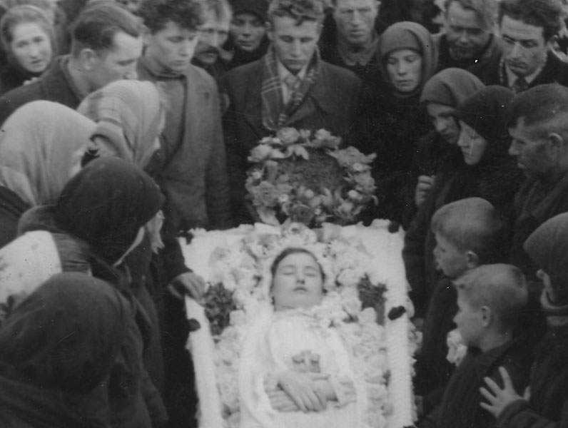
Different unquiet death issue: people who die young – illness, but mostly accidents
Ukrainian method of dealing with early death, especially of those who died unmarried is wedding of the dead
This will let the deceased rest in peace and not become revenants
This practice existed in Canada until about 1970
Edmonton area – Chipman accident (1960) reported in Edmonton Journal
Many people still remember such burials and have photos of death weddings
Old Canadian photo of a death wedding

Slide 19
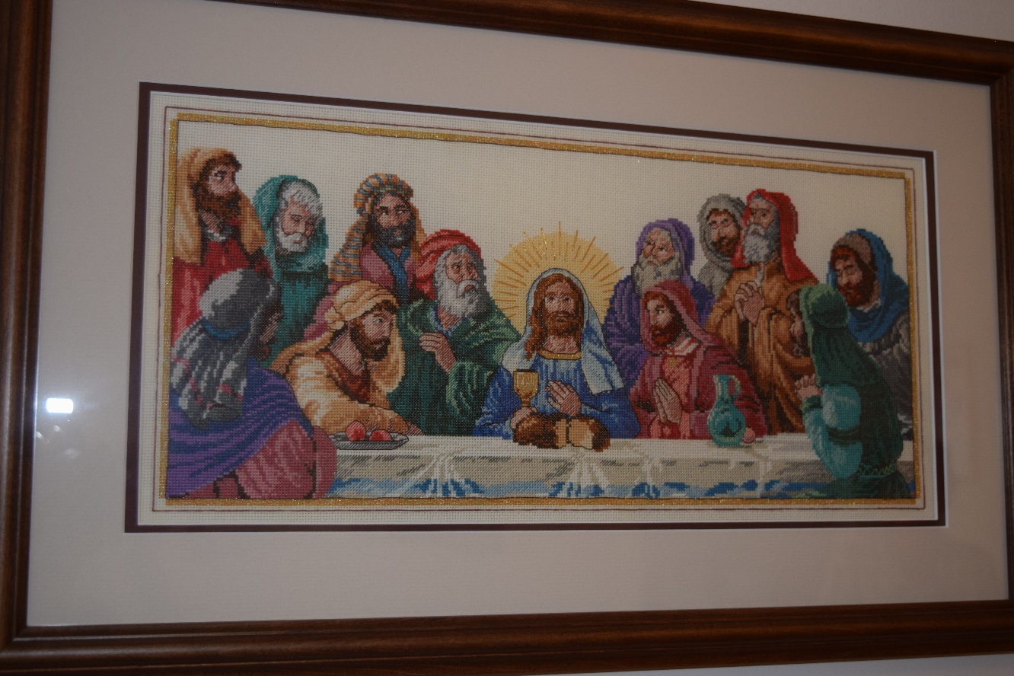
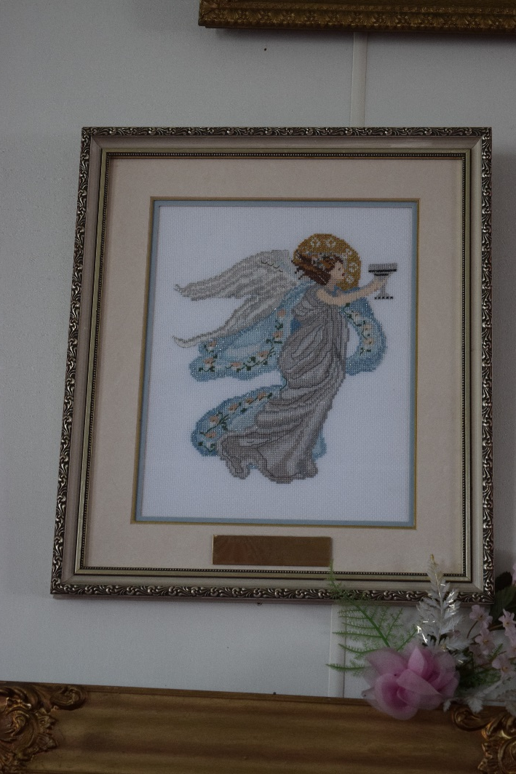
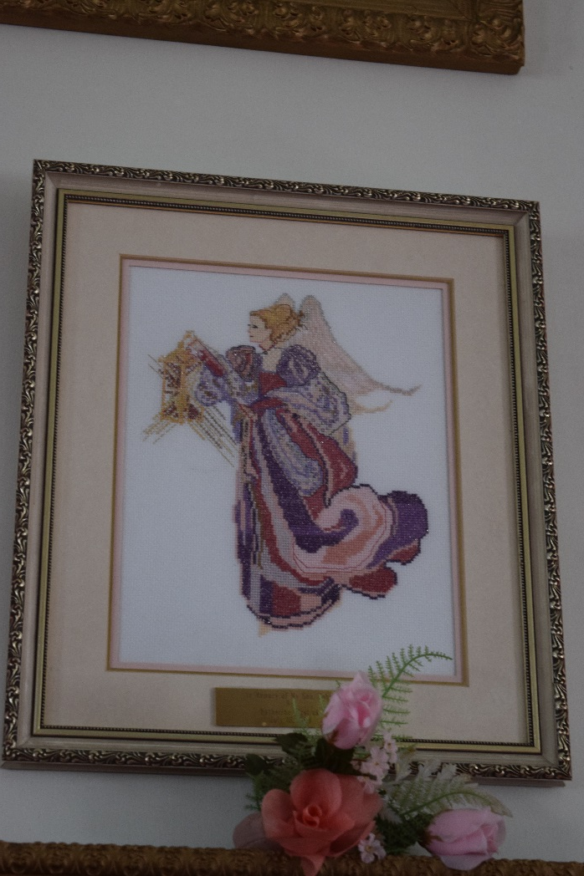
Contemporary approach – special commemoration desired; takes form of an object that will “live” in the church
Icons, typically hand-embroidered, donated to the church
Angels are in Edmore SK

Slide 20
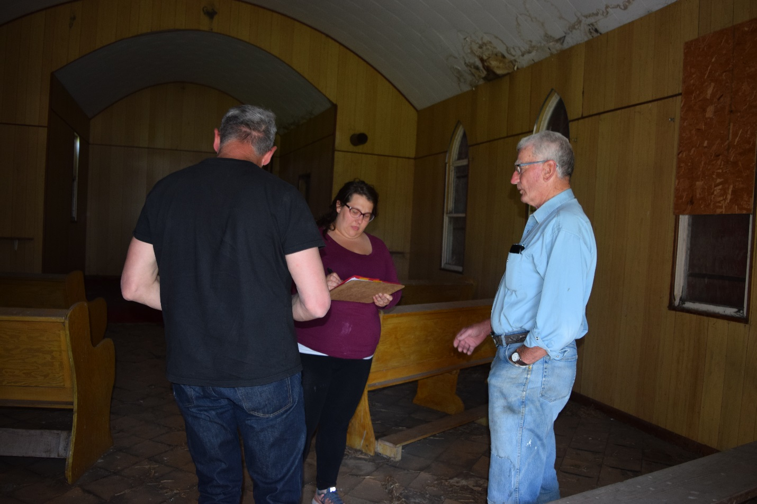
What to do with donated objects when a church is closed and scheduled for burning?
Families want the objects returned
But do they belong to the family once they have been donated and sanctified?
Destruction of these objects, usually by burning along with the rest of the church
Will there be a folk movement like the one affecting cemeteries?
Some individual action, like taking objects even though this goes against church dictates

Slide 21
The issue of place
Graveyard
Liminal place; place of transition
As a liminal place allows transition in church practice
Vernacular religion influences canonical practice
The 3 steps lead to acceptance by the church (both Orthodox and Eastern rite Catholic)
Church
Also a liminal space – place where the human can interact with the divine
Place of transformation of the human spirit
But here influence of vernacular religion not allowed
Folk religion cannot affect church practice

Slide 22
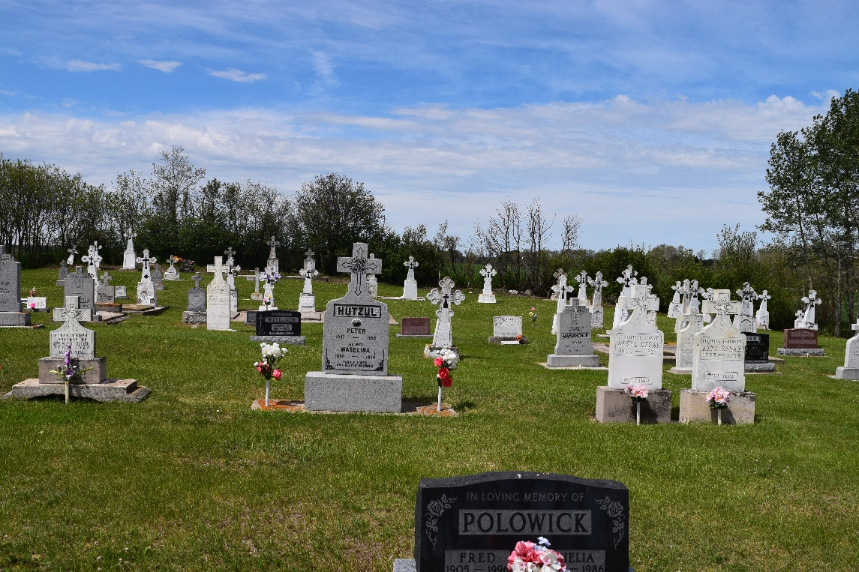
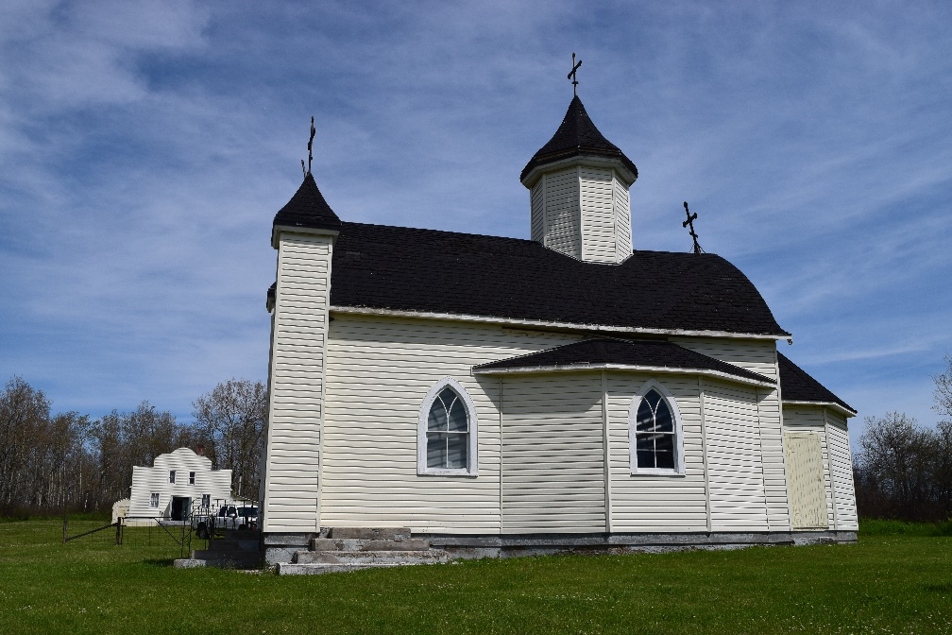
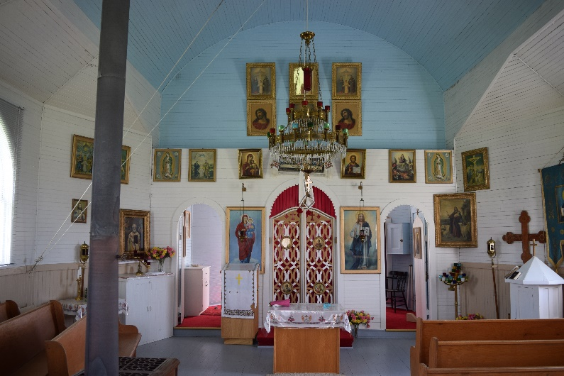
Westbrook Church of the Holy Ascension (UO)
Division between church property and cemetery
Both donated by congregation
As church closes, congregation gets to keep cemetery
Church will be burned and land sold by eparchy

Slide 23
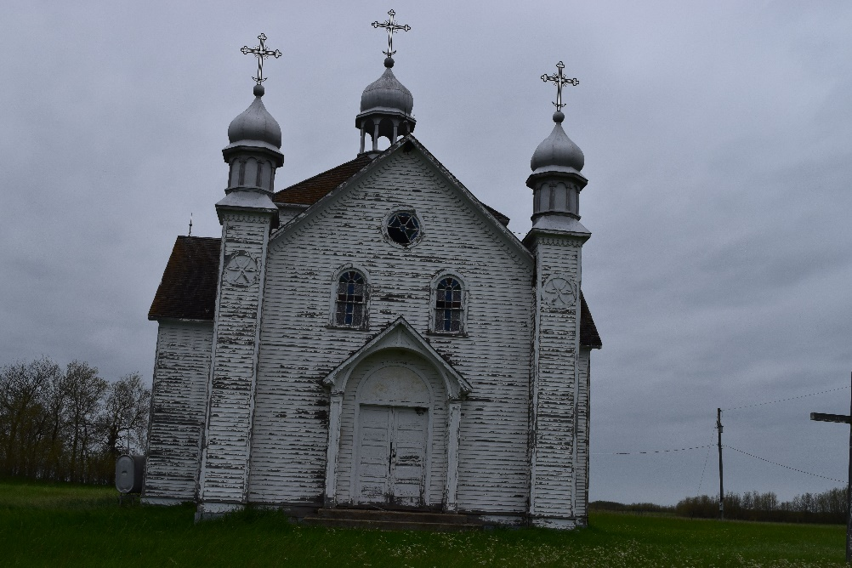
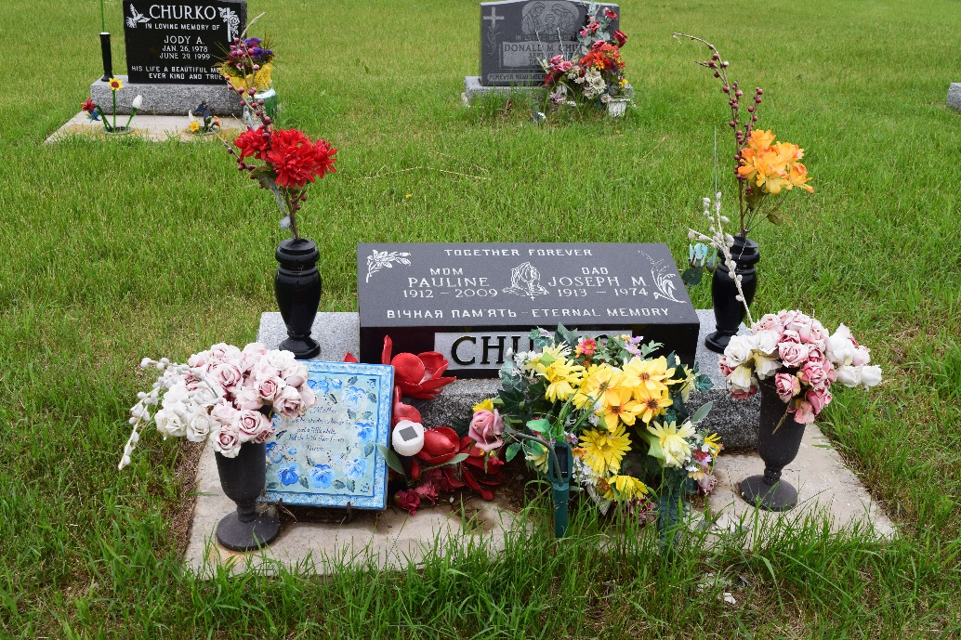
Vernacular religion and place
Vernacular religion is religion as it is lived
Closing of churches at the beginning of talk
Will vernacular religion bring life to the church?
The church and the cemetery at Plainview
Irony of place of death = cemetery as place where faith lives on

