Slide 1
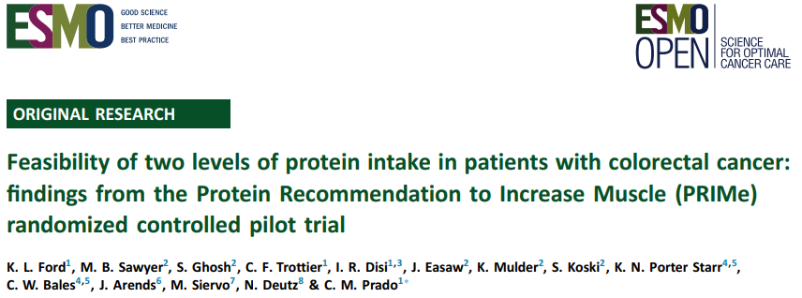
Figures for Presentations

Slide 2
Figures adapted from the paper

Slide 3
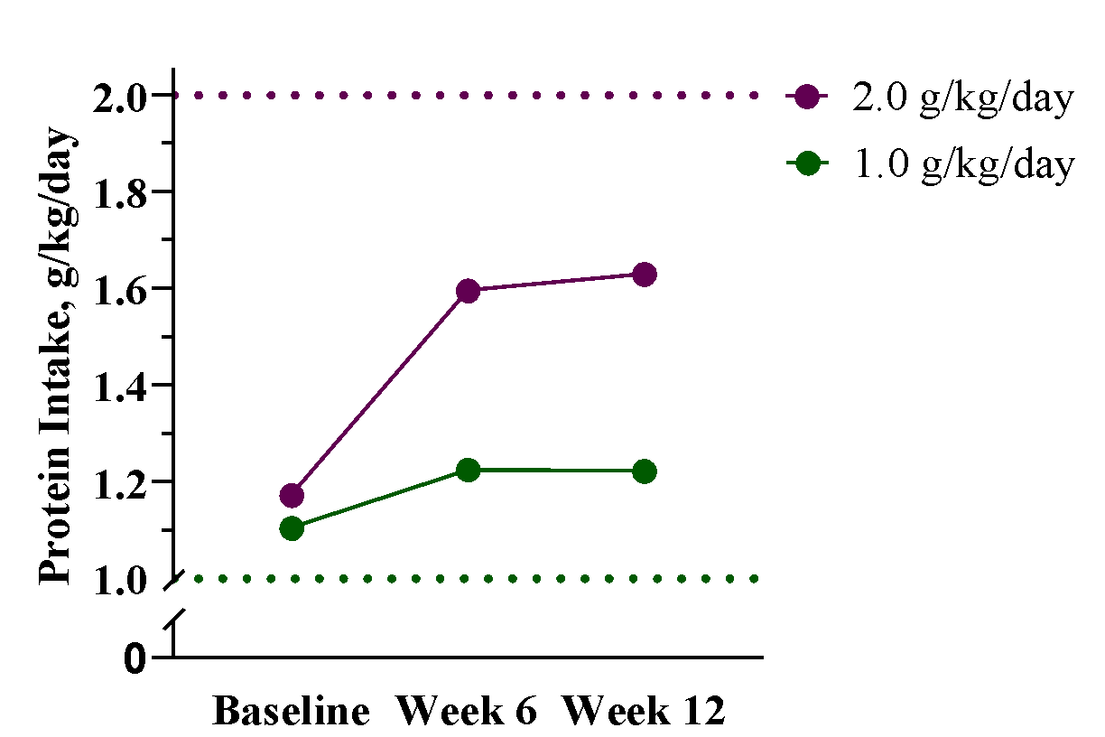
Mean protein intake by study arm and timepoint. The dotted lines represent the target protein intake per study group. Baseline: n=50 (1.0 g/kg/day group: n=25; 2.0 g/kg/day group: n=25); 6 weeks: n=44 (1.0 g/kg/day group: n=24; 2.0 g/kg/day group: n=20); 12 weeks: n=40 (1.0 g/kg/day group: n=23; 2.0 g/kg/day group: n=17).
Adapted from: Ford et al. ESMO Open. 2024;9(7):103604.

Slide 4
1.6 g/kg/day
A 0.4 g/kg/day difference between groups was achieved at week 12 vs. the intended 1.0 g/kg/day difference
1.2 g/kg/day
Mean protein intake by study arm and timepoint. The dotted lines represent the target protein intake per study group. Solid arrows indicate mean intake achieved at week 12. Baseline: n=50 (1.0 g/kg/day group: n=25; 2.0 g/kg/day group: n=25); 6 weeks: n=44 (1.0 g/kg/day group: n=24; 2.0 g/kg/day group: n=20); 12 weeks: n=40 (1.0 g/kg/day group: n=23; 2.0 g/kg/day group: n=17).
Adapted from: Ford et al. ESMO Open. 2024;9(7):103604.

Slide 5
Mean ALSTI at each timepoint. ALSTI, Appendicular Lean Soft Tissue Index; 6 weeks: n=44 (1.0 g/kg/day group: n=24; 2.0 g/kg/day group: n=20); 12 weeks: n=40 (1.0 g/kg/day group: n=23; 2.0 g/kg/day group: n=17).
Adapted from: Ford et al. ESMO Open. 2024;9(7):103604.

Slide 6
Figures published in the paper

Slide 7
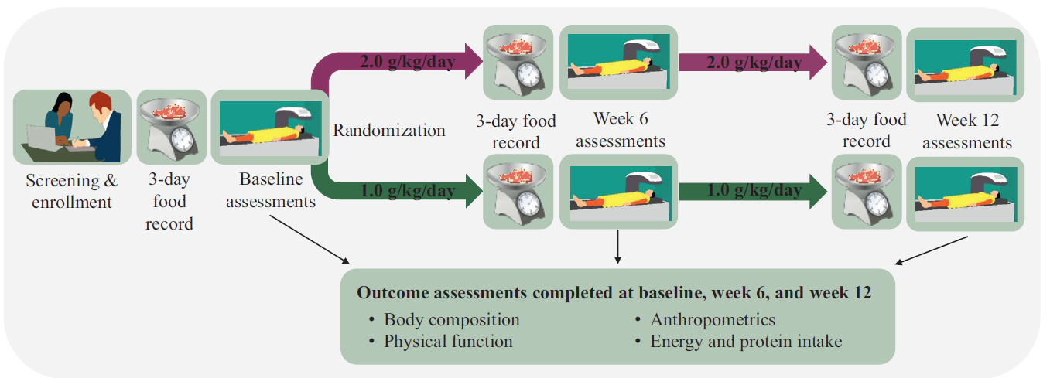
Figure 1. Graphical illustration of the Protein Recommendation to Increase Muscle (PRIMe) study protocol.
Ford et al. ESMO Open. 2024;9(7):103604.

Slide 8
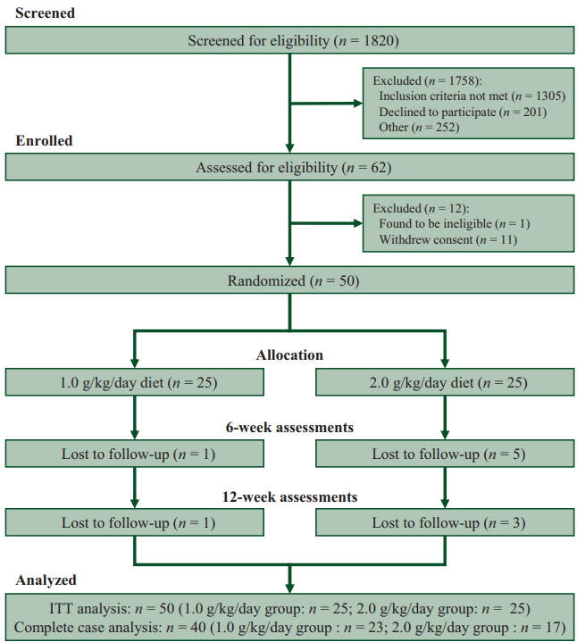
Figure 2. Patient flow through the trial. ITT: intention to treat.
Ford et al. ESMO Open. 2024;9(7):103604.

Slide 9
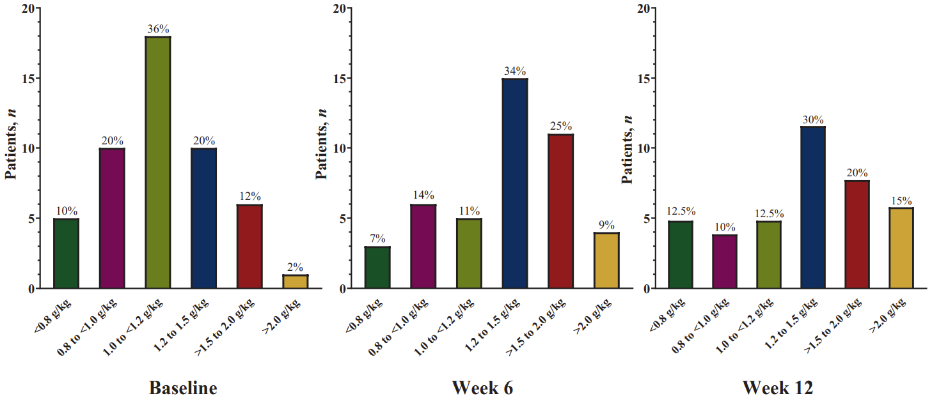
Figure 3. Protein intake across study timepoints in patients with newly diagnosed colorectal cancer. <0.8 g/kg: below RDA; 0.8 to <1.0 g/kg: meeting RDA; 1.0 to <1.2 g/kg: ESPEN minimum; 1.2-1.5 g/kg: ESPEN target; >1.5 – 2.0 g/kg: ESPEN high target; >2.0 g/kg: above ESPEN range. Baseline n=50; Week 6 n=44; Week 12 n=40. ESPEN: European Society for Clinical Nutrition and Metabolism; g/kg: grams of protein per kilogram of body weight per day; RDA: recommended dietary allowance.
Ford et al. ESMO Open. 2024;9(7):103604.

Slide 10
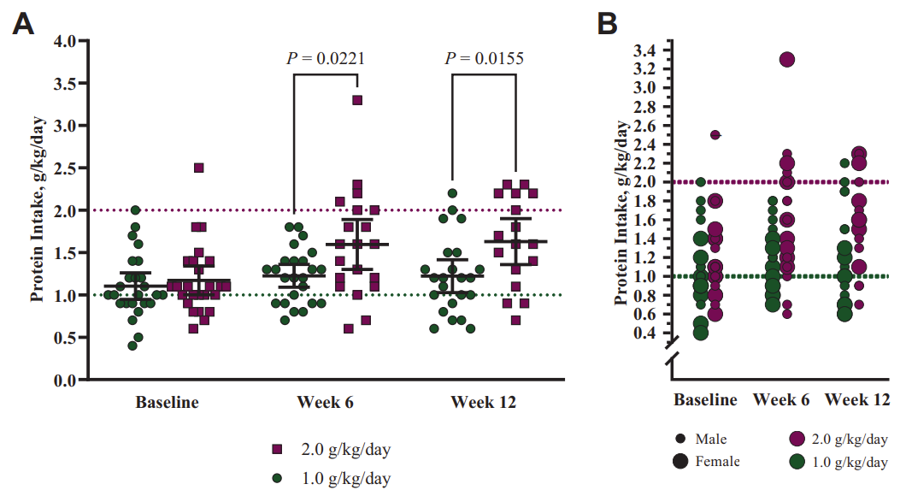
Figure 4 A-B. Protein intake by (A) study arm and timepoint and (B) study arm, timepoint, and sex. Data are presented as mean. Green circles represent the 1.0 g/kg/day protein diet group; purple squares represent the 2.0 g/kg/day protein diet group. The dotted lines represent the target protein intake per study group. Smaller circles represent males; larger circles represent females. Data point with a through line indicates an extreme outlier (significance was not impacted by the extreme outlier). Differences between study arms at each timepoint were assessed by independent samples t-test or Mann-Whitney U test for non-normality. Difference between baseline and week 12 intake by the study arm was assessed by paired samples t-test; 1.0 g/kg/day: 0.1±0.4 g/kg/day (P=0.357) and 2.0 g/kg/day: 0.5±0.4 g/kg/day (P<0.001). g/kg/day, grams of protein per kilogram of body weight per day. Baseline: n=50 (1.0 g/kg/day group: n=25; 2.0 g/kg/day group: n=25); 6 weeks: n=44 (1.0 g/kg/day group: n=24; 2.0 g/kg/day group: n=20); 12 weeks: n=40 (1.0 g/kg/day group: n=23; 2.0 g/kg/day group: n=17).
Ford et al. ESMO Open. 2024;9(7):103604.

Slide 11
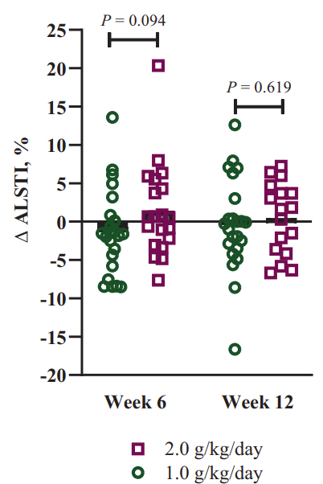
Figure 5. Percent change since baseline in muscle mass estimated by ALSTI. Each data point represents a patient. Black bars represent the group mean. Differences between study groups were assessed by independent samples t-test or Mann-Whitney U test in the case of non-normality. ALSTI, Appendicular Lean Soft Tissue Index; 6 weeks: n=44 (1.0 g/kg/day group: n=24; 2.0 g/kg/day group: n=20); 12 weeks: n=40 (1.0 g/kg/day group: n=23; 2.0 g/kg/day group: n=17).
Ford et al. ESMO Open. 2024;9(7):103604.

Slide 12
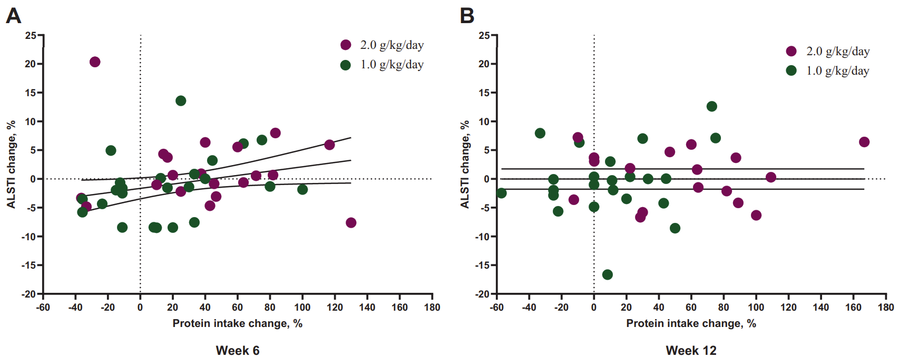
Figure 6A-B. Percent change since baseline in ALSTI plotted against percent change in protein intake since baseline at (A) week 6 and (B) week 12 by study arm. Each data point represents a participant. The hashed lines are a marker of no change. ALSTI: appendicular lean soft tissue index.
Ford et al. ESMO Open. 2024;9(7):103604.

Slide 13
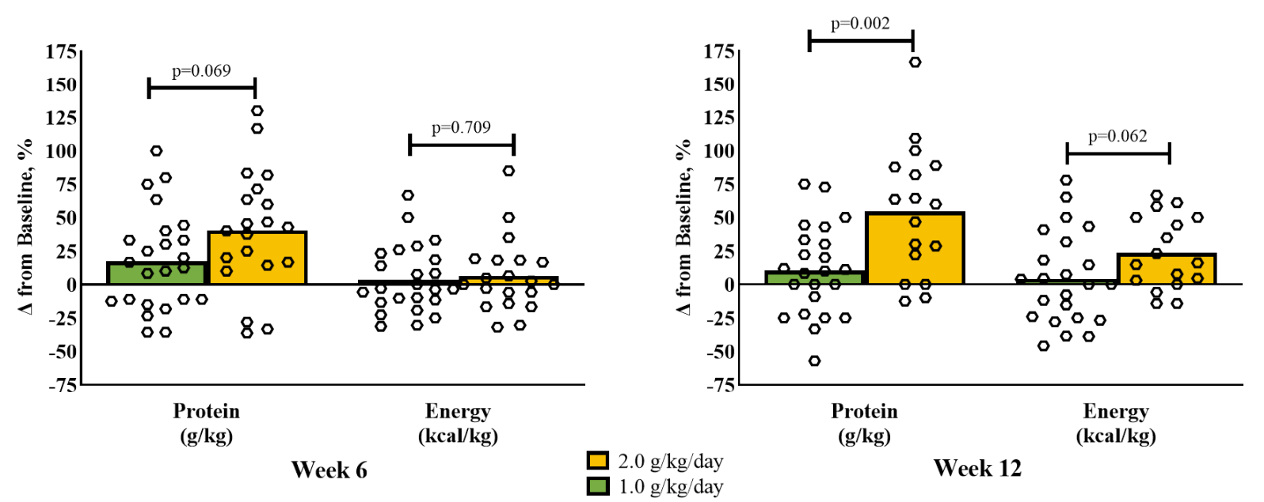
Supplemental Figure 1. Percent change for protein and energy intakes adjusted for body weight from baseline at six and twelve weeks. Boxes represent the mean; dots represent individual patients. Independent samples t-test was used to compare groups for each variable at each time point. All patients who completed the illustrated assessments are included. Six weeks: n=44 (1.0 g/kg/day group: n=24; 2.0 g/kg/day group: n=20); Twelve weeks: n=40 (1.0 g/kg/day group: n=23; 2.0 g/kg/day group: n=17). Δ: change; g/kg: grams per kilogram [body weight]; kcal/kg: kilocalories per kilogram [body weight].
Ford et al. ESMO Open. 2024;9(7):103604.

Slide 14
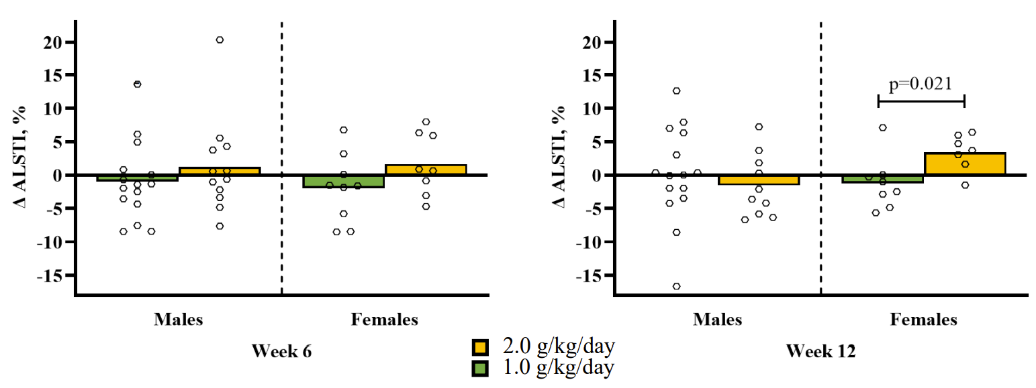
Supplemental Figure 2. Percent change in appendicular lean soft tissue index by study arm and sex from baseline to six and twelve weeks. Each data point represents a patient. Data point with through line represents extreme outlier (significance was not impacted by extreme outlier). Bars represent the group mean. ALSTI: appendicular lean soft tissue index. Six weeks: n=44 (1.0 g/kg/day group: n=24; 2.0 g/kg/day group: n=20); Twelve weeks: n=40 (1.0 g/kg/day group: n=23; 2.0 g/kg/day group: n=17).
Ford et al. ESMO Open. 2024;9(7):103604.

Slide 15
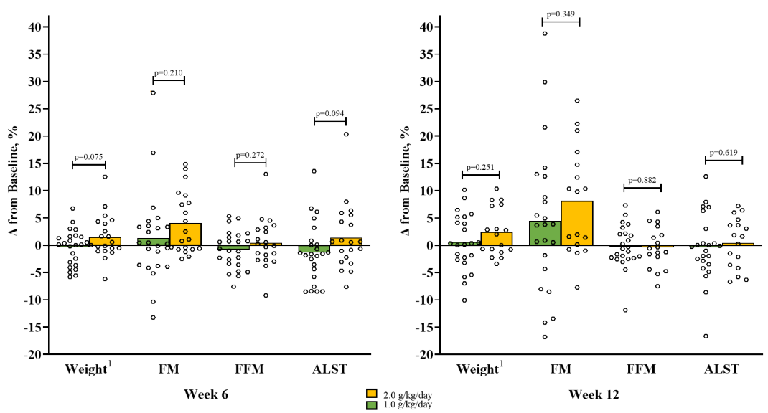
Supplemental Figure 3. Percent change since baseline in weight, fat mass, fat-free mass, and appendicular lean soft tissue at six and twelve weeks. Boxes represent the mean. Data point with through line represents extreme outlier (significance was not impacted by extreme outlier). Independent samples t-test was used to compare groups for each variable at each time point. All patients who completed the illustrated assessments are included. Six weeks: n=44 (1.0 g/kg/day group: n=24; 2.0 g/kg/day group: n=20); Twelve weeks: n=40 (1.0 g/kg/day group: n=23; 2.0 g/kg/day group: n=17). ¹Weight was obtained from dual-energy X-ray absorptiometry scale. Δ: change; ALST: appendicular lean soft tissue; FFM: fat-free mass; FM: fat mass.
Ford et al. ESMO Open. 2024;9(7):103604.

Slide 16
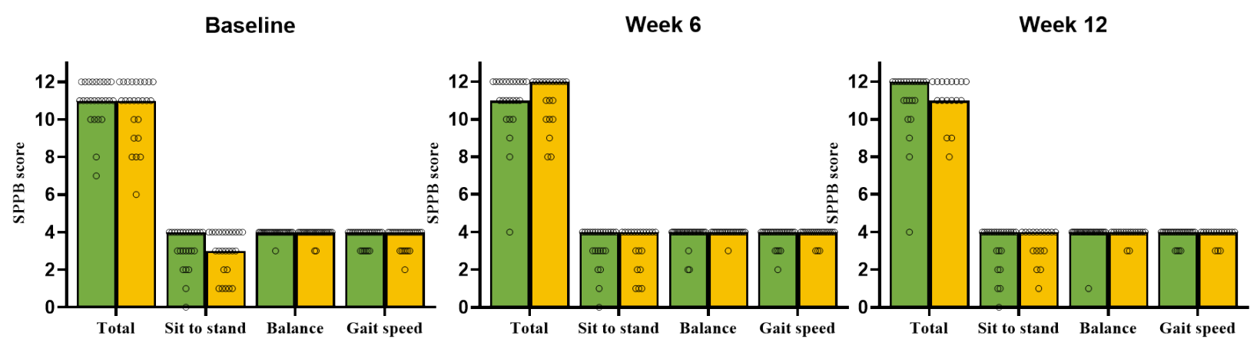
Supplemental Figure 4. Short physical performance battery test scores at baseline, week 6, and week 12. Boxes represent the median; dots represent individual patients. All patients who completed the illustrated assessments are included. Baseline: n=50 (1.0 g/kg/day group: n=25; 2.0 g/kg/day group: n=25); Six weeks: n=44 (1.0 g/kg/day group: n=24; 2.0 g/kg/day group: n=20); Twelve weeks: n=40 (1.0 g/kg/day group: n=23; 2.0 g/kg/day group: n=17). SPPB: short physical performance battery.
Ford et al. ESMO Open. 2024;9(7):103604.

