Slide 1

Assigning Causality to Anti-Cancer Agents: Decision Making in Early Phase Oncology Clinical Trials
Jacqueline Torti, MA; Jarold Cosby, PhD; Andrew Arnold, MD

Slide 2
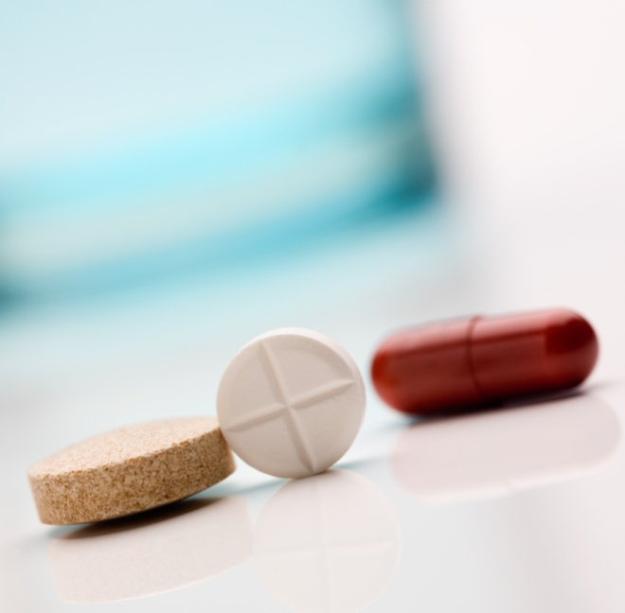
Agenda
Outline of Presentation
1
Introduction
2
Objectives
✓
3
Rationale
4
Data Collection
5
Data Explication
6
Results
7
Conclusion

Slide 3
The Process of Clinical Trials
Phases of Drug Development
Phase | Objective | Size
Phase 1 | Maximally Tolerated Dose (MTD) is determined | 10-80 participants
Phase 2 | Measure biologic activity & adverse events | 50-300 participants
Phase 3 | Evaluate effectiveness of an intervention | 100s-1000s of participants
Phase 4 | Long term surveillance | Unknown
Notes:
Phase I & Phase II of drug development were the main focus of my research study
Phase I:
Commences the testing of an intervention:
-tested for the 1st time, or previous trial exposure but is being tested in a different medical setting (ie different pathology)
-MTD; maximum dosage of a drug that can be administered before unacceptable toxicity levels are reached
Phase II:
works to further establish the safety of an intervention

Slide 4
Research Objectives
Threefold:
Psychosocial Understanding
Challenges
Role of Oncologist & Physicians
Come to a psychosocial understanding of causality assessment
Understand the role oncologist and physicians play in this decision making process
Understand the challenges faced by professionals when assigning causality

Slide 5
Rationale for this Research
Why is it needed?
Lack of a Standard Method
Definition of Harm
Time Constraints
Current Tools for Assessing Causality
Constraints of Error Reporting Systems
Under-Reporting of Adverse Events

Slide 6

Data Generation
How did we generate the data?
Mukherjee and colleagues 2010 research paper entitled A Qualitative Study Evaluating Causality Attribution for Serious Adverse Events During Early Phase Oncology Clinical Trials
32 interviews; 25-50 minutes in length
Semi-structured interview guide
  Piloted at the Juravinski Cancer Centre,
  Hamilton Ontario
Notes:
Pre: *analyzing pre-collected data from….
-32 interviews: face to face; private manner, between may 1st and august 1st, 2006; interviews were digitally recorded, hand written field notes, English, internal researcher trained in qualitative research
-Semi-structured interview guide: open-ended questions; developed by the research team and two external researchers
-Piloted at the Juravinski Cancer Centre, Hamilton Ontario: to ensure appropriateness and clarity
Pre: *analyzing pre-collected data from….
-32 interviews: face to face; private manner, between may 1st and august 1st, 2006; interviews were digitally recorded, hand written field notes, English, internal researcher trained in qualitative research
-Semi-structured interview guide: open-ended questions; developed by the research team and two external researchers
-Piloted at the Juravinski Cancer Centre, Hamilton Ontario: to ensure appropriateness and clarity

Slide 7
Participant Characteristics
Notes:
The BC Cancer Research Centre, the Juravinski Cancer Centre, the Kingston Regional Cancer Centre, the London Regional Cancer Centre, and the Ottawa Regional Cancer Centre were used as participant recruitment sites.
In order to ensure rich data, the original research team used purposeful sampling techniques to recruit participants through the NCIC CTG Investigational New Drug (IND) committee. Only those individuals with experience in phase I and phase II of oncology clinical trials were recruited, resulting in a total 32 participants with a 65% participation rate.

Slide 8
Data Explication
Secondary Data Analysis
1
Phenomenological Reduction
2
Gathering a Sense of the Whole
3
Delineating Meaning Units
4
Clustering Meaning Units and Forming Themes
5
Composite Summary
Notes:
Pre-slide: use of the term explication of data over data analysis due to the dangerous implications analysis can have on phenomenological study. The term ‘analysis’ implies breaking something down it to bits and pieces, and if this were the case, within a phenomenological study, the phenomenon as a whole would be lost [62]. On the other hand, explication of the data implies that the phenomenon will remain it its entirety but the various elements of the phenomenon will be investigated [62].
-Phenomenological reduction: reading over the data repeatedly until the meaning starts to emerge
-Gathering a sense of the whole: holistic perspective; reviewing the data and making more detailed notes
-Delineating meaning units: This involves picking out statements, quotes or sentences that bring meaning to the phenomenon aka horizontilization
-Clustering meaning units and forming themes: look for meaning units that naturally group together
-Composite summary: summary that incorporates all themes

Slide 9
Themes
Uncertain because there is rarely objectivity
Subjective due to lack of resources
Lack of resources lead to apprehensive behaviour
Apprehensive due to competing goals
Coping with Uncertainty
Subjective Judgments
Insufficient Resources
Apprehensive Causality Attributions
Competing Goals
Consider protocol drug
Variations in experience level
No causality tool
Fear of under attributing causality
Patient safety vs. drug development
Consider other drugs
Variations in work ethic
Lack of detail
Fear of over attributing causality
Accuracy vs. workload and timelines
Cognitive approach: consider all variables
Patient Subjectivity
Communication issues
Lack of a standardized tool
Financial Pressures
Comfort in grey area
Patient vs. physician
Sponsor and interviewees
Temporal association
Patient and interviewees
Err on the side of caution
Rely on Experience

Slide 10
Insufficient Resources
No training
  “There’s no formal training really, you just kind of got thrown into the position.”- S32
No tool
  “None. [no] No, well I mean, I guess I shouldn’t say that, none in terms of standardized criteria that’s for sure. Resources, unless you mean basically going back to see maybe the investigator brochure and trying to understand some of the toxicities.” - S13
Lack of resources
  “It’s more on a, just based on the experience of taking part in the study and the hunch factor. I don’t actually have a tool that I use, so I think something like this would be very handy.” - S10

Slide 11
Communication Issues
Between Physicians and Trial Sponsors
  “Well usually there’s teleconferences and other meetings to discuss what’s happening with other patients. But a lot of times communication isn’t as good as it could be.”- S07
Coping Strategy: Searching for additional resources online, and by consulting with other physicians.
Notes:
Between Physicians and Trial Sponsors
For instance, the interviewees often had questions about a certain adverse event, but found it difficult to access information that would allow them come to a better understanding of the drug’s pharmacology beyond the investigator’s brochure. Even when writing up adverse event reports, interviewees felt that it would be helpful to know more about the sponsor’s data management. It would help them to understand their role, and understand how companies try to collate the information they send to them. This lack of communication makes it extremely difficult to come to a unanimous decision with the other physicians in the trial.
Between the Physicians and Patients
Different things tend to be reported to different people, depending on the professional position that a person holds within the trial. It is also human nature for patients to forget things. If it is a very serious event, it is likely to be recorded and made known to others working in the clinical trial setting. However, not all patients understand that these professionals are just as interested in the minute events, such as the minor side effects of a treatment.

Slide 12
Communication Issues Continued
Between Physicians and Patients
  “A lot of the times I find it’s hard and I don’t think it’s an on purpose thing from patients, but I don’t necessarily think that we do get every single bit of information all the time.”- S11
Coping Strategy: Getting to know their patients. By coming to a better understanding of the patient’s personality and outlook on the trial, both of which are viewed to be very subjective, the physician is better equipped to make more informed decisions when assigning causality. This can also help eliminate the inaccurate representations of adverse events from patients.
Notes:
Between Physicians and Trial Sponsors
For instance, the interviewees often had questions about a certain adverse event, but found it difficult to access information that would allow them come to a better understanding of the drug’s pharmacology beyond the investigator’s brochure. Even when writing up adverse event reports, interviewees felt that it would be helpful to know more about the sponsor’s data management. It would help them to understand their role, and understand how companies try to collate the information they send to them. This lack of communication makes it extremely difficult to come to a unanimous decision with the other physicians in the trial.
Between the Physicians and Patients
Different things tend to be reported to different people, depending on the professional position that a person holds within the trial. It is also human nature for patients to forget things. If it is a very serious event, it is likely to be recorded and made known to others working in the clinical trial setting. However, not all patients understand that these professionals are just as interested in the minute events, such as the minor side effects of a treatment.

Slide 13
Over Attributing Causality
Fear of making the wrong attribution
  “If it’s done incorrectly, it’s a pain in the ass for all the trial nurses and all the investigators, all the trial doctors all over the world because it takes time to sort out.”- S03
Over/Under Reporting Adverse Events
  I think there’s two big concerns. One is if you assign causality and say it’s related improperly then it might tarnish a good drug and stop dose escalation in a way that wouldn’t be appropriate. Alternatively if you ignore it, it might cause further toxicities in others and be potentially dangerous to other patients. I think it’s a very dangerous thing. I also think that sometimes as oncologists we tend to minimize rather then maximize because we’re used to toxicity with drugs and that can be dangerous.- S16
Notes:
Fear of Making the Wrong Decision
With limited resources to aid in assigning causality, these professionals are extremely apprehensive when making attributions. There is this general fear of making the wrong decision, which is primarily based on the very serious consequences of misattributions.

Slide 14
Over Attributing Causality Continued
Consequences of Over Attributing Causality
  “…I think one concern is over assigning causality. Because patients are, they can get sick, morbidities, multiple medications, actually a lot of reasons and it sometimes it’s easier to blame it on the drug. But I think my fear is that if you do that liberally you’d be, not discrediting the drug but…it could lead to dose reductions, could eventually work their way into an ineffective treatment schedule for that population…”- S04
Coping Strategy: Try to better understand the protocol drug and its sister agents in order to better equip themselves to make these important decisions.
Notes:
Over attributing causality to the study drug can contaminate the entire database in terms of the causality of these toxicities. The onus on these professionals is extremely high, because they have the ability to undermine the trial by making an erroneous attribution. This risks the drug not going to the market when it may be a potentially legitimate drug.

Slide 15
Internal Pressures
Physicians Feeling Pressured by Patients
  “…But the patients of course feel that they’re on the treatment to help their cancer so there’s a little bit of a disconnect there. So they’re more interested in what the drug is doing for their cancer and they kind of are hunkered down with the idea, many of them are very stoical right they say I’m going to put up with whatever side effects I have to put up with um, to get through this treatment because it’s going to help my cancer…”- S19
  “….sometimes I will have a patient who is having a serious toxicity and I want to stop the drug and the patient is pressuring me to keep on the drug…. if you are going to keep them on the drug then maybe you have to under report the toxicity.”- S21
Coping Strategy: Clinicians cope with patient pressures by reassuring themselves that patient safety is their top priority.
Notes:
There are many competing goals in the process of a clinical trial, whether it is the workload, timeframe, the patient’s well being, or the development of the drug. Most interestingly are the competing goals between clinicians and patients

Slide 16
Conclusion
Pattern of Main Themes
Identified Grey Area
Potential Consequences
Coping Strategy
Notes:
Each main theme followed a unique pattern of by which interviewees
1. Identified a grey or problem area
2. Provided a description of the potential consequences that may result from these problem areas.
3. Identified a strategy for coping with the issue

Slide 17
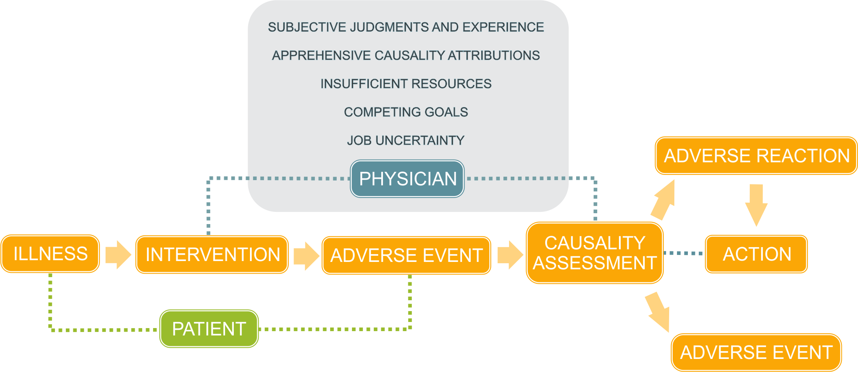
Templates
Your own sub headline
    =
The Process of Assigning Causality

Slide 18
Conclusion
Main Findings
It is very difficult to keep consistency between professionals when there is no universally accepted tool to assign causality.
Subsequent research could include using the information gathered from this study to design and evaluate a standardized tool that can be used for causality assessment in early phase oncology clinical trials.
With a deep understanding of the decision making process, the goal of designing a standardized tool is closer to reality.
Such a tool will aid clinicians in dealing with time constraints without sacrificing the quality of their decision-making.

Slide 19
Conclusion
Future Research
Develop a Training Program
Develop Standardized Tool
1
Further research direction may include developing a training program for causality assessment in early phase oncology clinical trials.
It is hypothesized that the reason for the high utilization of clinical judgment stems from the lack of formal training.
Clinical judgment is criticized on aspects of validity primarily because of its low reproducibility rates.
If formalized training were introduced, it is hypothesized that this would promote greater consistency when using clinical judgment, and therefore raise reproducibility rates.
2
However, if a standardized tool were developed, this could become a standard practice for training.
This educational process could also be extended to trial sponsors and be used to help inform patients about how decisions are made.
This type of future research could help eliminate error, improve patient safety, narrow communication gaps, promote more confident attributions, and promote consistency amongst professionals.

Slide 20
Acknowledgements
The original research project, from which this analysis was based, was funded through an unrestricted research grant from Astra Zeneca, and received ethics approval from the Behavioural Research Ethics Board at McMaster University.
This secondary data analysis, which was not sponsored, received ethics approval from the Behavioural Research Ethics Board at McMaster University, as well as the Research Ethics Board at Brock University.

Slide 21
THANK YOU!
QUESTIONS?
Jacqueline Torti
torti@ualberta.ca

