Slide 1
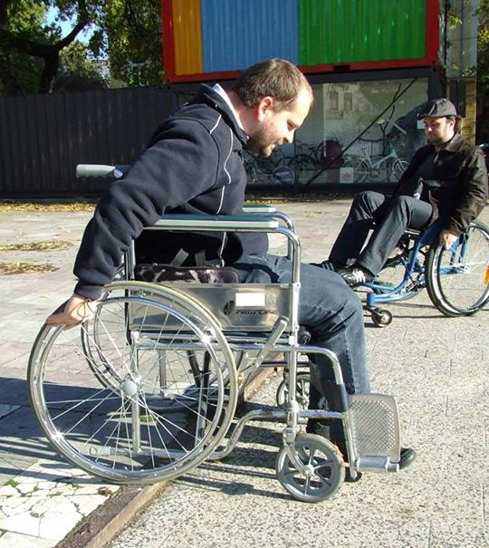
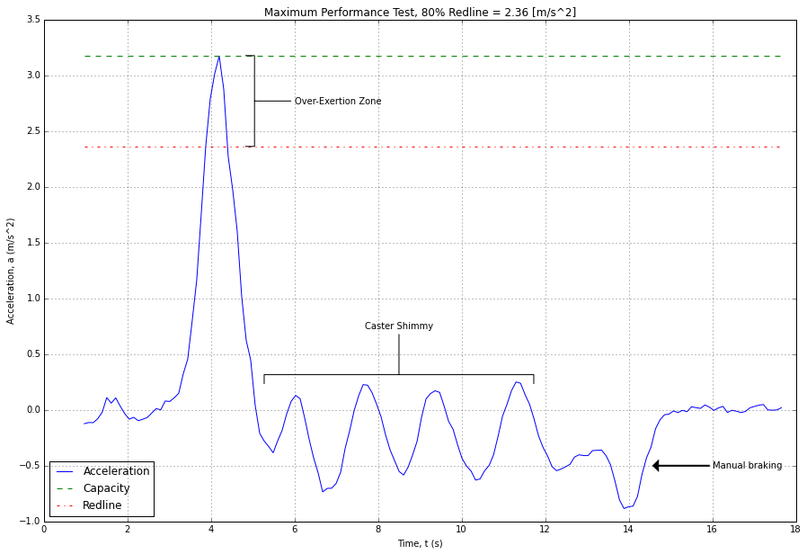
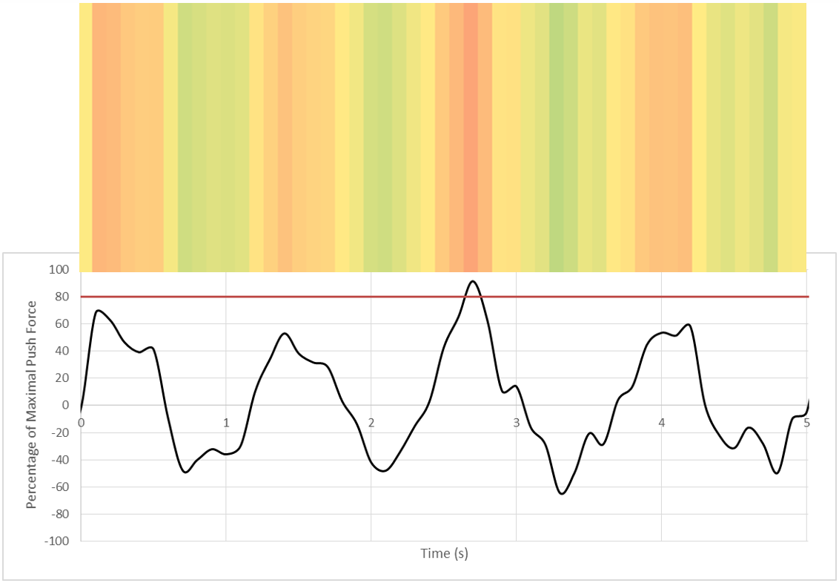
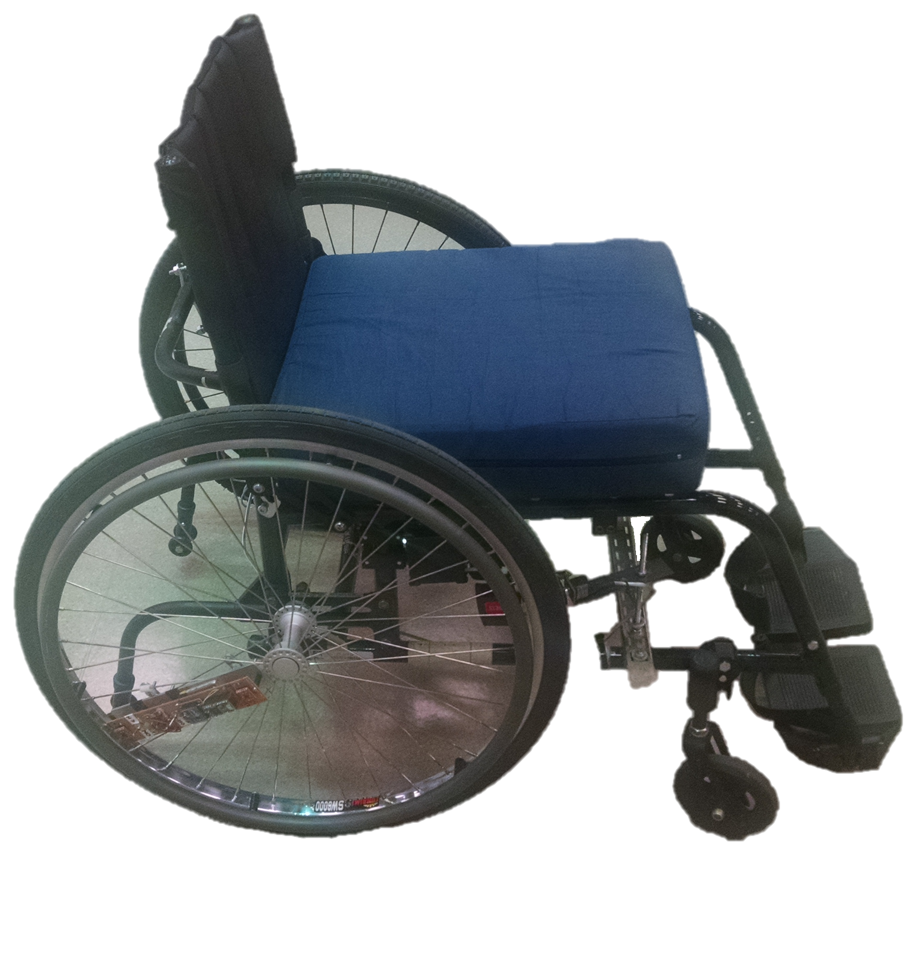
Zohreh Salimi, M.Sc.
Martin Ferguson-Pell, Ph.D
Redliner: A device for monitoring wheelchair users’ over-exertion events during functional mobility activities
Kenton Hamaluik, M.Sc.
Adam Pinkoski, B.PE.
Background
Results
Many wheelchair users suffer from shoulder injuries due to over-use of the structures of the upper extremities. Over-exertion injuries, result in chronic pain, reduced quality of life, increase the dependence of wheelchair on care-givers and lead to further loss of function. Being active is important for wheelchair users to prevent joint degenereation¹, and to maintain cardiovascular health².
A number of products have become very popular recently to provide an indication for able bodied persons of everyday levels of activity (Fitbit, Garmin, Polar and many others). Mainly designed to record walking activity and coupled in some cases to heart rate monitoring, these devices are not intended to be accurate measures of phyiological energy consumption. Instead they provide a simple means to record and sustain daily levels of activity. Similar devices have not been produced for wheelchair users where the relationship between ambulation and cardiovascular challenge is complex.
A review of studies that have considered the use of activity monitors for measuring meaningful wheelchair activities suggests that they are not reliable. Activity monitors such as Actiwatch⁷, CSA⁸, and PAMS&GWRM⁹ have been studied. The Actiwatch⁷ and CSA⁸ (Computer Science and Applications Inc.) were shown to have an intermediate correlation (~ 50 to 60%) with self-reported activity level and energy expenditure, respectively. They do not provide measures like push counts that are informative and beneficial for wheelchair users. PAMS&GWRM⁹ looks promising, but provides very limited information for wheelchair users, and is not commercially available. Instead of measuring acitivity we have broadened the specifications for such a device so that it measures both the level of activity and also the frequency with which the wheelchair user over-uses his/her upper exteremities during wheelchair propulsion in every day activities.
Below is shown the Redliner’s results for one single maximal push. This is how the ‘redline’ is defined for each surface.
Redliner single push acceleration
As a showcase, Redliner’s results for the task of propelling wheelchair in a straight line on grass is shown below. Propelling on grass represents a particularly challenging task both for the wheelchair user and for Redliner’s sensors.
PCI
The PCI (Physiological Cost Index) is a simple, easy to measure indicator of the physiological cost associated with walking³. It is an indicator of energy cost⁴ during walking for a self-selected speed⁵. We have investigated its potentail for the remote monitoring of wheelchair user levels of activity. However, in a recent study⁶ that we undertaken under carefully controlled conditions we have found that PCI is not a valid measure of the physiological cost of wheelchair ambulation.
Redliner’s result for straight-line wheelchair propulsion on grass
Methods
Conclusion
A low cost device using a proprietary design has been developed and mounted on the wheelchair’s wheels. A series of tests has been performed in real world settings: on grass, linoleum, cobblestones, and asphalt. On each of these surfaces a set of four tests was completed: straight-line pushing, maneuvering, maximal push, and coast down. The maximum acceleration obtained from maximal test in each setting (e.g. asphalt) was used to estimate the maximum force the participant could apply in that setting. Then, all the instances that the participant exceeded 80% (according a study¹⁰ conducted by Hills, 2011) of his maximal force was considered to be “red-lining”, or over-exertion. A threshold of 80% of maximum capacity is widely used in physiological studies as an indicator of over exertion.
Redliner is both an activity monitor and a means to detect the frequency and circumstances of over exertion events during wheelchair propulsion. An Android app is also developed to vibrate the device on the occasions of redlining as a real-time feedback, in addition to visualizing the summary of the wheelchair user’s propulsion data. An opportunity assessment for the potential commercialization of Redliner is being planned.
Acknowledgement
This project was funded in part by Alberta Paraplegia Foundation, Telus Health Space, and Mitacs.
Validation study
References
To validate the outcome of redliner, we tested it against a standard measure of acceleration of wheelchairs: SMART^{Wheel}.
1. Wylie EJ, Chakera TM. Degenerative joint abnormalities in patients with paraplegia of duration greater than 20 years. Paraplegia. 1988;26(2):101–6.
2. Jacobs PL, Nash MS. Exercise recommendations for individuals with spinal cord injury. Sports medicine (Auckland, N.Z.). 2004;34(11):727–51.
3. Reliability of Physiological Cost Index Measurements in Walking Normal Subjects Using Steady-state , Non-steady-state and Post-exercise Heart Rate Recording. 1978.
4. Chin T, Sawamura S, Fujita H, Nakajima S, Ojima I, Oyabu H, Nagakura Y, Otsuka H, Nakagawa a. The efficacy of physiological cost index (PCI) measurement of a subject walking with an Intelligent Prosthesis. Prosthetics and orthotics international. 1999;23(1):45–9.
5. Graham RC, Smith NM, White CM, Rc AG, Nm S, The WCM. The reliability and validity of the physiological cost index in healthy subjects while walking on 2 different tracks. Archives of physical medicine and rehabilitation. 2005 [accessed 2014 Mar 26];86(10):2041–6.
http://www.ncbi.nlm.nih.gov/pubmed/16213251
6. Salimi Z, Ferguson-Pell MW, Ramadi A, Haennel R, Mohammadi F, Qi L. Investigating validation of physiological cost index for wheelchair users. In: 15th Biomedical Engineering conference (BME) Program and Proceedings. ; p. 73.
7. Warms CA, Belza BL. Actigraphy as a measure of physical activity for wheelchair users with spinal cord injury. Nursing Research. 2004;53(2):136–143.
8. Washburn RA, Copay AG. Assessing physical activity during wheelchair pushing: validity of a portable accelerometer. Adapted Physicl Activity Quarterly. 1999;16(3):290–299.
9. Wongsirikul N. Field-based usability study of physicL activity monitoring and sharing systems for manual wheelchair users with spinal cord injudt. University of Pittsburgh; 2014.
10. Hills L. Every push matters. University College London; 2011. 1-141 p.
Validation of redliner against SMART^{Wheel} for a single maximal push. Pearson correlation coefficient of 91.84% and Intraclass Correlation Coefficient of 61.14% shows the high agreement of redliner data with SMART^{Wheel} data.
Validation of redliner against SMART^{Wheel} for performing a figure-8 maneuvering task. Pearson correlation coefficient of 90.56% shows the high agreement of redliner data with SMART^{Wheel} data.

