Slide 1
LICENSED LIBRARY RESOURCES
November 2019
Notes:
Hello and welcome to the University of Alberta’s Opening Up Copyright Instructional Module on licensed library resources.

Slide 2
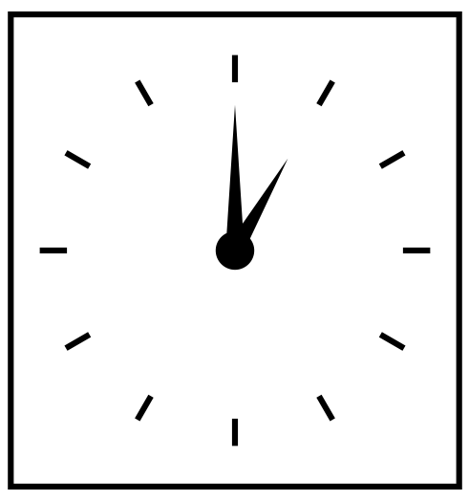



TROUBLE ACCESSING ARTICLES
Harbinger of Impending Doom
Simone
Magical Box That is Supposed to Show Her the Article
Notes:
Simone has to read an article for a class that starts in seven hours but is not able to open the article using the link provided by their Teaching Assistant or “TA.” What’s going on? Why would a TA give her a dead link? Searching the web for the article doesn’t help. If the article assigned by the instructor was an open access article, there’s a good chance that Simone would have been able to read it from home without much effort. However, the majority of all academic literature is not freely available online.
Simone is likely trying to access an article that is behind a paywall. They might also access content behind a paywall when paying for music on iTunes or subscribing to Netflix to watch TV and movies. When it comes to academic articles, books, and streaming media, however, the library is usually the one paying to access the content and that access is then generally restricted to students and other members of that university. The TAs link to the article likely would have worked if Simone were connected to the university’s computing network, whether on campus or remotely.

Slide 3


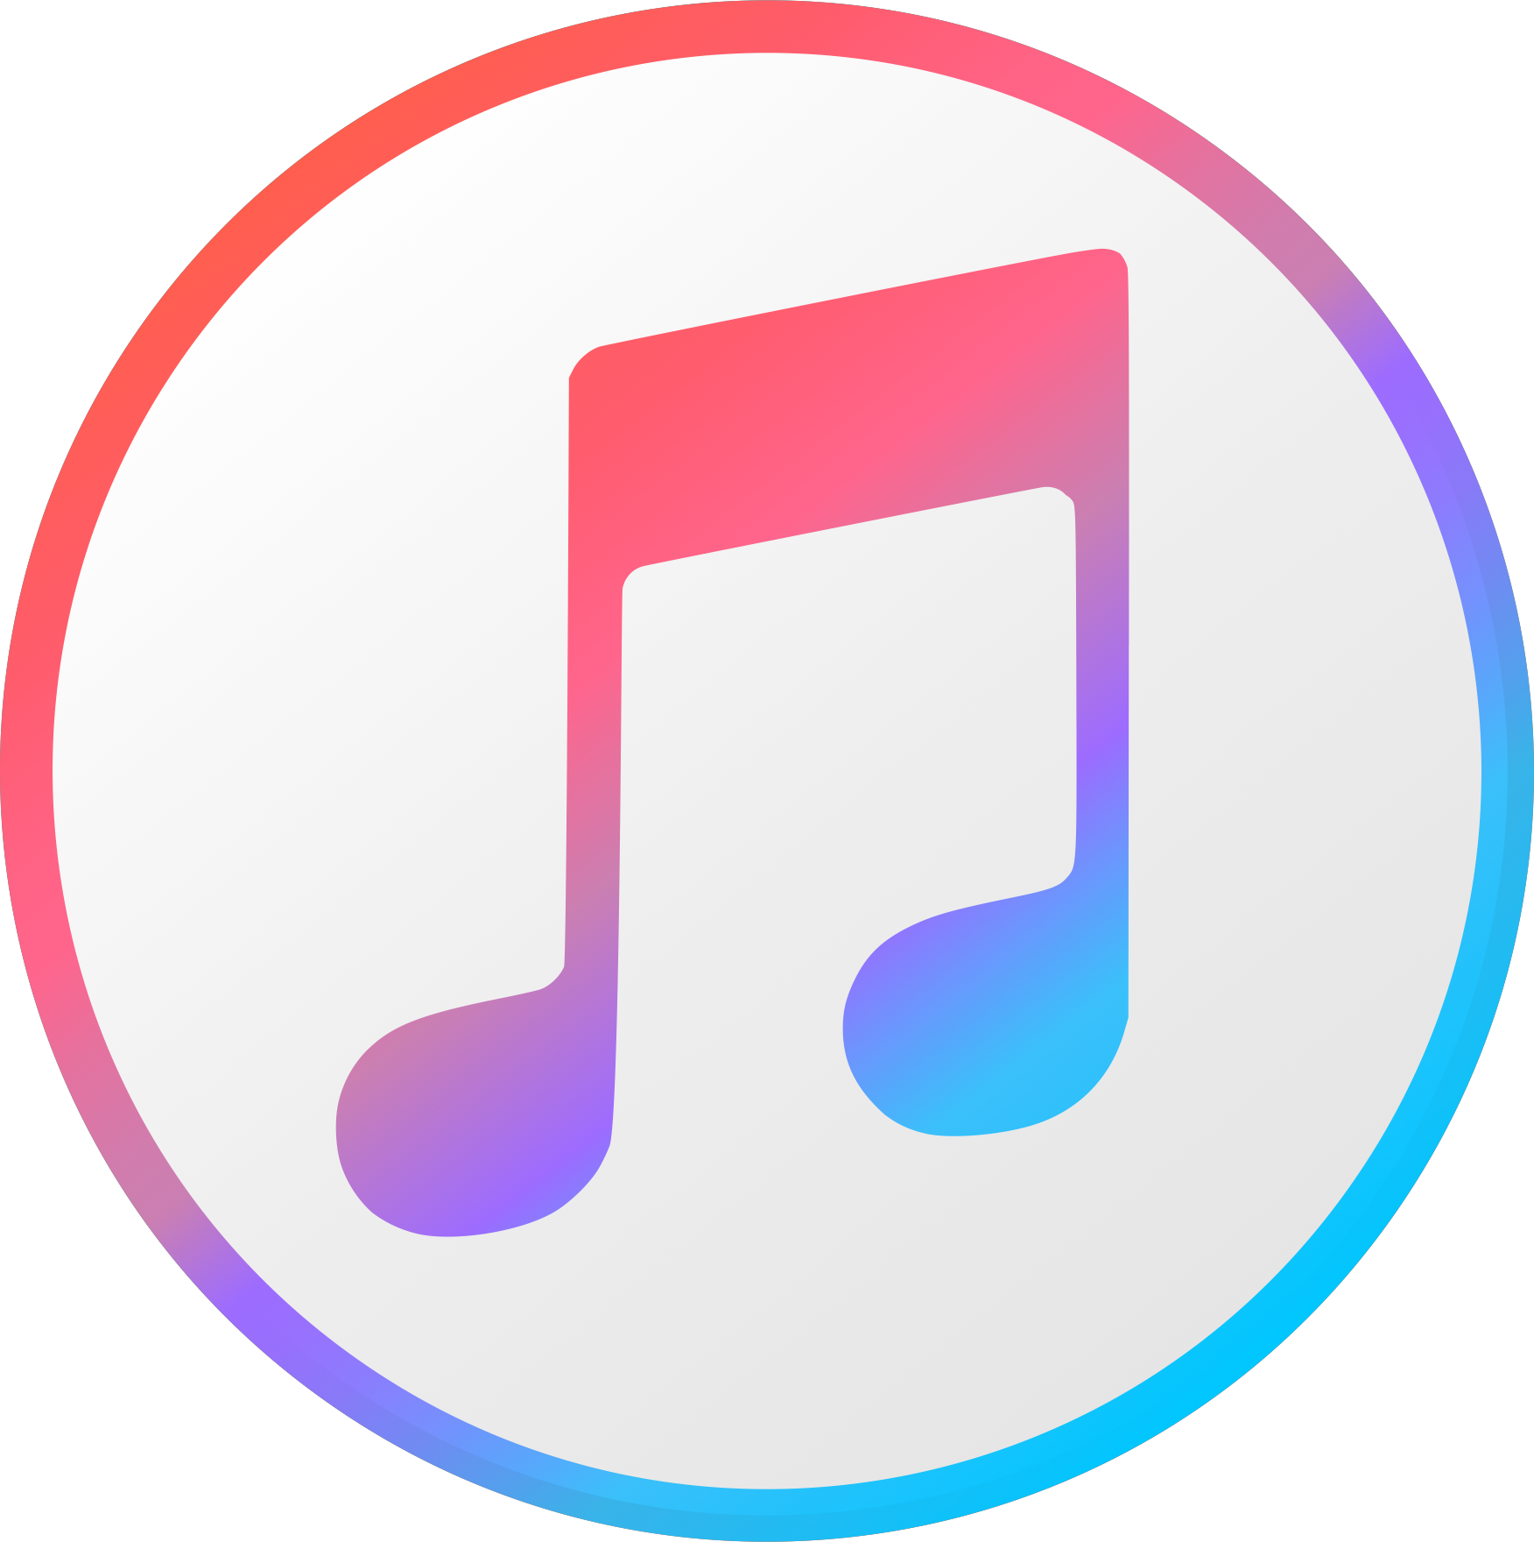





TROUBLE ACCESSING ARTICLES
The library pays for these
Simone pays for these
Open Access refers to free, unrestricted online access to research outputs such as journal articles and books.
“What is Open Access?” Springer Nature [website]
University
Network
Paywall
Notes:
Simone has to read an article for a class that starts in seven hours but is not able to open the article using the link provided by their Teaching Assistant or “TA.” What’s going on? Why would a TA give them a dead link? Searching the web for the article doesn’t help. If the article assigned by the instructor was an open access article, there’s a good chance that Simone would have been able to read it from home without much effort. However, the majority of all academic literature is not freely available online.
Simone is likely trying to access an article that is behind a paywall. She might also access content behind a paywall when paying for music on iTunes or subscribing to Netflix to watch TV and movies. When it comes to academic articles, books, and streaming media, however, the library is usually the one paying to access the content and that access is then generally restricted to students and other members of that university. The TAs link to the article likely would have worked if Simone were connected to the university’s computing network, whether on campus or remotely.

Slide 4





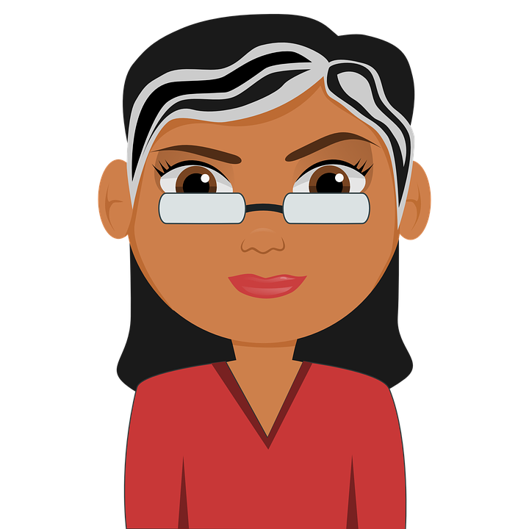
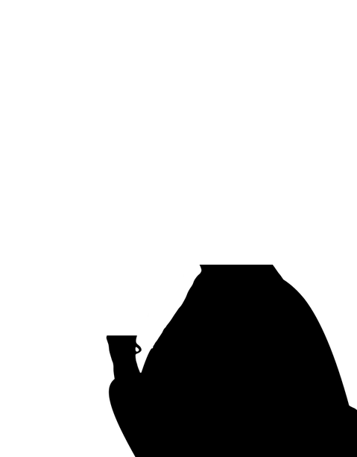
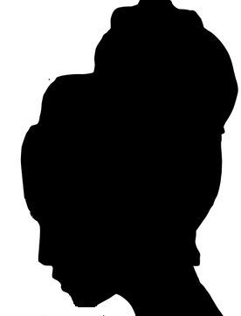



LICENCE AGREEMENTS
LICENCE AGREEMENTS
Expert Negotiators
Terms of Use Include:
Price
Restrictions on access
Restrictions on use
Licensed
Library Resources
eClass
Notes:
Academic libraries purchase or subscribe to a wide range of electronic journals, e-books, and databases from commercial vendors. Because libraries sign licence agreements that enable access to these things, these are often called "licensed library resources.” The terms of use for these licensed resources include things like price (how much the university pays for access), who can access the database content (students, faculty, etc.) and what they can do with those articles and ebooks (copy or share and where or how). Most licence agreements are negotiated by academic librarians for their institutions. These agreements allow for educational uses like posting copies of the articles on a restricted learning management system or including the content in a student assignment that is submitted directly to an instructor for grading. In most cases, these licence agreements also allow for members of the public to walk in and use the databases at a library workstation, but not access them from off-campus. Off-campus access is usually limited to members of the university community.
Simone: “Don’t profs just write articles and then the library provides access? And, how is copyright involved in all of this?”
It’s a bit more complicated than that, although some open access publishing models are moving in that direction. Right now, however, it’s more likely that books and articles written by professors, such as Professor Pam [H5P link to Publishing Agreements], and graduate students will be published in an academic journal.

Slide 5

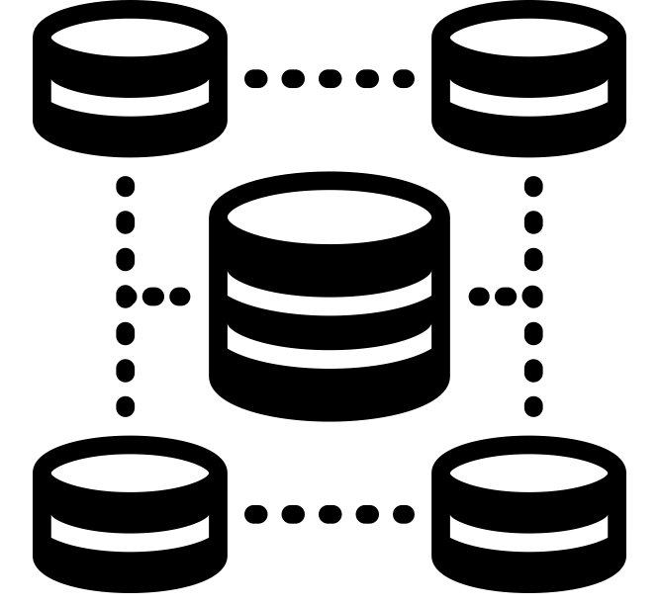

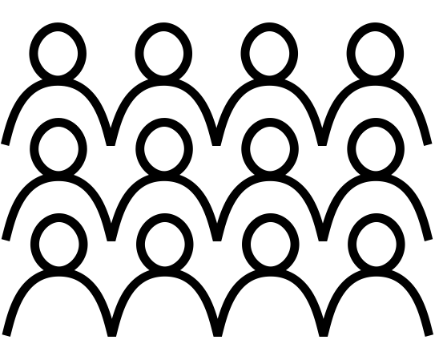

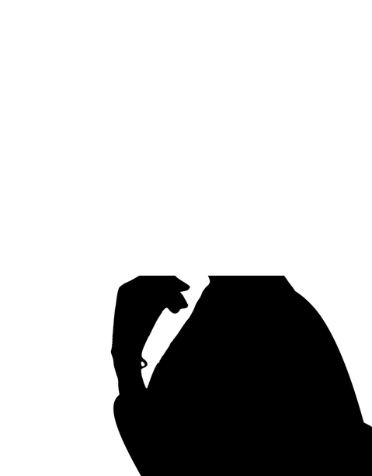
JOURNEY OF AN ACADEMIC ARTICLE
NEXT STOP DISSEMINATION STATION!
HUZZAH!
Content Aggregator
Publishing
Agreement
Academic
Author
Publisher
University Community
Library
Notes:
The steps between writing and accessing the book or article may vary but, in general, it involves the author, the academic publisher, content aggregators , and libraries.
Once the book or article has been accepted for publication, the author almost always transfers some or all of their rights under copyright to the academic publisher. Academics are often willing to license or transfer their copyrights because publishers can help with distribution of their work, especially to libraries and traditional retailers.
Publishers either distribute the articles and books via platforms and databases they build and maintain themselves or sell access to the articles and books via other companies known as content aggregators that combine content from multiple publishers.
Simone: “So academics give these companies the right to sell their works to university libraries?”
Yes, the publishing agreements signed by authors usually give the publisher the right to sell the article or book, either directly to libraries or through content aggregators that provide access to library licensed resources. Put another way, the publisher has obtained the copyright or a licence from the author to reproduce and provide access to the content, which can then be sold to the university.”
Simone: “So academic authors must get paid for that, right?”

Slide 6
TRADITIONAL ACADEMIC PUBLISHING
I’M LOOKING INTO PUBLISHING OPEN ACCESS NEXT TIME…
Sad Author
(AKA Professor Pam)
HA! JUST KIDDING!
Academic
Author
Publisher
Library
Notes:
Academic authors rarely make additional income publishing their articles and books. Academic journal articles are normally published without any royalties or payments to the author. And while some academic books may result in royalties, these royalties are usually calculated as a percentage of net sales, and the amounts are normally very small. Of course, there are a few exceptions.

Slide 7

PUBLISHING OPEN ACCESS
By 2025 :
44%
70%
Like this one.
H. Piwowar, J. Priem, & R. Orr (2019). “The Future of OA: A Large-Scale Analysis Projecting Open Access Publication and Readership”
Notes:
The growth of open access funding and mandates, along with the development of open educational resources, is changing the the shape of the academic publishing industry. In fact, an article published in October 2019 estimated “that by 2025: 44% of all journal articles will be available as OA. 70% of article views will be to OA articles. The declining relevance of closed access articles is likely to change the landscape of scholarly communication in the years to come” (H. Piwowar, J. Priem, & R. Orr, 2019).

Slide 8
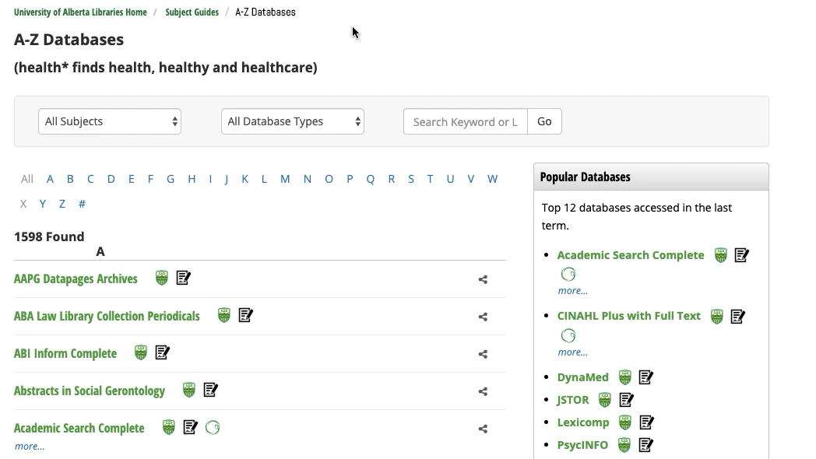
ACCESS TO LLRs
Notes:
While more academic authors are choosing to make their articles and books freely available on the open web, there are still millions of articles and books that are only available via licensed library resources.
Simone: “So I only have access to content behind my university library’s paywall while I am a student?”
That’s right, unless you visit a university library in person and obtain a guest ID and password. Information about off-campus access while you are a student can be found on your library’s website. No more worrying about dead links at 1am!
Don’t forget -- your public library may also have licensed library resources available to you through your public library account.

Slide 9
LEARNING OBJECTIVES
You should now be able to:
  Explain why licensed library resources are only accessible to members of the library’s parent organization or community
  Describe the role of publishing and licence agreements in relation to licensed library resources
  Recognize how the future of scholarly publishing is becoming more open
Notes:
You should now be able to:
Explain why licensed library resources are only accessible to members of the library’s parent organization or community.
Describe the role of publishing and licence agreements in relation to licensed library resources
Recognize how the future of scholarly publishing is becoming more open

Slide 11
QUESTIONS
Licensed library resources are only available to authorized users (such as university staff and students) because:
Of the restrictions outlined in s.30.2 of the Copyright Act
Terms and conditions in licence agreements negotiated by librarians restrict access to authorized users
Academic articles should not be used by the general public because they have better things to do with their time
Libraries want to make as much money as possible
To compensate for transferring their rights to publishers, academics normally receive:
Generous royalty payments from academic publishers
First class travel to academic conferences
Free access to that academic journal for life
Nothing but prestige

Slide 12
QUESTIONS
All licence agreements for library resources:
Have terms and conditions
Are negotiated by librarians based on their professional expertise
Should reflect the needs of the user community (e.g. typical academic uses)
All of the above
If you are not a member of the university community you might be able to access licensed library resources by logging into an academic library workstation with a temporary password. True or False?

Slide 13
QUESTIONS
Simone could not access the article her TA assigned because:
She was not logged into her account on the university networt
The TA hopes to sabotage Simone’s GPA
She is not an authorized user
Sunspot activity
The nature of scholarly communications is becoming more open, in part, because:
Of the rise of open access mandates and open educational resources
Academic publishers want to reinvest in creators
Of the intrawebz
There isn’t any money in academic publishing anyway

Slide 14
Mohamad_Hassan (n.d.). [Simone]. Pixabay. https://pixabay.com/vectors/programmer-computer-woman-support-3607627/
Fahmihorizon ID (n.d.). Time. The Noun Project. CC BY. https://thenounproject.com/search/?q=clock%201%20pm&i=1193576
Straget (2017). Clock Ticking. Freesound. https://freesound.org/people/straget/sounds/405423/
Tatyana RU (n.d.). Question Mark and Exclamation Mark. The Noun Project. CC BY. https://thenounproject.com/tanyasolo1986/uploads/?i=2460596
Rflor (n.d.). Article. The Noun Project. CC BY. https://thenounproject.com/search/?q=ARTICLE&i=645939
Progressor (2015). [Creative Commons]. Pixabay. CC0. https://pixabay.com/en/creative-commons-licenses-icons-by-783531/
arif dajar yulianto (n.d.). Wall. The Noun Project. CC BY. https://thenounproject.com/search/?q=wall&i=1647938
Bareform (2014). Boom Bang. Freesound. https://thenounproject.com/search/?q=wall&i=1647938

Slide 15
Danimasetoma (2017). Logo Netflix. Wikimedia Commons. CC BY SA. https://commons.wikimedia.org/wiki/Category:Netflix_logos#/media/File:Logo_Netflix.png
Apple Inc. [Itunes logo]. Wikimedia Commons. Public Domain. https://commons.wikimedia.org/wiki/File:ITunes_logo.svg#/media/File:ITunes_12.2_logo.png
Dawid Sobolewski (n.d.). [Online article]. The Noun Project. CC BY. https://thenounproject.com/search/?q=article%20mockup&i=244221
TukTuk Design (n.d.). [ebook]. The Noun Project. CC BY. https://thenounproject.com/search/?q=article%20online&i=43708
Icomoon (n.d.). Database. The Noun Project. CC BY. https://thenounproject.com/search/?q=database&i=1472004
Eric Benoit (n.d.). Upstairs. The Noun Project. CC BY. https://thenounproject.com/search/?q=stairs%20person%20&i=32888
Icomoon (n.d.). Database [Content aggregator]. The Noun Project. CC BY. https://thenounproject.com/search/?q=database&i=1472004

Slide 16
IconTrack (n.d.). Arrow. The Noun Project. CC BY. https://thenounproject.com/search/?q=arrow%20with%20dotted%20line&i=2793910
Chrystalizabeth (n.d.). [Pam] https://pixabay.com/en/teacher-bookworm-glasses-professor-359311/
Daria Szymonowicz (n.d.). Essay. The Noun Project. CC BY. https://thenounproject.com/search/?q=essay&i=1353220#
Michael Wohlwend (n.d.). Gutenberg press. The Noun Project. CC BY. https://thenounproject.com/icon/86670/
Rob Crosswell (n.d.). Library. The Noun Project. CC BY. https://thenounproject.com/crosswellrob/uploads/?i=1122689
Vladimir Belochkin (n.d.). Contract. The Noun Project. CC BY. https://thenounproject.com/icon/869929/
Priyanka (n.d.). Database. The Noun Project. CC BY. https://thenounproject.com/search/?q=database&i=2864695
Tafsir Jalalain (n.d.). Computer. The Noun Project. CC BY. https://thenounproject.com/search/?q=computer&i=2387560

Slide 17
A-Z Databases (n.d.). University of Alberta Libraries [website]. https://guides.library.ualberta.ca/az.php?
Daubs, K. (2011). The house that math built. The Toronto Star. Retrieved from: https://web.archive.org/web/20190301135907/https://www.thestar.com/news/gta/2011/02/04/the_house_that_math_built.html
Off-Campus Access (n.d.). University of Alberta Libraries [website]. https://www.library.ualberta.ca/services/off-campus-access
Online Resources (n.d.). Edmonton Public Library [website]. https://www.epl.ca/resources/
Piwowar, H., Priem, J., & Orr, R. (2019). “The future of OA: A large-scale analysis projecting open access publication and readership.” INFOdocket [website]. Retrieved from: https://www.infodocket.com/2019/10/09/research-article-the-future-of-oa-a-large-scale-analysis-projecting-open-access-publication-and-readership-preprint/

Slide 18
Piwowar, H., Priem, J., Larivière, V., Alperin, J.P., Matthias, L., Norlander, B., Farley, A., West, J., & Haustein, S. (2018). The state of OA: A large-scale analysis of the prevalence and impact of Open Access articles. PeerJ 6:e4375 https://doi.org/10.7717/peerj.4375
Tennant, J.P., Waldner, F., Jacques, D.C., Masuzzo, P., Collister, L.B., & Hartgerink, C.H.J. (2016). “The academic, economic, and societal impacts of open access: An evidence-based reivew” [Version 3]. F1000 Research. Retrieved from: https://f1000research.com/articles/5-632/v1
What is Open Access? (n.d.). Springer Nature [website]. Retrieved from: https://www.springernature.com/gp/open-research/about/what-is-open-access
Where do you find information? [video] (n.d.). University of Alberta Libraries [website]. Retrieved from: https://www.library.ualberta.ca/tutorials/foundational/where-do-you-find-information

Slide 19
Sarah Polkinghorne

Slide 20
University of Alberta. 2019. “Licenced Library Resources.” Opening Up Copyright Instructional Module. https://sites.library.ualberta.ca/copyright/

