Slide 1
Broadband 101
Except Certain Images
Michael B. McNally
Alberta Rural Connectivity Form 2022
Mar. 17, 2022

Slide 2
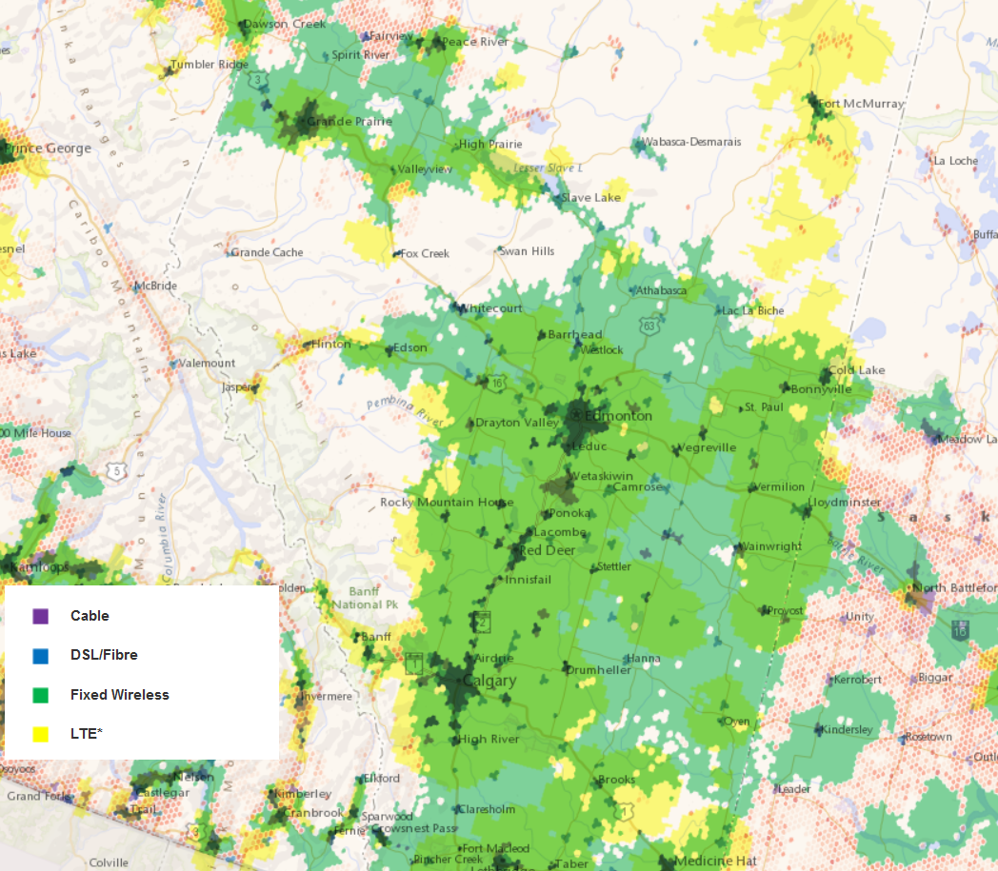
Outline
Putting Broadband in Context
Broadband Technologies
Policy and Regulation
2022 Broadband Landscape
CRTC Broadband Availability Map (2022)
Alberta Rural Connectivity Form 2022
Notes:
Canadian Radio-television and Telecommunications Commission (CRTC). 2022. “Broadband Availability Map.” https://crtc.gc.ca/cartovista/internetcanada-en/

Slide 3
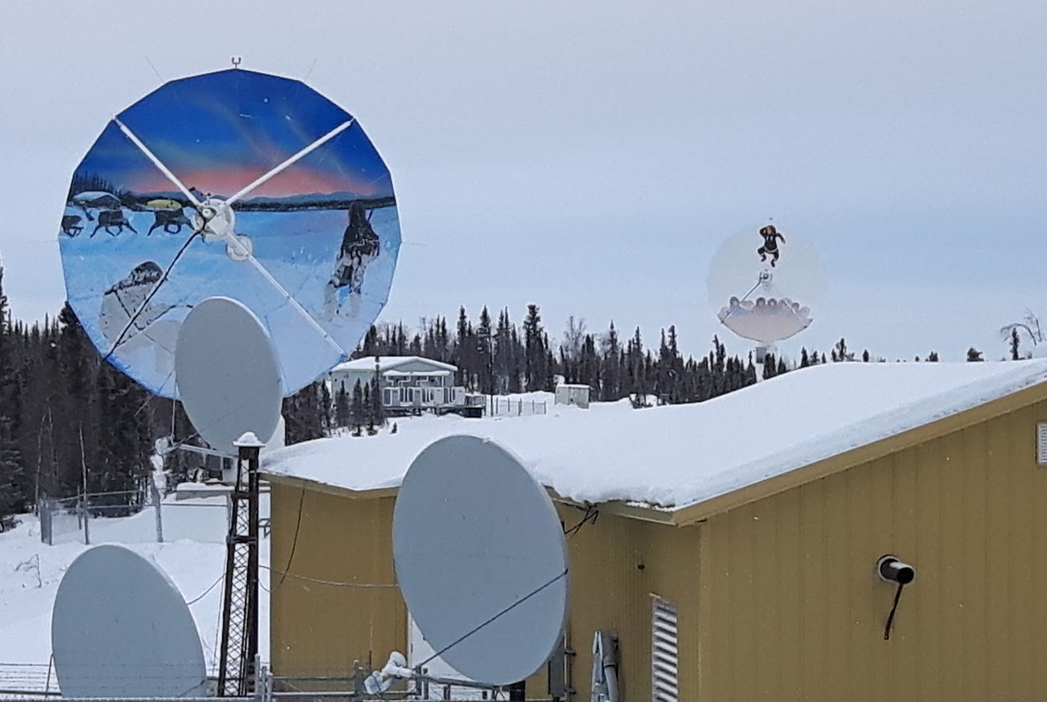
From Why? to How?
Rural connectivity a question of how? – How to get it right?
How to ensure we can connect the farm between two hamlets
How to ensure we don’t just connect Indigenous communities, but that we have broadband that is high quality, reliable and affordable
How to ensure the infrastructure we build suits current and future needs
Alberta Rural Connectivity Form 2022
Notes:
BASFPlantScience. 2009. “Farm in Schweden.” https://commons.wikimedia.org/wiki/File:Farm_Kartoffelfeld_Schweden.jpg
Michael B. McNally. 2019.
Hanne Pearce. 2016. “Server.” Understanding Community Broadband: The Alberta Broadband Toolkit. https://doi.org/10.7939/R3H708B16

Slide 4
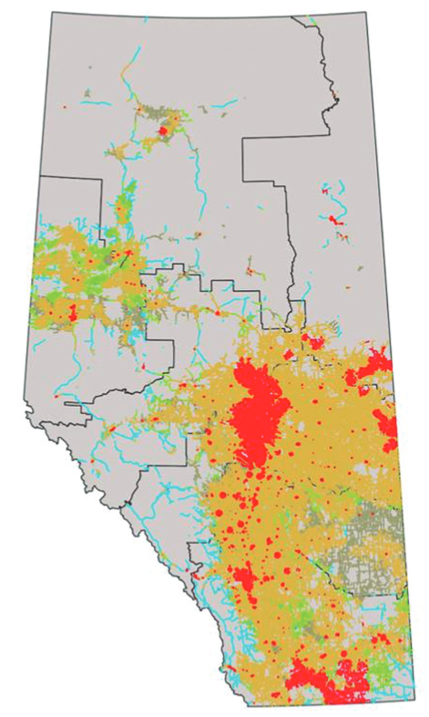
Alberta Connectivity
Better connectivity is:
~10% a technology problem
~10% a capital/financing problem
~80% a social problem
According to the GoA, as of 2022 only the Red areas meet the federal broadband speed targets
Alberta Rural Connectivity Form 2022
Notes:
Alberta. 2022. Alberta Broadband Strategy 2022: Connecting Albertans, Growing the Economy. https://open.alberta.ca/publications/alberta-broadband-strategy-2022

Slide 5
Key Concepts
Speed
Usually “Megabits per second” (Mbps)
Download and upload speed
Actual Speed vs. Advertised Speed
National targets (set 2016) 50 Mbps download/ 10 Mbps Upload (50/10)
Data
Bits and bytes (8 bits = 1 byte)
Tera, Giga and Mega Bytes (TB, GB, and MB)
1TB = 1,000 GB = 1,000,000 MB
Alberta Rural Connectivity Form 2022
Notes:
Chaitawat. 2017. “Fibre Optic Cable.” https://commons.wikimedia.org/wiki/File:Fiber_Optical_Cable.jpg

Slide 6
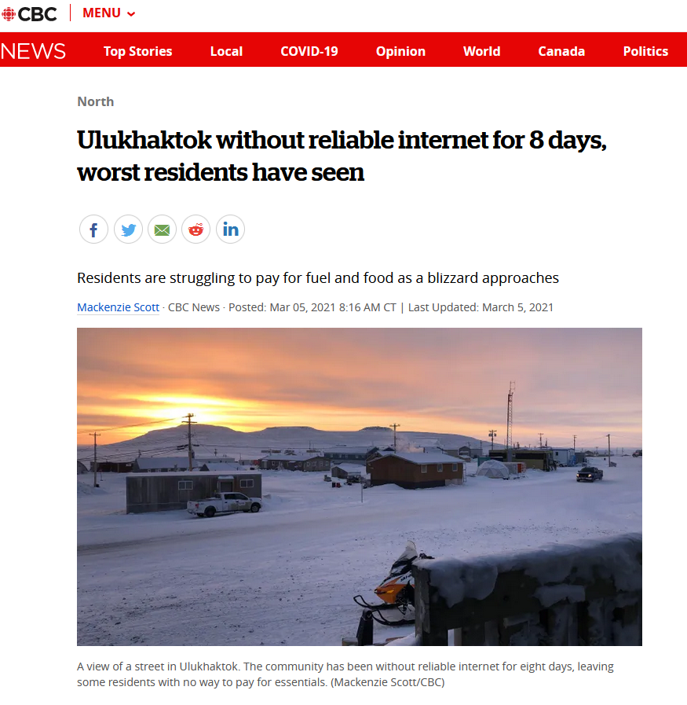
Key Concepts
Cost
Affordability
Data caps/allowances
Quality
Redundancy
Reliability
Latency
Alberta Rural Connectivity Form 2022
Notes:
Mackenzie Scott. 2021. “Ulukhaktok without reliable internet for 8 days, worst residents have seen.” https://www.cbc.ca/news/canada/north/ulukhaktok-without-reliable-internet-for-8-days-1.5937597

Slide 7
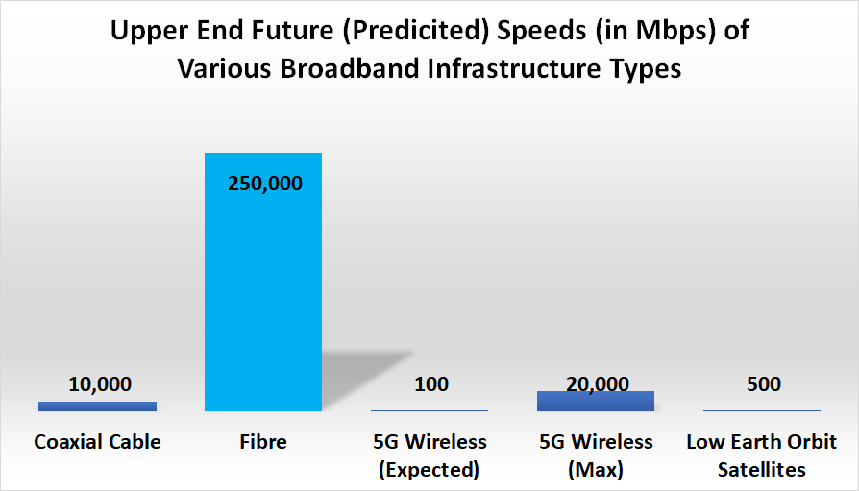
Fibre
Gold standard of broadband technologies
Fastest
Most reliable
Synchronous connections
High capacity
However
Generally more expensive than wireless
Alberta Rural Connectivity Form 2022
Notes:
Data for this (and the following figures) are:
Organisation for Economic Cooperation and Development (OECD)—Working Party on Communication Infrastructures and Services Policy. 2015. Development of High Speed Networks and the Role of Municipal Networks. https://www.oecd.org/officialdocuments/publicdisplaydocumentpdf/?cote=DSTI/ICCP/CISP%282015%291/FINAL&docLanguage=En
OECD. 2018. Bridging the Rural Digital Divide. https://www.oecd-ilibrary.org/science-and-technology/bridging-the-rural-digital-divide_852bd3b9-en
CRTC. 2018. Telecom Decision CRTC 2018-44. https://crtc.gc.ca/eng/archive/2018/2018-44.htm
CRTC. 2016. Telecom Regulatory Policy CRTC 2016-496https://crtc.gc.ca/eng/archive/2016/2016-496.htm
CableLabs. N.d. “Docsis 4.0” https://www.cablelabs.com/technologies/docsis-4-0-technology
International Telecommunications Commission (ITU)—Broadband Commission. 2021. The State of Broadband: People Centred Approaches for Universal Broadband. https://www.itu.int/dms_pub/itu-s/opb/pol/S-POL-BROADBAND.23-2021-PDF-E.pdf
ITU—Broadband Commission. 2016. The State of Broadband: Broadband Catalyzing Sustainable Development. https://www.itu.int/dms_pub/itu-s/opb/pol/S-POL-BROADBAND.17-2016-PDF-E.pdf
ITU—Radiocommunication Study Groups—Working Party 5D. 2017. Minimum Requirements Related to Technical Performance for IMT-2020 Radio Interferences. https://www.itu.int/dms_pubrec/itu-r/rec/m/R-REC-M.2083-0-201509-I!!PDF-E.pdf

Slide 8
Wireless Connectivity
Three key types of wireless connectivity
Fixed Wireless (FWA) | Mobile Wireless | Satellite
Fixed point to point Cheap to deploy Varied speed | Mobile and higher speed Costly (to deploy and use) Dominated by Big 3 | Historically a ‘last resort’ New Low Earth Satellite (LEO) options Long term viability - ???
Alberta Rural Connectivity Form 2022
Notes:
Hanne Pearce. 2016. “Fibre Optic Cable” and “Wireless Tower” Understanding Community Broadband: The Alberta Broadband Toolkit. https://doi.org/10.7939/R3H41JR36
Maruizio Pesce. 2015. “Smart Phone.” https://commons.wikimedia.org/wiki/File:Polaroid_Selfie_5,5%22_Android_Smartphone_(16675836918).jpg
Marty France. 2010. “Satellite Dishes.” https://commons.wikimedia.org/wiki/File:Satellite_dishes_at_Kodiak_Launch_Complex_(101119-F-0000F-270).jpg
Joe Rogan Experience. 2018. “Episode #1169 – Elon Musk.” https://www.youtube.com/watch?v=ycPr5-27vSI

Slide 9
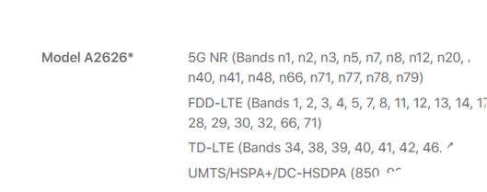
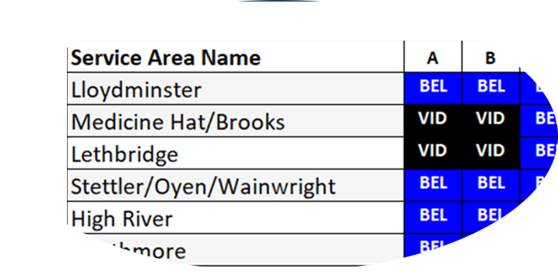
Wireless – Putting it All Together
Wireless service requires the mix of:
Right hardware – hardware limited to certain spectrum frequencies
Spectrum (usually a spectrum licence)
Spectrum allotted in various bands (frequencies)
E.g. 700 MHz, 3500 MHz, 3800 MHz
Geography – allotments done by various ‘tiers’
Backhaul – a connection back to a wired network
Alberta Rural Connectivity Coalition
Notes:
Apple. 2021. “iPhone 13 Specs.” https://www.apple.com/ca/iphone-13/specs/
Michael B. McNally. 2021.
ISED. 2021. “3500 MHz Auction – Provisional Results.” https://www.ic.gc.ca/eic/site/smt-gst.nsf/eng/sf11722.html

Slide 10
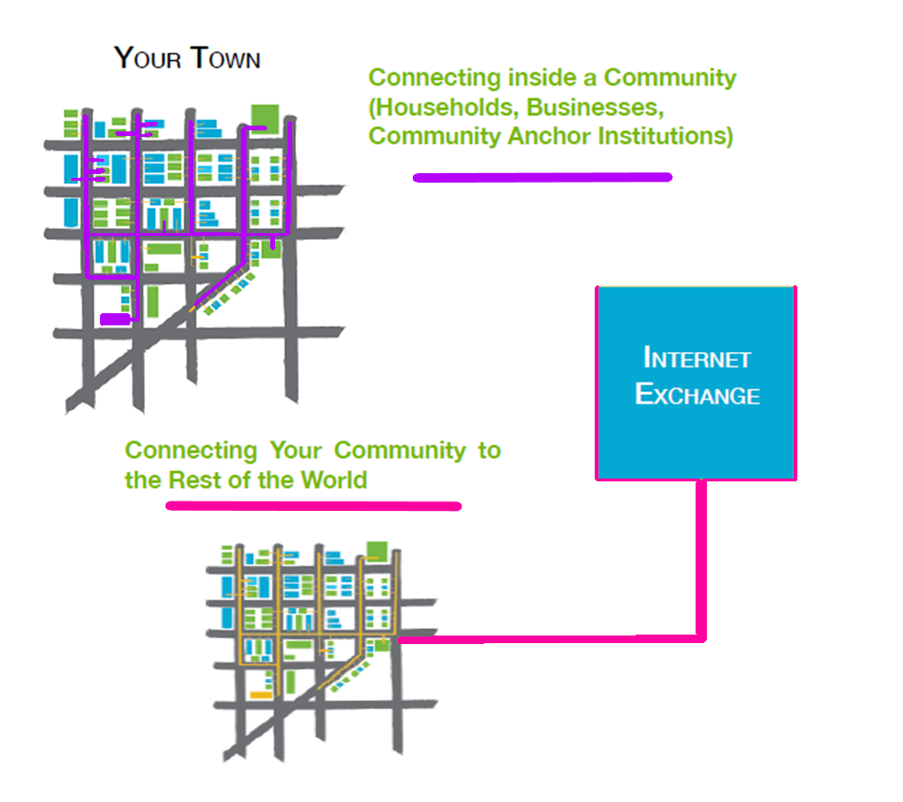
Transport and Local Connections
Need both
First/last mile connections in a community
Backhaul/transport connection to Internet Exchange (in Calgary or Edmonton)
Alberta Rural Connectivity Form 2022
Notes:
Hanne Pearce/McNally et al. 2016. Understanding Community Broadband: The Alberta Broadband Toolkit. https://doi.org/10.7939/R3H41JR36

Slide 11
Policy and Regulation
Federal Department
Funding
Wireline policy
Wireless policy and regulation
Arm’s length regulator
Wireline regulation
Some wireline policy
Some wireless regulation
Funding
+ Minister of Rural Economic Development
+ various provincial bodies Service Alberta (SuperNet) and JEI
Alberta Rural Connectivity Form 2022

Slide 12
Current Initiatives
Innovation, Science and Economic Development (ISED)
$2.75b Universal Broadband Fund
$2b Rural and Norther Stream of the Investing in Canada Infrastructure Program
$2b in Canadian Infrastructure Bank Spending
$600m Low Earth Orbit capacity agreement (with Telesat)
Canadian Radio-television and Telecommunications Commission
Broadband Fund –$750 over 5 years (second call now closed)
Speed targets
Wholesale market regulation (Telecom Decision CRTC 2021-181)
MVNO regulation (Telecom Decision CRTC 2021-130)
Alberta Rural Connectivity Form 2022

Slide 13
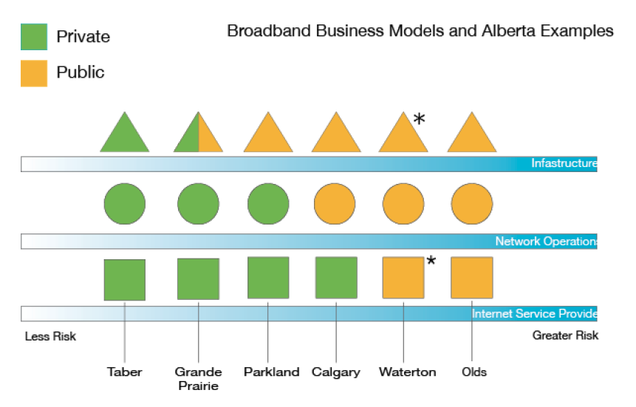
Public, Private or Both
Alberta Rural Connectivity Form 2022
Notes:
Hanne Pearce/McNally et al. 2016. Understanding Community Broadband: The Alberta Broadband Toolkit. https://doi.org/10.7939/R3H41JR36

Slide 14
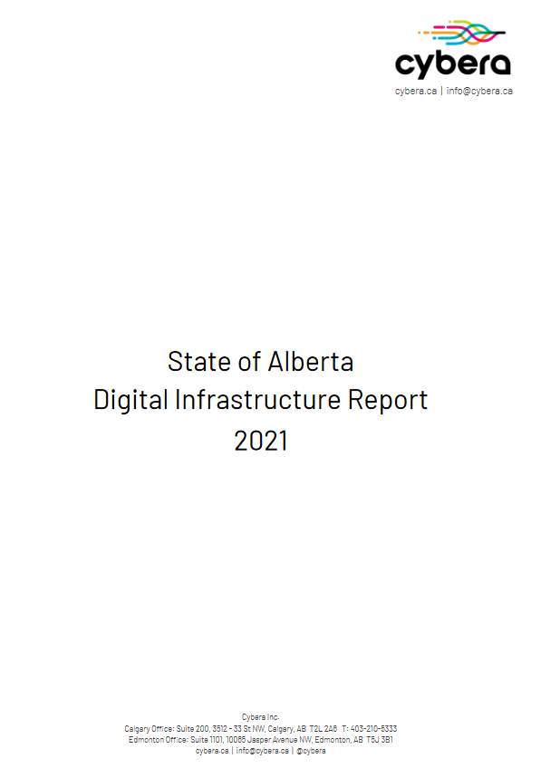
Recommendations Galore
Covid has resulted in a richness of broadband studies
Problem is clear, and many best practices/solutions known
Several AB voices involved in the Agricultural Producers Association of Saskatchewan (APAS) Report
Alberta Rural Connectivity Form 2022
Notes:
Canadian Council of Academies. 2021. Waiting to Connect: Expert Panel on High-Throughput Networks for Rural and Remote Communities in Canada. https://www.cca-reports.ca/reports/high-throughput-networks-for-rural-and-remote-communities/
Institute for Fiscal Studies and Democracy. 2021. Assessing the Efficacy for the Delivery of Rural Broadband. https://www.ifsd.ca/en/blog/reports/Assessing%20the%20efficacy%20of%20instruments%20for%20the%20delivery%20of%20rural%20broadband
Cybera. 2021. State of Alberta Digital Infrastructure Report 2021. https://www.cybera.ca/wp-content/uploads/2021/07/State-of-Alberta-Digital-Infrastructure-Report-2021.pdf
Gregory Taylor/Calgary Economic Development. 2021.5G and Connectivity. https://www.calgaryeconomicdevelopment.com/assets/Uploads/calgary+technology+5G-Connectivity-Report.pdf
Agricultural Produces Association of Saskatchewan. 2021. Rural Connectivity Task Force: Final Report. https://apas.ca/pub/documents/Advocacy%20and%20Resources/Rural%20Connectivity/rctf-final-report-final-web.pdf

Slide 15
GoA Broadband Strategy
Key highlights:
100% connectivity by Mar. 31, 2027 at 50/10
Currently only 33% of rural, and
20% of Indigenous communities at these speeds
$390 million in funding
Mix of Fibre, FWA and LEO
Alberta Rural Connectivity Form 2022

Slide 16
Rogers-Shaw
Mar. 2021 – Rogers announces $26B takeover of Shaw
Multi-layer regulatory review
CRTC – completed
House of Commons – completed, non-binding
Competition Bureau – completed
ISED – pending
Alberta Rural Connectivity Coalition

Slide 17
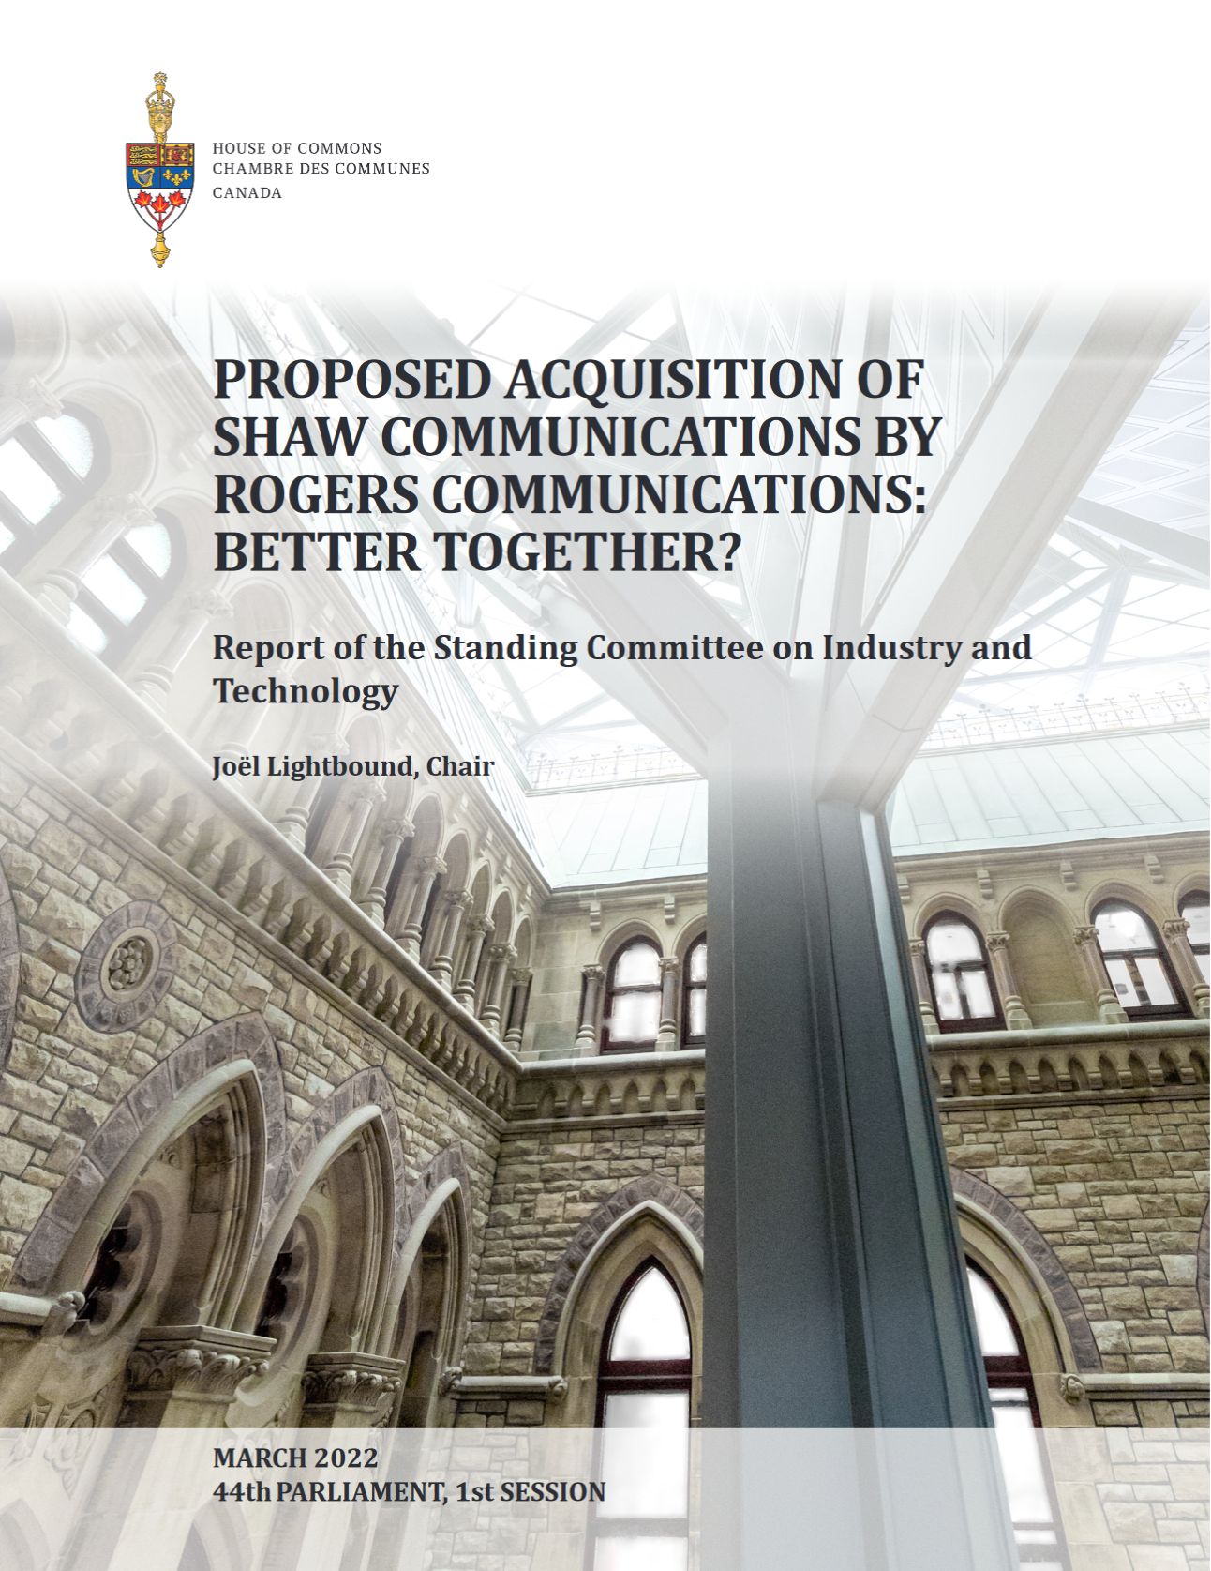
Rogers-Shaw
Alberta Rural Connectivity Form 2022
Notes:
Canada – House of Commons – Standing Committee on Industry and Technology (INDU). 2022. Proposed Acquisition of Shaw Communications by Rogers Communications: Better Together?. 44th Parl. 1st Sess. https://www.ourcommons.ca/DocumentViewer/en/44-1/INDU/report-1/

Slide 18
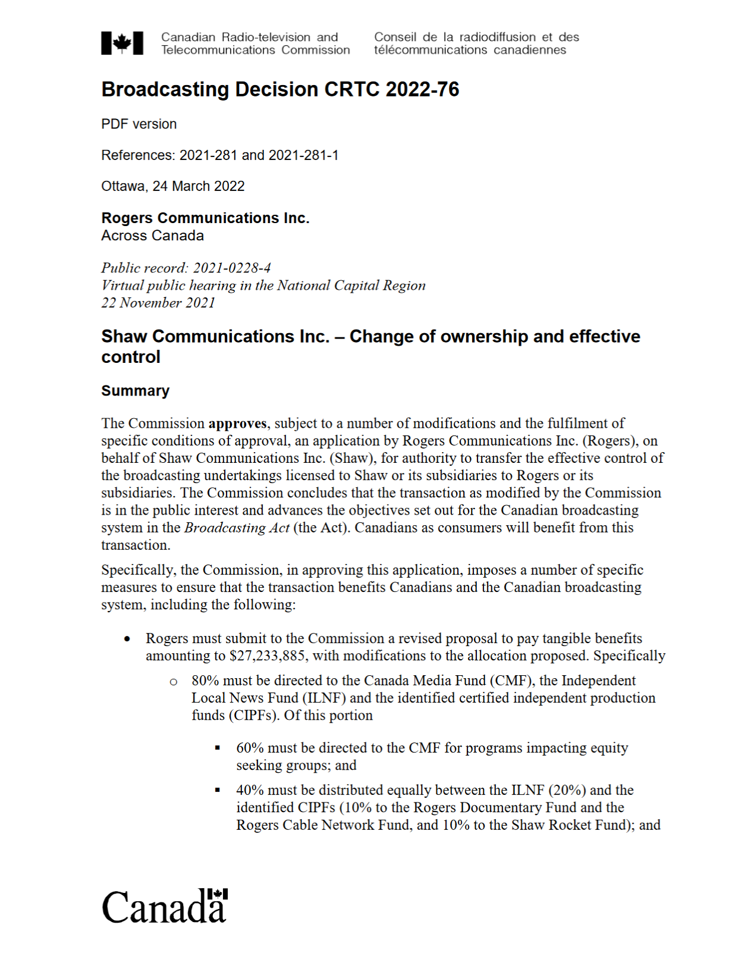
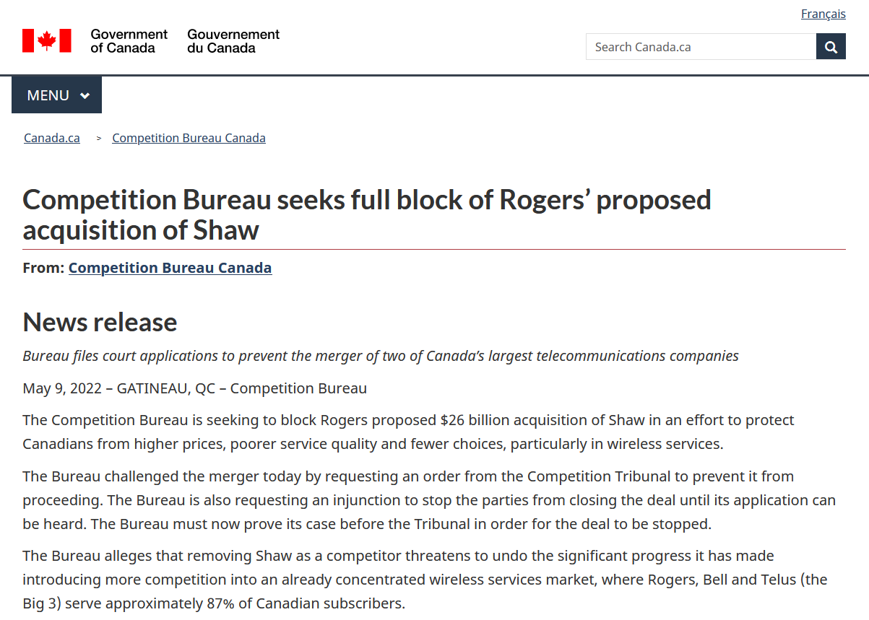
Rogers-Shaw
Alberta Rural Connectivity Form 2022
Notes:
CRTC. 2022. Broadcasting Decision CRTC 2022-76. https://crtc.gc.ca/eng/archive/2022/2022-76.htm
Competition Bureau of Canada. 2022. Competition Bureau Seeks full blook of Roger’s Proposed Acquisition of Shaw.” https://www.canada.ca/en/competition-bureau/news/2022/05/competition-bureau-seeks-full-block-of-rogers-proposed-acquisition-of-shaw.html

Slide 19
2022-23 Wireless Changes
Many looming wireless changes
Deployments of 5G in 3500 MHz band (auctioned in 2021)
Auction of more 5G spectrum (3800 MHz band) early 2023
“Access Licensing” decision (see ARCC Webinar from 2021)
Available from Cybera’s YouTube page
Alberta Rural Connectivity Form 2022

Slide 20
From How to What Next?
Connectivity is not inevitable, but the ‘why’ has never been clear
Getting it right (the ‘how’) is key
Need to think about what next?
Speeds and affordability for the future
Digital Skills/Literacy
What can we do with 100% connected AB?
Alberta Rural Connectivity Form 2022

Slide 21
Document Sources and Other Links
Agricultural Produces Association of Saskatchewan. 2021. Rural Connectivity Task Force: Final Report. https://apas.ca/pub/documents/Advocacy%20and%20Resources/Rural%20Connectivity/rctf-final-report-final-web.pdf
Alberta. 2022. Alberta Broadband Strategy 2022: Connecting Albertans, Growing the Economy. https://open.alberta.ca/publications/alberta-broadband-strategy-2022
Alberta Rural Connectivity Coalition/Michael B. McNally. “How Wireless Spectrum Regulation will Impact Rural Connectivity.” https://www.youtube.com/watch?v=uO-Xu8RQGN8
Canada – House of Commons – Standing Committee on Industry and Technology (INDU). 2022. Proposed Acquisition of Shaw Communications by Rogers Communications: Better Together?. 44th Parl. 1st Sess. https://www.ourcommons.ca/DocumentViewer/en/44-1/INDU/report-1/
Canadian Council of Academies. 2021. Waiting to Connect: Expert Panel on High-Throughput Networks for Rural and Remote Communities in Canada. https://www.cca-reports.ca/reports/high-throughput-networks-for-rural-and-remote-communities/
CRTC. 2022. Broadcasting Decision CRTC 2022-76. https://crtc.gc.ca/eng/archive/2022/2022-76.htm
Canadian Council of Academies. 2021. Waiting to Connect: Expert Panel on High-Throughput Networks for Rural and Remote Communities in Canada. https://www.cca-reports.ca/reports/high-throughput-networks-for-rural-and-remote-communities/
Competition Bureau of Canada. 2022. Competition Bureau Seeks full blook of Roger’s Proposed Acquisition of Shaw.” https://www.canada.ca/en/competition-bureau/news/2022/05/competition-bureau-seeks-full-block-of-rogers-proposed-acquisition-of-shaw.html
Cybera. 2021. State of Alberta Digital Infrastructure Report 2021. https://www.cybera.ca/wp-content/uploads/2021/07/State-of-Alberta-Digital-Infrastructure-Report-2021.pdf
Gregory Taylor/Calgary Economic Development. 2021.5G and Connectivity. https://www.calgaryeconomicdevelopment.com/assets/Uploads/calgary+technology+5G-Connectivity-Report.pdf
Institute for Fiscal Studies and Democracy. 2021. Assessing the Efficacy for the Delivery of Rural Broadband. https://www.ifsd.ca/en/blog/reports/Assessing%20the%20efficacy%20of%20instruments%20for%20the%20delivery%20of%20rural%20broadband
Alberta Rural Connectivity Form 2022

