Slide 1
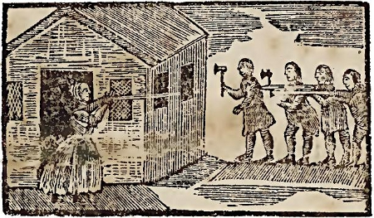
Avoiding the Stereotypes: History, Heritage, and How to Navigate Indigenous Imagery
Virginia McLaurin-Hill
PhD Student, UMass Amherst
Writing Stick Conference
June 9, 2017

Slide 2
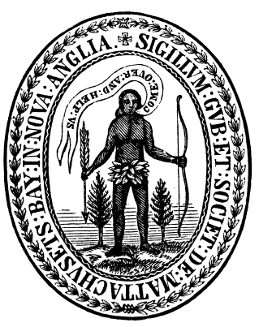
The “Savage”
The “Noble Savage”
Depiction of Mary Rowlandson, a colonist and captive during King Philip’s War, 1675-1678
Seal of the Massachusetts Bay Company, with a text banner reading “Come Over and Help Us”

Slide 3
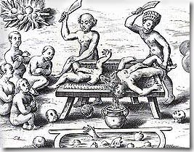
The “Savage”
The “Noble Savage”
Drawing of cannibalistic Caribs based on the account of Christopher Columbus.
Seal of the Massachusetts Bay Company, with a text banner reading “Come Over and Help Us”

Slide 4
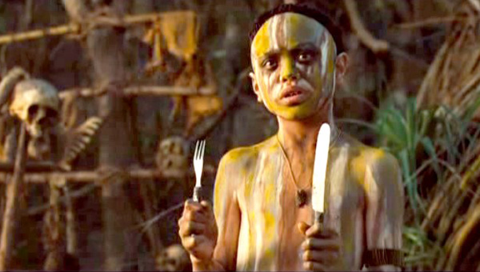
The “Savage”
The “Noble Savage”
Still shot of a “Caribbean cannibal” from “Pirates of the Caribbean: Dead Man’s Chest”
Seal of the Massachusetts Bay Company, with a text banner reading “Come Over and Help Us”

Slide 5
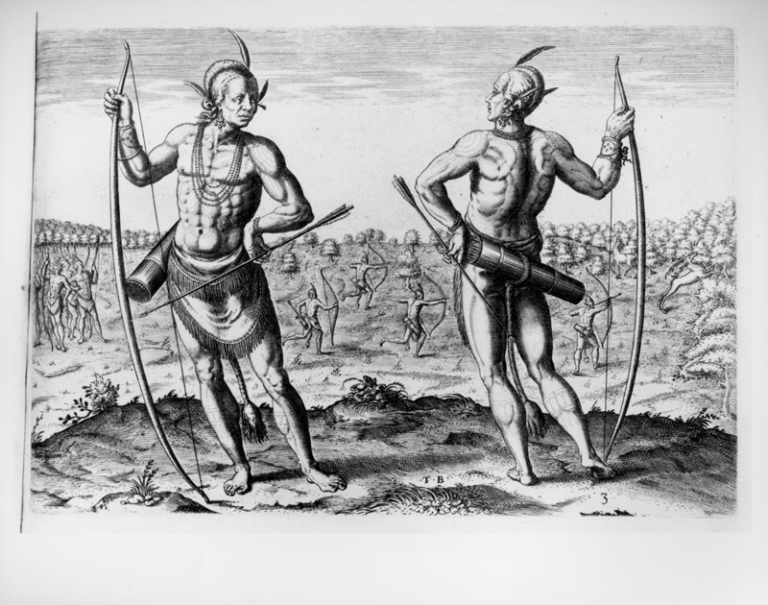
The “Savage”
The “Noble Savage”
Still shot of a “Caribbean cannibal” from “Pirates of the Caribbean: Dead Man’s Chest”
1590 engraving of physically superior Indigenous people in Virginia, by Theodor de Bry

Slide 6
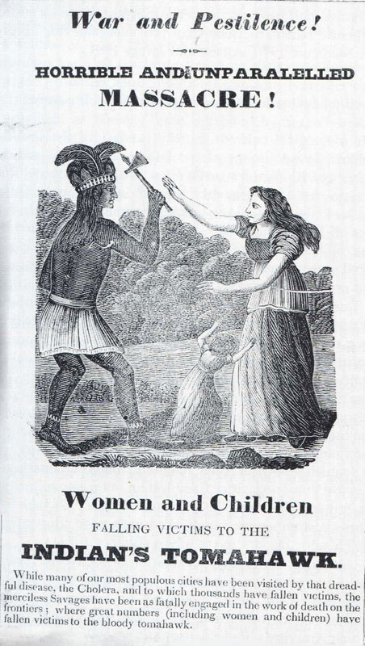
The “Savage”
The “Noble Savage”
Newspaper notice, circa 1800s, stating women and children were massacred by Indigenous men
1590 engraving of physically superior Indigenous people in Virginia, by Theodor de Bry

Slide 7
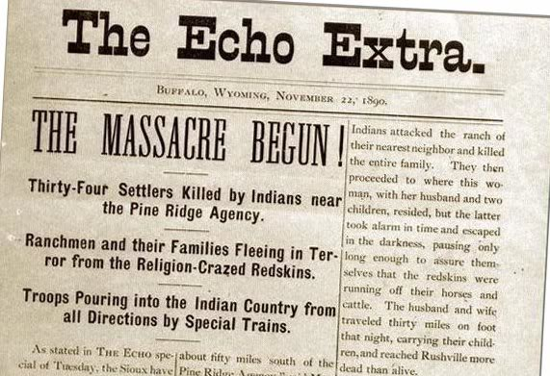
The “Savage”
The “Noble Savage”
An 1890 Wyoming newspaper raises fears over the Ghost Dance movement, later resulting in the Wounded Knee Massacre that same year
1590 engraving of physically superior Indigenous people in Virginia, by Theodor de Bry

Slide 8
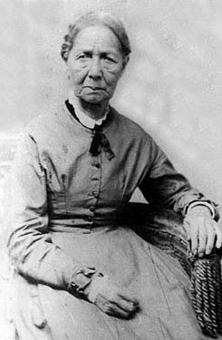
The “Savage”
The “Noble Savage”
An 1890 Wyoming newspaper raises fears over the Ghost Dance movement, later resulting in the Wounded Knee Massacre that same year
Unlike her vilified ancestors in the 1700s, by the 1800s Mary Curless Vickers was praised as an upstanding Christian and citizen

Slide 9
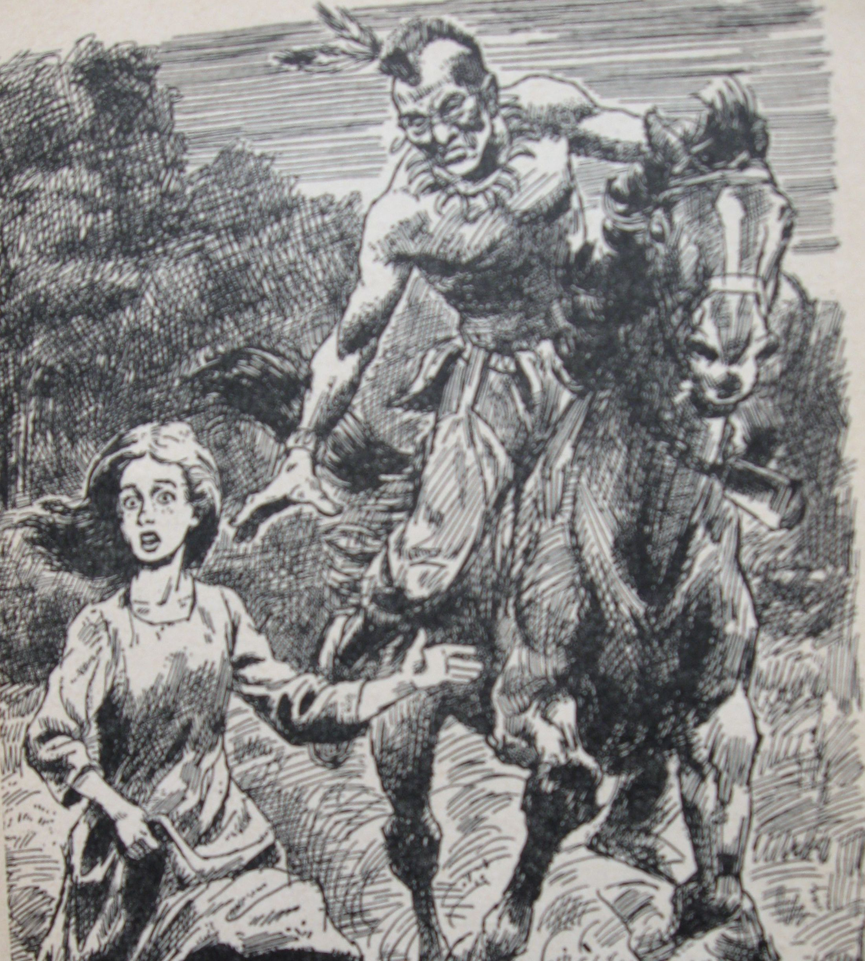
The “Savage”
The “Noble Savage”
Original drawing from the children’s book “Fear in the Forest”
Unlike her vilified ancestors in the 1700s, by the 1800s Mary Curless Vickers was praised as an upstanding Christian and citizen

Slide 10
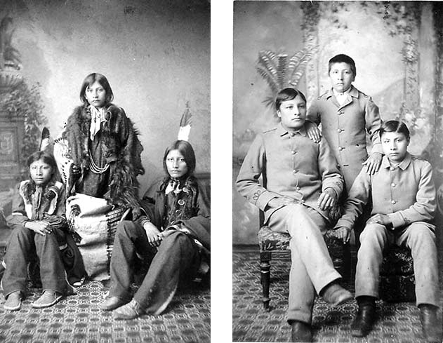
The “Savage”
The “Noble Savage”
Original drawing from the children’s book “Fear in the Forest”
Three Lakota brothers attending Carlisle; these before and after images were used as publicity and “proof” of the success of civilization efforts

Slide 11
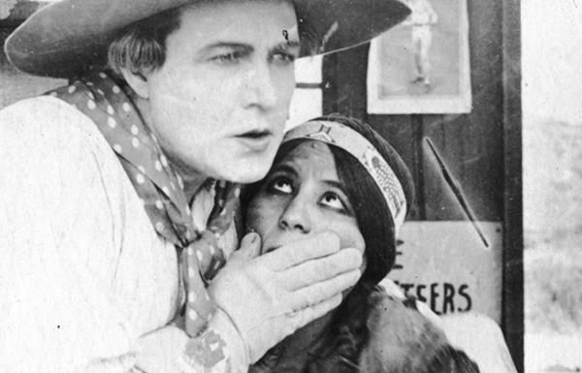
The “Savage”
The “Noble Savage”
In “The Squaw Man” (1914) and many other silent films, Indigenous love interests and sidekicks die after providing white male protagonists with land, gold, or children
Original drawing from the children’s book “Fear in the Forest”

Slide 12
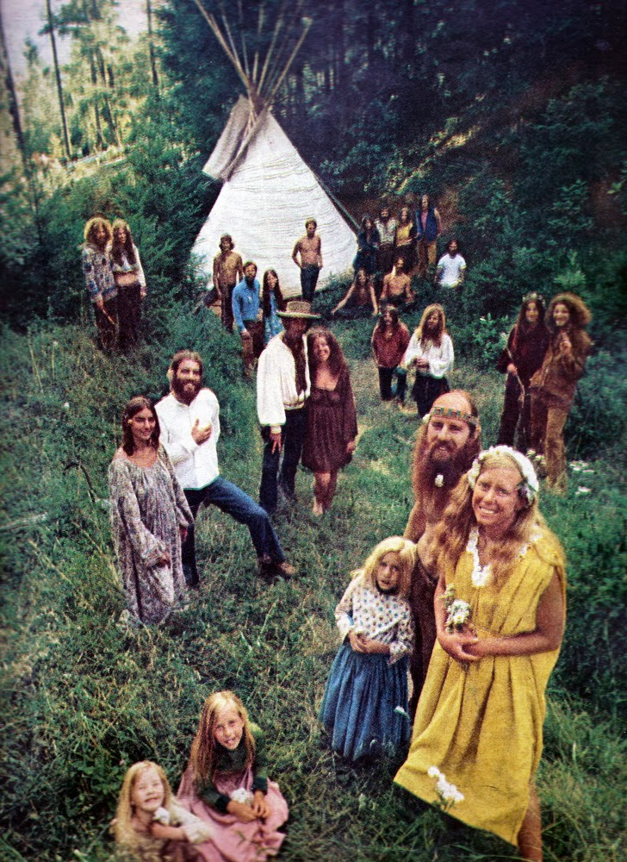
The “Savage”
The “Noble Savage”
Original drawing from the children’s book “Fear in the Forest”
A 1960s commune incorporates a teepee as a symbol of Indigeneity

Slide 13
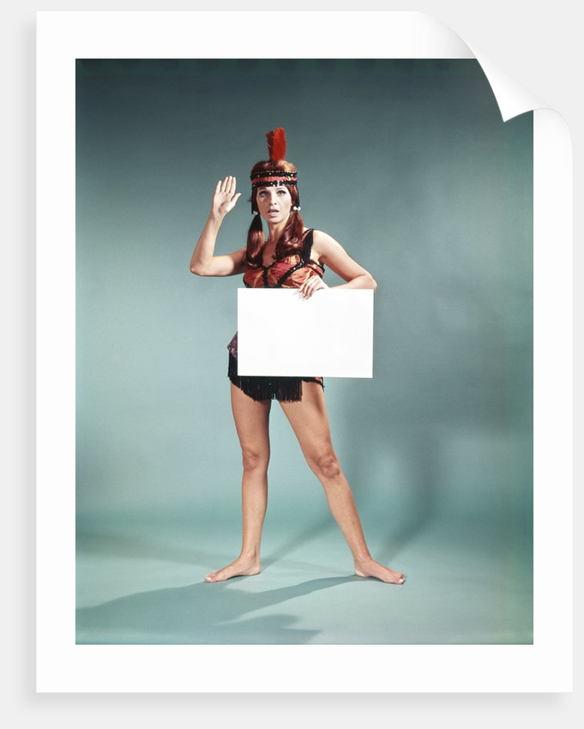
The “Savage”
The “Noble Savage”
Original drawing from the children’s book “Fear in the Forest”
A 1960s ad shows a woman in a headband with a feather

Slide 14
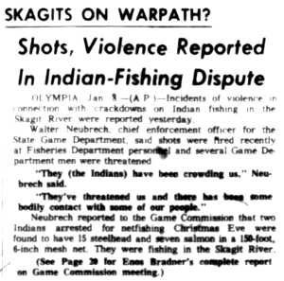
The “Savage”
The “Noble Savage”
1963 Seattle Times article uses “warpath” metaphor to describe activism over fishing rights in the Pacific Northwest
A 1960s ad shows a woman in a headband with a feather

Slide 15
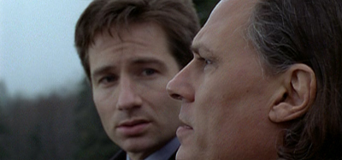
The “Savage”
The “Noble Savage”
In the X-Files episode “Shapes,” no one on the reservation will speak to the agents
1963 Seattle Times article uses “warpath” metaphor to describe activism over fishing rights in the Pacific Northwest

Slide 16
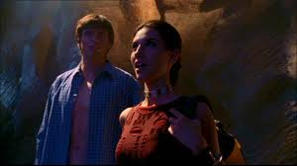
The “Savage”
The “Noble Savage”
Alien writings inside a cave match up with Indigenous “legends” on “Smallville,” and this Indigenous character later shapeshifts into a wolf
1963 Seattle Times article uses “warpath” metaphor to describe activism over fishing rights in the Pacific Northwest

Slide 17
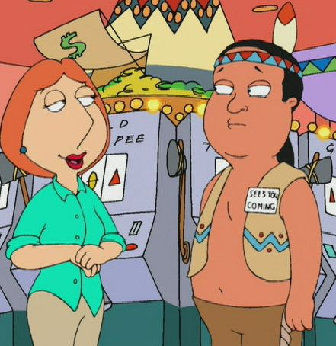
The “Savage”
The “Noble Savage”
Alien writings inside a cave match up with Indigenous “legends” on “Smallville,” and this Indigenous character later shapeshifts into a wolf
The cartoon “Family Guy” depicts a morally bankrupt group of Indigenous casino owners

Slide 18
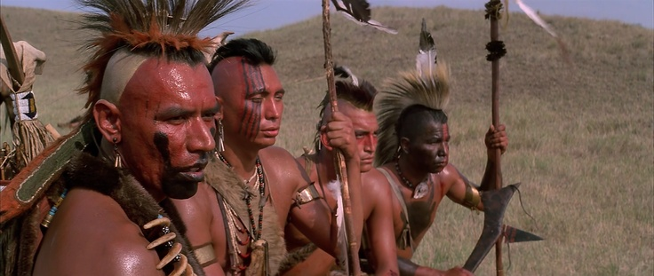
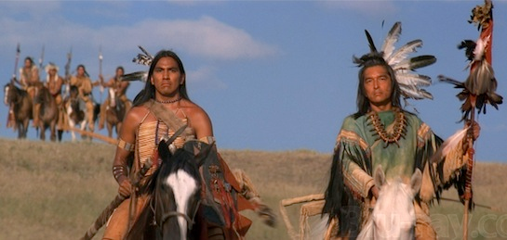
The “Savage”
The “Noble Savage”
In “Dances with Wolves,” the Pawnee are depicted as savage...
...while the Lakota are purely good and inviting to outsiders.

Slide 19
Moving Forward
Engagement
Learning about stereotypes in the past
Looking for complex characters
Feedback from Indigenous communities
Support Indigenous artists
Staying involved

