Slide 1
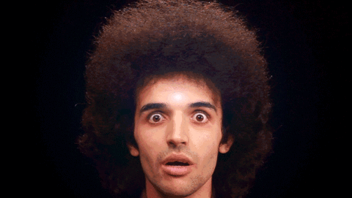
WILU
Jacqueline Kreller-Vanderkooy
jkreller@uoguelph.ca
Melanie Parlette-Stewart
mparlett@uoguelph.ca
LIGHTNING TALK
Using animated GIFs to walk the line between skill development and higher-level concepts in information literacy instruction
MAKING GIFs
pixlr.com - photo editing
resizeimage.net - image resizing
gifmaker.me; gifcreator.me - GIF makers
FINDING GIFs
giphy.com
reddit.com
tumblr.com
KnowYourMeme.com
ACCESSIBLE GIFs
Alternative Text - WebAIM
Alternative Text for Images - Oregon State University
FURTHER READING
Mestre, L. (2012). Student preference for tutorial design: A usability study. Reference Services Review, 40(2), 258-276.
Suhr, K. (2014). Using animated GIF images for library instruction. In the Library with the Lead Pipe.
Notes:
https://giphy.com/gifs/syfy-3ohzdQChVBWTRSkILe

Slide 2
WILU
Jacqueline Kreller-Vanderkooy
jkreller@uoguelph.ca
Melanie Parlette-Stewart
mparlett@uoguelph.ca
LIGHTNING TALK
Using animated GIFs to walk the line between skill development and higher-level concepts in information literacy instruction
MAKING GIFs
pixlr.com - photo editing
resizeimage.net - image resizing
gifmaker.me; gifcreator.me - GIF makers
FINDING GIFs
giphy.com
reddit.com
tumblr.com
KnowYourMeme.com
ACCESSIBLE GIFs
Alternative Text - WebAIM
Alternative Text for Images - Oregon State University
FURTHER READING
Mestre, L. (2012). Student preference for tutorial design: A usability study. Reference Services Review, 40(2), 258-276.
Suhr, K. (2014). Using animated GIF images for library instruction. In the Library with the Lead Pipe.

