Slide 1
Partnerships on Campus and Beyond
DSC as Case Study
Lydia Zvyagintseva
Head, Digital Scholarship Services
Notes:
DI Brownbags delivered on Jan. 22 & 24, 2019
All images https://www.pexels.com/@rawpixel and Lydia Zvyagintseva

Slide 2
Notes:
What is DS? Everyone hears a version, but no one knows quite what it is.
In other words, by virtue of the DSC operating under the Library umbrella, what differentiates us from units such as the Centre for Teaching and Learning, Information Technology, Student Services, Research Services?
“Digital Scholarship” is defined as any scholarly activity that makes extensive use of one or more of the new possibilities for teaching and research opened up by the unique affordances of digital media. These include, but are not limited to, new forms of collaboration, new forms of publication, and new methods for visualizing and analyzing data. - University of Washington
“Scholarship that critically appreciates and makes use of the affordances of our evolving digital environment.” - Abby Smith Rumsey
[design term, making use of design principles and methods]
Digital scholarship is broadly defined as using digital technologies in support of research and teaching to ask and answer questions in new ways. - McGill U Library

Slide 3
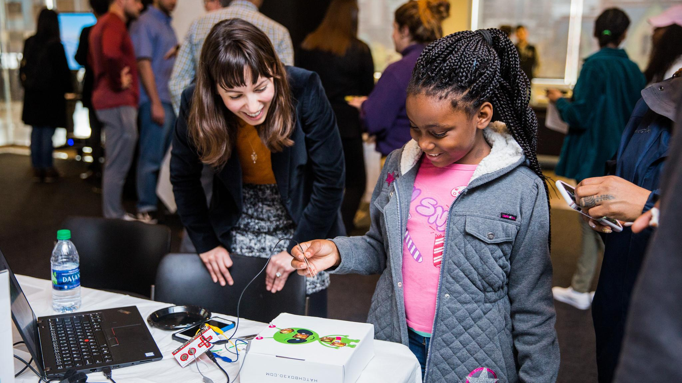
Notes:
My perspective on it: Technology = computers, computer-driven tools ie. robots, physical computing

Slide 4
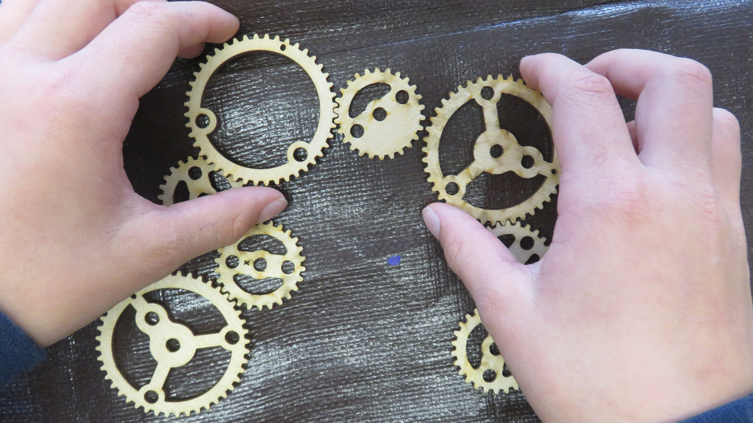
Notes:
Pedagogy - acquisition of skills, process of learning, critical reflection on what’s happening, digital literacy

Slide 5
Notes:
Collaboration - relationships among researchers, sharing of the final product, publishing, project management elements that go into the production of knowledge

Slide 6
Boundary Objects/Boundary Staff
Consequences of Framing DH Tools as Easy
Collaborative DS Librarianship
Notes:
Articles that I have found recently helpful to think about this stuff:
“Boundary Objects/Boundary Staff” (2017). Montoya, R.D.
“Framing DH Tools as Easy” (2018). Morgan, P.C.
“Skills and Competencies” (2018). King, M.
More interest in DS-themed research articles? Jamie Spivak has put together this growing list.

Slide 7
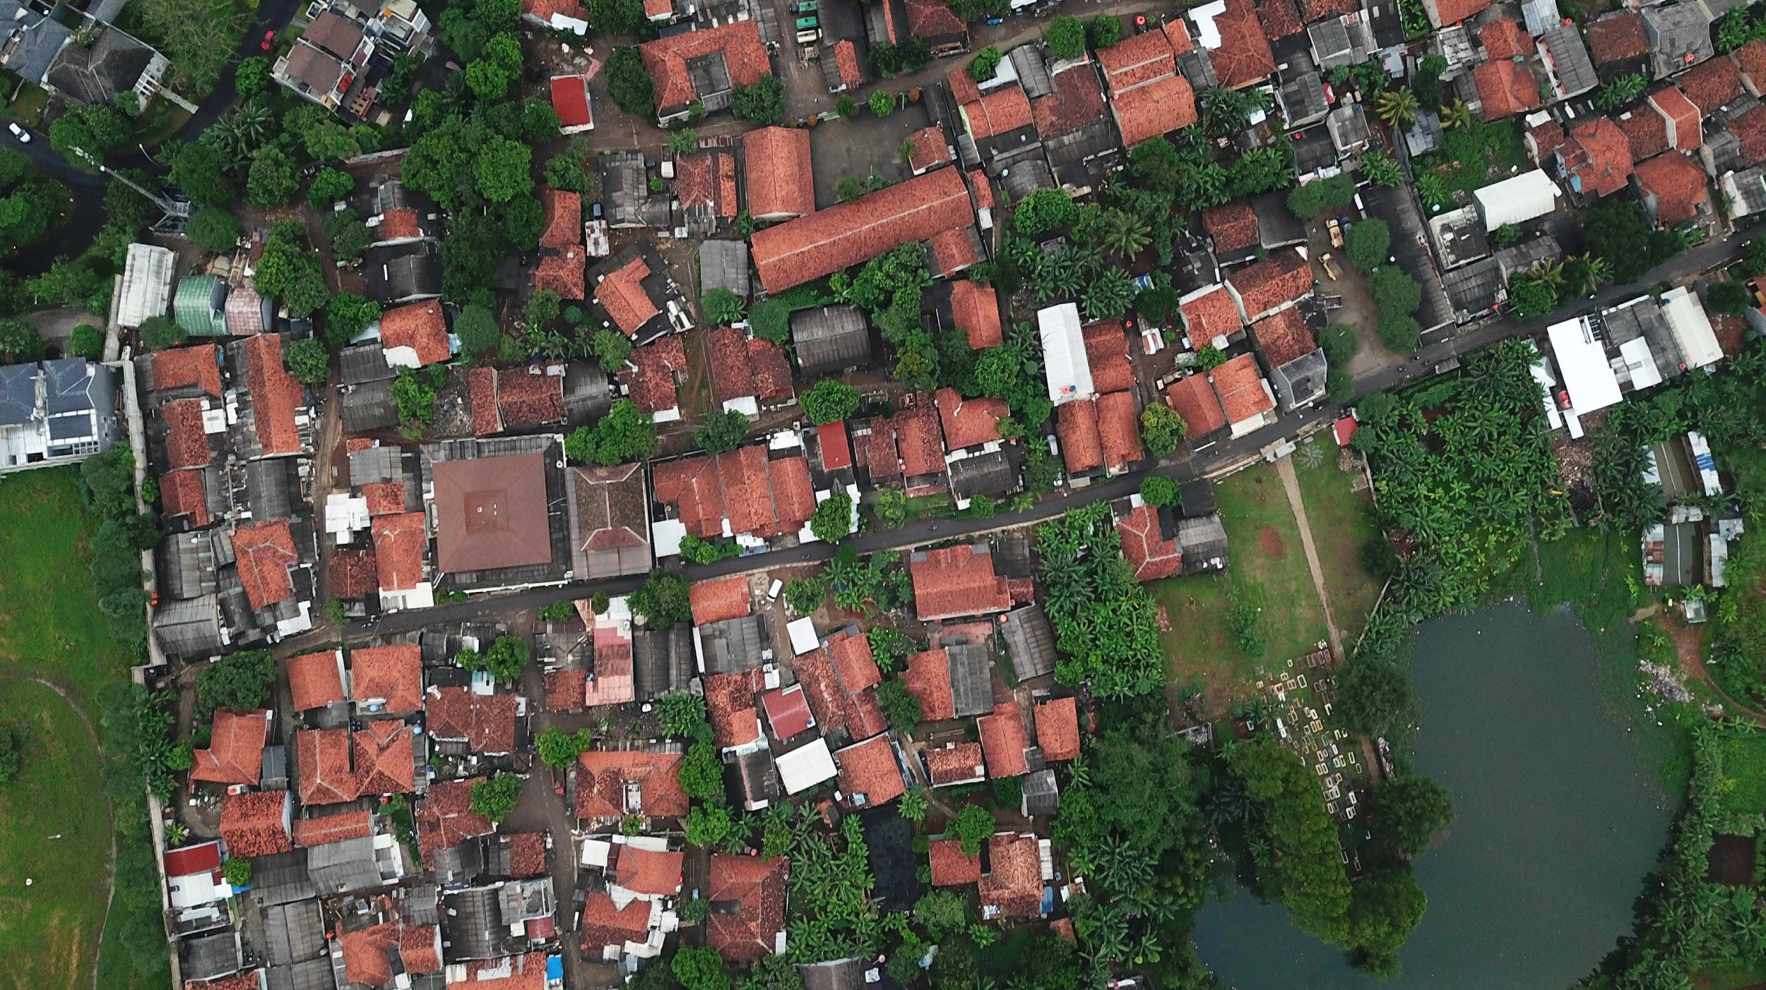
Notes:
This grounding of what we mean by digital scholarship has philosophical implications when we connect theory to practice. In other words, all of a sudden, it might change our perspective about how we relate to the campus and wider community.
Here, I am thinking about the ideas of “exchange” vs. “collaboration” on services - being service providers vs. being partners in research, erasure of labour, not being recognized, etc.
My argument here is that spaces like DS centres provide an opportunity to understand service provision and informal learning in new ways, and we have to be intentional about the choices we make to support and participate in scholarly activity.

Slide 8
Why?
Already happening
Wicked problems demand 21st century approaches
“We do it for the people” - Common
Notes:
How we already work in the 21st century
Contemporary problems are likely to need multiple skills sets
Putting human back into technology

Slide 9
Examples
Notes:
Perhaps it might be easier to think about this “partnered digital scholarship thing” through some examples

Slide 10
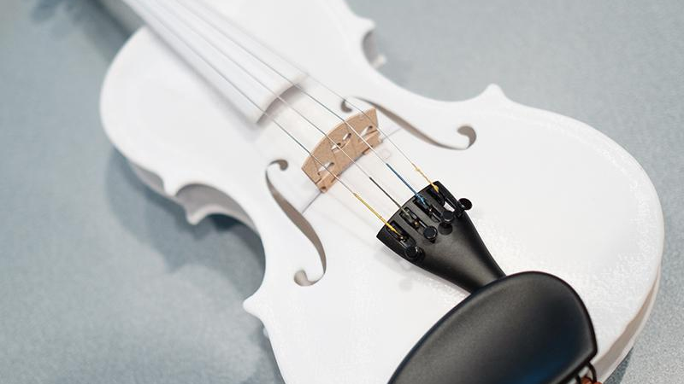
Notes:
National 3D Printed Musical Instrument Challenge (http://canadamakes.ca/tag/3d-challenge/)
Canada Makes and the Ottawa Symphony Orchestra are launching a new Canada-Wide 3D Printing Challenge to improve or design an ergonomically optimized musical instrument that leverages the power of 3D Printing (metal or polymer) for its fabrication and remains cost-effective.
What new instruments and sounds can we create using today’s newest technologies?
To explore the new creative possibilities that technology brings to music, the Ottawa Symphony Orchestra has commissioned Ottawa violin maker Charline Dequincey and the Industrial Technology Centre in Winnipeg to create original 3D-printed string instruments.

Slide 11
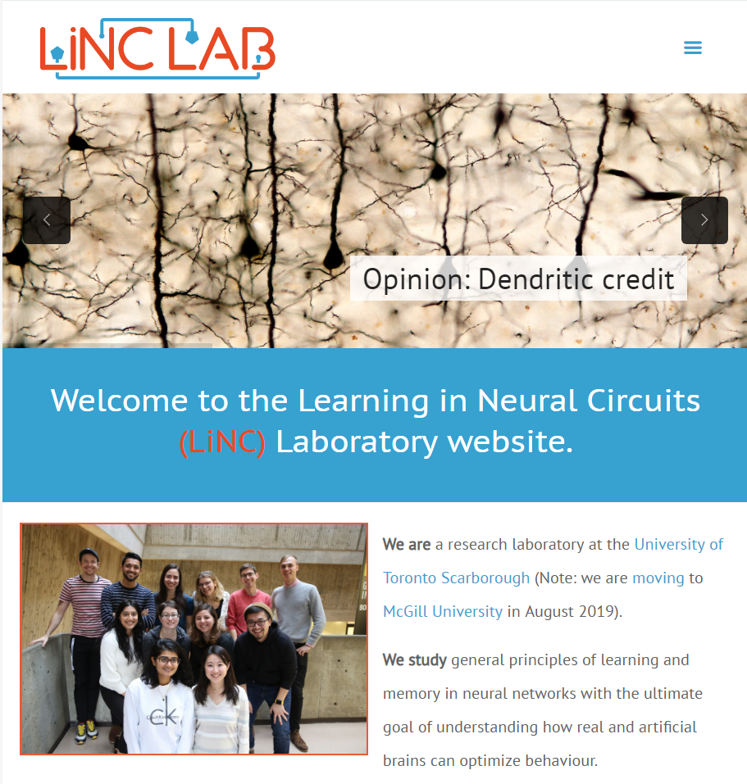
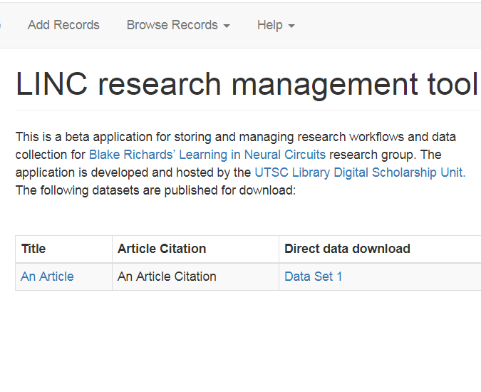

Slide 12
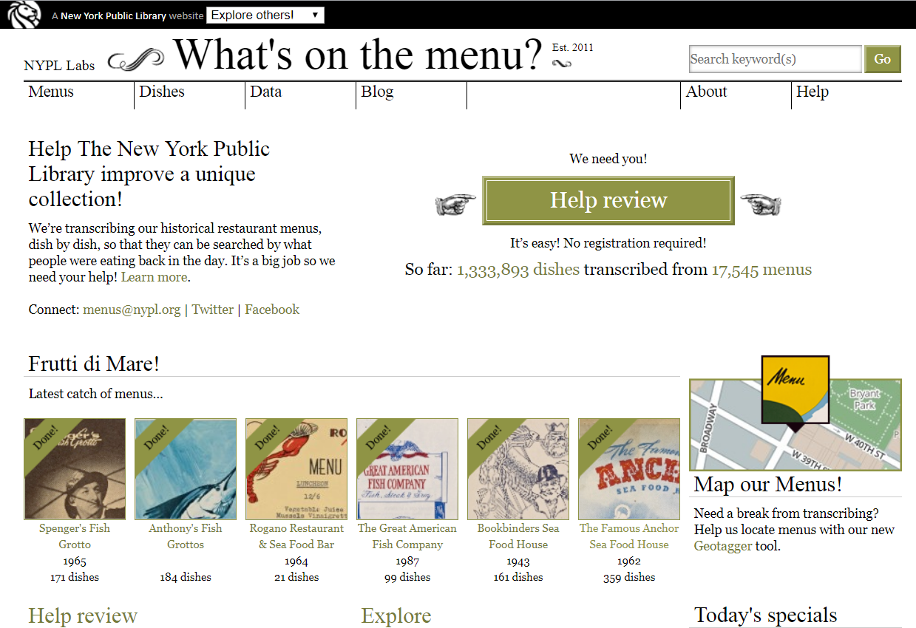
Notes:
Curating Menus - http://curatingmenus.org/ ; “Against Cleaning” by Katie Rawson (Emory) and Trevor Munoz (UMD)
We began to think of the work we were doing as building something like a back-of-the-book index for the What’s On the Menu? data. We would create additional data structures around and atop the existing data, generating links between a set of names or categories we created and the larger and more heterogeneous set of data from NYPL. We are interested in ultimately building two interconnected indexes, one focused on historical food concepts and one on the organizations connected to the menus (businesses, community organizations, fraternal societies, etc.).
These new opportunities fall somewhere between digital library practices and digital humanities research, but the gap is one that more projects should embrace the opportunity to fill. There is a need for projects that take “authority work” as an invitation to new creativity; an invitation for making and building. In such a model, multiple regimes of authorities might be built up from critically-aware and engaged intellectual communities to meet their own specific needs while also participating in larger technological and information systems.

Slide 13
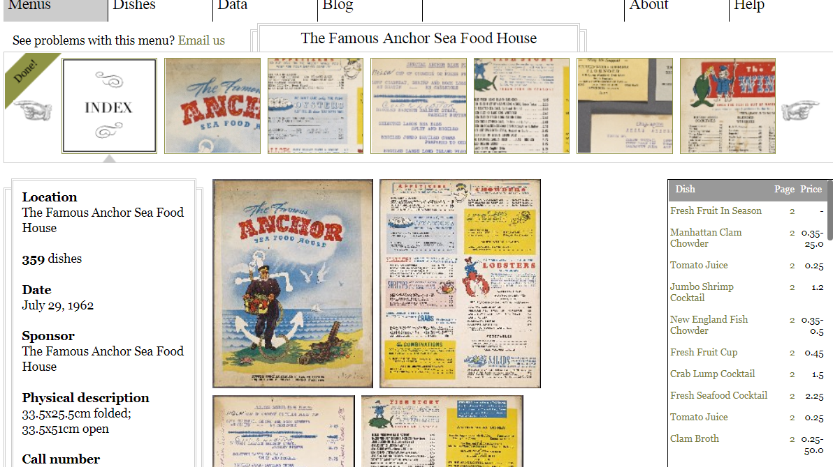
Notes:
We imagine those communities will contain librarians and scholars. Though librarians and humanities scholars have frequently intersected, they have rarely interacted in the ways we are calling for. Simplifying to the point of caricature, these existing interactions go something like this: humanities scholars point out that the structure and content of a specific archive or collection represents even recreates certain cultural logics. For example, the systems of describing collections—such as the widely-used Library of Congress Subject Headings—reify concepts about persons or cultures that really ought to be interrogated more closely or perhaps discredited and dismantled all together. For the most part, librarians, archivists, and information scientists acknowledge these flaws and perhaps even work to remedy them in the course of maintaining systems that preserve whatever partial archives do exist or helping patrons to find information they need.

Slide 14
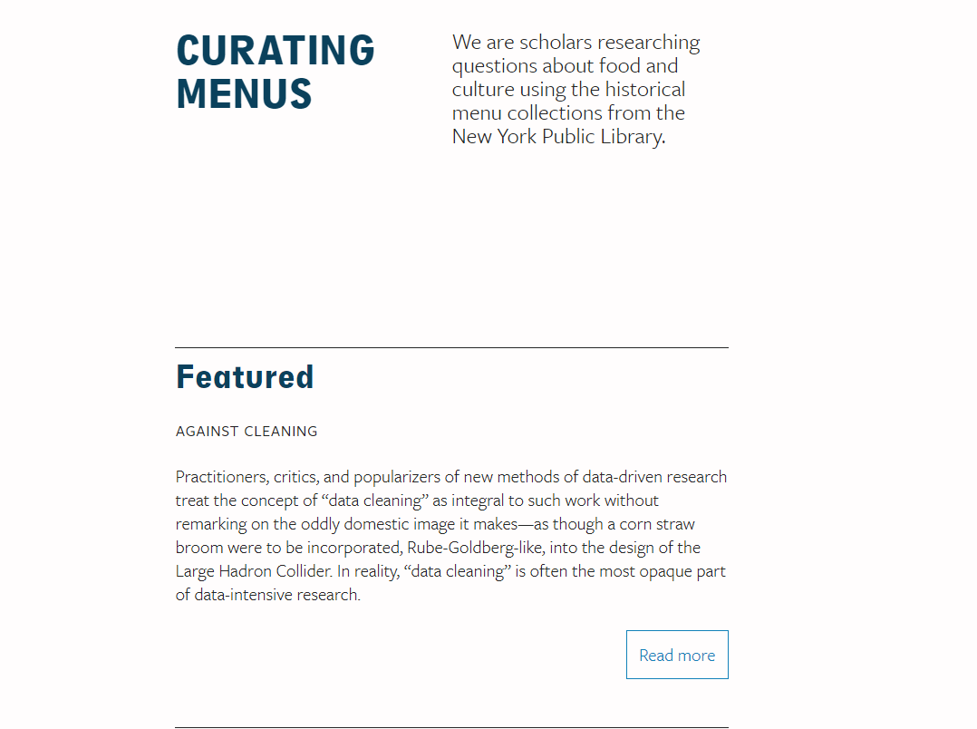
Notes:
We are looking for new forms of collective action that can be expressed through the professional work of humanities scholars and librarians. This is not simply a call for the production of more and more data—attempting to subvert the work of categorization and classification through the production of ever more local, finely-wrought distinctions, details, qualifications. Our aim is to develop ways of working that validate local experiences of data without removing them from a more global network of information exchange.

Slide 15
Notes:
Computational recognition of sound, its types, sources, and components is crucial for a wide array of fields, including ethnomusicology, music studies, sound studies, linguistics (especially phonetics), media studies, library and information science, and bioacoustics, in order to enable indexing, searching, retrieval, and regression of audio information. While expert human listeners may be able to recognize complex sound environments with ease, the process is slow. Through this project, we aim to explore opportunities for application of big data deep learning that will ultimately enable these functions across large sound collections for ongoing interdisciplinary research. - https://soundstudies.ualberta.ca/deep-learning-sound-recognition/
Department of Music
Department of Linguistics
Department of Biological Sciences
Department of Computing Science
MLCS/DH
University of Alberta Libraries

Slide 16
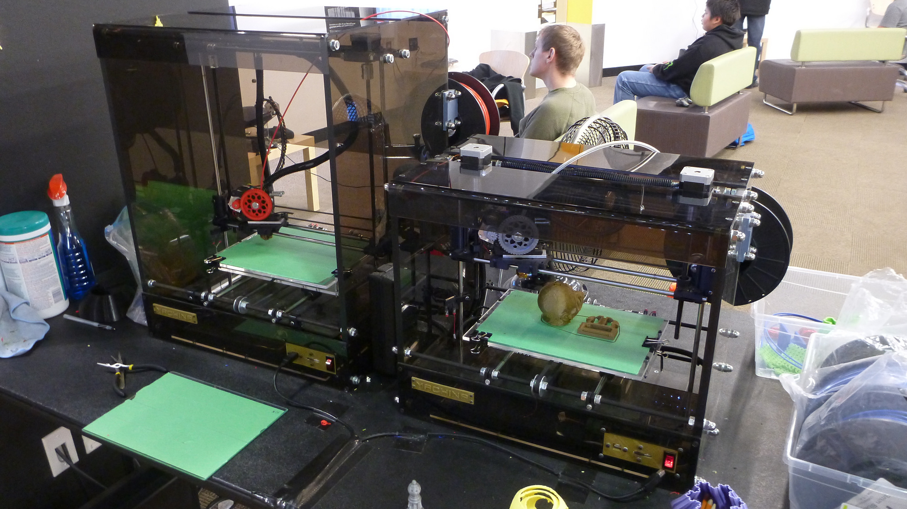
3D Printing Community of Practice
Notes:
Examples of partnerships so far: Research Computing, 3D printing, DHSI sponsorship, FURCA

Slide 17
Notes:
IST + Lib regular event

Slide 18
Notes:
You may have heard of the Open Data Day, which is an annual international event. For the past 5 years, it has been hosted by the City of Edmonton and the Edmonton Public Library. This year, the event will be centered on the theme of Climate Change and how Open Data can support related initiatives. The various municipalities have prepared new datasets to be shared on the City’s Open Data portal related to this theme.

Slide 19
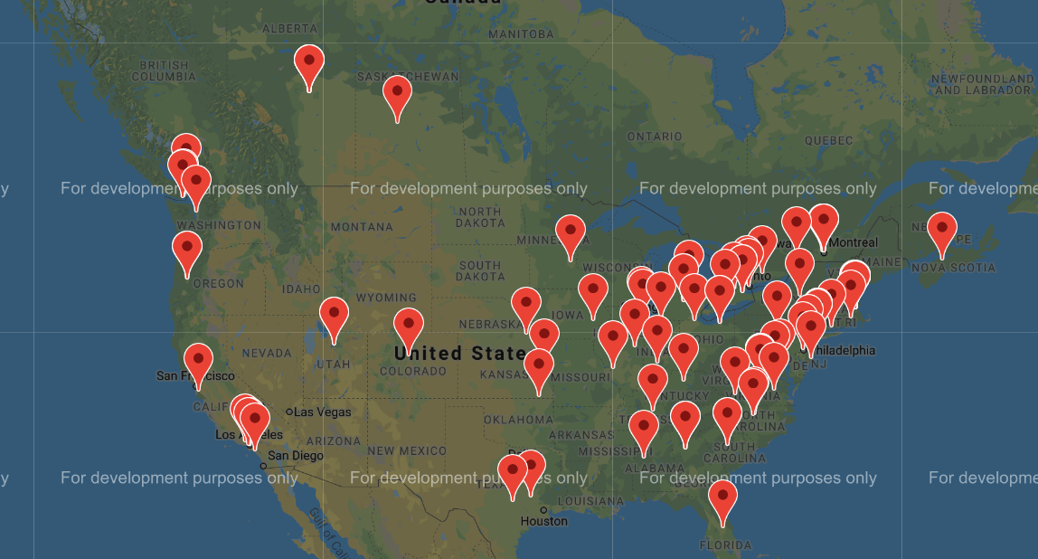
Notes:
New partnerships I’d like to develop - network of centres across Canada, a mini centre-net, but with a focus on library-led spaces rather than strictly DH research groups.
centerNet is an international network of digital humanities centers formed for cooperative and collaborative action to benefit digital humanities and allied fields in general, and centers as humanities cyberinfrastructure in particular.
Anchored by its new publication DHCommons, centerNet enables individual DH Centers to network internationally — sharing and building on projects, tools, staff, and expertise. Through initiatives such as Day(s) of DH and Resources for Starting and Sustaining DH Centers, centerNet provides a virtual DH center for isolated DH projects and platform for educating the broader scholarly community about Digital Humanities.

Slide 20
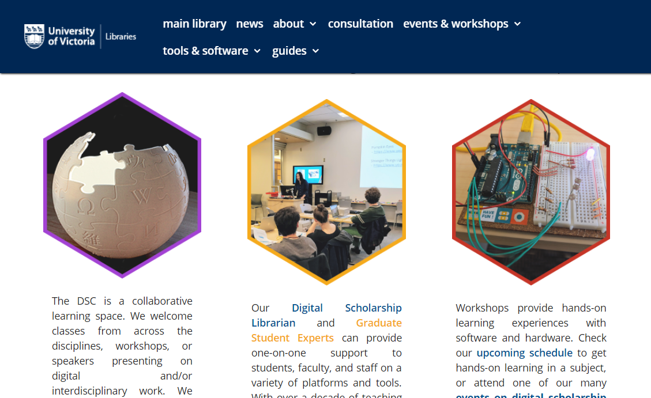
Notes:
UVic’s Library Digital Scholarship Commons

Slide 21
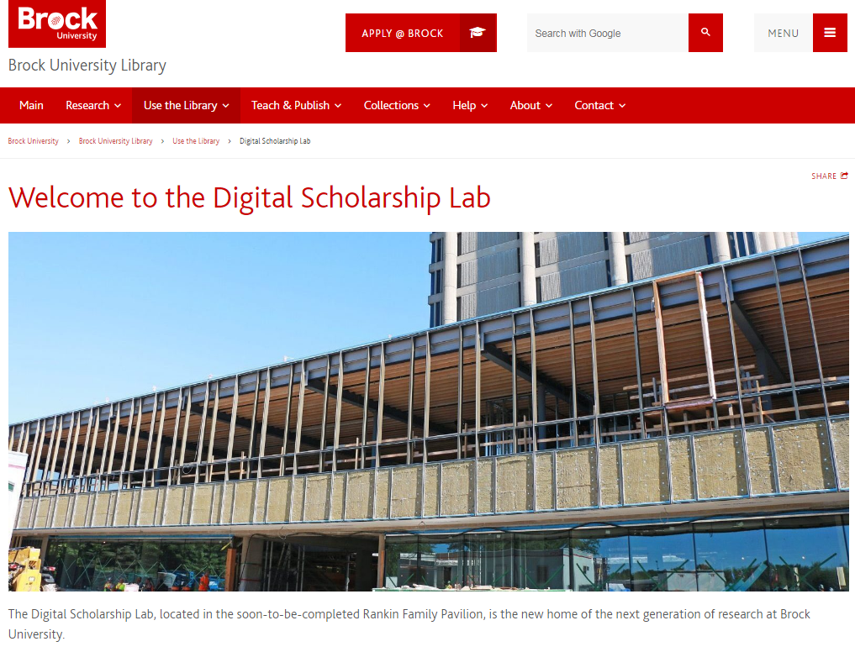
Notes:
Brock Library’s Digital Scholarship Lab

Slide 22
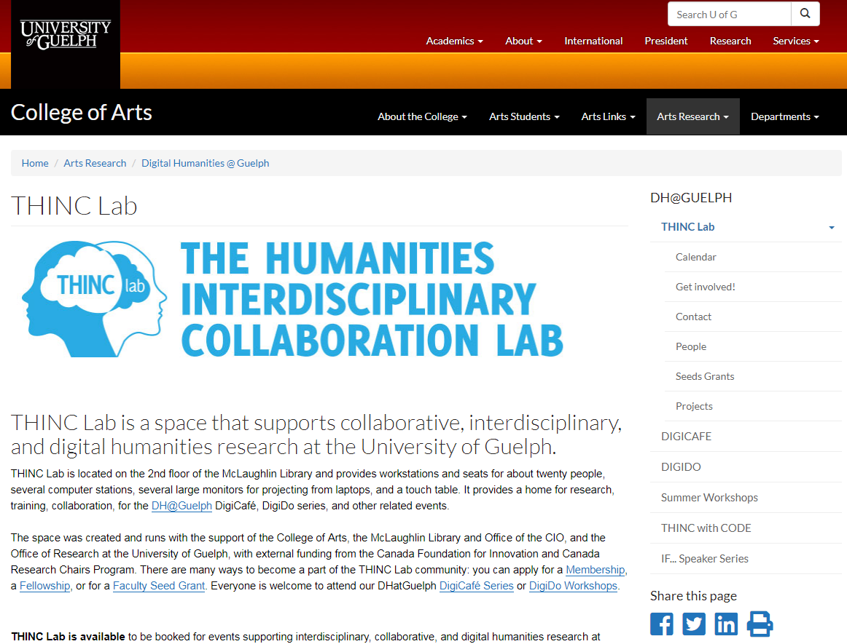
Notes:
Guelph’s THINCLab

Slide 23
Other partnerships?
Notes:
Other partnerships you would like to see or can suggest?

Slide 24
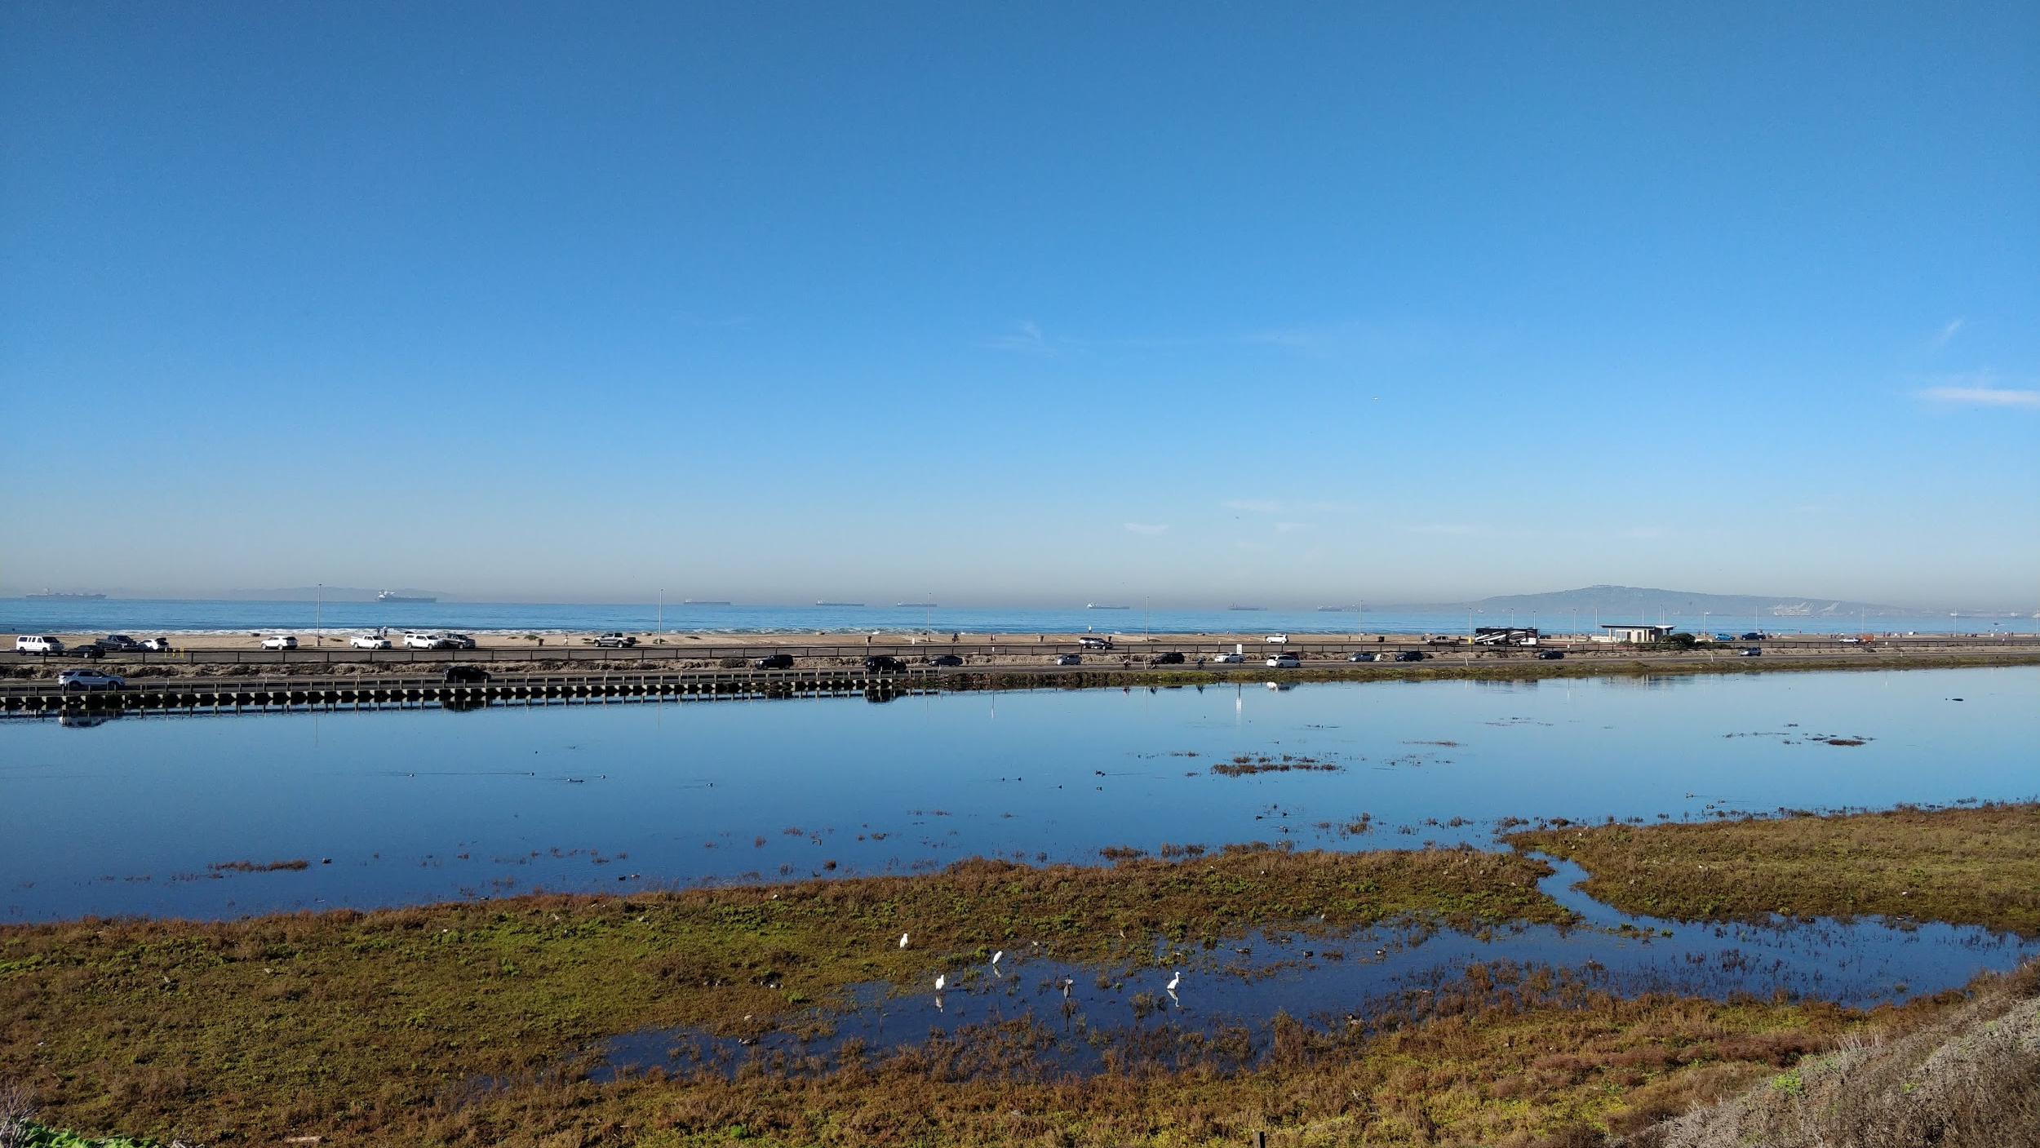
Continuous Learning
Notes:
How can we be at once ignorant schoolmasters and specialists of our field? Well, it requires a focus on the process of learning, of being able to self-start, self-teach, learn from others. This is not to say it’s easy, but it’s a different type of skill or knowledge than knowing everything about the habitat of north american wetland bird species, for example. Academia does focus on the latter, but my argument here is for valuing of other strengths that learning units like ours bring.

Slide 25
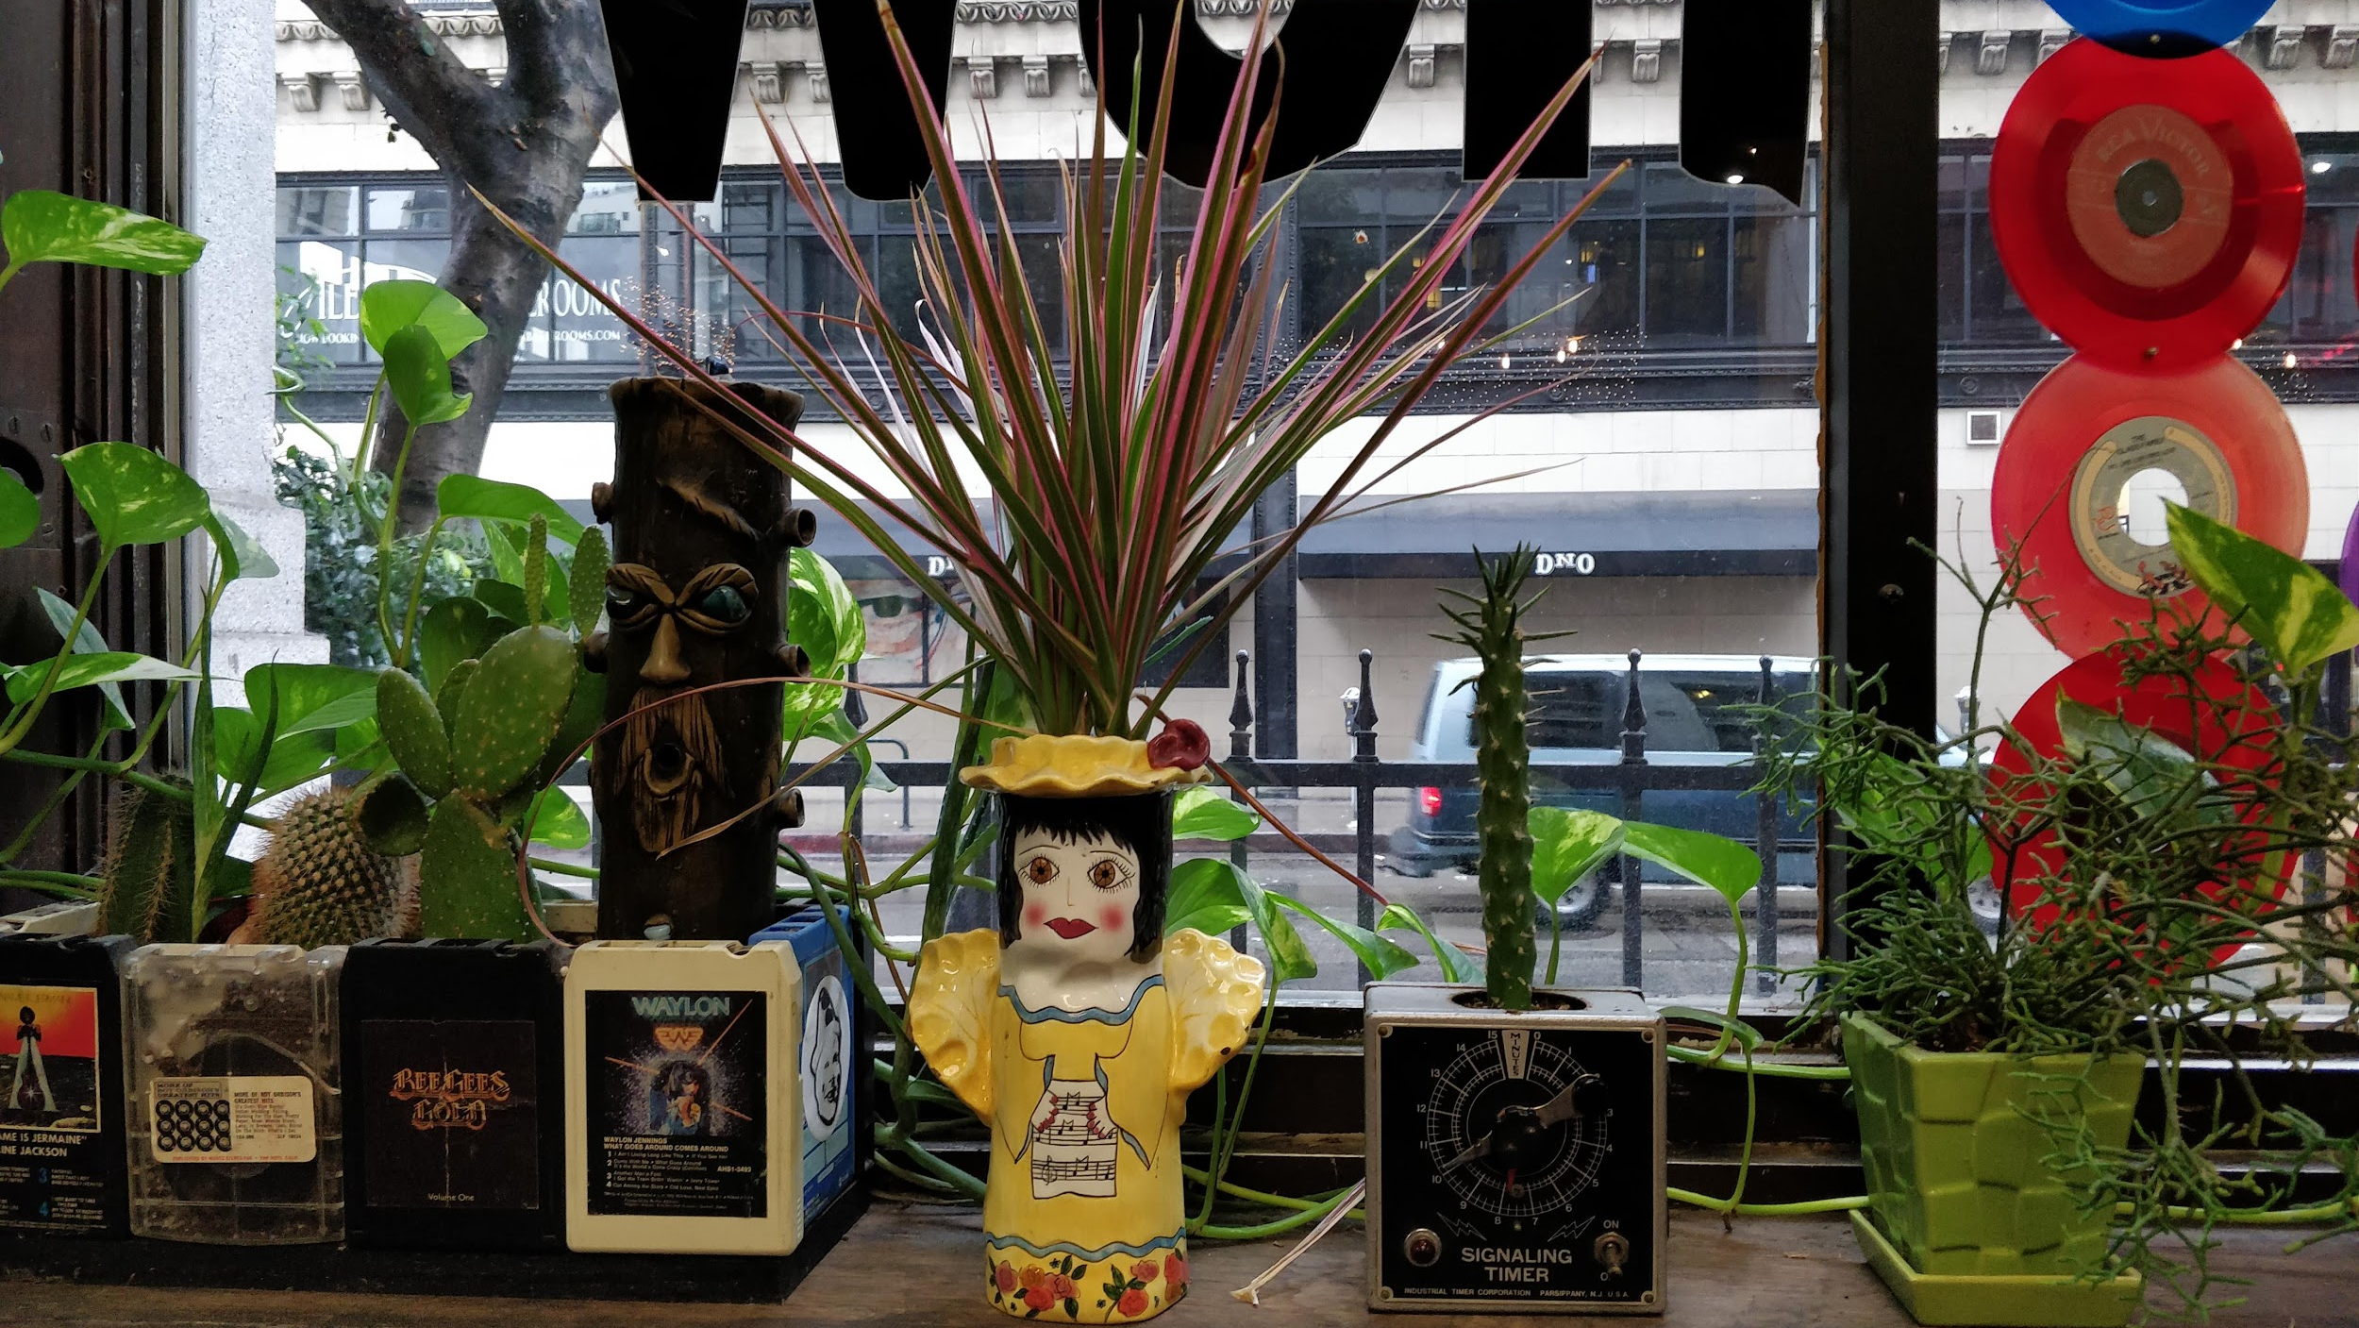
Partnerships
Notes:
Partnerships are not the answer to everything and they are not necessarily easily achieved. They take time and space away from other things, but committing to select ones signals our valuing this approach.
This also means that the kind of service interaction in digital scholarship centers will be different from a “typical” library service desk (if there is one). We don’t always have the answer, we can’t know every tool or software package, but we are committed to learning with our “clients”, to grow and develop projects. Just as software platforms migrate from, say Drupal 7 to 8, so do our strategies for solving the “mapping of migration patterns of 14th century Turkish peoples” need.

Slide 26
Thanks!
lydiaz@ualberta.ca

