Slide 1
Know your rights
What to consider before you submit to a journal and sign a copyright transfer agreement
Jessica Lange | Scholarly Communications Librarian
Alexandra Kohn | Head, Office of Copyright Compliance
Please note that all logos, screenshots and publisher content are used here under fair dealing and do not fall under the terms of the Creative Commons licence
Notes:
SK

Slide 2
Notes on using Zoom
Please turn off your video
Use chat for questions
Will use the raise hand icon or 'thumbs up' (Reactions)
Keyboard shortcut: ALT-Y

Slide 3
Objectives
Identify and compare copyright transfer agreements in academic journals
Evaluate journals based on their author rights agreements
Describe which rights are retained/revoked in these agreements
Determine whether a journal’s policies allow you to comply with the Tri-Agency Open Access Policy on Publications
Notes:
SK

Slide 4
Workshop outline
Copyright 101
Key terms
Sample copyright agreement exercise

Slide 5
Disclaimer
Content in this presentation is provided for informational purposes only and should not be relied on for legal advice
Notes:
SK

Slide 6
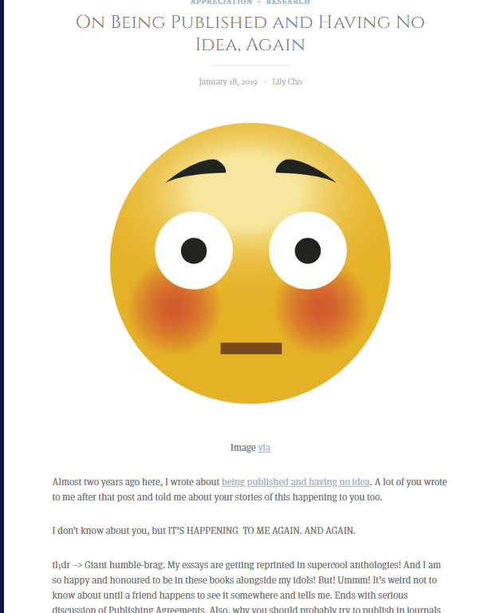
Why?
https://hookandeye.ca/2019/01/18/on-being-published-and-having-no-idea-again/
Notes:
What are copyright transfer agreements?
Why do they matter?
Shifting landscape
Open access movement
Funding requirements
SK
A copyright transfer agreement is a contract you sign with a publisher. It usually entails you signing over copyright to your work (e.g. book, article etc.). Copyright means the right to publish, copy, translate, and distribute the work and the right to authorize others to do so. Basically these transfer agreements mean publishers now have (in many cases) the sole right to publish, translate, and distribute your work. By signing these agreements you are transferring those rights to them and thus no longer maintain those rights yourself.
Copyright agreements vary widely by publisher. It‘s important to be aware of what rights you are tranferring/maintaining when you enter these agreements. For example, many authors are surprised to learn they often no longer have the rights to images/graphs/figures they produced and thus have to request permission from the publisher in order to use them in future works.
Author rights have been a growing subject of debate within the publishing community. With the advent of the open access movement, many journals, particularly open access journals, permit authors to retain their copyrights.
It‘s also important to be aware of any funding agency requirements. Some funding agencies are now requiring the results of grant-funded research to be made open access. Some publisher agreements permit this while others do not.

Slide 7
Why?
“..a couple days ago, a friend wrote to congratulate me on being included in the new Photography Cultures Reader…
I looked up my Taylor and Francis agreements. …I gave T&F the right to republish my articles in any form in any time in the future in any part of the world.”
https://hookandeye.ca/2019/01/18/on-being-published-and-having-no-idea-again/
Notes:
What are copyright transfer agreements?
Why do they matter?
Shifting landscape
Open access movement
Funding requirements
SK
A copyright transfer agreement is a contract you sign with a publisher. It usually entails you signing over copyright to your work (e.g. book, article etc.). Copyright means the right to publish, copy, translate, and distribute the work and the right to authorize others to do so. Basically these transfer agreements mean publishers now have (in many cases) the sole right to publish, translate, and distribute your work. By signing these agreements you are transferring those rights to them and thus no longer maintain those rights yourself.
Copyright agreements vary widely by publisher. It‘s important to be aware of what rights you are tranferring/maintaining when you enter these agreements. For example, many authors are surprised to learn they often no longer have the rights to images/graphs/figures they produced and thus have to request permission from the publisher in order to use them in future works.
Author rights have been a growing subject of debate within the publishing community. With the advent of the open access movement, many journals, particularly open access journals, permit authors to retain their copyrights.
It‘s also important to be aware of any funding agency requirements. Some funding agencies are now requiring the results of grant-funded research to be made open access. Some publisher agreements permit this while others do not.

Slide 8
Why?
“Cunningham and hundreds of his colleagues were recently irked by a takedown notice he received from the American Psychological Association, telling him that the articles he had published through the organization and then posted on his website were in violation of copyright law.”
http://www.insidehighered.com/news/2019/10/23/what-happened-when-professor-was-accused-sharing-his-own-work-his-website

Slide 9
Grant agencies requiring open access
Canadian Institute of Health Research (CIHR)
Social Sciences and Humanities Research Council (SSHRC)
Natural Sciences and Engineering Research (NSERC)
Fonds de Recherche du Québec (FRQ)
…. and more
To find out if a funding agency has an OA policy see: https://v2.sherpa.ac.uk/juliet/

Slide 10
Check-in
?

Slide 11
Copyright 101

Slide 12
Copyright basics: definitions
Copyright is the “the sole right to produce or reproduce the work or any substantial part thereof in any material form whatever”
(Copyright Act R.S.C., 1985, c. C-42)

Slide 13
Exclusive rights of the copyright holder
produce or reproduce the work
perform the work in public
publish the work
translate the work
adapt the work to another format (e.g. novel to film, film to play)
record a literary, dramatic or musical work
broadcast the work
exhibit an artistic work
…..authorize others to do any of the above.

Slide 14
What can I do with my work?
Until (or unless) you transfer or assign your copyright:
Only you have the right to produce or reproduce, publish, translate, modify, record, adapt the work to another format, perform the work in public
… or to authorize anyone else to do these things.

Slide 15
What is a copyright transfer agreement?
¹
¹Right to publish, copy, translate, and distribute the work…and authorize others to do so
Notes:
SK
A copyright transfer agreement is a contract you sign with a publisher. It usually entails you signing over copyright to your work (e.g. book, article etc.). Copyright means the right to publish, copy, translate, and distribute the work and the right to authorize others to do so. Basically these transfer agreements mean publishers now have (in many cases) the sole right to publish, translate, and distribute your work. By signing these agreements you are transferring those rights to them and thus no longer maintain those rights yourself.

Slide 16
What is a copyright transfer agreement?
Notes:
SK
It’s sometimes easier to think of copyright as a bundle of rights. You as author may maintain one ‘slice’ while another component goes to the journal. For example, you may retain the right to republish the article in an edited book but other rights (like translation, electronic distribution etc.) may go to the publisher.
This will vary by publisher. Some agreements will ask for all your copyrights but more commonly, you will get to retain a certain set of rights.

Slide 17
What is a copyright transfer agreement?
Notes:
SK

Slide 18
Raise your hand if you'd like to be able to:
1. Post your article on your website
2. Reuse images from your article in future publications
3. Ensure you meet open access requirements for a grant.
Notes:
SK

Slide 19
Key terms: Versions
Pre-print
Author’s original, submitted version
Author’s accepted manuscript (AAM)
Accepted version
Post-print
Publisher’s final version
Publisher’s PDF
Version of Record (VoR)
Notes:
SK
These are some important definitions to keep in mind when reviewing copyright transfer agreements (CTAs). Often these agreements will stipulate different rights for different versions of your article. Unfortunately, the terms for these versions are not completely standardized across publishers, but most will recognize three distinct versions of the article which correspond to different stages in the publication process.
For example, most CTAs will permit you to post a pre-print of your article to your personal website. However, few will permit this for the publisher PDF.

Slide 20
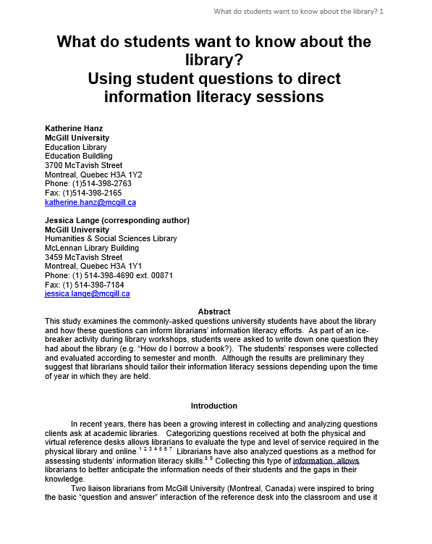
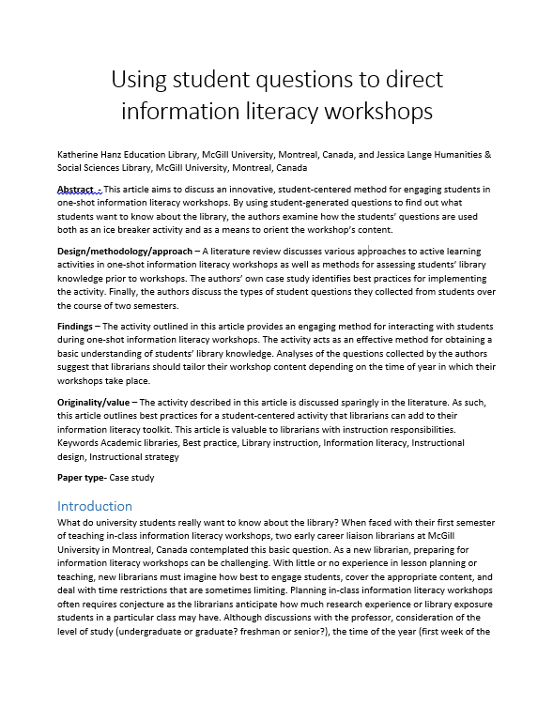
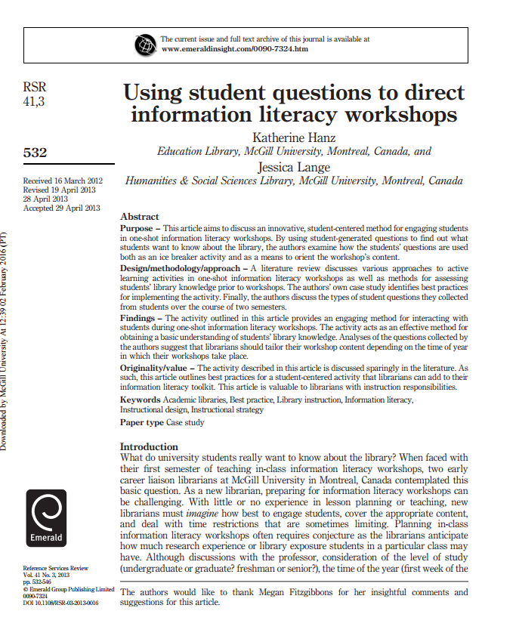
Archive your versions and your author agreements!
Pre-print = Initial submission
Accepted manuscript = Final version without layout
Publisher’s version = Final copy with layout
Notes:
SK

Slide 21
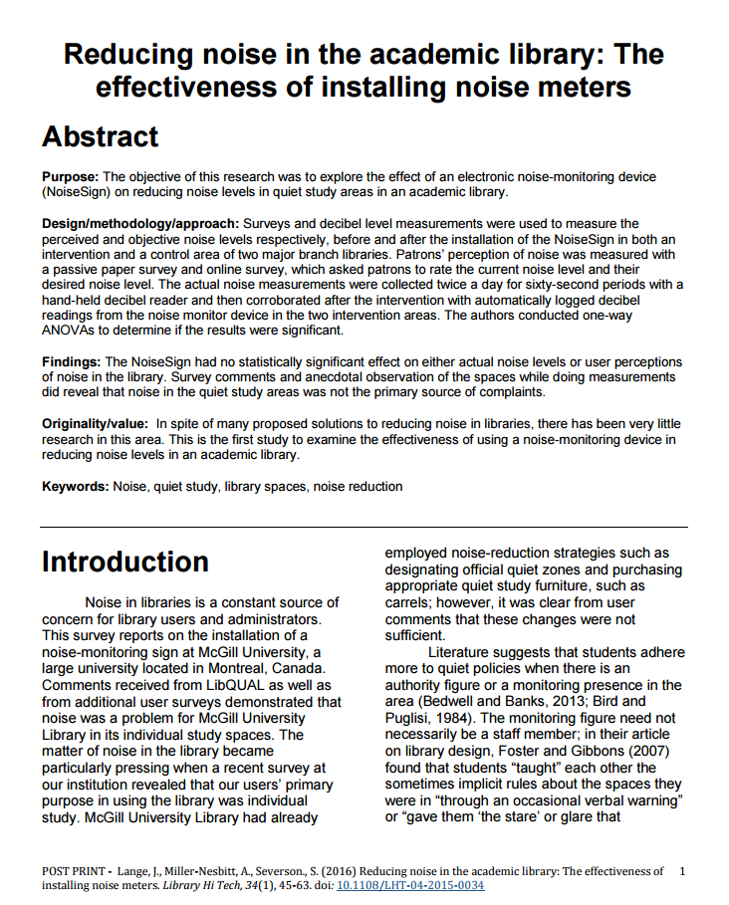
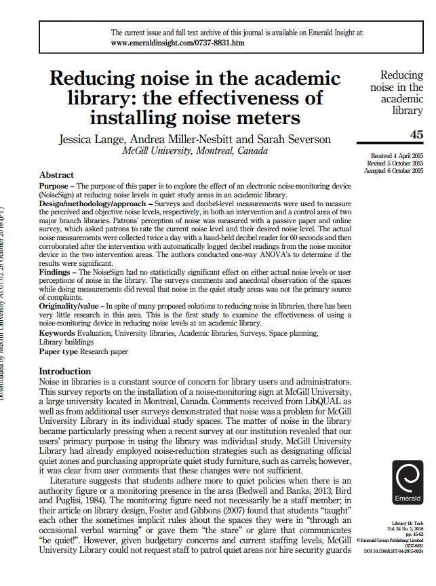
What is an accepted manuscript (cont’d)?
VS
Accepted manuscript
Saved by RESEARCHER
Typically CAN be posted to repositories
Intellectually THE SAME as the publisher version
Publisher’s version
Created by PUBLISHER
Typically CANNOT be posted to repositories
Notes:
SK
Remember to save (and appropriately name) the different versions of your article.

Slide 22
Check-in
?

Slide 23
Key terms: Preprint servers and repositories
Preprint servers
Electronic archive of scholarly content NOT YET PUBLISHED/PEER-REVIEWED
E.g. bioRxiv, MedrXiv
Repositories
Electronic archive of scholarly content
E.g. McGill’s eScholarship

Slide 24
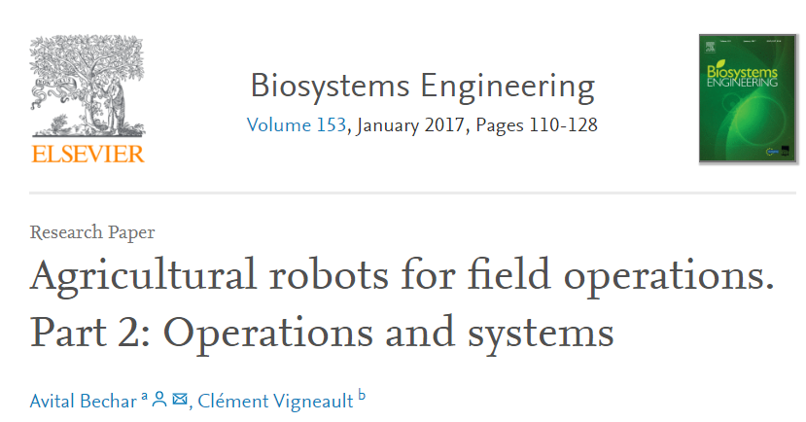
Key terms: Embargos
Embargos
Period of time before something can be released (i.e. delay)
Journal of the Academy of Nutrition & Dietetics (12 months)
Computer and Electronics in Agriculture (24 months)
Journal of Proteome Research (12 months)

Slide 25
Key terms: Assigning vs. licensing
Assignment/transfer
Transfer of some or all of your rights to another party (e.g. a publisher).
License
Permission for another party to use your work under certain conditions
You maintain copyright ownership
Similar to 'selling' an item versus 'renting' it to someone.
Note: In many agreements, you transfer copyright to the publisher and they license certain rights back to you.
Notes:
SK

Slide 26
Key terms: Exclusive vs. non-exclusive license
Example
Exclusive:
Could only publish article with Wiley
Non-exclusive:
Could publish article with multiple different publishers.
Notes:
SK
An exclusive license means the rights that are being given can only be used exclusively by that publisher/person. For example, if you signed an exclusive publishing agreement with Sage, that means you cannot license anyone else to publish your article.
A non-exclusive license is the opposite. You can elect to license those rights to other publishers/persons as well. For example, if you signed a non-exclusive license with Sage to publish your article, you can also license that article to Cambridge.

Slide 27
Non-exclusive license example
McGill thesis license!
I .. grant to McGill University …a non-exclusive, worldwide, irrevocable, royalty free license… in respect of my thesis, to reproduce, convert, publish, archive, preserve, conserve, communicate and distribute…I understand that I retain copyright ownership and moral rights in my thesis.
[emphases added]

Slide 28
Check-in
?

Slide 29
Anatomy of the sample copyright transfer agreement

Slide 30
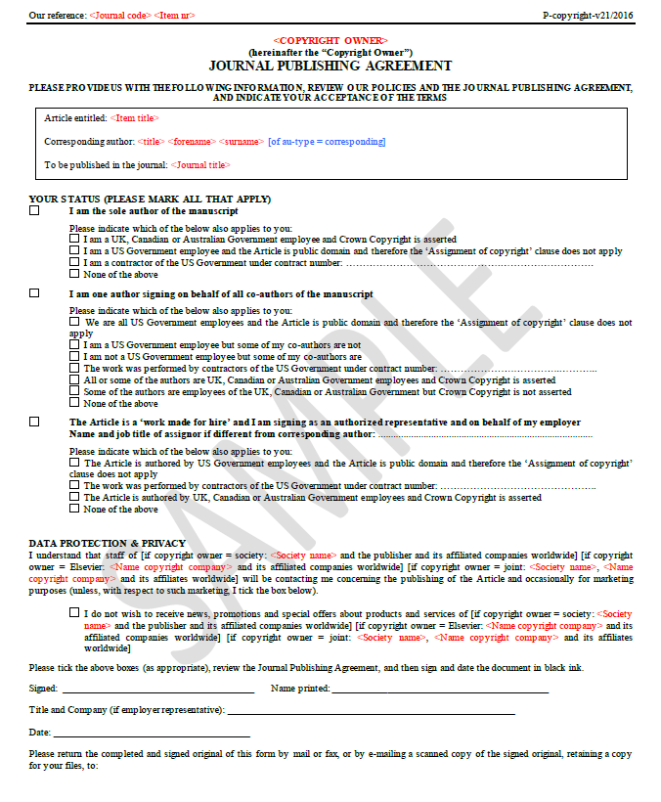
p. 1
Overview of author status and affiliation
Notes:
JL
Page 1 in this case is just going over author status and affiliation. This is included because the work done by U.S. government employees falls under a different set of copyright rules.
Otherwise, this first page isn’t particularly interesting.

Slide 31
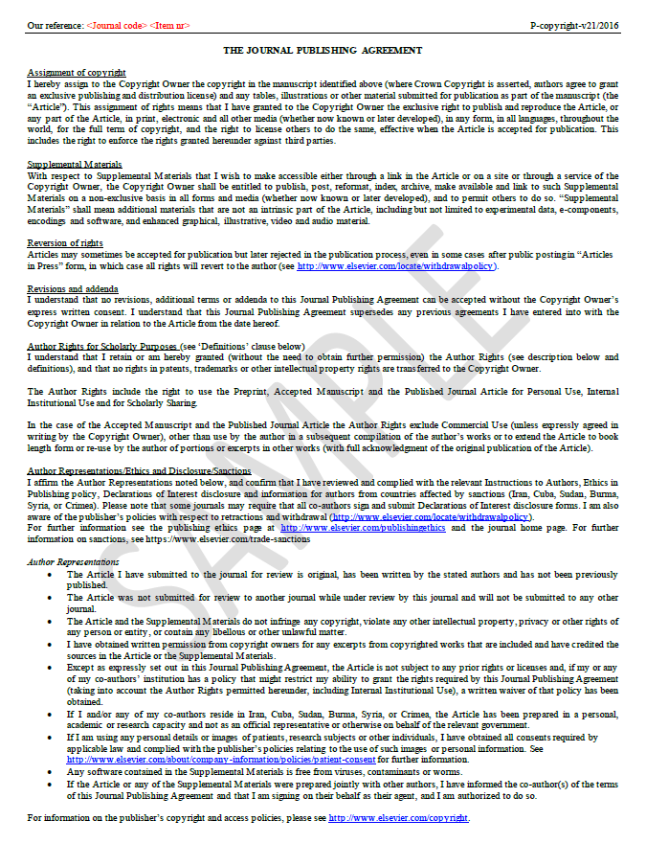
p. 2
Standard copyright assignment
Author representations
Notes:
JL
Page 2 gets more into the nitty gritty of the actual agreement. It includes a fairly standard copyright assignment clause (see Assignment of Copyright). Additionally it includes information on what rights you retain as author ( see Author Rights for Scholarly Purposes).

Slide 32
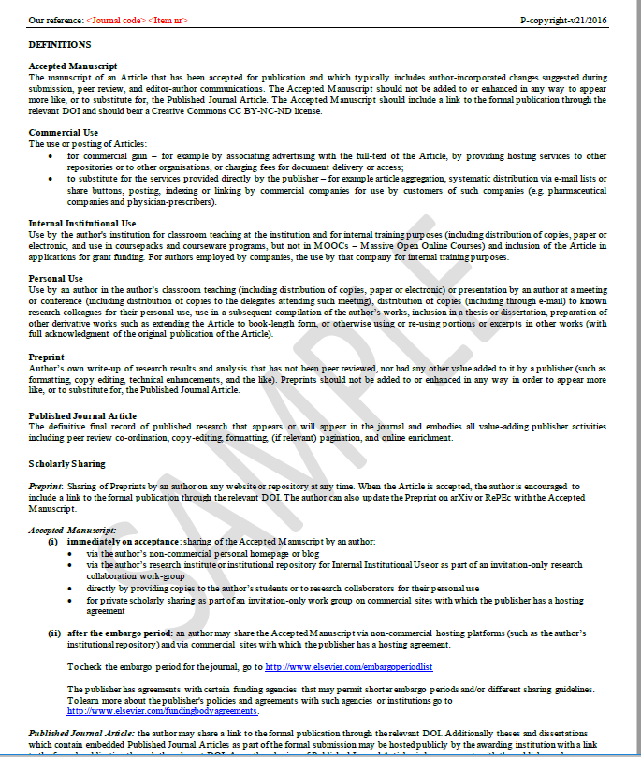
p. 3
Definitions and details of author rights
Tip!
If you see a noun capitalized, that means it should defined somewhere.
(e.g. Personal Use).

Slide 33
Pre-Workshop activity: Copyright Transfer Agreements
Re-review the copyright transfer agreement (previously emailed) (~2-3 minutes)
Highlight anything that’s unclear/confusing
Access and download the agreement here: https://mcgill.ca/x/4wx
Notes:
JL

Slide 34
p.2, 1st paragraph
Assignment of copyright
I hereby assign to the Copyright Owner the copyright in the manuscript identified above (where Crown Copyright is asserted, authors agree to grant an exclusive publishing and distribution license) and any tables, illustrations or other material submitted for publication as part of the manuscript (the “Article”)... I have granted to the Copyright Owner the exclusive right to publish and reproduce the Article, or any part of the Article, in print, electronic and all other media (whether now known or later developed), in any form, in all languages, throughout the world, for the full term of copyright, and the right to license others to do the same, effective when the Article is accepted for publication. This includes the right to enforce the rights granted hereunder against third parties.
Notes:
JL
If we parse the Assignment of copyright section further we see it includes not only the article (aka manuscript) but also any tables, illustrations or other material submitted for publication. The copyright for all these items will now lie with this publisher.
This is also an exclusive license. Meaning you cannot enter into another agreement with another publisher regarding the right to publish and reproduce the article. This also means the publisher now has the right to license your article to other publishers/persons (e.g. license a translation of your work).
Finally, it states that the publisher has the right to enforce any of these rights. So for example, if someone was found to breaking copyright with regards to this article, the publisher could pursue them.

Slide 35
p.2 , 5th paragraph
Author Rights for Scholarly Purposes (see ‘Definitions’ clause below)
I understand that I retain or am hereby granted (without the need to obtain further permission) the Author Rights (see description below and definitions), and that no rights in patents, trademarks or other intellectual property rights are transferred to the Copyright Owner.
The Author Rights include the right to use the Preprint, Accepted Manuscript and the Published Journal Article for Personal Use, Internal Institutional Use and for Scholarly Sharing.
In the case of the Accepted Manuscript and the Published Journal Article the Author Rights exclude Commercial Use (unless expressly agreed in writing by the Copyright Owner), other than use by the author in a subsequent compilation of the author’s works or to extend the Article to book length form or re-use by the author of portions or excerpts in other works (with full acknowledgment of the original publication of the Article).
Notes:
JL
This section outlines what rights are maintained. For example, intellectual property rights remain with the author. Furthermore, the author maintains rights for personal use, internal institutional use and for scholarly sharing (see p.3 for definitions of what those mean). The agreement also permits the author to use the work in a future compilation of the author’s work (provided acknowledge is provided of the original publication).

Slide 36
p.3, 3rd paragraph
Internal Institutional Use
Use by the author's institution for classroom teaching at the institution and for internal training purposes (including distribution of copies, paper or electronic, and use in coursepacks and courseware programs, but not in MOOCs – Massive Open Online Courses) and inclusion of the Article in applications for grant funding. For authors employed by companies, the use by that company for internal training purposes.
Personal Use
Use by an author in the author’s classroom teaching (including distribution of copies, paper or electronic) or presentation by an author at a meeting or conference (including distribution of copies to the delegates attending such meeting), distribution of copies (including through e-mail) to known research colleagues for their personal use, use in a subsequent compilation of the author’s works, inclusion in a thesis or dissertation, preparation of other derivative works such as extending the Article to book-length form, or otherwise using or re-using portions or excerpts in other works (with full acknowledgment of the original publication of the Article).

Slide 37
p.3, 7th paragraph
Scholarly Sharing
Preprint: Sharing of Preprints by an author on any website or repository at any time. When the Article is accepted, the author is encouraged to include a link to the formal publication through the relevant DOI. The author can also update the Preprint on arXiv or RePEc with the Accepted Manuscript.
Accepted Manuscript:
(i) immediately on acceptance: sharing of the Accepted Manuscript by an author:
via the author’s non-commercial personal homepage or blog
via the author’s research institute or institutional repository for Internal Institutional Use or as part of an invitation-only research collaboration work-group
directly by providing copies to the author’s students or to research collaborators for their personal use
for private scholarly sharing as part of an invitation-only work group on commercial sites with which the publisher has a hosting agreement
(ii) after the embargo period: an author may share the Accepted Manuscript via non-commercial hosting platforms (such as the author’s institutional repository) and via commercial sites with which the publisher has a hosting agreement.
...

Slide 38
p.3, 8th paragraph
Published Journal Article: the author may share a link to the formal publication through the relevant DOI. Additionally theses and dissertations which contain embedded Published Journal Articles as part of the formal submission may be hosted publicly by the awarding institution with a link to the formal publication through the relevant DOI.
Any other sharing of Published Journal Articles is by agreement with the publisher only.

Slide 39
According to this agreement, what can you do?
Post to a personal website?
Yes. Any version at any time.
(p. 3 "Scholarly Sharing")
Reuse in a later publication?
Yes. Any version provided you give full acknowledgement.
(p. 3 "Personal Use")
Deposit in a repository?
Yes. But only the pre-print or accepted version. ​
Accepted version after an embargo period. ​
(p.3 "Scholarly Sharing")

Slide 40
According to this agreement, what can you do?
Use in classroom teaching?
Yes. Any version. But not for MOOCs.
(p. 3 "Internal Institutional Use")
Include in funding applications?
Yes. Any version.
(p.3 "Internal Institutional Use")
Post to ResearchGate?
Yes for preprint.
-No for accepted or publisher version
-Prohibits commercial use for these versions.
(p. 3 "Commercial Use")

Slide 41
Summary
Permitted uses | Pre-print | Post-Print/Accepted manuscript | Publisher PDF | Conditions
Post to personal website | YES | YES | NO | Immediately; link to final publication (DOI) and have license CC BY NC ND
Reuse in a later publication (e.g. edited book) | YES | YES | YES | Provide full acknowledge of original publication.
Deposit in a repository | YES | YES | NO | Immediately for preprint; after embargo period for post-print; link to final publication (DOI) and have license CC BY NC ND; should not be enhanced to look like publisher version
Classroom teaching and internal distribution | YES | YES | YES | Not for MOOCs; paper or electronic distribution permitted to known colleagues
Include in fellowship applications | YES | YES | YES
Post to social networking site (e.g. ResearchGate) | Unclear/Yes | NO | NO | Prohibits commercial use for post-print and publisher version
Notes:
JL

Slide 42
Check-in
?

Slide 43
Lots of variation
“Contributors may re-use figures, tables, artwork, and selected text up to 250 words from their Contributions” (Wiley)
“..agreement..does not allow full articles to be posted on SSRN, or other such commercial networks.”(Cambridge University Press)
“…you agree to have the CC BY license applied to your work…you as the author agree that anyone can reuse your article... even for commercial purposes. Anyone may copy, distribute, or reuse the content as long as the author and original source are properly cited” (PLOS)
Notes:
JL
There’s no “standard” copyright transfer agreement although often you’ll see similar language. However, rights of the author vary publisher to publisher and the agreements often change so it’s important to keep track of what you sign.

Slide 44
Publisher Websites
How can I know the policies before I submit?
Sherpa/Romeo
Database of publisher policies
https://v2.sherpa.ac.uk/romeo/
Tip! Includes links to the relevant materials on the publisher websites.
Publisher website
See Sections:
Copyright
Author guidelines
Permissions
Author services
Submission guidelines
Instructions for authors
Etc.
Notes:
JL
There’s lots of resources to help you understand publisher policies. SHERPA/ROMEO is a handy tool for understand publisher’s self-archiving policies (i.e. the right to post your article/work to a repository or website). Note however it doesn’t look at the full suite of rights - just those specific to self-archiving. This tool is handy if you’ve received funding that has an open access requirement.
Otherwise, the publisher’s website is the best source of information. Locating the copyright agreement information can be tricky sometimes. Depending on the publisher it will appear in various sections (as listed above). You can also always write the editor or the journal publisher if you have questions.

Slide 45
Compliance with Tri-Agency Open Access policy
Grant recipients are required to have their peer-reviewed journal publications freely accessible online within 12 months of publication.
Accepted manuscript or publisher version
All 3 agencies (SSHRC, NSERC, CIHR)
Grants awarded after May 1, 2015
For CIHR, policy applies to grants awarded January 1, 2008
http://www.science.gc.ca/eic/site/063.nsf/eng/h_F6765465.html?OpenDocument

Slide 46
Compliance with FRQ Open Access policy
Grant recipients are required to have their peer-reviewed journal publications freely accessible online within 12 months of publication.
Grants awarded after April 1, 2019
Applies to all peer-reviewed article publications
Applies to student grants
http://www.frqsc.gouv.qc.ca/en/science-ouverte
Notes:
JL

Slide 47
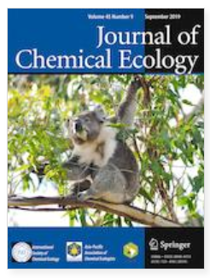
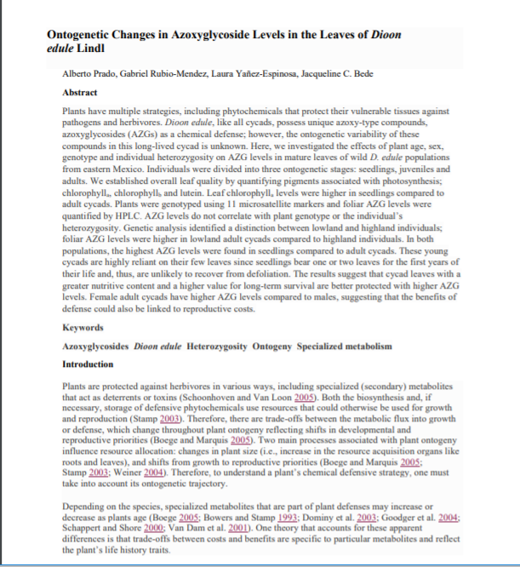
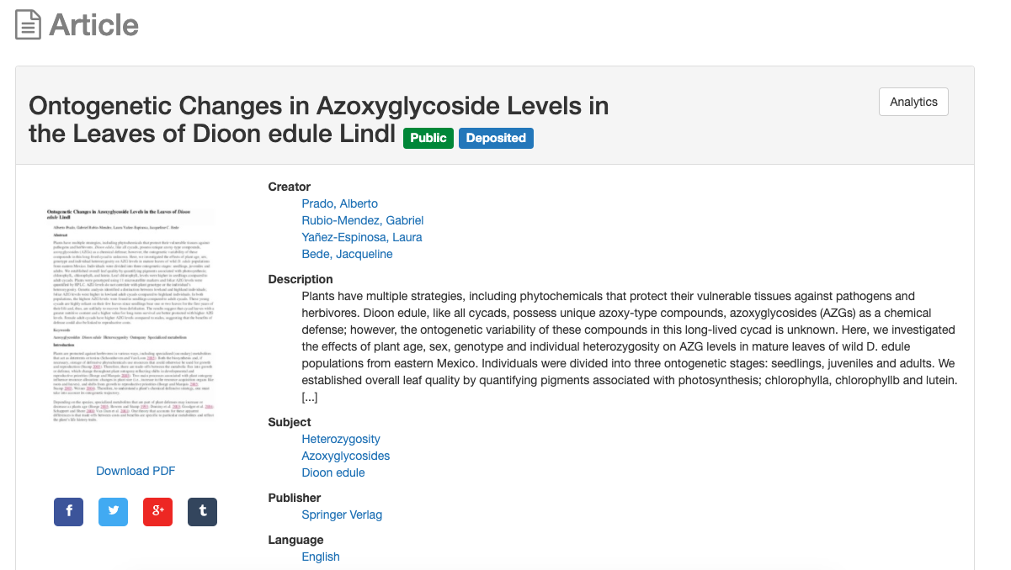
Option 1: Deposit in a repository
Example:
You publish in Journal of Chemical Ecology.
Email accepted manuscript to escholarship.library@mcgill.ca
A copy lives in the repository (after 12 month delay/embargo)
Notes:
JL

Slide 48
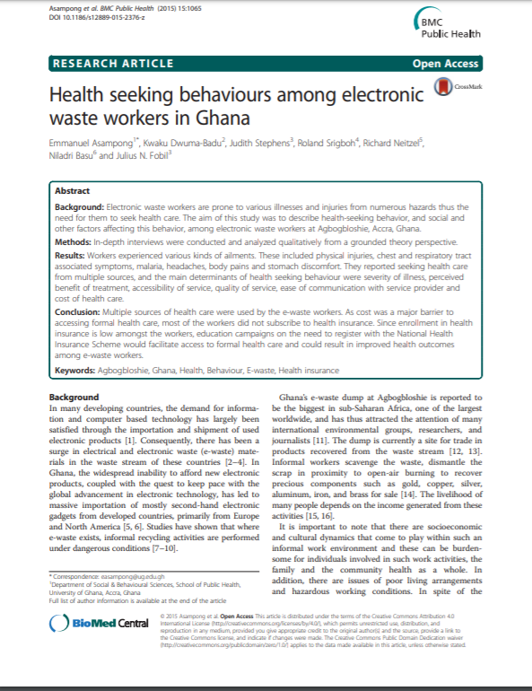
Option 2: Publish in an open access journal
Example:
You publish in BMC Public Health
Pay $2390 APC (USD)
Article is now freely available to everyone on the journal’s website.
See list of APC discounts available through the Library here:
https://www.mcgill.ca/library/services/open-access/how#apc
Notes:
JL

Slide 49
Negotiation tips
Determine what matters to you
E.g. Reusing images; depositing in a repository, etc.
Engage in back and forth with publisher/ editor
Send an email ; provide an addendum ; strike out material, etc.
Same as negotiating for any other matter
e.g. mortgage, car etc.
Negotiation Resources
Arizona State Negotiation Guide
SPARC author addendum
Science Commons sample addendums
Quilter, Laura, "2I Negotiating Author Agreements" (2015). New England Copyright Boot Camp. Paper 14. http://scholarworks.umass.edu/cbc/14
Notes:
JL
Negotiating these contracts is an option although it’s perhaps more common if you’re publishing a book than an article. If you’re interested in trying to engage with the publisher the above resources and tips are available to you.

Slide 50
See the guide! http://libraryguides.mcgill.ca/authorrights

Slide 51
FAQs
The lead author signed the agreement without telling me about the license conditions. Am I bound to those conditions?
What if I want to do something that’s not permitted by my agreement?
What if the copyright transfer agreement doesn’t match what’s on the publisher’s website?
What happens if I breach the agreement?

Slide 52
Questions?

Slide 53
Feedback https://mcgill.ca/x/4SE

Slide 54
Contact
Notes:
We are both available if you have any additional questions. We are very happy to review any copyright agreements or assist you in determining a publisher’s/journal’s policies.

Slide 55
Image Credits
Resume by Nicholas Menghini from the Noun Project: https://thenounproject.com/
student by Mourad Mokrane from the Noun Project: https://thenounproject.com/

