Slide 1
Re-engaging Canadians with fair dealing: Fandom as stepping stone to copyright literacy
Rebecca katz
Phd candidate, mcgill university school of information studies

Slide 2
Contents
1. Definitions
2. Typical hypothetical
3. Background: stakeholder copyright myths, norms, concerns
4. Lessons from fans: fan-tastic copyright myths and where to find them
5. Laying the ghosts of copyright myths – for fans or students
6. Takeaway: thoughts for what a ‘Copyright 101’ workshop might look like

Slide 3
Defining terms
Remix culture: “the taking of “cultural artifacts [to] combine and manipulate them into new kinds of creative blends” (Knobel, Lankshear, 2008, p. 22).
Fanfiction: stories “based on any identifiable segment of popular culture” (Tushnet, 1997), typically shared in amateur, non-profit online fan sites.
Fandom: the underlying source text inspiring fan fiction, and the ensemble of fan sites, works, and communities around that text.
Fair dealing: an essential part of Canadian copyright, by which certain dealings with works are not infringement provided they 1) are done for a statutory purpose, and 2) are deemed fair based on a list of criteria.

Slide 4
Typical hypothetical
Your start-up has just released a successful video game, which has inspired a devoted fandom. Some fans create custom content, such as new skins for characters and in-game objects. Some of this content clearly ‘mashes up’ your game with other franchises (such as character skins that depict Star Wars costumes). Some custom content creators sell these items, while other fans offer them for free and criticize those trying to sell and profit from them. You are flattered by the fan engagement. However, while you want to keep your fans happy, you also want to develop and sell official sequels or expansion packs and avoid complaints from other IP owners.
What issues should you consider?
Where can you learn about them?
What do you do?
Notes:
Take 2 minutes to discuss.

Slide 5
Typical hypothetical
What is the point of this sort of hypothetical?
Consider ALL of legal, ethical, practical issues
Recognize how common practices interact with multiple copyright issues
Recall and apply fair dealing analysis, UGC exemption
Review sources of copyright law, where law is written and where to go to enhance your understanding
Notes:
- May have different levels of success – even Master’s students, for example, sometimes struggle with that ‘where’ question, i.e., thinking of all possible legal sources plus secondary sources

Slide 6
Typical hypothetical
In general: Why use fandom as a stepping stone?
Hopefully fun, ‘relatable’ to students
Every day practice demonstrates how nuanced and messy law is – “it depends!”
Also problematizes:
Common copyright assumptions e.g. credit and profit, and
Power differentials which can influence copyright in practice

Slide 7
Background: stakeholder copyright myths, norms, concerns
Are there myths common to different amateur copyright stakeholders?
Such myths could be useful to tackle in ‘Copyright 101’ or ‘Fair Dealing 101’

Slide 8
Background: stakeholder copyright myths, norms, concerns
Academic stakeholders have variable copyright knowledge:
Canadians underrepresented in literature (DiValentino, 2016, on faculty)
E.g., confusion with plagiarism; varied by field (NUS, 2013)
Fair use myths, copyright stress, varied info sources (Hobbs et al, 2007)
Students need a ‘stake’? (Folk-Farber, 2016; NUS, 2013, however, found copyright considered important to future careers)
‘Local’ information sources may be prevalent, but some primary ones (Hobbs et al, 2007; NUS, 2013; DiValentino, 2016)

Slide 9
Background: stakeholder copyright myths, norms, concerns
Are fans/remixers similar to academics? Some overlap:
Again, research underrepresents Canadians
Some empirical work with fans, other remixers: share intuitions, misconceptions & turn to each other & community norms (Fiesler, Bruckman, 2014; Fiesler et al, 2014; Fiesler et al, 2015)
Freund (2014) investigated fan vidders’ copyright literacy and experiences, finding baseline knowledge of fair use, often imported from professional lives
Thomson (2013) found heuristics and norms helpful to remixers
Notes:
Some suggestions that misinformation circulates in fan spaces (Fiesler and collaborators), that knowledge of copyright and fair use varies.

Slide 10
Lessons from fans: fan-tastic copyright myths and where to find them
Why use fandom as stepping stone to fair dealing literacy?
1) Fanfiction arguably growing (see e.g. De Kosnick, 2016) – and overlap between fans and other roles: we could be anywhere, even in your class
2) Myths found among fans may be common to students:
Disengagement from law: sense of safety, difficulty with legal sources
Some curiosity about law, but does not always outweigh above
Canadians do not know Canadian law; it is dwarfed by US

Slide 11
Lessons from fans: fan-tastic copyright myths and where to find them
“I don't know what the laws are and I don't honestly care all that much. […] Head in the sand.” (EW)
“I am hiding in the herd, is what I'm doing. I figure the herd is very large and I am very small and am hoping that I will go unnoticed” (CH)
“Until [head writer of TV show] comes knocking at my door and says cut it out, I'll continue to not really think too much about that aspect of it” (SD)

Slide 12
Lessons from fans: fan-tastic copyright myths and where to find them
Q: Are you familiar with fair dealing?
“I've heard fair use a lot more than fair dealing. […] Fair use has come up often either at work or in my little research sprees about copyright and fandom and stuff” (~SA)
“Not actively. No. I have not.” (~EW)
“Fair use or fair dealings would be being able to use it - In a certain way, I guess” (AM)
Notes:
Even well-educated fans with relevant professional experience, in Canadian libraries, academia, still more familiar with fair use than fair dealing.

Slide 13
Lessons from fans: fan-tastic copyright myths and where to find them
Copyright norms, ethical intuitions – not always wrong, but not always accurate
Profit or lack thereof most important?
Credit, plagiarism = copyright?
No ‘amateur’ ownership of or stake in copyright

Slide 14
L Lessons from fans: fan-tastic copyright myths and where to find them
“Copyright is people owning […] I think it's maybe different than intellectual property or […] a subtype of intellectual property rights where people own published text that they have produced themselves…” (EW)
“Copyright I guess [is] like plagiarism and, you know, stealing another creator's characters and stealing their plots and ideas […] I mean stealing if you make money from it…” (Interviewee SD)

Slide 15
Lessons from fans: fan-tastic copyright myths and where to find them
Q: How would you get a copyright?
“I guess if you're published? […] With original characters […] I would assume it has something to do with publishing, but I don't know” (SD)
“My publisher did it for me so I don't know. I think maybe you automatically have copyright over a text that you produce unless you sell it or give it away or otherwise divest yourself of it” (EW)

Slide 16
Lessons from fans: fan-tastic copyright myths and where to find them
Q: Can fans own copyright in all or some of their fanfiction stories?
“I feel like [I put] a lot of work into my fanfictions […] but I guess […] I can't really claim any ownership of it ” (SD)

Slide 17
Lessons from fans: fan-tastic copyright myths and where to find them
“I'd have to see a notary, I think? But I'm guessing right now […] I don't actually know. […] Someone had basically stolen [my friend’s] entire video and posted it. But it was a YouTube video and he didn't own a copyright for it because he's just like a small time creator guy that didn't sign any documents or whatever…” (SA, on getting a copyright and fan ownership)
Notes:
These misconceptions seem to be typical of fans and other members of the public:
1) low awareness of what, precisely, copyright is, how to distinguish from plagiarism or IP generally; imprecise understanding;
2) low awareness of how to get a copyright – or who or what might be protected

Slide 18
Lessons from fans: fan-tastic copyright myths and where to find them
Remember, myths found among fans and academic stakeholders:
Misconceptions abound – not always wrong (Graveline, 2010), but lack nuance
Varied motivation to learn; Folk-Farber (2016) suggests students apathetic toward copyright when it seems irrelevant
Librarians, institutional policies (“local sources”) common sources of copyright knowledge for academics (DiValentino, 2016)
Noting parallel myths, assumptions, motivations can inform copyright pedagogy – “Copyright and Fair Dealing 101”
Notes:
These parallel assumptions, misconceptions, motivations or lack thereof relevant to fans AND academics – and help inform copyright and fair dealing engagement in the academic context.

Slide 19
Laying the ghosts of copyright myths
Myth 1: no stake; “Why should I care?”
Popular culture is helpful, accessible to all
Make stakes clear – and there are multiple stakes:
E.g., consumers, commenters on pop culture – maybe even remixers
Academic stakes – not JUST risk of infringement, but also creating own works
Yes, you can own copyright without bureaucracy
Monetary impact on education? Time permitting

Slide 20
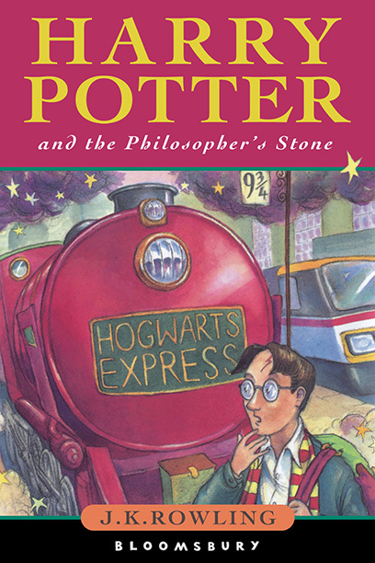
Laying the ghosts of copyright myths
Copyright pedagogy with fluffy clouds
Photocopy & sell cheaper editions?
Retype & post word-for-word to my blog?
Translate to a new language?
Cut up and use in crafts to sell on Etsy?
Write a story about a kid with special powers & their adventures?
Figure 1. Harry Potter book cover (EW, 2018)
Sell t-shirts with the Warner Brothers Harry Potter logo?
Make into a videogame?
Notes:
So, the fluffy cloud diagram is amusing and should drive home the point that – contrary to popular belief – you do have an investment in copyright.
Also, this is an active learning tool that, when shown at start of a class or workshop, gets people thinking about 1) what they already know; 2) what seems moral or intuitive; 3) what practices they see in the wild.
When I have time to address the public domain, I do a similar fluffy cloud diagram for Dracula – so, if you have more time, comparing it with an “old” work that students may see many adaptations of can also be helpful.

Slide 21
Laying the ghosts of copyright myths
Myth 2: No distinction between copyright, IP, plagiarism…
Myth 2.1: Need to clarify legal issue versus academic offense of plagiarism, inadequate credit, passing off
Examples/solutions helpful? E.g., credit a solution to plagiarism but not a copyright/fair dealing issue

Slide 22
Laying the ghosts of copyright myths
Myth 2.2: no distinction between copyright, IP, plagiarism…
Easy compared to distinguishing plagiarism!
Build categorical thinking in explaining IP versus copyright

Slide 23
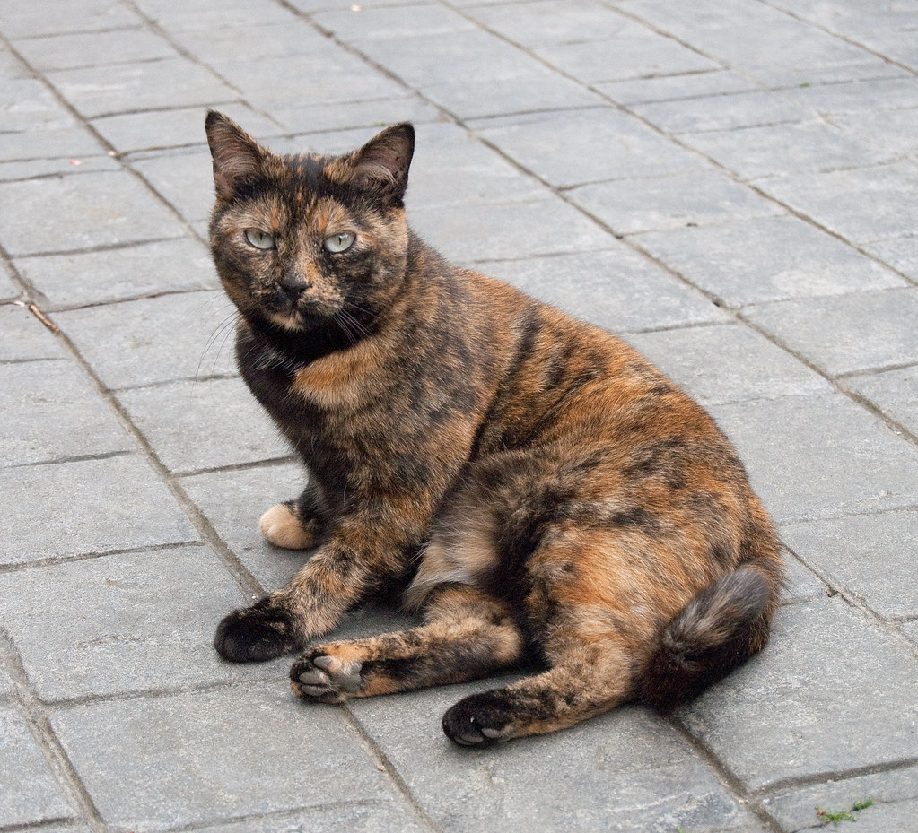
Laying the ghosts of copyright myths
Copyright pedagogy with cute animals: first slide in the Powerpoint Intellectual Property and Copyright.
(… “IP and Copyright” is a bit like saying “Pets and Cats”, or “Dogs and Scotties”)
"Asgard" by O'Colan is licensed under CC BY-ND 2.0
"Cat" by nembow is licensed under CC BY-NC 2.0
Notes:
My first slide in the Powerpoint Intellectual Property and Copyright, GLIS 690 Information Policy, September 2019.

Slide 24
Laying the ghosts of copyright myths
Myth 3: Everything is fair use; everything is American
Distinguish Canadian, US law (but US services may be under US law)
Mention our Copyright Act, distinct court system that interprets and makes laws (e.g., fair dealing test)

Slide 25
Laying the ghosts of copyright myths
Helpful to explain fair dealing in charts…
Allowable statutory purpose from Act?
Fair on balance of factors, then yes, fair dealing
No: not fair
Yes: Consider factors
No? Then not fair dealing

Slide 26
Laying the ghosts of copyright myths
0. Copyright Act-approved purpose? | Research, private study, education, parody/satire, criticism/review, news?
1. Purpose of dealing? | See stage 0; also, commercial or non-commercial (more likely fair)?
2. Character? | How work deal with? Typical practices/norms?
3. Amount? | How much copied?
4. Alternatives? | Practical ones available to achieve goal?
5. Nature of work? | Fact or fiction, published or unpublished?
6. Effect on work? | Likely to compete?

Slide 27
Laying the ghosts of copyright myths
Myth 4: is profit everything in a copyright analysis?
Basic fair dealing literacy should highlight that no, it is only one factor
Non-commercial dealings may have a stronger case, but analysis is more nuanced than that!

Slide 28
Takeaway: thoughts for what a ‘Copyright 101’ workshop might look like
I ask my students “what, where, why do we care?” to assess understanding and sense of ‘stakes’… Helpful structure onto which to build myths and realities?
Copyright and fair dealing principles – what? (Could distinguish copyright from IP, plagiarism)
The big copyright law sources in Canada – where? (Also distinguishes from US)
Context – why do we care? (Engage existing knowledge, stakes)
Hypotheticals/fact-patterns
Notes:
What might a brief explanation of each of these, geared toward students, look like/include? What would you highlight?

