Slide 1
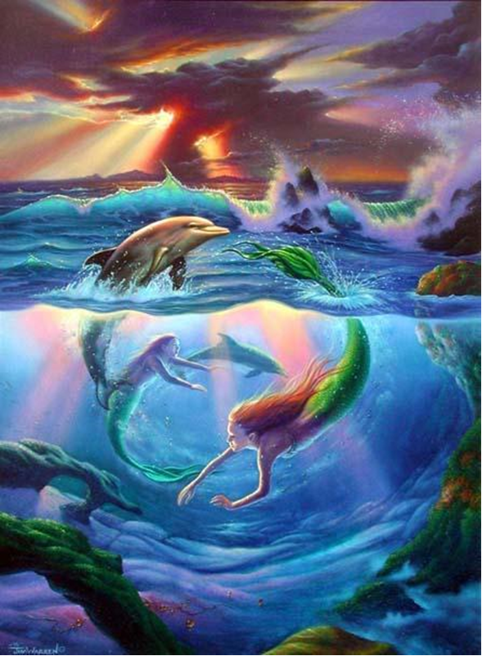
Mer-Human
By Anna Wilson
Adapted from: Hans Christen Anderson's The Little Mermaid
.
Murals Your Way. Retreived From http://www.muralsyourway.com/
Notes:
Murals Your Way. Retreived From http://www.muralsyourway.com/
https://www.pinterest.com/pin/448882287834345559/

Slide 2
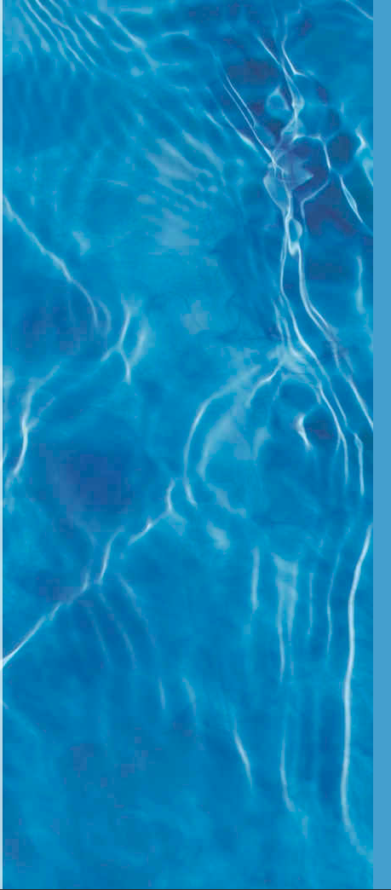
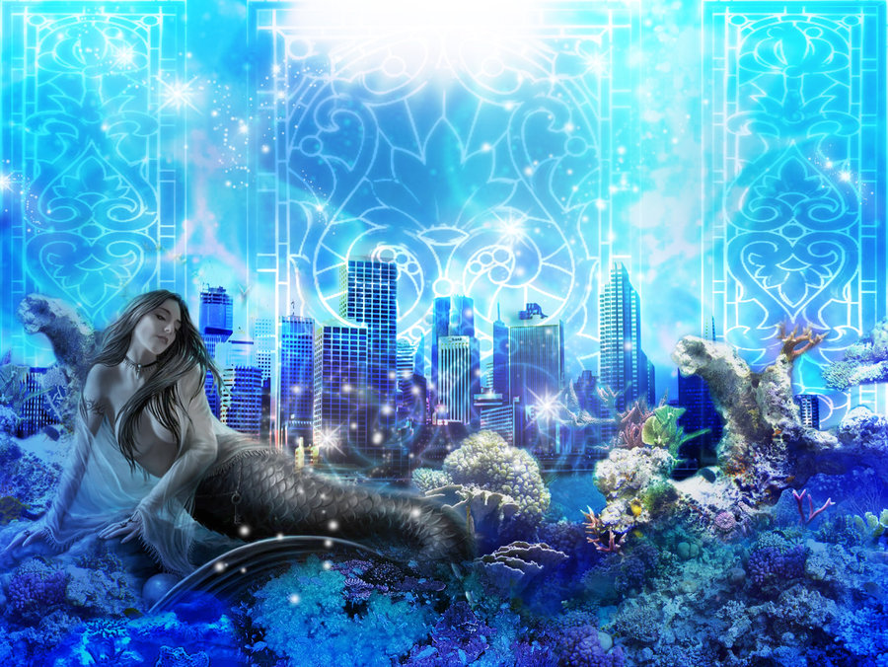
Once upon a time deep in the ocean there was a beautiful mermaid named Anahita. Anahita was the Persian goddess of fertility and water. She had magical powers and the wonders of the sea always surrounded her. Her tail was bright and shimmery, and she loved to play at the surface when the moon rises. Sailors and mermen, flocked to her for her incomparable inner and outer beauty. Although she loved the ocean, Anahita longed to be a human so she could marry the not-so happy Prince Saponi and learn how to become a great warrior princess.
Anahita - Behind the Name www.behindthename.com/name/anahita
http://cakes-and-tarts.deviantart.com/art/Underwater-Fiasco-244880446
Notes:
Mer-human
Once upon a time deep in the Pacific Ocean there was a beautiful mermaid named Anahita. Anahita was the Persian goddess of fertility and water. She had magical powers and the wonders of the sea always surrounded her. Her tail was bright and shimmery, and she loved to play at the surface when the moon rises. Sailors and mermen, flocked to her for her incomparable inner and outer beauty. Although she loved the ocean, Anahita longed to be a human so she could marry the not-so happy Prince Saponi and learn how to become a great warrior princess.

Slide 3
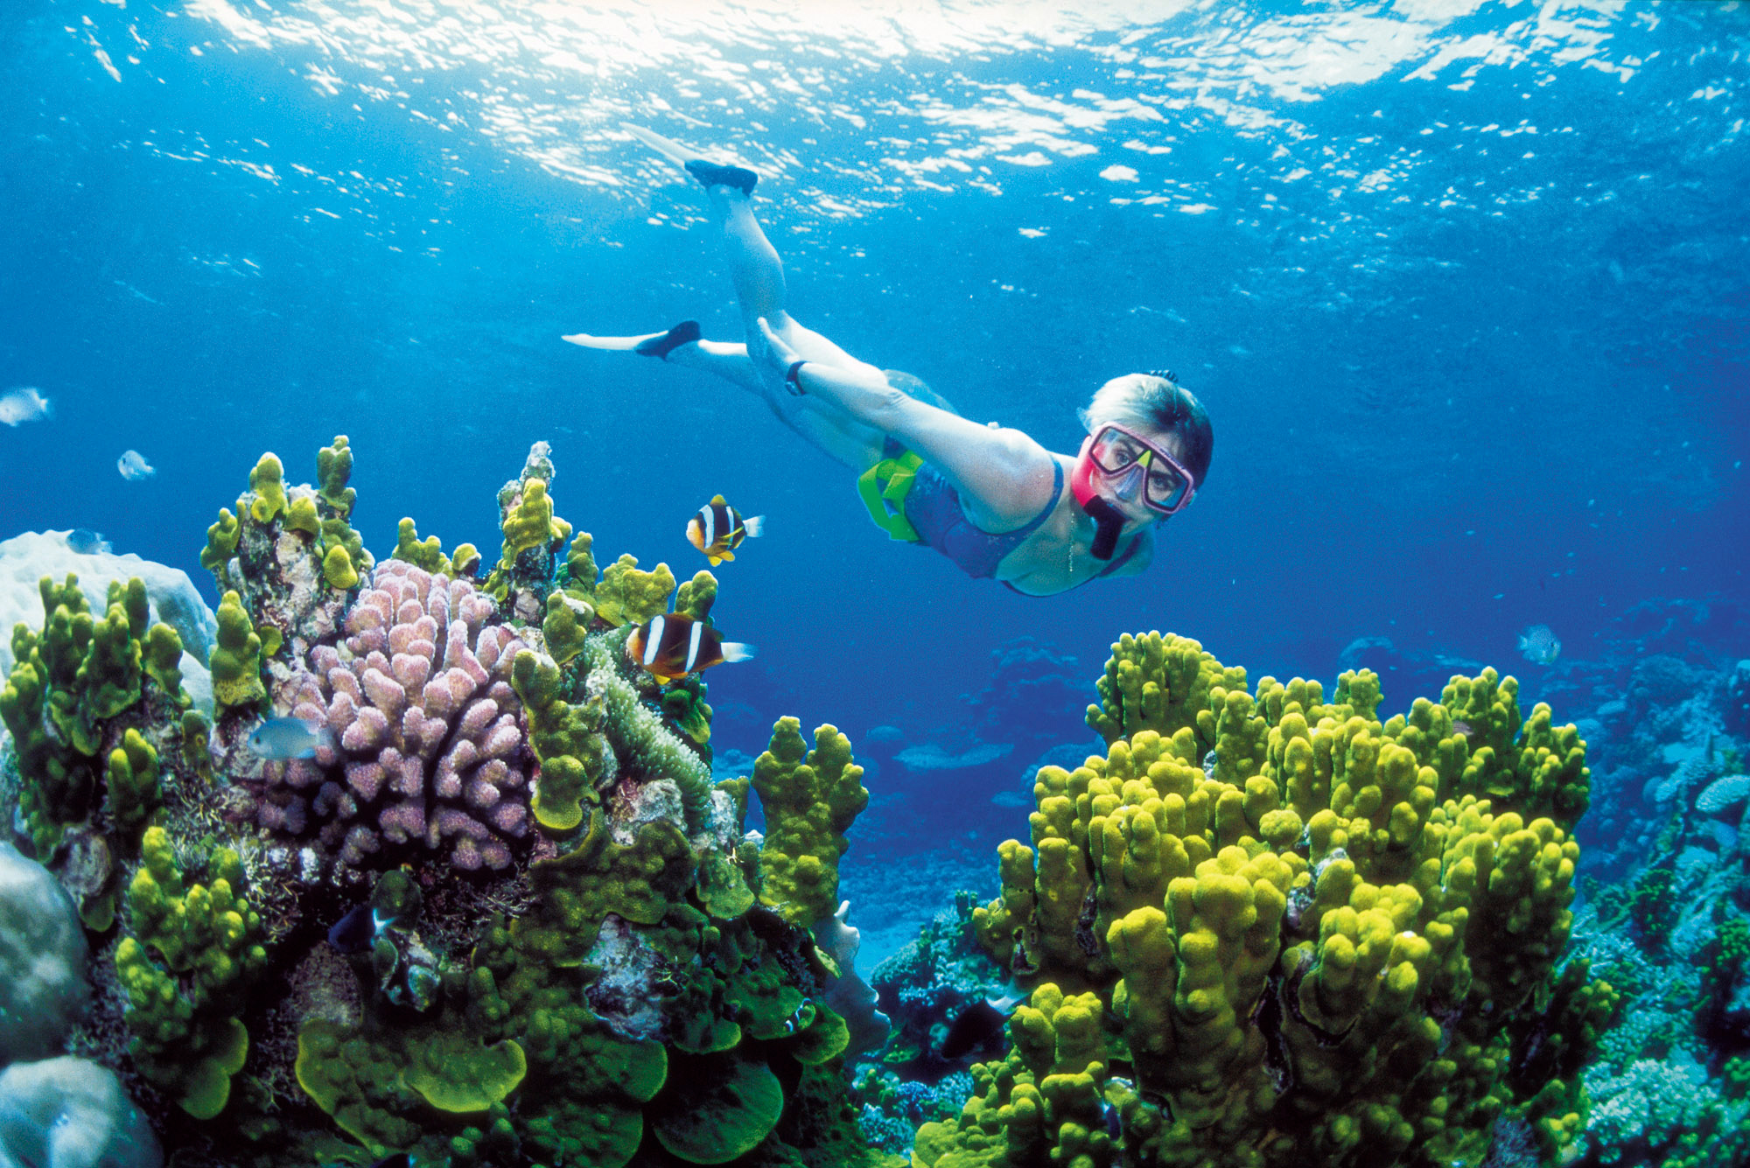
While this beautiful young enchanted mermaid dreamed of life on land. Merhuman, a woman with a disability dreamed of being a mermaid, because she a strong swimmer. As she stood by the ocean and peered at her reflection, Anahita was sound-bound by her heartbeat vibrations yearning for her wishes. She hoped that King Triton could allow Merhuman and she to trade places but to give her Mer-human’s legs before she became ill so she could have her mermaid tale. Anahita would teach her how to save the ocean wildlife from pollution.
Photo Credit (Cousteau, 1979, p. 9)
Notes:
While this beautiful young enchanted mermaid dreamed of life on land. Merhuman, a woman with a disability dreamed of being a mermaid, because she a strong swimmer. As she stood by the ocean and peered at her reflection, Anahita saw her and heard her wishes through the beating of their hearts. She hoped that King Triton could allow Merhuman and she to trade places but to give her Merhuman’s legs before she became ill so she could have her mermaid tale. Anahita would teach her how to save the ocean wildlife from the evil oil tankers and pollution.
jacques cousteau the ocean world

Slide 4
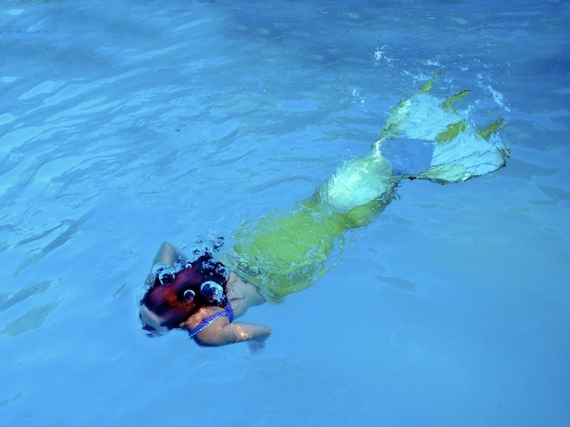
Anahita wrote a letter to King Triton, beseeching him of her wishes:
Dear King Triton
I am a good mermaid. Although my evil sister always tries to bring me down she never wins because I am committed to kindness. I work hard not to hurt anyone's feelings and I try to look out for others by taking care of the ocean and sea creatures, like my own children. I pray that you can help me to trade places with Merhuman but to give me Merhuman’s legs before she became ill so she could have her mermaid tale. I promise to teach her how to save the ocean wildlife from pollution.
Image Credit: http://rcdg.deviantart.com/art/Mermaid-Shepherd-68985081
Notes:
Anahita wrote a letter to King Triton, beseeching him of her wishes:
Dear King Triton
I am a good mermaid. Although my evil sister always tries to bring me down she never wins because I am committed to kindness. I work hard not to hurt anyone's feelings and I try to look out for others by taking care of the ocean and sea creatures, like my own children. I pray that you can help me to trade places with Merhuman but to give me Merhuman’s legs before she became ill so she could have her mermaid tale. I promise to teach her how to save the ocean wildlife from the evil oil tankers and pollution.

Slide 5
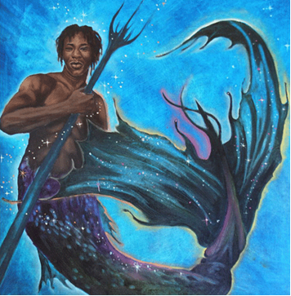
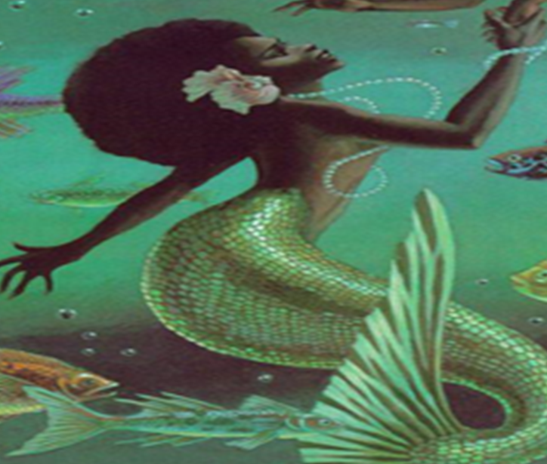
As King Triton pondered the letter, he wanted to stop the selfish-gene in humans from making them pollute the oceans. He hoped that Anahita could teach Mer-human about the Creator’s order of dependencies which placed:
Mother Earth, her air and her oceans first on spiritual stewardship because the plants and marine wildlife depend upon the water and soil to eat and grow.
2. Birds, insects, rodents and animals depend upon water, marine wildlife, plants and each other to eat and grow.
Humans depend upon water, plants, marine wildlife and animals to eat and grow.
King Triton grieved over humans placing themselves before Mother Earth, her air, her oceans, plants and animals. Queen Triton suggested that maybe Anahita and Mer-human could help him to teach humans to place Mother Earth first to care for the air, soil, oceans , plants and animals (Makokis, 2009)
Image Credit:https://www.pinterest.com/pin/433964114070117537
Notes:
As King Triton pondered the letter, he wanted to stop the selfish-gene in humans from making them pollute the oceans and waste water. He hoped that Anahita could teach Mer-human about the Creator’s order of dependencies which placed:
Mother Earth, her air and her oceans first on spiritual stewardship because the plants and marine wild-life depend upon the water and soil to eat and grow.
2. Birds, insects, rodents and animals depend upon water, marine wildlife, plants and each other to eat and grow.
Humans depend upon water, plants, marine wildlife and animals to eat and grow.
King Triton grieved over humans placing themselves before Mother Earth, her air, her oceans, plants and animals. Maybe Anahita and Mer-human could help him to teach humans to place Mother Earth first to care for the air, soil, oceans , plants and animals adapted from (Leona Mokasis’ Disordered Dependencies.

Slide 6
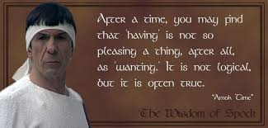
King Triton responded:
Dear Anahita,
I will grant you your wish after you teach Mer-human the laws of the sea and how to care and protect the ocean marine wildlife.
Report to my coral reef at noon sharp tomorrow at which time I shall transform Mer-human into a mermaid for your instruction.
If after 21 days, you have successfully taught Mer-humany enough to survive undersea and help the ocean from environmental destruction-she will be transformed back into a mermaid forever and you will remain human forever.
However, I must caution you in the wise vulcan words of Spock- “You may soon learn that wanting is sometimes better than having.”
Sincerely,
King Triton
Wisdom of Spock.https://www.pinterest.com/pin/333618284871084020/
Colored Mermaids & Merman:https://www.pinterest.com/pin/4339641140701175
Image Credit:https://www.pinterest.com/pin/433964114070117537/
Notes:
King Triton responded:
Dear Anahita,
I will grant you your wish after you teach Mer-human the laws of the sea and how to care and protect the ocean marine wildlife. Report to my coral reef at noon sharp tomorrow at which time I shall transform Mer-human into a mermaid for your instruction. After 30 days, you both will be transformed into a human for her to instruct you of the laws of the land. If after 30 days, Mer-human has successfully taught you enough to successfully live and help the human race from their own war and environmental destruction- she will be transformed back into a mermaid forever and you will remain human forever. However, I must caution you in the wise vulcan words of Spock- “You may soon learn that wanting is sometimes better than having.”
Sincerely,
King Triton

Slide 7
Anahita followed King Triton’s instructions and taught Merhuman the laws, secrets and wonders of the sea. Mer-human taught Anahita the laws of Mother Earth and paradoxes of Western human experience. Although, Anahita did not understand why the history books referred to North America as Western Civilization because she did not think that the way white humans treated brown humans, red humans and yellow humans was very civilized at all. This is why she wanted to become a Saponi Princess to help the brown and red people find freedom. Anahita diligently taught Mer-human how to navigate her way around the sea. They danced with the jellyfish, dolphins and sea horses while keeping a close watch out for pirates. Image Credit: Murals Your Way.http://www.muralsyourway.com/
Notes:
Anahita followed King Triton’s instructions and taught Merhuman the laws, secrets and wonders of the sea and she taught Anahita the laws of Mother Earth and paradoxes of Western human experience. Although, Anahita did not understand why the history books referred to North America as Western Civilization because she did not think that the way white humans treated brown humans, red humans and yellow humans was very civilized at all, This is why she wanted to become a Saponi Princess to help the brown and red people find freedom. Anahita diligently taught Mer-human how to navigate her way around the sea. They danced with the jellyfish, dolphins and sea horses while keeping a close watch out for pirates.

Slide 8
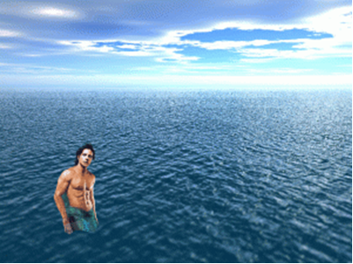
Mer-human saw a merman emerging from the Atlantic Ocean. She thought the merman was John F. Kennedy Jr.. Anahita told her that he was rescued with his Fiancée’ by the mermaids because his heart loved the ocean. He wanted to save the oceans and the marine wildlife from pollution like his cousin Robert F. K ennedy Jr. the Water-Keeper Alliance's President. The Water-keeper Alliance is rooted in the belief that grassroots, community-based organization is the key to winning clean water across Canada. http://www.waterkeepers.ca/become.html
Image Credit: https://southenquirer.wordpress.com/
Notes:
https://southenquirer.wordpress.com/
There was a sighting of a merman emerging from the Atlantic Ocean. I think the merman was JFK Jr. who was rescued with his Fiancée’ by the mermaids because his heart loved the ocean and he wanted to save the oceans and the marine wildlife from pollution like his cousin RFK Jr. the Water-Keeper Alliance's President. The Waterkeeper Alliance is rooted in the belief that grassroots, community-based organization is the key to winning clean water across Canada. http://www.waterkeepers.ca/become.html
These dolphins are carrying JFK Jr. Fiancé’s unborn baby to safety to develop in a school of fish.

Slide 9
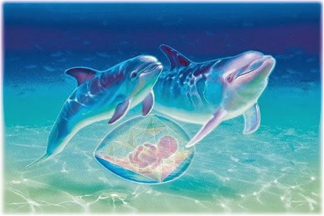
These dolphins are carrying JFK Jr. Fiancé’s (Caroline Basset’s ) unborn baby to safety.
Image Credit: http://theearthplan.blogspot.com/2014/02/conversation-with-dolphins-mernaids-and.html
Notes:
http://theearthplan.blogspot.com/2014/02/conversation-with-dolphins-mernaids-and.html

Slide 10
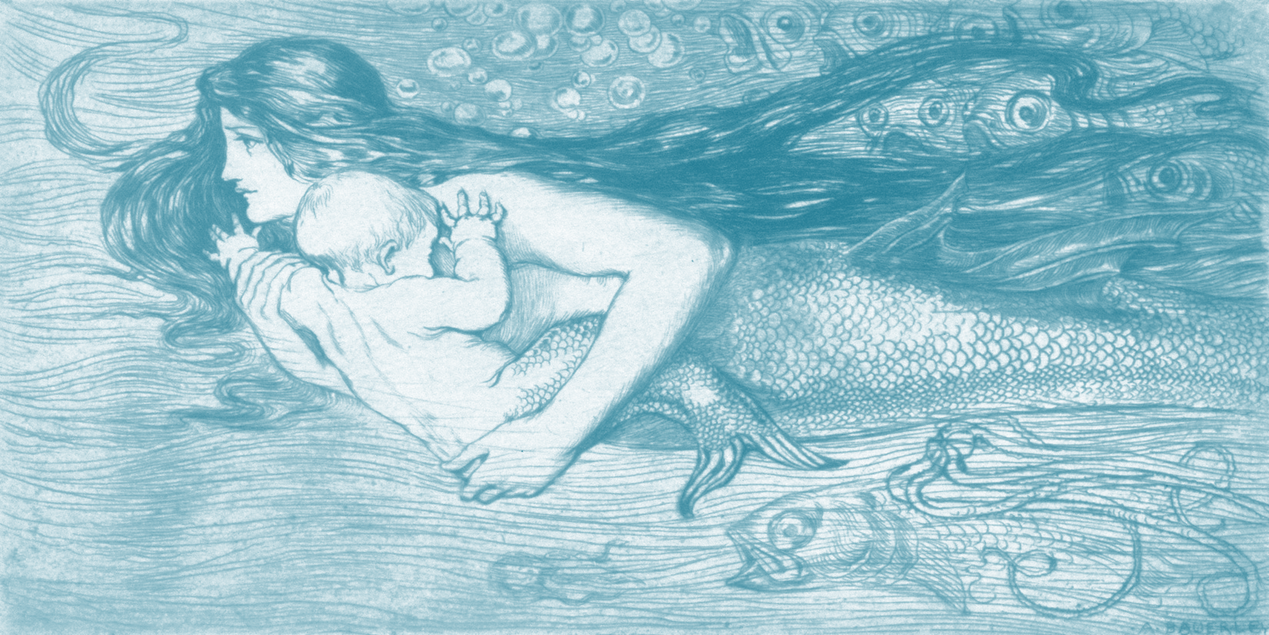
Carolyn Basset was rescued by mermaids who saved her baby. King Triton transformed Carolyn and her baby into mermaids.
Image Credit: Bowerly,A.(1873). Mermaid Swimming with Child. Flickr. https://www.flickr.com/photos/sofi01/6355697671
Notes:
Carolyn Basset was rescued by mermaids who saved her baby. King Triton transformed Carolyn and her baby into mermaids.
https://www.pinterest.com/aikoone/mermaidsmermenmerchildren-and-merbabies/

Slide 11
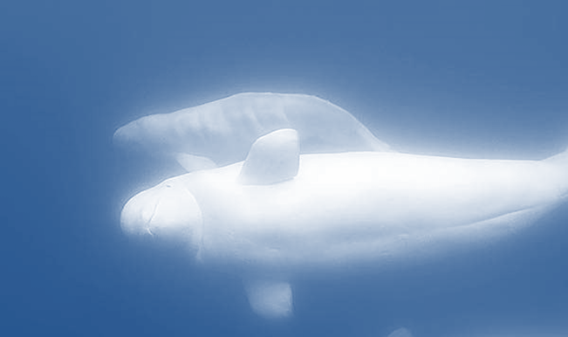
One day, a baby beluga whale washes up on a gravel beach. “Oh, no!”, exclaimed Anahita, “This baby beluga whale is sick from eating polluted fish filled with the toxic chemicals!” How did that happen?” Asked Mer-human. Anahita told Mer-human the story of European settlers who killed thousands of belugas for leather and oil. Then, in the 1920s, the government put a bounty on belugas because fishermen mistakenly believed the whales were destroying fisheries. Whale hunting continued until 1979. Finally, marine biologists researched the harsh decline of the whale population and their intelligence and social lives ( Michaud, 2016, as cited in Suzuki, para. 9).The fate of one beluga whale– just like the fate of all whales and Mother Earth – depends upon humans to stop polluting oceans, and over-fishing. Image Credit: http://www.cbc.ca/natureofthings/episodes/call-of-the-baby-beluga
Notes:
One day, a baby beluga whale washes up on a gravel beach. “Oh, no!”, exclaimed Anahita, “This baby beluga whale is sick from eating polluted fish filled with the toxic chemicals!” How did that happen?” Asked Mer-human. Anahita told Mer-human the story of European settlers who killed thousands of belugas for leather and oil. Then, in the 1920s, the government put a bounty on belugas because fishermen mistakenly believed the whales were destroying fisheries. Whale hunting continued until 1979. Finally, marine biologists researched the harsh decline of the whale population and their intelligence and social lives ( Michaud, 2016, as cited in Suzuki, para. 9).The fate of one beluga whale– just like the fate of all whales and Mother Earth – depends upon humans to stop polluting oceans, and over-fishing. Image Credit: http://www.cbc.ca/natureofthings/episodes/call-of-the-baby-beluga

Slide 12
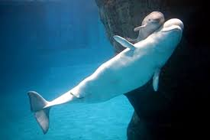
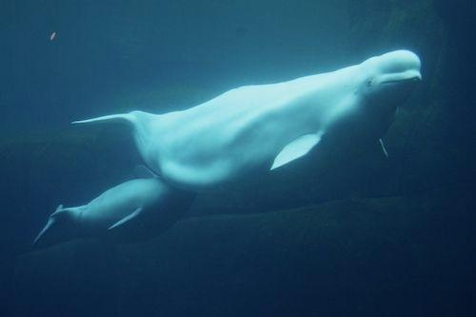
Anahita and Mer-human helped the baby beluga find a new mother beluga to nurse him back to health. Beluga mother whales love to nurse orphaned baby beluga whales (Suzuki, 2016, para. 12).
Image Credit: (Suzuki, 2016, para. 12).
Notes:
Anahita and Mer-human helped the baby beluga find a new mother beluga to nurse him back to health. Beluga mother whales love to nurse orphaned baby beluga whales (Suzuki, 2016, para. 12).
Anahita and Mer-human helped the baby beluga whale find a new mother beluga whale to nurse him back to health.
http://www.oceanelders.org/the-ocean-elders/

Slide 13
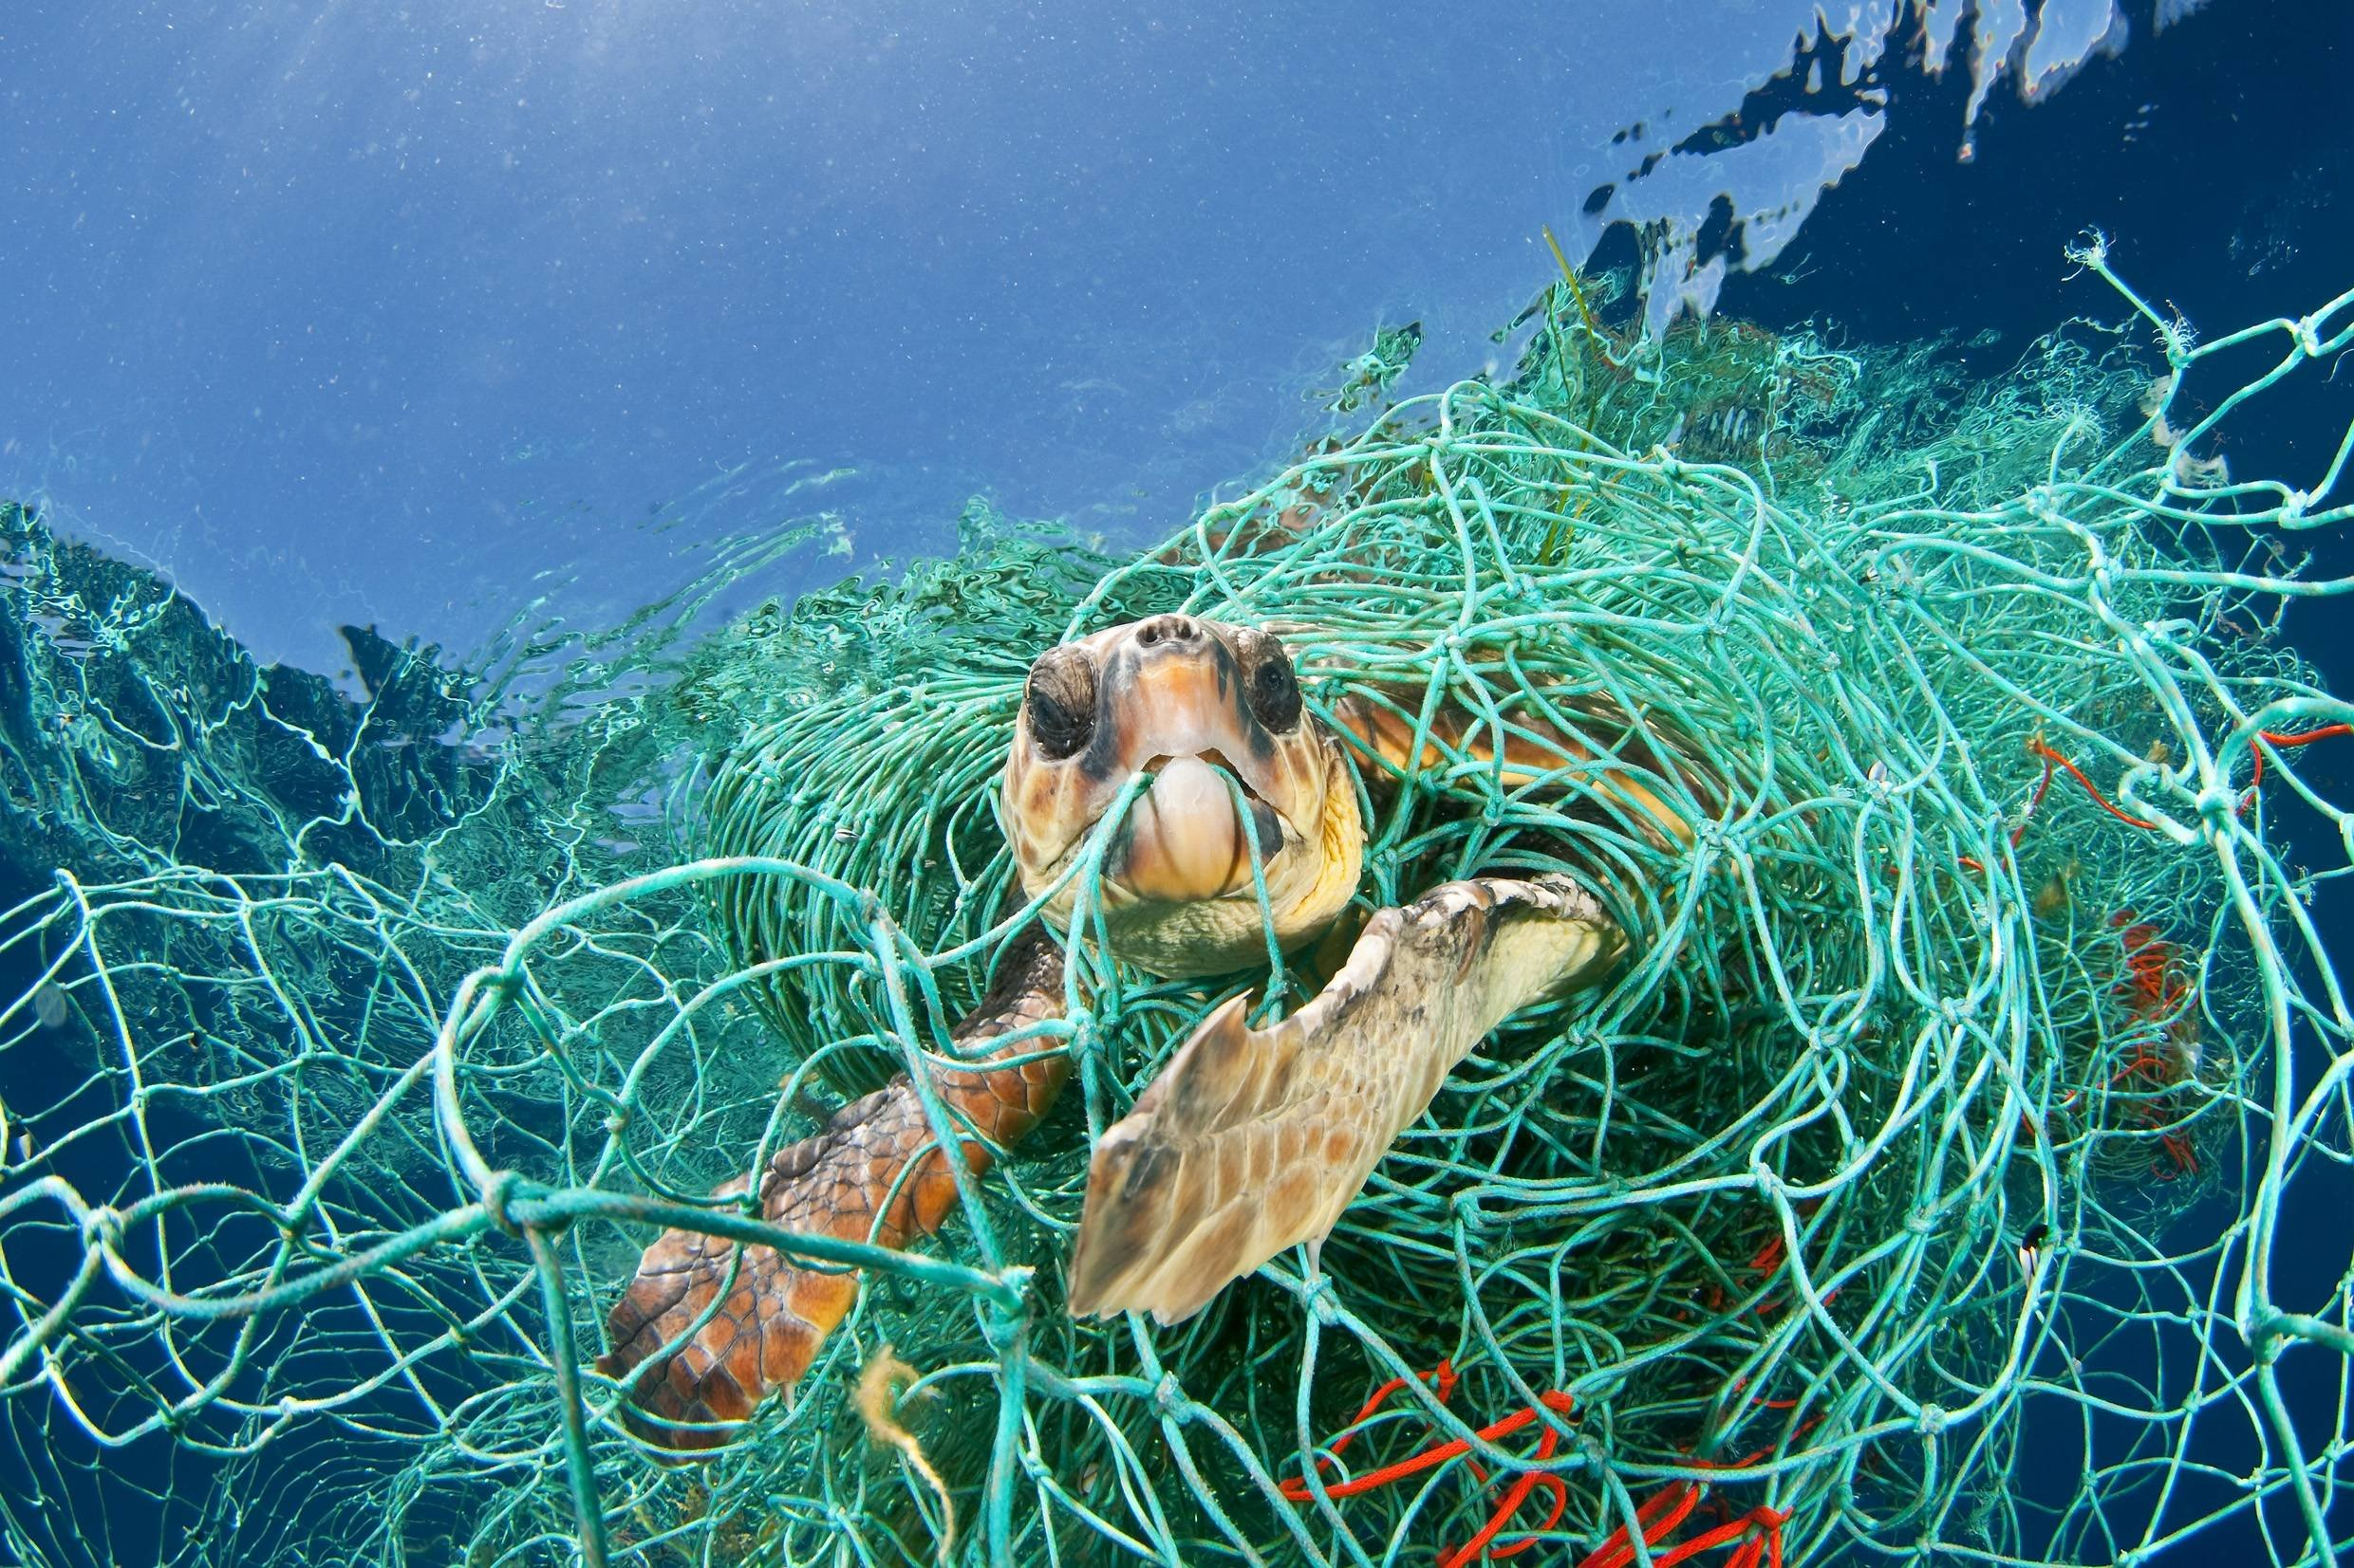
Sammy the sea turtle got stuck in a plastic fish net and could barely move. He called out for help for a long time.
Image Credit: (Cousteau, 1986, p. 29)
Notes:
Sammy the sea turtle got stuck in a plastic fish net and could barely move. He called out for help for a long time.
Image Credit: (Cousteau, 1986, p. 29)

Slide 14
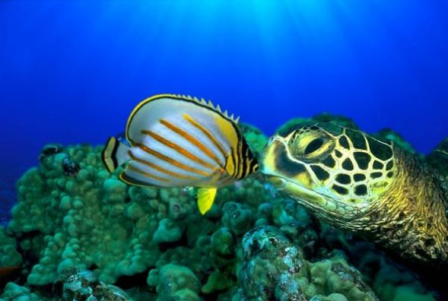
Finally, Freddie Fin heard Sammy’s cries for help and came swimming. “Please call the mermaids for help, I am stuck in this fish net and in a lot of pain! “Right on the double pal!” Freddie Fin promised. He swam as fast as he could.
Image Credit: (Cousteau, 1986, p. 30)
Notes:
Finally, Freddie Fin heard Sammy’s cries for help and came swimming. “Please call the mermaids for help, I am stuck in this fish net and in a lot of pain! “Right on the double pal!” Freddie Fin promised. He swam as fast as he could.
Image Credit: (Cousteau, 1986, p. 30)

Slide 15
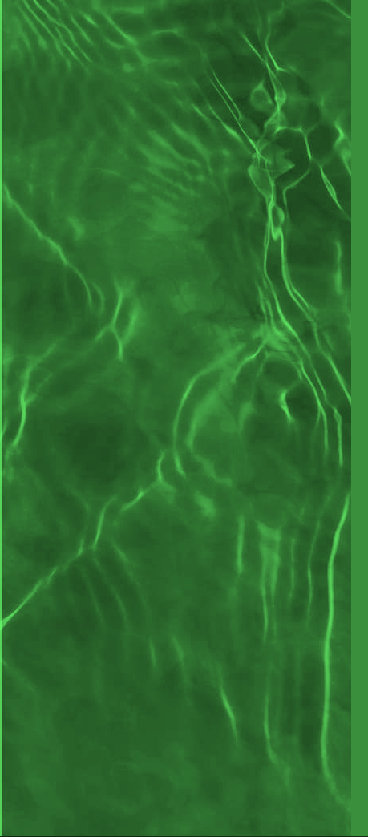
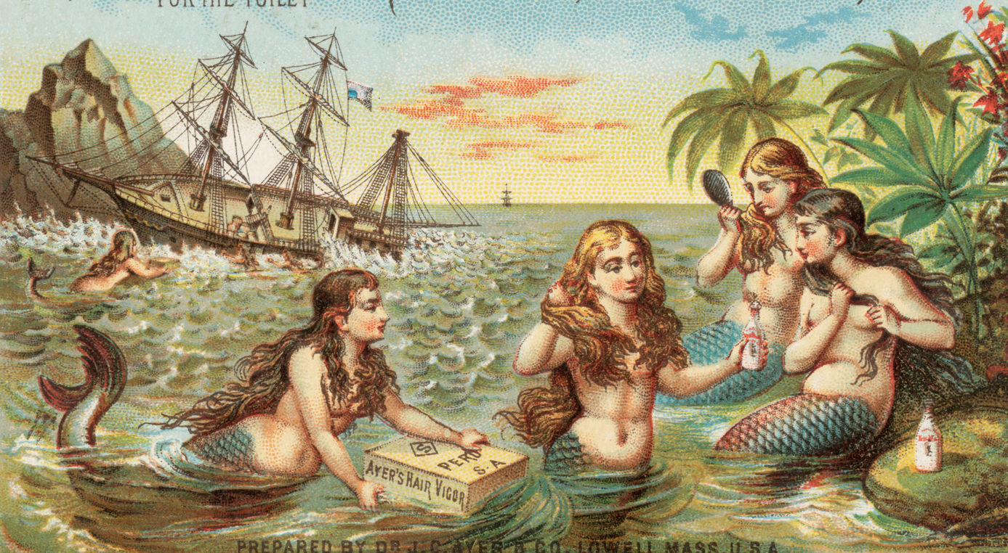
Freddie called out to the mermaids: “ Help Sammy the sea turtle is stuck in a fish net! The mermaids, Athena, Aphrodite, Anahita and Mer-human swam quickly to help. They noticed that the water stunk like rotten algae bloom.
Image Credit: https://www.flickr.com/photos/boston_public_library/8558173388
Notes:
Freddie called out to the mermaids: “ Help Sammy the sea turtle is stuck in a fish net! The mermaids, Athena, Aphrodite, Anahita and Mer-human swam quickly to help. They noticed that the water stunk like rotten algae bloom.
Image Credit: https://www.flickr.com/photos/boston_public_library/8558173388

Slide 16
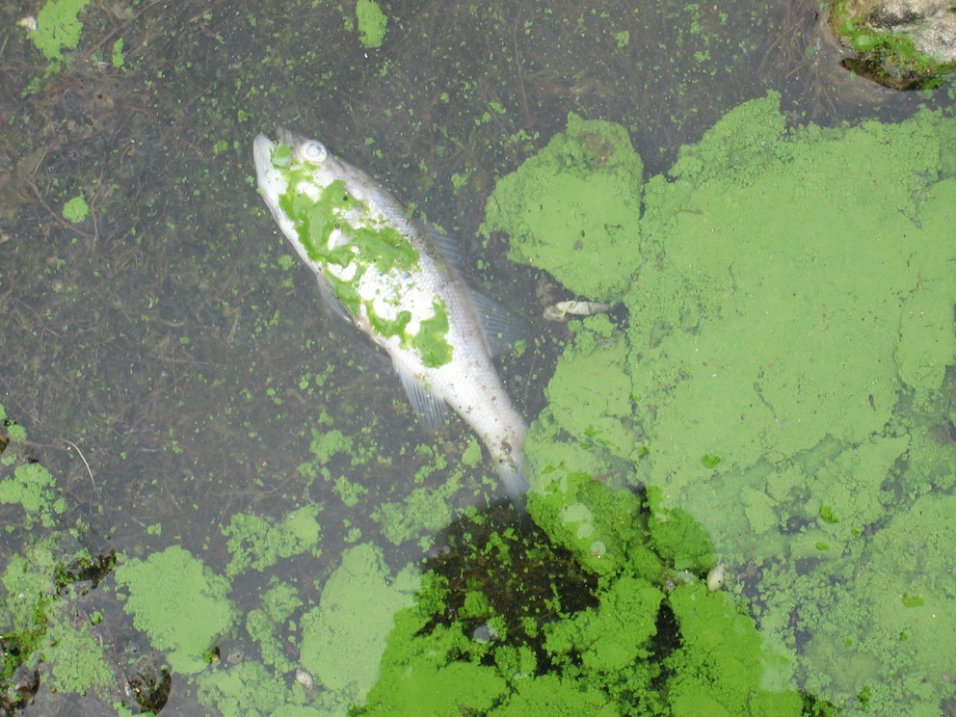
After they freed Sammy, the mermaids swam to the sea shore only to find fish dying from the algae bloom. Anahita explained to Mer-human that heavy bursts of rainfall intensified by climate change cause agricultural and sewage infrastructure to release more phosphorous runoff. Free-floating algae mats grow in its western basin; in its Eastern basin, large blooms along the shoreline clog water intake, decrease water quality and pose of health risk to humans, pets and wildlife (Bejankiwar, as cited in Broadley, 2014, para. 11).
Broadley, L. (2014). It came from Lake Erie: Why toxic algae’s a nightmare for Canada, too. Global News. Retrieved From:
http://globalnews.ca/news/1492850/it-came-from-lake-erie-why-toxic-algaes-a-nightmare-for-canada-too/.
Broadley, L. (2014). It came from Lake Erie: Why toxic algae’s a nightmare for Canada, too. Global News. Retrieved From:
http://globalnews.ca/news/1492850/it-came-from-lake-erie-why-toxic-algaes-a-nightmare-for-canada-too/.
Notes:
Broadley, L. (2014). It came from Lake Erie: Why toxic algae’s a nightmare for Canada, too. Global News. Retrieved From:
http://globalnews.ca/news/1492850/it-came-from-lake-erie-why-toxic-algaes-a-nightmare-for-canada-too/.
After they freed Sammy, the mermaids swam to the sea shore only to find fish dying from the algae bloom. Anahita explained to Mer-human that heavy bursts of rainfall intensified by climate change cause agricultural and sewage infrastructure to release more phosphorous runoff. Free-floating algae mats grow in its western basin; in its Eastern basin, large blooms along the shoreline clog water intake, decrease water quality and pose of health risk to humans, pets and wildlife (Bejankiwar, as cited in Broadley, 2014, para. 11).

Slide 17
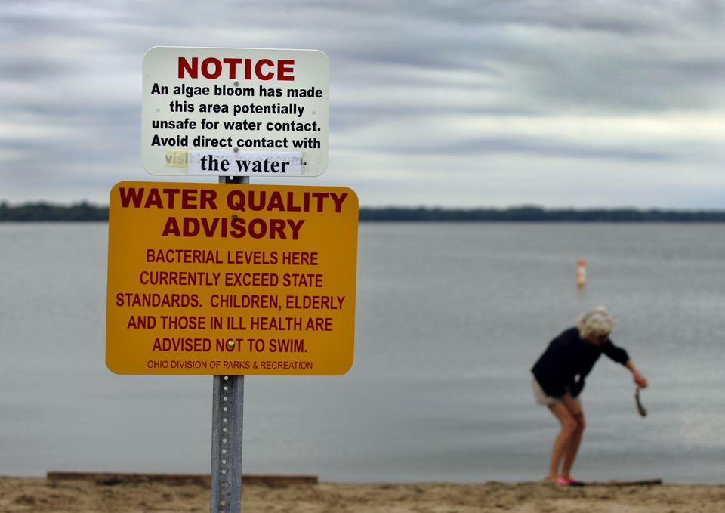
People could not swim in the water because it was poisonous. Many fish and marine wildlife died.
Image Credit: DeBrosse, J. (2013). Grand Lake St. Marys 'dying' from toxic algae.
Retrieved From: http://www.daytondailynews.com/news/news/local/grand-lake-st-marys-dying-from-toxic-algae/nNFBJ
Notes:
Broadley, L. (2014). It came from Lake Erie: Why toxic algae’s a nightmare for Canada, too. Global News. Retrieved From:
http://globalnews.ca/news/1492850/it-came-from-lake-erie-why-toxic-algaes-a-nightmare-for-canada-too/.
After they freed Sammy, the mermaids swam to the sea shore only to find fish dying from the algae bloom. Anahita explained to Mer-human that heavy bursts of rainfall intensified by climate change cause agricultural and sewage infrastructure to release more phosphorous runoff. Free-floating algae mats grow in its western basin; in its Eastern basin, large blooms along the shoreline clog water intake, decrease water quality and pose of health risk to humans, pets and wildlife (Bejankiwar, as cited in Broadley, 2014, para. 11).

Slide 18
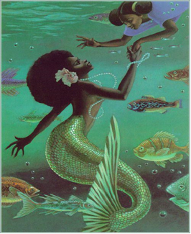
Suddenly, they heard cries from the ocean floor as Queen Triton cried out for clean water for the fish .
Image Credit:Colored Mermaids. https://www.pinterest.com/pin/433964114070117537/
Notes:
Suddenly, they heard cries from the ocean floor as Billie Holiday begged for clean water and air.
Image Credit:Colored Mermaids. https://www.pinterest.com/pin/433964114070117537/

Slide 19
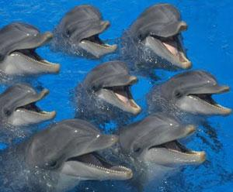
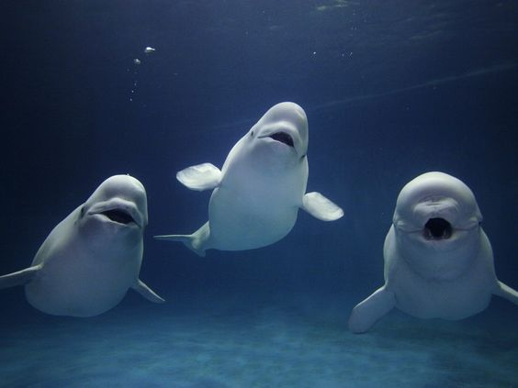
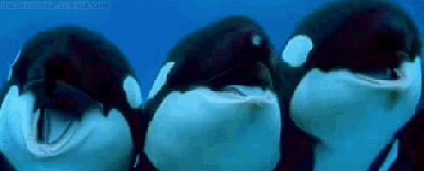
Suddenly, they heard Whales and Dolphins singing from the ocean crying for help!
Whale Song Image Credit: Cousteau, J. (1985). Jacques Cousteau : the ocean world (p. 65).
Dolphins songs
Notes:
Suddenly, they heard cries from the ocean floor as Billie Holiday begged for clean water and air.
Image Credit:Colored Mermaids. https://www.pinterest.com/pin/433964114070117537/

Slide 20
Athena telecasted the pain of the marine wildlife on international television.
Image Credit: http://decorist.co/2014/06/27/nostaljik-reklamlarin-guzelligi/#sthash.fYLotEa2.dpbs.

Slide 21
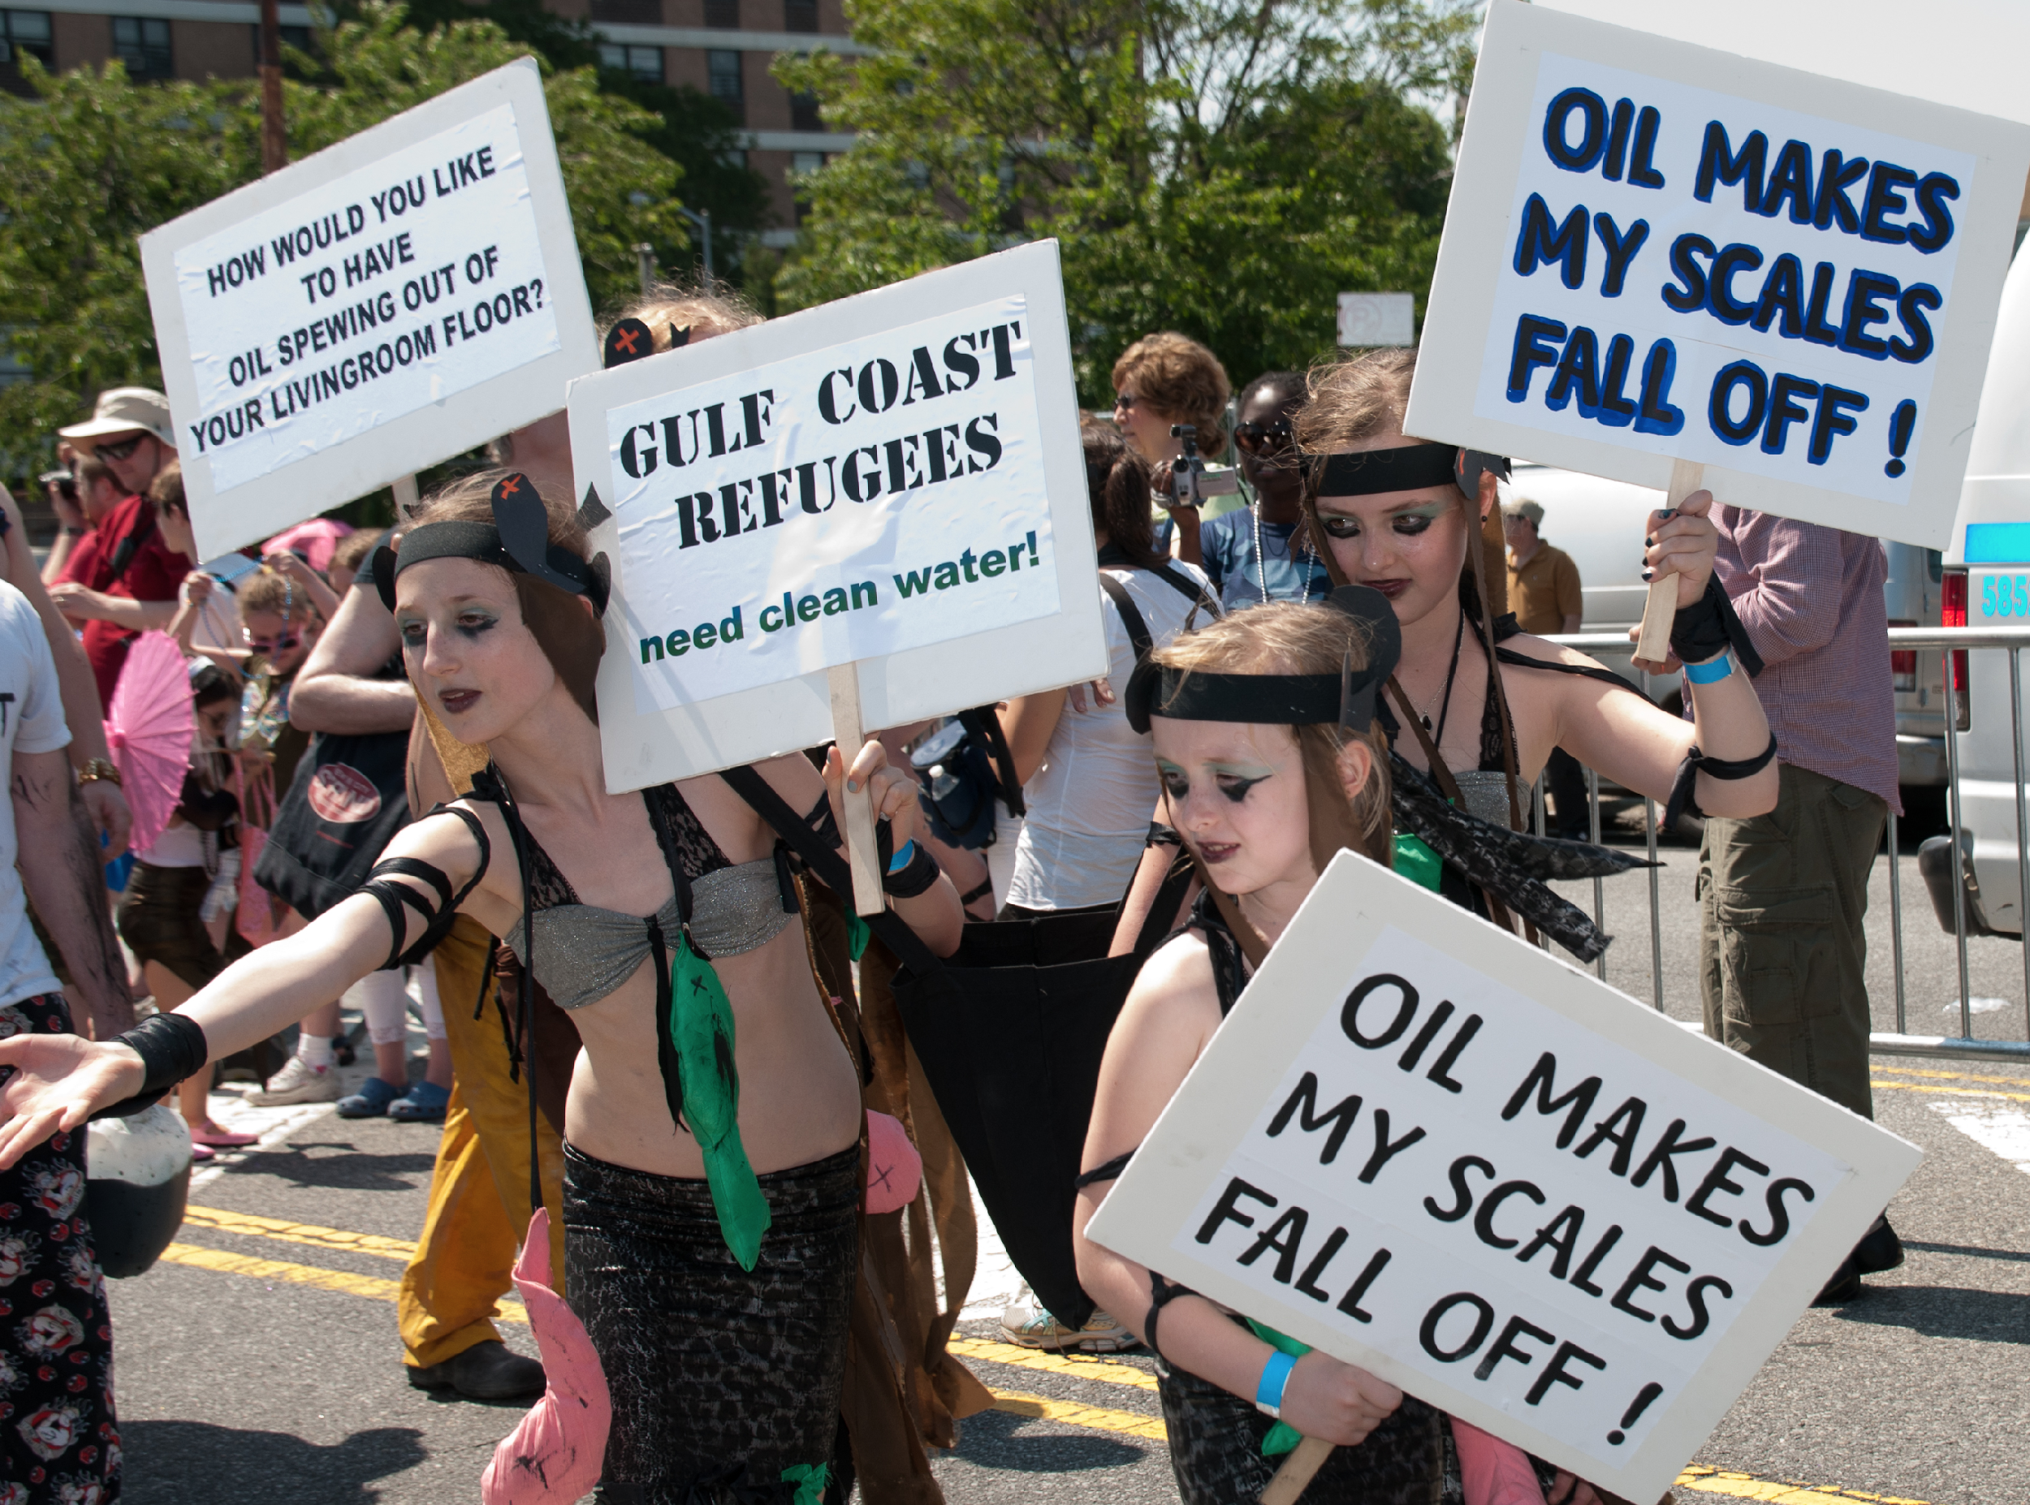
King Triton sent Anahita and Mer-human to the shore as humans to protest to the United Nations to stop the pollution of all the oceans, rivers, lakes and water-ways in the world. They joined the Idle No More Movement, the David Suzuki Foundation, Oceana Canada, and Ocean Elders to stop people and corporations from polluting the waters of Mother Earth. There they meet a Michigan University Professor who claims he can stop the pollution with their help. Queen Triton turns Merhuman and Anahita into humans to help Professor John Miller.
File:Coney Island Mermaid Parade 2010-BP Kills Mermaids.jpg https://commons.wikimedia.org/wiki/File:Coney_Island_Mermaid_Parade_2010-BP_Kills_Mermaids.jpg
Notes:
King Triton sent Anahita and Mer-human to the shore as humans to protest to the United Nations to stop the pollution of all the oceans, rivers, lakes and water ways in the world. They joined the Idle No More Movement, the David Suzuki Foundation, Oceana Canada, Green Peace and Ocean Elders to stop people and corporations from polluting the waters of Mother Earth.
File:Coney Island Mermaid Parade 2010-BP Kills Mermaids.jpg https://commons.wikimedia.org/wiki/File:Coney_Island_Mermaid_Parade_2010-BP_Kills_Mermaids.jpg

Slide 22
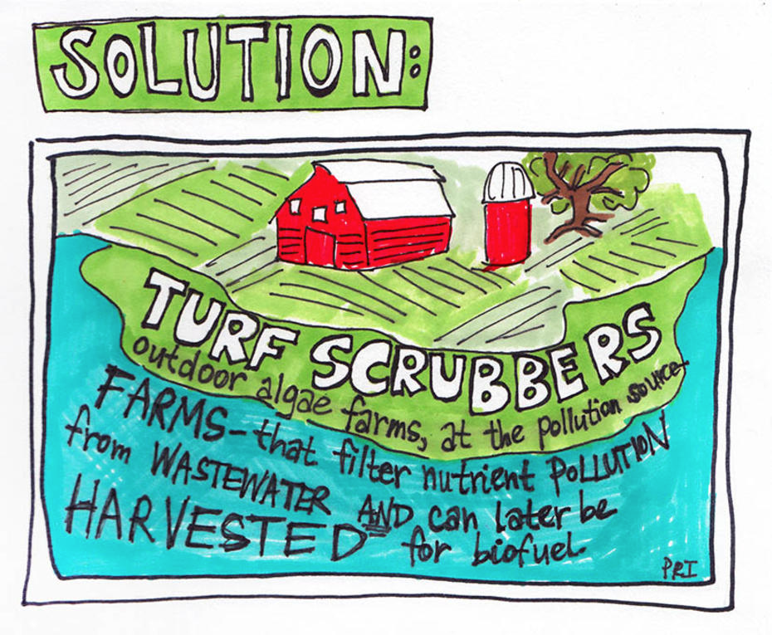
Professor John Miller who teaches them how to transform algal blooms into useful biofuel. As turf-scrubbers are systems in which thick mats of algae filter wastewater and are periodically harvested for biofuel.
Image Credit: Perron@OnEarth.http://www.onearth.org/tags/algal-blooms
Notes:
What if we could flip algal blooms on their heads to make them useful instead of harmful?

Slide 23
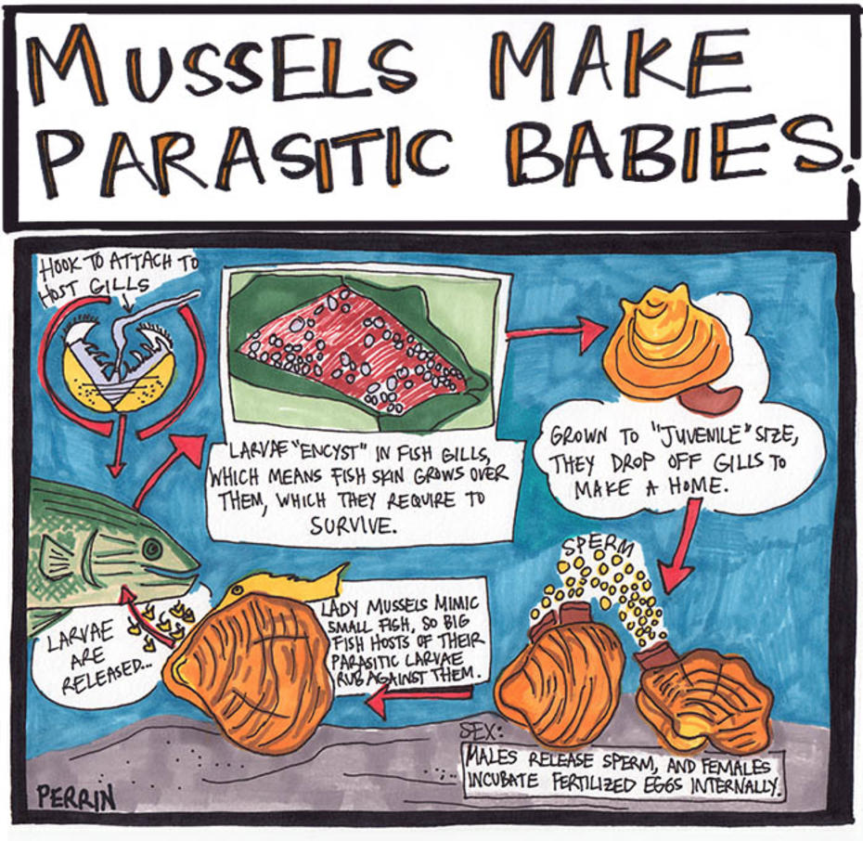
Professor John Miller taught them that: reviving mussels’ endangered freshwater colonies helps to clean polluted waterways. Mussels have parasitic larvae that grow in fish gills, so protecting fish help mussels thrive.
Image Credit: Perron@OnEarth.http://www.onearth.org/tags/algal-blooms
Notes:
What if we could flip algal blooms on their heads to make them useful instead of harmful? Maddie Stone,

Slide 24
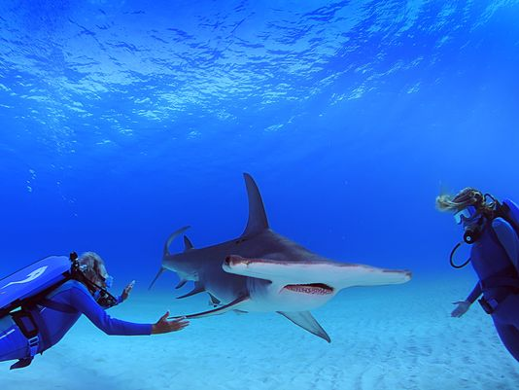
Anahita and Mer-human works with Ocean Elders, Oceana and the David Suzuki Foundation to help save Mother Earth’s oceans from pollution and they all lived happily ever after!!!
Image Credit: Cousteau, J. (1985). Jacques Cousteau : the ocean world (p. 65).
Notes:
https://www.pinterest.com/aikoone/merAnahita and Mer-human works with Ocean Elders, Oceana and the David Suzuki Foundation to help save Mother Earth’s oceans from pollution. maidsmermenmerchildren-and-merbabies/

Slide 25
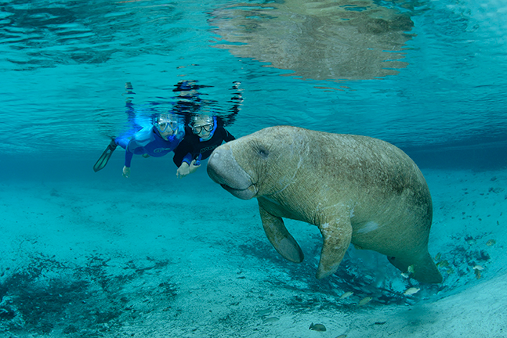
http://www.oceanelders.org/
http://www.davidsuzuki.org/
http://www.oceana.ca/en
You can also work with Ocean Elders, Oceana and the David Suzuki Foundation to help save Mother Earth’s oceans from pollution. Just follow the above web links!
Image Credit: Cousteau, J. (1985). Jacques Cousteau : the ocean world (p. 67).
Notes:
https://wwwYou can also work with Ocean Elders, Oceana and the David Suzuki Foundation to help save Mother Earth’s oceans from pollution.
.pinterest.com/aikoone/merAnahita and Mer-human works with Ocean Elders, Oceana and the David Suzuki Foundation to help save Mother Earth’s oceans from pollution. maidsmermenmerchildren-and-merbabies/

Slide 26
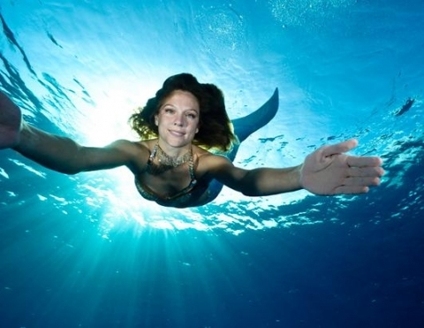
http://www.oceanelders.org/
http://www.davidsuzuki.org/
http://www.oceana.ca/en
Cleaner oceans mean we can enjoy our beaches for swimming, fishing and recreation. There’s plenty you can do, either on your own or in a group, to make a huge difference.
Organise a beach clean-up.
Reduce your rubbish.
Make sure only rain goes down the drain. Most drains flow straight to the sea … which means we could end up swimming in anything that goes down them!
Take care of a local stream.
Find out more about your local beach.
Image Credit: Cousteau, J. (1985). Jacques Cousteau : the ocean world (p. 67).
Notes:
https://wwwYou can also work with Ocean Elders, Oceana and the David Suzuki Foundation to help save Mother Earth’s oceans from pollution.
.pinterest.com/aikoone/merAnahita and Mer-human works with Ocean Elders, Oceana and the David Suzuki Foundation to help save Mother Earth’s oceans from pollution. maidsmermenmerchildren-and-merbabies/

Slide 27
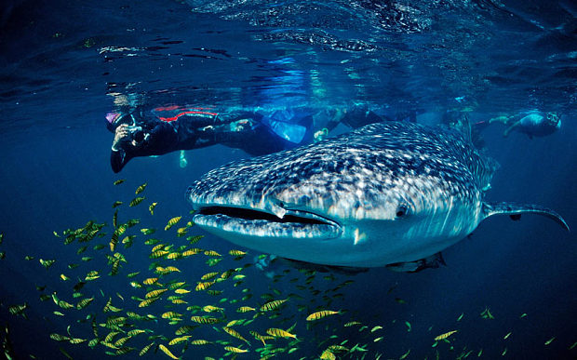
http://www.oceanelders.org/
http://www.davidsuzuki.org/
http://www.oceana.ca/en
You can join the online blog communities of Ocean Elders, Oceana and the David Suzuki Foundation to share your ideas and stories on how save Mother Earth’s oceans from pollution so we can all live happily ever after!
Image Credit: Cousteau, J. (1985). Jacques Cousteau : the ocean world (p. 74).
Notes:
https://www.pinterestYou can join the online blog communities Ocean Elders, Oceana and the David Suzuki Foundation to share your ideas and stories on how to save Mother Earth’s oceans from pollution.
.com/aikoone/merAnahita and Mer-human works with Ocean Elders, Oceana and the David Suzuki Foundation to help save Mother Earth’s oceans from pollution. maidsmermenmerchildren-and-merbabies/

Slide 28
References
Adamson, G. (1995). Help me, Jacques Cousteau. Erin, Ont. : Porcupine's Quill, c1995.
Bankston, J. (2003). Jacques-Yves Cousteau : his story under the sea. Bear, DE : Mitchell Lane, c2003.
Broadley, L. (2014). It came from Lake Erie: Why toxic algae’s a nightmare for Canada, too. Global News. Retrieved From:
http://globalnews.ca/news/1492850/it-came-from-lake-erie-why-toxic-algaes-a-nightmare-for-canada-too/.
Cousteau, J. (1985). Jacques Cousteau : the ocean world. New York : Abradale Press, 1985.
Cousteau, J., & Paccalet, Y. (1988). Jacques Cousteau--whales. New York : H.N. Abrams, 1988.
Cousteau, J., Cousteau, P., & Flaum, M. (2009). Jacques Cousteau's Voyage to the edge of the world.
[videorecording]. [United States] : Synergy Entertainment ; New York : American Pop Classics, [2009].
Hutcheon, L. (2006). Where? When? (Contexts). Chapter 5 Indigenization. A Theory of Adaptation. Routledge: New
York.
Makokis, L. (2009). Disordered dependencies: the impact of language loss and residential schooling on Indigenous
peoples. Rural Social Work & Community Practice, 14(2), 6-11 6p.
Matsen, B. (2009). Jacques Cousteau : the sea king. New York : Pantheon Books, c2009.
Colored Mermaids. Retrieved From: https://www.pinterest.com/pin/433964114070117537/.
Yeoman, B. (2015).The Algae That (Almost) Ate Toledo: Summertime in Toledo: Lakeside barbecues, Mud Hens double-headers, and toxic algae blooms.OnEarth: Magazine of the Natural Defences Council. Retrieved From: http://www.onearth.org/tags/algal-blooms.
https://www.pinterest.com/aikoone/mermaidsmermenmerchildren-and-merbabies/
Notes:
https://www.pinterest.com/aikoone/mermaidsmermenmerchildren-and-merbabies/
References
Adamson, G. (1995). Help me, Jacques Cousteau. Erin, Ont. : Porcupine's Quill, c1995.
Bankston, J. (2003). Jacques-Yves Cousteau : his story under the sea. Bear, DE : Mitchell Lane, c2003.
Broadley, L. (2014). It came from Lake Erie: Why toxic algae’s a nightmare for Canada, too. Global News. Retrieved From:
http://globalnews.ca/news/1492850/it-came-from-lake-erie-why-toxic-algaes-a-nightmare-for-canada-too/.
Cousteau, J. (1985). Jacques Cousteau : the ocean world. New York : Abradale Press, 1985.
Cousteau, J., & Paccalet, Y. (1988). Jacques Cousteau--whales. New York : H.N. Abrams, 1988.
Cousteau, J., Cousteau, P., & Flaum, M. (2009). Jacques Cousteau's Voyage to the edge of the world.
[videorecording]. [United States] : Synergy Entertainment ; New York : American Pop Classics, [2009].
Hutcheon, L. (2006). Where? When? (Contexts). Chapter 5 Indigenization. A Theory of Adaptation. Routledge: New
York.
Makokis, L. (2009). Disordered dependencies: the impact of language loss and residential schooling on Indigenous
peoples. Rural Social Work & Community Practice, 14(2), 6-11 6p.

Slide 29
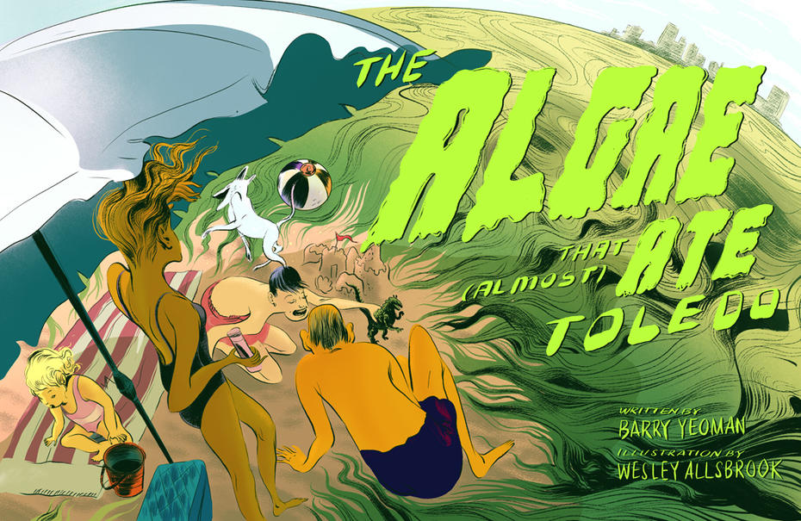
Readers’ Advisory
Yeoman, B. (2015). The Algae That (Almost) Ate Toledo: Summertime in Toledo: Lakeside barbecues, Mud Hens double-headers, and toxic algae blooms.OnEarth: Magazine of the Natural Defences Council. Retrieved From: http://www.onearth.org/tags/algal-blooms.
Notes:
Broadley, L. (2014). It came from Lake Erie: Why toxic algae’s a nightmare for Canada, too. Global News. Retrieved From:
http://globalnews.ca/news/1492850/it-came-from-lake-erie-why-toxic-algaes-a-nightmare-for-canada-too/.
After they freed Sammy, the mermaids swam to the sea shore only to find fish dying from the algae bloom. Anahita explained to Mer-human that heavy bursts of rainfall intensified by climate change cause agricultural and sewage infrastructure to release more phosphorous runoff. Free-floating algae mats grow in its western basin; in its Eastern basin, large blooms along the shoreline clog water intake, decrease water quality and pose of health risk to humans, pets and wildlife (Bejankiwar, as cited in Broadley, 2014, para. 11).

Slide 30
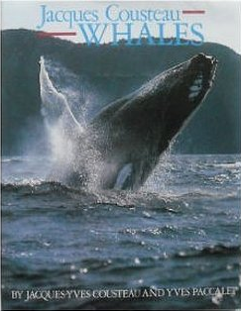
Readers’ Advisory
Jacques Cousteau--Whales
Cousteau, J., & Paccalet, Y. (1988). Jacques Cousteau--Whales. New York : H.N. Abrams, 1988.
Notes:
There are roughly 900 belugas in the St. Lawrence today, down from 10,000 in 1885.

Slide 31
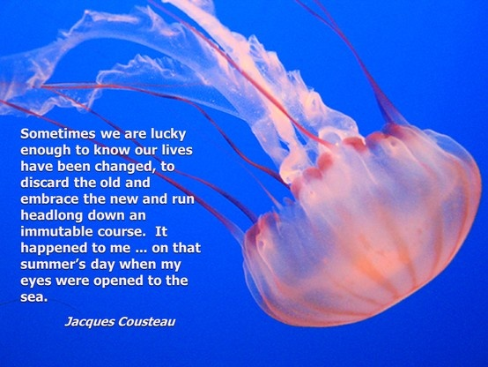
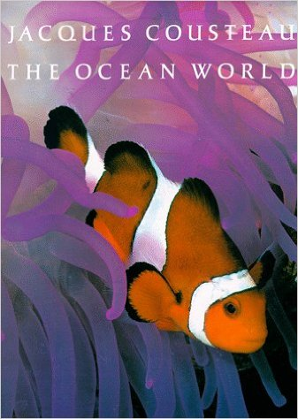
Readers’ Advisory
Jacques Cousteau :The Ocean World
Cousteau, J. (1985). Jacques Cousteau: The Ocean World. New York : Abradale Press, 1985.
Notes:
There are roughly 900 belugas in the St. Lawrence today, down from 10,000 in 1885.

Slide 32
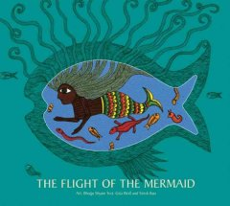
Readers’ Advisory
The Flight of the Mermaid
The reader finds a fish with a humanoid eye. As the first page opens up, this eye transforms into the eye of the Little Mermaid. She is a guiding light surrounded by deep sea marine wild life. The mermaid’s narrative of her adventures through human existence and romantic love. Themes of metamorphosis and transformation prevail, as she journeys from mermaid to human and then to a daughter of the air.
Shyam, B., Wolf, G., Rao, S., & Andersen, H. C. (2009). The Flight of the Mermaid. Chennai ;London : Tara Books, c2009.

