Slide 1
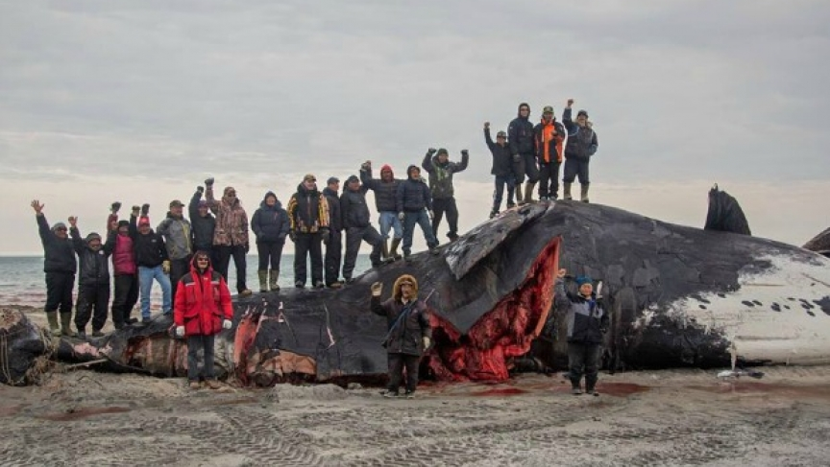
The United Nations Declaration of the Rights of Indigenous Peoples (UNDRIP) & Food Security in Nunavut
By Anna Wilson MEd., MLIS
PhD Candidate Social Justice & International
Education Policy Studies
amw2@ualberta.ca

Slide 2
Agenda-Thank-you Treaty 6 First Nations
Nunavut Narrative
United Nations Declaration of the Rights of Indigenous Peoples (UNDRIP)
Marie Battiste’s Nourishing the Learning Spirit (NLS)
First Nations Growers Solutions
Barriers to Accessing Traditional Foods
Canada’s Nutrition North Program Advisory Statistics
Feeding My Family Facebook Group Northern Voices in Solidarity
Critical Analysis
Food Banks Canada call to action

Slide 3
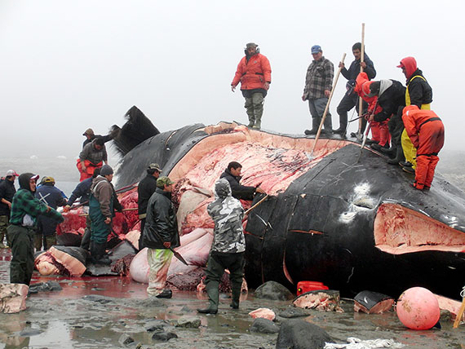
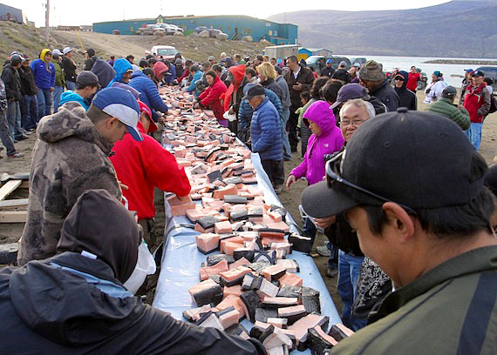
Maktaaq from bowhead whale hunt celebration in Pangnirtung shared
Tanya Tagaq Animism
Tanya Tagaq Aorta

Slide 4
The United Nations Declaration of the Rights of Indigenous Peoples
and Food Security
The Minister of Indigenous Affairs is concerned that Canada’s adoption the United Nations Declaration of the Rights of Indigenous Peoples (UNDRIP) is “without qualification, as Canada’s obligations to fulfil UNDRIP include free, prior and informed consent” (Fontaine, 2016, para. 2).
Many Indigenous communities cannot hunt and harvest for their traditional sources of food owing to the destruction of their eco-systems from corporate resource extraction that is sanctioned by the government.
Indigenous Peoples’ food insecurity is exacerbated by the extremely high food prices in isolated grocery stores.

Slide 5
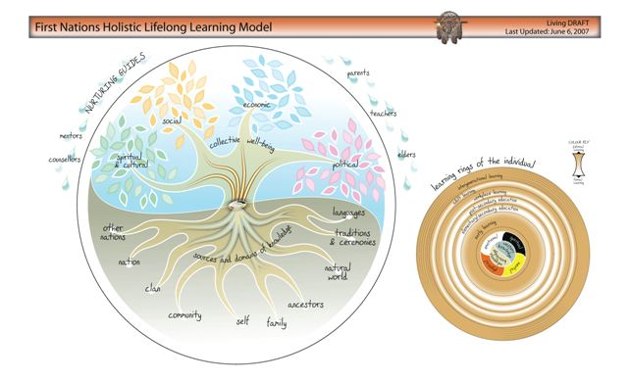
Marie Battiste’s Nourishing the Learning Spirit (NLS):
the community spirit of Indigenous peoples is nourished through reclaiming their right to control their sources of food traditionally as promised in the UNDRIP. Indigenous research engages Indigenous persons as investigators to extend their knowledge across diverse Indigenous communities. (
(Battiste, 2013, as cited in Anuik, 2015)
From Igloos, To Microwaves

Slide 6
UNDRIP and Food Security in Nunavut
In Marie Battiste's Nourishing the Learning Spirit text, she chronicles how the Mi'kmaq parents collectively developed Indigenous language classes in their children’s schools.
Similarly, some Indigenous peoples regained their food security through First Nations Growers (FNG) which empowers Indigenous communities to harvest their own nutritious food.
FNG provides First Nation and Inuit communities with affordable year-round gardens to grow produce, herbs and traditional medicines. Each community garden farm is owned by the Indigenous community and operated providing fresh foods and jobs even in the most remote communities.

Slide 7
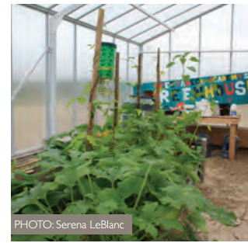
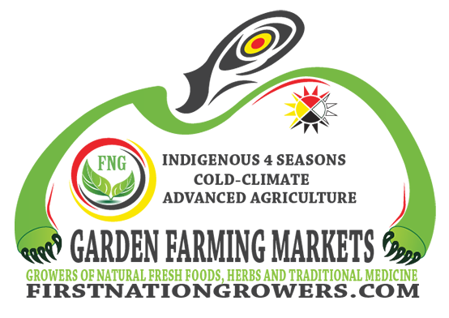
First Nations Growers (FNG)
Empowers First Nations & Inuit communities into becoming world leaders in the holistic approach to year round, indoor, organic gardening across Canada and globally to address world hunger.
FNG provides First Nation and Inuit communities with on-line workshops, and hands on growing of vegetables and fruit based on research from: Food Secure Canada (2016). Paying for Nutrition: A Report on Food Costing in the North. Retrieved Fromhttp://www.firstnationgrowers.com/wp-content/uploads/2016/11/paying_for_nutrition_fsc_report_final.pdf.
Inuvik Community Greenhouse
Geothermal Greenhouse

Slide 8
Barriers to accessing traditional foods & contributing to higher food prices include:
Northern First Nations rely on 1 non locally owned food store carrying fresh, perishable items. This store is part of a chain that has a monopoly in the region.
Higher transportation and fuel costs. Higher heating, cooling, lighting, and building maintenance expenses.
Complex food distribution with longer, less frequently traveled routes. Maximum capacity for weight and mass on airplanes limits volume purchases.
Greater risk of damage to perishables during the long transport. Unreliable availability of foods due to weather and unforeseen circumstances (FSC, 2016, p. 11).

Slide 9
Criticism of First Nations Growers & Nutrition North
Hydroponically grown produce in Nunavut requires massive irrigation of safe drinking water which is unavailable.
Providing safe tap water from a Public-Private-Nonprofit is economically unfeasible.
Traditional Indigenous farming in Nunavut requires the Traditional Knowledge of Indigenous Elders.
Nunavut land preservation by Self-Government to restore fish and marine wildlife is a better solution for long term sustainability and food security.
Nutrition North subsidies need to be paid directly to the residents of Nunavut instead of Grocers out to make a profit.
More local food banks and community kitchens can also empower Nunavut residents to feed themselves locally. Qayuqtuvik Society Soup Kitchen Iqaluit, Nunavut

Slide 10
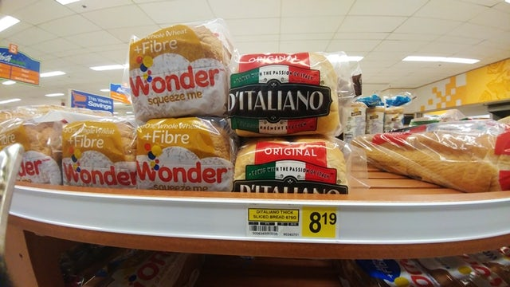
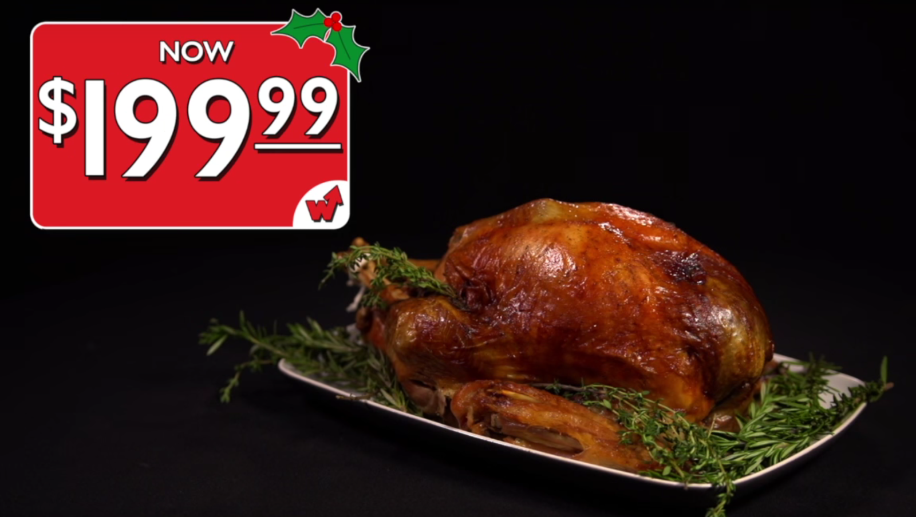
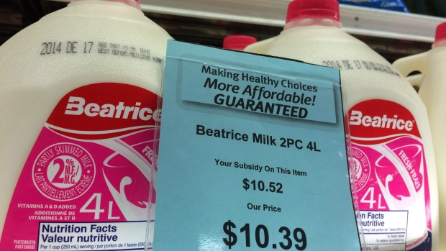
Yearly Food Survey reveals Nunavut Prices 3X Above Canada’s Average
Nunavut residents spend up to $600 a week for food
frozen chicken strips cost $32, bacon $19,
four-pound frozen pork roast over $30
Let’s talk turkey!

Slide 11
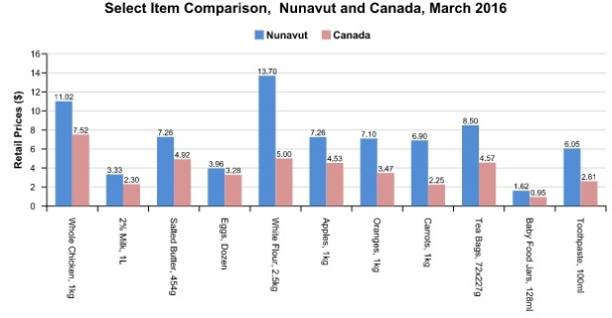
Skura, E. (2016). Food in Nunavut still costs up to 3 times national average. CBC News. Retrieved from http://www.cbc.ca/news/canada/north/nunavut-food-price-survey-2016-1.3650637.

Slide 12
Feeding My Family Facebook Group Voices 1. Empower Northerners to create interdependence from within the people at the grassroots level. | Nutrition North Advisory Voices 1. Importance of the food sharing network within northern communities for locally harvested foods. Using a retail-based subsidy model is counter to traditional practices.
2. Unify people across the North to share one voice. | 2.Increased consumption of wild food, increases the need to monitoring & manage harvest requiring additional funding.
3. Government policy-makers & retailers must find better ways lower the cost of food (Nutrition North Canada [NNC] is not doing enough). | 3. subsidy or tax exemption for hunting and fishing equipment
4. Encourage new food suppliers to operate in the North in order to increase competition and lower prices. | 4. funds for community hunts & hunter support programs, community freezers, or hunters & trappers fund org. air freight subsidy for community trade.

Slide 13
Feeding My Family Facebook Group Voices 5. Improvements in food quality through better inventory control, such as: Removing inedible and rotting food from store shelves; Proper food shipping & handling; and Reducing transit time for perishable foods. | Nutrition North Advisory Voices 5.license hunters to supply local stores and subsidize those foods purchased
6. Establish more Food Banks. | 6. Allow more hunting & provide support for domesticated herds to increase Northerners’ access to traditional food while respecting the sustainability of the resources.
7. All hunters & fishers to work together IN SOLIDARITY with Government and other NGOs to improve the overall quality of life for Northerners. | 7. Does resource sustainability restrict Indigenous hunting & harvesting? Sapiqangitunga

Slide 14
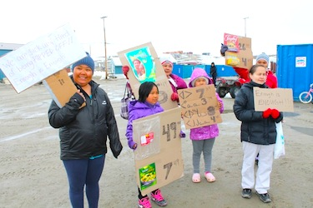
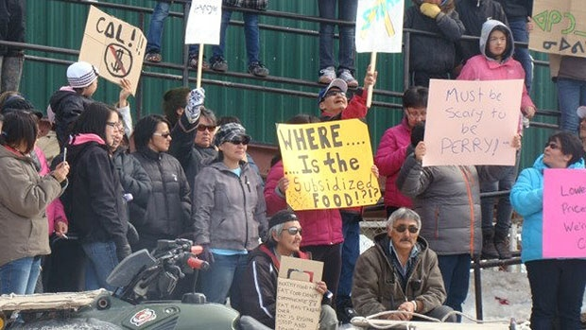
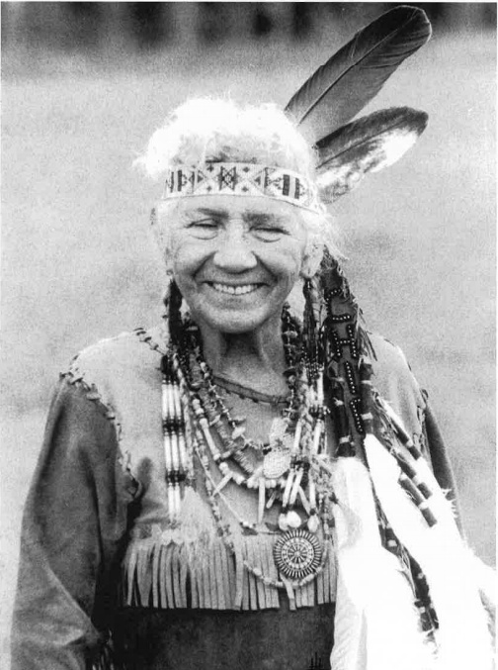
Hunger in the North: Food Banks Canada.
All Indigenous Peoples have the right to eat healthy, affordable food!
https://www.foodbankscanada.ca/Hunger-in-Canada/Hunger-in-the-North.aspx
Alaska

Slide 15
References
Anuik, J. (2015). Applying the First Nations Holistic Lifelong Learning Model to the Study of Crime: A Teaching Note. Exploring Our Connective Educational Landscape. Retrieved From http://ineducation.ca/ineducation/article/view/196/764.
Battiste, M. (2013). Decolonizing education: Nourishing the learning spirit. Saskatoon, SK: Purich Publishing Ltd.
First Nations Growers. (2017). Retrieved From http://firstnationgrowers.com/
Food insecurity in Nunavut 'should be considered a national crisis,' expert says. (2017). CBC News. Retrieved From http://www.cbc.ca/news/health/food-insecurity-1.4122103.
Martin, D., Jamal, A., Ramsay, M., Stothart, C., Veeraraghavan, G., Burnett, K., Skinner, K.,Williams, P. (2016). Paying for Nutrition: A Report on Food Costing in the North. Food Secure Canada. Retrieved From http://www.firstnationgrowers.com/wp-content/uploads/2016/11/paying_for_nutrition_fsc_report_final.pdf.

Slide 16
References
Pomart, P., Gunn, B., Pearce, T. ,Shura, C., Heather O’Mara, H.. (2011). Understanding the United Nations Declaration of Rights of Indigenous Peoples: An Introductory Handbook. Indigenous Bar Association & Faculty of Law. University of Manitoba:Winnipeg. Retrieved From: http://www.indigenousbar.ca/pdf/undrip_handbook.pdf.
Smith, L., T.(1999). Decolonizing Methodologies. Zed Books. Retrieved From: https://nycstandswithstandingrock.files.wordpress.com/2016/10/linda-tuhiwai-smith-decolonizing-methodologies-research-and-indigenous-peoples.pdf.
kura, E. (2016). Food in Nunavut still costs up to 3 times national average. CBC News.http://www.cbc.ca/news/canada/north/nunavut-food-price-survey-2016-1.3650637
Wernichttps, A. (2014). A successful whale hunt in northern Canada revives an ancient Inuit tradition As It Happens. PRI. Retrieved From http://www.pri.org/stories/2014-08-11/successful-whale-hunt-northern-canada-revives-anc
Woo, A. (2014).Critics slam Canada’s northern food program. The Globe and Mail. Retrieved from https://beta.theglobeandmail.com/news/critics-slam-canadas-northern-food-program/article21451386/?ref=http://www.theglobeandmail.com&. The Jerry Cans - Mamaqtuq
"Iqaluit"

