Slide 1
Copyright Act, Section 41: Technological Protection Measures
*September 2019
Notes:
*Updated: December 2024
Hello, and welcome to the University of Alberta’s Opening Up Copyright instructional module on section 41 of the Copyright Act: Technological Protection Measures.

Slide 2
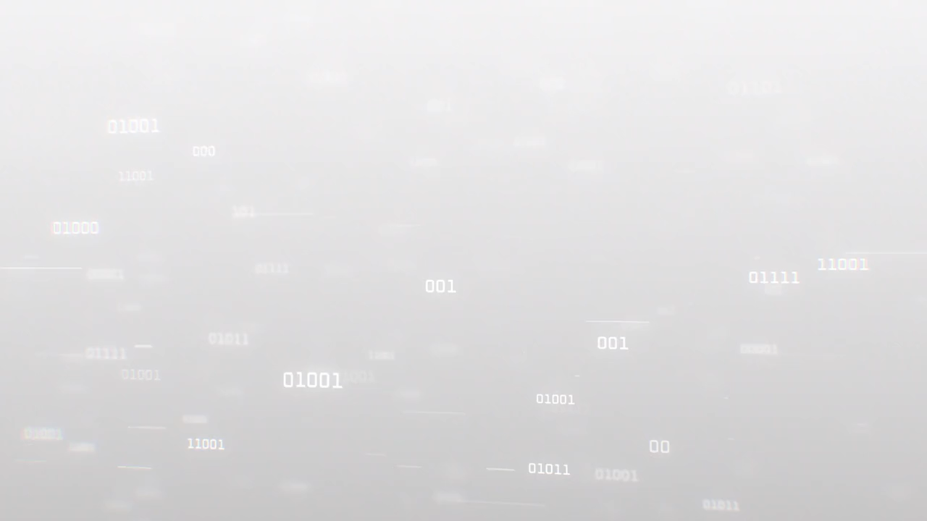


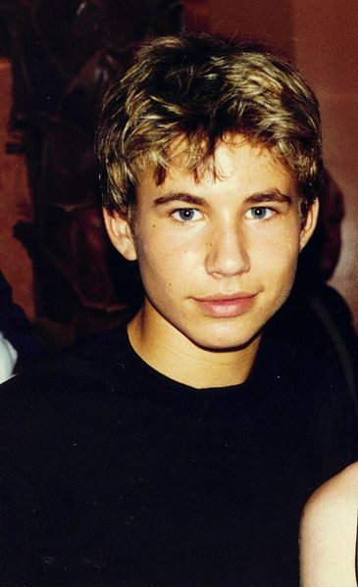

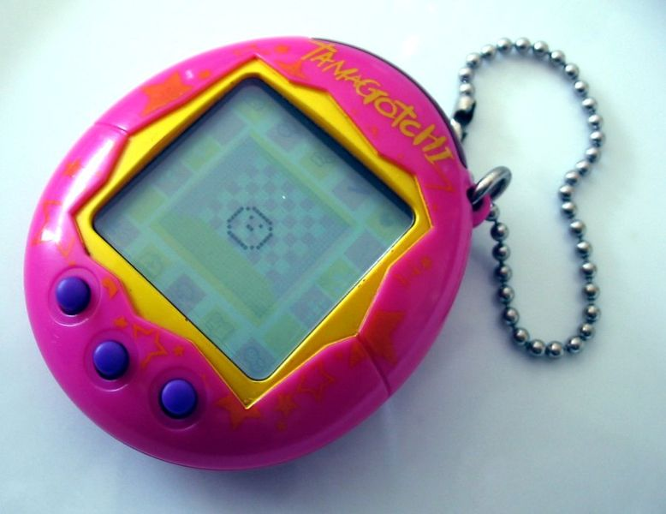
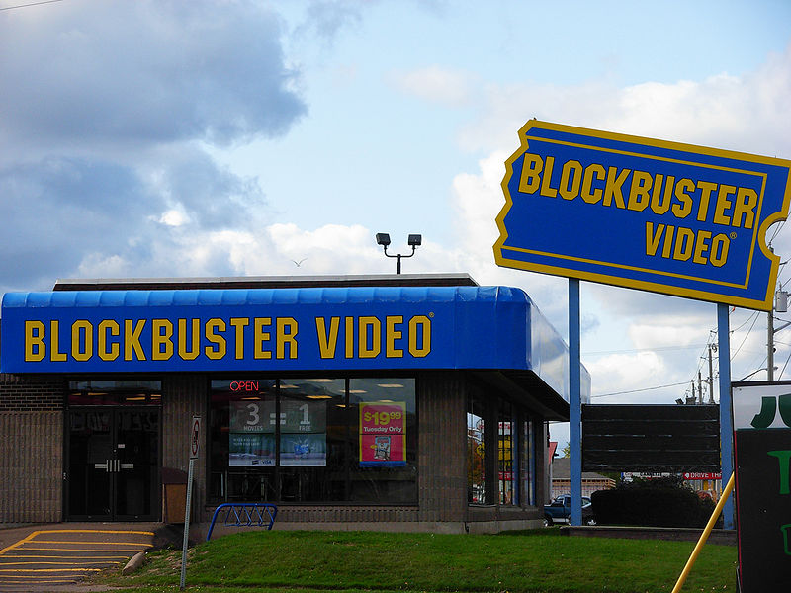

THE RISE OF THE INTERNET
Y2K! THE END IS NIGH!
Notes:
Hey, do you guys remember the nineties? The World Wide Web was just beginning to explode. Despite only having about 10 million active users at that time, analysts were predicting that the internet was going to market for products and services that would grow faster than anything we’d seen in print or broadcasting. In response to concerns that the digital age would create new problems for copyright, and because other attempts to update the Berne Convention and TRIPS didn’t address the internet in particular, the World Intellectual Property Organization adopted a Copyright Treaty in 1996.

Slide 3

THE RISE OF THE INTERNET
©?
WIPO
Notes:
Digital files are very easy to copy, and this makes it very easy to violate copyright on protected works.

Slide 4

THE WIPO COPYRIGHT TREATY
THE WIPO COPYRIGHT TREATY
THE WIPO COPYRIGHT TREATY
Article 11: “Contracting Parties shall provide adequate legal protection and effective legal remedies against the circumvention of effective technological measures that are used by authors in connection with the exercise of their rights under this Treaty or the Berne Convention.”
Notes:
To fight against widespread copying, rights holders began to use technological tools to control access to or copying of protected content.
The WIPO Copyright Treaty, sometimes called the WCT, added protection for these mechanisms in Article 11: “Contracting Parties shall provide adequate legal protection and effective legal remedies against the circumvention of effective technological measures that are used by authors in connection with the exercise of their rights under this Treaty or the Berne Convention.”

Slide 5




TECHNOLOGICAL PROTECTION MEASURES (TPMs)
TECHNOLOGICAL PROTECTION MEASURES (TPMs)
TPMs:
“Any effective technology, device or component” that controls access to a work or that restricts any activity, such as copying, that violates the rights of a copyright holder” (s. 41).
Can control the uses of a work
Can control access to a work
2012 END OF DAYS!
s. 41
“Digital lock” = TPM
Notes:
Canada updated its Copyright Act to add support for Article 11, but this took until 2012. They did it with the introduction of “technological protection measures” (or TPMs) in section 41 of the Copyright Act. The definition is: “any effective technology, device or component” that controls access to a work or that restricts any activity, such as copying, that violates the rights of a copyright holder. To reiterate: a TPM can be used to control the uses of a work, but it can also be used to control access to a work. You may have heard the term “digital lock,” which is a more general term used to describe TPMs.
Now that we’ve decided what a digital lock is in the Copyright Act, we need to understand what happens when someone breaks one or gets around it.

Slide 6

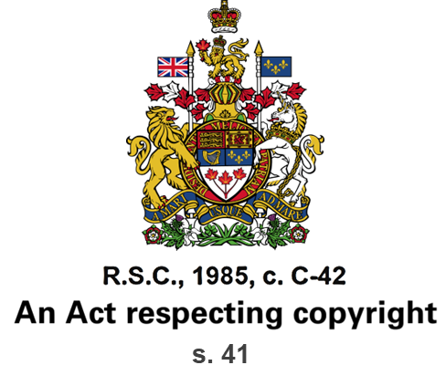
THE CIRCUMVENTION OF TPMs
Impairing
Deactivating
Descrambling
Circumvention
Removing
Decrypting
s. 41
Bypassing
Avoiding
Notes:
Most of section 41 creates rules around the circumvention of TPMs, which the Act defines as descrambling or decrypting a work, or doing things that “avoid, bypass, remove, deactivate or impair” the TPM without the authorization of the rights holder.
There are 9 subsections related to TPMs in the Copyright Act. These define what acts of circumvention are prohibited, and provide a few situations where circumventing a technological protection measure is permitted.
Probably most importantly, section 41.1 states that no person may circumvent a TPM, offer services whose primary purpose is circumvention, or make, import, distribute, sell or rent any technology or device primarily intended to circumvent TPMs. In general, then: you can’t circumvent TPMs.
This prohibition isn’t universal, but the limited number of exceptions allowed in the Act make it pretty close. In fact, you cannot circumvent a TPM for the purposes of fair dealing, which are outlined in section 29 of the Act.

Slide 7


THE CIRCUMVENTION OF TPMs
No person may:
Circumvent a TPM
Offer services whose primary purpose is circumvention
Make, import, distribute, sell or rent any technology or device primarily intended to circumvent TPMs
What acts of circumvention are prohibited?
Notes:
Probably most importantly, section 41.1 states that no person may circumvent a TPM, offer services whose primary purpose is circumvention, or make, import, distribute, sell or rent any technology or device primarily intended to circumvent TPMs. In general, then: don’t circumvent TPMs.
This prohibition isn’t universal, but the limited number of exceptions allowed in the Act make it pretty close. In fact, you cannot circumvent a TPM for the purposes of fair dealing, which are outlined in section 29 of the Act.

Slide 8




CIRCUMVENTION EXCEPTIONS
1
If you are in law enforcement, working for the purposes of national security (s. 41.11)
2
You need to get pieces of software to interoperate with one another (s. 41.12)
3
  You are engaged in research related to encryption technologies (s. 41.13)
4
  You need to prevent software from collecting personal information
  (s. 41.14)
Notes:
The circumvention exceptions are limited to seven very narrow cases. Here are the reasons you can circumvent a technological protection measure:
If you are in law enforcement, working for the purposes of national security
You need to get pieces of software to interoperate with one another
You are engaged in research related to encryption technologies, which are often used to build and implement TPMs
You need to prevent software from collecting personal information, or verify that it does not collect personal information

Slide 9



CIRCUMVENTION EXCEPTIONS
5
You have perceptual disabilities or provide support services to people with perceptual disabilities
(s. 41.16)
6
You are broadcasting a copyright-protected work and the rights holder has not given you a TPM-free way to do the broadcast
(s. 41.17)
7
You need to circumvent a TPM on radio equipment in order to get access to a telecommunications service
(s. 41.18)
Notes:
You have perceptual disabilities or provide support services to people with perceptual disabilities, in a case where the TPM impairs the accessibility of content
You are broadcasting a copyright-protected work and the rights holder has not given you a TPM-free way to do the broadcast
You need to circumvent a TPM on radio equipment in order to get access to a telecommunications service

Slide 10


CIRCUMVENTION EXCEPTIONS
But wait…
there are 2 more!
41.11 Law enforcement and national security
41.12 Interoperability
Diagnosis, maintenance and repair
41.13 Encryption research
41.14 Personal information
Security
41.16 Persons with perceptual disabilities
41.17 Broadcasting undertakings
41.18 Radio apparatus
8
  You want to maintain or repair a product, either for yourself or for someone else
  (s. 41.121)
  41.121
9
You are assessing or correcting flaws in computer or network security
(s. 41.15)
41.15

Slide 11
CIRCUMVENTION EXCEPTIONS
Notes:
This limited range of exceptions for circumvention is controversial.

Slide 12


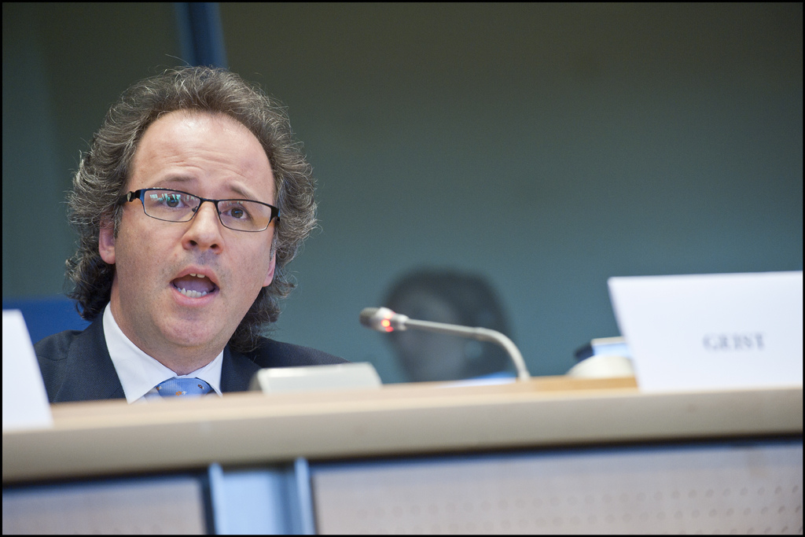


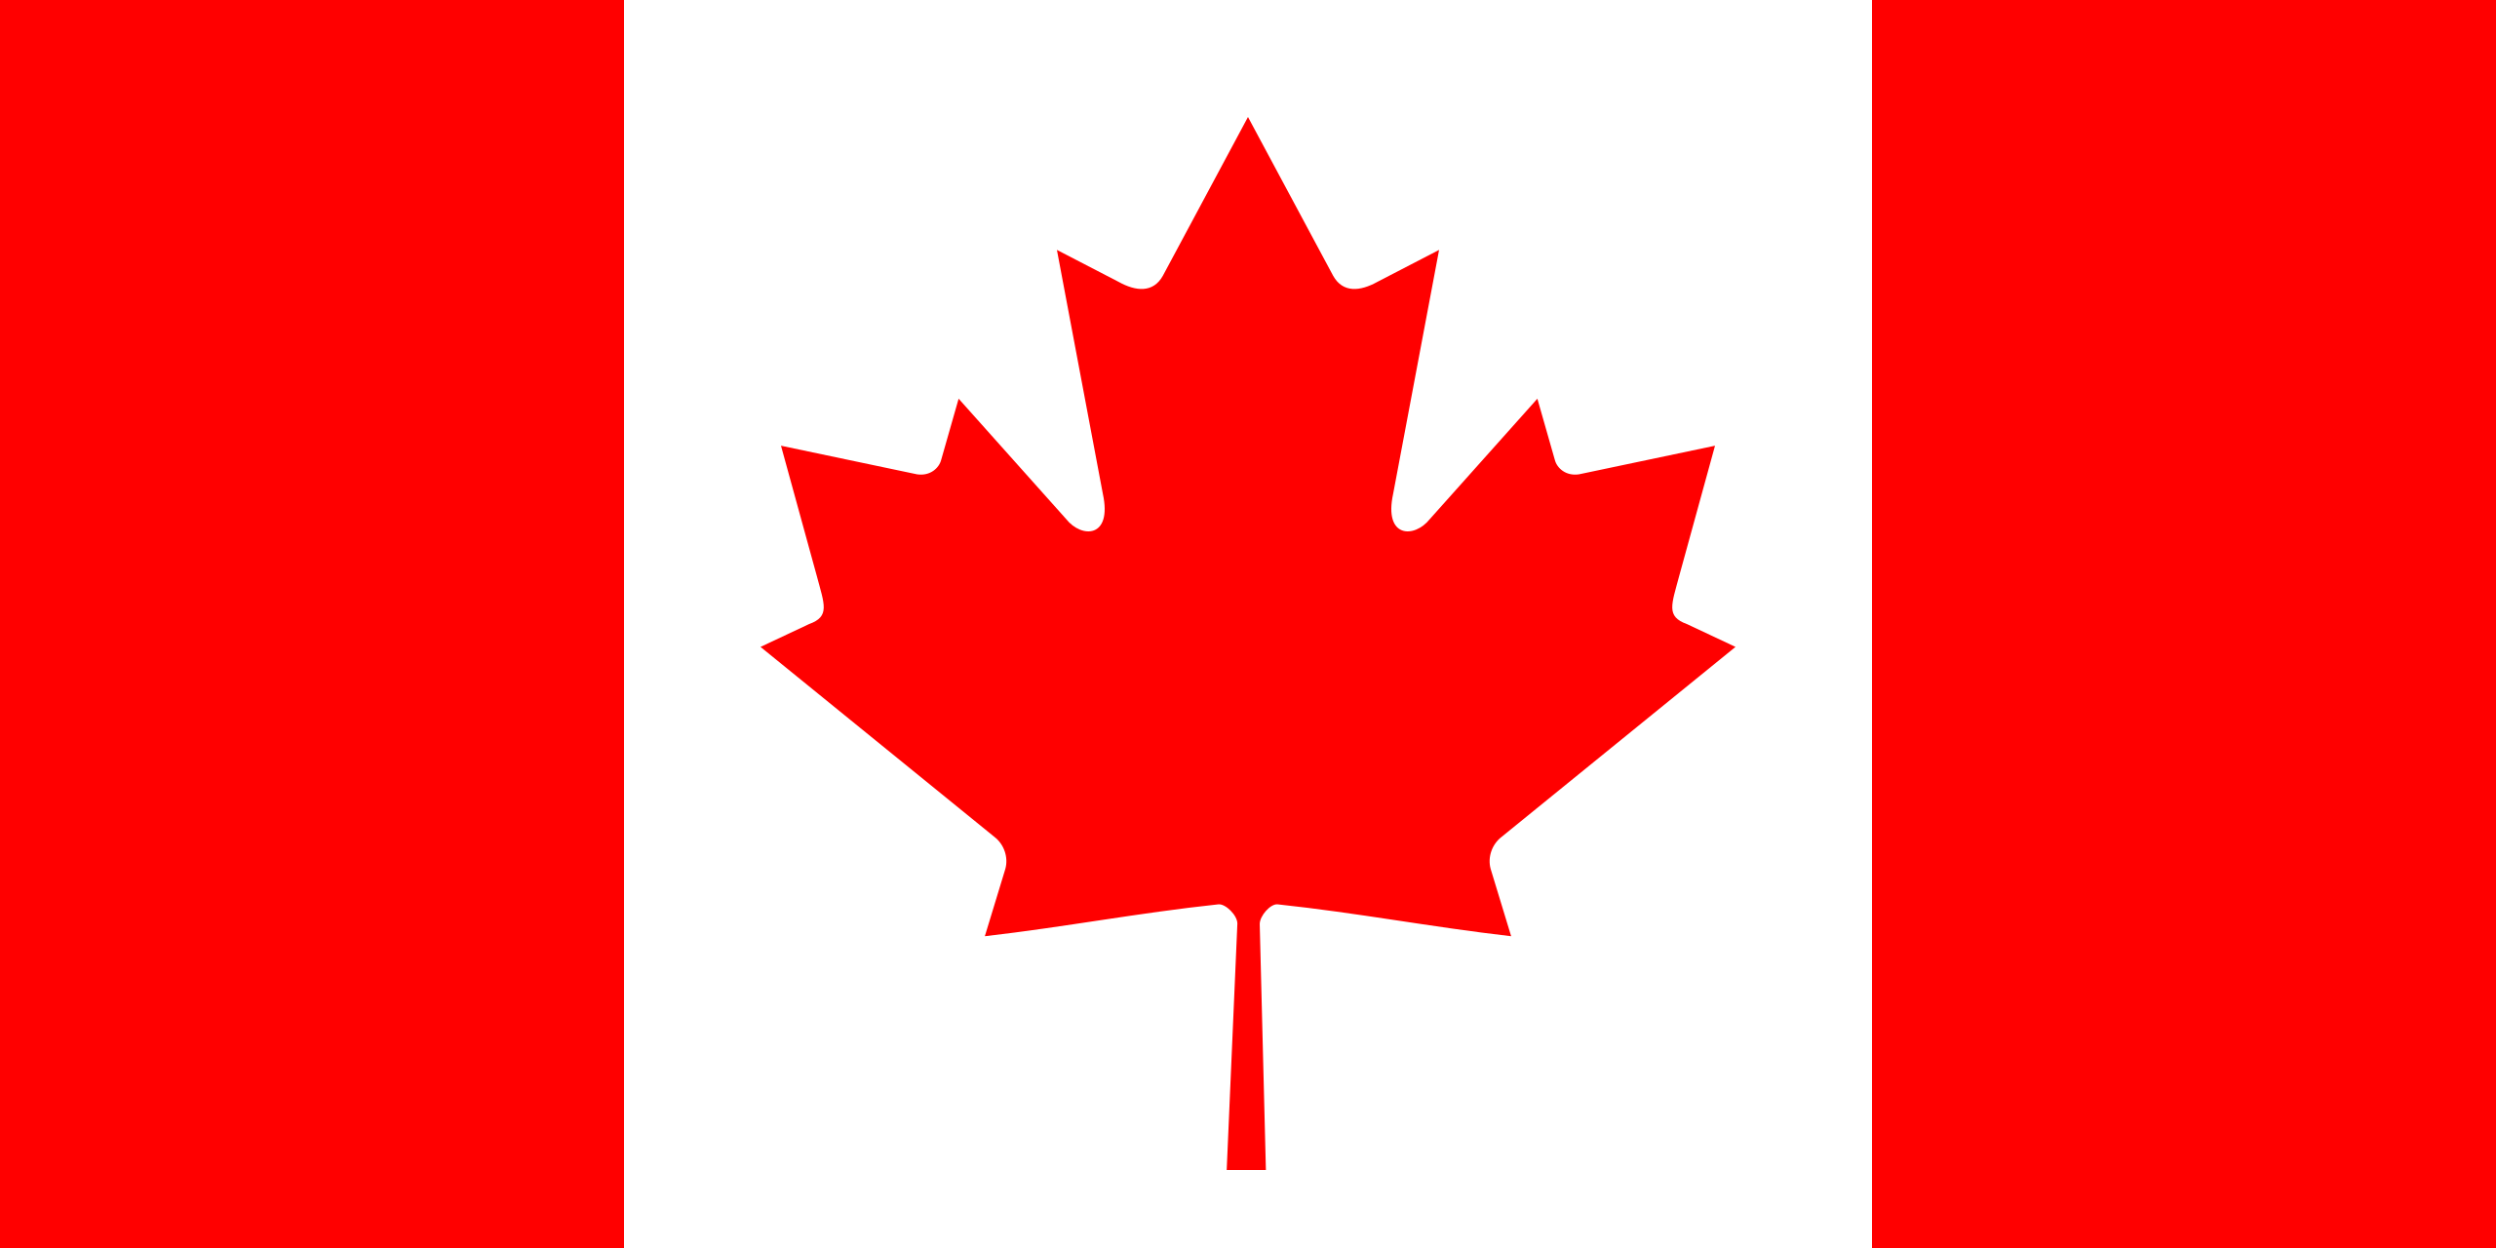
CONTROVERSY
YOU GOT THAT RIGHT, JTT.
DUDE, THERE SHOULD BE EXCEPTIONS WHEN IT IS FOR NON-INFRINGING PURPOSES!
MUAHHAHAHAHA!
…Furthermore, those who would infringe can easily access and use circumvention software through the Internet–almost all digital lock mechanisms are eventually broken. The locks thus do not stop those determined to break the law. Instead, they merely frustrate legitimate consumers and creators.”
“Archivists and librarians cannot preserve locked content without breaking the law; filmmakers, news reporters, and other innovative creators cannot legally access the content they need. These restrictions undermine Canadian innovation and the public domain...
Notes:
After the provisions were implemented in 2012, law professor Michael Geist shared statements from a broad range of dissenters. All of these complaints echo the same theme: there should be exceptions to circumvention in cases where the digital lock is being bypassed for non-infringing purposes. As CIPPIC stated in its comments during the Copyright Act review:
“Archivists and librarians cannot preserve locked content without breaking the law; filmmakers, news reporters, and other innovative creators cannot legally access the content they need. These restrictions undermine Canadian innovation and the public domain. Furthermore, those who would infringe can easily access and use circumvention software through the Internet–almost all digital lock mechanisms are eventually broken. The locks thus do not stop those determined to break the law. Instead, they merely frustrate legitimate consumers and creators.”

Slide 13
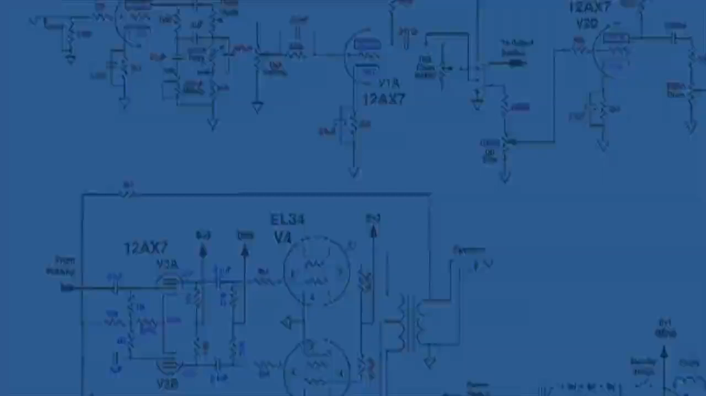
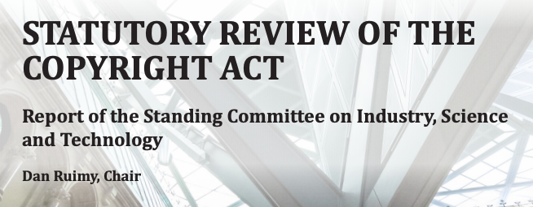

DIFFERING PERSPECTIVES
“…while anti-circumvention rules should support the use of TPMs to enable the remuneration of rights-holders and prevent copyright infringement, they should generally not prevent someone from committing an act otherwise authorized under the [Copyright] Act” (INDU Committee, 2019).
Notes:
On the other hand, groups like the Canadian Publishers Council believe that TPMs are critical to protecting their businesses, ensuring that creators are compensated properly for their works, and preventing unauthorized modification of digital content such as video games.
These concerns were reflected in the INDU Committee’s report in June 2019 from its statutory review of the Copyright Act, where it wrote “while anti-circumvention rules should support the use of TPMs to enable the remuneration of rights-holders and prevent copyright infringement, they should generally not prevent someone from committing an act otherwise authorized under the [Copyright] Act.”

Slide 14
BALANCE OF RIGHTS
RIGHTS OF CREATORS RIGHTS OF USERS
Notes:
Technological Protection Measures can serve to protect the rights of copyright holders, but like the Copyright Act itself, there is a delicate balance to strike between the rights of creators and the rights of users.

Slide 15
LEARNING OBJECTIVES
You should now be able to:
  Define “technological protection measures” as they are outlined in Canada’s Copyright Act
  Summarize the conditions under which a technological protection measure may be circumvented without penalty
  Understand the connection between s. 41 of the Copyright Act and the WIPO Copyright Treaty
Notes:
You should now be able to:
Define “technological protection measures” as they are outlined in Canada’s Copyright Act
Summarize the conditions under which a technological protection measure may be circumvented without penalty
Understand the connection between section 41 of the Copyright Act and the WIPO Copyright Treaty

Slide 16
Notes:
This has been the University of Alberta’s Opening Up Copyright instructional module on section 41 of the Copyright Act: Technological Protection Measures. Thank you for your attention.

Slide 17
The Act defines a technological protection measure as “any effective technology, device or component” that:
  Controls access to a work or that restricts any activity that violates the rights of a copyright holder
  Is completely effective in preventing this misuse of copyright-protected materials
  Informs potential users that they are accessing copyright-protected works
  Prevents the modification of works that are both covered under copyright and in the public domain
Section 41.1 of the Copyright Act states that no person may:
  Circumvent a TPM
  Offer a service to circumvent a TPM
  Make, import, distribute, sell or rent any technology or device primarily intended to circumvent TPMs
  All of these

Slide 18
Under which of the following conditions is it okay to circumvent a TPM?
  When the purpose of using the material is covered under fair dealing
  When a library or archive is attempting to preserve locked content
  If you are in law enforcement, working for the purposes of national security
  If you are a news reporter and you require access in order to verify the facts of your story
Controversy around TPMs in the Copyright Act often centers around the argument that:
  There should be exceptions to circumvention in cases where the digital lock is being bypassed for non-infringing purposes
  Anyone can get around a digital lock, so what is the point?
  TPMs mean that the rich get richer
  TPMs are really annoying

Slide 19
Which of the following is NOT one of the seven reasons you can circumvent a TPM?
  You are engaged in research related to encryption technologies
  You need to prevent software from collecting personal information
  An evil mastermind is broadcasting a hypnotic mind-control signal over the airwaves which will brainwash millions and you need to stop them, by jingo!
  You have perceptual disabilities
Canada implemented TPM protection in s. 41 of the Copyright Act in 2012 in order to comply with this international treaty:
  Berne Convention
  TRIPS Agreement
  WIPO Copyright Treaty (WCT)
  Treaty of Versailles
  The Nairobi Treaty

Slide 20
Carlson, N. (2014). Presenting: This is what the internet looked like in 1996. Business Insider. https://www.businessinsider.com/the-coolest-web-sites-from-1996-2014-4
IFPI. (2003, March). The WIPO treaties: Technological measures. https://web.archive.org/web/20180417033805/https://www.ifpi.org/content/library/wipo-treaties-technical-measures.pdf
INDU Committee. (2019). Statutory review of the Copyright Act. https://www.ourcommons.ca/Content/Committee/421/INDU/Reports/RP10537003/indurp16/indurp16-e.pdf
Samuelson, P. (1996). The US digital agenda at WIPO. Virginia Journal of International Law, 37(369), 369-440.
Sheinblatt, J. (1998). The WIPO Copyright Treaty. Berkeley Technology Law Journal, 13(1): 535-550. https://doi.org/10.15779/Z383X1Q
World Intellectual Property Organization. (n.d.). WIPO copyright treaty (WCT). Retrieved from https://www.wipo.int/treaties/en/ip/wct/

Slide 21
Copyright Act, RSC 1985, c C-42. https://laws-lois.justice.gc.ca/eng/acts/c-42/page-1.html

Slide 22
virctorhfs. (2019). Computer sounds (chuck generated). Freesound. CC 0. https://freesound.org/people/victorhfs/sounds/469782/
MavsFan28. (1998). Jonathan Taylor Thomas. Wikimedia Commons. CC BY-SA. https://commons.wikimedia.org/wiki/File:Jonathan_Taylor_Thomas.jpg
RCA Records. (1998). ’N sync logo. Wikimedia Commons. CC BY-SA. https://commons.wikimedia.org/wiki/File:%27N_Sync_Logo.svg
NBC. (2021). [Fresh Prince logo]. Wikimedia Commons. https://commons.wikimedia.org/wiki/File:Fresh_Prince_Bel_Aire_logo.png
[Megaphone]. (2018). Pixabay. https://pixabay.com/vectors/megaphone-icon-symbol-design-3790270/
Government of Canada. (2018). Official rendition of the coat of arms of Canada. Converted to svg by Zscout370. Wikipedia. https://en.wikipedia.org/wiki/Arms_of_Canada#/media/File:Coat_of_arms_of_Canada.svg
Jacques_Barrette (2018). [Code video]. Pixabay. https://pixabay.com/videos/technology-computer-network-17077/

Slide 23
Stu pendousmat. (2008). A blockbuster location in Moncton. Wikimedia Commons. CC BY-SA. https://commons.wikimedia.org/wiki/File:BlockbusterMoncton.JPG
Thomasz Sienicki. (2005). [Tamogatchi]. Wikimedia Commons. CC BY-SA. https://commons.wikimedia.org/wiki/File:Tamagotchi_0124_ubt.jpeg
crz1990. (2011). Keyboard typing sounds. Freesound. CC BY. https://freesound.org/people/crz1990/sounds/135872/
tommyvideo. (2016). [Computer video]. Pixabay. https://pixabay.com/videos/computer-keyboard-technology-5399/
Adrien Coquet. (2018). Unlock. The Noun Project. CC BY. https://thenounproject.com/icon/unlock-1862800/
Mohamed_hassan. (2018). [Copyright thief]. Pixabay. https://pixabay.com/illustrations/copyright-stealing-asset-bag-3197524/
Nick Bluth. (2016). Avoid. The Noun Project. CC BY. https://thenounproject.com/icon/avoid-337011/

Slide 24
OpenClipart-Vectors. (2013). [Prohibited symbol]. Pixabay. https://pixabay.com/vectors/prohibited-don-t-do-not-ban-155486/
qubodup. (2008). Whoosh. Freesound. CC 0. https://freesound.org/people/qubodup/sounds/60013/
Rflor. (2015). Police investigation. The Noun Project. CC BY. https://thenounproject.com/icon/police-investigation-286692/
Arthur Bauer. (2018). Interoperate. The Noun Project. CC BY. https://thenounproject.com/icon/interoperate-1624548/
Edwin PM. (2018). Lock. The Noun Project. CC BY. https://thenounproject.com/icon/lock-1786028/
Eliricon. (2017). Big data. The Noun Project. CC BY. https://thenounproject.com/icon/big-data-1434542/
Gregor Cresnar. (2018). Help. The Noun Project. CC BY. https://thenounproject.com/icon/help-1616214/
Montu Yadav. (2015). Broadcast. The Noun Project. CC BY. https://thenounproject.com/icon/broadcast-201837/

Slide 25
OCHA Visual. (2012). Emergency telecommunications. The Noun Project. CC BY. https://thenounproject.com/icon/emergency-telecommunications-4213/
Jay_You. (2019). Music elevator ext part 1/3. Freesound. CC BY. https://freesound.org/people/Jay_You/sounds/467243/
AVAM. (2019). Computer repair. The Noun Project. CC BY. https://thenounproject.com/icon/computer-repair-3455747/
Kholifah. (2024). Network security. The Noun Project. CC BY. https://thenounproject.com/icon/network-security-6744214/
European Parliament. (2012). ACTA workshop at the EP. [Michael Geist]. Flickr. (CC BY-NC-ND 2.0). https://www.flickr.com/photos/european_parliament/6944244255/
Rob Crosswell. (2017). Library. The Noun Project. CC BY. https://thenounproject.com/icon/library-1122689/
basadev4. (2017). [Andre]. Pixabay. https://pixabay.com/illustrations/black-avatar-cute-cheerful-3025348/

Slide 26
raditya cadwraight. (2018). Microphone. The Noun Project. CC BY. https://thenounproject.com/icon/microphone-1685533/
DigestContent. (2019). Thump. Freesound. CC 0. https://freesound.org/people/DigestContent/sounds/458877/
tommyvideo. (2016). [Data locked video]. Pixabay. https://pixabay.com/videos/electronics-circuit-component-5364/
Canadian Publishers Council logo [Screenshot]. (n.d.). Retrieved from https://pubcouncil.ca/
Statutory review of the Copyright Act [Screenshot of cover page]. (2019). Retrieved from https://www.ourcommons.ca/Content/Committee/421/INDU/Reports/RP10537003/indurp16/indurp16-e.pdf
Closing Slides Music: Rybak, Nazar. (n.d.). Corporate Inspired. HookSounds. CC BY. http://www.hooksounds.com
Unattributed materials are contributions from the Opening Up Copyright Project Team and placed in the Public Domain.

Slide 27
University of Alberta. (2019). Copyright Act, Section 41: Technological Protection Measures. Opening Up Copyright Instructional Module. https://sites.library.ualberta.ca/copyright/

