Slide 1
Collective Licensing Agencies and the Copyright Board
*July 2020
Notes:
*Updated: January 2025
Hello and welcome to the University of Alberta’s Opening Up Copyright instructional module on collective licensing and the Copyright Board.

Slide 2
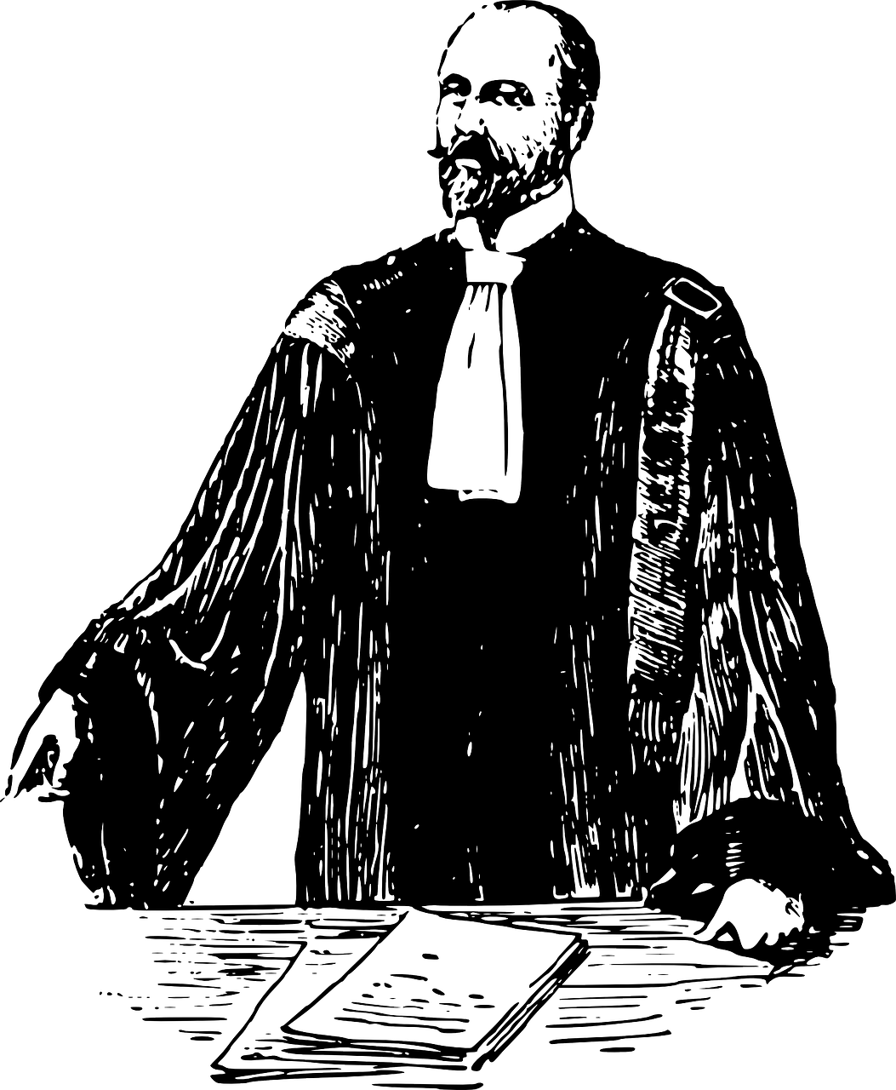
COLLECTIVE LICENSING AGENCIES
SODRAC
COPIBEC
CARCC
DID SOMEONE SAY LAWYER?!
Collectives
©
Notes:
Do you know what COPIBEC, SODRAC and CARCC are? I’ll give you a hint – they are not the most popular baby names of 2020, but collective licensing agencies! Collective licensing agencies, or collectives, are societies that represent creators and owners of copyright-protected works. These collectives do not represent all rights holders and do not themselves own the rights to works, but rather act on behalf of participating rights holders by administering licences to their works. It all sounded great on paper... until most people in post-secondary stopped using paper. Then things got confusing. And that was before the lawyers got involved. The decade-long lawsuits that followed made things even more unclear.

Slide 3
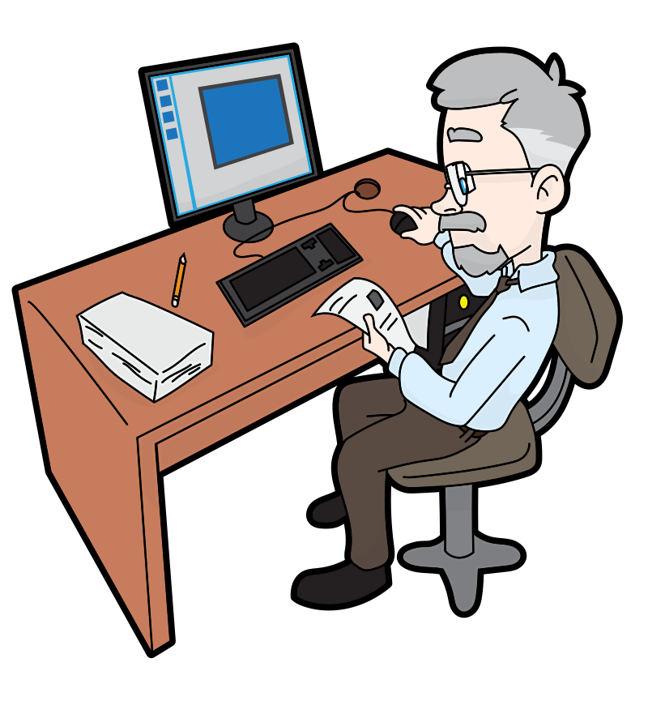
COLLECTIVE LICENSING AGENCIES
©
Notes:
Locating and negotiating with copyright holders when you want to use their books or songs can be a long process, and for large organizations, such as a Ministry of Education, negotiating separately with each of the rights holders for works that teachers might copy from is too complicated and time-consuming a process.
Collectives can provide licences for specific re-use rights associated with copyright-protected works and will redistribute some of the associated fees to the individual rights holders of those works. These licences can outline how all of the items in a collective’s repertoire can be used and for what purposes, which might be called a “blanket licence.” But collectives can also offer licences that refer specifically to a particular work and outline specific limitations and conditions around the use of that work. Therefore, when collective licencing agencies are working effectively, they can be super useful for publishers and businesses, as well as for non-corporate rights holders. However, many of these agencies have, in practice, proven very controversial with both users and creators alike.

Slide 4
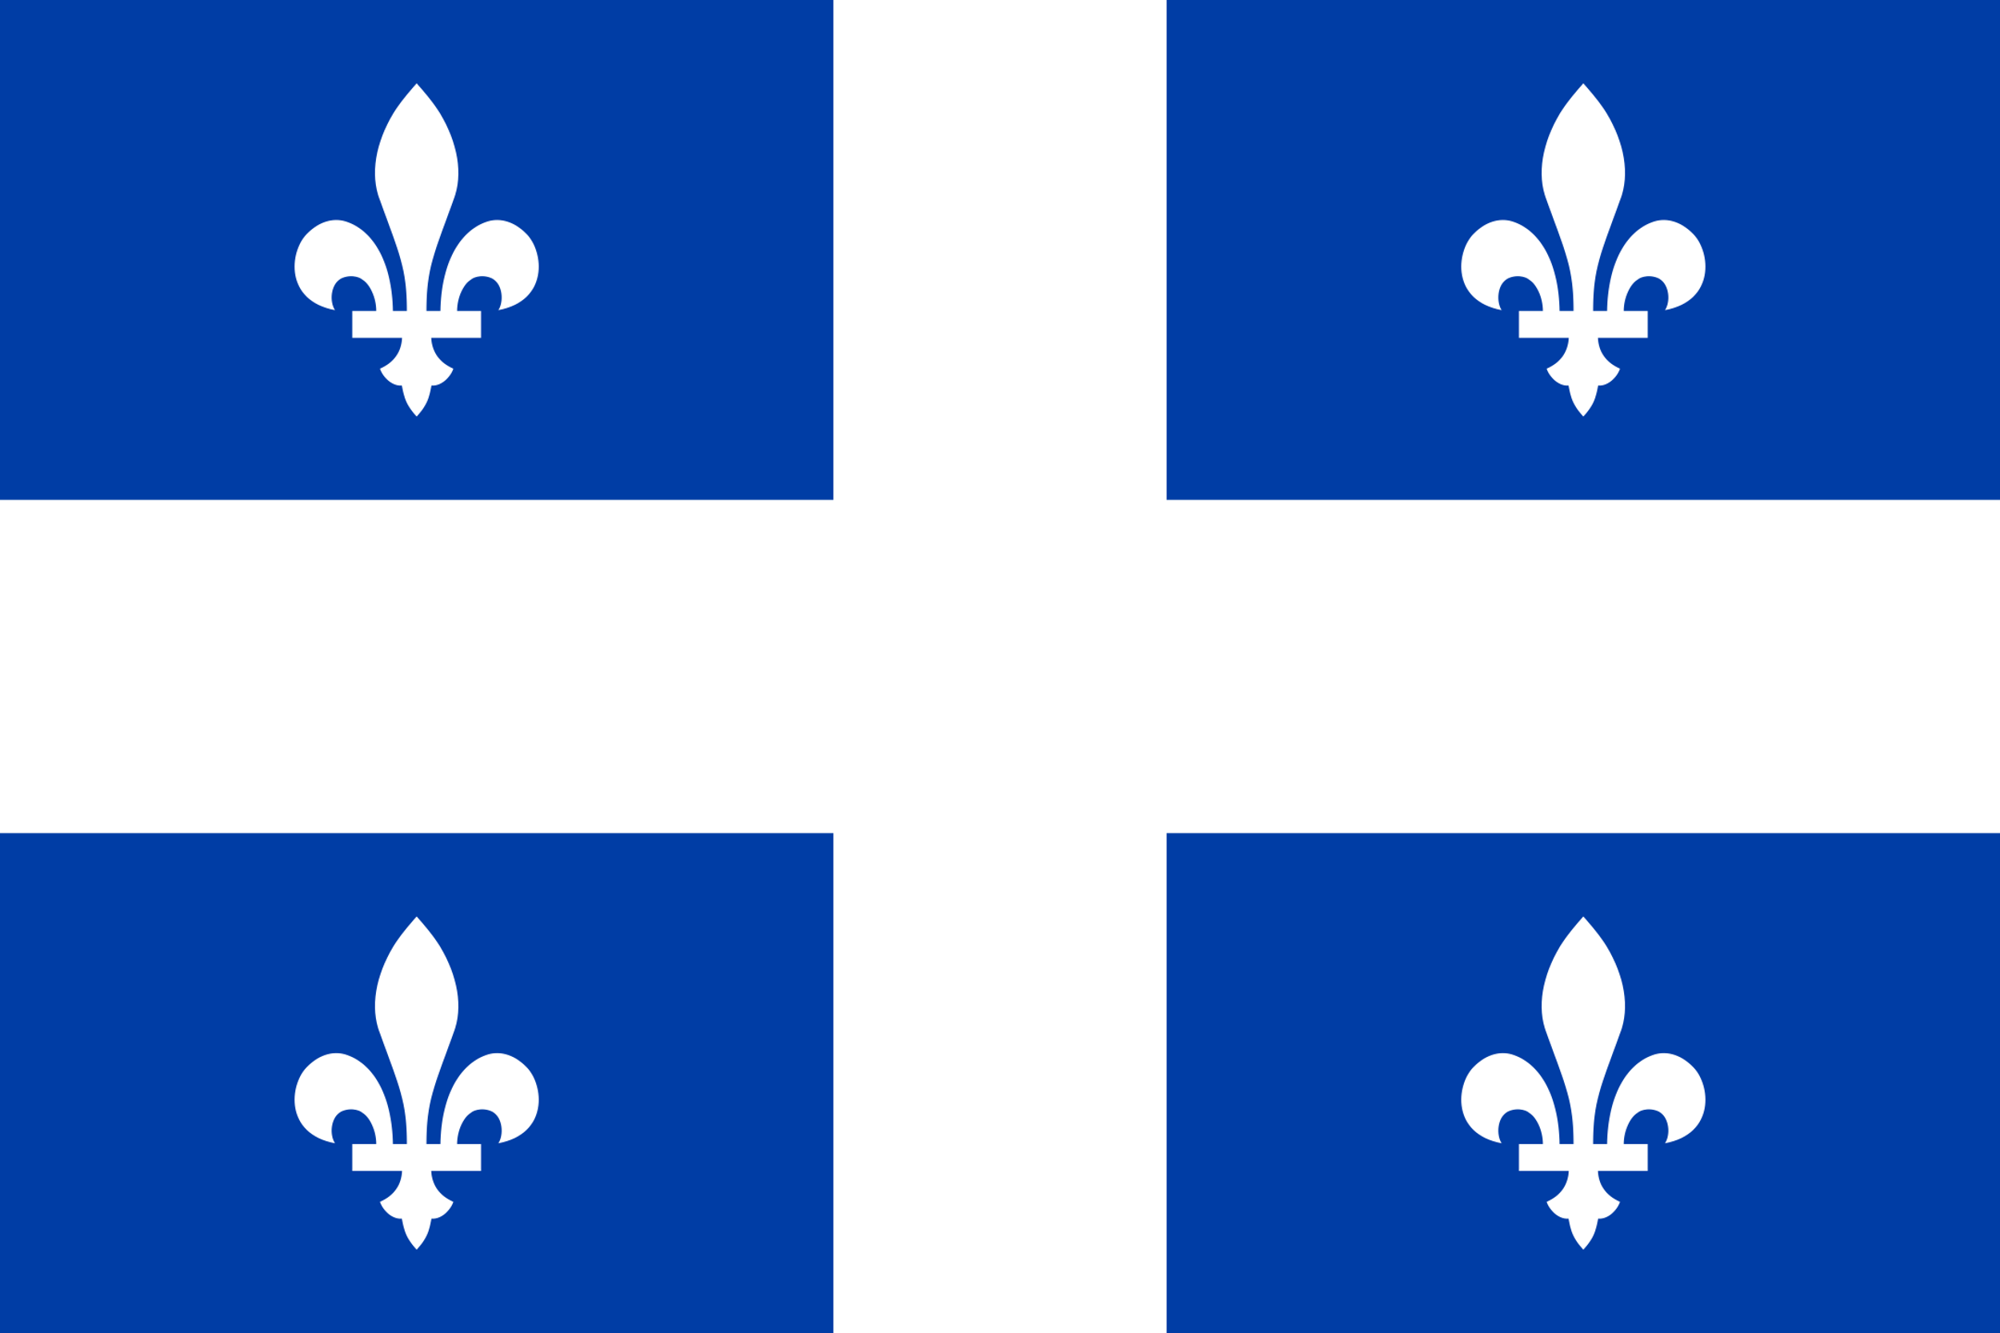
COLLECTIVE LICENSING AGENCIES
SOCAN
Access
Copyright
COPIBEC
Notes:
For better or worse, Canada is a global leader when it comes to the number of collective licensing agencies, with over thirty such groups, which can make things a little confusing.
For example, the Society of Composers, Authors, and Music Publishers of Canada or SOCAN is one of eleven different music-related collectives and represents rights owners of musical works. It acts as an intermediary with radio stations or other venues that pay for the right to broadcast or “perform” recordings of those works. Access Copyright is another collective founded by groups of creators and publishers to license the photocopying of works, except for in Quebec, where Copibec is the responsible collective. Educational institutions can enter into licensing agreements with individual publishers or collectives such as Access Copyright, which grant certain rights in exchange for fee. Collective licensing agencies such as Access Copyright and SOCAN are regulated by the Copyright Board of Canada. So what is the Copyright Board?

Slide 5
THE COPYRIGHT APPEAL BOARD
THEY’RE HIGHWAYMEN!
STOP THEM, BOARD!
Notes:
The Copyright Appeal Board (later simply the Copyright Board) was established under the Copyright Act in 1936. The Copyright Appeal Board initially dealt exclusively with the regulation of tariffs for the public performance right of music. The mandate of the original board was to control the egregious demands and increases in the costs of licences set out by the Canadian Performing Right Society, a collective at the time. The Copyright Appeal Board’s goal was to balance the rights of copyright holders with the rights of users.

Slide 6
THE COPYRIGHT BOARD
Before 1988 collectives only represented rights owners of musical works
1988
Notes:
Following the 1988 revisions to the Copyright Act, the Copyright Board would oversee collective administration in all existing and future areas – not just for music. The 1988 revisions also allowed for the creation of new collective societies that could collect fees on behalf of any group of creators. The Copyright Board is part of the Government of Canada, but, rather than being a direct government department, it is a quasi-judicial arm’s length regulatory agency. Basically, that is a mouthful for saying that it is a regulator that has some degree of independence from the government.

Slide 7
THE COPYRIGHT BOARD
???
BORED!
BORED!
✓
BORED!
Tariff
BORED!
Notes:
When users and institutions enter into a licence agreement with one of these collective licensing agencies, that licence allows them to use works in that collective’s repertoire in the ways that are outlined in the terms and conditions of that licence. This is supposed to make things simpler and easier, but that doesn’t always happen.
When issues around the terms and conditions of a licence agreement with a collective arise, collectives can apply to the Copyright Board to address the situation with a tariff. The Canadian Copyright Act requires that the Copyright Board consider the proposed tariffs, which can then be approved by the Board either with or without alterations.
The Board does not make or establish tariffs but rather it considers proposed tariffs submitted to it by collective societies. An approved tariff is then published in Part 1 of the Canada Gazette, which, in case you didn’t know (because almost nobody does), is the official newspaper of the Government of Canada.
I know what you are thinking: Copyright Board? More like Copyright BORED! I know, my friends, I know – this is dry stuff! Lucky for you we can’t cover every aspect of collective licensing here, but let's get to some spicy tension areas around these collectives. I’ll even throw in some exciting sound effects to help get us all through this.

Slide 8
TENSION: ARE TARIFFS MANDATORY?
Tariff
Notes:
One hotly contested issue is whether tariff proposals that have been approved by the Copyright Board are mandatory, even for those who have not agreed to the licence. This issue was directly addressed in Access Copyright v. York and the appeal that followed.

Slide 9
TENSION: WHO BENEFITS?
WHAT’D I MISS?
“…schools, colleges and universities think they are paying money to writers, but they are not. Writers get virtually nothing.” (Murray & Trosow, 2013, p. 91)
Notes:
Collective licensing agencies’ distribution of revenue that the collective receives as royalties or licence fees and other practices are also controversial. Despite assertions that they are designed to represent the interests of creators, collectives’ distribution practices have been criticized for actually putting writers at a disadvantage. For example Access Copyright has long been criticized for distribution practices that primarily reflect the interests of large academic publishing companies as opposed to those of the writers. This is significant because, as Murray and Trosow put it, “...schools, colleges and universities think they are paying money to writers, but they are not. Writers get virtually nothing” (p 91). Indeed, in some ways it appears that collectives such as Access Copyright have found a business model in collective licensing that, well… makes money to support the collective instead of its members.

Slide 10
TENSION: STRUCTURE OF THE COPYRIGHT BOARD
✓
DID SOMEONE SAY LAWYER?!
Tariff
Federal Court of Canada
Notes:
Another tension that exists in relation to the Copyright Board is that there is no internal appeal process available to either copyright user or owner if they are dissatisfied with the ruling of the board. The only option is an appeal to the Federal Court. This is not an attractive option for small groups of users or independent users given the costs associated with litigation (D’Alton, 2013, p. 210-211).

Slide 11
TENSION: USER REPRESENTATION
BUSTED!
OKAY!
SO, SUE US!
BUSTED
AGAIN!
ASK MY BUDDY FOR ADVICE! HE’S AN EXPERT
vs.
Tariff Levels
Notes:
Another concern is that while the role of both the Copyright Board, and copyright law in general, is to balance the rights of owners with the rights of users, the Board is often composed primarily of intellectual property experts. Thus, the views of the average user are often underrepresented on the Board. This has potentially contributed to the “upward creep” trend in tariff levels with collectives.
A similar criticism of the functioning of the board is that there is often great value placed on the testimony of “expert” witnesses when disagreements arise between collectives and user. There is sometimes concern that many of these “experts are in fact closely related to the industries petitioning the board” (D’Alton, 2013, p.211). This behaviour would go against the normal evidentiary principles that guide the Canadian court system, but remember the Copyright Board is not technically a court.

Slide 12
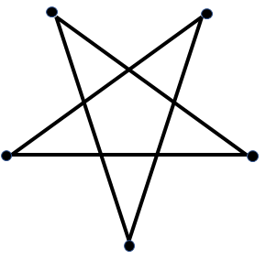
COLLECTIVES AND LITIGATION
NEXT STOP LITIGATION STATION!
SOCAN v. Bell
Alberta (Education) v. Access Copyright
v.
Rogers v. SOCAN
Re:Sound v. MPTAC
Access Copyright
ESAC v. SOCAN
Notes:
Despite the fact that collectives such as SOCAN and Access Copyright are relatively new, these groups have been very active in copyright litigation. In the pentalogy of Supreme Court cases on copyright in 2012, all five involved a collective (and bad news for the collectives, they lost in four of those five cases). It was a mere hot second (well, 9 months) after the pentalogy decision in June 2012 before Access Copyright was at it again, filing the claim against York University in 2013. Ongoing legal action on the part of collectives might impede or discourage legitimate uses of copyrighted material by users or institutions. Some have suggested that…

Slide 13
COLLECTIVES AND LITIGATION
Collectives
Notes:
…rather than threatening to sue over the scope of fair dealing, perhaps collectives could follow models such as Spotify or iTunes and provide licences or downloads of specific works (or excerpts of works) for low fees. Or perhaps we will find that new collectives will emerge and bring with them a new approach to collective licencing. (Murray & Trosow, 2013, p. 235)

Slide 14
LEARNING OBJECTIVES
You should now be able to:
Describe the roles of the Copyright Board and collective licensing agencies in the Canadian copyright landscape
Summarize the regulatory relationship between collective licensing agencies and the Copyright Board
Notes:
You should now be able to:
Describe the roles of the the Copyright Board and collective licensing agencies in the Canadian copyright landscape
Summarize the regulatory relationship between collective licensing agencies and the Copyright Board

Slide 15
Notes:
This has been the University of Alberta’s Opening Up Copyright instructional module on collective licensing agencies and the Copyright Board. Thank you for your attention.

Slide 16
The original intention of the Copyright Appeal Board was to:
Balance the rights of copyright owners with those of users
Regulate the tariffs for the performance right of music
Control the egregious increases in the costs of licences set out by a collective licensing agency at the time
All of the above
The Copyright Board is:
A court of law
Fully independent of the Government of Canada
A quasi-judicial, arm's length regulatory agency
A Quasimodo arm's length gargoyle of Notre Dame

Slide 17
When users and institutions enter into a licence agreement with a collective licensing agency, they are allowed to use works in that collective’s repertoire in the ways that are outlined in the terms and conditions of that licence.
True
False
When issues around the terms and conditions of a licence agreement with a collective arise, collectives can apply to the Copyright Board to address the situation with a tariff.
True
False
An approved tariff is published in Part 1 of the official newspaper of the Government of Canada which is called:
Pravda
The Canada Gazette
The Canada Gazelle
The Canada Impala

Slide 18
Brett, B. (2012). An open letter to Access Copyright and the Canadian copyright emergency. The Tyee. https://web.archive.org/web/20170714224000/https://thetyee.ca/Mediacheck/2012/06/28/Access-Copyright/
Copyright Board of Canada. (n.d.). Mandate, Jurisdiction & Role. Retrieved from https://www.cb-cda.gc.ca/en/about-us/mandate-jurisdiction-role
D'Alton, L. J. (2012). A critical historical analysis of the public performance right [Doctoral dissertation, University of Western Ontario]. Electronic Thesis and Dissertation Repository. 442. https://ir.lib.uwo.ca/etd/442
Gervais, D. J. (2008). A uniquely Canadian institution: The Copyright Board of Canada. In Y. Gendreau (Ed.), An Emerging intellectual property paradigm: Perspectives from Canada (pp. 197-226). Edward Elgar Publishing. https://ssrn.com/abstract=1335948
Murray, L. J., & Trosow, S. E. (2013). Canadian copyright: A citizen’s guide (2nd ed.). Between the Lines.

Slide 19
Tkachuk, D., & Day, J. A. (2016). Copyright Board: A rationale for urgent review. Report of the Standing Senate Committee on Banking, Trade and Commerce. Senate of Canada. https://sencanada.ca/content/sen/committee/421/BANC/Reports/FINALVERSIONCopyright_e.pdf
Vaver, D. (2011). Intellectual property law: Copyright, patents, trade-marks (2nd ed.). Irwin Law.

Slide 20
Alberta (Education) v. Canadian Copyright Licensing Agency (Access Copyright), 2012 SCC 37. https://decisions.scc-csc.ca/scc-csc/scc-csc/en/item/9997/index.do
Canadian Copyright Licensing Agency v. York University, 2017 FC 669. https://decisions.fct-cf.gc.ca/fc-cf/decisions/en/item/232727/index.do
Entertainment Software Association v. Society of Composers, Authors and Music Publishers of Canada, 2012 SCC 34. https://decisions.scc-csc.ca/scc-csc/scc-csc/en/item/9994/index.do
Re:Sound v. Motion Picture Theatre Associations of Canada, 2012 SCC 38. https://decisions.scc-csc.ca/scc-csc/scc-csc/en/item/9999/index.do
Rogers Communications Inc. v. Society of Composers, Authors and Music Publishers of Canada, 2012 SCC 35. https://decisions.scc-csc.ca/scc-csc/scc-csc/en/item/9995/index.do
Society of Composers, Authors and Music Publishers of Canada v. Bell Canada, 2012 SCC 36. https://decisions.scc-csc.ca/scc-csc/scc-csc/en/item/9996/index.do
York University v. Canadian Copyright Licensing Agency, 2020 FCA 77. https://decisions.fca-caf.ca/fca-caf/decisions/en/item/469654/index.do

Slide 21
Tatyana. (2019). Question and exclamation mark. The Noun Project. CC BY. https://thenounproject.com/icon/question-and-exclamation-mark-2460596/
bolkmar. (2019). Voice male humming-thinking. Freesound. CC0. https://freesound.org/people/bolkmar/sounds/469603/
Icon Sea. (2015). Building. The Noun Project. CC BY. https://thenounproject.com/icon/building-164596/
AmruID. (2019). Account writer. The Noun Project. CC BY. https://thenounproject.com/icon/account-writer-2928435/
Rob Crosswell. (2017). Library. The Noun Project. CC BY. https://thenounproject.com/icon/library-1122689/
DesignNex. (n.d.). Document. The Noun Project. CC BY. https://thenounproject.com/search/?q=copyright&i=93928
Adrien Coquet. (2019). Download. The Noun Project. CC BY. https://thenounproject.com/icon/download-2941913/

Slide 22
Clker-Free-Vector-Images. (2012). [Lawyer]. Pixabay. https://pixabay.com/vectors/lawyer-attorney-barrister-judge-28838/
qubodup. (2008). Whoosh. Freesound. CC0. https://freesound.org/people/qubodup/sounds/60013/
Vector Toons. (2018). Charming cartoon businessman. Wikimedia Commons. CC BY-SA. https://commons.wikimedia.org/wiki/File:Charming_Cartoon_Businessman.svg
WiStudio. (2019). Government agencies. The Noun Project. CC BY. https://thenounproject.com/icon/government-agencies-3191240/
Creative Stall. (2015). Education. The Noun Project. CC BY. https://thenounproject.com/icon/education-108236/
Vector Toons. (2018). [Sam the teacher at desk]. Wikimedia Commons. CC BY-SA. https://commons.wikimedia.org/wiki/File:Senior_Guy_At_The_Office_Cartoon.svg
deleted_user_96253. (2016). Cha ching. Freesound. CC0. https://freesound.org/people/deleted_user_96253/sounds/351304/
Rockicon. (2018). Book. The Noun Project. CC BY. https://thenounproject.com/icon/book-1573145/

Slide 23
Daria Szymonowicz. (2017). Documents. The Noun Project. CC BY. https://thenounproject.com/icon/documents-1353220/
Michael Wohlwend. (2014). Gutenberg press. The Noun Project. CC BY. https://thenounproject.com/icon/gutenberg-press-86670/
Kick. (2017). Antenna. The Noun Project. CC BY. https://thenounproject.com/icon/antenna-1182087/
Gan Khoon Lay. (2016). Musician. The Noun Project. CC BY. https://thenounproject.com/icon/musician-637313/
Gan Khoon Lay. (2016). Writer. The Noun Project. CC BY. https://thenounproject.com/icon/writer-637213/
Krun. (2005). [Flag of Quebec]. Wikimedia commons. Public domain. https://commons.wikimedia.org/wiki/Category:Flag_of_Quebec#/media/File:Flag_of_Quebec.svg
Copyright Board of Canada. (n.d.). [Copyright Board Banner]. https://cb-cda.gc.ca/home-accueil-e.html

Slide 24
Gabriela Rodríguez. (2017). Panel. The Noun Project. CC BY. https://thenounproject.com/icon/panel-1142582/
Woody Guthrie. (1940). Ain’t Got No Home [song]. https://archive.org/details/WoodyGuthrieSongs/IAintGotNoHome.mp3
Gan Khoon Lay. (2018). 30s fashion [woman]. The Noun Project. CC BY. https://thenounproject.com/icon/30s-fashion-1917601/
Gan Khoon Lay. (2018). 30s fashion [man]. The Noun Project. CC BY. https://thenounproject.com/icon/30s-fashion-1917501/
Mike Wirth. (2014). Radio. The Noun Project. CC BY. https://thenounproject.com/icon/radio-79599/
Designs by MB. (2019). Paper money. The Noun Project. CC BY. https://thenounproject.com/icon/paper-money-3360185/
Adrien Coquet. (2018). Magnify. The Noun Project. CC BY. https://thenounproject.com/icon/magnify-2011168/
[Spicy]. (2020). Pixabay. https://pixabay.com/illustrations/spicy-text-flame-hot-font-fire-4797431/

Slide 25
FullMetalJedi. (2017). Piece of shred. Freesound. CC0. https://freesound.org/people/FullMetalJedi/sounds/401144/
DigestContent. (2018). Woosh punch. Freesound. CC BY. https://freesound.org/people/DigestContent/sounds/442755/
Jofae. (2016). Comical sprout. Freesound. CC0. https://freesound.org/people/Jofae/sounds/364692/
waveplay_old. (2014). Softer car sceech. Freesound. CC0. https://freesound.org/people/waveplay_old/sounds/233558/
sirplus. (2017). JuicyLoop16. Freesound. CC0. https://freesound.org/people/sirplus/sounds/385813/
InspectorJ. (2017). Violin, glissando, ascending. Freesound. CC BY. https://freesound.org/people/InspectorJ/sounds/411728/
morganpurkis. (2016). Clang. Freesound. CC0. https://freesound.org/people/morganpurkis/sounds/370245/
YuguDesign. (2015). Bags of money. The Noun Project. CC BY. https://thenounproject.com/icon/bags-of-money-247251/

Slide 26
Federal Court. (2007). [Federal Court’s Coat of Arms]. https://www.fct-cf.gc.ca/en/pages/the-federal-courts-coat-of-arms
AnthonyRox. (2014). Pop. Freesound. CC0. https://freesound.org/people/AnthonyRox/sounds/212974/
[Logo York University]. (2015). Wikimedia Commons. Public domain. https://en.wikipedia.org/wiki/York_University#/media/File:Logo_York_University.svg
[Spotify Logo with Text]. (n.d.). Wikimedia Commons. Public domain. https://commons.wikimedia.org/wiki/File:Spotify_logo_with_text.svg
No-longer-here. (2017). [Spectrum]. Pixabay. https://pixabay.com/illustrations/spectrum-background-rainbow-color-2781501/
Thoribass. (2014). Ringtone2. Freesound. CC BY. https://freesound.org/people/Thoribass/sounds/254822/
Closing Slides Music: Rybak, Nazar. (n.d.). Corporate Inspired. HookSounds. CC BY. http://www.hooksounds.com
Unattributed materials are contributions from the Opening Up Copyright Project Team and placed in the Public Domain.

Slide 27
University of Alberta. (2020). Collective Licensing Agencies and the Copyright Board. Opening Up Copyright Instructional Module. https://sites.library.ualberta.ca/copyright/

