Slide 1

Open Educational Resources (OER)
Michael B. McNally
SLIS Teaching Symposium (2017)
May 5, 2017

Slide 2
Outline
A. OER Overview
B. OER Considerations
C. Case Study – LIS 598 Information Policy

Slide 3
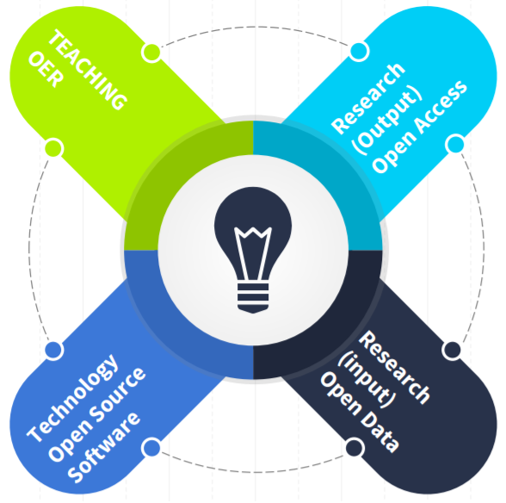
A-I. Openness and the Academy
Four ‘opens’ well represented in the academy
Ideological connection between ‘opens’ and academia
However, not all are equally favoured, and major disciplinary differences exist
Source: Christiansen (2016), adapted from McNally (2014)

Slide 4
A-II. What Are Open Educational Resources (OER)
The OECD in Giving Knowledge for Free (2007) defined OER as: “digitised materials offered freely and openly for educators, students and self-learners to use and reuse for teaching, learning and research”
Three types of OER according to the OECD
  Content – courseware and other learning objects
  Tools – for creating and delivering resources
  Implementation Resources – such as licensing systems

Slide 5

A-II. OER at U of A
Creation of OER can be considered service work within the Faculty Collective Agreement
  “…and dissemination of knowledge to the general public by making available the staff members expertise and knowledge of the discipline....” (7.02.1c)
OER Lib Guide: http://guides.library.ualberta.ca/open-educational-resources
Provincial OER Starter and
Champions Toolkits developed
at U of A

Slide 6
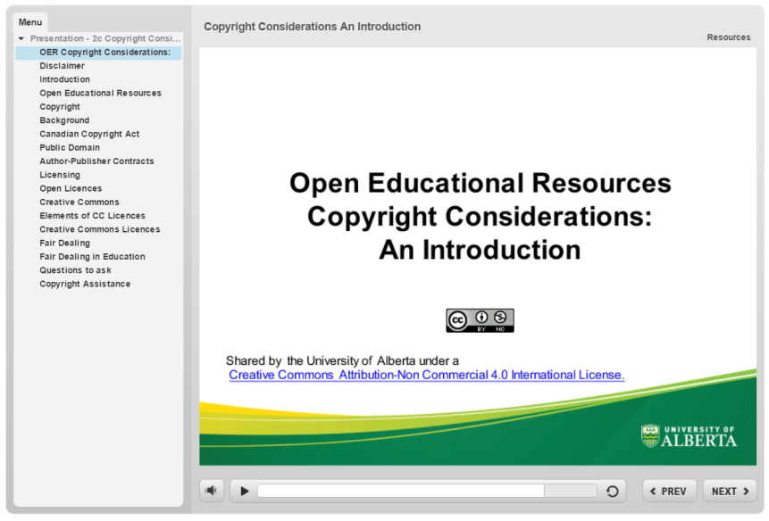
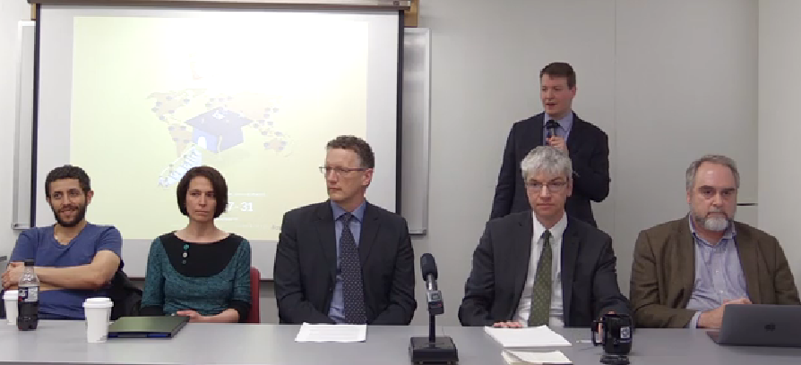
A-II. OER at U of A
OER Copyright Resources from the Copyright Office (“Introduction” and “Use in Practice”)
OER Interest Group (meets roughly once a semester)
Open Education Week Activities
Source: Screen capture from “Be it Resolved All Knowledge be Open.” (2017)

Slide 7
B-I. Tension between Neoliberal and Altruistic Motives in OER
OER initiatives undertaking for several motives (Falconer et al. 2016):
  Enhance reputation
  Reduce student textbook/learning material costs
  Enhanced pedagogy
  Broaden access to knowledge/information
Two former can be seen as marketized/neoliberal incentives; two later are altruistic motives
  Little evidence of OERs factoring into promotion and tenure concerns at most institutions (note UBC as exception), and OERs do little for the expanding pool of precarious sessional instructors (Crissinger, 2015)

Slide 8
B-II. Pedagogical Concerns
Ideally OER creation should not undermine teaching, but
  In class room techniques may not necessarily translate to OER
  Recording of class time for outside consumption may supress discussion
  Quantitative assignments and open access readings are ideal for OER but not all classes
  Designing for global audience may mean not utilizing domestic fair dealing rights

Slide 9
B-III. For Whom is this Learning Object?
Creating materials for use in class or presentations to also serve as OERs makes sense
  However, considering of the needs of both leads to competing design needs
Need to consider primary and secondary audience (Smith and Ragan, 2005)
Secondary audience for OERs though include both learners and OER creators, arguably across the whole globe
  Learners do seem to be the most common users – MIT notes that only 9% of those who use its Open Courseware Portal are educators (MIT, 2011)

Slide 10
B-IV. OERs Are Not Universal
Access to OERs is limited by several divides:
  Language divide – less that 500 million native English speakers (Ethnologue, 2015).
  Digital divide – 15% of Canadians still do not use the internet (ITU, 2014)
  Electrical Divide – estimated 20% of the global population doesn’t have access to electricity; 32% lack access in rural areas globally (IEA, 2012)
Major users still appear to be from more wealthy regions
  Of MIT OCW users only 4% from Latin and South America, 4% from Northern Africa, and 2% from Sub-Saharan Africa (MIT, 2016)
Be mindful that OERs can be seen as a form of educational neo-colonialism (Weiland, 2015; Crissinger, 2015, Amiel, 2012)

Slide 11
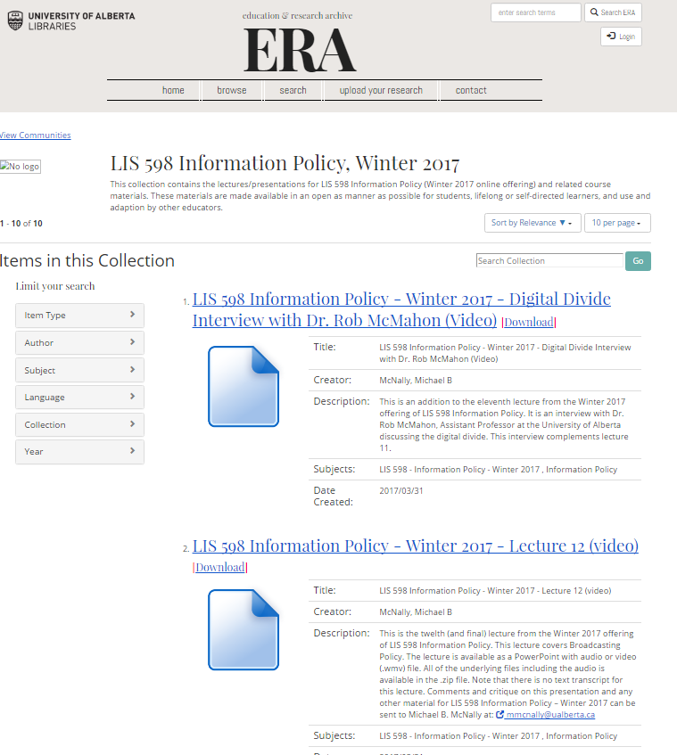
C-I. Case Example – LIS 598 Information Policy (Wint 2017)
LIS 598 Information Policy first online offering in Winter 2017
Course partially open
  Some readings not open
  Lectures and underlying materials made open
Lectures in video (.wmv) and as PowerPoint with audio made available in ERA
  Underlying PowerPoint and MP3 files also put in ERA
  Lecture scripts only produced for two lectures

Slide 12
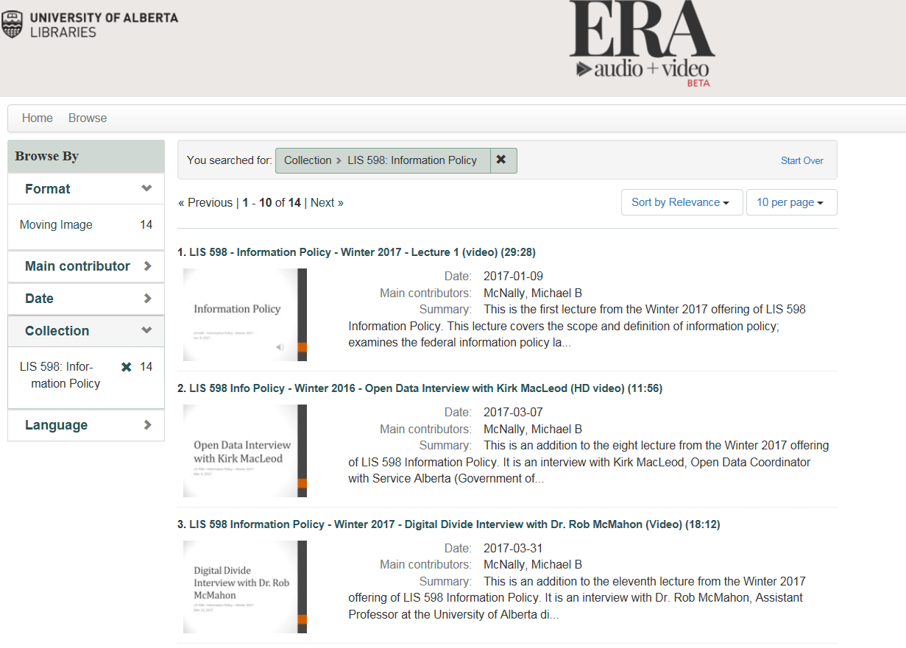
C-I(ii). Case Example – LIS 598 Information Policy (Wint 2017)
ERA A/V – new beta service from UAL – also used to provide streaming format for content
Overcame some limitations with file formats
Mediated deposit a limitation

Slide 13
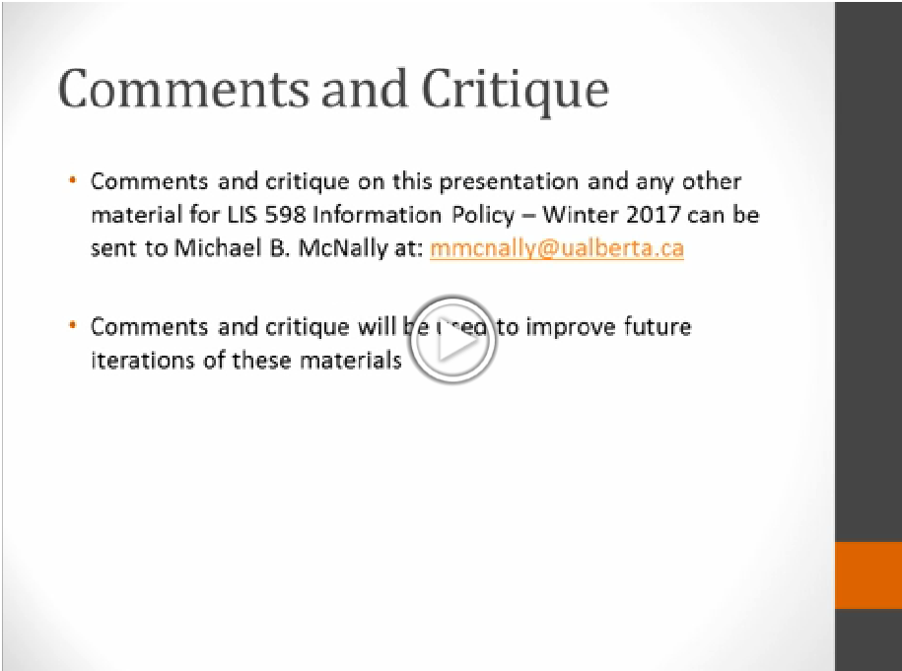
C-I(iii). Case Example – LIS 598 Information Policy (Wint 2017)
All content in lectures is either public domain or CC-BY
Lectures themselves are CC-BY-4.0 licensed
In line with OER best practices, end of each lecture solicits comments/critique
Thanks:
  Leah Vanderjagt, Sean Luyk and Umar Qasim (UAL)
  Amanda Wakaruk (CRO)
  Sandra Schwab, Kirk MacLeod, and Rob McMahon

Slide 14
Sources
Ameil, Tel. 2012. “Identifying Barriers to the Remix of Translated Open Educational Resources.” International Review of Research in Open and Distance Learning, 14(1): p. 16-144.
“Be it Resolved that All Knowledge Be Open.” 2017. Panel Discussion for Open Education Week 2017 at the University of Alberta. Edmonton, AB, 30 Mar. 2017. https://era-av.library.ualberta.ca/media_objects/avalon:1288
Christiansen, Erik. 2016. “Everything is Shareable: Why Open Educational Resources are Critical to Lifelong Learning and the Sharing Economy.” Presented at Code4Lib Alberta Conference, Edmonton, AB, 24 Nov. 2016. https://era.library.ualberta.ca/files/bht24wj47b#.WQvdCPnyupo
Christiansen, Erik, Michael B. McNally, John Locke, and Janet Welch. 2016. The Starter Toolkit. https://docs.google.com/document/d/162y7HdY4Lsu0nKzUimeaCMY2M-zBC41cR6CgjV_biGo/edit
Crissinger, Sarah. 2015. “A Critical Take on OER Practices: Interrogating, Commercialization, Colonialism and Content.” In the Library with the Lead Pipe, (Oct. 2015),: http://www.inthelibrarywiththeleadpipe.org/2015/a-critical-take-on-oer-practices-interrogating-commercialization-colonialism-and-content/
Falconer, Isobel, Allison Litteljohn, Lou McGill, Helen Beetham. 2016. “Motives and tensions in the release of open educational resources: The UKOER program.” Australian Journal of Educational Technology, 32(4): 92-105.
International Telecommunications Union (ITU). 2014. “Percentage of Individuals Using the Internet.” http://www.itu.int/en/ITU-D/Statistics/Pages/stat/default.aspx
Lewis, M. Paul, Gary F. Simons, and Charles D. Fennig (eds.). 2015.Ethnologue: Languages of the World, Eighteenth edition. Dallas, Texas: SIL International. Online version: http://www.ethnologue.com.
McNutt, Krysta, Erik Christiansen, and Janet Welch. 2016. The Champion’s Toolkit. https://docs.google.com/document/d/1Fyt-dhaXwvGVHKv2ZB4HtphTNYCPsfl8m68Q_xw3CdQ/edit

Slide 15
Sources
MIT. 2011. “MIT OpenCourseWare 2011 Program Evaluation Findings Summary.” http://ocw.mit.edu/about/site-statistics/11_Eval_Summary_112311_MITOCW.pdf
MIT. 2016. “MIT OpenCourseWare Site Statistics.” https://ocw.mit.edu/about/site-statistics/Organisation for Economic Cooperation and Development (OECD). 2007. Giving Knowledge for Free: The Emergence of Open Educational Resources. http://www.oecd.org/edu/ceri/givingknowledgeforfreetheemergenceofopeneducationalresources.htm
Organisation for Economic Cooperation and Development (OECD). 2007. Giving Knowledge for Free: The Emergence of Open Educational Resources. http://www.oecd.org/edu/ceri/givingknowledgeforfreetheemergenceofopeneducationalresources.htm
Smith, Patricia L., and Tillman J. Ragan. 2005. Instructional Design. 3rd Ed. Hoboken, NJ: Wiley.
University of Alberta. 2006/2008. Faculty Agreement. http://www.hrs.ualberta.ca/MyEmployment/~/media/hrs/MyEmployment/Agreements/Academic/Faculty.pdf
University of Alberta. 2016. OER Copyright Considerations: An Introduction. https://www2.library.ualberta.ca/tutorials/copOpen Educational Resourcesyright/oer-copyright-introduction-output/story_html5.html
University of Alberta. 2016. OER Copyright Considerations in Practice. https://www2.library.ualberta.ca/tutorials/copyright/oer-copyright-practice-output/story_html5.html
Weiland, Steven. 2015. “Open Educational Resources: American Ideals, Global Questions.” Global Education Review, 2(3): 4-22.

Slide 16
Feedback and Licensing Information
Feedback
Feedback (including criticism) on this presentation can be sent to mmcnally@ualberta.ca
Licensing Information and Image Sources:
  Slide 3 – “Image of ‘Opens.” Christiansen. 2016. CC-BY. https://era.library.ualberta.ca/files/bht24wj47b#.WQvdCPnyupo
  Slide 5 – “The Starter Toolkit” Christiansen et al. 2016. CC-BY-NC. https://docs.google.com/document/d/162y7HdY4Lsu0nKzUimeaCMY2M-zBC41cR6CgjV_biGo/edit
  Slide 6 – “OER Copyright Considerations: An Introduction.” University of Alberta. 2016. CC-BY-NC. https://www2.library.ualberta.ca/tutorials/copyright/oer-copyright-introduction-output/story_html5.html
  Slide 6 – “Be it Resolved…” No Author. 2017. CC-BY-4.0. https://era-av.library.ualberta.ca/media_objects/avalon:1288
  Slide 11 – “ERA Screenshot.” University of Alberta Libraries. 2017.
  Slide 12 – “ERA A/V Screenshot.” University of Alberta Libraries. 2017.
  Slide 13 – “Internet Policy Lecture.” McNally. 2017. CC-BY-4.0.

