Slide 1
Berne and TRIPS Agreements
April 2019
Notes:
Hi, and welcome to the University of Alberta’s Opening Up Copyright Instructional Module on the Berne and TRIPS Agreements.

Slide 2
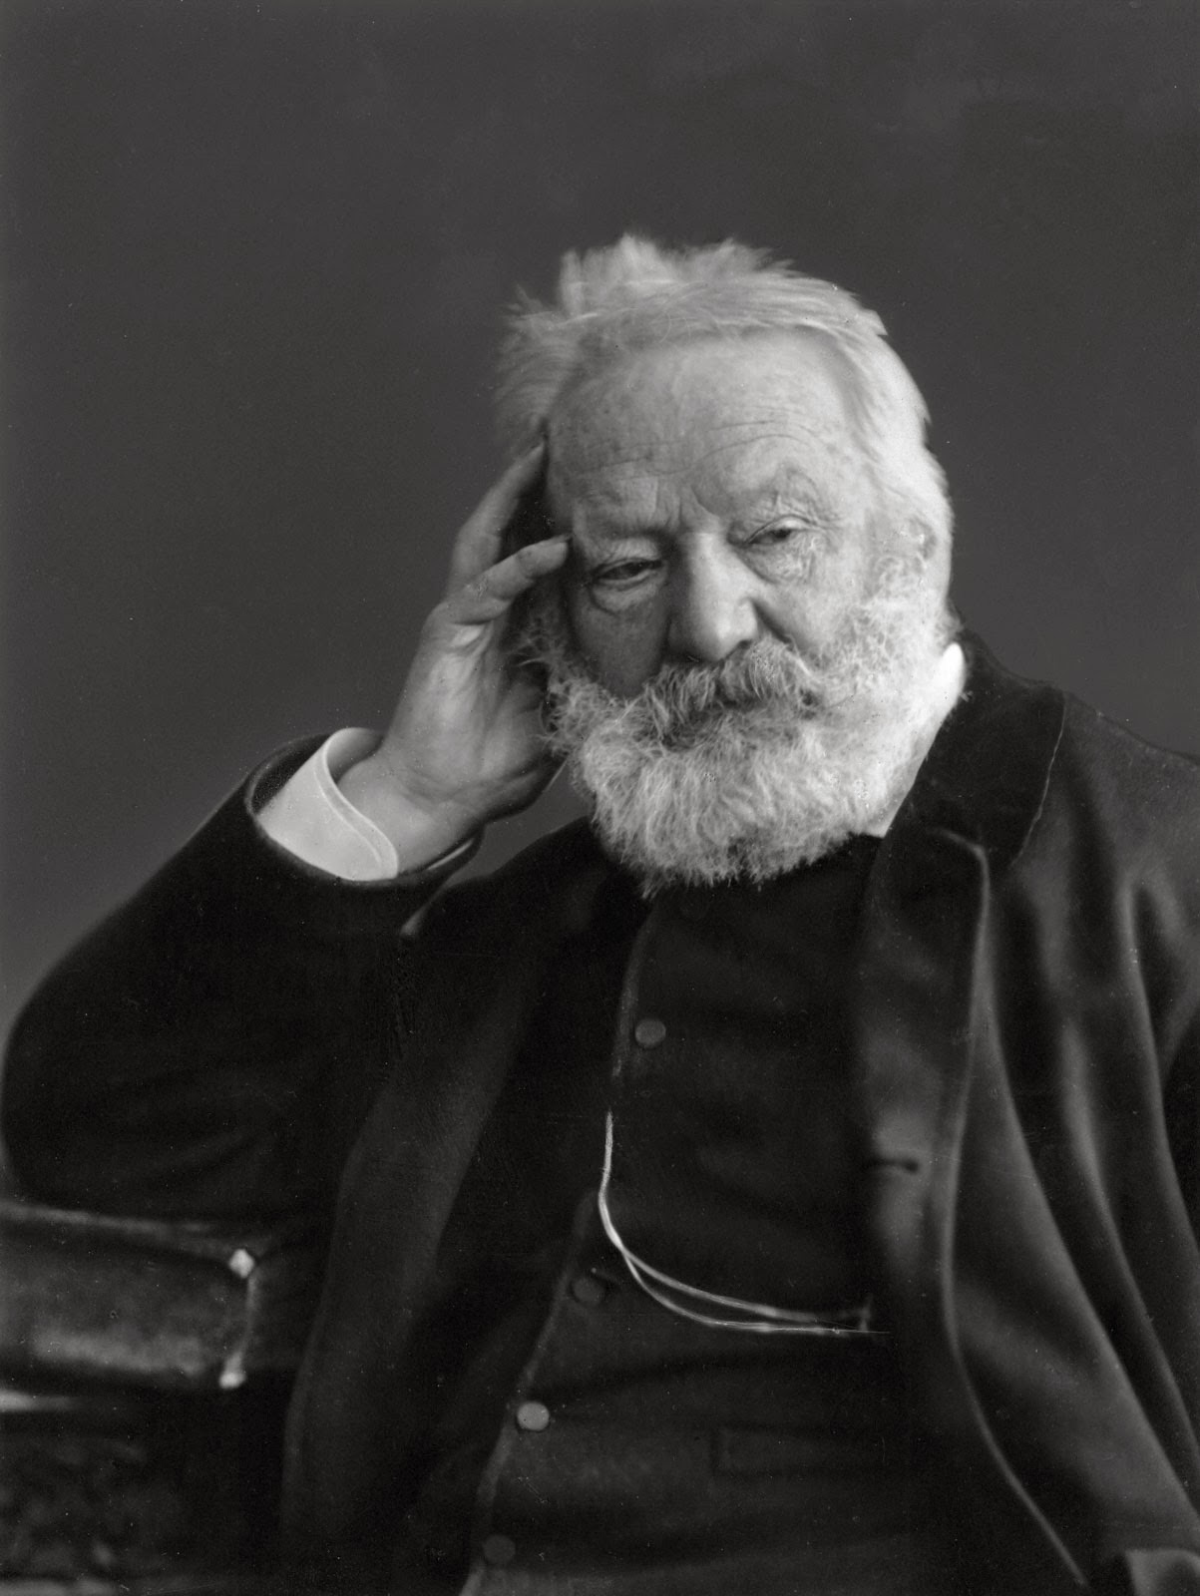
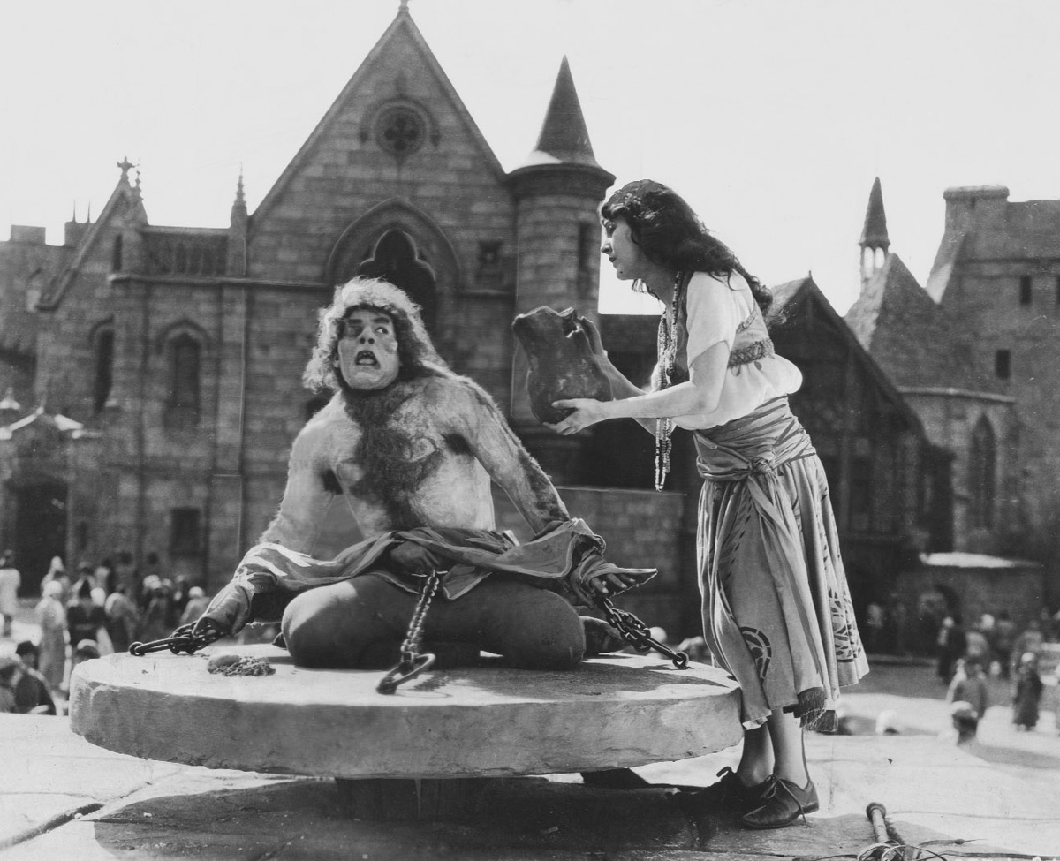

MEET VICTOR
VICTOR WHO?
COPYWHATNOW?
THANKS FOR
THE BOOK!
…sigh…
Notes:
Meet Victor. It’s 1831, and he’s just published an immensely-successful book called “The Hunchback of Notre Dame” in France. The book has been selling well at home and, as the author, Victor wants to profit from sales in other countries. After inquiring about getting the book published in America he makes an unfortunate discovery: because Victor is not an American citizen, “Hunchback” has no copyright on American soil. In fact, in the years after the book’s release, publishers in the United States did their own English translations and sold the book without giving Victor Hugo any compensation.

Slide 3
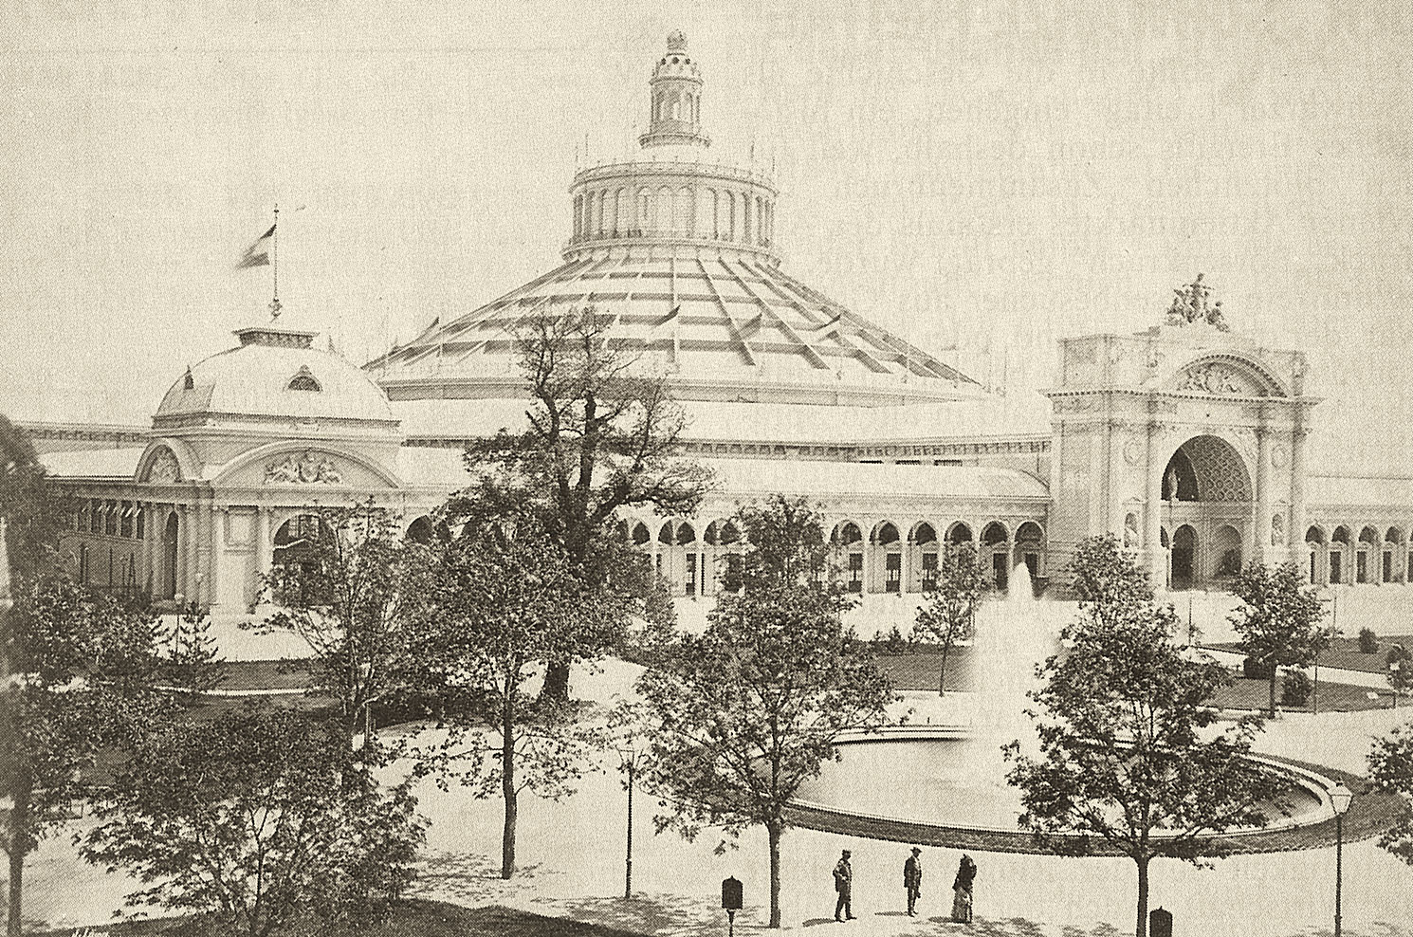
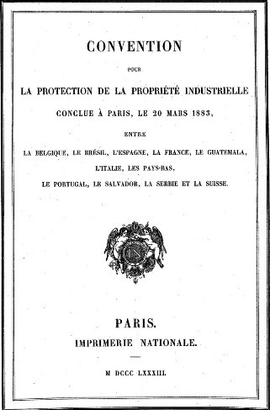
THE PARIS CONVENTION (1883)
Extended intellectual property protections internationally…
…for “industrial property” only
Literary and artistic works not covered
…sigh…
Notes:
This problem was addressed by the Paris Convention, in 1883. The convention came about, in part, because of the International Expo in Vienna ten years earlier. American inventors were anxious about showing off their latest inventions there because they didn’t want entrepreneurs from other countries to steal their creations The Paris Convention dealt with this fear by extending intellectual property protections internationally, but only for “industrial property.” Literary and artistic works, like Victor Hugo’s books, weren’t covered at all.

Slide 4
THE BERNE CONVENTION (1886)
…sigh…
Notes:
Because he was passionate about this issue, Victor Hugo himself was one of the driving forces behind meetings that led to the creation of The Berne Convention. The Convention, created in 1886, did for literary and artistic works what the Paris Convention did for industrial property. Sadly, he didn’t live long enough to see see it finalized.

Slide 5






THREE PRINCIPLES
1. National treatment
©
Life + 50 yrs
Life + 100 yrs
2. Fixed copyright
NO MAS!
USA! USA! USA!
VIVE LA FRANCE!
…sigh…
Life + 70 yrs
3. Foreign protections can be independent …of protections in country of origin
Life + 70 yrs
Notes:
The Berne Convention has changed a great deal since 1886, but here’s what it stands for now. It’s based on three basic principles:
First, when a work originating in one country – for example, France – is used in another country – for example, the United States – it is treated as if it had been created in the other country (in other words, if Hunchback of Notre Dame – which was written in France - were published in the United States under the Berne Convention, it would be treated as if it had been created in the USA). This is known as the principle of national treatment.
Second, copyright protection is automatic. This is known as “fixed” copyright, meaning that the copyright comes into effect automatically as soon as the work is completed in a fixed medium. No registration is required!
Third, copyright protection in a foreign country can be independent of the protections provided by the country of origin. However, if the foreign country has a longer copyright term than the country of origin, protection may be denied in the foreign country once the original copyright term ends.

Slide 6



APPLICATION
Applies to every work of expression in the domains of:
  Art
  Literature
  Science
Minimum copyright term
  Life + 50 years
Life + 50 yrs
IT’S 1935!
SET ME FREE!
Notes:
Though it was originally written for literary and artistic works, The Berne Convention now applies to every work of expression in the artistic, literary, and scientific domain. The word “expression” here is key, because the convention doesn’t affect patents or trademarks. The Berne Convention does, however, set a minimum international standard for copyright terms, which is 50 years after the author’s death. In our Hunchback of Notre Dame example from the beginning of this module, this meant that Victor Hugo’s works were protected until 1935.

Slide 7



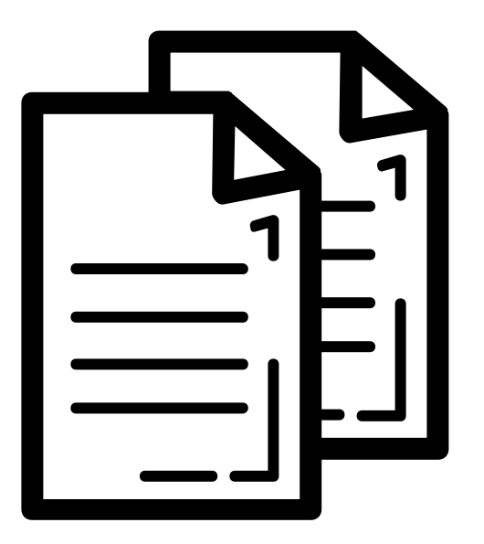




BERNE CONVENTION RIGHTS
Honor
Reputation
Notes:
Rights covered by the Berne Convention include the right to translate, to make adaptations or arrangements, to perform or recite in public, to broadcast, to make reproductions, to communicate about the work to the public, or to use a work as the basis of an audiovisual work. The Convention also includes “moral rights” — the right to object to any transformation of the work that would be prejudicial to the author’s honor or reputation.

Slide 8
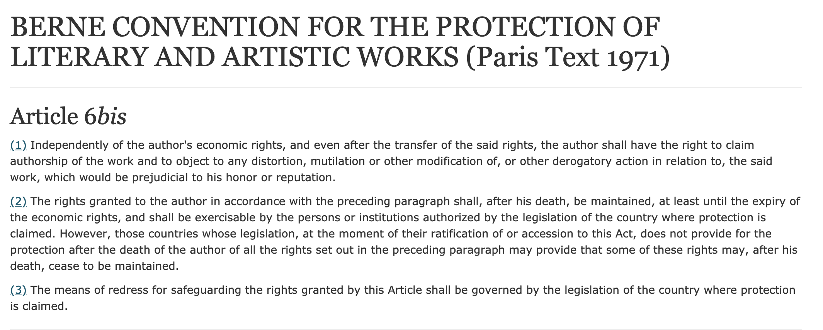
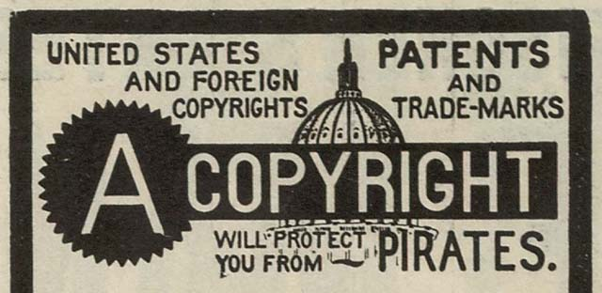
MORAL RIGHTS
WE THINK MORAL RIGHTS ARE COVERED ELSEWHERE.
BESIDES, WHAT ARE YOU GONNA DO ABOUT IT?
…sigh…
YOU HAVE NO MORALS!
DARN RIGHTS!
Notes:
Did you catch that last part, about moral rights? Interesting story there: these are covered by Article 6bis of the Berne Convention, but the United States Copyright Act makes no reference to moral rights at all. In fact, this highlights one of the challenges of the Berne Convention: it is not self-executing, meaning that it does not govern laws. When countries become signatories to the Berne convention, they agree to enact laws that conform to the terms of the convention…. But they may not do it exactly as the Berne drafters expected, and there is no enforcement body that can force them to do so.
In other words: If a country signs the Berne convention and doesn’t abide by it, that country may face criticism from others for not living up to their Berne obligations… but there is no single, central organization that has the authority to enforce the agreement.

Slide 9
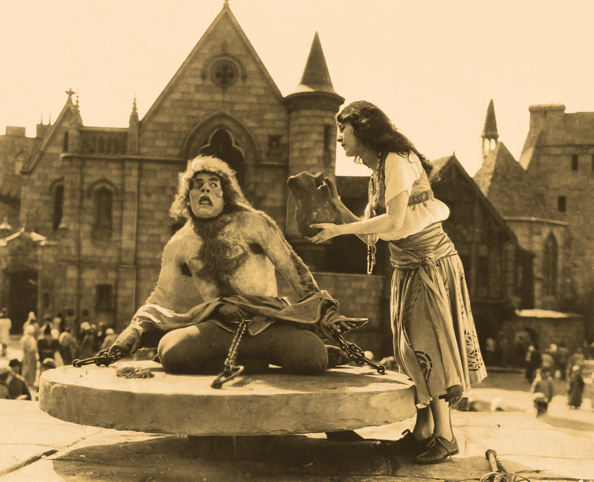
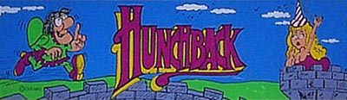
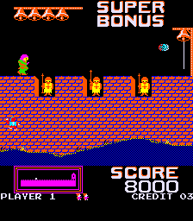
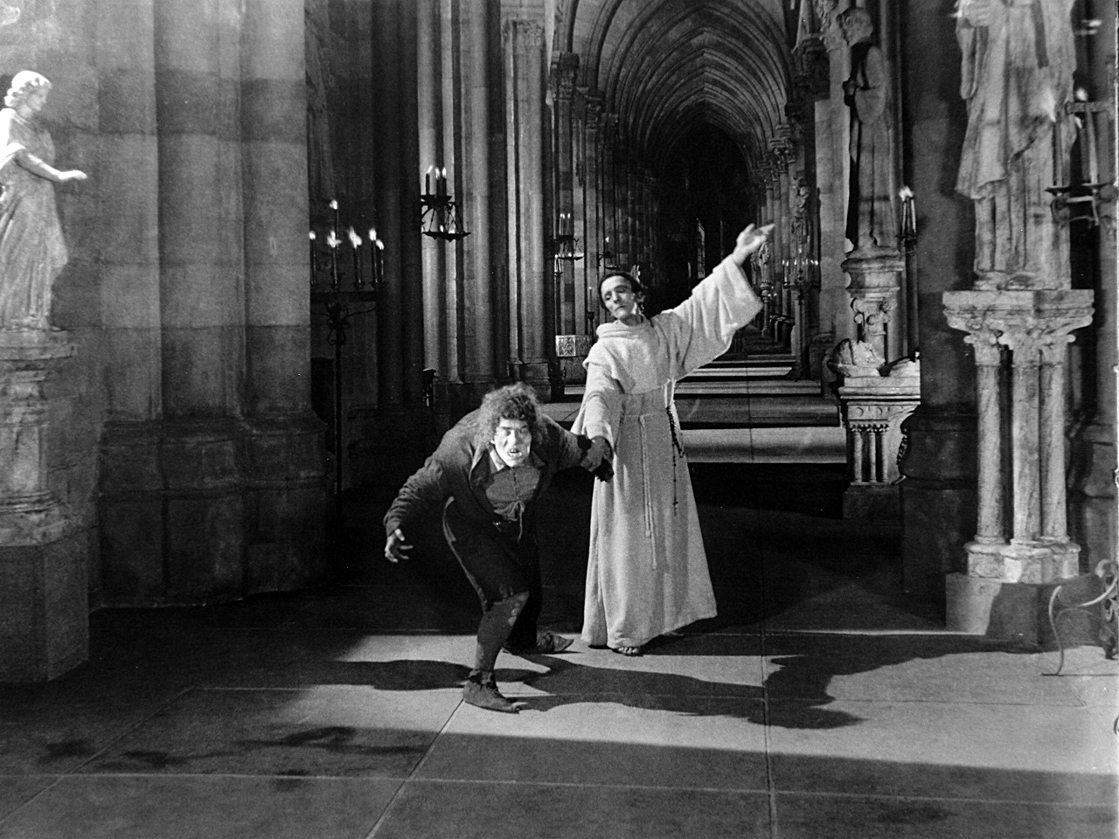
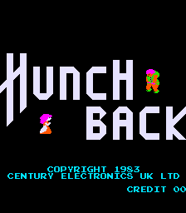
INTRODUCING TRIPS
TRIP
rade-
elated aspects of
ntellectual
roperty right
#DED
DARN RIGHTS!
S
I CAN DO WHATEVER
I WANT, NOW!
YOU STILL HAVE NO MORALS!
This is a real game!
Images courtesy of The International Arcade Museum
(arcade-museum.com)
Notes:
Now, suppose it is 1995. Victor Hugo died in 1885, so his novel "Hunchback of Notre Dame" has already been in the public domain for decades. Suppose you want to turn that novel into an epic first-person shooter video game – don’t laugh, by the way. It’s been done before, so play along, and let’s Get ready to RING EVIL’S BELL! To see how international copyright might affect your game you’d have to look at the TRIPS Agreement -- or “Trade-Related Aspects of Intellectual Property Right…. s.” This agreement was finalized in 1994 and is administered by the World Trade Organization (WTO). It’s linked to the Berne Convention because it incorporated the terms of the Convention completely -- except for the Berne Convention’s Article 6bis mentioned earlier, which addresses moral rights.

Slide 10





THE TRIPS AGREEMENT
Protects expressions, not ideas
Computer programs protected as literary works
Authors can authorize or prohibit commercial rental
©
print(“SANCTUARY!”);
SCORE: 30
TRIPS
Notes:
TRIPS is one of the World Trade Organizations’ core agreements, linking intellectual property rights and trade. Being newer, it addresses some of the more current copyright complexities in several areas.
Like Berne, TRIPS protects expressions, not ideas, - so your Hunchback game - even as a new expression of a public domain work - would be eligible for copyright protection.
What about the game itself? TRIPS states that computer programs - both the source code and the executable versions - are protected as literary works. Databases are protected, too, assuming that the arrangement or ordering of data can be seen as an original intellectual creation.
Lastly, under the TRIPS Agreement, authors have the right to authorize or prohibit the commercial rental of their works. For cinematographic works (what normal people call “movies”), this right is not applicable UNLESS it can be shown that the rental has led to widespread copying of the work.

Slide 11


TRIPS CONCERNS
Sets minimum standards for copyright protection
“The TRIPS agreement seeks to establish a particular settlement regarding intellectual property that privileges certain private interests while downgrading previously legitimate (and carefully developed) public-regarding aspects of their recognition and governance.”
“TRIPS was the first stage in the global recognition of an investment morality that sees knowledge as a private, rather than public, good.”
Life + 100 yrs
Life + 50 yrs
Life + 70 yrs
Christopher May. The Global Political Economy of Intellectual Property Rights: The New Enclosures. 2nd Ed. London, Routledge, 2010, p.88.
Peter Drahos with John Braithwaite. Information Feudalism: Who Owns the Knowledge Economy? New York, The New Press, 2002, p.10.
Notes:
One of the largest concerns expressed over the TRIPS Agreement is that, while it sets minimum standards for copyright protection, there’s `no ceiling. The effect of this is that when bilateral trade agreements are being negotiated (usually for the benefit of commercial interests), the “minimum” copyright standards seem to get ratcheted upwards. Some say this shifts the balance of copyright too much in favour of creators. IP scholar Christopher May states, “the TRIPS agreement seeks to establish a particular settlement regarding intellectual property that privileges certain private interests while downgrading previously legitimate (and carefully developed) public-regarding aspects of their recognition and governance,” and Drahos and Braithwaite suggest “TRIPS was the first stage in the global recognition of an investment morality that sees knowledge as a private, rather than public good.”

Slide 12

TRIPS AND THE WTO
WE HAVE BANANAS TO SELL
Agreement on Agriculture
Agreement on Preshipment Inspection
OHAI SOMALIA! WE ❤️ BANANAS!
TRIPS
General Agreement on Tariffs and Trade (GATT)
General Agreement on Trade in Services (GATS)
…BUT COPYRIGHT FOR LIFE + 30 YEARS JUST DOESN’T WORK
FOR US…
Agreement on Textiles and Clothing
TRIPS
Agreement on Technical Barriers to Trade
Agreement on Trade-Related Investment Measures
…sigh…
…sigh…
…SO LET’S GO ON A TRIPS TOGETHER!
Marakesh Protocol
…and more…
Notes:
Finally, there is another wrinkle to the [c] TRIPS Agreement. It is one of the [c] many core agreements of the World Trade Organization, and any country that wants to be a member of the WTO must enforce all WTO agreements. In other words:[c] if you are a non-WTO country and you just want [c] access to world markets for your agricultural goods, [c] you must also implement the TRIPS agreement on copyright and intellectual property. For many countries in the developing world, this has a [c] negative impact on their ability to achieve equality with more economically-advanced nations. [c]

Slide 13


TRIPS AND THE WTO
TRIPS
Notes:
What really sets TRIPs apart from Berne, is that TRIPS requires an enforcement mechanism. When you sign on to the WTO agreements, you also become subject to the WTO’s Dispute Settlement mechanism, which can result in harsh penalties.

Slide 14
ISN’T IT IRONIC?
HEY! REMEMBER WHEN YOU GUYS USED TO JUST COPY MY STUFF WITHOUT MY PERMISSION?
UH…
NEW PHONE.
WHO DIS?
Notes:
It is somewhat ironic that the United States - which used to capitalize on the lack of intellectual property rights for international works in the 19th century - is now a driving force in a regime that protects their works in international markets.

Slide 15
LEARNING OBJECTIVES
You should now be able to:
Contrast the relationship between the Berne Convention and the TRIPS Agreement
Discuss the connection between these agreements and the World Trade Organization
Infer how agreements like the Berne Convention and the TRIPS agreement might impact global economic development and trade
Notes:
You should now be able to:
Contrast the relationship between the Berne Convention and the TRIPS Agreement
Discuss the connection between these agreements and the World Trade Organization
Infer how agreements like the Berne Convention and the TRIPS agreement might impact global economic development and trade.

Slide 16
Notes:
This has been the University of Alberta’s Opening Up Copyright Module on the Berne and TRIPS Agreements. Thank you for your attention.

Slide 17
How is the World Trade Organization (WTO) connected to the TRIPS Agreement?
The WTO is an outspoken critic of TRIPS
TRIPS is administered by the WTO
The Berne Convention was created by the WTO but TRIPS was not
The WTO created TRIPS at the 1883 Paris Convention
A country can join the World Trade Organization without having to abide by the TRIPS Agreement
True
False

Slide 18
Which of these statements is correct?
The TRIPS Agreement incorporates all of the Berne Convention except its article on moral rights
The Berne Convention was created as a response to shortcomings in the TRIPS Agreement
Victor Hugo wrote Hunchback as an allegory for intellectual property issues
The Berne Convention serves as the historical basis for modern patent law
Berne and TRIPS set the minimum standard for copyright terms as:
Life of the author
Life of the author plus 30 years
Life of the author plus 50 years
Life of the author plus 70 years

Slide 19
The TRIPS Agreement provides a central dispute settlement mechanism but the Berne Convention does not.
True
False
Which of the following is NOT a criticism of the TRIPS agreement?
Its permanent link between intellectual property rights and access to world trade markets harms developing nations
It tends to concentrate wealth in the hands of developed countries
The agreement does not apply to literary or artistic works
When minimum copyright and patent terms are enforced internationally, innovation in developing countries is stifled

Slide 20
Nadar. (1885). Victor Hugo photograph. Wikimedia Commons. Public Domain. http://concise.britannica.com/ebc/art-11798/Victor-Hugo-photograph-by-Nadar
Wallace Worsley. (1923). Publicity photo for Hunchback film. Wikimedia Commons. Public Domain. https://upload.wikimedia.org/wikipedia/commons/3/3a/Hunchback_of_Notre_Dame.jpg
Jacobus. (2006). US Flag with 24 stars. Wikimedia Commons. Public Domain. https://commons.wikimedia.org/wiki/File:Flag_of_the_United_States_(1822-1836).svg
Dbenbenn. (2008). Flag image of the United States. Wikimedia Commons. Public Domain. https://commons.wikimedia.org/w/index.php?curid=318418
Stadtchronik Wien. (1873). Wien, Rotunde, zeitgenössische Ansicht um 1873. Wikimedia Commons. Public Domain. https://commons.wikimedia.org/wiki/File:W_Rotunde.jpg#/media/File:W_Rotunde.jpg
Joseph Ferdinand Keppler. (1886). The Pirate Publisher. Wikimedia Commons. Public Domain. https://commons.wikimedia.org/wiki/File:Joseph_Ferdinand_Keppler_-_The_Pirate_Publisher_-_Puck_Magazine_-_Restoration_by_Adam_Cuerden.jpg

Slide 21
Joseph Ferdinand Keppler. (1886). The Pirate Publisher. Wikimedia Commons. Public Domain. https://commons.wikimedia.org/wiki/File:Joseph_Ferdinand_Keppler_-_The_Pirate_Publisher_-_Puck_Magazine_-_Restoration_by_Adam_Cuerden.jpg
Ralf Schmitzer. (n.d.). Automatically. The Noun Project. CC BY. https://thenounproject.com/term/automatically/944735
ProSymbols. (n.d.). Art. The Noun Project. CC BY. https://thenounproject.com/icon/1976897
Enshia. (n.d.). Book. The Noun Project. CC BY. https://thenounproject.com/icon/1787402/
Shastry. (n.d.). Science. The Noun Project. CC BY. https://thenounproject.com/term/science/909459
Andrejs Kirma. (n.d.) Process. The Noun Project. CC BY. https://thenounproject.com/term/process/2067352
Montu Yadav. (n.d.) Broadcast. The Noun Project. CC BY. https://thenounproject.com/term/broadcast/201837
Blair Adams. (n.d.) Drama. The Noun Project. CC BY. https://thenounproject.com/term/drama/953398
Becris. (n.d.) Public speaking. The Noun Project. CC BY. https://thenounproject.com/term/public-speaking/1681645

Slide 22
Andrey Vasiliev. (n.d.) Film Projector. The Noun Project. CC BY. https://thenounproject.com/term/film-projector/336166
Priyanka. (n.d.) Adapt. The Noun Project. CC BY. https://thenounproject.com/term/adapt/2122894
ATOM. (n.d). Copy. The Noun Project. CC BY. https://thenounproject.com/term/copy/1474212
Eucalyp. (n.d.) Moral. The Noun Project. CC BY. https://thenounproject.com/term/moral/901639
Library of Congress. (1906). Copyright advertisement from the New York Clipper, 1906. Wikipedia. Public Domain. https://en.wikipedia.org/wiki/Copyright_infringement#/media/File:Copyrightpirates.jpg
MGM Studio. (1923). Publicity still from Hunchback of Notre Dame. Wikimedia Commons. Public Domain. https://commons.wikimedia.org/wiki/File:Hunchback_-Notre_Dame_1923.jpg
International Arcade Museum. (n.d.) Hunchback video game. International Arcade Museum. Attribution. https://www.arcade-museum.com/game_detail.php?game_id=8156
AfterGrind. (n.d.) Sword. The Noun Project. CC BY. https://thenounproject.com/term/swords/2288788
Marek Polakovic. (n.d.) Shield. The Noun Project. CC BY. https://thenounproject.com/term/shield/304268
Notes:
3

Slide 23
Daniel Polshin. (n.d.) Helmet. The Noun Project. CC BY. https://thenounproject.com/term/helmet/593366
Putra Theoo. (n.d.) Database. The Noun Project. CC BY. https://thenounproject.com/term/database/2262291
Priyanka. (n.d.) Impose. The Noun Project. CC BY. https://thenounproject.com/term/impose/2248951
Gan Khoon Lay. (n.d.) Police Riot Control Equipment. The Noun Project. CC BY. https://thenounproject.com/term/police-riot-control-equipment/1584298
Kevin Macleod. (N.d.) Danse Macabre by Saint-Saens. Incompetech. CC BY. https://incompetech.com/music/royalty-free/index.html?collection=005
Madmanmusic (2016) Battle preparations. Freesound. CC0. https://freesound.org/people/madmanmusic/sounds/347981/
Rykenn. (2018). Various short blows/puffs of air from male mouth. Freesound. CC0. https://freesound.org/people/rykenn/sounds/432170/
Giddster. (2016). Sigh, male. Freesound. CC0. https://freesound.org/people/giddster/sounds/336539/

Slide 24
LittleRainySeason. (2016). Wow sound. Freesound. CC0. https://freesound.org/people/LittleRainySeasons/sounds/338047/
Guinefurrie. (2018). Short female sigh. Freesound. CC0. https://freesound.org/people/guinefurrie/sounds/441508/
Dr. Phibes and the Ten Plagues of Egypt. (2010). Danse Macabre. Free Music Archive. CC BY ND. https://freemusicarchive.org/music/Dr_Phibes_and_The_Ten_Plagues_of_Egypt/Music_of_the_Gods_volume_1/
Rock Savage. (2009) Film projector. Freesound. CC0. https://freesound.org/people/Rock%20Savage/sounds/65921/
Onikage22. (2014) Blip-plock-pop. Freesound. CC0. https://freesound.org/people/onikage22/sounds/240566/
Newagesoup. (2016) Thick-stamp. Freesound. CC0. https://freesound.org/people/newagesoup/sounds/347324/
Closing Slides Music: Rybak, Nazar. (n.d.). Corporate Inspired. HookSounds. CC BY. http://www.hooksounds.com/
Unattributed materials are contributions from the Opening Up Copyright Project Team and placed in the Public Domain.

Slide 25
University of Alberta. 2019. “Berne and TRIPS Agreements.” Opening Up Copyright Instructional Module. https://www.ualberta.ca/copyright/resources/opening-up-copyright-instructional-modules

