Slide 1



Updated Findings from an Environmental Scan and Evaluation
Assessing Online Systematic Review Training:
Leah Boulos, Sarah Visintini, Robin Parker,
Krista Ritchie, Jill Hayden
Presented by Leah Boulos
CHLA/ABSC Conference 2017
May 17, 2017

Slide 2
Objective
To conduct an environmental scan and assessment of online systematic review training resources in order to:
Describe available resources
Evaluate whether they follow current best practices for online instruction

Slide 3
Methods:
Environmental scan
Broad Google search
Exhaustive YouTube search
Targeted website search
Google search string:
((“systematic review” OR “scoping review” OR “evidence review” OR “knowledge synthesis” OR “evidence synthesis”) online teaching OR course OR workshop OR seminar OR education OR training OR module)

Slide 4
Selection criteria
Content | Format | Availability | Language
At least three of six systematic review steps | Online courses, videos, web tutorials or modules | Available to the public or a group to which membership is open | English
Six systematic review steps:
Defining a research question and/or creating a protocol
Conducting a rigorous search
Determining selection criteria
Critical appraisal and/or risk of bias assessment
Data extraction
Analysis and/or creation of an in-depth report

Slide 5
Methods:
Evaluation
Evaluation framework based directly on Foster, Shurtz, & Pepper (2014)
In turn based on QuADEM approach
Four categories, 26 questions, 37 possible points
Content
Design
Interactivity
Usability

Slide 6
Methods:
Evaluation
Content
Design
Credibility, relevance, currency, organization, ease of understanding, focus, appropriateness of language
Levels of Bloom’s Taxonomy, learning objectives, learning styles
Interactivity
Usability
Level of interactivity, variety of tasks, appropriateness and difficulty of tasks, opportunities for reflection and feedback
Layout, navigation, compliance with Americans with Disabilities Act

Slide 7
Methods:
Analysis
All resources separately and top five (top quartile)
Produced descriptive statistics
Repeated measures ANOVA between scores in each category

Slide 8
Results:
Environmental scan
Resources identified through environmental scan
(n = 55)
Multi-part resources combined to make new total
(n = 48)
Resources screened for eligibility after duplicates removed (n = 41)
Resources excluded (n = 14):
Did not meet content criteria (n = 10)
Did not meet format criteria (n = 4)
Resources identified as candidates for evaluation (n = 27):
Creators contacted (n = 13)
Resources excluded (n = 7):
No contact information (n = 2)
No response (n = 5)
Resources included for evaluation
(n = 20)

Slide 9
Results:
Environmental scan
Audiences: researchers, health care professionals, and students
Creators: universities, research organizations, and government agencies

Slide 10
Results:
Environmental scan
Time to complete ranges from < 1 hour to over 200 hours
14/20 resources available free of charge
Prices range from $15 USD to over $3,000 USD

Slide 11
Results:
Evaluation

Slide 12
Results:
Top five resources
Top five resources (top quartile)
Resource # | Resource name | Creator
R01 | Comprehensive Systematic Review Training Program (CSRTP) | Joanna Briggs Institute
R02 | Introduction to Systematic Review and Meta-Analysis | Johns Hopkins University (through Coursera) – FREE
R03 | Online Learning Modules for Cochrane Authors | Cochrane Training – FREE
R04 | Introduction to Systematic Review and Meta-Analysis Course | Dalla Lana School of Public Health, University of Toronto / Knowledge Translation Program, St. Michael's Hospital
R05 | Systematic Reviews: diversity, design and debate | EPPI-Centre

Slide 13
Principal finding #1:
High cost did not always correlate with high score

Slide 14
Results:
Content
Coverage of systematic review steps
Step | % (n) of resources covering step
Defining a research question and/or creating a protocol | 90% (18)
Conducting a rigorous search | 90% (18)
Determining selection criteria | 80% (16)
Critical appraisal and/or risk of bias assessment | 90% (18)
Data extraction | 85% (17)
Analysis and/or creation of an in-depth report | 95% (19)
12 resources covered all 6 steps
Five resources covered 5/6 steps
Remaining three resources covered 3/6 steps

Slide 15
Results:
Content

Slide 16
Principal finding #2:
Audience was frequently undefined, leading to lower scores

Slide 17
Results:
Usability

Slide 18
Results:
Design

Slide 19
Results:
Interactivity

Slide 20
Principal finding #3:
Low interactivity scores were related to deficiencies in design

Slide 21
Principal finding #3
In the top five, average content–design difference is 9%; average content–interactivity difference is 1%
In the remaining 15 resources, the differences are 38% and 45%, respectively

Slide 22
Principal finding #4:
Format correlated with score; online courses performed best

Slide 23
Principal finding #4
As a reminder, here are the overall scores by format:

Slide 24
Summary:
Principal findings
High cost did not always correlate with high score
Audiences were frequently undefined
Low interactivity scores were related to deficiencies in design
Format correlated with score; online courses performed best

Slide 25
Discussion:
Recommendations
Include measurable objectives and increase interactivity to cover more levels of Bloom’s Taxonomy
Improve video resources
Recommend appropriate resources

Slide 26
Discussion:
Future research
Which users would benefit from different resource types and formats?
User testing of high-quality resources
Evaluating learner satisfaction
Assessing rate of completion and quality of resulting reviews

Slide 27
Discussion:
Limitations
Environmental scan currency
Systematic review step coverage
Access to complete resources

Slide 28
Conclusions
Reflect on the material currently being used and developed
Be aware of common limitations of online resources
Keep in mind important elements of content, design, interactivity, and usability

Slide 29
Thank You
Contact
Leah Boulos
Evidence Synthesis Coordinator
Maritime SPOR SUPPORT Unit
LeahM.Boulos@nshealth.ca
References
Foster M. Evaluation of best practices in the design of online evidence-based practice instructional modules. JMLA. 2014;102(1):31-40.
Galipeau J, Moher D. Repository of ongoing training opportunities in journalology [Internet]. [Winnetka (IL)]: World Association of Medical Editors; c2017 [cited 22 Mar 2017]. Available from: <http://www.wame.org/about/repository-of-ongoing-training-opportunities>.
Opdenacker, L, Stassen, I, Vaes, S, Waes, LV, Jacobs, G. Quadem: manual for the quality assessment of digital educational material. Antwerpen: Universiteit Antwerpen; 2010.
Armstrong P. Bloom's taxonomy: the revised taxonomy (2001) [Internet]. Nashville (TN): Vanderbilt University, Center for Teaching; c2017 [cited 10 May 2017]. Available from: <https://cft.vanderbilt.edu/guides-sub-pages/blooms-taxonomy/#2001>.

Slide 30
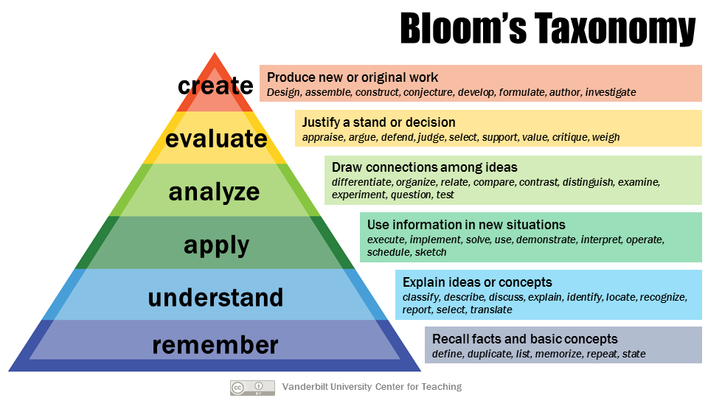
Appendix:
Bloom’s Taxonomy
Armstrong P. Bloom's taxonomy: the revised taxonomy (2001) [Internet]. Nashville (TN): Vanderbilt University, Center for Teaching; c2017 [cited 10 May 2017]. Available from: <https://cft.vanderbilt.edu/guides-sub-pages/blooms-taxonomy/#2001>.

