Slide 1
Reporting on Indigenous Stories
Writing Stick Festival
Duncan McCue
CBC News/UBC Journalism School
@duncanmccue @RIICNews

Slide 2

www.riic.ca

Slide 3
STORYTELLERS
or
STORYTAKERS

Slide 4
4Ds Rule
“How Indians Get in the News”
Drumming
Dancing
Dead
Drunk

Slide 5

Dancing
Source: CBC.ca News (Aboriginal Backgrounder)

Slide 6
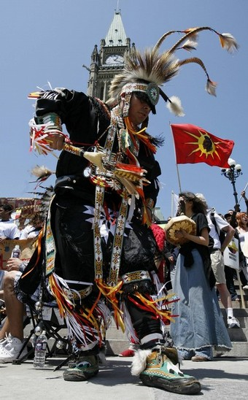
Source: Reuters, May 2008
“a protest on the National Day of Action on the steps in front of the Peace Tower on Parliament Hill in Ottawa May 29, 2008. Canada cares less and less about the "third-world" living conditions faced by many of its native peoples, protesters said”
Notes:
Aboriginal Alden Pompana dances during a protest on the National Day of Action on the steps in front of the Peace Tower on Parliament Hill in Ottawa May 29, 2008. Canada cares less and less about the "third-world" living conditions faced by many of its native peoples, protesters said on Thursday in the second annual aboriginal National Day of Action. A crowd of around 1,000 people, led by drummers and dancers in traditional colored dress, held the protest to air their grievances.

Slide 7
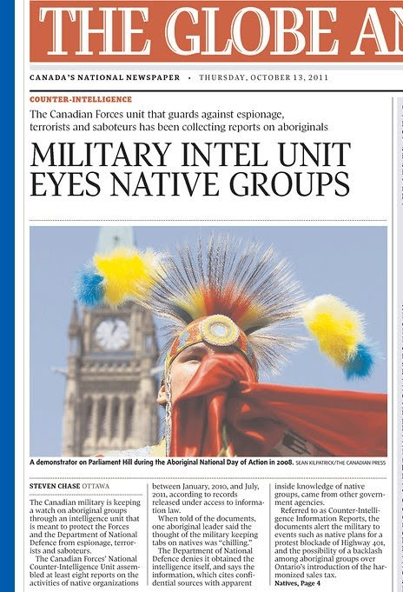

Slide 8
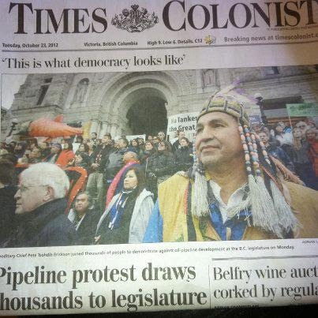

Slide 9
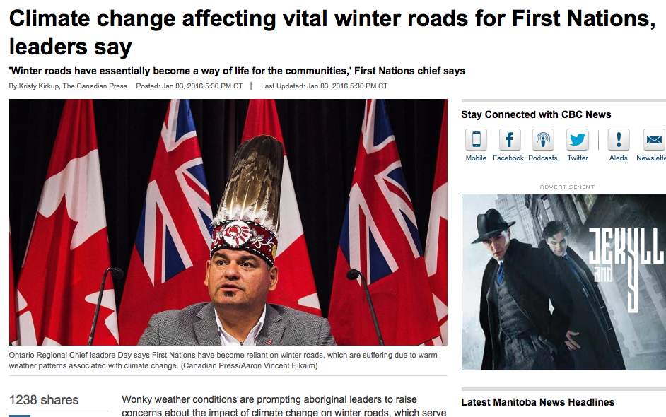

Slide 10
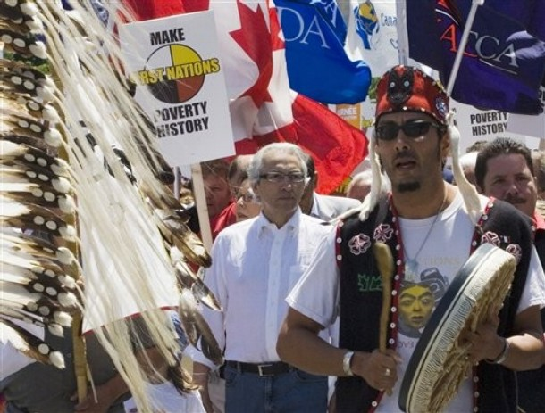
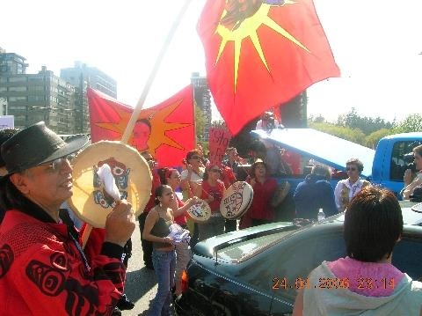
Drumming
Aboriginal Day of Action

Slide 11
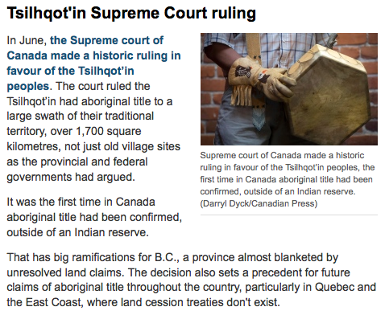

Slide 12
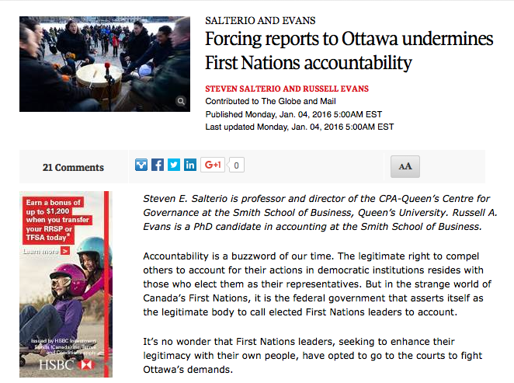

Slide 13
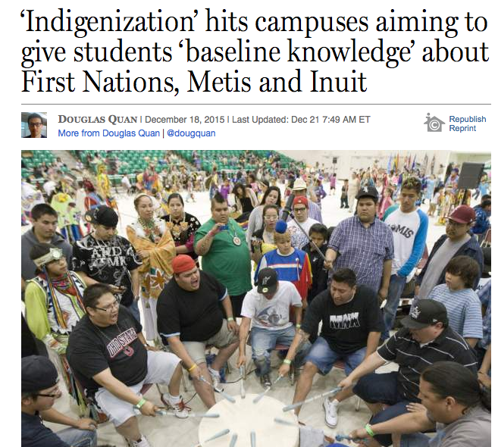

Slide 14
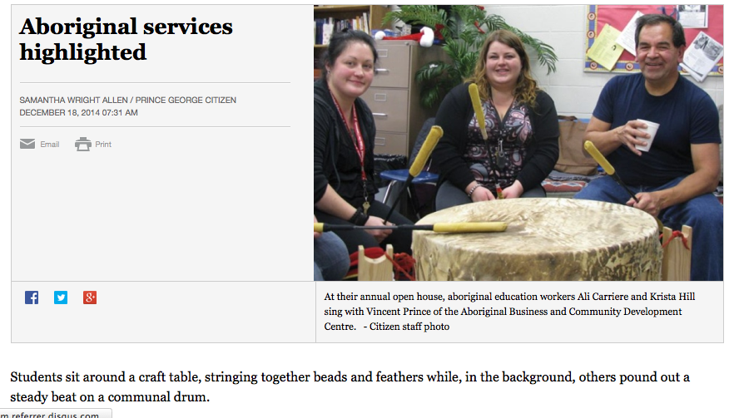
Notes:
Pickton Trial

Slide 15
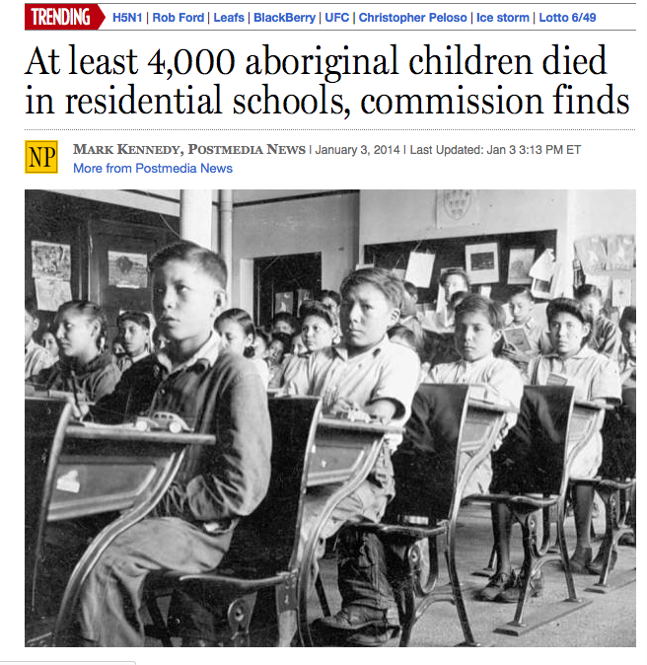
Dead

Slide 16
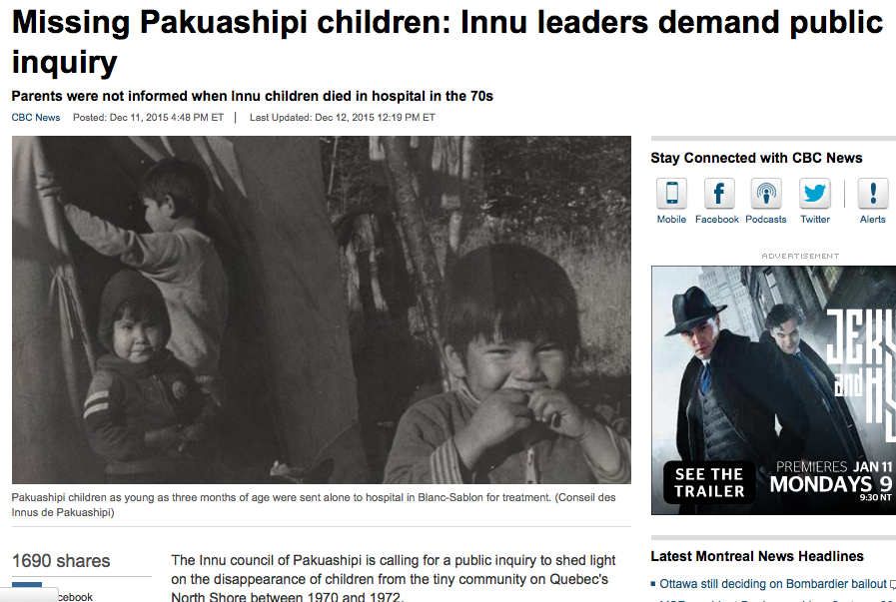

Slide 17
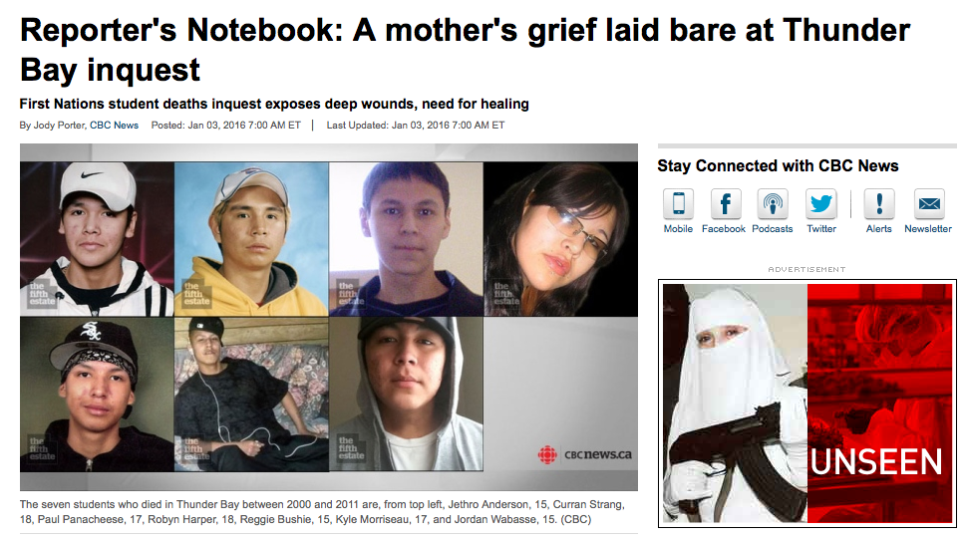

Slide 18
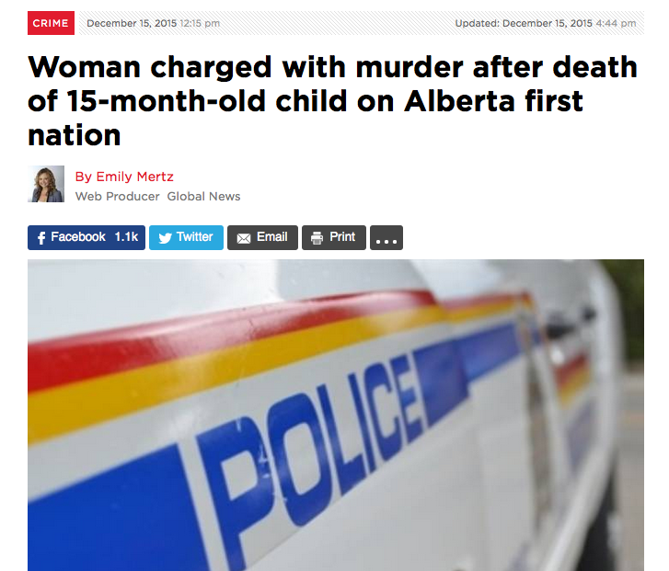

Slide 19
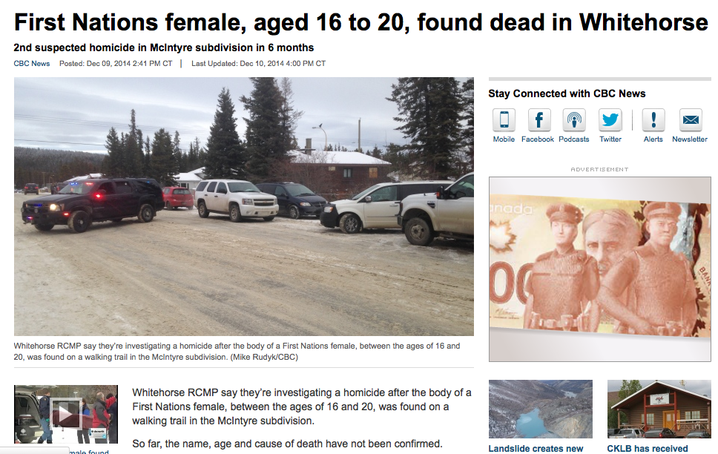

Slide 20
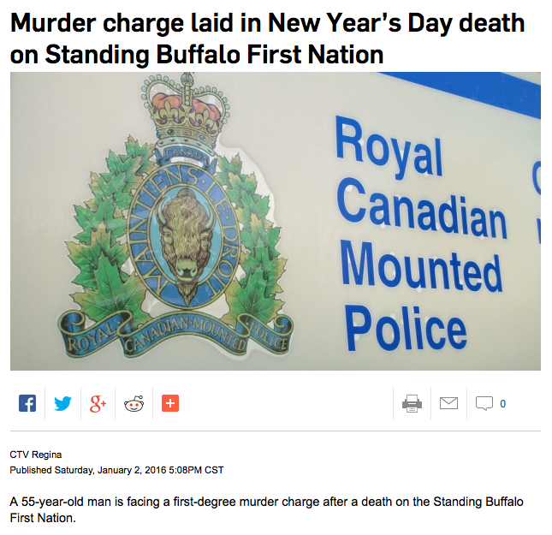

Slide 21
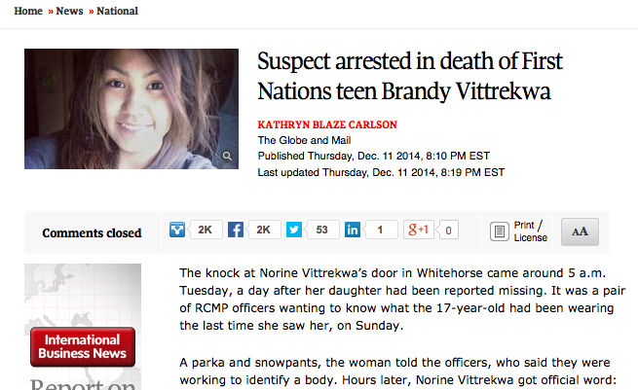

Slide 22
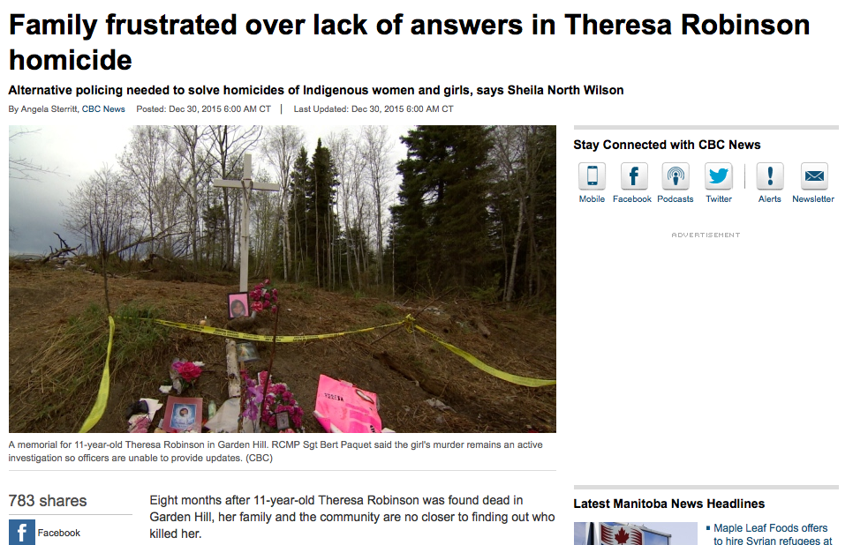

Slide 23
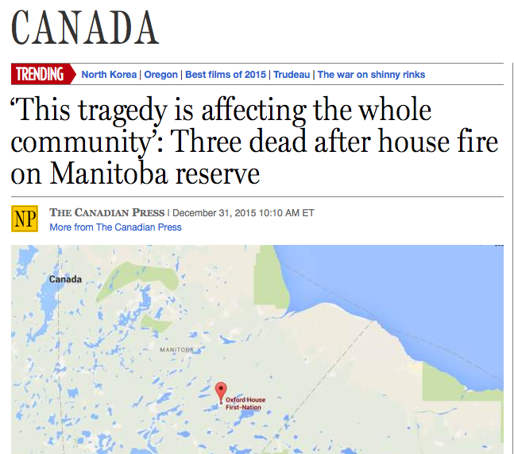

Slide 24
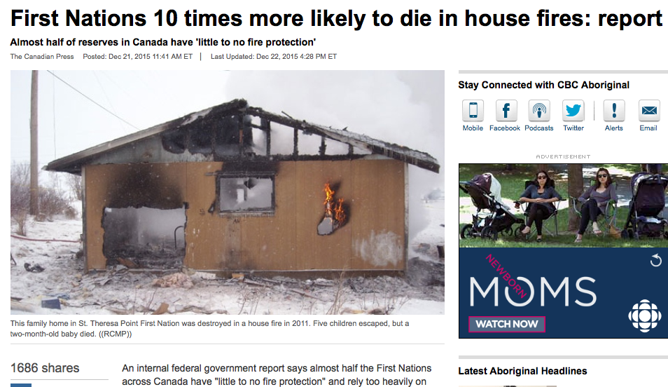

Slide 25
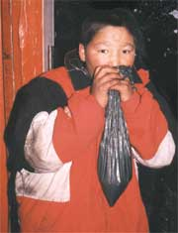
Drunk
Gas Sniffing amongst Labrador Innu

Slide 26
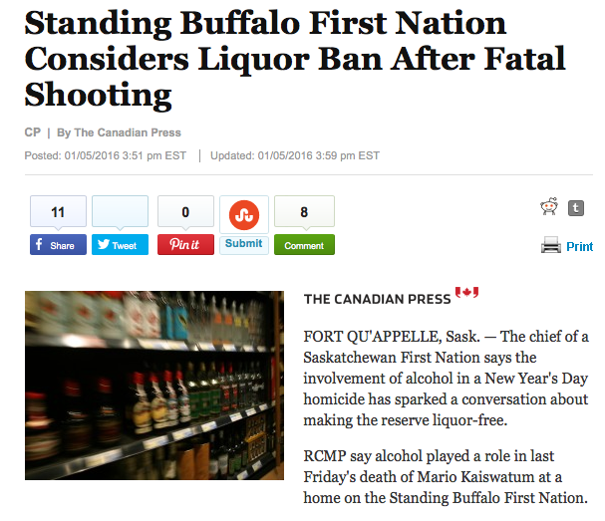
Notes:
Frank Paul…

Slide 27
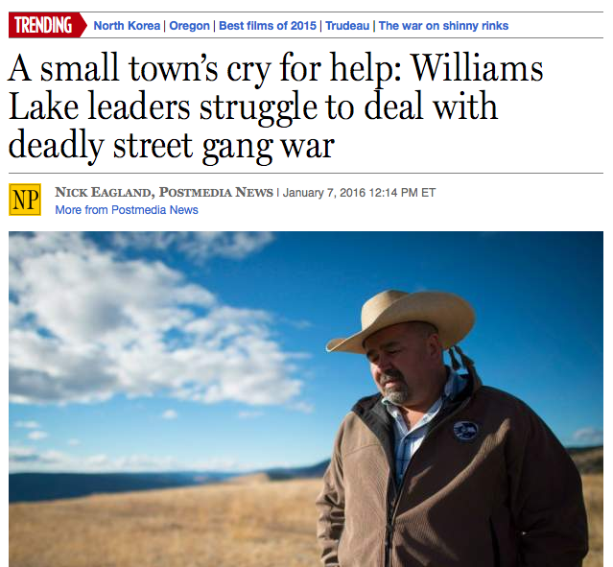

Slide 28
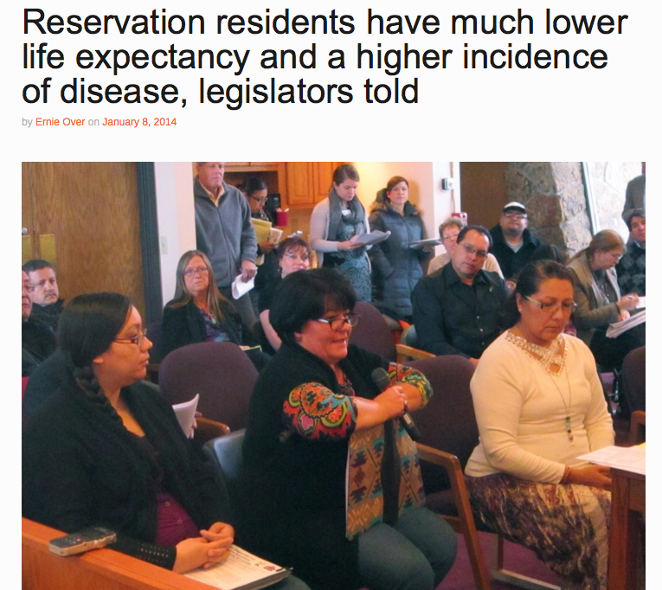

Slide 29
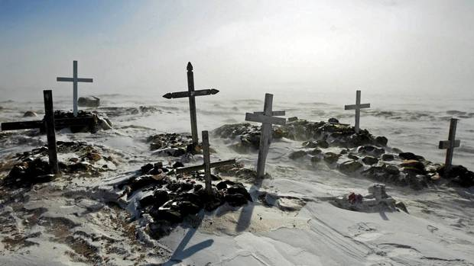
VICTIMS

Slide 30
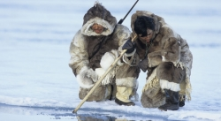
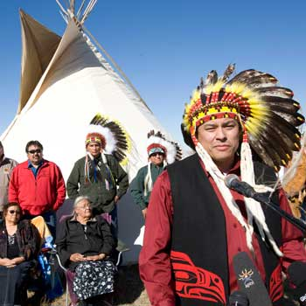
EXOTIC

Slide 31

“The Indian began as a White Man’s mistake, and became a White Man’s fantasy.”

Slide 32
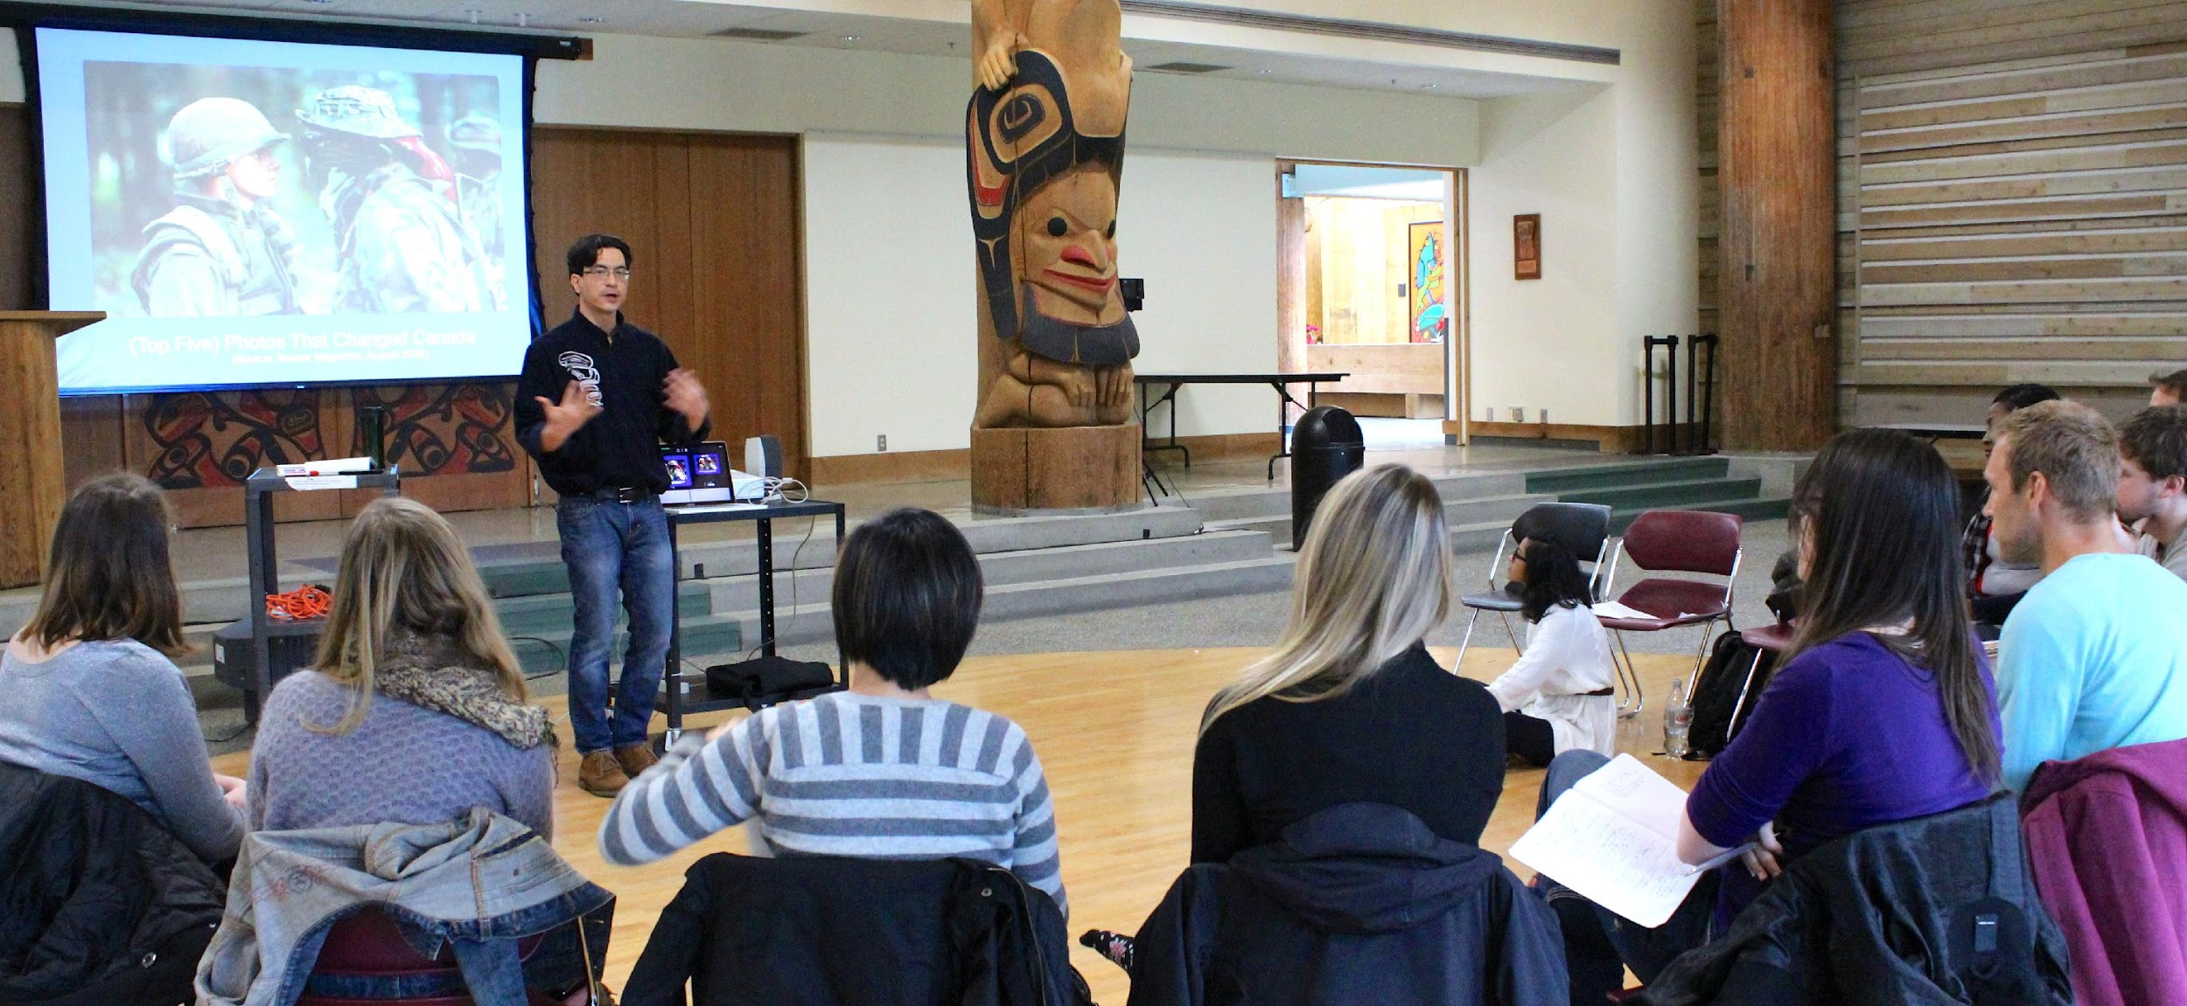
www.indigenousreporting.com

Slide 33
sometimes, when I interview a person of Indigenous descent,
I feel ______.

Slide 34
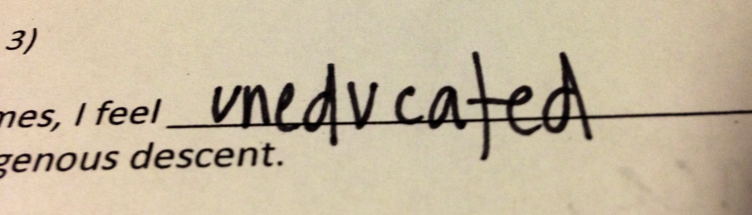
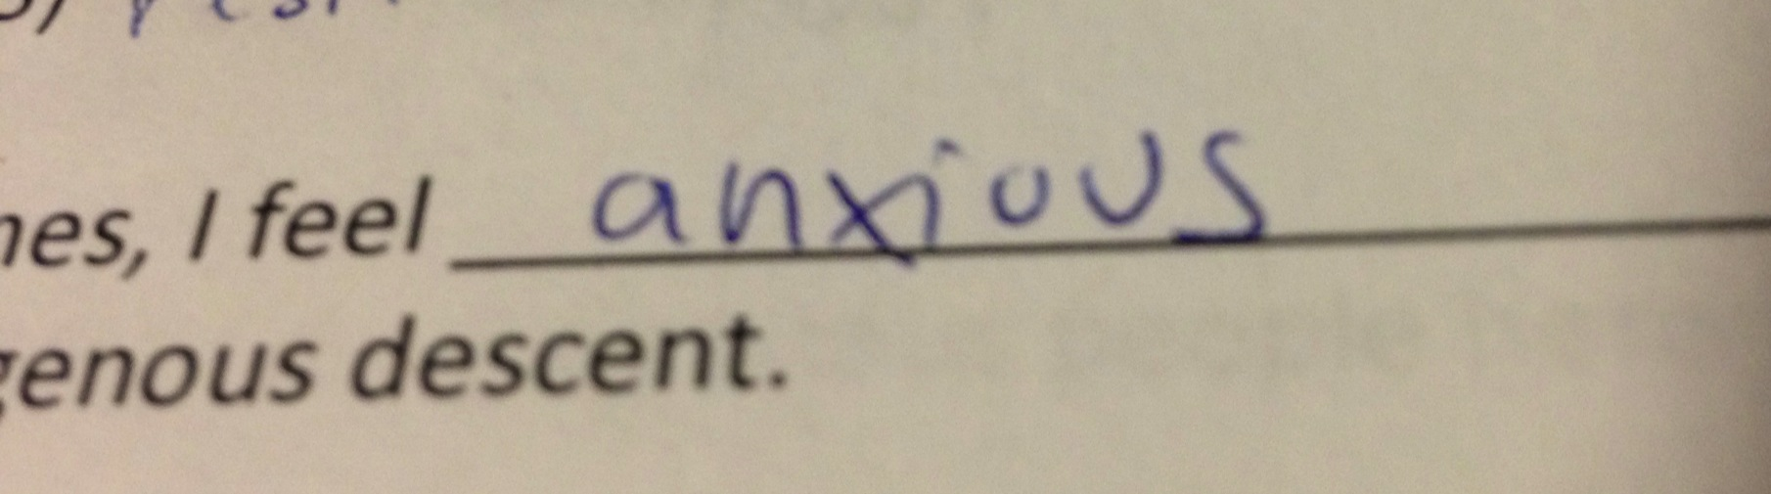
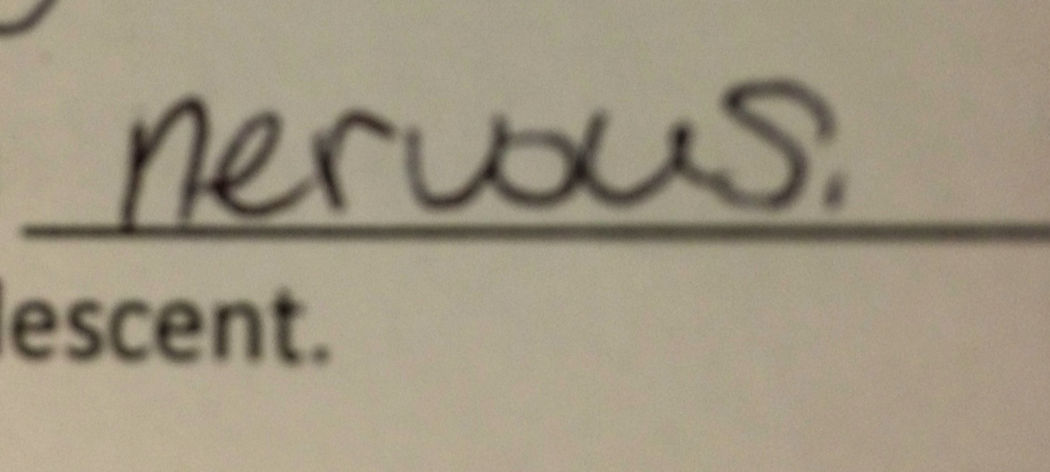
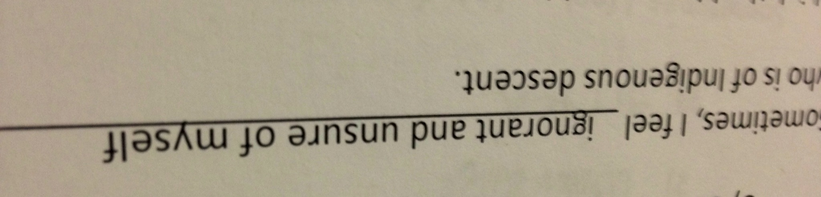

Slide 35
REPRESENTATION
RECIPROCITY

Slide 36
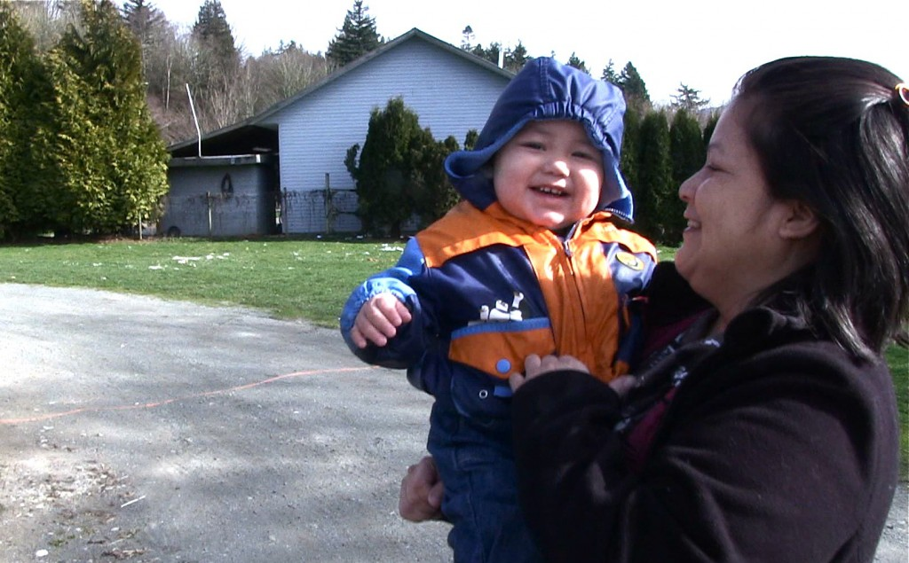
REPRESENTATION

Slide 37
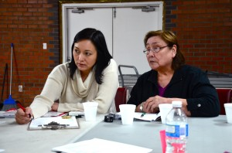
REPRESENTATION

Slide 38
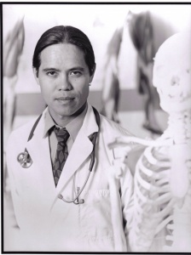
REPRESENTATION

Slide 39
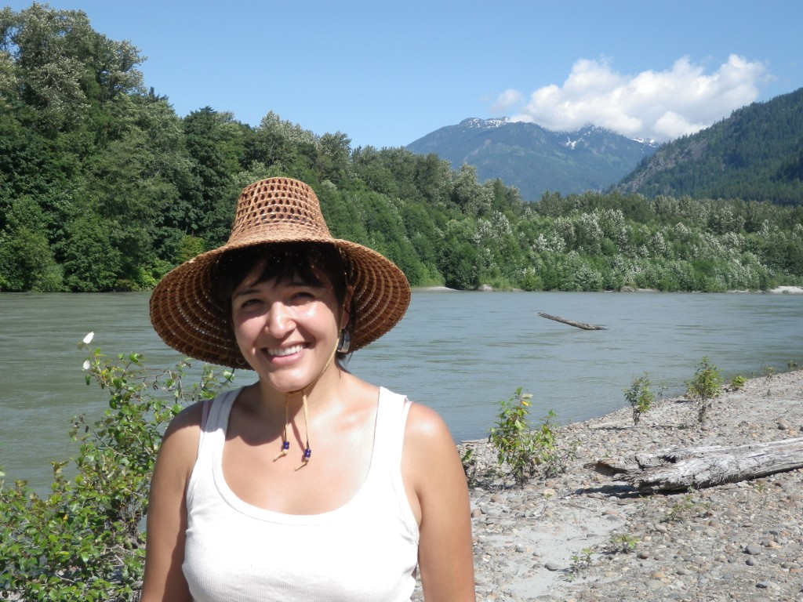
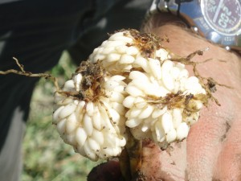
RECIPROCITY

Slide 40

RECIPROCITY

Slide 41
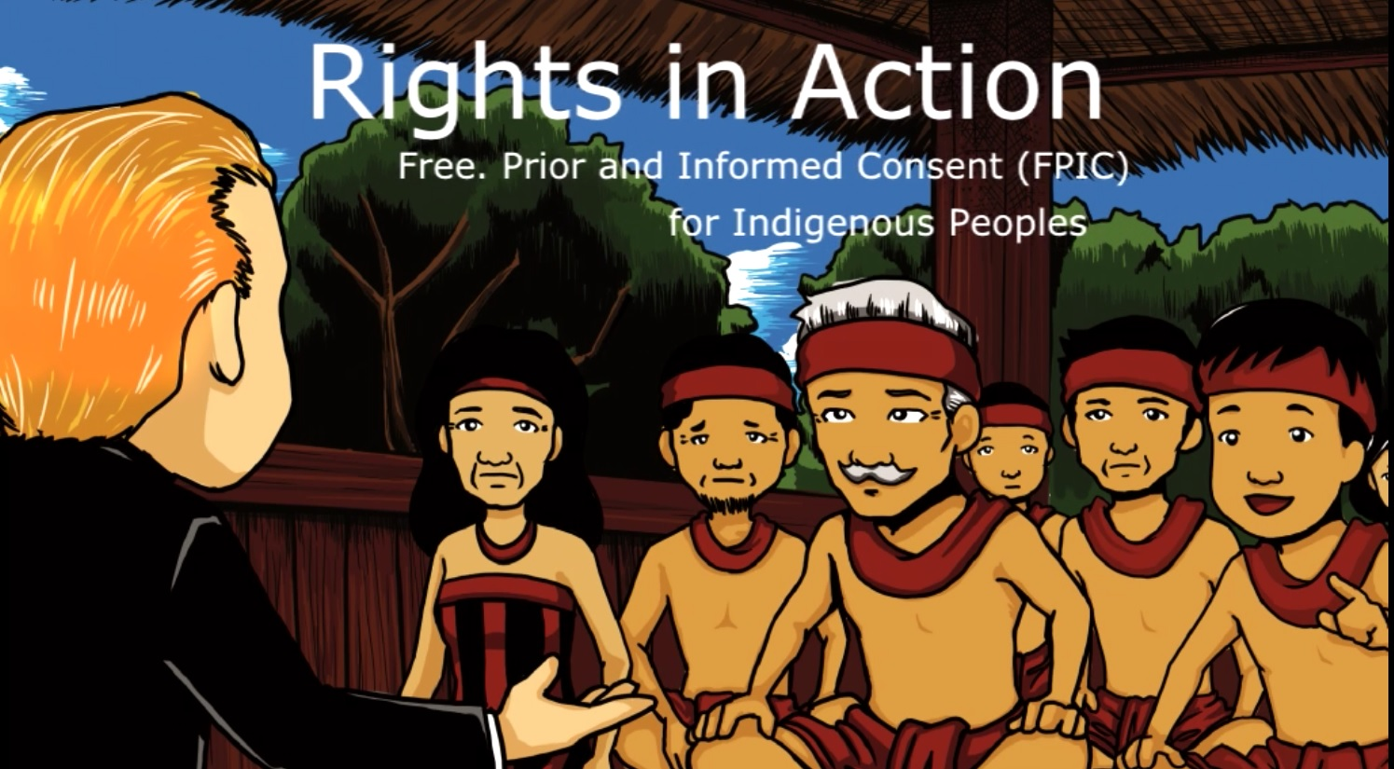

Slide 42
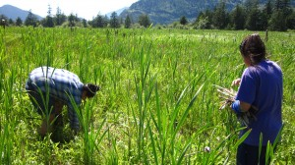
RECIPROCITY

Slide 43
RECIPROCITY
Be transparent.
Remember ‘Indian Time.’
Give back.
Ask not ‘How do I get access?’
ASK ‘HOW DO I GIVE BACK?’

Slide 44
www.riic.ca
@RIICNews
@duncanmccue

