Slide 1
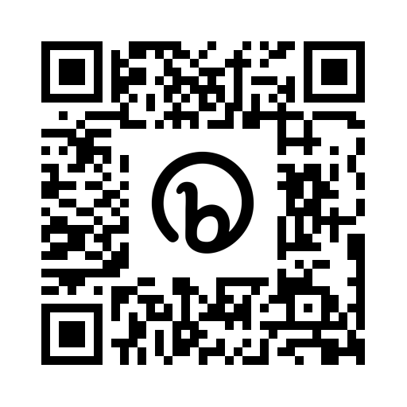
How does our advocacy garden grow?
Analyzing advocacy initiatives by Canadian library associations
Merran Carr-Wiggin, Céline Gareau-Brennan,
Hélène Carrier, and Michael B. McNally
https://bit.ly/LibAvocacyCAPAL2023

Slide 2
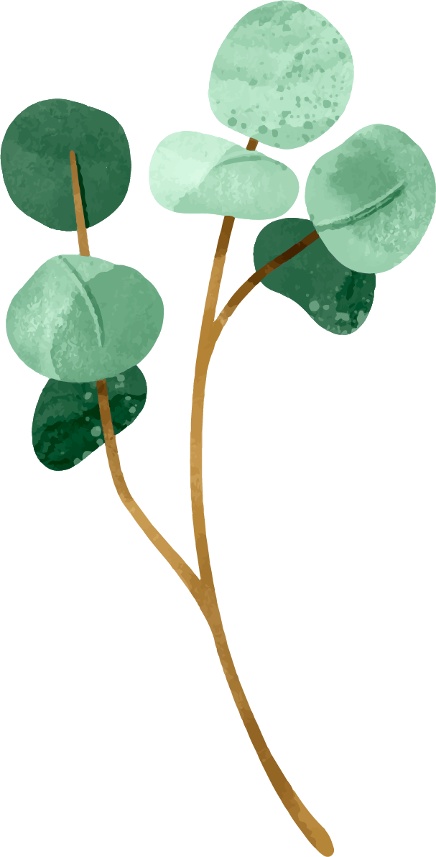
Land Acknowledgments
Hélène (UofO)
Works and lives on the unceded territory of the Algonquin people.
Merran (UofC)
Works and lives on Treaty 7 territory, which is also home to the Métis Nation of Alberta Region 3.
Céline and Michael (UofA)
Work and live on Treaty 6 territory, which is also home to the Métis Nation of Alberta Region 4.
We also acknowledge that York University is located on territory of many Indigenous nations and the territory is subject to the Dish with One Spoon Wampum Belt Covenant

Slide 3
The Plan
01
Project Origins
02
Literature Review
03
Methodology
04
Results
05
Discussion
06
Next Steps/ Future Work
07
Questions

Slide 4
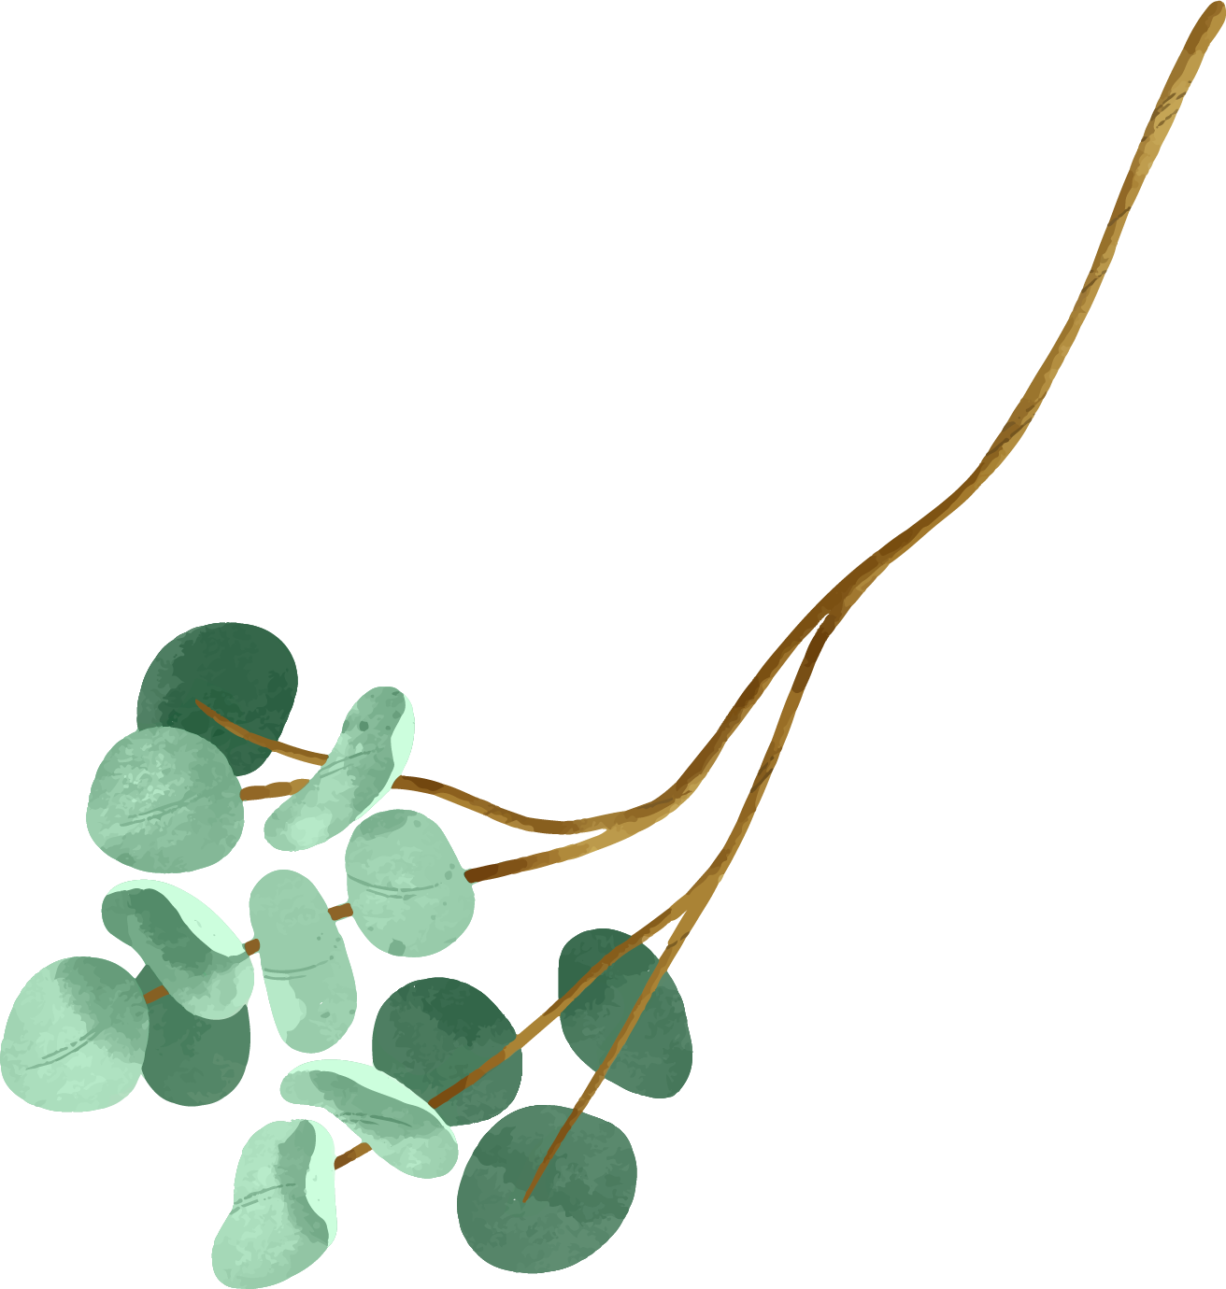
Project Origins
Common interest in assessing library advocacy among research team
Recognition of changing advocacy landscape since 2016
Need to understand current context (quantitatively) to facilitate future work

Slide 5
Literature Review
Library Advocacy
Library advocacy focused on generating awareness, building relationships and influence, engaging legislators and championing causes (Hicks, 2016; Burns 2015)
Library literature tends to be practical in nature or focused on thought leaders with few empirical studies (Cleyle, 2020; Bourne-Tyson, 2017; Million and Bossaler, 2020)
Previous CLA advocacy has been criticized for failing to meet the expectations of its members and addressing the needs of library workers (Whitmell, V. (1999); DeYoung, M. (2020); Oliphant & McNally, 2014; Canadian Library Association (n.d.))

Slide 6
Literature Review
Schein’s Approach to Organizational Behaviour
Schein’s framework for analyzing culture uses three manifestation categories:
artifacts
espoused beliefs and values, and
basic underlying assumptions (Schein 1990; Schein and Schein, 2016)
Artifacts, espoused beliefs and values and underlying assumptions can be contradictory (Schein, 1990; Schein & Schein, 2016).

Slide 7
Methodology
Exploratory scan of advocacy outputs (artifacts) by three national organizations (CARL, CFLA and CULC) from 2016-2022
Extracted advocacy artifacts from organization websites
Thematic coding (Clarke and Braun, 2006) used for document type, audience and themes

Slide 8
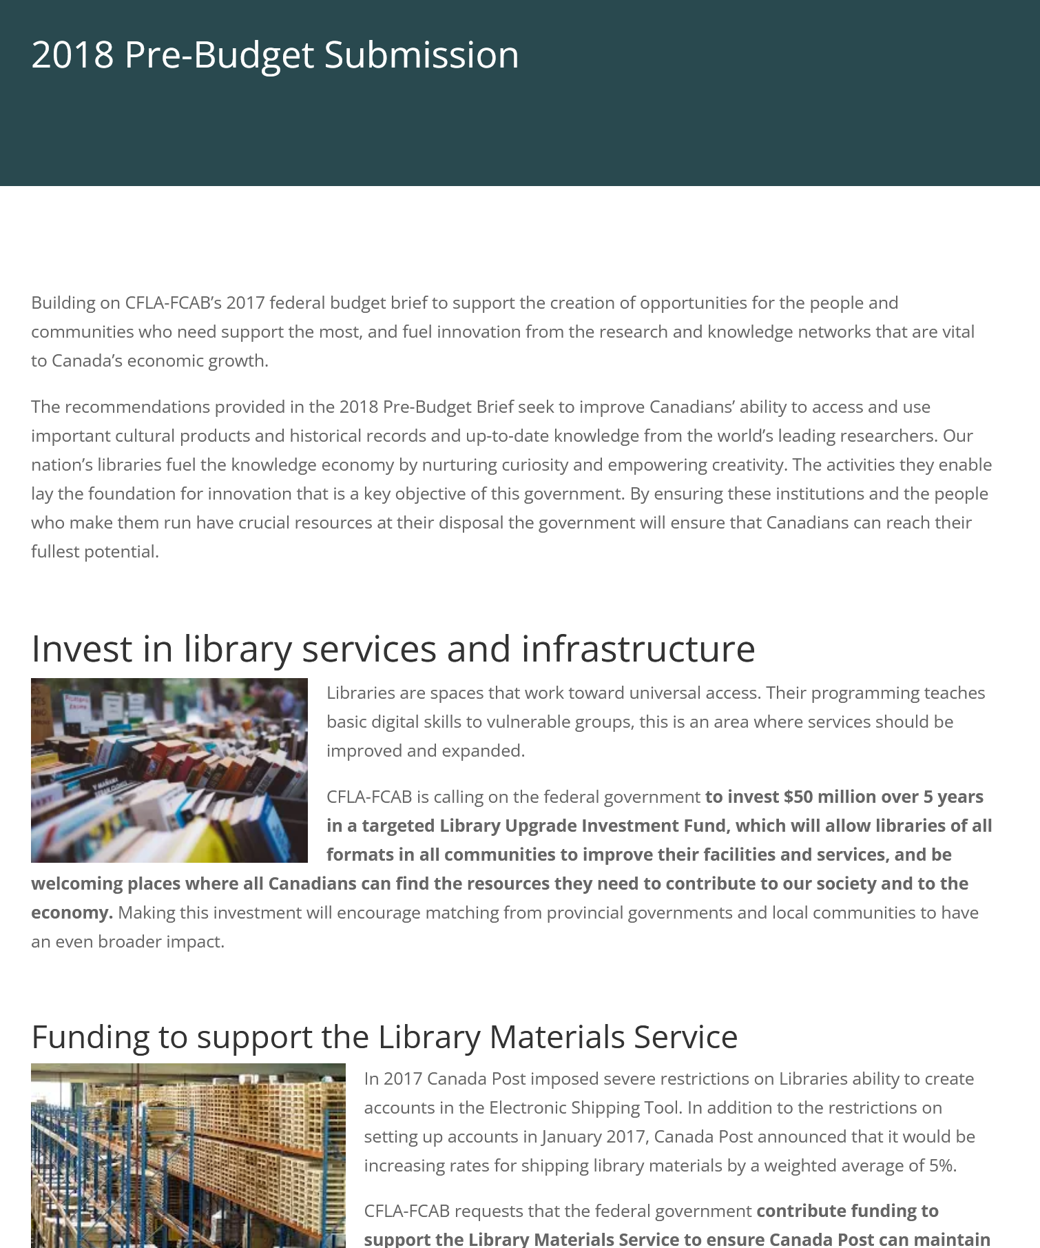
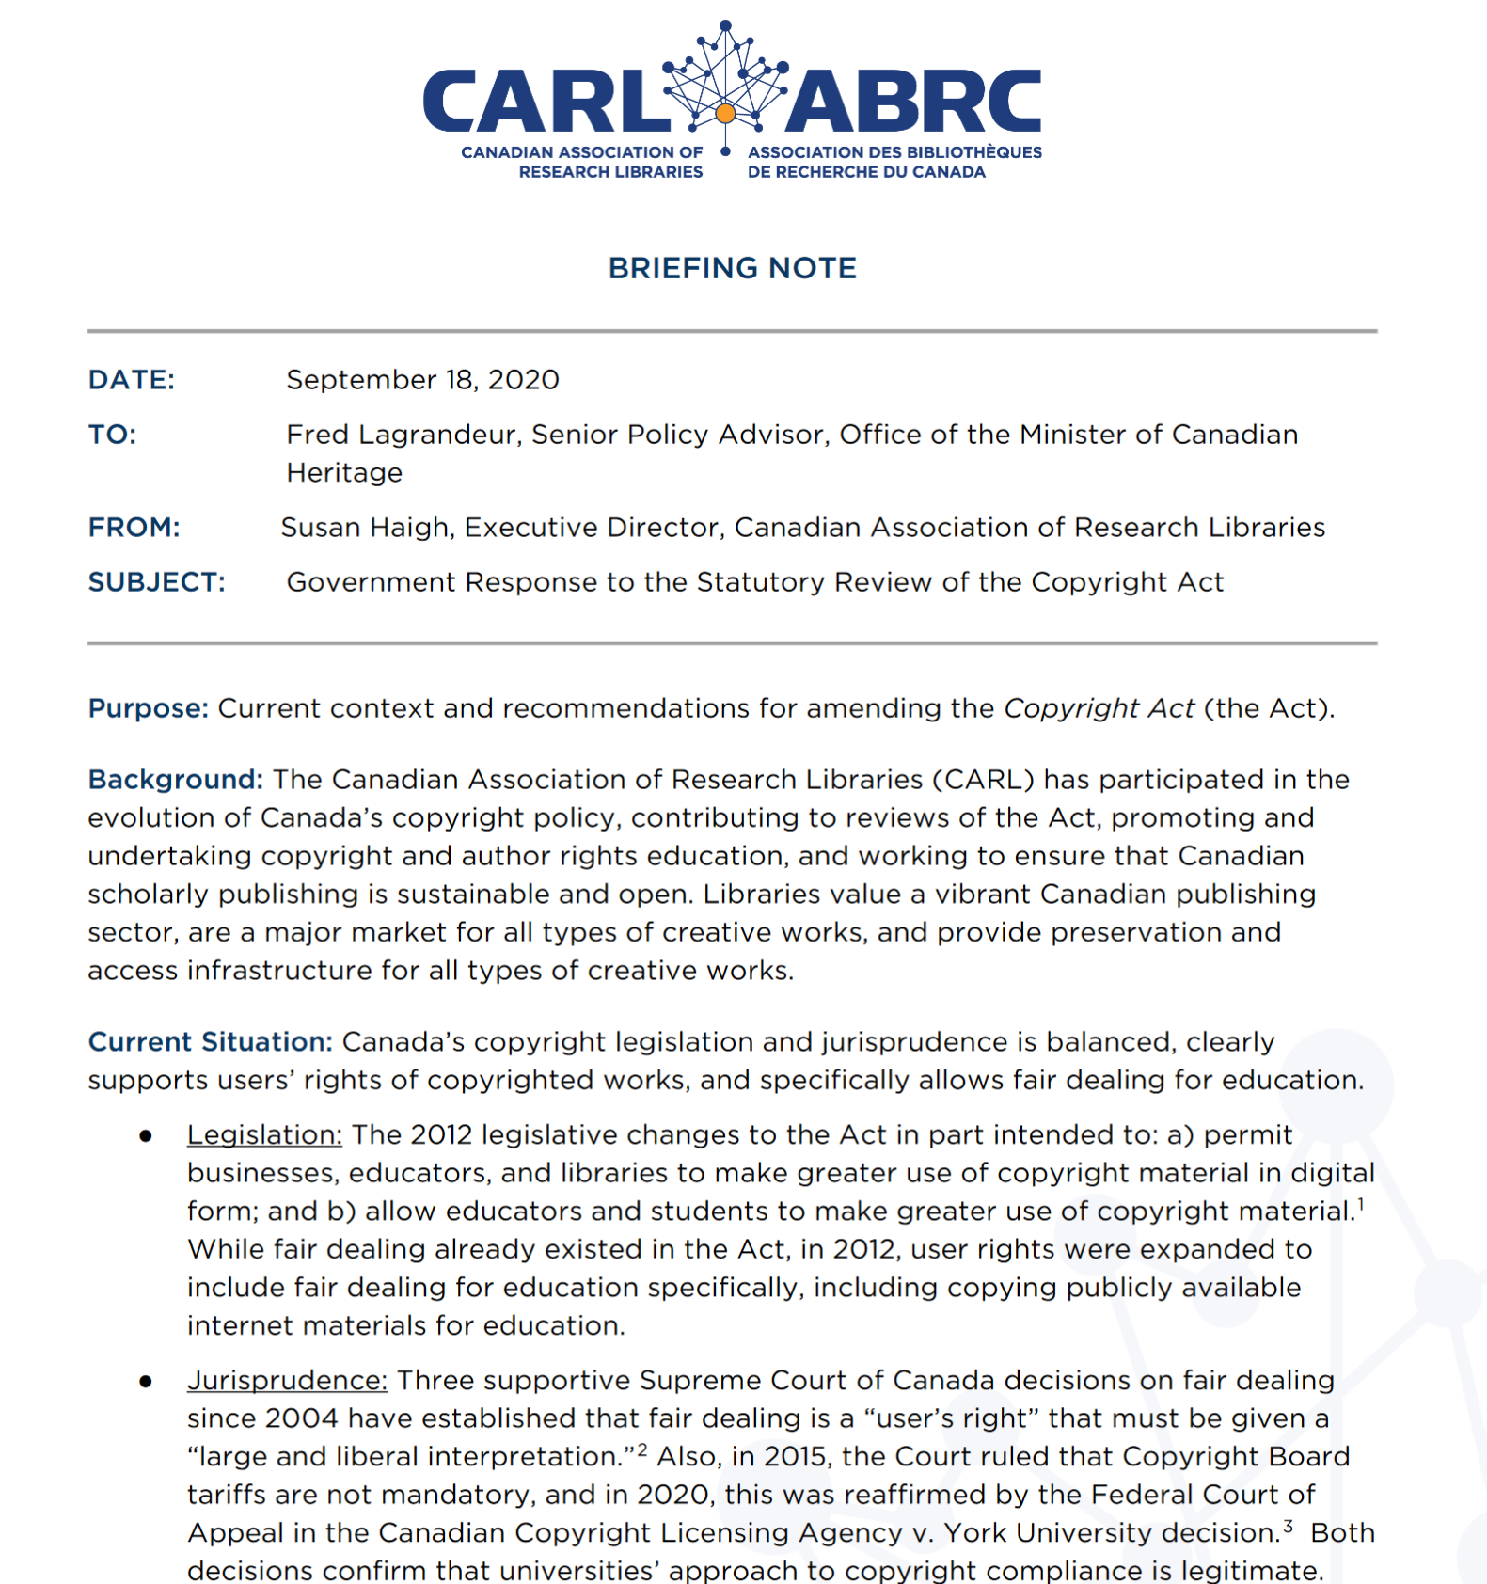
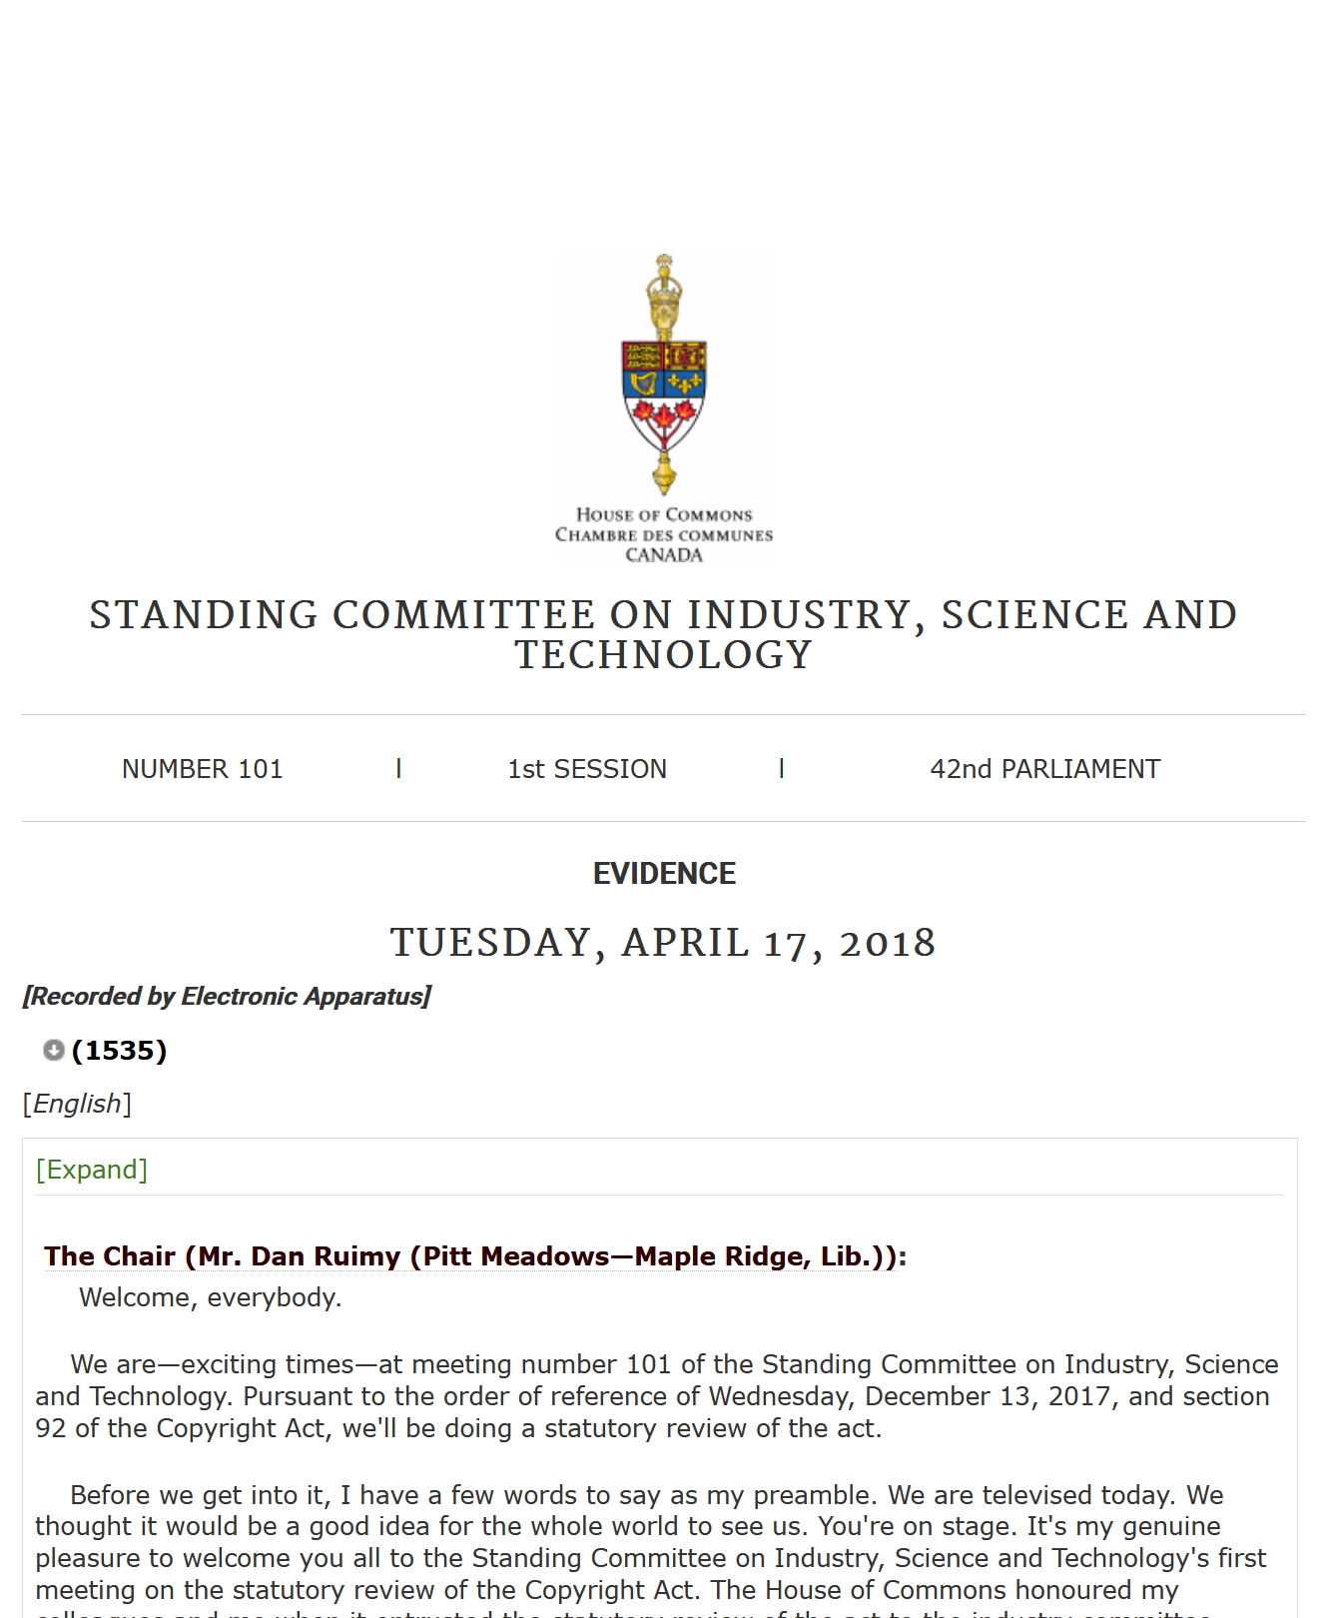
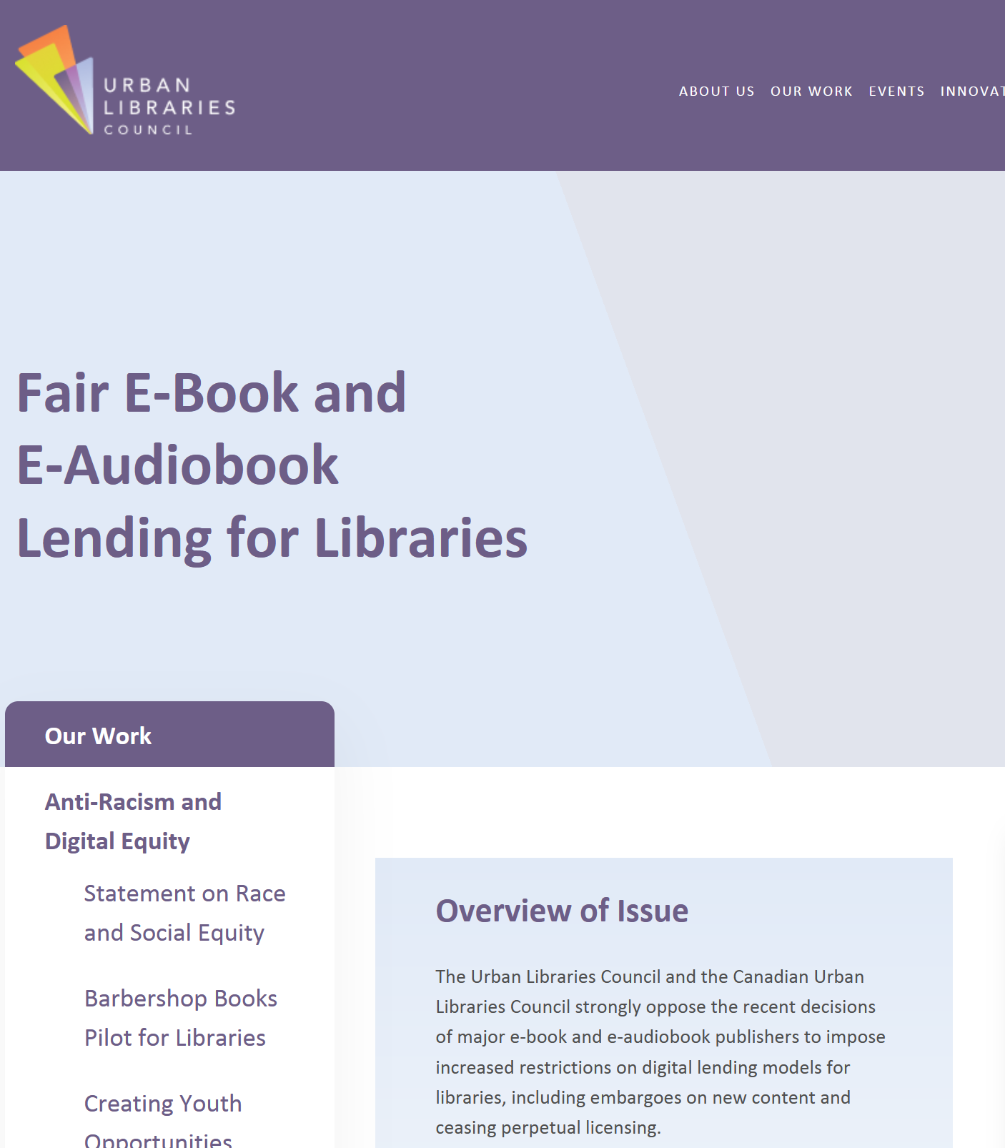
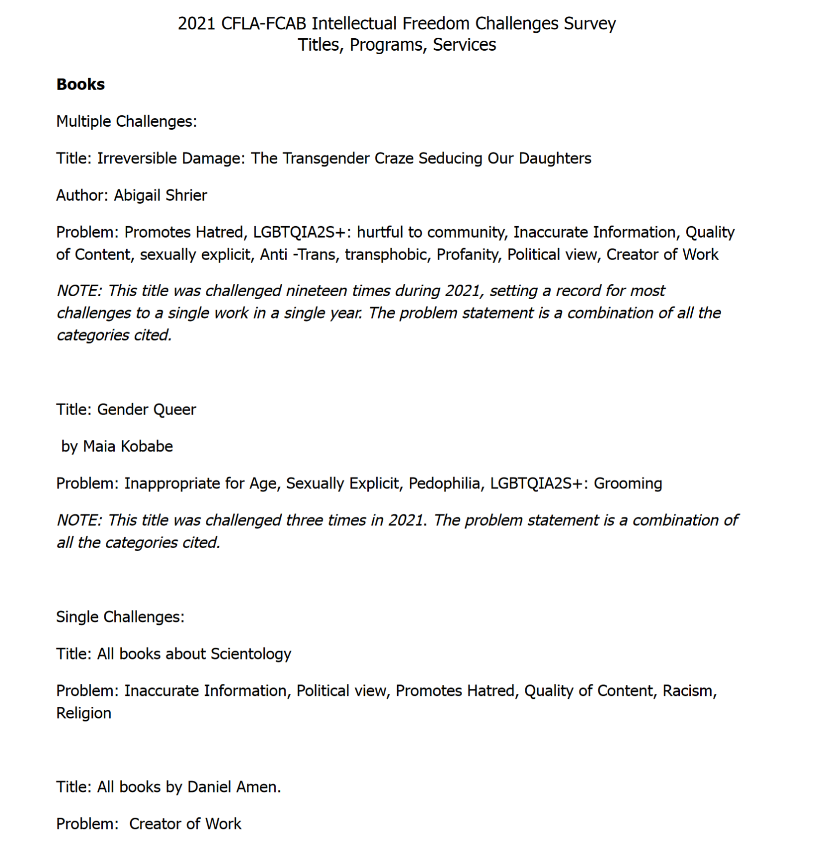
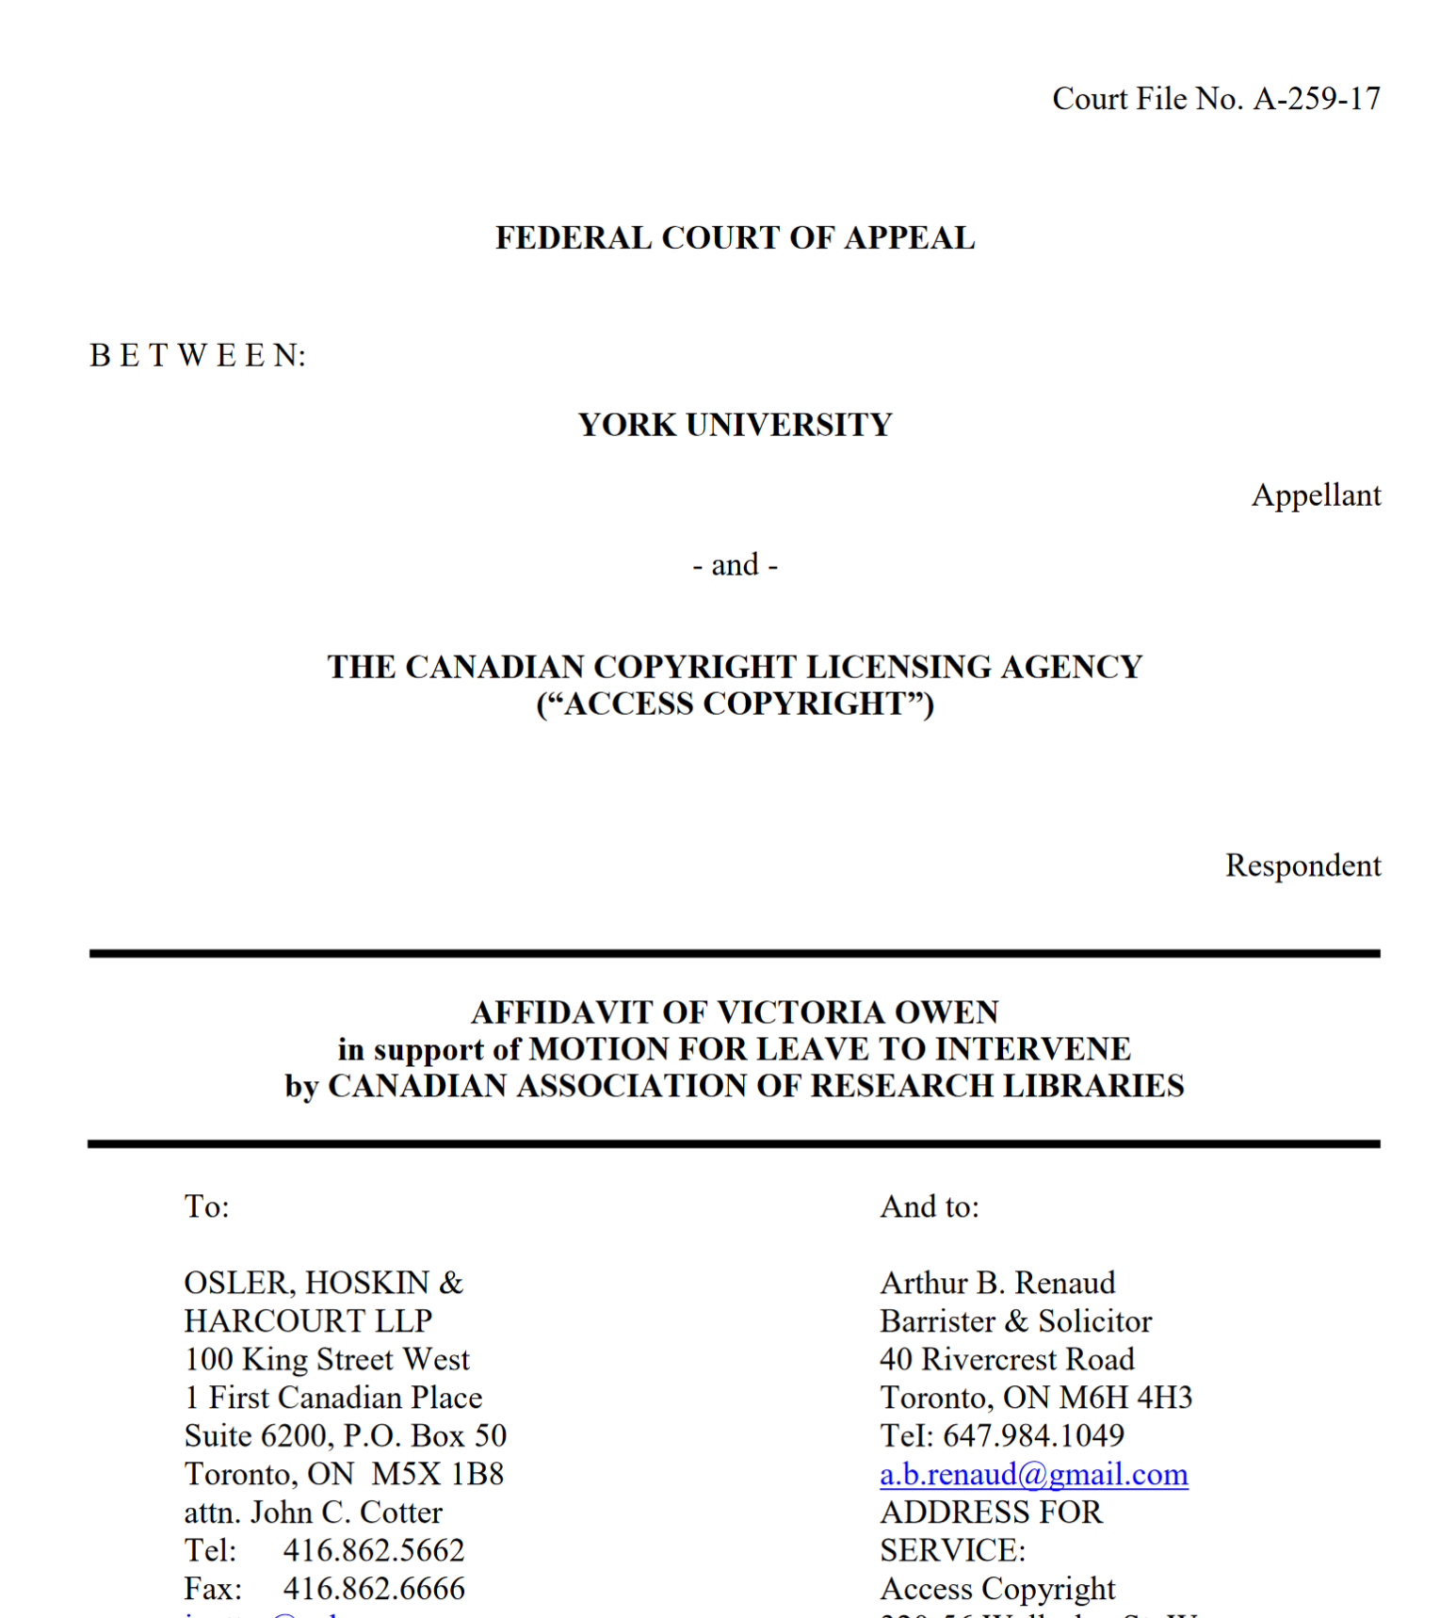
Methodology
Exploratory scan of advocacy outputs (artifacts) by three national organizations (CARL, CFLA and CULC) from 2016-2022
Extracted advocacy artifacts from organization websites
Thematic coding (Clarke and Braun, 2006) used for document type, audience and themes

Slide 9
Results- Summary
Quantitative analysis more confirmatory than revelatory in findings
Data does not tell the human (qualitative) story behind advocacy
Patterns across the field and each organization and over time
The field produces roughly 20 advocacy artifacts per year - how can advocacy capacity be enhanced

Slide 10
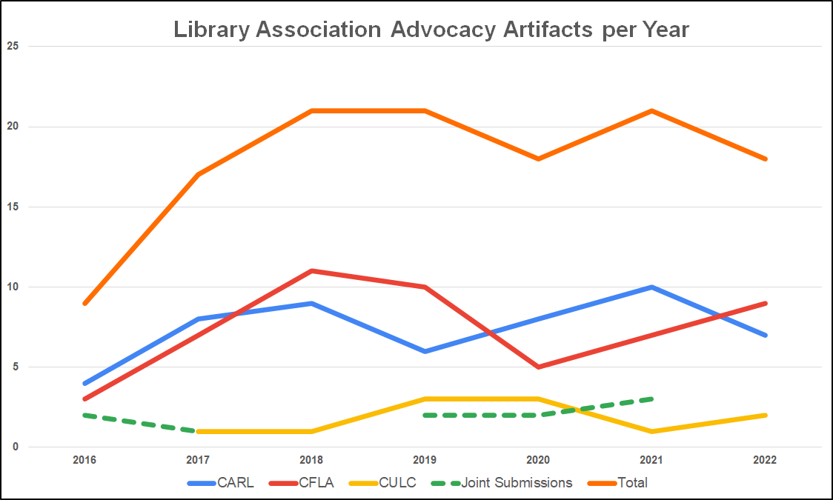

Slide 11
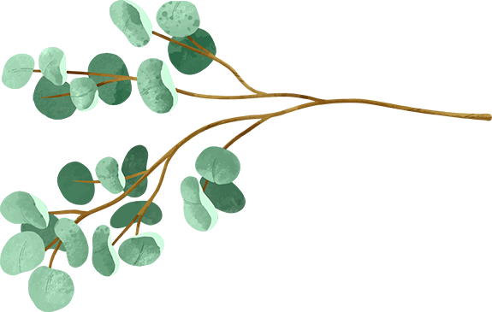
Advocacy Audiences
Artifacts Addressed to Branches of the Federal Government
Legislative - 42
Judicial - 1
QJALRA - 9
Artifacts Addressed to Non-Federal Audiences
Executive - 44
Non-Government Audiences - 60
Provincial Governments - 4

Slide 12
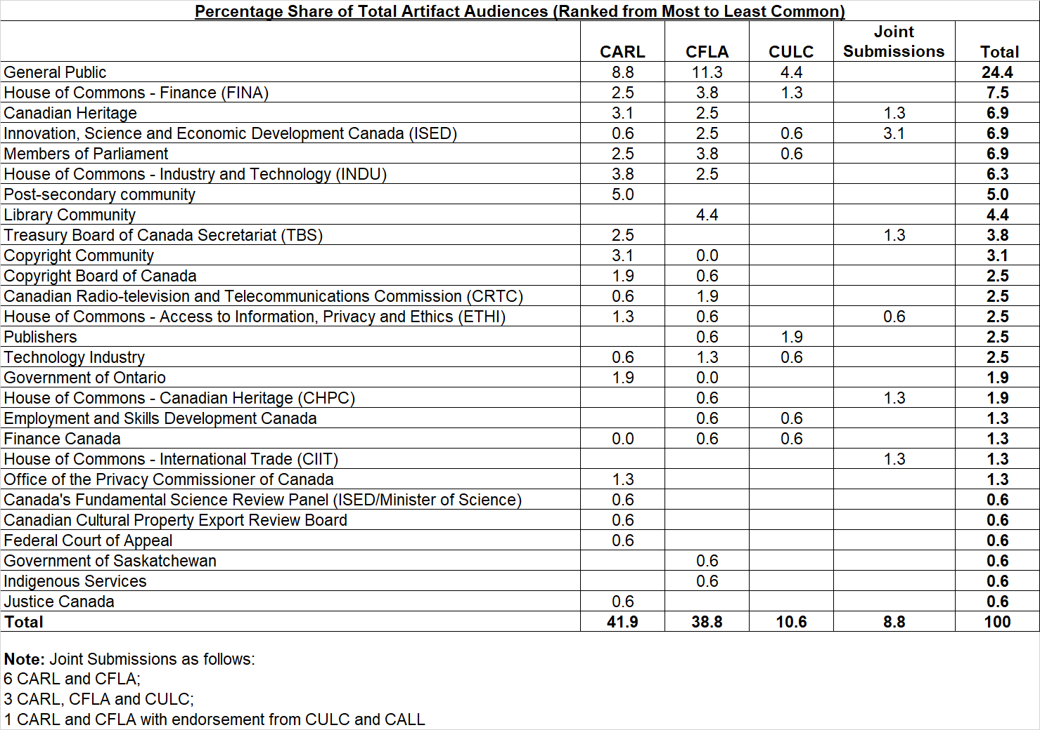
Advocacy Audiences

Slide 13
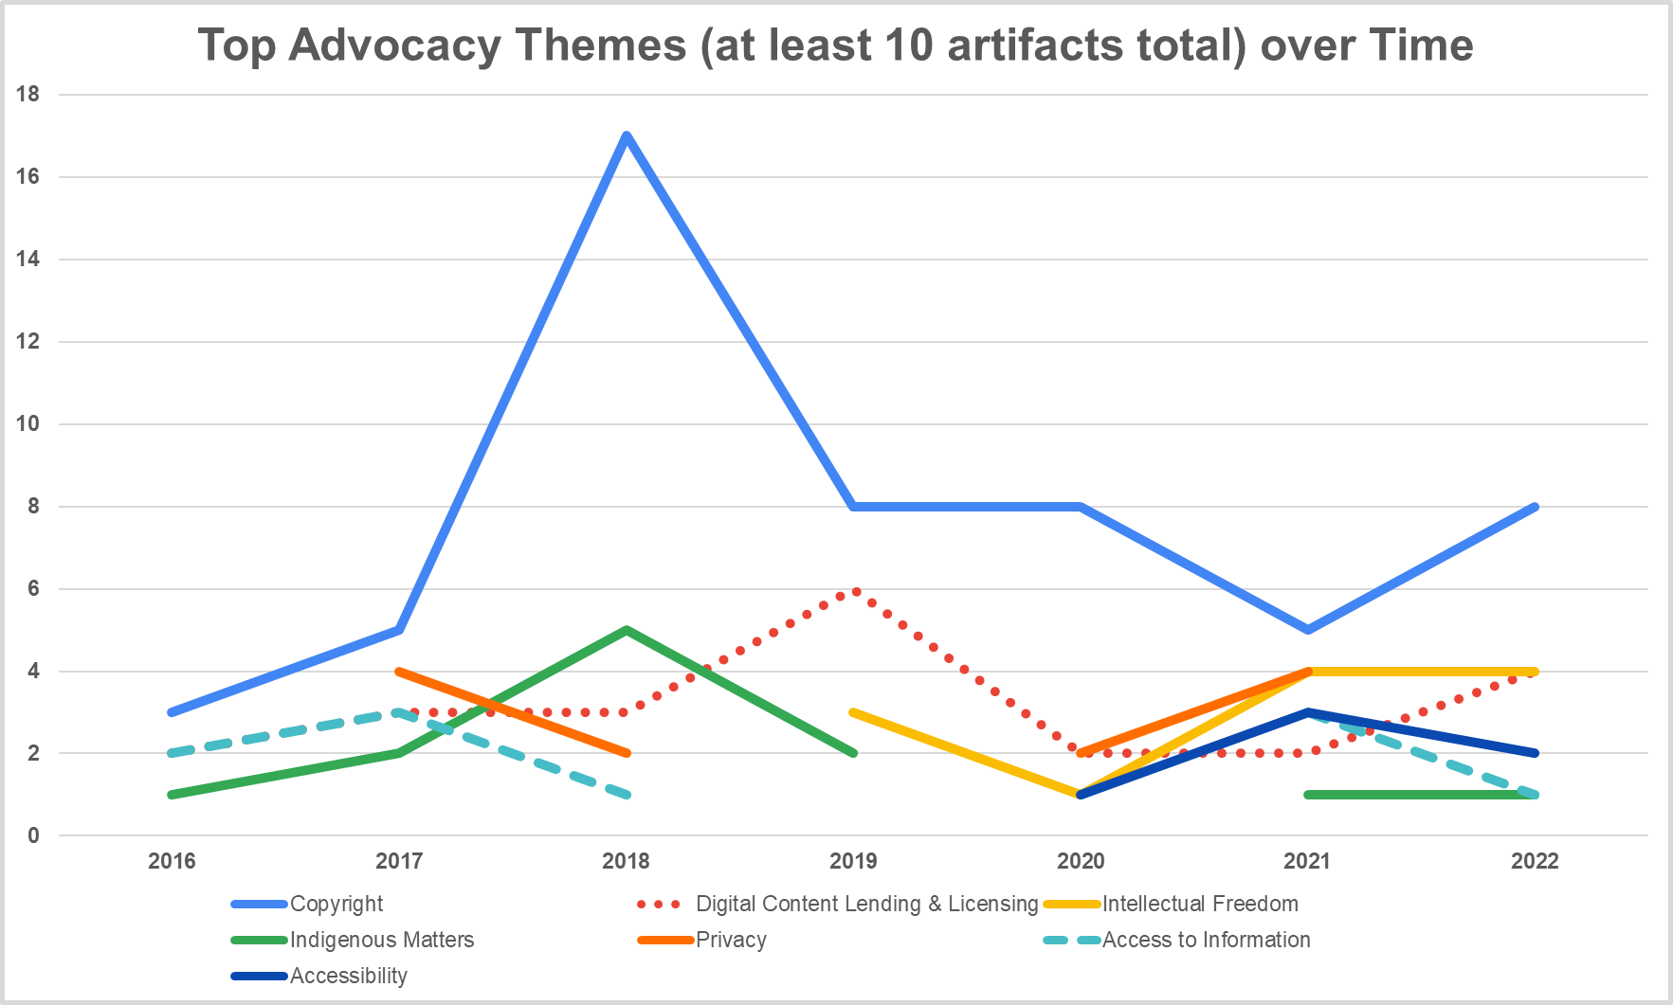

Slide 14
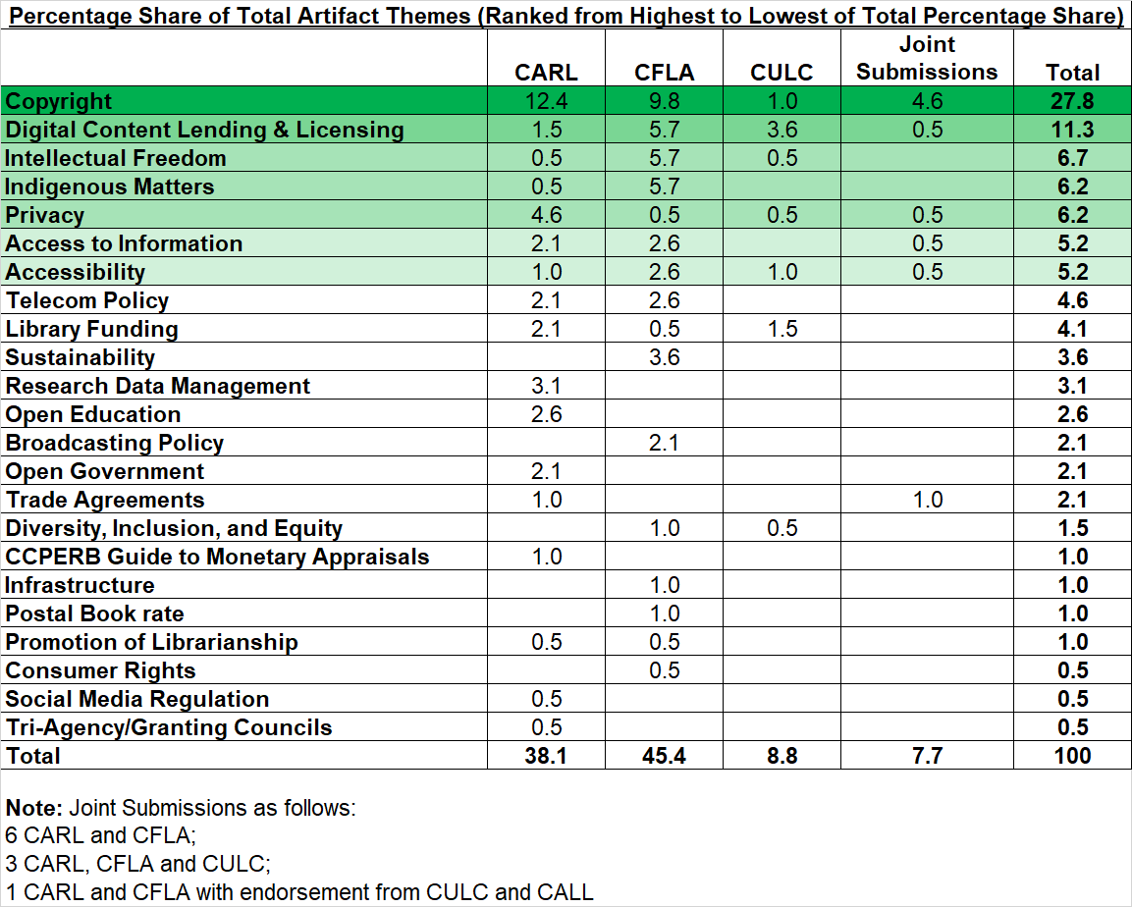
Advocacy Themes

Slide 15
Joint Submissions
10 joint submissions total
6 CARL and CFLA
3 CARL, CFLA and CULC
1 CARL and CFLA with endorsement from CULC and CALL
Copyright was the primary focus of joint submissions (9 of 15 total themes)
ISED was the primary audience for joint submissions (5 of 14 total audiences)

Slide 16
Considering Library Advocacy in Relation to Schein’s Organizational Behaviour Lens
Artifacts should reflect underlying beliefs
“Users/patrons” figure prominently in library association advocacy (e.g. concern re users’ rights in copyright; promoting digital access)
CFLA/IFLA Code of Ethics underscores advocacy for copyright and this is borne out in practice

Slide 17
Considering Library Advocacy in Relation to Schein’s Organizational Behaviour Lens
However contradiction may also be evinced
Notably promotion of librarianship was a marginal theme (2 of 194 total themes)
Collaboration occurred in just 8% of total artifacts
Some notable gaps in advocacy (e.g. literacy promotion)

Slide 18
Next Steps and Future Work
Study impact of media/press releases - do library association press releases garner any press?
Engage CFLA, CARL and CULC on findings
Larger qualitative study - understand the human dynamics behind library association advocacy

Slide 19
Thanks! Questions?
Merran merran.carrwiggin@ucalgary.ca
Céline crg@ualberta.ca
Hélène hcarrier@uottawa.ca
Michael mmcnally@ualberta.ca

Slide 20
Sources
Bourne-Tyson, D. & Haigh, S. (2017). How does a nascent federation of library associations work well with others? The case of Canada. International Federation of Library Associations World Library and Information Congress. https://library.ifla.org/id/eprint/1823/1/140-bourne-tyson-en.pdf
Braun, V., & Clarke, V. (2006). Using thematic analysis in psychology. Qualitative research in psychology, 3(2), 77-101. https://doi.org/10.1191/1478088706qp063oa
Burns, E. (2015). Practitioner perceptions of school library advocacy. Education Libraries, 38(1). https://doi.org/10.26443/el.v38i1.6
Canadian Library Association. (n.d.) Advocacy. https://cla.ca/cla-at-work/advocacy/
Clarke, V., & Braun, V. (2006). Using thematic analysis in psychology. Qualitative research in psychology, 3(2), 77-101. https://doi.org/10.1191/1478088706qp063oa
Cleyle, S., & van den Hoogen, S. (2020). Shift happens: The recent evolution of Canadian library associations. Partnership: The Canadian Journal of Library and Information Practice and Research, 15(1). https://doi.org/10.21083/partnership.v15i1.5904
DeYoung, M. (2020). From the Canadian Library Association to the Canadian Federation of Library Associations: A confluence of evolution and circumstance. Partnership: The Canadian Journal of Library & Information Practice & Research, 15(1), 1–10. https://doi.org/10.21083/partnership.v15i1.6048
Hicks, D. (2016). Advocating for librarianship: The discourses of advocacy and service in the professional identities of librarians. Library Trends, 64(3), 615-640. https://core.ac.uk/download/pdf/158312979.pdf
Million, A.J. & Bossaller, Jenny (2020). Lobbying and political advocacy: A review of the literature and exploratory survey of state library associations. The Political Librarian, 4(2). https://openscholarship.wustl.edu/pollib/vol4/iss2/8
Oliphant, T. & McNally, M. B. (2014). Professional decline and resistance: The case of library and archives Canada. Radical Teacher, 99, 54-61. https://radicalteacher.library.pitt.edu/ojs/radicalteacher/article/view/105/61
Schein, E. H. (1990). Organizational Culture. American Psychologist, 45(2), 109-119. https://doi.org/10.1037/0003-066X.45.2.109
Schein, P. A., & Schein, E. H. (2016). Organizational culture and leadership (5th ed.). John Wiley & Sons.
Whitmell, V. (1999). Of advocacy and coalitions [CLA's 1998-2000 Strategic Plan]. Feliciter, 45(1), 9-9,11. https://www.proquest.com/trade-journals/advocacy-coalitions-clas-1998-2000-strategic-plan/docview/223166144/se-2

Slide 21
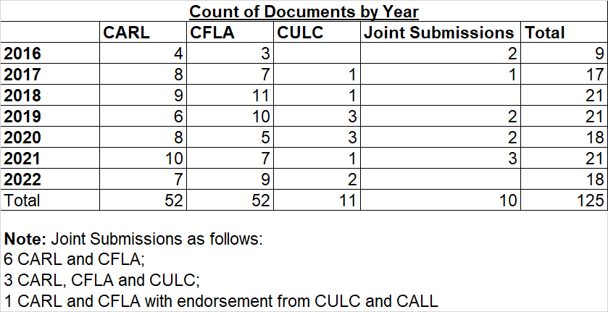
Appendix/Data Tables

Slide 22
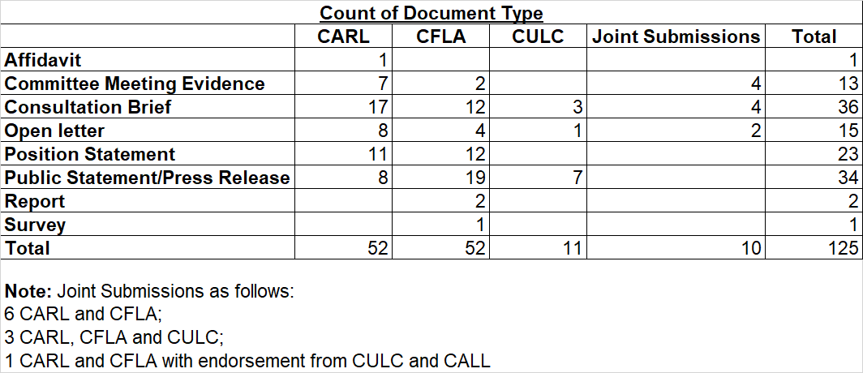
Appendix/Data Tables

Slide 23
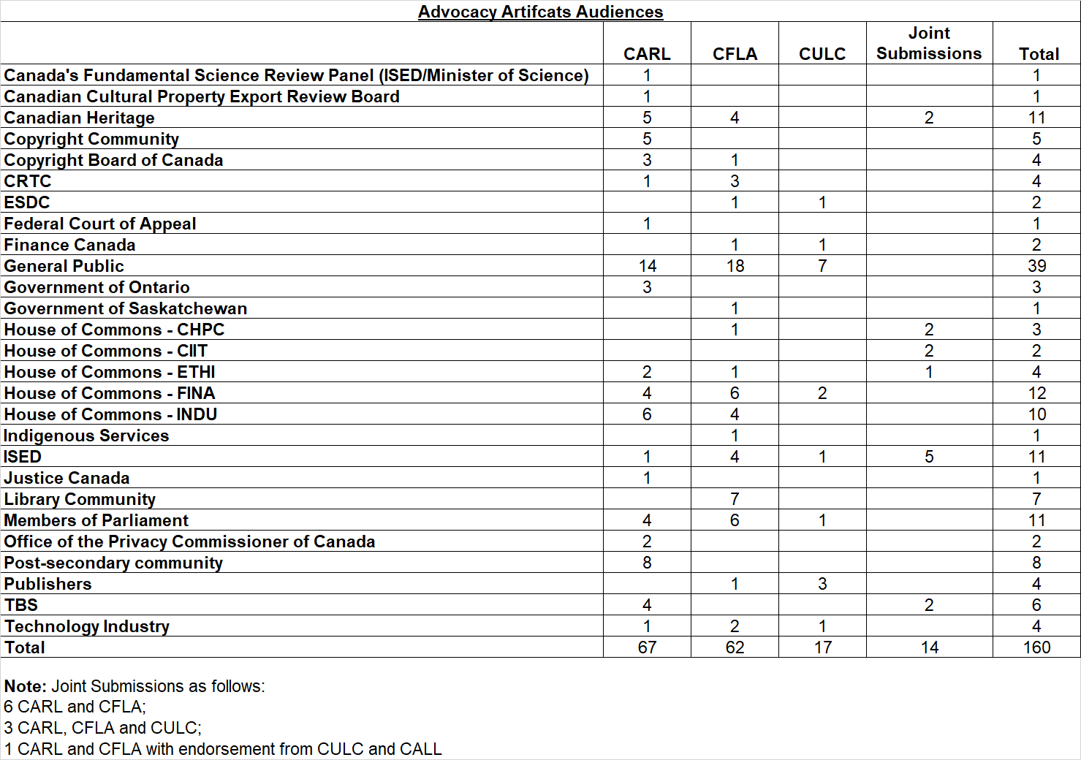
Appendix/Data Tables

Slide 24
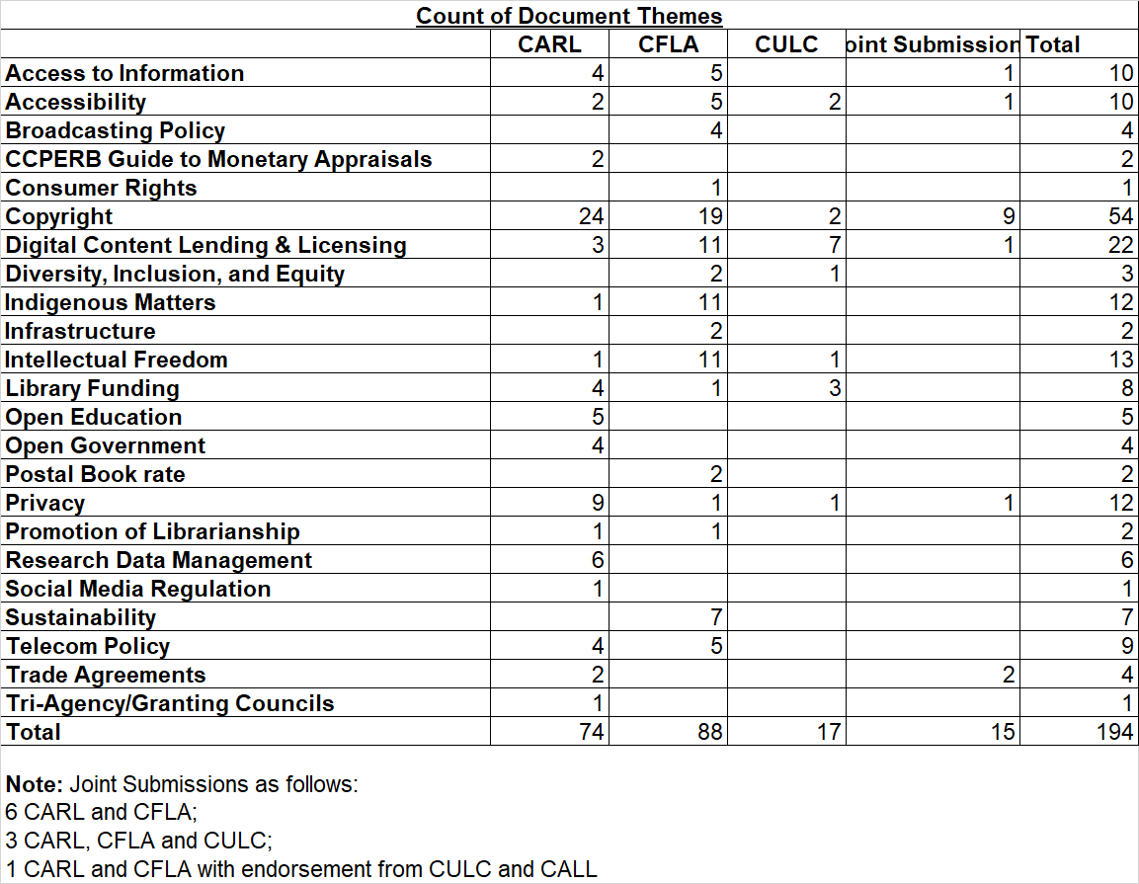
Appendix/Data Tables

Slide 25
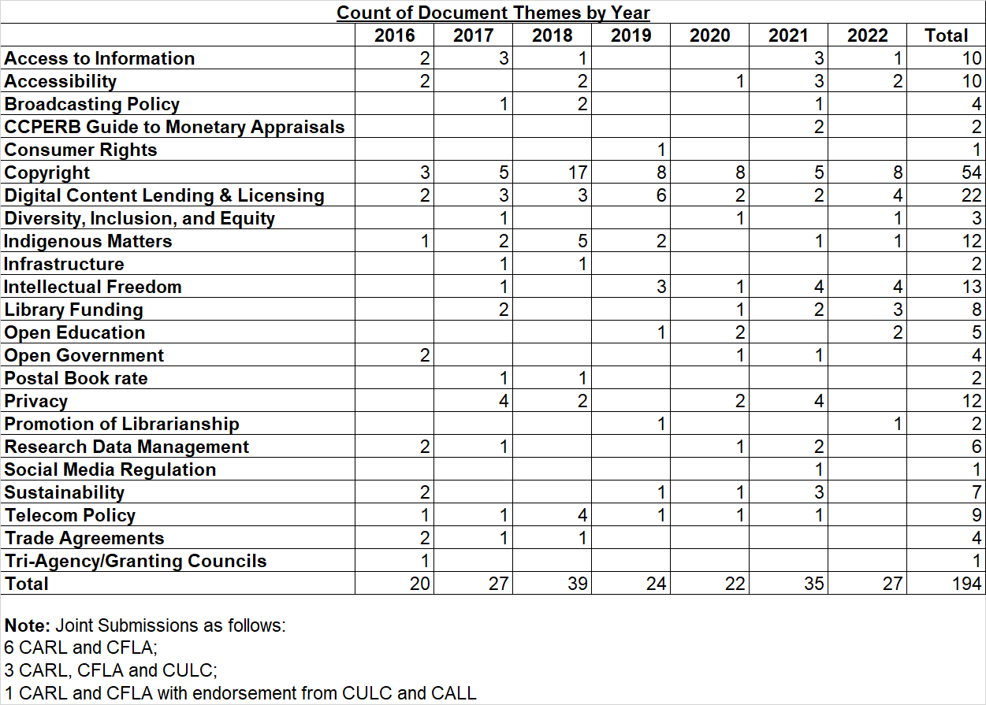
Appendix/Data Tables

