Slide 1
Images
November 2019
Notes:
Narrator: Hello and welcome to the University of Alberta's Opening Up Copyright Instructional Module on Images.

Slide 2
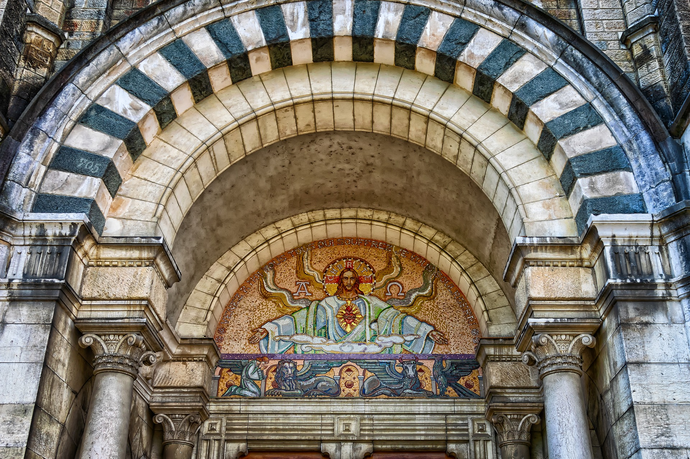
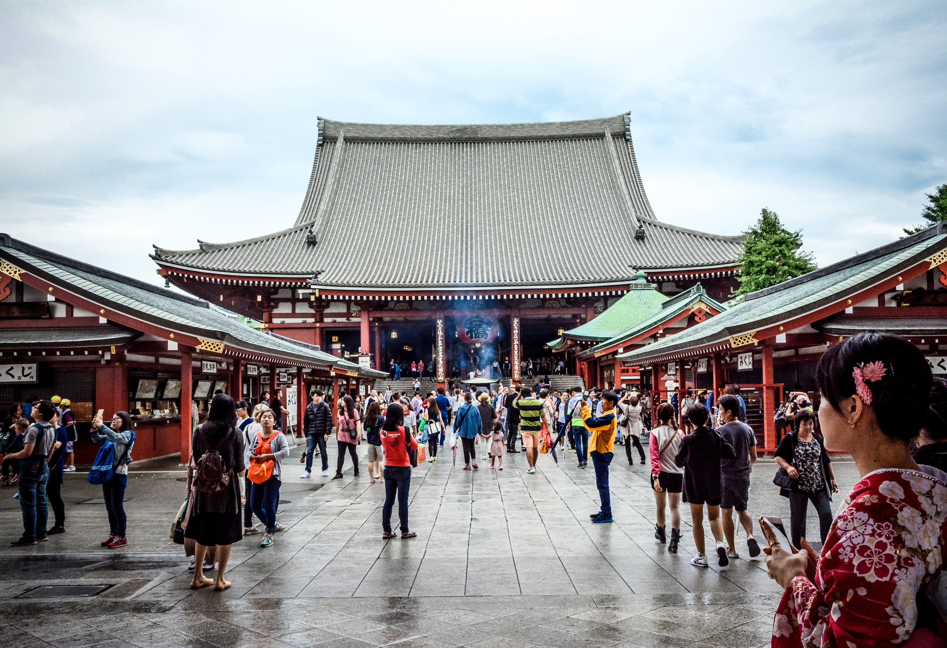
MEET ISABELLE
Notes:
Narrator: Let me introduce you to Isabelle. In Isabelle’s work -
Isabelle: I’m researching visual culture!
Narrator: - She writes a number of papers and articles. She often likes to add visual elements to support the ideas and concepts that she is expressing-
Isabelle: Just makes things clearer you know?

Slide 3
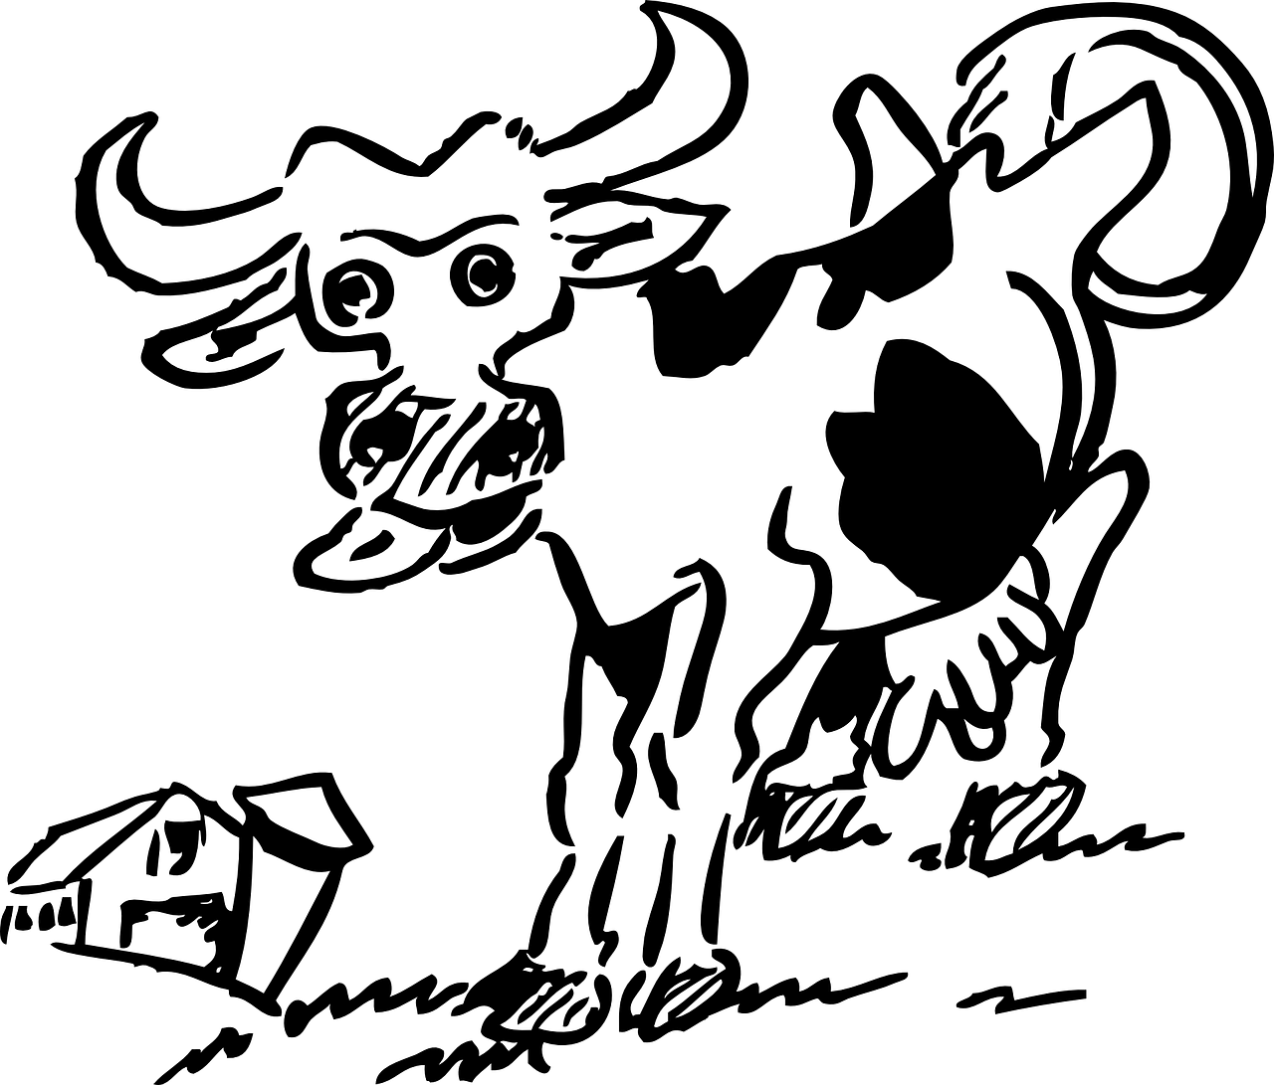
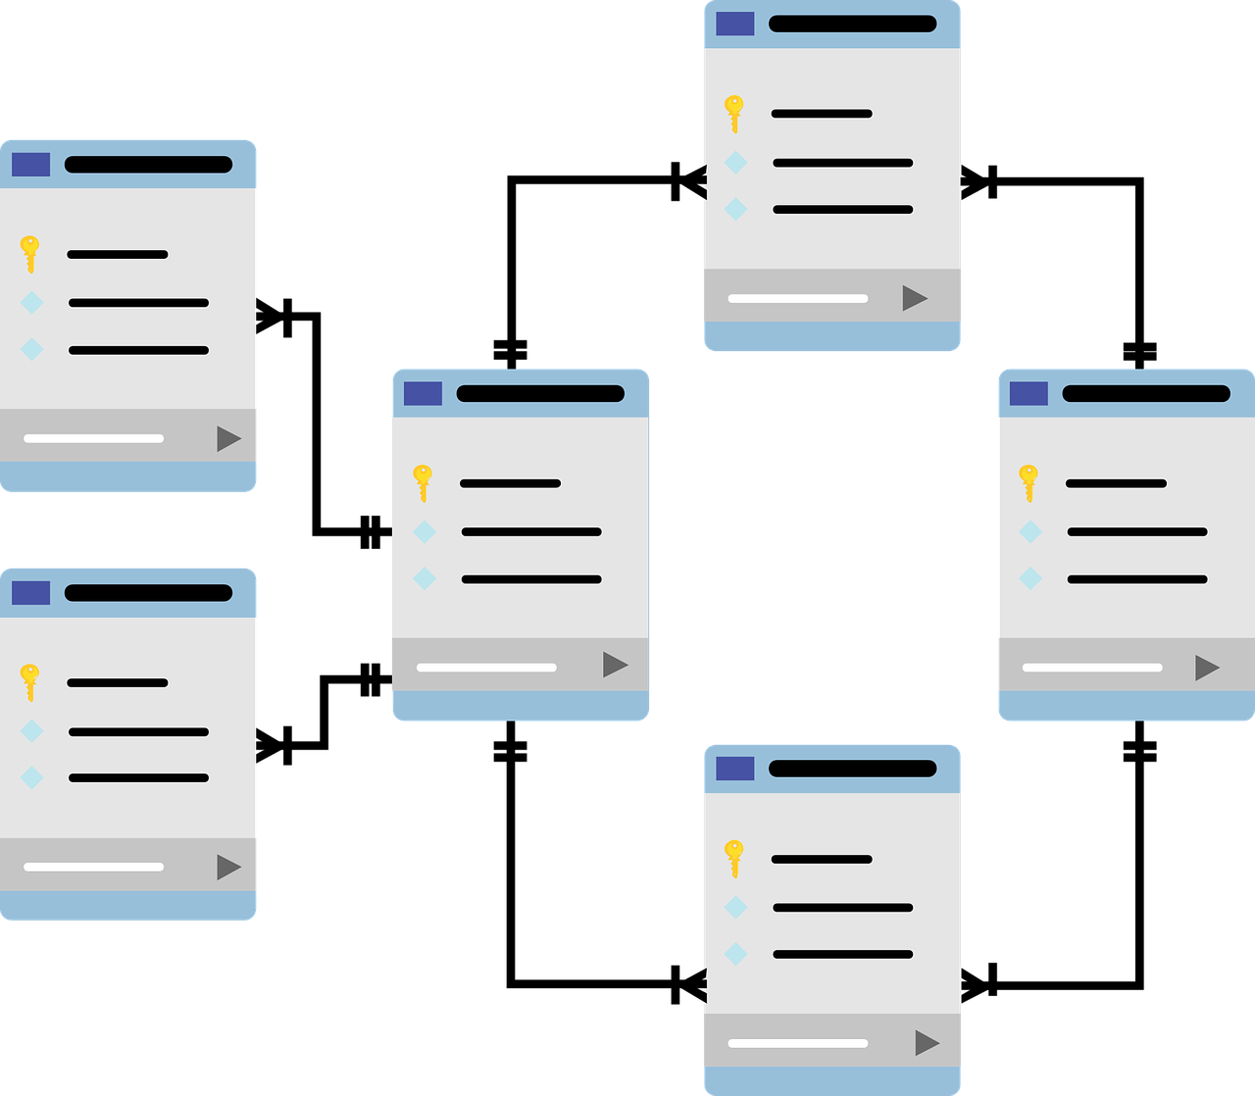
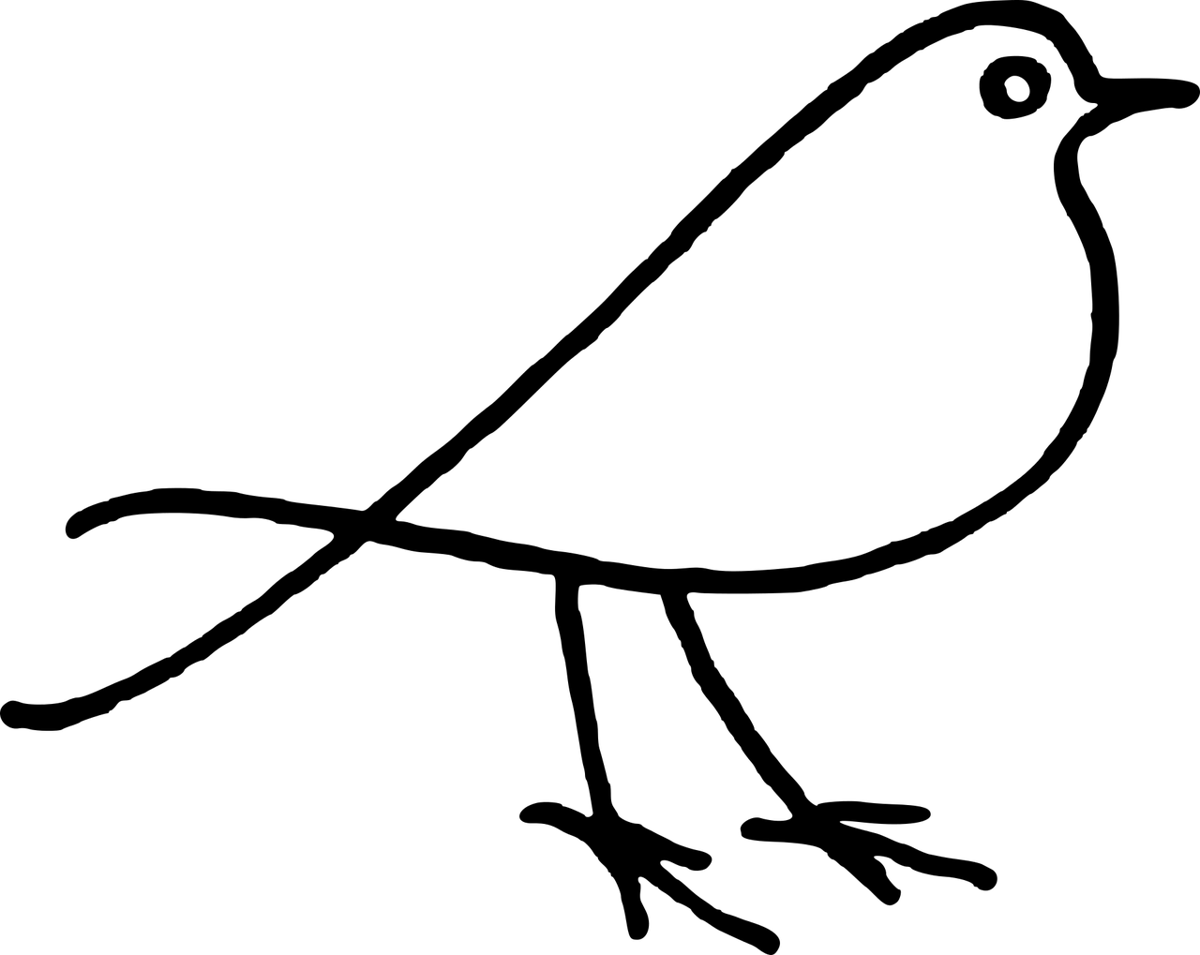
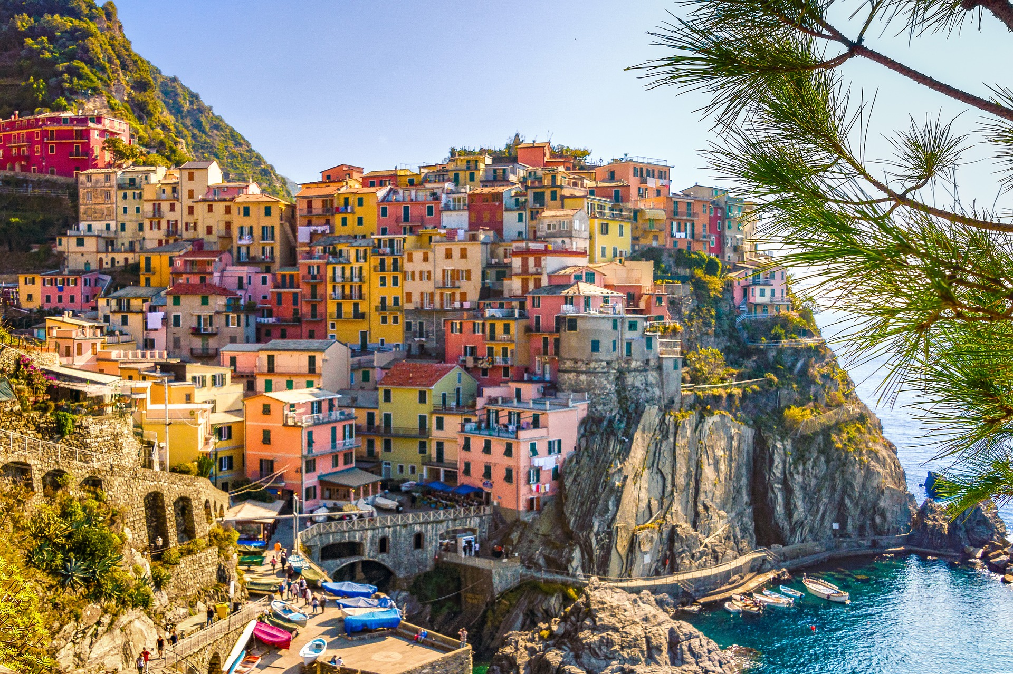
CREATING IMAGES
As the rights holder, Isabelle can decide what to do with her images
Creation → automatic copyright
Notes:
Narrator: She draws images, takes photos, and creates tables, graphs and charts. As soon as Isabelle creates any of these images, they are automatically protected by copyright.
Isabelle: They are?
Narrator: And, as the sole rights holder, Isabelle can essentially do whatever she wants with them. Isabelle is pretty proud of the images she creates-
Isabelle: -I mean I’m no Picasso but they’re not the worst-
Narrator: -and she has started thinking about sharing them.
Isabelle: Yeah! Sharing them can increase the visibility of my work, and can also help other people who want to add visual elements to their own work!
Narrator: But, before Isabelle starts sharing her work, she needs to consider a few things.

Slide 4
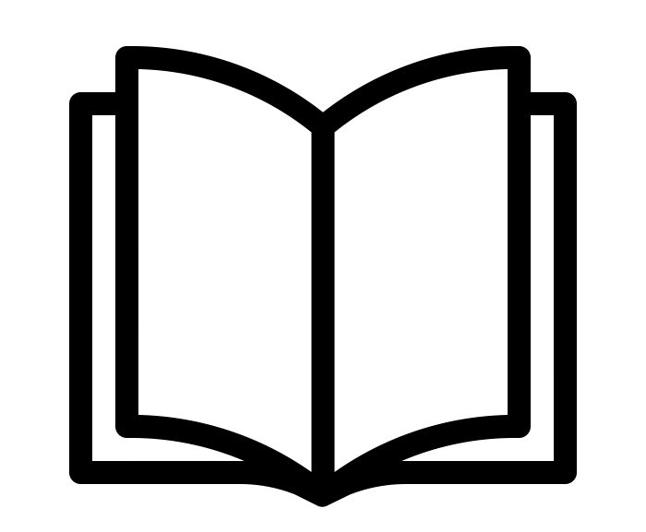
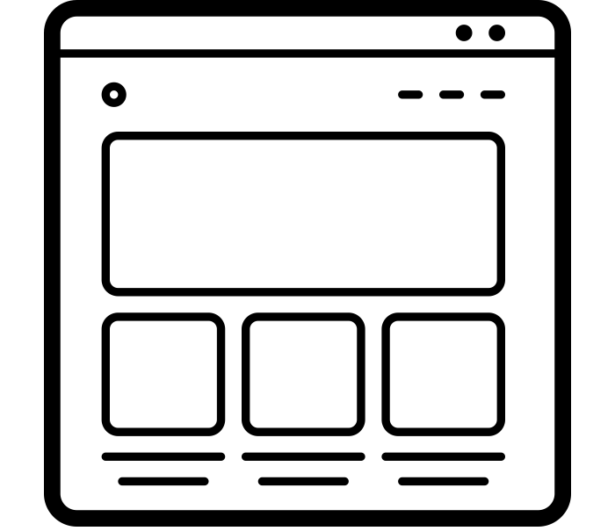
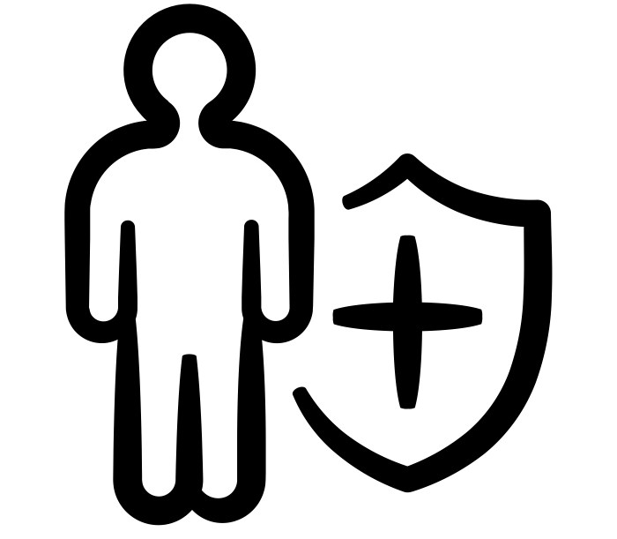
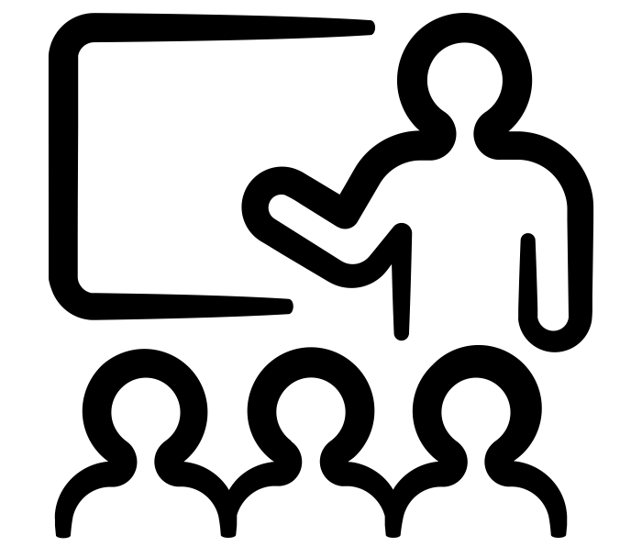
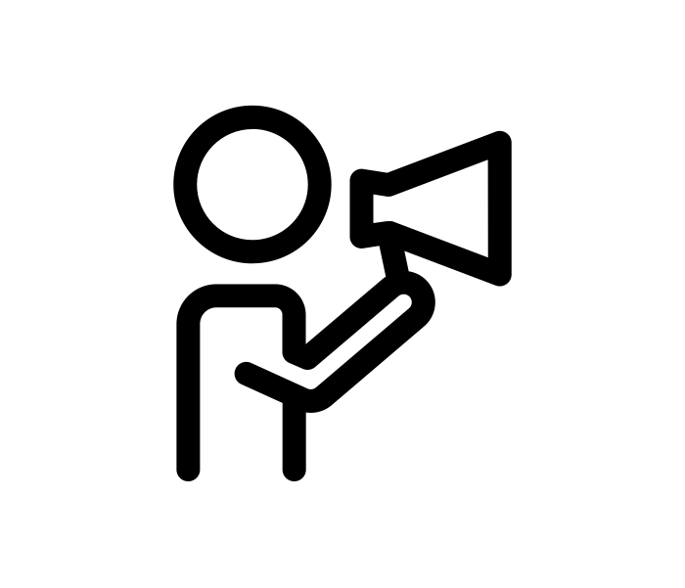
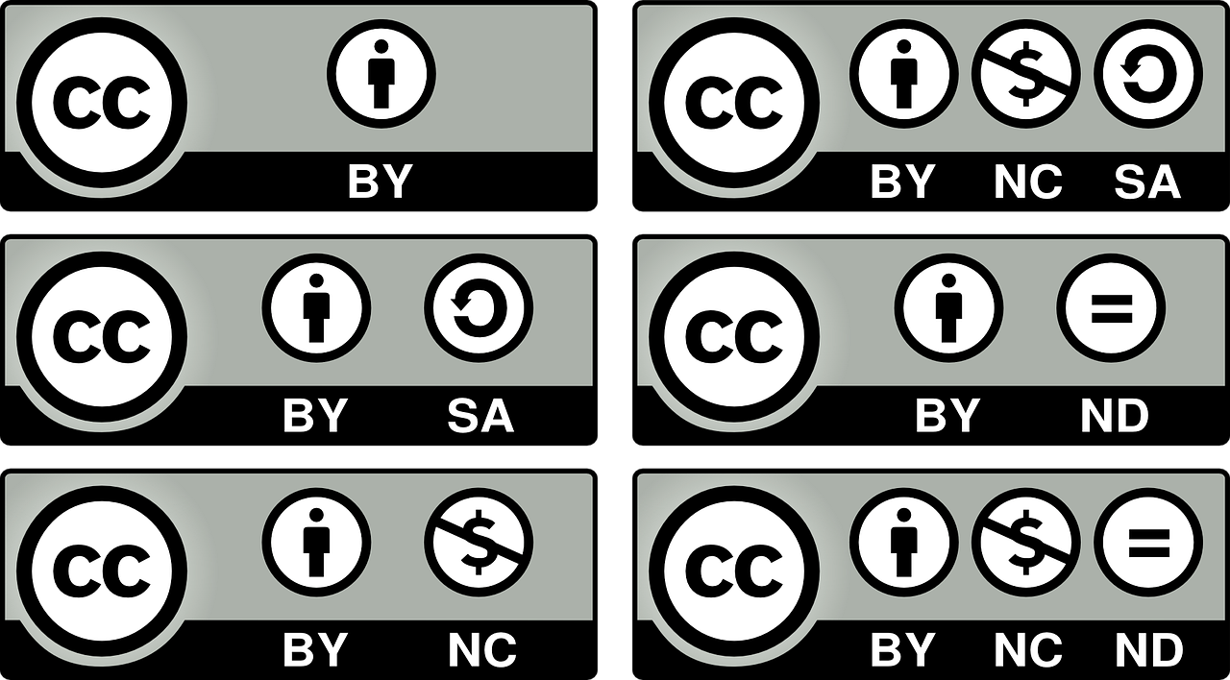
SHARING IMAGES
How does she want to use her images?
How does she want others to use her work?
Add a statement or open licence
What rights does she want to retain or transfer to others?
Notes:
Isabelle: I’m listening…
Narrator: How does she want to use her images, both now and in the future? How does she want others to use her work? Essentially, what rights does she want to retain and what rights is she willing to license or transfer to others?
Isabelle: Huh.
Narrator: In some cases Isabelle may want to simply put her images on her personal website, or in other cases she may want to include them in a presentation she is making. In the event that Isabelle would be publishing her images along with her research in a journal or a book she would need to make sure that she understands the terms of the publishing agreement before signing it. She should consider retaining the right to continue using her images in the future. If Isabelle decides to share her images openly on a website, she needs to tell people who visit that site how she would like them to be used. She can do this by adding a statement or open licence, like a Creative Commons licence.
Isabelle: For some of my images I think a CC license would be great because I don’t mind if other people use them at all.

Slide 5
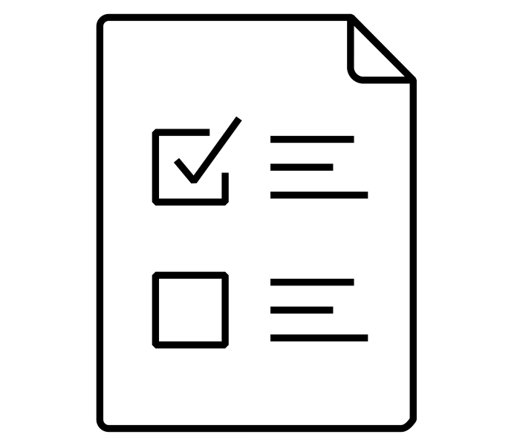
STATEMENTS & LICENCES
Derivative works
Attributed as creator
Restrict commercial use
Prevent modification
Notes:
Narrator: Adding such a statement or licence will allow Isabelle to quickly and easily inform others about how they can use her images. For some images Isabelle may simply want to be attributed as the creator giving as much freedom as possible to others to use her images. In other cases she may want to restrict commercial uses or prevent others from sharing modifications of her work.
Isabelle: Sounds good.
Narrator: Isabelle should also know that some sites where she wants to share her images may require her to agree to their terms and conditions before uploading them.
Isabelle: You mean those things I never read?
Narrator: In some cases, these terms may allow site operators to modify her images and create derivative works which might conflict with her own uses of the work.
Isabelle: Woah. Good to know! Hmmm… While I am here maybe I should see what images other people have created..

Slide 6
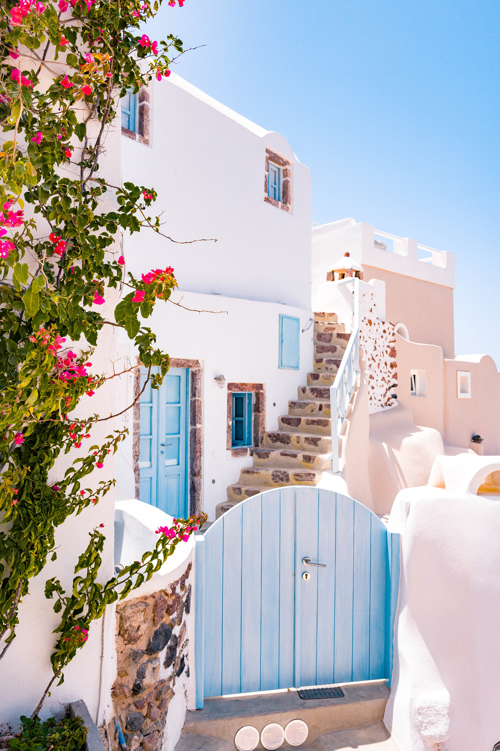
USING IMAGES
Notes:
Narrator: What happens if Isabelle finds an image that somebody else created and she really wants to use it in her own work?
Isabelle: Woah. Love. This one would be perfect on the cover of my first book!
Narrator: Just as any image that Isabelle creates is protected by copyright, so are most images created by others. If Isabelle really wants to use this image, then she needs to find out if there are limitations on its use.
Isabelle: Let’s see....

Slide 7
TYPES OF LICENCES
Public Domain
= unrestricted use
Open Licence or Terms of Use
= follow the terms of use
If terms of use are unclear
= contact the rights holder
Notes:
Narrator: If this image is in the Public Domain, then Isabelle can use the image any way she likes, without asking for permission. If the image has an open licence such as a Creative Commons licence or any other terms of use, then those terms should govern how Isabelle uses the image. If the terms of use are unclear, Isabelle will have to contact the rights holder for clarification.
Isabelle: I can’t tell with this one...
Narrator: Isabelle is lucky and works at a large institution that has its own Copyright Office, so she can ask them if she is unsure about how she can use the image.
Isabelle: Hey Copyright Librarian, Can I ask you a question?

Slide 8
EXCEPTIONS TO INFRINGEMENT
Notes:
Narrator: Isabelle should also know that some uses of the image may be allowable under the fair dealing provisions or other exceptions in the Copyright Act.
Isabelle: Hmmm, I guess because I would want it for my book cover I don’t think my use of it would fall under fair dealing or y other exceptions in this case… and I still can’t find a licence…

Slide 9
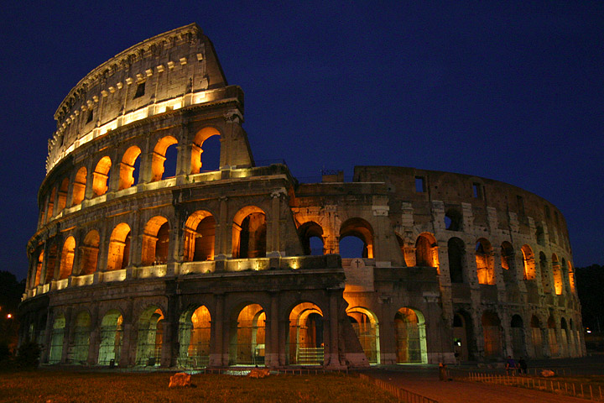
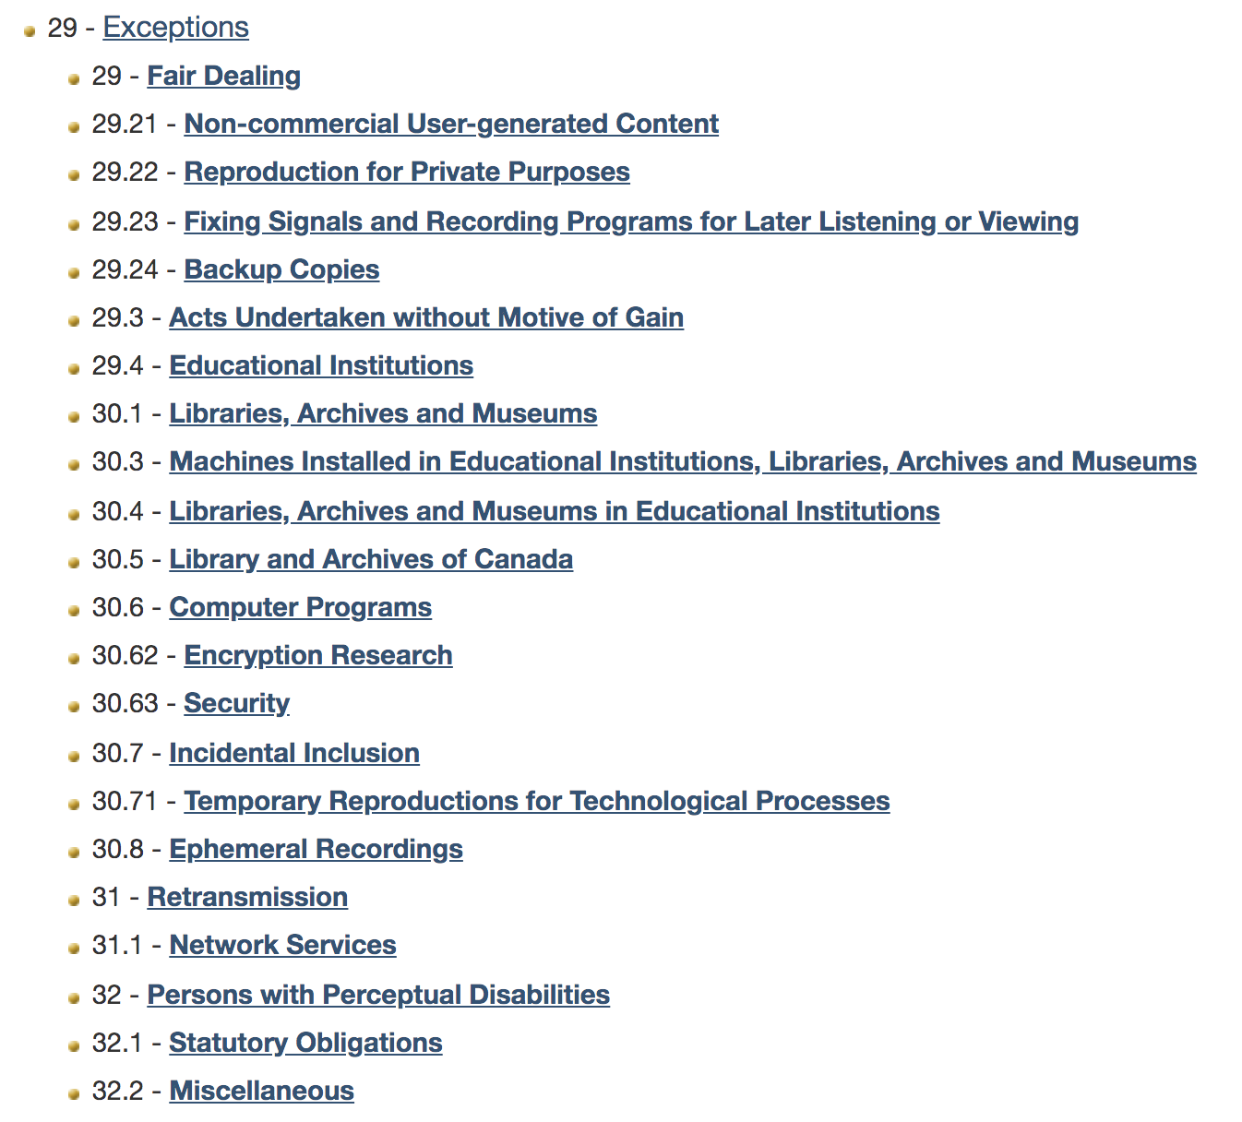
TERMS OF USE
Notes:
Narrator: If Isabelle can’t find terms of use information for the image or any contact information for the rights holder, and the exceptions in the Copyright Act do not apply to her use of the image, she should consider using a different image.
Isabelle: Well I’ll explore some other options I guess....(*sigh)
Narrator: If she still really wants to use the image, she can contact the Copyright Board of Canada to apply for a licence to use a work for which the copyright owner is unlocatable.
https://cb-cda.gc.ca/unlocatable-introuvables/brochure2-e.html
Isabelle: This Creative Commons one is also good. I know its terms of use, so maybe I’ll just use this one instead.

Slide 10
IT’S BETTER TO BE SAFE…
Notes:
Narrator: At the end of the day, it is likely easier for Isabelle to use one of her own images or a Creative Commons licensed image, because she knows exactly how she can use them. Wikimedia and an Advanced Google Search are two ways she can find Creative Commons images.
Isabelle: I watched a video about that actually...And hey! If I use a Creative Commons licence for my images other people can use them too!

Slide 11
LEARNING OBJECTIVES
You should now be able to:
Recognize the rights associated with images you use, either your own or others’
Identify applicable terms of use when you want to use someone else’s images in your own work
Understand the difference between using public domain images and images protected by copyright (including those with a Creative Commons licence)
Determine what to do when you want to use someone else’s images in your own work
Notes:
You should now be able to:
Recognize the rights associated with images you use, either your own or others’;
Identify applicable terms of use when you want to use someone else’s images in your own work;
Understand the difference between using public domain images and images protected by copyright (including those with a Creative Commons licence); and
Determine what to do when you want to use someone else’s images in your own work

Slide 12
Notes:
This has been the University of Alberta’s Opening Up Copyright instructional module on images. Thank you for your attention.

Slide 13
QUESTIONS
1. Copyright for an image exists:
From the time the image is created
From the time the creator applies for copyright
From the time the image is published in a larger work
Images may not be copyrighted
2. To inform others about how they can use your image:
Attach the copyright mark ©
Assign a licence
Link to a publishing agreement
None of the above

Slide 14
QUESTIONS
3. If someone’s image is protected by copyright, then you can’t:
Use the image however you please
Seek permission to use it from the copyright holder
Rely on a Copyright Act exception
Use the image as specified in the terms of use
4. Public domain images and Creative Commons images can always be used in the same way.
True
False
5. If you are unsure about acceptable uses for an image, you may do any of the following reasonably except:
Find another image with terms that clearly support your intended use
Create your own original image
Contact the copyright expert in your institution
Use the image anyway

Slide 15
Concordia University Library. (2017). Copyright Guide: Still Images. Retrieved from https://library.concordia.ca/research/copyright/?guid=stills
Creative Commons. (n.d.). CC Search for images. Retrieved from https://search.creativecommons.org/
Murray, L.J., & Trosow, S.E. (2013). Chapter 12: Visual Arts, in “Canadian copyright: A citizen’s guide.” Toronto, ON: Between the Lines. Pp. 158-164.
Wikipedia:Public domain image resources (n.d.). In Wikipedia. Retrieved November 13, 2019 from https://en.wikipedia.org/wiki/Wikipedia:Public_domain_image_resources

Slide 16
IMAGE AND SOUND REFERENCES
Rawpixel. (n.d.). [Isabelle]. Pixabay. https://pixabay.com/illustrations/cartoon-casual-character-drawing-3685566/
Tama66. (n.d.). [Mosaic archway]. Pixabay. https://pixabay.com/photos/archway-cathedral-church-portal-3615590/
TEDDY2 H. (2015). [Japanese landmark]. Unsplash. https://unsplash.com/photos/mjA7HPG2SYA
Ben Davis. (n.d.). Essay. The Noun Project. CC BY. https://thenounproject.com/search/?q=essay&i=575679
Mooms. (n.d.). Idea. The Noun Project. CC BY. https://thenounproject.com/search/?q=idea&i=1174992
OpenClipart-Vectors. (n.d.). [Bird doodle]. Pixabay. https://pixabay.com/vectors/animal-bird-doodle-stylised-1298179/
Kookay. (n.d.). [Cinque Terre, Italy]. Pixabay. https://pixabay.com/photos/italy-sea-houses-cinque-terre-4093227/
Mcmurryjulie. (n.d.). [Data tables]. Pixabay. https://pixabay.com/vectors/database-schema-data-tables-schema-1895779/
Janjf93. (n.d.). [Charts and graphs]. Pixabay. https://pixabay.com/vectors/browser-graphic-flat-design-window-3614768/
Nadir Balcikli. (n.d.). Copyright. The Noun Project. CC BY. https://thenounproject.com/search/?q=copyright&i=453533
Fauzi Ahmad. (n.d.). Key. The Noun Project. CC BY. https://thenounproject.com/search/?q=key&i=2855823

Slide 17
IMAGE AND SOUND REFERENCES
Clker-Free-Vector-Images. (n.d.). [Cow doodle]. Pixabay. https://pixabay.com/vectors/cow-farm-animal-barn-crazy-40133/
Iconstock. (n.d.). Sharing. The Noun Project. CC BY. https://thenounproject.com/icon/1261785/
Fritz. (n.d.). visibility. The Noun Project. CC BY. https://thenounproject.com/search/?q=visibility&i=122738
akash khandavilli. (n.d.). rule. The Noun Project. CC BY. https://thenounproject.com/search/?q=rules&i=2631577
Gregor Cresnar. (n.d.)a. Question. The Noun Project. CC BY. https://thenounproject.com/search/?q=question&i=1603787
Gregor Cresnar. (n.d.)b. export. The Noun Project. CC BY. https://thenounproject.com/grega.cresnar/uploads/?i=1683159
Gregor Cresnar. (n.d.)c. insurance. The Noun Project. CC BY. https://thenounproject.com/grega.cresnar/uploads/?i=1603771
priyanka. (n.d.) website. The Noun Project. CC BY. https://thenounproject.com/search/?q=website&i=1527491
Gregor Cresnar. (n.d)d. presentation. The Noun Project. CC BY. https://thenounproject.com/search/?q=presentation&i=1616165
Martin. (n.d.). Book. The Noun Project. CC BY. https://thenounproject.com/search/?q=book&i=1909323

Slide 18
Vectors Market. (n.d.). agreement. The Noun Project. CC BY. https://thenounproject.com/search/?q=agreement&i=1461585
Mello. (n.d.). marketing. The Noun Project. CC BY. https://thenounproject.com/search/?q=announce&i=1668284
progressor. (n.d.). [Creative Commons licences]. Pixabay. https://pixabay.com/vectors/creative-commons-licenses-icons-by-783531/
Eat Bread Studio, Chiang Mai. (n.d.). contract. The Noun Project. CC BY. https://thenounproject.com/search/?q=agreement&i=2488287
GDJ. (n.d.) [Red bow]. Pixabay. https://pixabay.com/vectors/red-ribbon-hair-accessory-clothing-1227873/
kropekk_pl. (n.d.). [Question mark]. Pixabay. https://pixabay.com/vectors/the-question-mark-sign-question-ask-350170/
Ryan Spencer. (2018). Greek Cottage. Unsplash. https://unsplash.com/photos/WJDR8_QxVR8
Crosswell, Rob. (n.d.). Library. The Noun Project. CC BY. https://thenounproject.com/crosswellrob/uploads/?i=1122689
Three Six Five. (n.d.). Phone. The Noun Project. CC BY. https://thenounproject.com/search/?q=phone&i=1354627
coffeebeanworks. (n.d.). [Copyright librarian]. Pixabay. https://pixabay.com/de/illustrations/avatar-kunden-kundschaft-ikonen-2191932/

Slide 19
CopyrightFreePictures. (n.d.). [Creative Commons logo]. Pixabay. https://pixabay.com/vectors/creative-commons-cc-characters-785334/
Pauline. (n.d.). Book Cover. The Noun Project. CC BY. https://thenounproject.com/search/?q=book%20cover&i=2341922
Aaron Logan. (n.d.). [Colosseum]. Wikimedia. CC BY. https://commons.wikimedia.org/wiki/File:Lightmatter_colosseum.jpg
Lordy99. (n.d.). Pompei-nuova04. Wikimedia. CC BY-SA. https://commons.wikimedia.org/wiki/File:Pompei-nuova04.jpg

Slide 20
University of Alberta. 2019. “Images.” Opening Up Copyright Instructional Module. https://sites.library.ualberta.ca/copyright

Slide 21
Jamie Stewart
Matt Cheung
Library

