Slide 1


Increased Demand for Open and Accessible Copyright Education caused by COVID-19
Lauren Bourdages
Notes:
Hello and welcome to this OLITA Tech Talk on the increased demand for open and accessible copyright education caused by COVID-19. I’m Lauren Bourdages one of the Graduate Research Assistants working on the University of Alberta’s Opening Up Copyright project, which will be the main subject of this talk. I’m going to be telling you about the project and about how the COVID-19 pandemic seemed to cause a spike of interest in our videos.

Slide 2
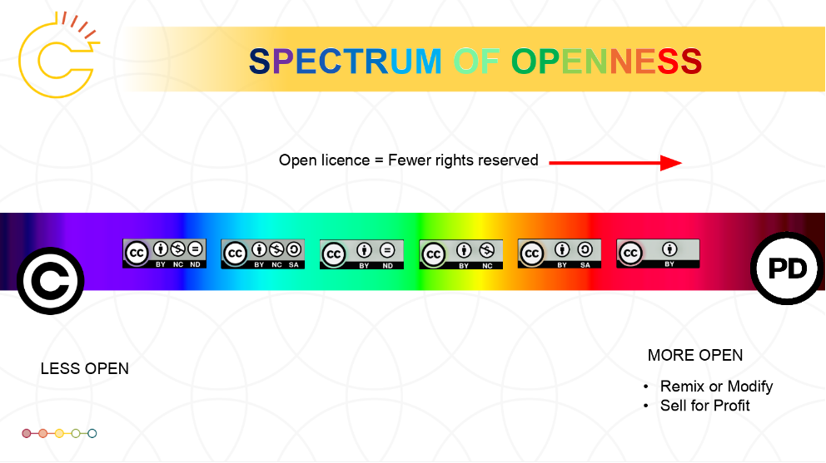
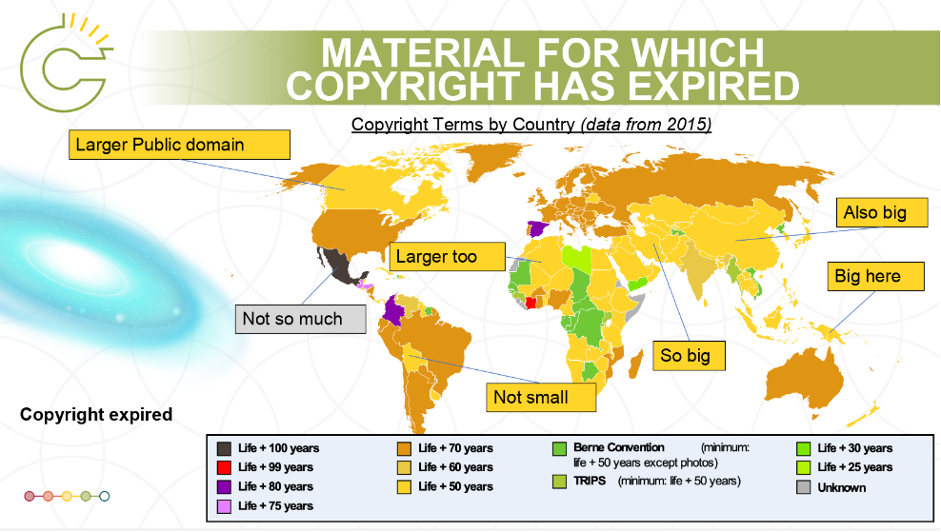
Overview of OUC
Notes:
The Opening up Copyright project (OUC) is a series of interactive, H5P, audiovisual open education resource instructional modules, focused on Canadian copyright education. The original aim of the project was to provide this education to students, faculty, and staff at the University of Alberta, and the general public. Since the project launched its first two videos in March 2018 however, they have realised that there is a much broader audience across Canada, and abroad, eager for freely available and open copyright education. The hope is that one day OUC will have not only a community of users but also a community of contributors who are remixing and building upon the original modules developed by the University of Alberta.

Slide 3
Overview of OUC
Legend: Bold + Italics = In development
Level 1
Modules
Level 3
Modules
Level 4
Modules
Level 4
Modules
Level 5
Modules
Introduction to Copyright
OUC: An Introduction
Fair Dealing
History of Copyright
Images
Including Third Party Content in Your Work
Indigenous Knowledges, Cultural Expression and Copyright
Infringement
Moral Rights
Open Licensing and Creative Commons
Other Types of IP
Theoretical Foundations for Copyright
Applying Fair Dealing
Asking Permission and Transactional Licenses
Berne and TRIPS Agreements
Collective Licensing Agencies and the Copyright Board
Educational Institutions’ Policies and Practices
Finding Open and Creative Commons Content
Interlibrary Loan and Controlled Digital Lending
Licensed Library Resources
Makerspaces and Copyright
Photocopying in the Library
Public Domain
Publishing Agreements
Technological Protection Measures (Digital Locks)
Access Copyright v. York
Alberta (Education) v. Access Copyright
CCH v. LSUC
Nintendo v. Go Cyber
Section 3: Copyright in Works
Section 13: Ownership of Copyright
Section 29: Fair Dealing
Sections 29.4 – 30.03: Educational Institution Exceptions
Section 41: Technological Protection Measures
SOCAN v. Bell
Level 2
Modules
Creating and Sharing Materials
Foundations, Theory and Context
Using Materials
Notes:
There are currently 30 instructional modules in the OUC series, and another 8 in various stages of development. There are broken down into 5 levels ranging from basic and broad at level 1 to very specific pieces of legislation and case law at level 5. As the project got underway the original team decided that it made the most sense to work backwards and build the more specific and specialised modules first so that earlier more general modules in the series would be able to point to places where viewers could go to learn more about the different concepts. As you can see, we’re nearing the end of the development of the initially planned modules, we’re hoping to debut the level 1 orientation modules and the level two basic modules before the end of 2021.

Slide 4
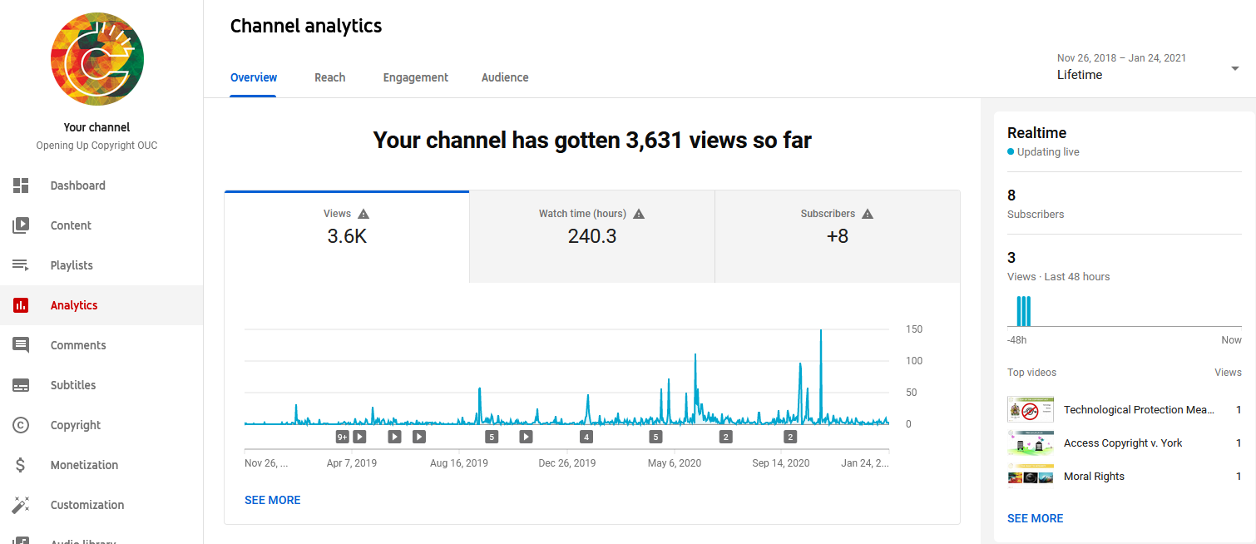
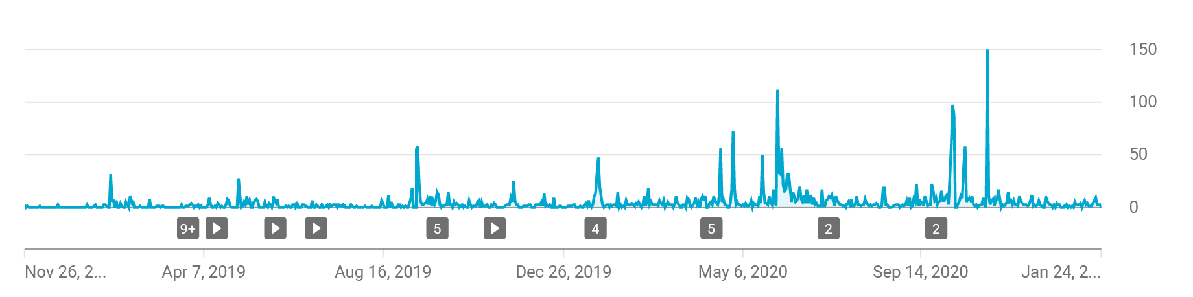
OUC and COVID-19: Overview
Notes:
Since the series is still under construction, and still building an audience it generates a relatively low level of daily views, punctuated by certain days or periods with more significant use. Over the course of 2020 though, as the pandemic continued to escalate it was noted that there was an increase in both the daily views and in the peaks that appeared to coincide with the pandemic responses. Correlation does not equal causality however, so more scrutiny is needed as there are two factors are at play.
There are two modules in the series that are designated as required viewing for UofA Grad Students as part of ethics/copyright training, and
The project has consistently added modules over time. The virtue of having a greater number of modules assumes that views would be up over time
To account for these factors, we downloaded data to look at how modules performed pre pandemic and during the pandemic. This idea is based on the metric of “same store sales” in business - we are examining how modules that were out before the pandemic did, after the pandemic.

Slide 5
OUC and COVID-19: Methodology for Data Analysis
THE CONTENDERS
(aka which modules are included in the analysis)
Alberta Education v. Access Copyright | Theoretical Foundations for Copyright
Makerspaces and Copyright | Public Domain
Other Types of IP | CCH v. LSUC
Section 3: Copyright in Works | Section 13: Ownership of Copyright
Notes:
So what did we do to make this ‘Same Store Sales Method’ methodology work? To create enough data for a comparison we excluded videos that were published after July 1, 2019, excluded rebuilt modules, and excluded modules that were part of the Faculty of Graduate Studies and Research training. The remaining 8 modules became our dataset for comparison, and as you can see from the slide they are:
Alberta Education v. Access Copyright
Theoretical Foundations
Makerspaces
Public Domain
Other Types of IP
CCH v. LSUC
Section 3
Section 13
Once we had the relevant viewing data for each module in the dataset we excluded all data before July 1, 2019, and data from after Dec 31, 2020 and began the analysis.

Slide 6
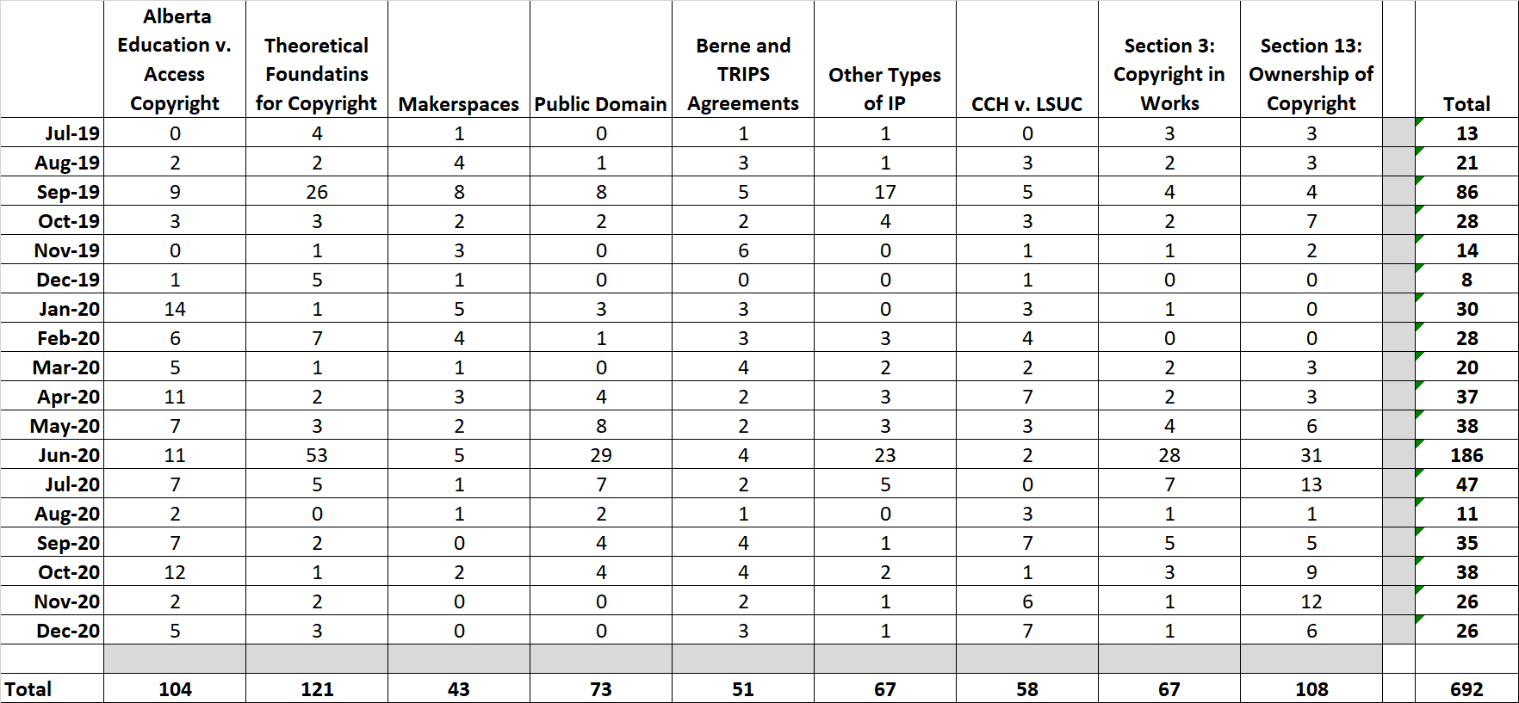
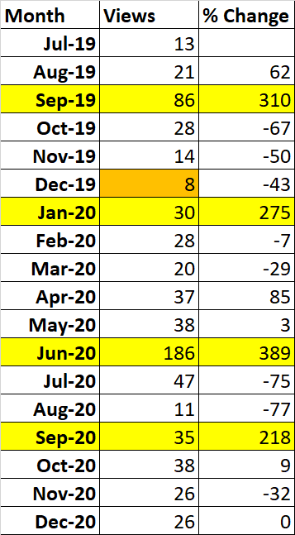
OUC and COVID-19: Monthly Data
Notes:
By starting with a more granular monthly view we can get a better sense of the way the pandemic seems to have affected the number of views these modules received. There is as you can see a clear spike in June of 2020 - 186, which is 100 more views than the next closest month which would be September of 2019.
Now, a September boom is typical because of the start of the academic term. The January 2020 boom can more than likely be attributed to the low volume in Dec 2019. But it does appear that the pandemic did produce the surge of interest we see in June. There are a couple of reasons that we’ve made that connection.
Firstly, it is perhaps not too early to think that it could be the building of courses and instructors working ahead for Fall given the looming threat/announcement of remote learning continuing into the Fall semester. It may also have been due to instructional designers/librarians thinking things through for fall for that same reason.
It’s interesting because if you look at the data, it really isn’t any one module producing this change - it is several modules that are sharply up. So it seems likely that somewhere there were a cluster of viewers watching the same modules -- a kind of localized outbreak of OUC, but this did not sustain itself into a general pandemic of OUC viewing.

Slide 7
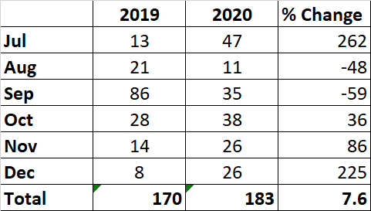
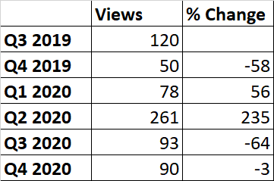
OUC and COVID-19: Quarterly Data
Q3&4 2019 v Q3&4 2020.
Percentage change by quarter.
Notes:
We also grouped the months into quarterly comparisons and as you can see in quarters 3 and 4 of 2019 versus those same quarters in 2020 there were some wild swings.
December and July were both way up for example, but, in total, there are only 7.6% more views for the same videos from year to year in the q3 and q4 periods.
This seems to indicate that after the first big spike of the pandemic, there wasn’t a major demand in the second half of 2020.
For example, the 7.6% increase should also account for the fact that there were a lot more modules overall, and thus a degree of a network effect in driving up traffic.
Where it does get interesting is the huge spike for Q2 2020, as seen on the second graph on this slide.
This was when that first major pandemic spike hit, but as noted, the increased interest did not seem to become sustained.

Slide 8
Thank you for your attention!
To view the Opening Up Copyright modules please go to: https://sites.library.ualberta.ca/copyright/
To view CARL’s Copyright Open Educational Resource for University Instructors and Staff modules please go to: https://www.carl-abrc.ca/influencing-policy/copyright/opencopyrightcourse/
Notes:
While we knew that there seemed to be a pandemic related increase in interest in the OUC modules, the interest didn’t seem sustained and the interest doesn’t seem to have been as increased as we originally thought. More observation is needed over time to see how the sustained effect of longer-term remote and online learning measures will impact the desire for copyright education, especially as some schools are already announcing the continuation of remote and online learning measure for Spring 2021, and starting to look ahead to planning for Fall 2021. It’s important to remember though that the 8 modules in our sample set are only representative of the whole series. As the number of modules added has increased there has been sustained growth in the viewership across the entire series as we see from the YouTube graphs, which I’ve brought back again here. This trend seems to speak more to the overall value of the series as a whole rather than just pandemic driven demand.
Copyright is complicated, especially in a digital environment, OUC will continue increasing awareness and understanding of Canada’s copyright law. As education continues to be digital, making sure that students and educators see the OUC modules becomes more important. Please check out the OUC website to watch the modules and find out more about the project. If you work in a University, you could also check out our sister project, the Copyright OER for University Instructors and Staff that has just been launched by CARL. Thank you for joining us for this tech talk.

