Slide 1
Linda Raymond - eLearning Curriculum Specialist, Keyano College, Fort McMurray, Alberta Krysta McNutt - Open Education Project Manager, University of Alberta, Edmonton, Alberta
Part 1 – 60 minutes – In celebration of open education week, this webinar will feature perspectives from university, college, and polytechnic institutions as well as student perspectives on the open education movement in Alberta, Canada. Joerdis Weilandt - University of Lethbridge Jessica Norman & Christine Horgan - Southern Alberta Institute of Technology Samara Burns - University of Calgary Robert Lawson - NorQuest College

Slide 2
Up Next: Background

Slide 3
Notes:
MOU - BC, SK and AB - cooperation, sharing and development of OER, identify, share and encourage use of best practices in OER, foster greated collaboration and understanding of key issues and trends.
Mandate of the ABOER Initiative: assist with reducing the costs of a post-secondary education for students; and, provide students and faculty members with the flexibility they need, offering updated, relevant content for learning.

Slide 4
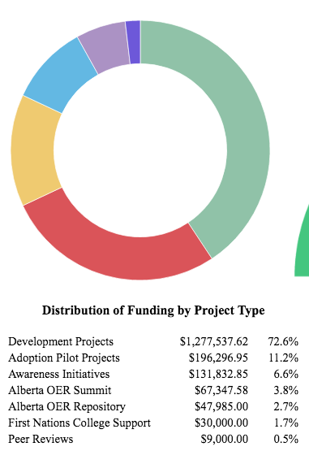
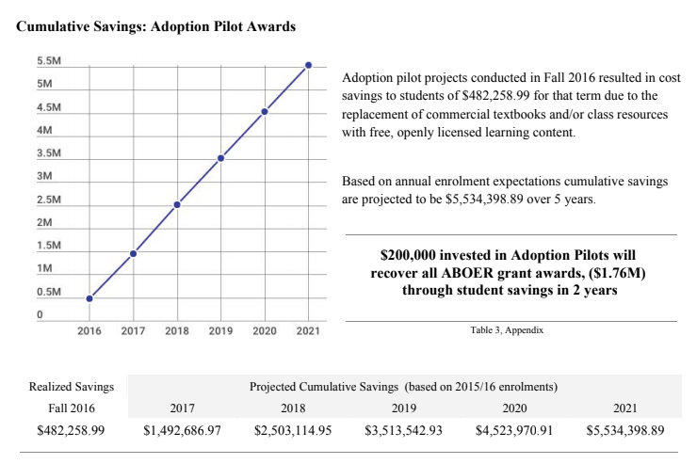
Notes:
MOU - BC, SK and AB - cooperation, sharing and development of OER, identify, share and encourage use of best practices in OER, foster greated collaboration and understanding of key issues and trends.
Mandate of the ABOER Initiative: assist with reducing the costs of a post-secondary education for students; and, provide students and faculty members with the flexibility they need, offering updated, relevant content for learning.
Sustainability of invested funds (reaping projected cost savings) (K)
Maintenance and continued quality of OER created (M)

Slide 6
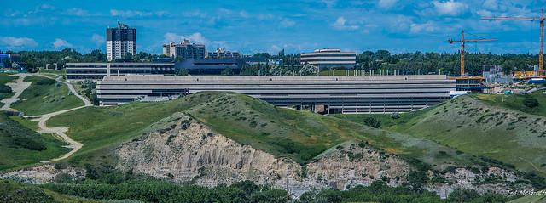
Joerdis Weilandt - University of Lethbridge
Photograph by: Ted McGrath, Attribution-NonCommercial-ShareAlike 2.0 Generic (CC BY-NC-SA 2.0)
Notes:
https://www.langedutech.de/professional-development/open-education-week/

Slide 7
Jessica Norman & Christine Horgan Southern Alberta Institute of Technology
By Calgary Economic Development (http://www.meetingscalgary.com/photo-gallery) [Public domain], via Wikimedia Commons

Slide 8
Student Perception of OERs
The SAIT Perspective

Slide 9
Notes:
459 student participants (20% response rate)
Most students had never heard of OERs/Open Courseware (68%).
The students who had heard of OERs were confused and often mistook it for outside learning materials (websites, YouTube), MOOCS, or tutorial websites (e.g. Lynda.com).

Slide 10
Notes:
Of those who reported their instructor used OERs, 94% said it was a benefit to their learning, and 71% stated they accessed that material weekly.
A number of students (27%) said they had sought out OERs on their own to help with a course, here again, there is confusion on what constitutes an OER

Slide 11
Notes:
For another question, 90% of students responded that textbook costs were concern.
A few students also listed drawbacks: free resources may not be good quality, lower attendance if the material is available elsewhere, what if the internet is not available?
Almost half students (48%) said they would prefer to take a course that used OER, and that offering that option would positively impact SAIT’s reputation (innovative, caring about students)

Slide 12
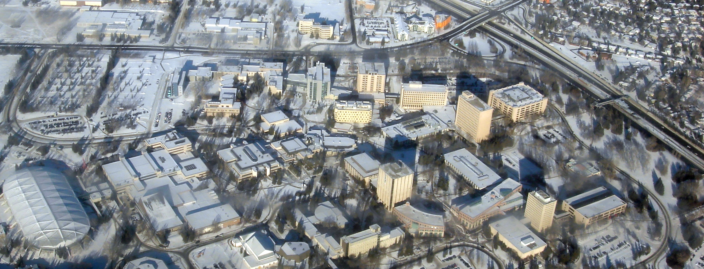
Samara Burns, University of Calgary
By Qyd (talk · contribs) (Self-photographed) [GFDL (http://www.gnu.org/copyleft/fdl.html), CC-BY-SA-3.0 (http://creativecommons.org/licenses/by-sa/3.0/) or CC BY 2.5 (http://creativecommons.org/licenses/by/2.5)], via Wikimedia Commons

Slide 14
Pilot
Project
Timeline
JULY 2017
SEPT 2017
OCTOBER 2017
JANUARY 2018
MARCH 2018
JUNE 2018
Pilot project launch
Call for proposals
Grant
Recipients
Announced
Open
education
week
Grant recipients begin working with student RAs to develop OER
Some OER-based courses launched
Pilot Project
Wrap-up
Notes:
Timeline graphic with pictures
(Intermediate)
To reproduce the picture effects on this slide, do the following:
On the Home tab, in the Slides group, click Layout, and then click Blank.
On the Insert tab, in the Images group, click Picture.
In the Insert Picture dialog box, select a picture and then click Insert.
Select the picture. Under Picture Tools, on the Format tab, in the Size group, click the Size and Position dialog box launcher.
In the Format Picture dialog box, in the Crop tab, in the Crop position section, crop the picture to the following values:
Width: 9”
Height: 2.65”
Left: .5”
Top: .5”
Adjust the values in the Picture position section to properly position the picture within the cropped image.
Under Picture Tools, in the Format tab, in the Size group, click Crop, click Crop to Shape, and then under Rectangles click Round Same Side Corner Rectangle (eighth option from the left).
Drag the top yellow diamond adjustment handle slightly to the right to decrease the amount of rounding on the corners.
Under Picture Tools, in the Format tab, in the Picture Styles group, click Picture Effects, point to Shadow, and then under Inner click Inside Center (second row, second option from the left).
To reproduce the timeline effects on this slide, do the following:
On the Home tab, in the Drawing group, click Rectangle. On the slide, drag to draw a rectangle.
In the bottom right corner of the Drawing group, click the Format Shape dialog box launcher.
In the Format Shape dialog box, do the following:
In the Size tab, set the Width of the rectangle to 9”, and then set the Height to .73”
In the Line Color tab, select No line.
In the Fill tab, select Solid fill, and then set the following values:
Color: Black, Text 1, Lighter 35%
Transparency: 20%
In the Shadow tab, click the button next to Presets, and then under Inner click Inside Center (second row, second option from the left).
Drag the rectangle onto the bottom of the picture.
Press and hold SHIFT and select the rectangle and the picture.
Under Drawing Tools, on the Format tab, in the Arrange group, and then do the following:
Click Align and then click Align Selected Objects.
Click Align and then click Align Center.
Click Align and then click Align Bottom.
Click Align and then click Align to Slide.
Click Align and then click Align Center.
To reproduce the month labels for the timeline, do the following:
On the Insert tab, in the Text group, click Text Box, and then on the slide, drag to draw the text box.
Type the text you want to appear in the text box (this example uses months of the year, so you might type “JAN”), and then select the text. Format the text in the textbox using the following steps:
On the Home tab, in the Font group, choose the Gill Sans MT Condensed font and a font size of 18.
Click the arrow next to Font Color, and then under Theme Colors click White, Background 1, Darker 35% (fifth row, first option from the left).
In the Paragraph group, click Center.
Select the text box. On the Home tab, in the Clipboard group, click the arrow under Copy, and then click Duplicate. Repeat the process until there is a total of six text boxes.
On the slide, drag the text boxes onto the rectangle to form a row.
Press and hold CTRL and select all six text boxes and the rectangle.
Under Drawing Tools, on the Format tab, in the Arrange group, do the following:
Click Align, and then click Align Selected Objects.
Click Align, and then click Align Middle.
Press and hold CTRL and cancel the selection of the rectangle, keeping the text boxes selected. Under Drawing Tools, on the Format tab, in the Arrange group, do the following:
Click Align, and then click Align to Slide.
Click Align, and then click Distribute Horizontally.
To change the text in the duplicate text boxes, click in each text box and edit the text (this example uses months of the year).
To change the color of a text box, select the text in the text box, and then on the Home tab, in the Font group, click the arrow next to Font Color, and then under Theme Colors click White, Background 1 (first row, first option from the left).
To reproduce the vertical line with text effects on this slide, do the following:
On the Home tab, in the Drawing group, click Line, and then, in the slide, draw a line.
On the Home tab, in the drawing group, click the Format Shape dialog box launcher.
In the Format Shape dialog box, in the Size tab, under Size and rotate, set the following values:
Height: 1.2”
Width: 0”
Rotation: 0˚
Also in the Format Shape dialog box, in the Line Style tab, set the Width to .75 pt and then, under Arrow settings, set the following values:
Begin type: Oval Arrow (second row, third option from the left).
Begin size: Arrow L Size 1 (first row, first option from the left).
End type: Oval Arrow (second row, third option from the left).
End size: Arrow R Size 1 (first row, first option from the left).
Also in the Format Shape dialog box, in the Line Color tab, select Solid line, and then set the Color option to White, Background 1, Darker 25% (fourth row, first option from the left).
Close the Format Shape dialog box.
On the Home tab, in the Clipboard group, click the arrow under Copy, and then click Duplicate.
Select the duplicate line. Under Drawing Tools, on the Format tab, in the Size group, in the Shape Height box, enter 2.6”.
Press and hold SHIFT and select both lines. On the Format tab, in the Arrange group, do the following:
Click Align, and then click Align Selected Objects.
Click Align, and then click Align Center.
Click Align, and then click Align Top.
Drag both lines together on the slide to position them under one of the timeline month labels.
Press and hold SHIFT and select both lines and the text box they are under. On the Format tab, in the Arrange group, do the following:
Click Align, and then click Align Selected Objects.
Click Align, and then click Align Center.
Create the subtext boxes:
On the Insert tab, in the Text group, click Text Box, and then on the slide, drag to draw the text box.
Type the text you want to appear in the text box, and then select the text. Format the text in the textbox using the following steps:
On the Home tab, in the Font group, choose the Gill Sans MT font and a font size of 20.
Click the arrow next to Font Color, and then under Theme Colors click White, Background 1 (first row, first option from the left).
In the Paragraph group, click Align Text Left.
On the Home tab, in the Paragraph group, click Align Text Left to align the text left in the text box.
On the slide, drag the text box to position it to the right of the vertical line.
To reproduce the background on this slide, do the following:
Right-click the slide background area, and then click Format Background. In the Format Background dialog box, click Fill in the left pane, select Gradient fill in the Fill pane, and then set the following values:
Type: Linear
Direction: Linear Down (first row, second option from the left).
Angle: 90˚
Under Gradient stops, click Add or Remove until two stops appear on the slider.
Also under Gradient stops, customize the gradient stops that you added as follows:
Select the first stop, and then set the following values:
Position: 50%
Color: Black, Text 1 (first row, second option from the left).
Select the second stop, and then set the following values:
Position: 99%.
Color: Black, Text 1, Lighter 35% (third row, second option from the left).

Slide 15
The Adopt & Adapt Model
Academic Faculty
Select three students to research and match syllabus based learning outcomes with existing open educational resources:
Two undergraduate students who will research and match 2-3 OERs with each syllabus based learning outcome
One graduate student who will peer review the researched and matched OERs.
Meet regularly with students (every 2-3 weeks) for OER development review.
Choose the most appropriate learning resources.

Slide 16
Undergraduate Student Has prior experience with the course content. Researches and matches two or three OERs with each syllabus based learning outcome. Receive OER research guidance from OER Lead at the Taylor Family Digital Library (TFDL) Consult with OER Research Assistant | Graduate Student Has prior experience with the course content. Peer reviews the researched and matched OERs selected by the undergraduate students. Receive OER peer review guidance from OER Lead at the Taylor Family Digital Library (TFDL) Consult with OER Research Assistant

Slide 17
The Adopt & Adapt Model
Suggested Budget
Two Undergraduate Student RAs: $1500/each
One Graduate Student RA: $1000
TOTAL: $4000
Expense Eligibility
OER develoment
Research assistants
Software licences

Slide 18
The Pilot Projects

Slide 19
OER Workshops
January 4, 2018: Best Practices for Sharing your OER with the World
November 10 and 14, 2017: Introduction to OER at a Postsecondary Level and its Implications
October 18 and 24, 2017: OER Publishing with GitHUb and LaTeX
September 20, 2017: Intangible OERs
July 27 and August 3, 2017: Open Educational Resource Orientation Session

Slide 20
Open Education Week
March 5, 2018: Best Practices for Sharing your OER with the World
March 6, 2018: Hands on Experience of OER Licensing at the Postsecondary Level
March 7, 2018: Open Educational Resources: What, Why, Where, How?
March 8, 2018: OER Pilot Project Showcase
March 9, 2018: OER Mythbusting

Slide 21
Looking Forward…
Pilot Project Wrap-Up (OER Survey, Catalog)
Institutional OER Repository?
Pressbooks installation for UCalgary Blogs?

Slide 22
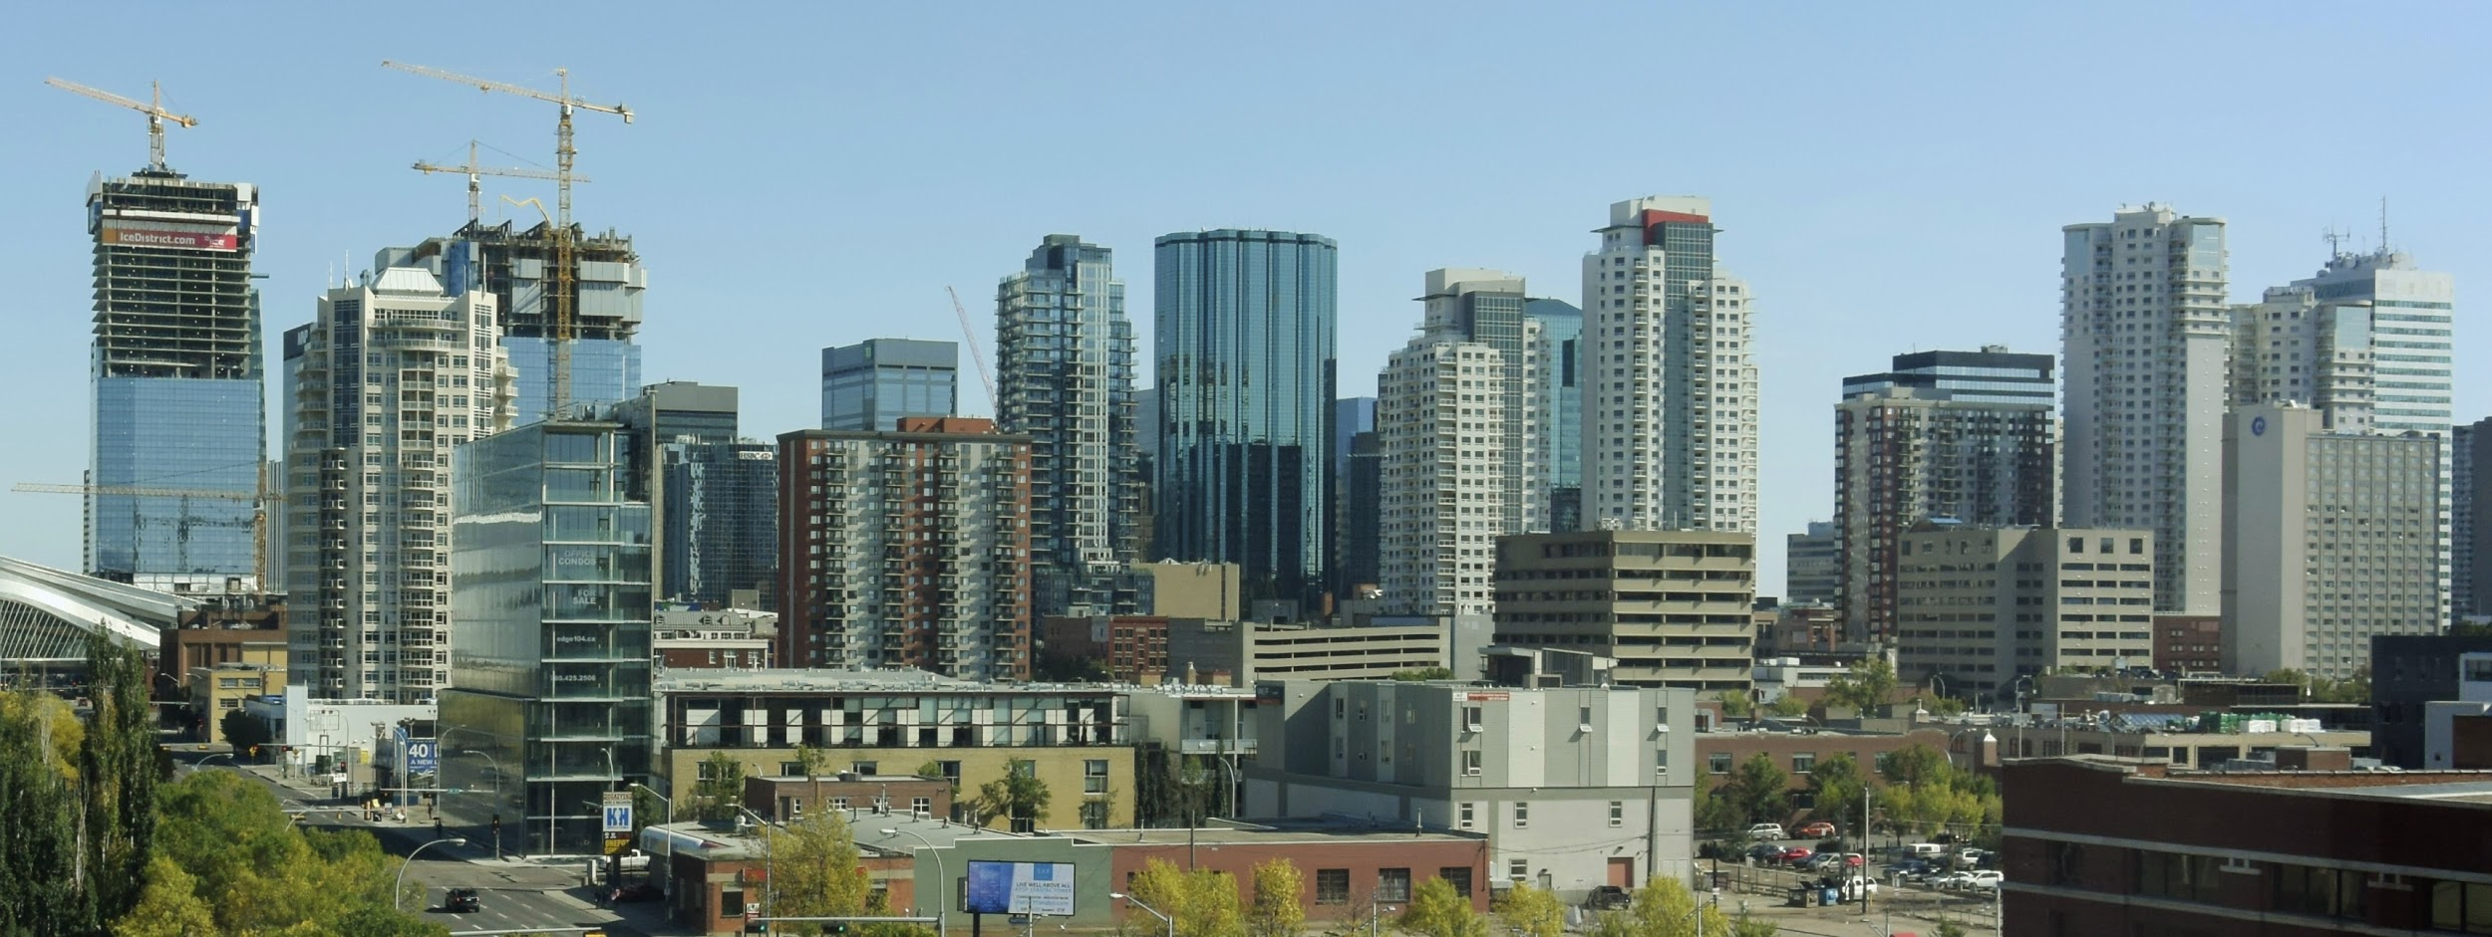
Robert Lawson, NorQuest College
By Thankyoubaby (Own work) [CC BY-SA 4.0 (https://creativecommons.org/licenses/by-sa/4.0)], via Wikimedia Commons

