Slide 1
Asking Permission and Transactional Licences
May 2020
Notes:
Hello and welcome to the University of Alberta’s Opening Up Copyright Instructional Module on asking permission and transactional licences.

Slide 2
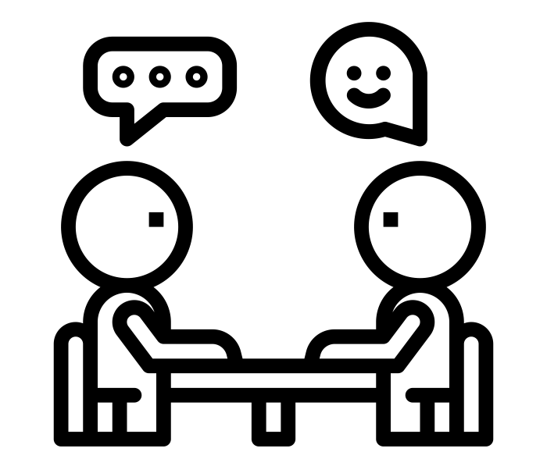
WHEN TO SEEK PERMISSION
1) When use is not supported by an exception to copyright infringement
AND
2) When the work is not already available via an open licence or clear terms of use
Notes:
Seeking permission to use someone else’s copyright-protected work is recommended when the following 2 criteria are met: First, when your use of that work is not supported by an exception to copyright infringement AND second, when the work you want to use is not already available for that use via an open licence or clear terms of use. Obtaining a transactional licence - essentially getting permission - from the rights holder is one way to do just that.

Slide 3
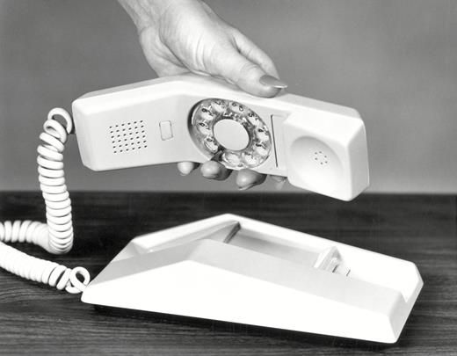
THIRD PARTY CONTENT
North Electric's Contempra telephone (1967). Reproduced in Hadlaw, J (2019).
Notes:
Jordan has just graduated from design school. Their final assignment was a series of images for a web-based advertising campaign for a local technology museum. Jordan received positive comments about their work on the assignment during a classroom presentation, from both instructors and other students. Central to the mock campaign was an image of a vintage telephone from the 1960s. The image was made available in The Journal of Design History, published by the Oxford University Press. Before including the image in their assignment, Jordan thought about what Copyright Librarian had taught them in their first year of design school.

Slide 4
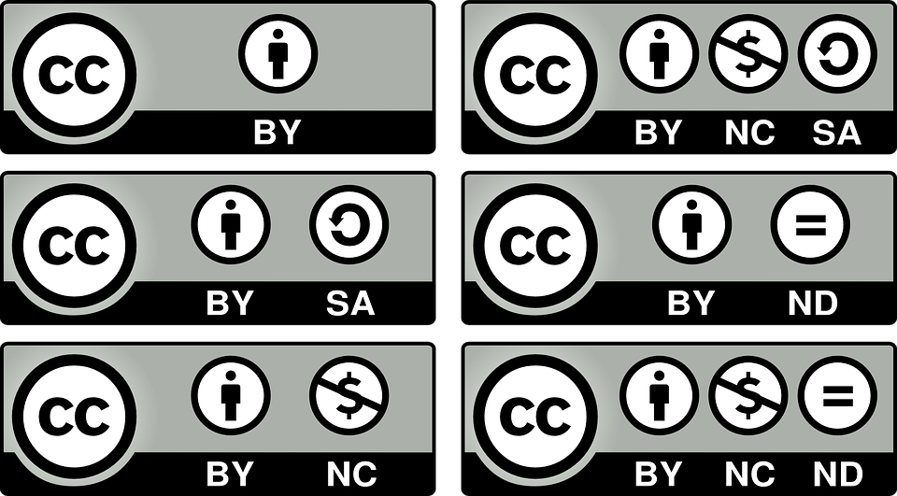
VERIFYING TERMS OF USE
©
Notes:
First, they considered whether the image was still protected by copyright -- which is very likely in this case. Next, they looked for an open licence but didn’t see one, and there were no clear terms of use that accompanied the image.

Slide 5
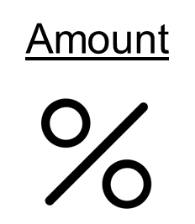
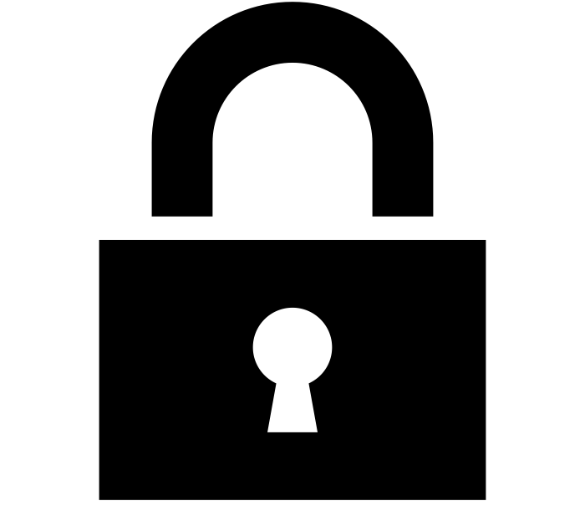
FAIR DEALING
Purpose
Notes:
Jordan then worked through a fair dealing assessment and felt that their use of the image would fall under this exception to copyright infringement, especially since the assignment was only going to be displayed in the classroom and submitted to their instructor.
However, once Jordan decided to include the assignment in their thesis, they also decided to ask the publisher for permission to use the work in this way, since the image was not freely available online and their thesis would be made openly available on the Internet.

Slide 6
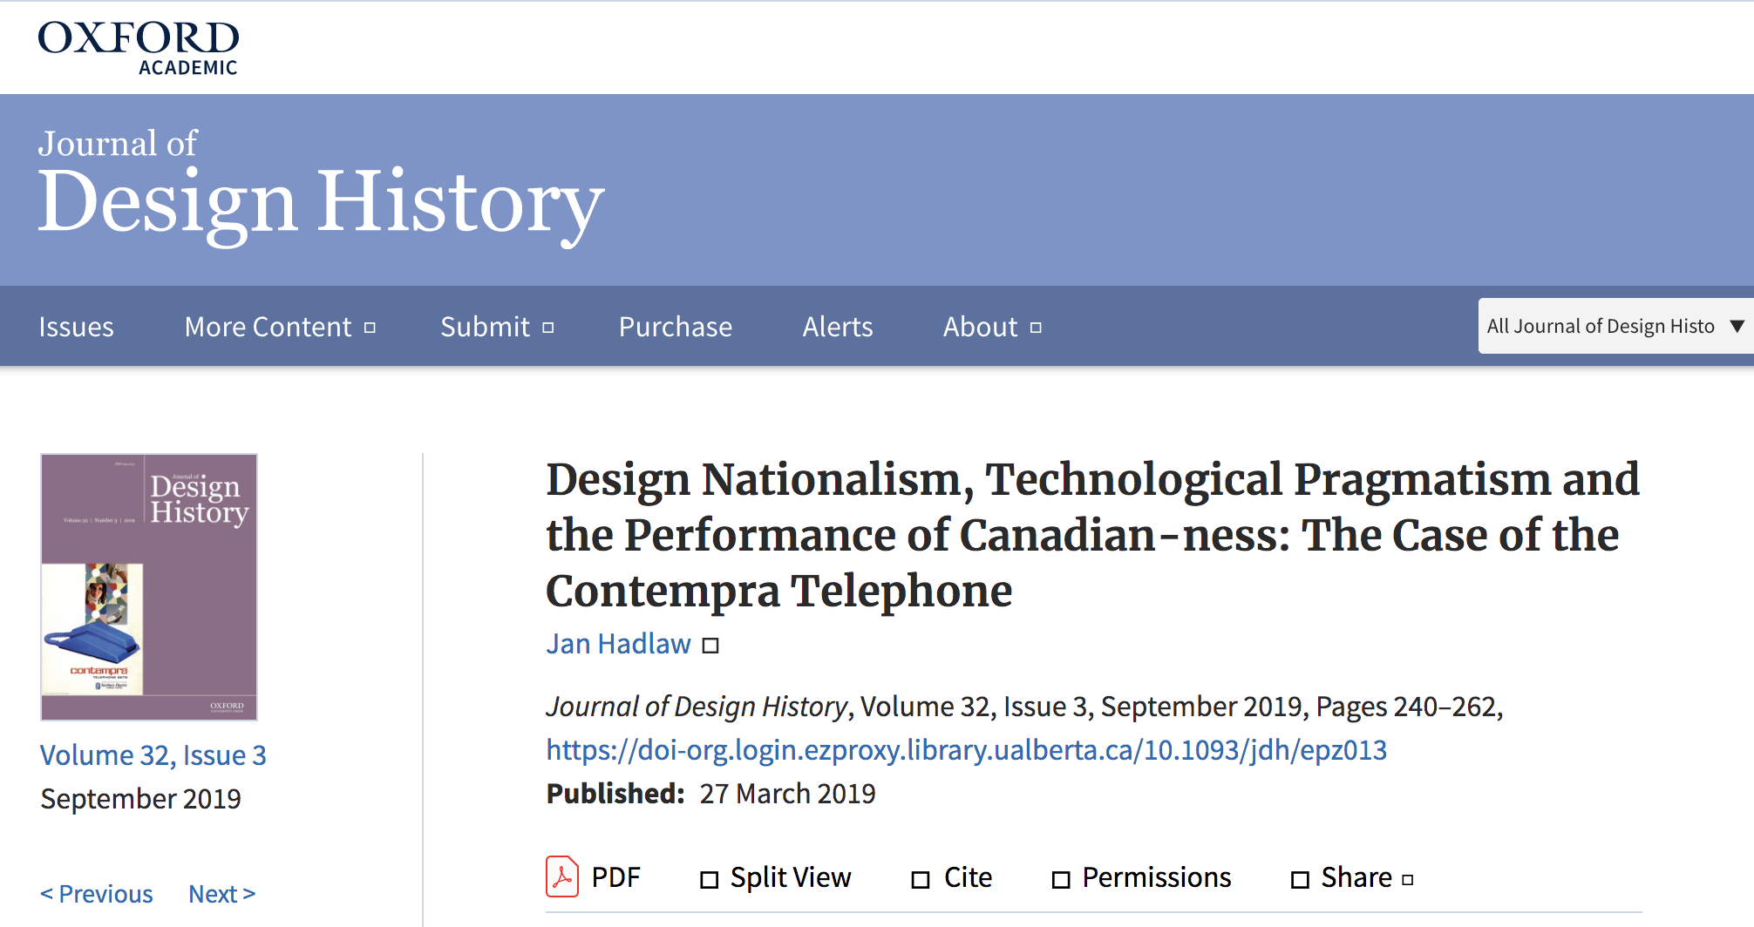
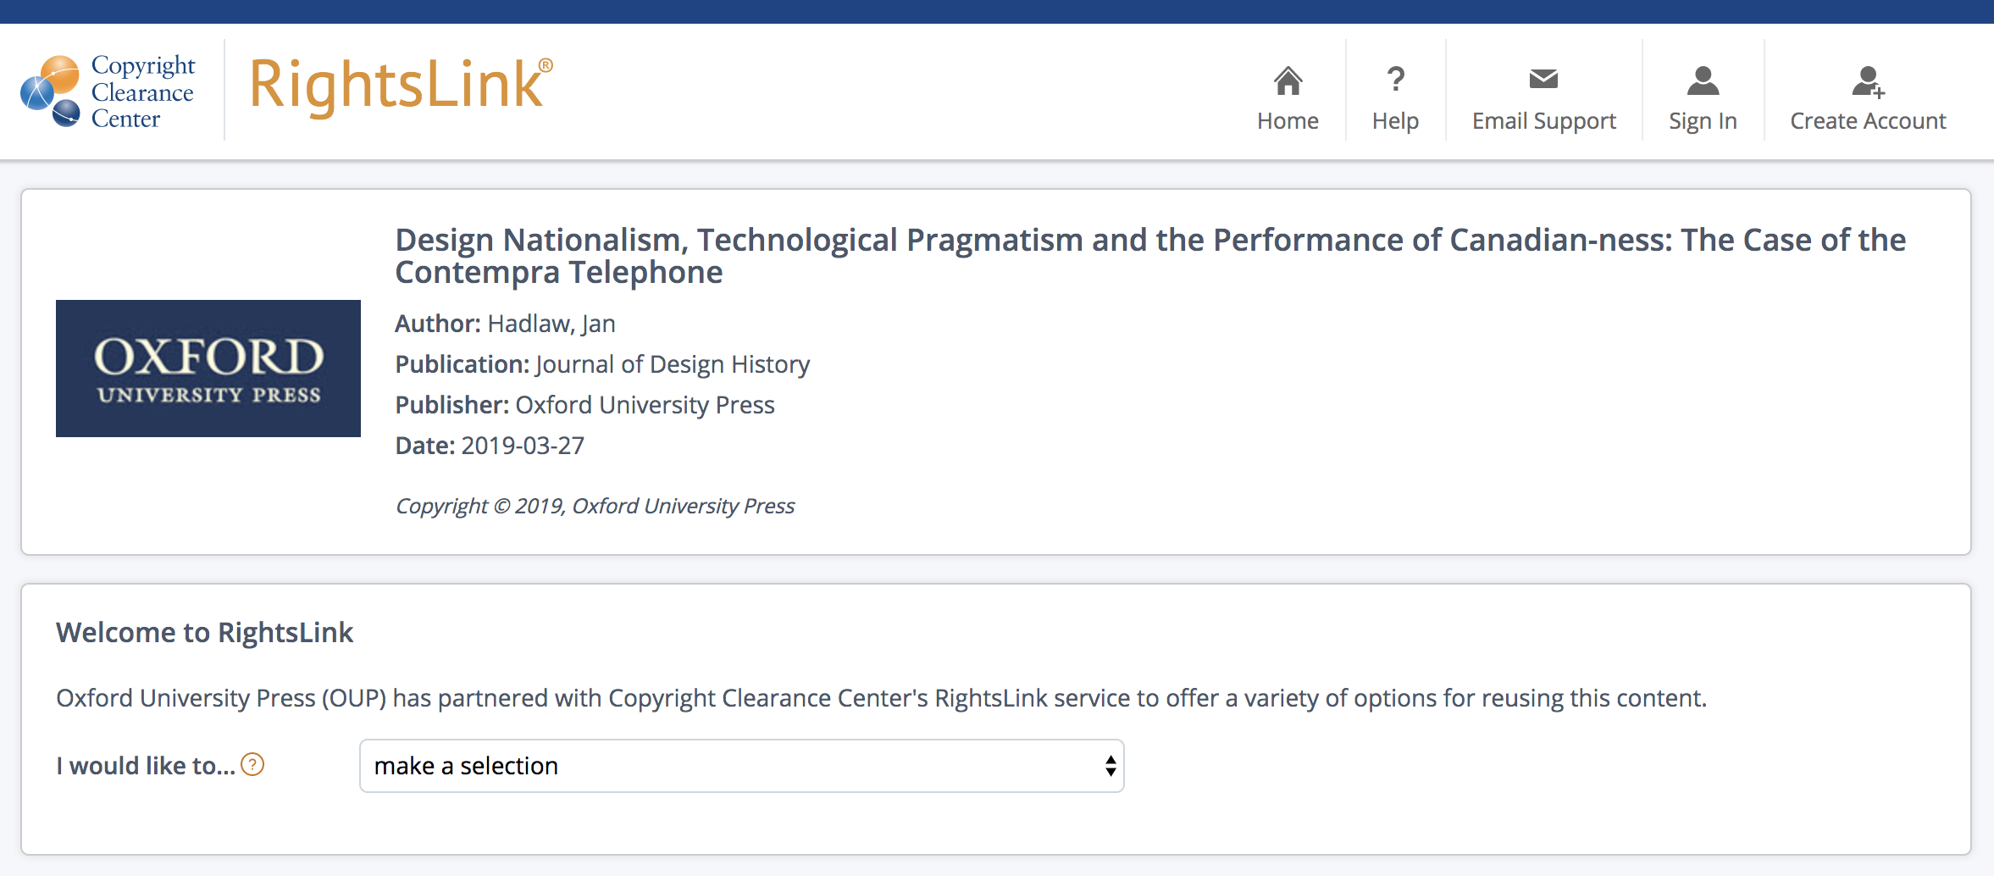
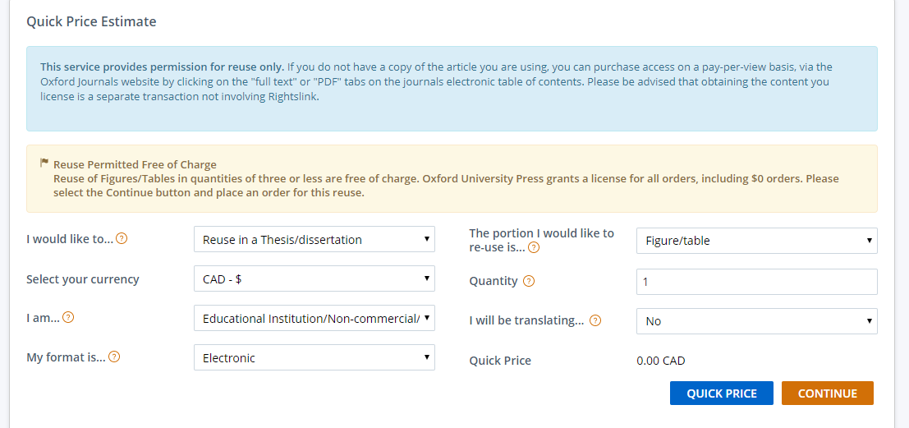
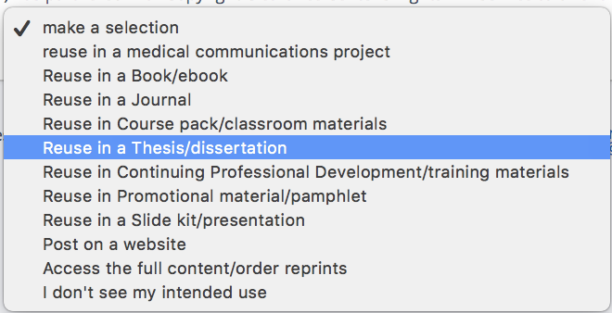
OBTAINING A TRANSACTIONAL LICENCE
Notes:
Many publishers use a permissions service that will provide a transactional licence to use works that they either own or hold the rights to re-distribute in this manner. In this example, and as used by most major academic publishers, the Copyright Clearance Centre is able to provide Jordan with a non-exclusive licence to use the image in their thesis. The licence is free and took Jordan about 2 minutes to obtain -- and another 10 minutes to read through it carefully.

Slide 7
COMMERCIAL USE OF CONTENT
©
©
?
$
$
$
$
$
$
Notes:
One of Jordan’s classmates had snapped a pic of the mock campaign and sent it to their friend Brian at a local advertising agency. Brian was blown away - partly because of the quality of the work and partly because the ad was perfect for a campaign they were working on. Brian contacted Jordan to talk about using the ads commercially.
While Jordan’s composition is their original work and they hold the copyright in that work, copyright in the image that is central to the campaign is held by someone else. In this case, the licence they obtained in order to include the image in their thesis does not allow for commercial uses.
In addition, the freelancer contract that Jordan negotiated with the ad agency makes it clear that Jordan is responsible for obtaining any necessary copyright permissions for third party content. Jordan doesn’t see any information about commercial uses on the Copyright Clearance Centre’s website for this image and decides to ask the rights holder for permission to use the digital image.

Slide 8
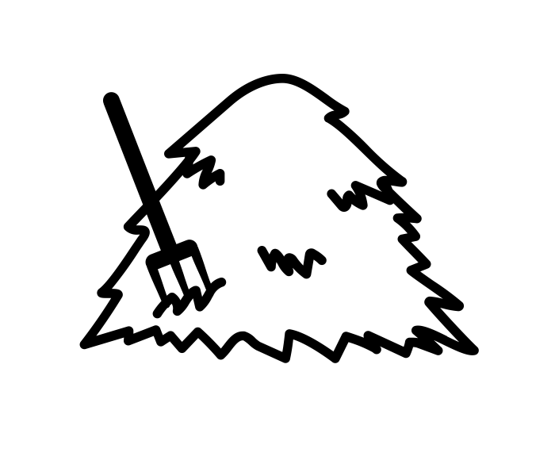
THREE STEPS IN GETTING PERMISSION
How to seek direct permission to use a work protected by copyright and owned by someone else:
©
Determine who holds the copyright in the work
Contact the rights holder and ask for permission
Retain documentation
Notes:
The first thing Jordan must do is determine who holds the copyright in the image. Sometimes this is easy to do, sometimes it is impossible. Luckily, Jordan is able to contact the author of the original article and quickly confirm that they had retained the copyright in their image. If the owner was unlocatable, they could contact the Copyright Board of Canada to apply for a licence to use the work.

Slide 9
CONTACT THE RIGHTS HOLDER
2. Contact the rights holder and ask for permission
Non-exclusive use
Notes:
Negotiating the specific terms to cover your use of the work is very important but doesn’t always have to be onerous. Jordan asks for the non-exclusive use of their digital photograph, worldwide, as a component of a larger online commercial ad campaign for a specific period of time. Jordan includes a mockup of the campaign with the proposal and suggests a one-time fee that they feel is reasonable for this use.

Slide 10
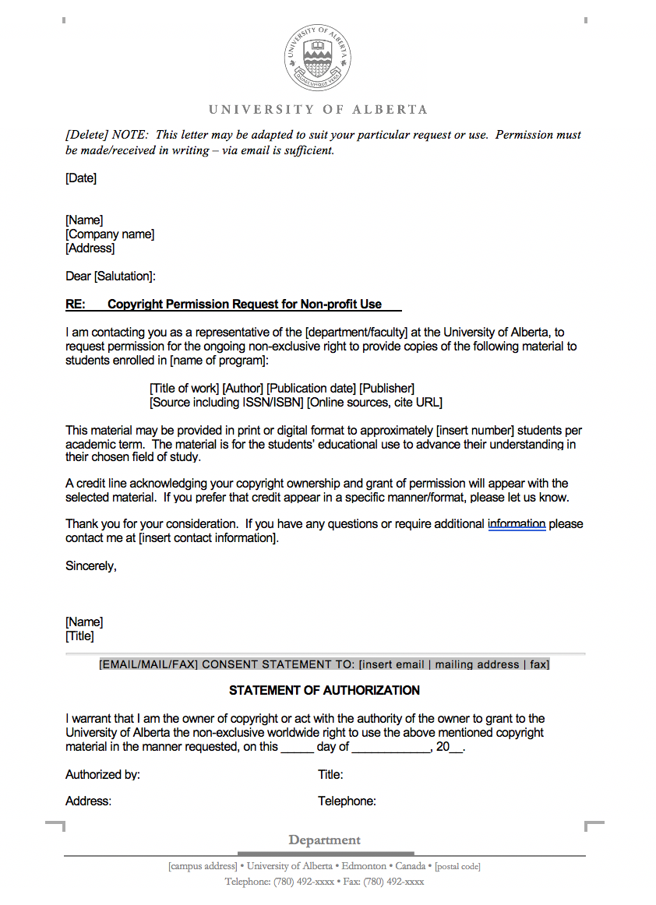
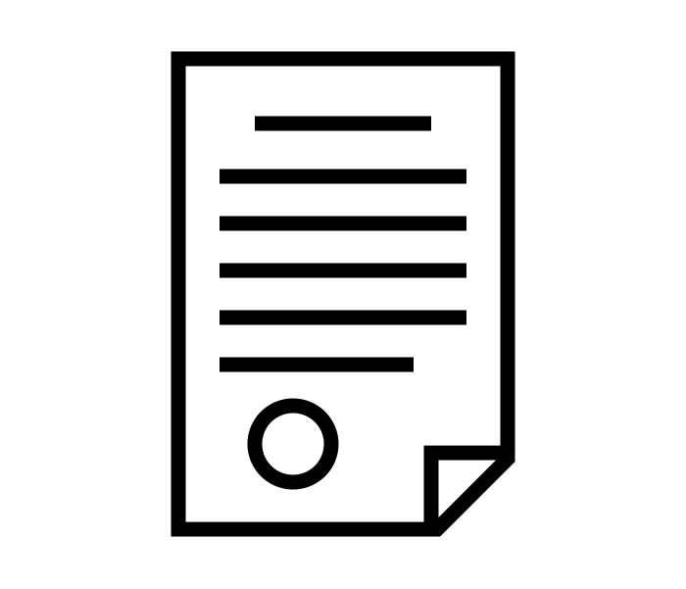
CONTACT THE RIGHTS HOLDER
2. Contact the rights holder and ask for permission
Notes:
After a bit of back and forth, Jordan obtains a transactional licence to use the image in an online commercial advertising campaign for one year. In this example, Jordan negotiated directly with the rightsholder over email. In some cases a template for seeking permission might have been useful, like these ones prepared for use in an educational environment.

Slide 11
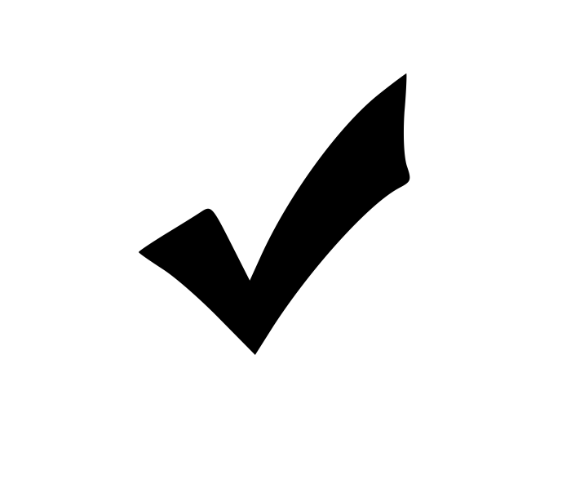
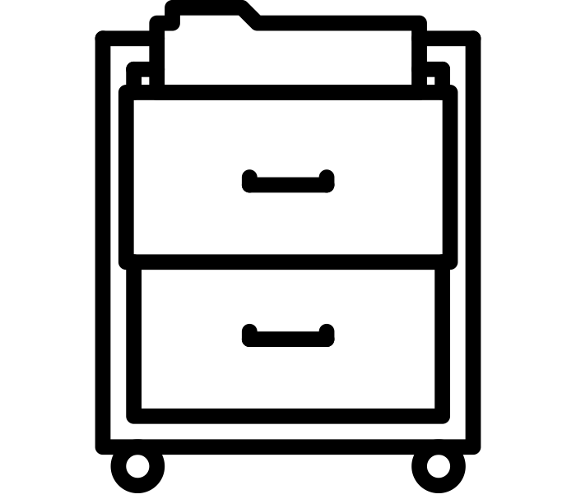
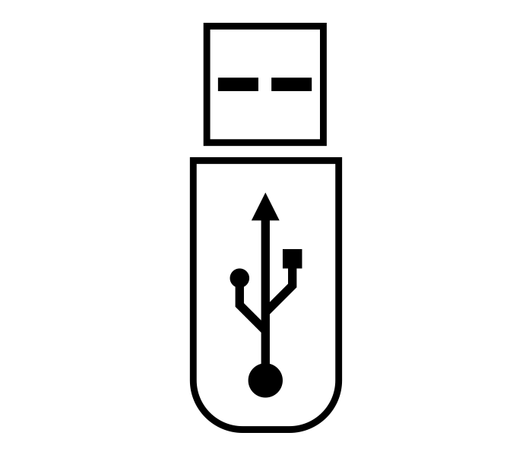
RETAIN DOCUMENTATION
3. Retain documentation
How to seek direct permission to use a work protected by copyright and owned by someone else:
?
Determine who holds the copyright in the work
Contact the rights holder and ask for permission
Retain documentation
Notes:
16. [Step 3: Retain documentation.]
Finally, Jordan files both a digital and hard copy of the transactional licence in safe places. Despite feeling like they have a good relationship with both the rights holder and the advertising agency, it’s important to keep a record of who agreed to what, in case Jordan’s use of the image in the campaign is called into question at a later date by either the creator’s estate or by new employees at the ad agency.
After working through the three steps in seeking a transactional licence, Jordan is happy to know how and when asking permission might be a good approach to make use of another’s copyright-protected works.
References
USB: https://thenounproject.com/search/?q=usb%20key&i=258531
Cabinet: https://thenounproject.com/search/?q=filing%20cabinet&i=2398292

Slide 12
LEARNING OBJECTIVES
You should now be able to:
Understand when asking permission or seeking a transactional licence is necessary
Describe the three steps involved in seeking a transactional licence
Notes:
You should now be able to:
- Understand when asking permission or seeking a transactional licence is necessary
- Describe the three steps involved in seeking a transactional licence

Slide 13
Notes:
This has been the University of Alberta’s Opening Up Copyright Instructional module on Asking Permission and Transactional Licences. Thank you for your attention.

Slide 14
QUESTIONS
You should seek permission to use another person’s copyright protected works
When your use isn’t supported by a copyright exception, terms of use, or a licence
To ensure a copyright exception applies
Always
Never
Which of the following statements correctly describes the connection between fair dealing and asking permission
You should ask for permission first, and if this fails then complete a fair dealing analysis
You should complete a fair dealing analysis, and if your use appears to be covered by fair dealing, then you also ask permission
You should complete a fair dealing analysis, and if the use appears to not be covered by fair dealing, then you should ask permission
Do whatever you like, it is easier to ask for forgiveness than permission

Slide 15
QUESTIONS
Which of the following is not a step in asking permission or seeking a transactional licence
Determining who holds the copyright in a work
Contacting the rights holder and asking for permission
Retaining documentation
Agreeing to give over your first born to the Minister of Innovation
If you cannot locate the copyright holder for a work you would like to use, you may apply to the Copyright Board for a licence.
True
False

Slide 16
Hadlaw, J. (2019). Design Nationalism, Technological Pragmatism and the Performance of Canadian-ness: The Case of the Contempra Telephone. Journal of Design History, 32(3), 249. Retrieved from https://doi.org/10.1093/jdh/epz013
Smith, K. L. (2020). Coaching copyright: rules and strategies for the game. In K. L. Smith & E. L. Ellis (Eds.), Coaching Copyright. Chicago: ALA Editions.

Slide 17
supalerk laipawat. (n.d.) Interview. The Noun Project. CC BY. https://thenounproject.com/icon/1962276
PNG ALL. (n.d.) Copyright All Rights Reserved. PNG ALL. CC BY. http://www.pngall.com/copyright-all-rights-reserved-symbol-png
Enshia. (n.d.). Book. The Noun Project. CC BY. https://thenounproject.com/icon/1787402/
coffeebeanworks. (2017). [Jordan]. Pixabay. https://pixabay.com/illustrations/avatar-clients-customers-icons-2191933/
Guilherme Furtado. (n.d.). Graduation. The Noun Project. CC BY. https://thenounproject.com/search/?q=graduation&i=3006064
motionstock. (2020). [Confetti]. Pixabay. https://pixabay.com/videos/confetti-party-party-poppers-31150/
beerre. (2016). spanish party noisemaker. Freesound. CC 0. https://freesound.org/people/beerre/sounds/344965/
iconcheese. (n.d.). Image. The Noun Project. CC BY. https://thenounproject.com/search/?q=image&i=3291251
OpenClipart-Vectors. (2013). [Ribbon]. Pixabay. https://pixabay.com/vectors/award-gold-winner-badge-accolade-151151/
coffeebeanworks. (2017). [Copyright librarian]. Pixabay. https://pixabay.com/de/illustrations/avatar-kunden-kundschaft-ikonen-2191932/

Slide 18
Progressor. (2015). [Creative Commons]. Pixabay. CC 0. https://pixabay.com/en/creative-commons-licenses-icons-by-783531/
Dezign, Ruslan. (n.d.). Target. The Noun Project. CC BY. https://thenounproject.com/icon/1005058/
ATOM, TH. (n.d.). Copy. The Noun Project. CC BY. https://thenounproject.com/search/?q=copy&i=1474212
Тимур Минвалеев, RU. (n.d.). Percent. The Noun Project. CC BY. https://thenounproject.com/search/?q=percent&i=397874
Farais, B, CL. (n.d.). Decision. The Noun Project. CC BY. https://thenounproject.com/search/?q=alternatives&i=1074053
AFY Studio, ID. (n.d.). Leaf. The Noun Project. CC BY. https://thenounproject.com/AFYstudio/uploads/?i=1737325
Cresnar, Gregor. (n.d.). Dollar sign. The Noun Project. CC BY. https://thenounproject.com/search/?q=dollar%20sign&i=171145
Ben Davis. (n.d.). Essay. The Noun Project. CC BY. https://thenounproject.com/search/?q=essay&i=575679
Lock: https://thenounproject.com/search/?q=locked&i=43556
Zoubir Noureddine. (n.d.). checkmark. The Noun Project. CC BY. https://thenounproject.com/search/?q=checkmark&i=154036

Slide 19
Rafael Farias Leão. (n.d.). Cursor. The Noun Project. CC BY. https://thenounproject.com/search/?q=mouse&i=1692870
deleted_user_4772965. (2014). Mouse click. Freesound. CC 0. https://freesound.org/people/deleted_user_4772965/sounds/256455/
Made by Made. (n.d.). Camera. The Noun Project. CC BY. https://thenounproject.com/search/?q=camera&i=1559468
applesandpears50. (2019). Camera Shutter. Freesound. CC 0. https://freesound.org/people/applesandpears50/sounds/485711/
coffeebeanworks. (2017). [Brian]. Pixabay. /illustrations/avatar-clients-customers-icons-2191934/
Vladimir Belochkin. (n.d). contract. The Noun Project. CC BY. https://thenounproject.com/icon/869929
mikicon. (n.d.). person. The Noun Project. CC BY. https://thenounproject.com/search/?q=person&i=737678
Copyright Board of Canada. (n.d.). [Copyright Board Banner]. Copyright Board of Canada. http://www.cb-cda.gc.ca/home-accueil-e.html
lambe Ndomble. (n.d.). ads. The Noun Project. CC BY. https://thenounproject.com/search/?q=online%20advertisement&i=2747454

Slide 20
Vicky Jeol. (n.d.). clock. The Noun Project. CC BY. https://thenounproject.com/search/?q=clock&i=3302986
TMD. (n.d.). usb stick. The Noun Project. CC BY. https://thenounproject.com/search/?q=usb%20key&i=258531
lastspark. (n.d.). Filing cabinets. The Noun Project. CC BY. https://thenounproject.com/search/?q=filing%20cabinet&i=2398292
Closing Slides Music: Rybak, Nazar. (n.d.). Corporate Inspired. HookSounds. CC BY. http://www.hooksounds.com

Slide 21
University of Alberta. (2020). Asking Permission and Transactional Licences. Opening Up Copyright Instructional Module. https://sites.library.ualberta.ca/copyright/

