Slide 1
Lifelong Learning and Open Educational Resources The Alberta Library Conference
Michelle Brailey
Data Librarian, Intern University of Alberta Libraries
brailey@ualberta.ca
Michael B. McNally
Assistant Professor, School of Library and Information Studies
University of Alberta
mmcnally@ualberta.ca

Slide 2
Outline
Defining Open Educational Resources
Open Educational Resources and Libraries: Context and Opportunities for Librarian Involvement
University of Alberta Libraries Open Education Project
Conclusions

Slide 3
Defining Open Educational Resources (OER)
OER defined as, “the open provision of educational resources, enabled by information and communications technologies, for consultation, use and adaption by a community of users for non-commercial purposes”
(http://portal.unesco.org/ci/en/ev.phpURL_ID=2492&URL_DO=DO_TOPIC&URL_SECTION=201.html)
“Open Educational Resources” coined at a 2002 UNESCO conference
OECD in Giving Knowledge for Free (2007) defined OER as:
“digitised materials offered freely and openly for educators, students and self-learners to use and reuse for teaching, learning and research” (http://www.oecd-ilibrary.org/education/giving-knowledge-for-free_9789264032125-en)

Slide 4
Openness and the Academy
OER include:
Open Course Ware (OCW)
Open Textbooks
Conference and research presentation materials
Assessment materials
Educational audio/visual material
Individual learning objects
Research (Output) :
Open Access Publishing
Teaching:
Open Educational Resources
Research (Input) :
Open Data
Technology:
Open Source Software

Slide 5
OERs in Public and School Libraries
Public library usage:
Some sparse examples, but clear room for further promotion
School library usage:
Rich tradition of use by K-12 educators, and in many jurisdictions considerable interest from relevant education departments/ministries

Slide 6
OERs, Lifelong Learning and Librarianship
Lifelong learning has consistently been seen as a core element of librarianship:
Dewey (1889, p. 8) argued “Education is a matter of a lifetime.”
Ranganathan in his Five Laws of Library Science declared:
Hence, even though a man has as many degrees as a thermometer, even though he be graduated with the highest honours, he is grossly uneducated, or will soon become so, if he stops reading and lets his brain grow rusty from the day of his convocation onwards. Education really begins at the cradle and is only completed at the grave. (1931, p. 148)
ALA regards education and lifelong learning as one of 11 Core Values of Librarianship
A recent 2016 study of Americans found 73% identify as “lifelong learners” (Harrington, 2016)
However, awareness of online learning resources is low

Slide 7
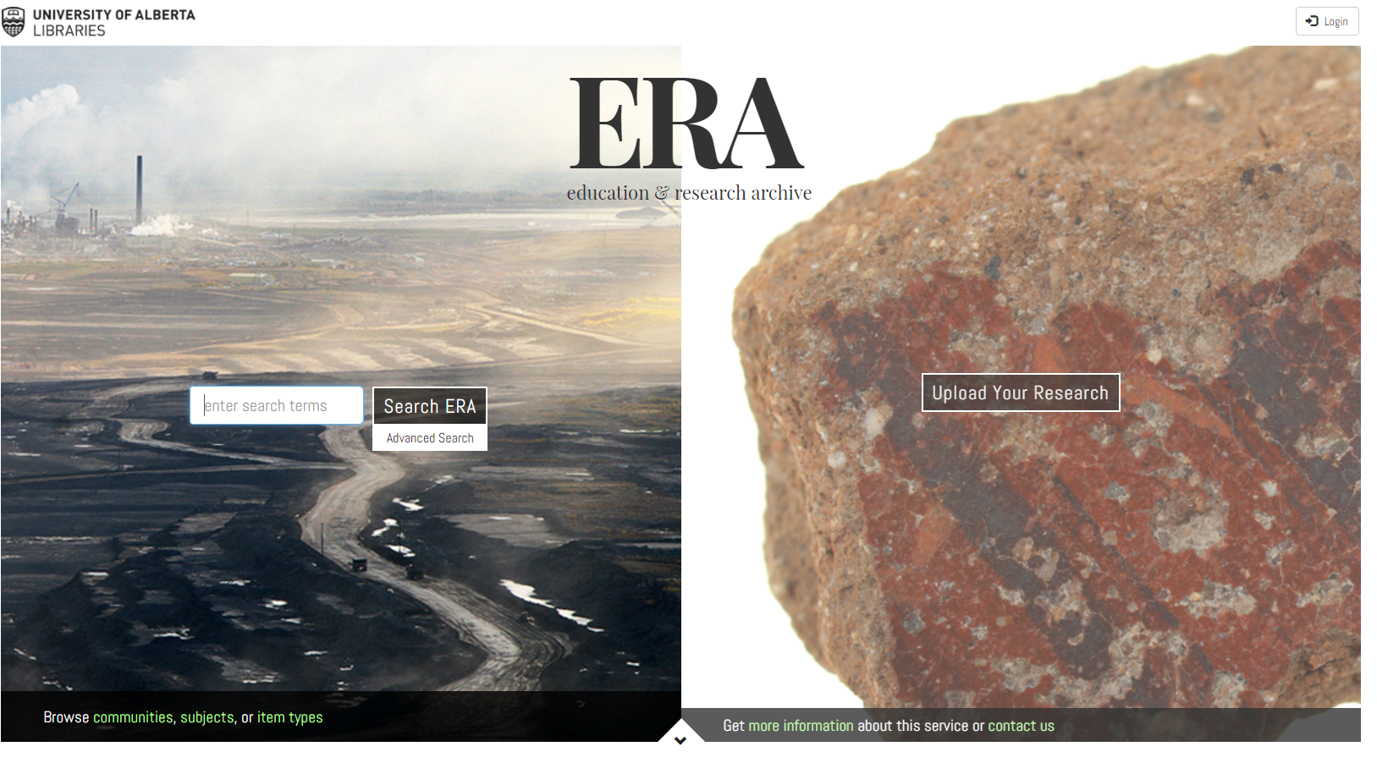
More than Content
Content not the only facet of OER
Also includes tools for creation and distribution and implementation resources (such as licensing systems)
Library has a particularly important role to play in the areas of tools and implementations resources
OER discussions should also be focused on both sides of the equation – use and creation
University of Alberta Libraries, (n.d.), ERA (Education and Research Archive) Homepage,
https://era.library.ualberta.ca/

Slide 8
Institutional Benefits (Post Secondary Institutions)
MIT (2011, 2016) reports numerous institutional and community benefits to its OCW initiative
MIT (2011, 2016) reports numerous institutional and community benefits to its OCW initiative
MIT OCW has had over 200 million visits by Feb 2016
Recruitment – 35% of freshmen aware of the OCW initiative were influenced to attend MIT because of it
Little impact on class levels – fewer than 4% of participating faculty report drops in in-class attendance
Positive student experience – 94% of MIT students say OCW has positively impacted student experience
MIT, (2011), 2011 Program Evaluation Findings Summary,
http://ocw.mit.edu/about/site-statistics/11_Eval_Summary_112311_MITOCW.pdf
MIT, (2016), MIT Open Courseware Dashboard Reprot Feb. 2016, http://ocw.mit.edu/about/site-statistics/monthly-reports/MITOCW_DB_2016_02.pdf

Slide 9
Libraries and librarians have several roles to play in relation to OER…
Advocacy and promotion
Assist in locating or disseminating OER
Instruction on evaluating OER
Address copyright and licensing concerns
Notes:
MB ->
OER fits with other conversations and initiatives - OA, Open Data -> Removing barriers to information and access to materials that can be remixed and redistributed.
4 areas of involvement…. Underlying all aspect of communicatio - Librarians in natural liaison roles and communication between faculty, students, admin, etc. needed for the initiative.

Slide 10
Notes:
The side of OER that I have been involved in is mainly awareness and promotion.
And the heart of this is seeking alternatives to high cost textbooks.

Slide 11
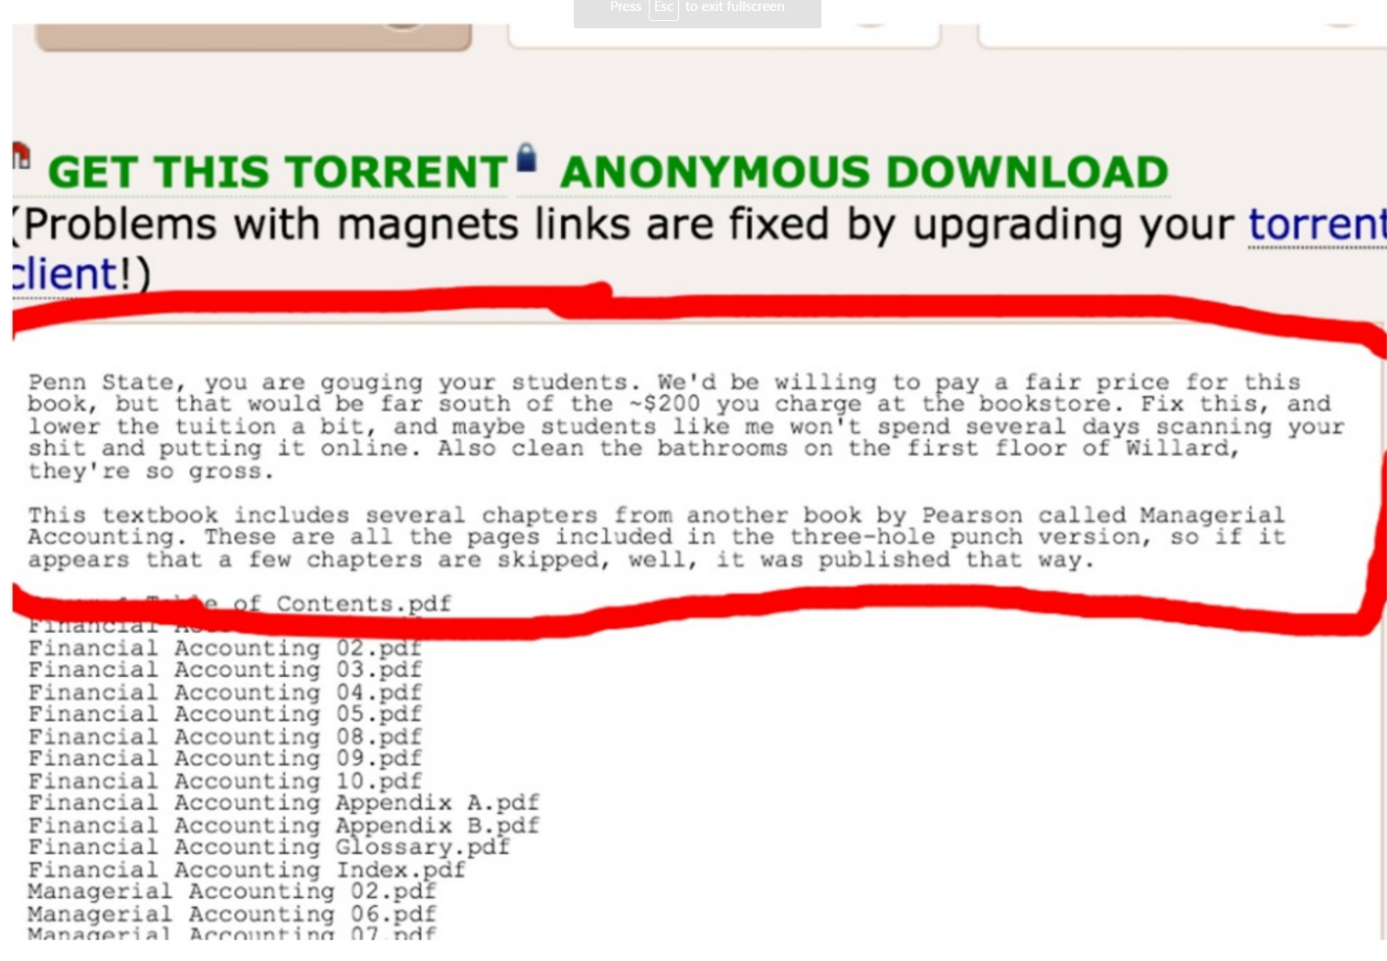
Notes:
cost of textbooks rising and Students seeking alternatives… pirating books, not purchasing texts or avoiding courses with required textbooks.

Slide 12
OER Advocacy and Promotion
78% of undergraduates report not purchasing a required course textbook due to cost (Billings et al. 2012).
Only ⅕ of students are legally obtaining all course textbooks (Czerniewicz 2016).
UMass Amherst calculates that its OER initiative has resulted in an average savings of $128 per student per course (Billings et al. 2012).
As of March 2016, the BC Campus estimates it has saved students $1,254,000 – $1,604,425 as a whole.
Upcoming estimates of student savings from AB OER initiative.
Open Education Week is in early March
Open Education Conference in November
Notes:
Research also shows this - One study from 2012 found that 78% of students were not purchasing a required textbook because of the cost. Recent study from 2016 found only ⅕ students were legally purchasing all course materials.
http://www.tandfonline.com/doi/abs/10.1080/17439884.2016.1160928?journalCode=cjem20&
Major advocacy events are OE Week and OE Conference ; also most localized initiatives Eg. UMass & Student savings, BC OER savings, AB OER initiative.

Slide 13
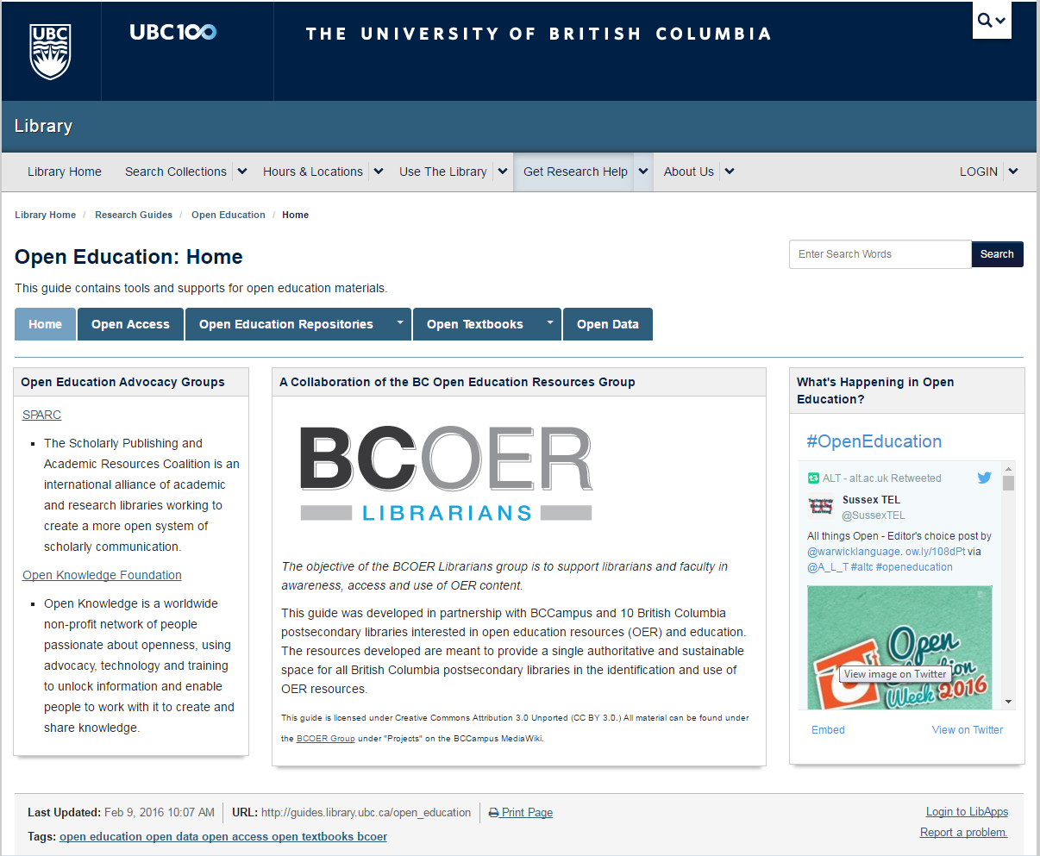
OER Lib Guides
University of Alberta
http://guides.library.ualberta.ca/open-educational-resources
Norquest College
http://libguides.norquest.ca/oa/open_education
Athabasca University
http://cldd.athabascau.ca/open-educational-resources/index.php
Mount Royal University
http://libguides.mtroyal.ca/oer
University of Lethbridge
http://libguides.uleth.ca/OER
UBC Library, (2016), Open Education: Home
http://guides.library.ubc.ca/open_education
Institutional Repositories are another area for libraries role in OER: - Encourage deposit
- Ensure high quality metadata
- Ensure discoverability
Notes:
Can also use current venues for sharing and locating information for OER
Amount of OER libguides growing - EG. How this slide has changed over the past year.
Can also use IR for sharing institutionally created resources like slides, lectures, keynotes, etc. which can be enriched with high quality metadata and made discoverable through the catalogue.
Institutional Repository is a key element of the library’s role in OER
Maximizing the potential of the repository includes
Encouraging deposit
Ensuring high quality metadata
Making repository content discoverable
Getting in into the catalogue/discovery system
Getting index by search engines and/or linking it to other OER repositories
OER from a local institutional repository come with one huge benefit from the potential of faculty – guest speakers

Slide 14
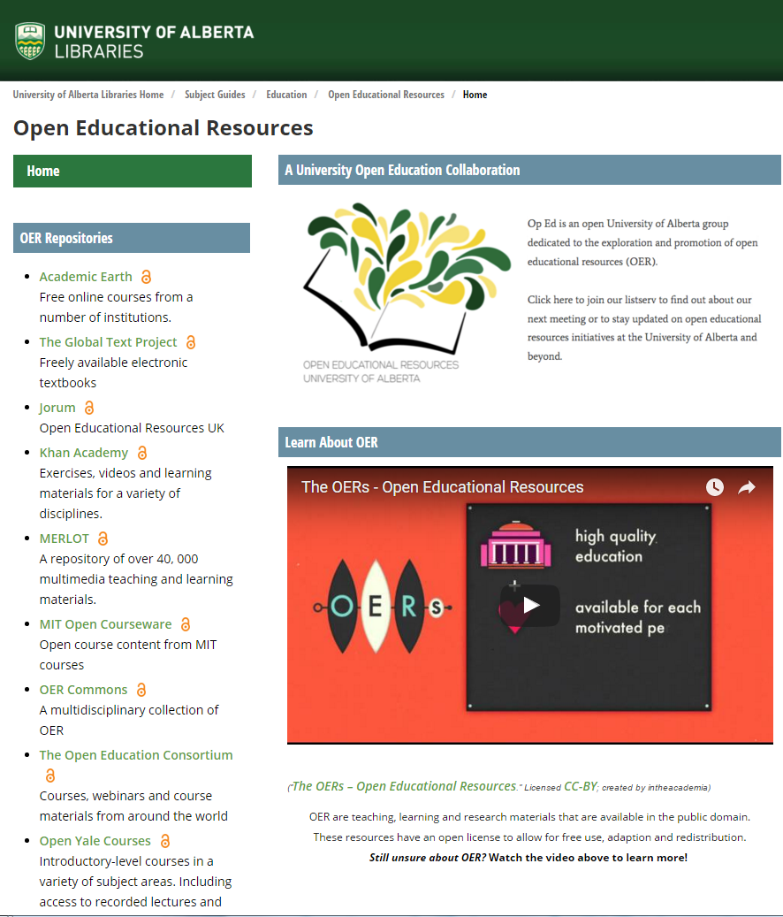
Locating OER
Open Courses | Open Textbooks | Multimedia OER
Saylor Academy http://www.saylor.org/ | Open Stax https://openstaxcollege.org/ | OER Commons http://www.oercommons.org/
Open CourseWare Consortium http://www.ocwconsortium.org/ | The Global Textbook Project http://globaltext.terry.uga.edu/ | Multimedia Educational Resource for Learning and Online Teaching (MERLOT) http://www.merlot.org/merlot/index.htm?action=find
Notes:
Look more closely at these OER repositories and what resources we can highlight…
Not just textbooks….
In most cases these materials are peer reviewed, or there is an opportunity to peer review them to ensure that quality is maintained.
Prestigious institutions like Yale and MIT sharing open courses.
There are also numerous subject/discipline repositories, national repositories, institutional repositories and other OER sources

Slide 15
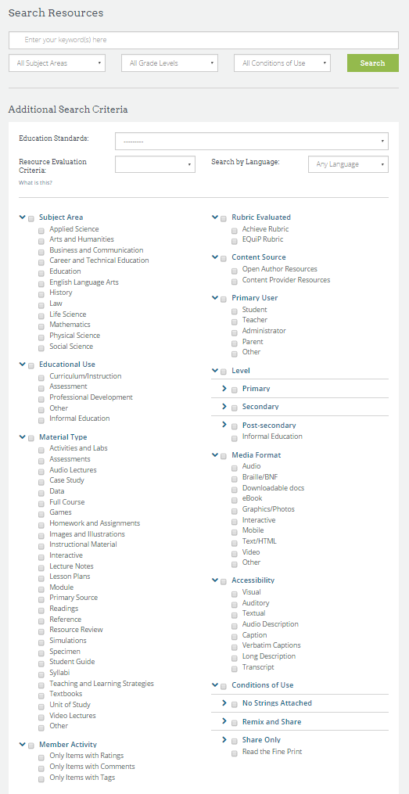
Locating OER and IL
Some OER repositories have very well developed search functionality
These could possibly serve as a platform for some instruction on searching/search skills
OER Commons, (2015), Advanced Search,
https://www.oercommons.org/advanced-search
Notes:
Beyond our subscription databases, OER repositories also have complex advanced search options that allow you to limit by a variety of fields dual purpose of locating OER and teaching advanced searching.
Particularly interesting is that you can limit by condition of use. When it comes to IL instruction, you don’t lose the ability to show complex searching, and the addition of the conditions of use field which could add another dimensions for IL

Slide 16
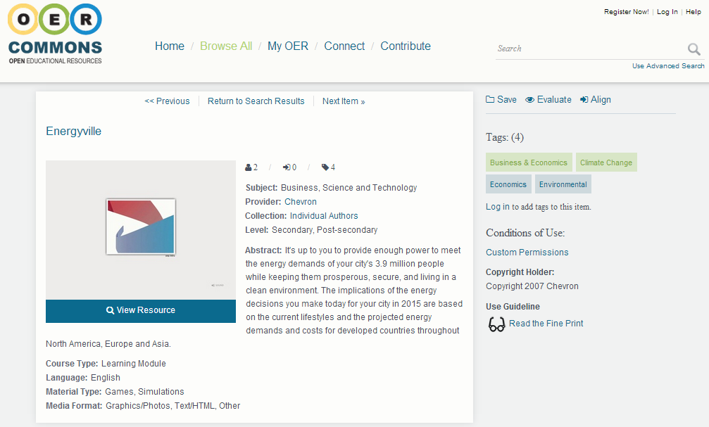
Evaluating OER
Librarian expertise on evaluating information sources is also relevant to OER
Even top quality repositories have resources that range considerably
For example the Energyville OER suffers from some bias as its creator is Chevron
Notes:
Coming back to peer review of OER
Librarian expertise…
Repositories have a range in quality and like other academic resources peer review is needed - EG. Energyville ( User must sustain community but at times oil is the only option for energy).
BC OER Librarians group has developed rubric for evaluating OER, BC Campus and AB OER have funding opportunities for peer reviewing OER . MB End

Slide 17
Library as Model OER User/Creator
Librarians are already great at sharing – and as such we make great model users

Slide 18
Copyright and Licensing Instruction
Concerns over copyright and licensing are one of the biggest barriers to use and creation of OER
Numerous issues including:
Lack of knowledge/understanding of copyright
Lack of understanding on copyright exceptions – particularly de minimus use and fair dealing
Lack of knowledge/understanding on licensing
Challenges in working with materials with various licenses
Institutional exceptions to copyright may not exist elsewhere
There are specific copyright exceptions for educational institutions in Canada
National differences in fair dealing/use

Slide 19
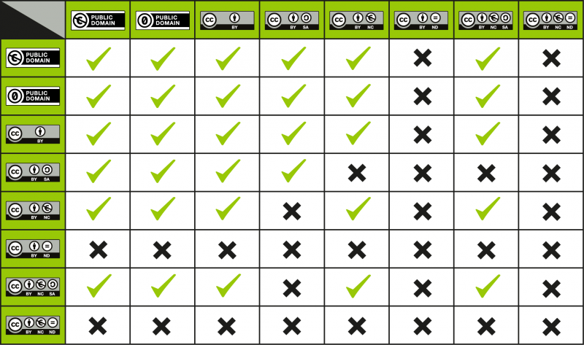
Copyright and Licensing Instruction
At a minimum libraries can point to Creative Commons compatibility tables found in the Creative Commons FAQ
http://wiki.creativecommons.org/Frequently_Asked_Questions

Slide 20
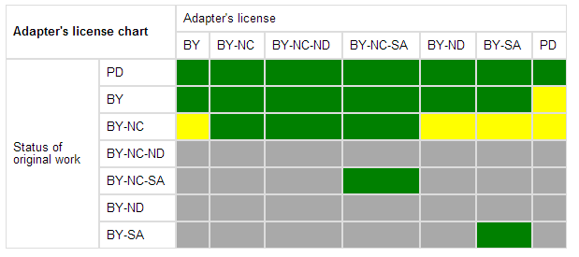
Copyright and Licensing Instruction
Libraries can also encourage OER creation with more permissive licenses (or even surrender to the public domain)
Libraries should also play a role in insuring institutional copyright policies are up-to-date and reflective of current law and jurisprudence
The University of Alberta’s Copyright Office has two OERs about Copyright and OERs:
Copyright Considerations: An Introduction
Copyright Considerations in Practice

Slide 21
Creating OER
Even though extensive OER exist, there are still gaps to be filled
OER are best developed collaboratively
Ask for feedback from both peers and students
Seek institutional support for both space to publish materials and recognition for OER work
Be mindful of copyright and other intellectual property rules as well as privacy policies and legislation

Slide 22
Creation Considerations
As an OER creator you have two means to control how open the resources is:
The licensing terms, and
The format of the file(s)
Surrender to the public domain, a CC Attribution (CC BY) license, and a CC Attribution, Share-Alike (CC BY-SA) licenses grant other users the greatest amount of freedom
Editable file formats (such as HTML, RTF and PNG) allow for much easier modification, while formats such as PDF fetter alteration
Logically, if the license allows modification of the OER, it makes sense to disseminate the file in an editable format

Slide 23
Creation Considerations
Consideration should also be given to proprietary file formats – many users may not be able to use the most current versions of major commercial software
Large fonts, captions for audio materials and clear contrasts between colours make works more accessible Localized or obscure cultural references, slang and neologisms can impede learning by users who are not familiar with the author’s language and culture
Hyperlinks are most useful when they are both linked and have the URL provided as potential users may print materials rather than use them in electronic form

Slide 24
Pedagogical Concerns
Ideally OER creation should not undermine teaching, but
In class room techniques may not necessarily translate to OER
Recording of class time for outside consumption may supress discussion
Quantitative assignments and open access readings are ideal for OER but not all classes
Designing for global audience may mean not utilizing domestic fair dealing rights

Slide 25
Initial Project Objectives
1
2
3
4
5
Plan a campus-wide OER special interest group > Develop a list serv > Work with colleagues to plan meetings
Plan a promotional event for Open Education Week (March 2016)
Investigate an impactful web presence for OER for the University of Alberta
Do presentations for the UAL community and beyond on OER
If time, meet with TAL to investigate province-wide initiatives
Notes:
Project emerged from a grant that the UAL libraries applied for but did not successful get.
Project started as very nebulous - doing something with OER but unaware of what was already going on on campus and where we fit in.
After talking with people already involved in the OER movement it became clear to us that one of the biggest barriers for OER is simply faculty awareness.
Because of this we decided to focus on raising awareness for OER on our campus.
The project objectives were to…

Slide 26
Context to OER in Alberta
March 13, 2014 a memorandum of understanding was signed between British Columbia, Alberta and Saskatchewan.
Greatest momentum for OER in Canada has come out of British Columbia.
2015 Alberta formed a provincial steering committee for OER with representatives from institutions, including students across the province.
Spring 2015, Alberta OER offered first round of grants for OER and funded 18 projects.
January 2016 Alberta OER had second round of funding for peer reviews and for implementing OER.
https://goo.gl/ygxvOj
Notes:
- - describe more of the context and environment
In 2014, there was also a memorandum of understanding signed between BC, Alberta and Sask to share as we develop OER in our provinces.
We knew at the beginning that BC had more progress than in OER than we have - However, there is also a BCOER Librarians group that has been a driving force for OER, in particular, this group has been involved in raising awareness, developing a rubric to evaluate OER, gaining faculty and librarian involvement.
In 2015 Alberta formed a steering committee for OER with faculty and student representatives from institutions across the province and through this committee Alberta offered its first round of grants for OER.
This round of funding funded 18 projects in the areas of promotion and OER development. It was decided that no projects involving infrastructure would be funded.
Another round of funding took place in January 2016, this was for peer reviews and for replacing a course textbook with an OER. Not OER creation, but finding an existing OER to pilot in a course. However, this funding was only available for the top 50 courses.
This funding closed in March and then was reopened again a few weeks later for courses beyond the top 50.
Although through the government of Alberta, the project lead for the steering committee is through the university of Alberta faculty of education, so this is really another pocket of expertise on campus.

Slide 27
Communication & The OER Movement at UofA
Pockets of activity on campus … But collaboration?
Notes:
https://contactzilla.com/wp-content/uploads/2014/06/collaboration-is-an-HR-issue-how-hr-managers-can-improve-workplace-collaboration.jpg
Aside from the faculty of education, we learned there was a faculty somewhere on campus who developed an OER, there is great interest and promotion of OER from our center for teaching and learning, and a member of the students union who has been working on the initiative already, we also learned there was someone in a faculty whose role is focused on OER. However all these groups were working independently, so we wanted to find where we fit in this initiative and honestly we weren’t sure if we were the right group to try and unify the momentum for OER on campus.
As part of my project I ended up meeting with the project lead for the steering committee and I was able to participate in the provincial steering committee and in the rounds of grant funding that took place in 2016.

Slide 28
Open Education Interest Group
Subscription to list serv = 38
Attendance to first meeting = 30ish
Representation: mostly librarians, few faculty, few students, student association.
Notes:
We also tried to bring the groups together through an Open Education Interest Group. This included a list serv which has 36 subscribers and a large interest group meeting.
In our first meeting about 30 people attended, most were from the libraries, a few were faculty, students, other staff and representatives from our students association.
We felt like there was interest so we moved forward with plans for open education week.

Slide 29
Open Education Week
4 Sessions - All open to everyone!
Webinar with Cable Green from Creative Commons
Keynote and workshop from Rajiv Jhangiani
Panel discussion with local speakers
Promotion started 3 weeks prior to events
Posted on the library home page.
Shared on several email lists… Twice!
Student union, student groups and each faculties communications person all contacted personally.
Directly contacted those who attended similar sessions in the past.
Several reminder Tweets sent out through the library and strong Twitter presence during events.
Notes:
Planned 4 sessions for open education week --- …..
All of the recordings for these events are on our library guide for OER on the ufoa library website.
heavily promoted through list servs, emailing people directly and through social media.

Slide 30
Attendance
Open Education Week Attendance
61 Registered
9 faculty
28 librarians
8 support staff (various areas)
1 Government
5 instructional design
7 students
1 manager
1 Assistant Dean
1 Researcher
Registered 39 Webinar
36 keynote
13 workshop
19 panel
Attended 48 Webinar (11 in person 37 virtual)
31 Keynote
11 Workshop
20 Panel
Notes:
In total we had 61 registered for week events.
However, we had a great deal more uptake from librarian compared to faculty.
The webinar had the highest registered and attended - and also had the greatest reach with some attending from across the country and in the states.
The keynote also had good attendance, but for those who showed up it was mostly library staff.

Slide 31
Lessons Learned
public and academic libraries can raise awareness and promote OER for lifelong learning (open courses or creating OER to contributing to a community of practice).
Public and Academic libraries interact with students/learners - We can help develop student advocacy by showing students that these resources exist.
Encouraging use of OER including supplementary learning materials (OER are not just textbooks!).
Completing or assisting with peer reviews of open textbooks, showing faculty funding opportunities for peer review.
Librarians part of the cultural shift as a whole.
Notes:
Lessons learned
Faculty were the hardest to get out, so as librarians we can communicate with patrons, faculty, students to even show them that these resources exist, that they can complete peer reviews or even that we can assist with peer reviews.
Part of cultural shift as whole.
…

Slide 32
A Few Critical Thoughts
OERs do not avail libraries of a responsibility for information literacy - they strengthen it
Extensive volume of OERs places specific emphasis on appropriately matching OERs with their users
OERs are not truly open - many barriers remain (language, literacy, digital divides)
Western bias in the creation of OERs does legitimate concerns over educational neocolonialism

Slide 33
Feedback and License Information
Previous OER Resources
If you are interested in other OER resources I have prepared please see:
Democratizing Access to Knowledge: http://ir.lib.uwo.ca/wlevents/10/
Broadening Access to Knowledge: http://hdl.handle.net/10402/era.38224
Design vs. Pedagogical Considerations for OERs: https://era.library.ualberta.ca/files/5x21tg169#.Vx_a9EyDFBc
Feedback
Feedback, including criticism, on this presentation is welcomed and can be sent to: mmcnally@ualberta.ca
References
For references to non hyper linked documents, please see the note section of relevant slides
Copyright and Licensing Information
On slide 5 the Gladstone Public Library logo originates from http://gladstonepubliclibrary.org/ - copyright Gladstone Public Library
On slide 5 the Pencho Slaveykov Public Library logo originates from http://www.libvar.bg/projects/index-eng.html - copyright Pencho Slaveykov Public Library
On slide 5 the Northeast Kansas Library logo originates from http://nekls.org/innovation-day-2015/ - copyright Northeast Kansas Library System
On slide 5 the Wisconsin Department of Public Instruction logo originates from http://dpi.wi.gov/imt/digital-learning-planning/open-education-resources - copyright Wisconsin Department of Public Instruction
On slide 5 the Open School BC and Government of British Columbia – Ministry of Education logos originate from http://www.openschool.bc.ca/k12/oer.html - copyright Open School BC and Government of British Columbia
On slide 5 the United States Government Office of Educational Technology logo originates from http://tech.ed.gov/open-education/
On slide 7, the screenshot of the University of Alberta Libraries Education & Research Archive webpage originates from: https://era.library.ualberta.ca/public/home - copyright University of Alberta Libraries
On Slide 10, image used from stock image repository, used under CC license: https://pixabay.com/en/photos/college%20students/

Slide 34
Feedback and License Information
On slide 12, the Open Educational Resources logo originates from: http://www.unesco.org/new/en/communication-and-information/access-to-knowledge/open-educational-resources/global-oer-logo/ - used under a CC-BY 3.0 Attribution license – original author Jonathas Mellos http://www.unesco.org/new/fileadmin/MULTIMEDIA/HQ/CI/CI/pdf/Events/global_oer_logo_manual_en.pdf
On Slide 12, the Open Education Week Logo originates from: http://www.openeducationweek.org/resources - Used under a CC-BY 4.0 license.
On Slide 11, this image was used from Dr. Rajiv Jhangiani’s slides on Slide share: http://www.slideshare.net/rajivjhangiani1
On slide 15, the OER Commons Advanced Search webpage originates from: http://www.oercommons.org/advanced-search - used under a CC-BY-NC-SA 3.0 license – original author OER Commons
On slide 16, the OER Commons record page for “Energyville” originates from: http://www.oercommons.org/courses/energyville - used under a CC-BY-NC-SA 3.0 license – original author OER Commons
On slide 17, the University of Alberta Libraries Information Literacy Tutorials Supplementary Materials webpage originates from: http://www.library.ualberta.ca/tutorials/supplementary/index.cfm - copyright University of Alberta Libraries
On slides 20 and 21, the two Creative Commons License Compatibility tables originate from: http://wiki.creativecommons.org/Frequently_Asked_Questions - used under a CC-BY 4.0 license - original author Creative Commons
On slide 23, public domain clip art found from the following links: floppy disc, http://publicdomainvectors.org/nl/vrije-vectoren/Vector-tekening-van-35-inch-floppy-disk/13432.htm notepad, https://pixabay.com/en/notepad-memo-pencil-writing-note-117597/l, www logo, http://anton-inyushkin.deviantart.com/art/WWW-World-Wide-Web-Internet-Logo-524049261
On slide 24, a stock clip art image used under a CC0 license https://pixabay.com/en/teacher-silhouette-black-isolated-309533/
On slide 26, the image was created by Todd Huffman and used under a CC 2.0 Attribution license - https://goo.gl/ygxvOj
On slide 27, the image was by flickr user IvanWalsh and used under a CC 2.0 Attributionlicense -https://www.flickr.com/photos/ivanwalsh/4006230793
On slide 28, this image was a screenshot from the University of Alberta OER library guide - http://guides.library.ualberta.ca/open-educational-resources
On slide 29, the Open Education Week Logo originates from: http://www.openeducationweek.org/resources - Used under a CC-BY 4.0 license.
On slide 31, image used from Library Girl, website under a CC 3.0 Sharealike license - https://c2.staticflickr.com/8/7438/8926992700_0ab4c8cfe0_z.jpg
On slide 32, image is from Pixbay by user dschap and is in the public domain https://pixabay.com/en/database-library-catalog-search-1189982/

