Slide 1
Access Copyright v. York
July 2020
Notes:
Hello and welcome to the University of Alberta’s Opening Up Copyright instructional module on Access Copyright v. York.

Slide 2
A DECADE IN THE MAKING
Interim tariff
proposed
York v. Access Copyright
Decision
Case filed against York
2010
2013
2020
2012
2017
Copyright Pentalogy
Access Copyright v. York
Decision
Notes:
In April 2020 the Federal Court of Appeal released a decision on the York v. Access Copyright case. A case that was already over a decade in the making. The outcome of this case continues to be very important to educational institutions and copyright collectives alike.

Slide 3
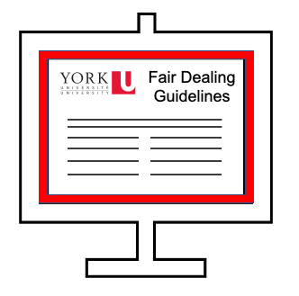
TWO MAIN ISSUES
1.
2.
Are tariffs mandatory?
Were York’s fair dealing guidelines fair?
Tariff
Notes:
The main issues revolve around whether tariffs approved by the Copyright Board are mandatory and whether the copyright fair dealing guidelines used by York University were fair.

Slide 4
COLLECTIVE LICENSING AGENCIES
The Copyright Board
Tariff
©
Notes:
Access Copyright is a collective licensing agency. If you are wondering what that means, it may be useful to watch the module on Collective Licensing Agencies and the Copyright Board for background information. In short, authors and copyright owners can choose to have licences to their works managed by copyright collectives. Access Copyright is one such collective and it manages the copying of literary works in its repertoire. Educational institutions can choose to enter into agreements with these collectives in order to cover routine copying of those works in their institutions according to formulas agreed on by both parties. When disagreements arise around the terms and conditions of a licensing agreement, the collective can apply to the Copyright Board to address the situation with a tariff. And if that doesn’t work...well you sue the other party. In Access Copyright v. York - spoiler alert - it didn’t work. At the core of the issue is differing views of how, when, and for whom the tariff (or interim tariff) is binding.

Slide 5
2010: A NEW TARIFF
If you:
Tariff
Scan
Considered ‘making a copy’ according to the proposed tariff
Print
$ 3.38
Store
$ 45
Display
Or $35 (colleges)
Send a link
Notes:
2010
In March of 2010 Access Copyright proposed a new tariff for its client universities and colleges with the Copyright Board. If approved, Access Copyright would be able to set a new standard rate in their licence agreements. The new tariff was a considerable increase over the previous agreements. They wanted to move from an agreement where institutions paid $3.38 fee per full time enrolled student with additional fees per page copied, to a proposed $45 per full time student for universities or a $35 fee for colleges, without the additional fee per page copied. For universities like York this would amount to a 1300% increase over the previous agreement. For universities like York this would mean a significant increase in fees. Beyond the massive increase in fees, the proposed tariff created other concerns for colleges and universities. Particularly this tariff intended to expand into the area of digital licensing, meaning that if you scan, print, store, display or send a link to a work this would be considered making a ‘copy.’ Additionally, the new tariff contained numerous audit, reporting, and monitoring provisions that would place new burdens on the institutions, their staff and their instructors. (D’Alton, 2012)

Slide 6
2011: THE INTERIM TARIFF
✓
WE’RE GOOD.
InterimTariff
Notes:
When licence renewal negotiations over these new terms between York University and Access Copyright started to languish, Access Copyright applied to the Copyright Board for, and was granted, an interim tariff. York briefly complied with the terms of the interim tariff but then, as many educational institutions did, “opted out.”
The educational institutions that opted out had determined that their copying could be managed through a combination of other strategies like using site licences from content vendors, open access materials, open educational resources, relying on fair dealing exceptions and transactional licences. They therefore did not need to enter into an institutional licence agreement with Access Copyright because they could manage their copyright compliance in other ways.

Slide 7
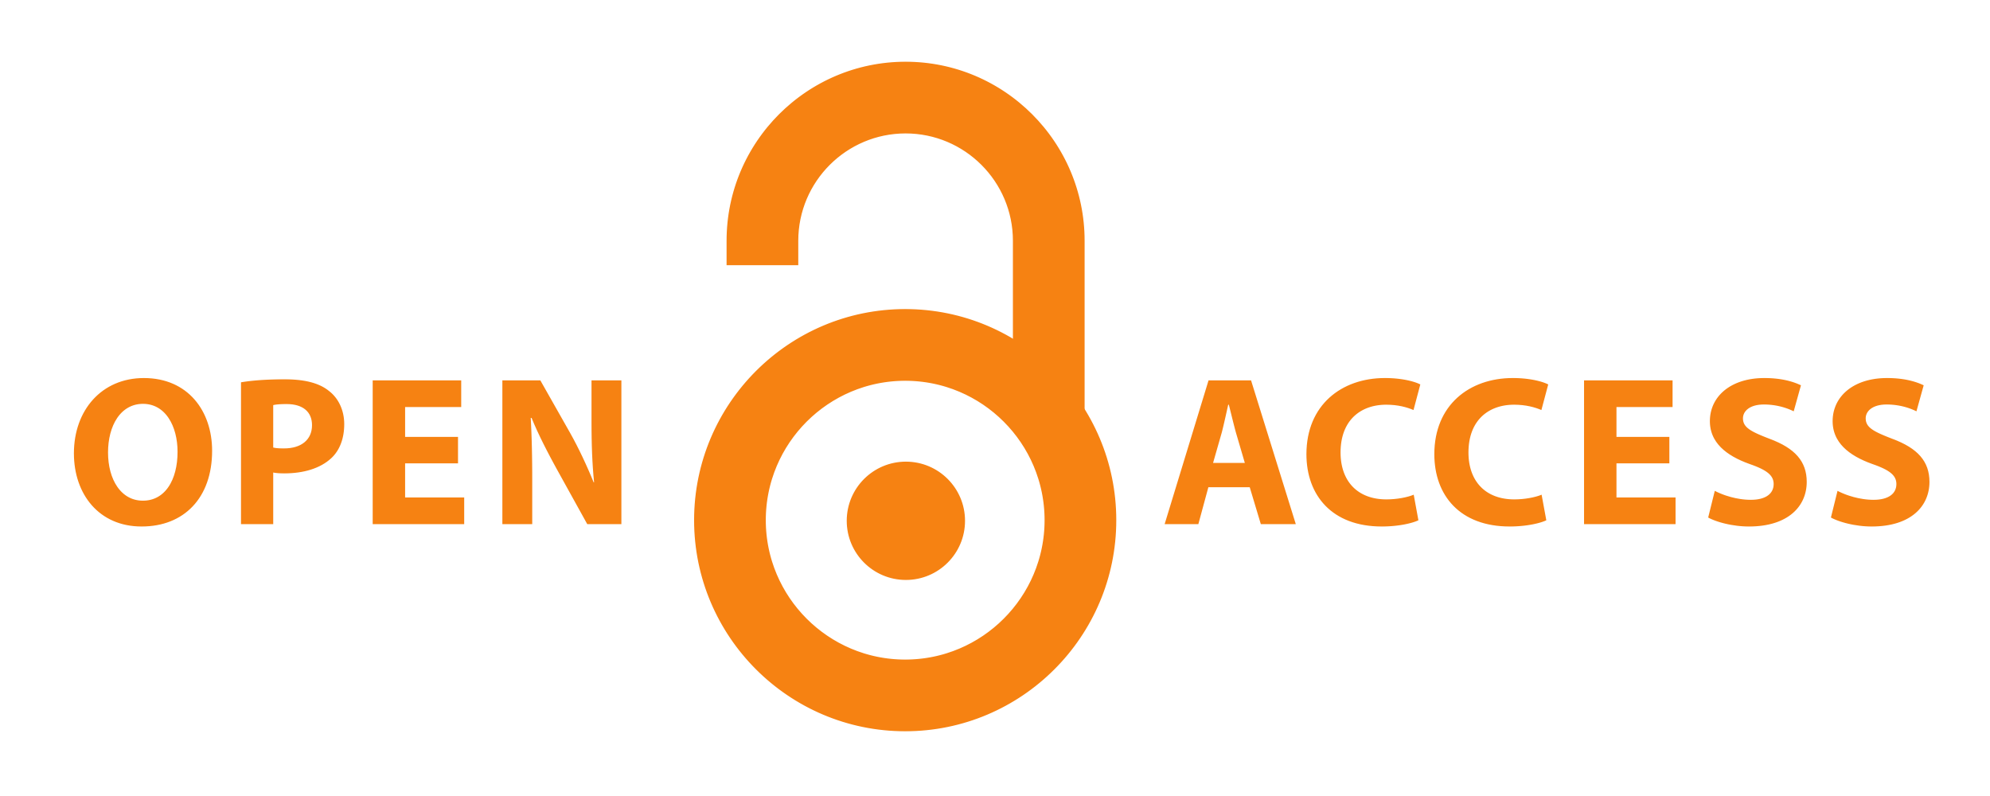
2011: OPTING OUT OF LICENCE AGREEMENTS
s. 29
Notes:
The educational institutions that opted out had determined that their copying could be managed through a combination of other strategies like using site licences from content vendors, open access materials, open educational resources, relying on fair dealing exceptions and transactional licences. They therefore did not need to enter into an institutional licence agreement with Access Copyright because they could manage their copyright compliance in other ways.

Slide 8
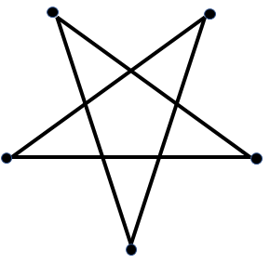
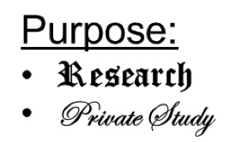
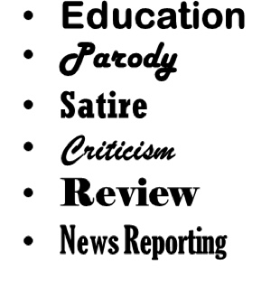
2012: THE COPYRIGHT PENTALOGY
SOCAN v. Bell
Alberta (Education) v. Access Copyright
WE’RE STILL GOOD.
Rogers v. SOCAN
Re:Sound v. MPTAC
ESAC v. SOCAN
Notes:
2012
The 2012 decisions of several Supreme Court cases around fair dealing including SOCAN v. Bell and Alberta(education) v. Access Copyright helped to clarify the fair dealing exceptions in the Act that universities were often relying on. In 2012, “Education” was also officially added as a purpose under fair dealing. This made the royalty rates proposed in the Access Copyright licence agreements since 2010 even less appealing to educational institutions, who now felt more confident that they could rely on Fair Dealing exceptions to cover their copying of portions of works in certain situations.
Which brings us to the case in question. Hopes that Access Copyright might be more cooperative with educational institutions following the decisions in 2012 were dashed

Slide 9
TRA-LA-LA-LA-LA
Notes:
Which brings us to the case in question. Hopes that Access Copyright might be more cooperative with educational institutions following the decisions in 2012 were dashed were dashed when Access Copyright sued York to enforce the terms of the interim tariff…

Slide 10
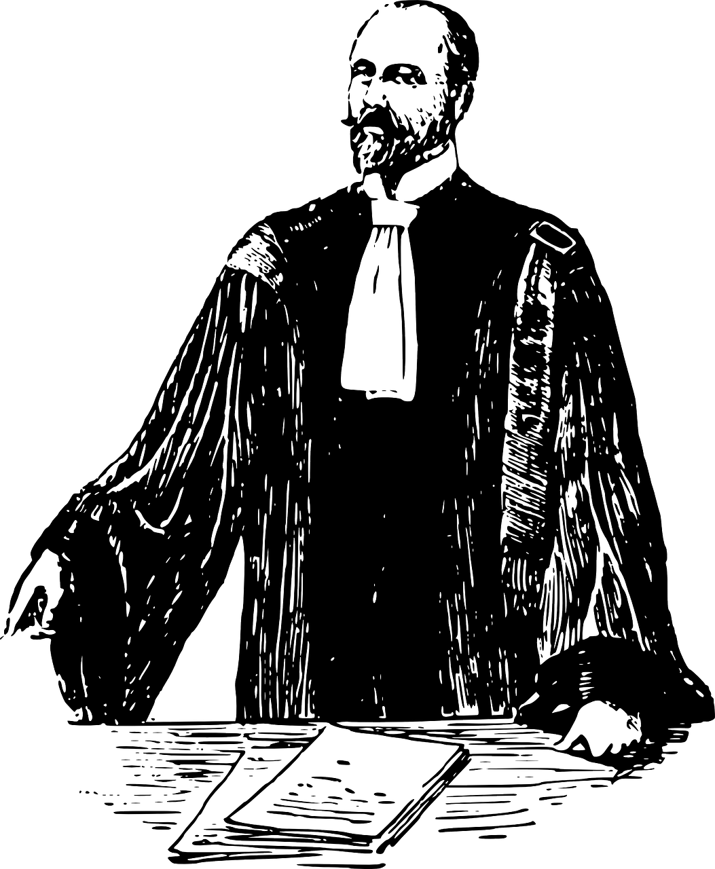
2013: ACCESS FILES THE LAWSUIT
NO INFRINGEMENT MEANS NO TARIFF!
TARIFF IS MANDATORY!
Notes:
2013
, essentially contending that the interim tariff had a mandatory effect on York and that York could not “opt out” and that if York made any infringing copy they would be responsible for the full amount of royalty payments outlined in the tariff. York countered with a request that the court declare any copying it made under its Fair Dealing Guidelines to be "fair dealing" and thus non-infringing. Therefore, York argued, even if the tariff was mandatory they had not infringed copyright.

Slide 11
TWO MAIN ISSUES
1.
2.
Are tariffs mandatory?
Were York’s fair dealing guidelines fair?
Tariff
Notes:
Therefore the two main questions in this case are:
Is the interim tariff that was issued by the copyright board mandatory? Even for institutions who are not under a licence with that collective?
And, can all copying done by York under the terms of its guidelines be considered fair dealing?

Slide 12
2017: FEDERAL COURT DECISION
Federal Court of Canada
1.
✓
Are tariffs mandatory?
2.
✘
Were York’s fair dealing guidelines fair?
Notes:
2017
The federal court decision in this case was reached in 2017 when the Federal Court of Canada delivered a complete victory in favour of Access Copyright. The court rejected York University’s approach to fair dealing and concluded that an interim tariff was in fact mandatory and enforceable against the University. Let’s break down the arguments in this first case and how the federal court came to this decision.

Slide 13
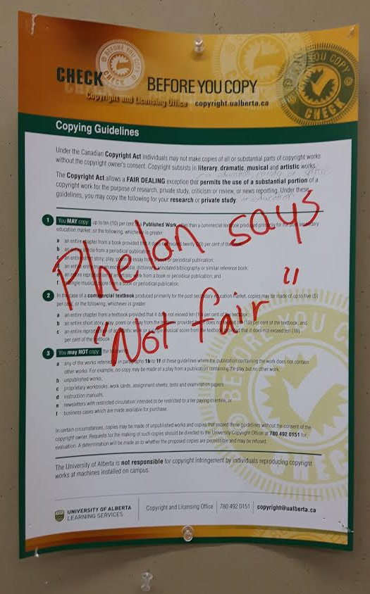
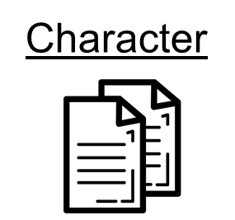
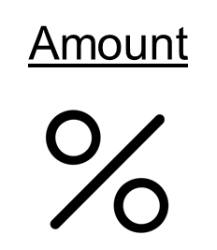
2017: FAIR DEALING DECISION
OKAY!
CONSIDER THE LIKELY IMPACTS THO.
Purpose
✘
Federal Court of Canada
✓
Notes:
Starting with the fair dealing assessment - The judge in this case, Justice Michael Phelan, found that the fair dealing guidelines outlined by York did not pass the six-factor test for assessing whether a dealing is fair.
It should be noted that the application of the six-factor test by the judge in this case has been criticised for contradicting past jurisprudence around applying the six factors. When assessing the ‘purpose of the dealing’ Justice Phelan determined that there are two ‘users’ to consider.the university and the students .*I cut here* This interpretation ignored the determination of past supreme court cases that the only relevant perspective when considering whether the dealing is for an allowable purpose is that of the end user - the students. (CCH, at paras. 48 and 64 - via Geist 2017).
While the ‘alternatives to the dealing factor’ was ruled to be more fair in favour of York *cut * Justice Phelan leaned heavily on the ‘effect of the dealing’ factor in making his final ruling. He agreed with the argument made by Access Copyright that the Court should consider all actual and likely financial impacts of the copying. In past fair dealing cases the Supreme Court had not considered ‘likely’ impacts of copying that could not be substantiated with evidence.
For these reasons, Justice Phelan sided with Access Copyright.

Slide 14
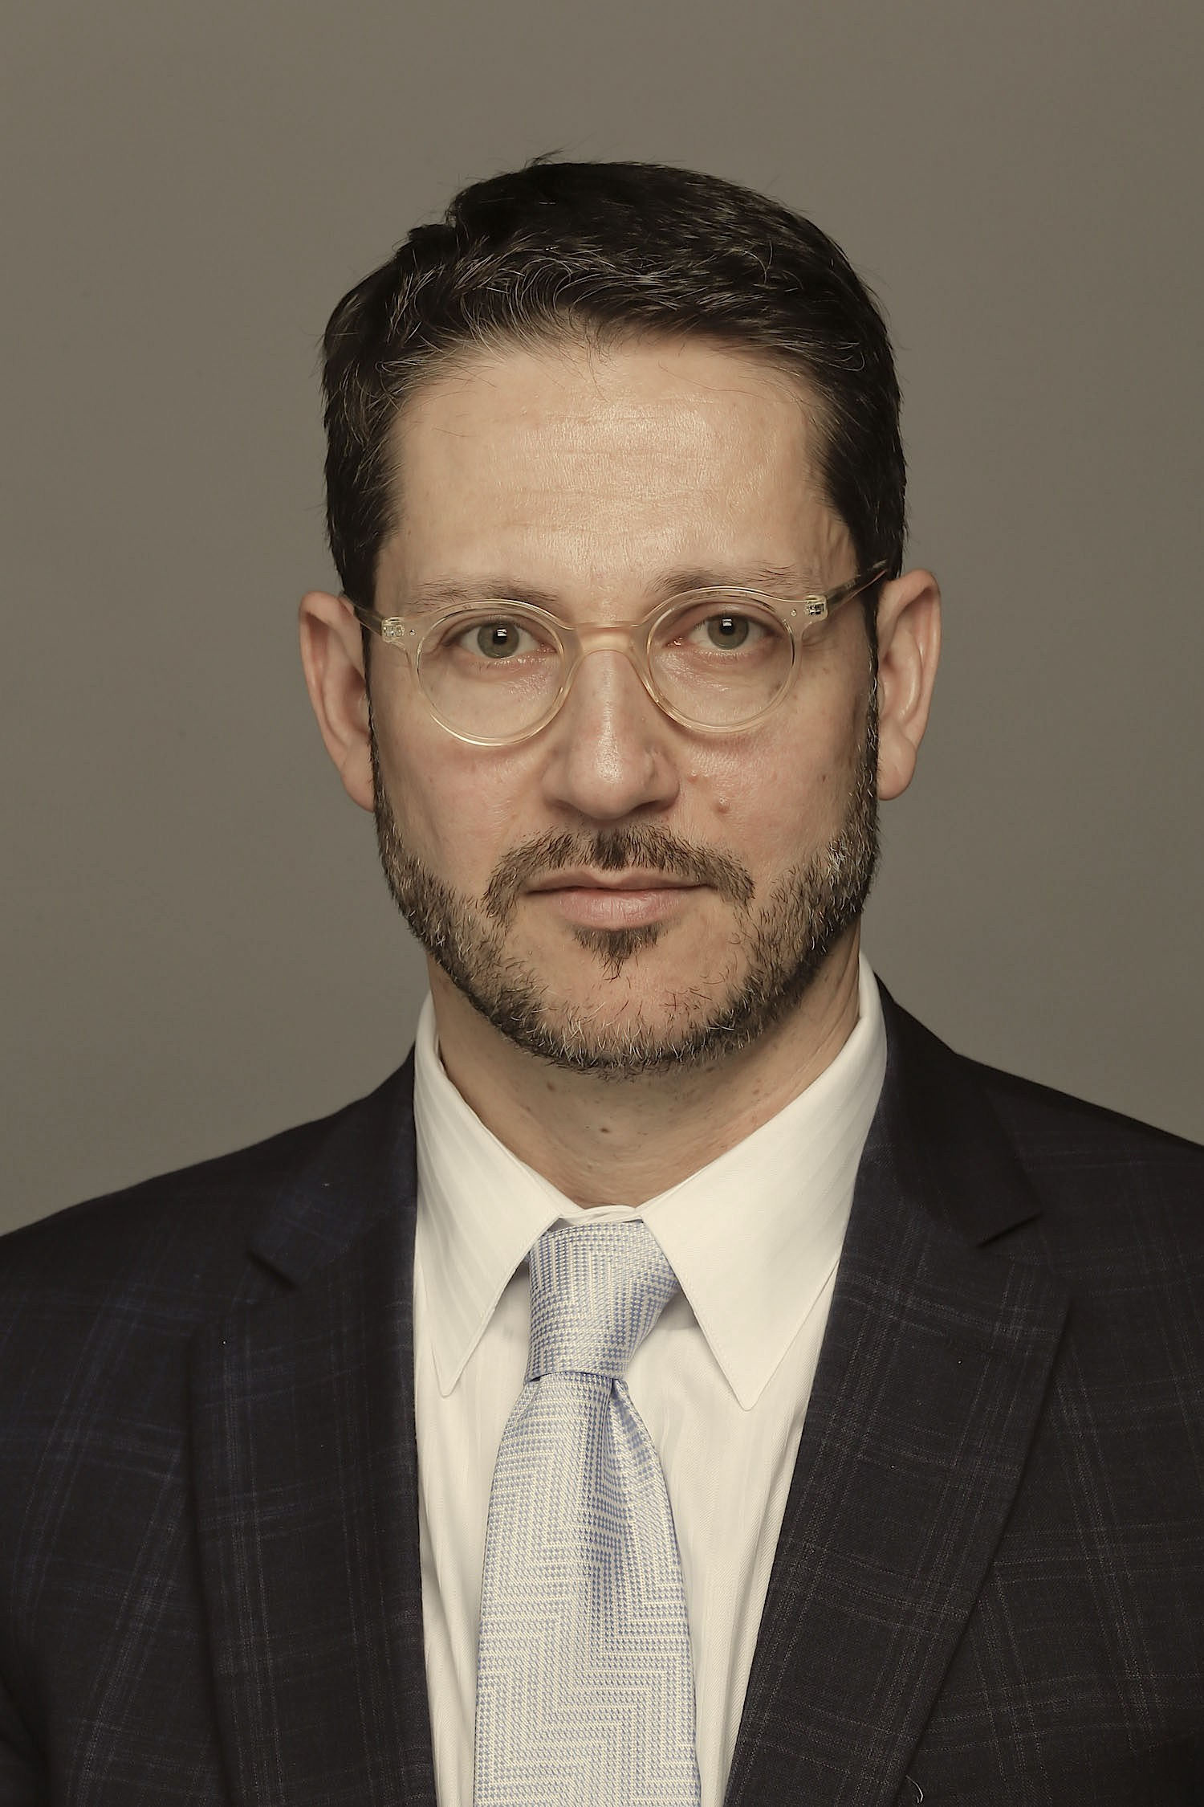
2017: MANDATORY TARIFF DECISION
‘Tariff’ = a fee that, once approved, can be included in licences
(it does not automatically apply to everyone)
‘Tariff’ = a fee that automatically applies to people or institutions. (whether or not they signed a licence agreement)
The Copyright Act doesn’t define ‘tariff.’
✓
The Act does define the nature of the particular tariffs relevant in this case.
Interim
Tariff
s. 70.13
Federal Court of Canada
Notes:
2017 - Mandatory Tariff Decision
As mentioned previously the Judge in this case sided with the collective on the other main issue as well, determining that the tariff proposed by Access should indeed be mandatory for York to pay. Both Access Copyright and the judge interpreted a ‘tariff’ as a fee that is imposed for a service and that automatically applies to anyone who does an action that falls under the agreement- whether they have agreed to that licence or not. The court also noted that the Copyright Act does not define the word ‘tariff’ and so it relied on other common definitions of the word. In responding to this decision Professor Ariel Katz pointed out that the court failed to notice that while the Act does define the word ‘tariff’ itself, it clearly defines the nature of the particular tariffs relevant in this case. Katz argued that a proposed tariff sets out the terms and conditions under which Access Copyright is able to issue licences but these terms do not automatically apply to non-licensees.
Because of criticism like this there was substantial push back following this ruling made by the Federal Court and it was no surprise that York appealed this decision on both grounds - the fairness of its guidelines and whether the tariff was mandatory.

Slide 15
2020 APPEAL: MANDATORY TARIFF DECISION
✓
Are tariffs mandatory?
“An individual cannot acquire a licence without the consent of the copyright owner and a copyright owner cannot impose financial or other terms, on a person who has not agreed to become a licensee” (para. 53-54).
Federal Court of Canada
“There is no grant of power to the Board to make or establish tariffs by regulation”(para. 149).
✘
Are tariffs mandatory?
s. 29
Federal Court of Appeal
©
Notes:
2020- Mandatory Tariffs
The Federal Court of Appeal reached its decision in the appeal of this case in April 2020. On the mandatory tariff issue, the Court overturned the decision of the court in 2017 ruling and found that tariffs are not mandatory.
The court determined that “An individual cannot acquire a licence without the consent of the copyright owner and a copyright owner cannot impose financial or other terms, on a person who has not agreed to become a licensee.(para 53-54 p.19-20) Instead, if copyright is infringed the copyright owner can choose to make an action for damages against those who are infringing on their rights.
The court went on to say that “There is no grant of power to the Board to make or establish tariffs by regulation” (para 149 p. 54).
This decision was a welcome result for the post-secondary community, as it allows institutions the freedom to choose from a range of possible approaches and licensing options to remain copyright compliant (Sheppard, 2020).

Slide 16
2020 APPEAL: FAIR DEALING DECISION
“York’s guidelines did not attempt to forestall downstream copying and redistribution by students” (para. 256).
Federal Court of Appeal
Notes:
In terms of the fair dealing aspect of the case the Federal Court of Appeal found that York did not show “that the Federal Court erred in law in its understanding of the relevant factors.” Thus the claim by York that the court had in the first decision misinterpreted fair dealing was dismissed.
The court also pointed out that, as the copier, it was incumbent on York to make sure that its guidelines were implemented according to their stated intention, but the Federal Court had found that safeguards were virtually absent and that this undermined York’s claim to fair dealing and tended to show unfairness in their copying (para 239). The court also noted that “York’s Guidelines did not attempt to forestall downstream copying and redistribution by students” (para 256). These statements by the court will likely shape the way that educational institutions develop and communicate their fair dealing policies in the future. Some have pointed out that the court’s examination of the fair dealing issue did not include a thorough historical reflection in the way that it had when it reviewed the mandatory tariff issue.

Slide 17
2020 APPEAL DECISION
✘
1.
Are tariffs mandatory?
2.
✘
Were York’s fair dealing guidelines fair?
Federal Court of Appeal
Notes:
Some have pointed out that the court’s examination of the fair dealing issue did not include a thorough historical reflection in the way that it had when it reviewed the mandatory tariff issue.

Slide 18
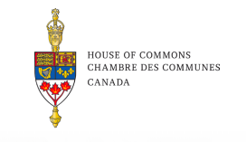
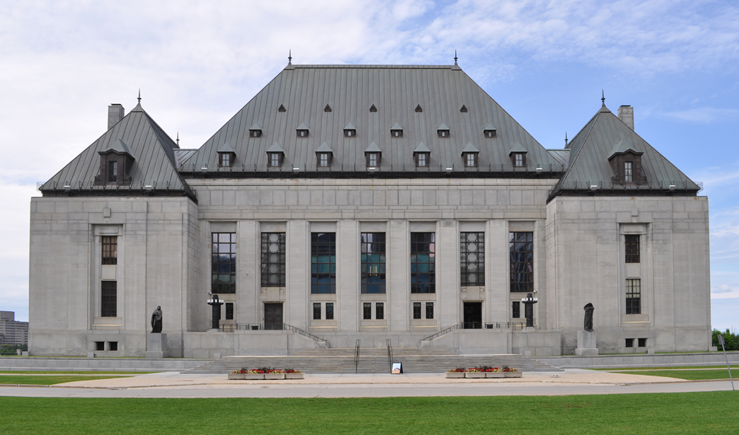
GOING FORWARD
Recommendation 16: That the Government of Canada consider establishing facilitation between the educational sector and the copyright (INDU 2019, p.65)
Notes:
Going Forward
The 2019 INDU statutory review of the Copyright Act acknowledged the ongoing tension between copyright collectives and educational institutions and suggested that in the future perhaps the government could help parties resolve their differences (INDU, 2019, p,65 ).
In June 2020 both Access Copyright and York have applied for leave to appeal with the Supreme Court. Who will ultimately emerge victorious in the Access/York debate… I guess we’ll just have to make another module.

Slide 19
LEARNING OBJECTIVES
You should now be able to:
Understand the debate around mandatory tariffs in this case and how this was interpreted by the courts
Describe how the fairness of York’s fair dealing guidelines were assessed in this case
Recognize the implications of this decision for educational institutions and collective licensing agencies
Notes:
You should now be able to:
Understand the debate around mandatory tariffs in this case and how this was interpreted by the courts
Describe how the fairness of York’s fair dealing guidelines were assessed in this case
Recognize the implications of this decision for educational institutions and collective licensing agencies

Slide 20
THANK YOU FOR YOUR ATTENTION
Notes:
This has been the University of Alberta’s Opening Up Copyright instructional module on Access Copyright v. York. Thank you for your attention.

Slide 21
QUESTIONS
In 2020 the Federal Court of Appeal overturned the mandatory tariff decision, made in 2017, when it determined that:
“There is no grant of power to the Board to make or establish tariffs by regulation.”
“Tariffs are not defined in the Copyright Act.”
“Educational institutions can rely on fair dealing so even if a tariff was mandatory York did not infringe copyright.”
“There is no reason to impose tariffs because nobody even reads anymore. These dang kids with their Netflix...”
In the 2017 decision, Justice Phelan agreed with Access Copyright that ‘tariff’ meant a fee that is imposed for a service and that it automatically applies to anyone who does an action that is outlined in the terms of the tariff agreement.
True
False
Given that the Federal Court of Appeal stated that it is incumbent on York, as the copier, to ensure that its guidelines are implemented, educational institutions should review and evaluate how they develop and communicate their fair dealing policies in the future.
True
False

Slide 22
QUESTIONS
In the 2017 decision the Federal Court of Canada controversially determined that:
York’s fair dealing guildelines did not pass the Six-factor Fair Dealing Test
When considering the Effect of The Dealing on the Work factor the court should consider actual and likely financial impacts of the copying
Both the perspective of the educational institutions and end-users (students) are relevant when considering if a dealing is for an allowable purpose under fair dealing
All of the above
The ongoing tension between copyright collectives and educational institutions led the parliamentary committee leading the last Copyright Act review to recommend:
That in the future perhaps the government could help parties resolve their differences
That more user representation should exist on the Copyright Board
That copyright collectives should really just get a life already
That the Copyright Act should include a definition of the word ‘tariff’
Fill in the year. In the 2017 decision the court found that tariffs were mandatory and that York's guidelines were not fair. In the 2020 decision the court found that tariffs were not mandatory and that York's guidelines were not fair.

Slide 23
D'Alton, L. J. (2012). A critical historical analysis of the public performance right [Doctoral dissertation, University of Western Ontario]. Electronic Thesis and Dissertation Repository. 442. Retrieved from: https://ir.lib.uwo.ca/etd/442
Geist, M. (2011). Access copyright: It’s “virtually impossible” to opt-out of tariff [blog post]. Retrieved from: https://www.michaelgeist.ca/2011/07/access-copyright-on-interim-tariff/
Geist, M. (2017) Ignoring the Supreme Court : Federal Court judge hands Access Copyright fair dealing victory [blog post]. Retrieved from: https://www.michaelgeist.ca/2017/07/ignoring-supreme-court-trial-judge-hands-access-copyright-fair-dealing-victory/ (this focuses on the weaknesses and inconsistencies of the fair dealing assessment in the initial 2017 federal court case)
Geist, M. (2020) Federal Court of Appeal deals Access Copyright huge blow as it overturns York University copyright decision [blog post]. Retrieved from: https://www.michaelgeist.ca/2020/04/federal-court-of-appeal-deals-access-copyright-huge-blow-as-it-overturns-york-university-copyright-decision/

Slide 24
House of Commons Standing Committee on Industry, Science and Technology (2019). Statutory Review of the Copyright Act. Retrieved from: https://www.ourcommons.ca/Content/Committee/421/INDU/Reports/RP10537003/indurp16/indurp16-e.pdf
Katz, A. (2017) Access Copyright v. York University: Anatomy of a Predictable but Avoidable Loss[blog post] Retrieved from: https://arielkatz.org/access-copyright-v-york-university-anatomy-predictable-avoidable-loss/
Knopf, H. (2017). Access Copyright v. York U – And All Eyes Over to York U for What's Next [blog post]. Retrieved from: https://excesscopyright.blogspot.com/2017/07/access-copyright-v-york-u-and-all-eyes_14.html
Murray, L.J., & Trosow, S. E. (2013). Canadian copyright: A citizen’s guide (2nd ed.). Between the Lines

Slide 25
Nair, M. (2020). York; some initial thoughts [blog post]. Retrieved from: https://fairduty.wordpress.com/2020/05/06/york-some-initial-thoughts/
Owens, R. C. (2017) The Court Backs Creators, Not Universities. Financial Post. Retrieved from: https://business.financialpost.com/opinion/the-court-backs-creators-not-universities_
Sheppard, A., (2020). The York appeal and fair dealing guidelines. The Quad. Retrieved from: https://blog.ualberta.ca/the-york-appeal-and-fair-dealing-guidelines-f6739fefe940 (this has a good breakdown of the fair dealing decision in the appeal)

Slide 26
Access Copyright v. York University, 2017 FCC 669 Retrieved from: https://decisions.fct-cf.gc.ca/fc-cf/decisions/en/item/232727/index.do?q=access+copyright+v+york+
York University v. Access Copyright, 2020 FCA 77 Retrieved from: https://decisions.fca-caf.gc.ca/fca-caf/decisions/en/item/469654/index.do

Slide 27
Till Teenck (n.d.). Accept Payment. The Noun Project. CC BY Retrieved from: https://thenounproject.com/tillt/collection/money-money/?i=402474
Kick(n.d.). Scales. The Noun Project. CC BY. https://thenounproject.com/search/?q=scale&i=1320645
Guilherme Fertado (n.d.). Sign. The Noun Prohect. CC BY. Retrieved from: https://thenounproject.com/search/?q=sign&i=1859815
Star and Anchor Designs (n.d.). Building. The Noun Project. Retrieved from: https://thenounproject.com/search/?q=building&i=164596
AmruID(n.d.). Account writer. The Noun Project. Retrieved from: https://thenounproject.com/search/?q=writer&i=2928435
Crosswell, Rob. (n.d.). Library. The Noun Project. CC BY. https://thenounproject.com/crosswellrob/uploads/?i=1122689
DesignNex (n.d.). Document. The Noun Project. CC BY. Retrieved from:https://thenounproject.com/search/?q=copyright&i=93928
Rockicon (n.d.) Book. The Noun Project. CC BY. Retrieved from: https://thenounproject.com/search/?q=book&i=1573145
Daria Szymonowicz (n.d.). Essay. The Noun Project. CC BY. https://thenounproject.com/search/?q=essay&i=1353220#
Gabriela Rodríguez(n.d.). Panel. The Noun Project. Retrieved from: https://thenounproject.com/search/?q=panel&i=1142582

Slide 28
Designs by MB (n.d.). Paper money. The Noun Project. CC BY. Retrieved from: https://thenounproject.com/search/?q=paper%20money&i=3360185
Tatyana RU (n.d.). Question Mark and Exclamation Mark. The Noun Project. CC BY. https://thenounproject.com/tanyasolo1986/uploads/?i=2460596
Rawpixel. (n.d.). [Isabelle]. Pixabay. https://pixabay.com/illustrations/cartoon-casual-character-drawing-3685566/
InspectorJ (2017). Violin Glissendo Ascending. Freesound. CC BY. Retrieved from: https://freesound.org/people/InspectorJ/sounds/411728/
Jake Dunham (n.d.). All seeing eye. The Noun Project. CC BY. Retrieved from: https://thenounproject.com/search/?q=all%20seeing%20eye&i=913953
Aliwijaya (n.d.). Weight. The Noun Project. CC BY. Retrieved from: https://thenounproject.com/search/?q=weight&i=1274253
https://thenounproject.com/search/?q=content%20management&i=1575870
”Logo York University” (2015). Wikimedia Commons. Public Domain. Retrieved from: https://en.wikipedia.org/wiki/York_University#/media/File:Logo_York_University.svg
Vector Market (n.d.). Content sharing. The Noun Project. CC BY. Retrieved from: https://thenounproject.com/search/?q=content%20management&i=1575870
Edwin PM (n.d.). Agreement. The Noun Project. CC BY Retrieved from: https://thenounproject.com/search/?q=agreement%20company&i=3373812

Slide 29
onathasmello (2012) Global Open Educational Resources Logo. Wikimedia Commons. CC BY. Retrieved from: https://commons.wikimedia.org/wiki/File:Global_Open_Educational_Resources_Logo.svg
Alexkandrel (2012). Royal sparkle woosh left to right. Freesound. CC0. https://freesound.org/people/alexkandrell/sounds/170522/
OpenClipart-Vectors (n.d.). [Fairy-tale land]. Pixabay. Retrieved from: https://pixabay.com/vectors/castle-chateau-landscape-147413/
OpenClipart-Vectors (n.d.). [bird]. Pixabay. Retrieved from: https://pixabay.com/vectors/aves-birds-flying-colors-sparrows-148952/
Czarcasis (2015). Shattering glass. Freesound. CC BY. Retrieved by: https://freesound.org/people/Czarcazas/sounds/330800/
Clker-Free-Vector-Images (n.d.). [Lawyer]. Pixabay. Retrieved from: https://pixabay.com/vectors/lawyer-attorney-barrister-judge-28838/
Federal Court. (n.d.). [Federal Court Coat of Arms]. Federal Court: https://www.fct-cf.gc.ca/Content/img/base/newCOA.jpg
Тимур Минвалеев, RU. (n.d.). Percent. The Noun Project. CC BY. Retrieved from: https://thenounproject.com/search/?q=percent&i=397874
ATOM, TH. (n.d.). Copy. The Noun Project. CC BY. Retrieved from: https://thenounproject.com/search/?q=copy&i=1474212

Slide 30
Farais, B, CL. (n.d.). Decision. The Noun Project. CC BY. Retrieved from: https://thenounproject.com/search/?q=alternatives&i=1074053
AFY Studio, ID. (n.d.). Leaf. The Noun Project. CC BY. Retrieved from: https://thenounproject.com/AFYstudio/uploads/?i=1737325
Cresnar, Gregor. (n.d.). Dollar sign. The Noun Project. CC BY. Retrieved from: https://thenounproject.com/search/?q=dollar%20sign&i=171145
[Photo of Ariel Katz] CC BY SA. Retrieved from: https://arielkatz.org/about
“Official rendition of the coat of arms of Canada”. Wikimedia Commons. Converted to svg by Zscout370.Crown Copyright. Fair Use TM. Retrieved from: https://en.wikipedia.org/wiki/Arms_of_Canada#/media/File:Coat_of_arms_of_Canada.svg
Dig deeper. (2017). [Supreme Court of Canada]. Wikimedia Commons. CC BY 4.0. https://commons.wikimedia.org/wiki/File:Supreme_court_of_Canada_in_summer.jpg
Closing Slides Music: Rybak, Nazar. “Corporate Inspired.” HookSounds. N.d. http://www.hooksounds.com (used under a CC-BY 4.0 Licence)
Unattributed materials are contributions from the Opening Up Copyright Project Team and placed in the Public Domain

Slide 31
University of Alberta. 2020. “Access Copyright v. York.” Opening Up Copyright Instructional Module. https://sites.library.ualberta.ca/copyright/

