Slide 1
Non-Operative
Full Thickness Rotator Cuff Tear
Fellow: Dr Simon Grange
Preceptor: Dr Richard Boorman
Advisor: Kristie Moore
Sport Medicine Clinic, University of Calgary
Alberta Bone and Joint Health Institute
McCaig Institute
Rotator Cuff, Full Thickness Tear, Rehabilitation

Slide 2

Identification of Favourable Prognostic Factors
For Non-Operative Management of Full Thickness Rotator Cuff Tears
Grange SAW^{1, 2, 3}, Moore K¹, Boorman RS¹
[1] Sport Medicine Clinic, University of Calgary
[2] Alberta Bone and Joint Health Institute
[3] Faculty of Rehabilitation Medicine, University of Alberta

Slide 3




Funding & Acknowledgements
The work has been funded through;
  Sport Medicine Clinic (UoC)
  Alberta Bone and Joint Health Institute (ABJHI)
Explore the potential for formalizing non-operative therapeutic approaches as part of a holistic approach to musculoskeletal care
Future work will be supported as part of the Calgary Orthopaedic Research and Education Fund (COREF)

Slide 4
Level of Evidence
This study is rated as level III
Therapeutic study
Retrospective analysis of a matched cohort
  O R_{T}
  O R_{C}
 | Therapeutic Intervention (R_{T}) | Control Group (R_{C})
Non-Operative | Outcome | Outcome
Operative | Outcome | Outcome
 | Therapeutic Intervention (R_{T}) | Control Group (R_{C})
Non-Operative | Outcome | Outcome
Operative | Outcome | Outcome
 | Therapeutic Intervention (R_{T}) | Control Group (R_{C})
Non-Operative | Outcome | Outcome
Operative | Outcome | Outcome
To identify who is likely to benefit from Non-operative measures
To identify who is NOT likely to benefit from Non-operative measures

Slide 5
Background

Slide 6
Background
Main indications for surgical intervention when treating full thickness rotator cuff tears;
  Relief of pain
  Restoration of function
Previous studies investigated the role of conservative measures
This study explores non-operative management as an alternative to surgery
Multiple regression analysis of retrospective data to identify factors affecting the likelihood of success

Slide 7
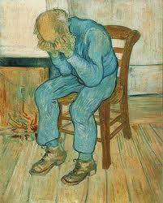
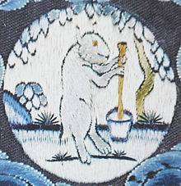
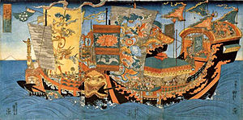
The Time is always NOW
By 2025;
  UK doubling the over 80 population
  10% have dementia
By 2050;
  UK may go bankrupt
  Health Economic Efficiency will decide
Van Gogh
1890
White Hare is
on the moon is making
elixir of immortality
Xu Fu's first expedition to the Mount of the immortals. 650 AD

Slide 8
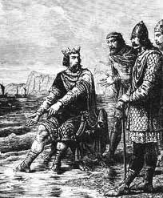
Turning back the tide
King Cnut (Canute)
Danish King of England
1032

Slide 9
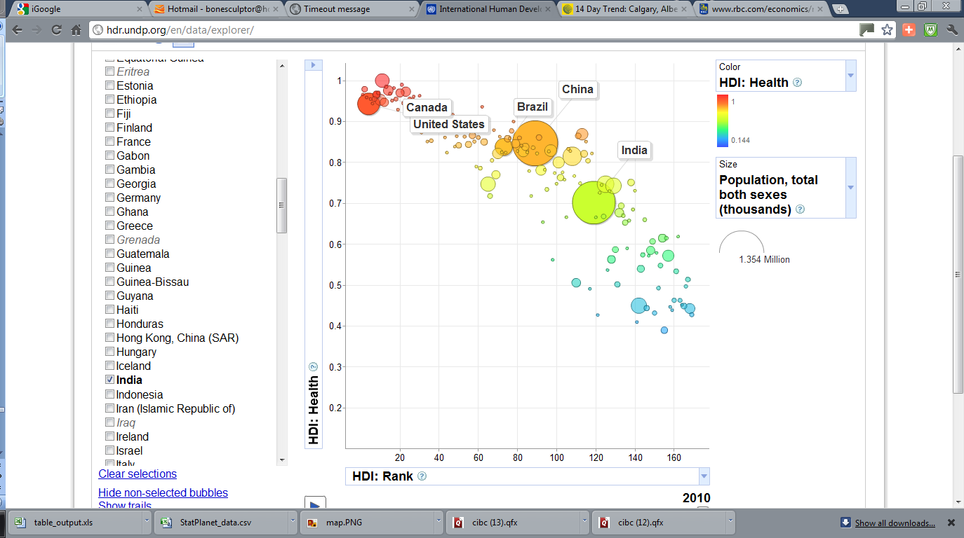
The World is flattening out

Slide 10
Methodology

Slide 11
Methods
Subjects were drawn from the population of subjects attending;
  University of Calgary (UoC)
  Sport & Exercise Medicine Clinic (SMC)
Managed using;
  UoC Non-operative
  Rotator Cuff
  Home Rehabilitation Program

Slide 12
Stretching
Strength

Slide 13
Strength

Slide 14
Results

Slide 15
Results
The non-operative management group had mean scores comparable to the operative management group at 2 years (p=0.05)
Significant reduction in the incidence of pain following rehabilitation compared with the operative group (n=159)

Slide 16
Continuous Variables Considered
Variable | Range | Mean | SD
Age | 33 – 85 | 58.5 | 9.8
Full External Range of Motion (ROM) | 30 – 180 | 157 | 25.9
RCQOL | 0 – 100 | 41.54
Size of Tear (mm) | 5 – 60 | 18.5 | 11.3
Duration Symptoms (months) | 3 – 180 | 23.1 | 29.9
http://www.bjjprocs.boneandjoint.org.uk/content/93-B/SUPP_IV/570.5.abstract for Rotator Cuff Quality of Life score (RCQOL) information

Slide 17
Discrete Variables Considered
Variable | Value | No. | Value | No.
Onset | Acute | 83 | Insidious | 72
External Rotation Strength | Full | 114 | Less than full | 41
Smoker | Yes | 17 | No | 131
Dominant Side Involved | Yes | 109 | No | 46

Slide 18
Comparison Between
Two Groups of Subjects
‘Successful’ and ‘Failed’ non-operative therapy
for full thickness rotator cuff tears

Slide 19
Univariate Models
Non-Op Retrospective Regression Analysis

Slide 20
 | Successful (n=77) # (SD) | Failed (n = 78) # (SD) | Sig *<0.25
Age (years) | 59.96 (9.9) | 57.15 (9.6) | 0.077*
range | 33 - 85 | 40 - 80
FE ROM (degrees) | 160 (20) | 154 (30) | 0.144*
range | 90 - 180 | 30 -180
RCQOL (/100) | 47.8 (22.2) | 35.4 (18.8) | 0.000*
range | 0 - 90 | 0.46 - 82
Duration Symptoms (months) | 27 (32) | 19 (28) | 0.109*
range | 4 - 180 | 3 - 180
Size of Tear (mm) | 15.4 (7.3) | 21.7 (13.6) | 0.007*
range | 5 to 50 | 5 to 60
Gender Male | 46 (60%) | 42 (54%) | 0.459
Female | 31 (40%) | 36 (46%)

Slide 21
 | Successful (n = 77) # (SD) | Failed (n = 78) # (SD) | Sig *<0.25
Age (years) | 59.96 (9.9) | 57.15 (9.6) | 0.077*
range | 33 - 85 | 40 - 80
FE ROM (degrees) | 160 (20) | 154 (30) | 0.144*
range | 90 - 180 | 30 -180
RCQOL (/100) | 47.8 (22.2) | 35.4 (18.8) | 0.000*
range | 0 - 90 | 0.46 - 82
Duration Symptoms (months) | 27 (32) | 19 (28) | 0.109*
range | 4 - 180 | 3 - 180
Size of Tear (mm) | 15.4 (7.3) | 21.7 (13.6) | 0.007*
range | 5 to 50 | 5 to 60
Gender
Male | 46 (60%) | 42 (54%) | 0.459
Female | 31 (40%) | 36 (46%)

Slide 22
 | Successful (n=77) # (SD) | Failed (n = 78) # (SD) | Sig *<0.25
ER Strength
Full | 29 (38%) | 12 (15%) | 0.002*
Less than full | 48 (62%) | 66 (85%)
Dominant Side Involved |  |  | 0.177*
yes | 58 (75%) | 51 (65%)
no | 19 (25%) | 27 (35%)
Onset |  |  | 0.093*
acute | 36 (47%) | 47 (60%)
insidious | 41 (53%) | 31 (40%)
Smoker |  |  | 0.889
yes | 8 (11%) | 9 (12%)
no | 64 (89%) | 67 (88%)

Slide 23
Bivariate Models
Non-Op Retrospective Regression Analysis (I)

Slide 24
 | 2LL | Nag R² | P | Exp(B) | 95%CI lower | 95% CI upper
RCQOL + AGE | 198 | 0.14
RCQOL |  |  | 0.000 | 1.031 | 1.013 | 1.048
AGE |  |  | 0.064 | 1.033 | 0.998 | 1.069
RCQOL + Onset | 197 | 0.14
RCQOL |  |  | 0.000 | 1.031 | 1.014 | 1.049
Onset |  |  | 0.055 | 1.934 | 0.986 | 3.794
RCQOL + Full ER St | 194 | 0.17
RCOQL |  |  | 0.002 | 1.028 | 1.010 | 1.045
ER st |  |  | 0.008 | 0.341 | 0.154 | 0.754
RCQOL + Tear Size | 141 | 0.153
RCQOL |  |  | 0.051 | 1.018 | 1.000 | 1.037
Tear Size (mm) |  |  | 0.007 | 0.939 | 0.897 | 0.983
Variables included were p<0.1 in univariate analyses

Slide 25
 | 2LL | Nag R² | P | Exp(B) | 95%CI lower | 95% CI upper
Age + Onset | 210 | 0.042
Age |  |  | 0.148 | 1.025 | 0.991 | 1.060
Onset |  |  | 0.184 | 0.642 | 0.333 | 1.235
Age + Full ER st | 200 | 0.122
Age |  |  | 0.033 | 1.039 | 1.003 | 1.075
ER st |  |  | 0.001 | 0.268 | 0.121 | 0.590
Age + Tear Size | 144 | 0.131
Age |  |  | 0.170 | 1.028 | 0.988 | 1.069
Tear Size (mm) |  |  | 0.005 | 0.937 | 0.896 | 0.981
Variables included were p<0.1 in univariate analyses

Slide 26
 | "-2LL | Nag R² | P | Exp(B) | 95%CI lower | 95% CI upper
Onset + Full ER st | 201 | 0.111
Onset |  |  | 0.067 | 0.538 | 0.277 | 1.044
ER strength |  |  | 0.002 | 0.287 | 0.131 | 0.626
Onset + Tear Size | 144 | 0.132
Onset |  |  | 0.157 | 0.568 | 0.260 | 1.243
Tear Size (mm) |  |  | 0.007 | 0.943 | 0.903 | 0.984
Full ER St + Tear Size | 143 | 0.138
ER strength |  |  | 0.111 | 0.491 | 0.204 | 1.179
Tear Size (mm) |  |  | 0.010 | 0.943 | 0.902 | 0.986
Variables included were p<0.1 in univariate analyses

Slide 27
Bivariate Models
Non-Op Retrospective
Regression Analysis (2)

Slide 28
 | 2LL | Nag R² | P | Exp(B) | 95%CI lower | 95% CI upper
RCQOL + AGE | 198 | 0.14
RCQOL |  |  | 0.000 | 1.031 | 1.013 | 1.048
AGE |  |  | 0.064 | 1.033 | 0.998 | 1.069
RCQOL + Onset | 197 | 0.14
RCQOL |  |  | 0.000 | 1.031 | 1.014 | 1.049
Onset |  |  | 0.055 | 1.934 | 0.986 | 3.794
RCQOL + Full ER St | 194 | 0.17
RCOQL |  |  | 0.002 | 1.028 | 1.010 | 1.045
ER strength |  |  | 0.008 | 0.341 | 0.154 | 0.754
RCQOL + Tear Size | 141 | 0.153
RCQOL |  |  | 0.051 | 1.018 | 1.000 | 1.037
Tear Size (mm) |  |  | 0.007 | 0.939 | 0.897 | 0.983
Variables included were p<0.1 in univariate analyses

Slide 29
 | 2LL | Nag R² | P | Exp(B) | 95%CI lower | 95% CI upper
Age + Onset | 210 | 0.042
Age |  |  | 0.148 | 1.025 | 0.991 | 1.060
Onset |  |  | 0.184 | 0.642 | 0.333 | 1.235
Age + Full ER st | 200 | 0.122
Age |  |  | 0.033 | 1.039 | 1.003 | 1.075
ER st |  |  | 0.001 | 0.268 | 0.121 | 0.590
Age + Tear Size | 144 | 0.131
Age |  |  | 0.170 | 1.028 | 0.988 | 1.069
Tear Size (mm) |  |  | 0.005 | 0.937 | 0.896 | 0.981
Variables included were p<0.1 in univariate analyses

Slide 30
 | 2LL | Nag R² | P | Exp(B) | 95%CI lower | 95% CI upper
Onset + Full ER st | 201 | 0.111
Onset |  |  | 0.067 | 0.538 | 0.277 | 1.044
ER st |  |  | 0.002 | 0.287 | 0.131 | 0.626
Onset + Tear Size | 144 | 0.132
Onset |  |  | 0.157 | 0.568 | 0.260 | 1.243
Tear Size (mm) |  |  | 0.007 | 0.943 | 0.903 | 0.984
Full ER St + Tear Size | 143 | 0.138
ER st |  |  | 0.111 | 0.491 | 0.204 | 1.179
Tear Size (mm) |  |  | 0.010 | 0.943 | 0.902 | 0.986
Variables included were p<0.1 in univariate analyses

Slide 31
Discussion

Slide 32
Discussion
The non-operative management of small to medium rotator cuff tears offers a viable alternative to the operative path within a selected cohort of subjects
The findings are important for clinicians and subjects
Faster, well structured rehabilitation philosophy;
  Returning subjects to good functional activity without the need for surgical reconstruction
  Validation will be by applying this model to a prospective cohort of subjects

Slide 33
Conclusion I
Identifying risk factors through multivariate retrospective analysis of outcomes
Creates a framework for a prospective study
  Evaluation of non-operative treatment of full thickness rotator cuff tears
Validates this approach
  Appropriate way to steer the future management of rotator cuff pathology
  Ongoing Prospective trial now established
  Results anticipated in 2013

Slide 34
Conclusion II
Key factors for accommodating the high burden of disease;
  R_{T} O Identifies subjects likely to benefit from
  non-operative management
  Treat these in a cost effective manner
Avoid delaying the surgery for those who can be confidently predicted to fail conservative measures
  R_{T} O Identifies subjects likely to benefit from operative management
The non-operative management technique influences the subjects’ outcomes
Key criteria can be identified to better target such rehabilitation management

Slide 35
Conclusion III
Application of an already validated rehabilitation approach
Confirms association with a well-defined subject population
Successful results for non-operative intervention can be demonstrated for a selective group of subjects
  Rotator cuff tears of less than 1cm in size
  Patient under 55 years of age
  Dominant shoulder
  High RCQOL score (over 50/100) at presentation

Slide 36
Conclusion IV
Application to other populations is possible
  Prospective trial already underway
Foundation for validation and adoption of the technique
  Retrospective matched cohort leads to a prospective study
  O R_{T} O O
  O R_{C} O O
Possible to provide appropriate training programmes
  Customised to the individual
Appropriate feedback to monitor progress
  Integrate the rehabilitation approach with the conventional orthopaedic management

Slide 37
References I
(1) Morrison DS et al. Non-operative treatment of subacromial impingement syndrome. J Bone Joint Surg Am. 79[5], 732-737. 2011.
(2) Coghlan Jennifer et al. Surgery for rotator cuff disease. The Cochrane Library 1. 2008.
(3) Tashjian RZ, Deloach J, Porucznik CA, Powell AP. Minimal clinically important differences (MCID) andápatient acceptable symptomatic state (PASS) forávisual analog scales (VAS) measuring pain in patientsátreated for rotator cuff disease. Journal of Shoulder and Elbow Surgery 2011 Nov;18(6):927-32.
(4) AAOS Clinical Practice Guidelines Unit. AAOS Guideline on Optimizing the Management of Rotator Cuff Problems. 2012.
(5) Gerald R.WilliamsJr. M, Charles A.RockwoodJr. M, Louis U.Bigliani M, Joseph P.Iannotti MP, Walter Stanwood M. Rotator Cuff Tears: Why Do We Repair Them? J Bone Joint Surg Am. 86[12], 2764-2776. 1-12-2004.
(6) DALTON SE. THE CONSERVATIVE MANAGEMENT OF ROTATOR CUFF DISORDERS. Rheumatology 1994 Jul 1;33(7):663-7.
(7) Bj+Ârnsson HC, Norlin R, Johansson K, Adolfsson LE. The influence of age, delay of repair, and tendon involvement in acute rotator cuff tears. Acta Orthop 2011 Mar 24;82(2):187-92.
(8) Burkhart SS, Danaceau SM, Pearce CE. Arthroscopic rotator cuff repair: Analysis of results by tear size and by repair technique-margin convergence versus direct tendon-to-bone repair. Arthroscopy: The Journal of Arthroscopic & Related Surgery 2001 Dec;17(9):905-12.
(9) Burkhart SS, Lo IKY. Arthroscopic Rotator Cuff Repair. J Am Acad Orthop Surg 2006 Jun 1;14(6):333-46.
(10) Yamaguchi K. Mini-open rotator cuff repair: an updated perspective. Instr Course Lect. 50, 53-61. 2001.
(11) Churchill RS, Ghorai JK. Total cost and operating room time comparison of rotator cuff repair techniques at low, intermediate, and high volume centers: Mini-open versus all-arthroscopic. Journal of Shoulder and Elbow Surgery 2010 Jul;19(5):716-21.
(12) Severud EL, Ruotolo C, Abbott DD, Nottage WM. All-arthroscopic versus mini-open rotator cuff repair: A long-term retrospective outcome comparison. Arthroscopy: The Journal of Arthroscopic & Related Surgery 2003 Mar;19(3):234-8.
(13) Fukuda H. THE MANAGEMENT OF PARTIAL-THICKNESS TEARS OF THE ROTATOR CUFF. J Bone Joint Surg Br 2003 Jan 1;85-B(1):3-11.

Slide 38
References II
(14) Teefey SA et al. Detection and quantification of rotator cuff tears. Comparison of ultrasonographic, magnetic resonance imaging, and arthroscopic findings in seventy-one consecutive cases. J Bone Joint Surg Am. 86-A[4], 708-716. 2004.
(15) Iannotti JP et al. Accuracy of office-based ultrasonography of the shoulder for the diagnosis of rotator cuff tears. J Bone Joint Surg Am. 87[6], 1305-1311. 2005.
(16) Reinus WR, Shady KL, Mirowitz SA, Totty WG. MR diagnosis of rotator cuff tears of the shoulder: value of using T2- weighted fat-saturated images. Am J Roentgenol 1995 Jun 1;164(6):1451-5.
(17) Walz D, Miller T, Chen S, Hofman J. MR imaging of delamination tears of the rotator cuff tendons. Skeletal Radiology 2007 May 1;36(5):411-6.
(18) Maman E et al. Outcome of nonoperative treatment of symptomatic rotator cuff tears monitored by magnetic resonance imaging. J Bone Joint Surg Am. 91[8], 1898-1906. 2009.
(19) Gladstone JN, Bishop JY, Lo IKY, Flatow EL. Fatty Infiltration and Atrophy of the Rotator Cuff Do Not Improve After Rotator Cuff Repair and Correlate With Poor Functional Outcome. The American Journal of Sports Medicine 2007 May 1;35(5):719-28.
(20) Kandemir U, Allaire R, Debski R, Lee T, McMahon P. Quantification of rotator cuff tear geometry: the repair ratio as a guide for surgical repair in crescent and U-shaped tears. Archives of Orthopaedic and Trauma Surgery 2010 Mar 1;130(3):369-73.
(21) Jain NB, Pietrobon R, Guller U, Ahluwalia AS, Higgins LD. Influence of provider volume on length of stay, operating room time, and discharge status for rotator cuff repair. Journal of Shoulder and Elbow Surgery 2007 Jul;14(4):407-13.
(22) Zingg PO et al. Clinical and structural outcomes of nonoperative management of massive rotator cuff tears. J Bone Joint Surg Am. 89[9], 1928-1934. 2007.
(23) More KD, Boorman RS, Bryant D, Mohtadi NG, Wiley P, Brett K. PREDICTING PATIENT OUTCOME OF NON-OPERATIVE TREATMENT FOR A CHRONIC ROTATOR CUFF TEAR. Journal of Bone & Joint Surgery, British Volume 2011 Nov 1;93-B(SUPP IV):570.
(24) Rawlings JO, Pantula SG, Dickey DAe. Applied Regression Analysis. Springer; 1998.
(25) Oh JH, Kim SH, Ji HM, Jo KH, Bin SW, Gong HS. Prognostic Factors Affecting Anatomic Outcome of Rotator Cuff Repair and Correlation With Functional Outcome. Arthroscopy: The Journal of Arthroscopic & Related Surgery 2009 Jan;25(1):30-9.

Slide 39

Thank you
This presentation
Questions?
Please contact us for more information: grange@ualberta.ca Or visit our website at;
http://www.sandbox.ualberta.ca/
where there are links to people, projects and ways that you can
join our collaborations and view our publications

Slide 40
Additional Slides
ICE

Slide 41
Associated Research Programs
Tissue Engineering Program
  Previously TE operational research leader for National Inst.
Sports Medicine / Shoulder
  Rotator cuff tear
Rehabilitation
  Neuroprostheses
MSK Informatics
  Global MSK Network / Virtual Research Environments
Education
  Virtual Learning Environments / MSK Course Convenor (MSc)

Slide 42
Research Program
Building the GBJ and Campus Alberta Concepts
Clinical Fellows
  Clinically oriented research assistants
Virtual Research Environments
  Building research tools for support of TR teams
  Robotics Sandbox
  Our Global Net

Slide 43
Epistemology
How do we know what we know?
ἐπιστήμη (epistēmē) = "knowledge, science”
λόγος (logos), = "study of”
Philosophy concerned with the nature and scope (limitations) of knowledge

Slide 44
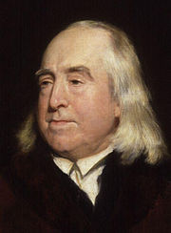
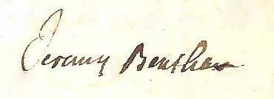
Jeremy Bentham
"fundamental axiom,
it is the greatest happiness of the greatest number that is the measure of right and wrong"

Slide 45
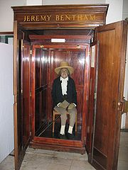
Bentham
Nature has placed mankind under the governance of two sovereign masters, pain and pleasure.
It is for them alone to point out what we ought to do, as well as to determine what we shall do. On the one hand the standard of right and wrong, on the other the chain of causes and effects, are fastened to their throne.
They govern us in all we do, in all we say, in all we think …
The Principles of Morals and Legislation. p. 1. (Chapter I) (1789)

Slide 46
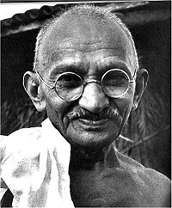

Gandhi
‘The things that will destroy us are;
politics without principles
pleasure without conscience
wealth without work
knowledge without wisdom
business without morality
science without humanity
and worship without sacrifice’

Slide 47
It is all Information Management
One’s and Nought's

Slide 48
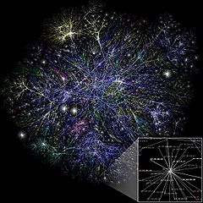
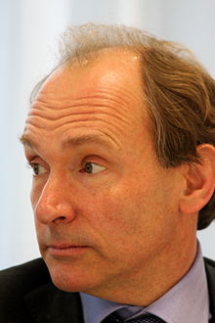
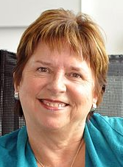
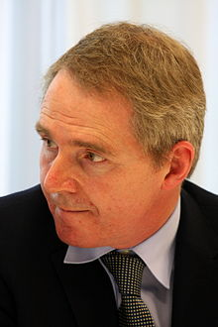
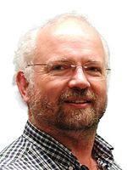

Cloud, Information Visualisation and the Wikinomics of Sharing
Nodes
matter

Slide 49
The Rules of Governance are Changing
The strategic domain is policy formation
Building on the impact of
  UK Comprehensive Research Network
  EU Directives
Focus on regulation for cell therapies in musculoskeletal science
  Advanced Therapeutic Medicinal Products (ATMP)
    Category of research products

Slide 50
Integration and Collaboration
Ensure Regulatory Compliance
Technology Research and Development plans
  Develop in close association between tissue engineering and treating clinicians
More stringent
  Interventions offered to treat conditions carry unpredictable side effects
    Novel therapeutic vectors
  Clinical relevance relates to the obligations to
    Ensure the best protection for subjects vs.
    Encourage the development of the field
  Evidence supports the concept of e-Governance

Slide 51
Translational Research
Conducting scientific research to make the results applicable to the population under study
Natural and biological, behavioural, and social sciences

Slide 52
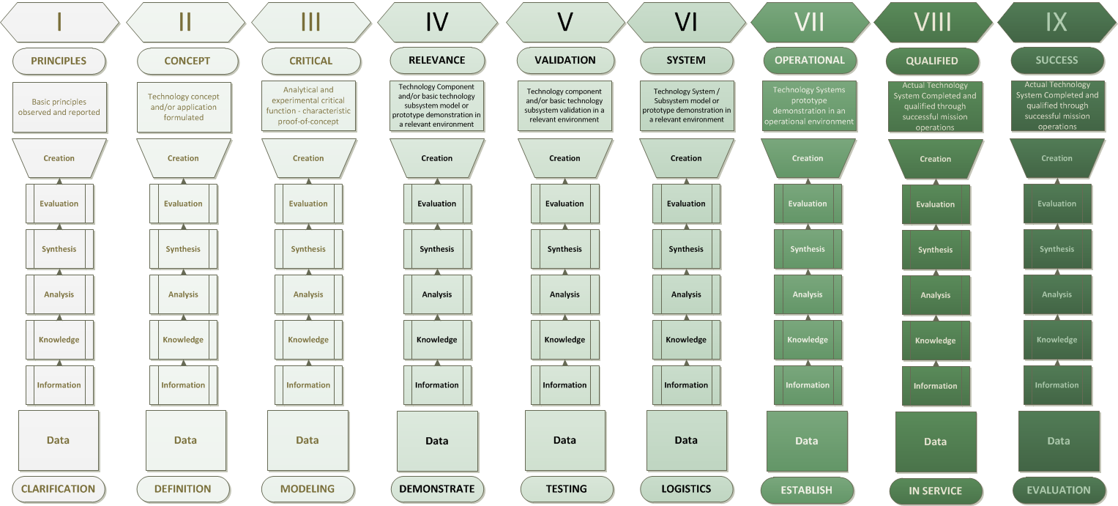
Translational Research
Return on Investment
  Don’t forget contextualisation
  Nature’s imperative (TRL-LS matrix)

Slide 53
Ecosystem
Knowledge-driven
  Constituents
    Generate, contribute, manage and analyze data across the landscape
  Feedback loops
    Accelerate translation of data into useful knowledge
  Collaboration
    Data sharing, data integration and standards are integral
  Seamlessly integrate and structure these data

Slide 54
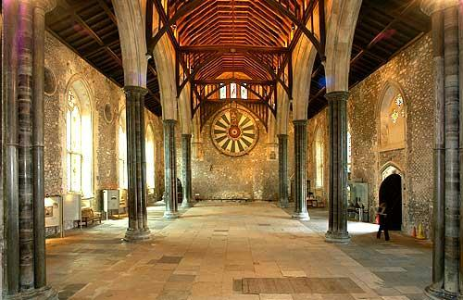
Winchester – Seat of Power
Nodes matter - The Great Hall

Slide 55
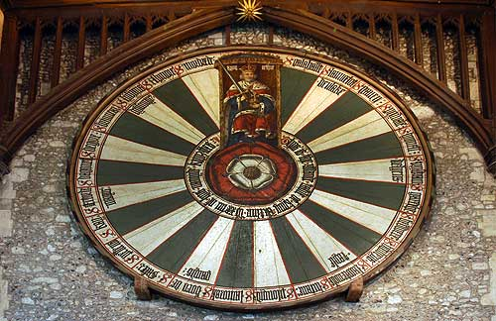
King Arthur’s Round Table

Slide 56
Most informatics systems in use today are inadequate
Handling complicated operations and contextually managing data analysis

Slide 57
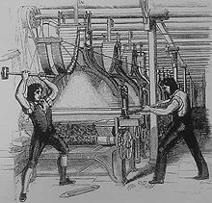
Knowledge Transfer (KT)
Cottage Industry
Threatened
Luddite Rebellion
1812

Slide 58

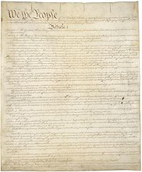
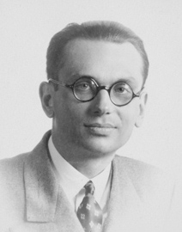
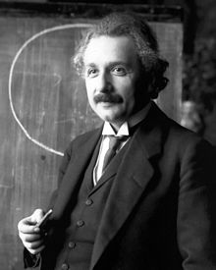
Logic Can Expose Errors
Godel & the US Constitution
1906 –1978
Statements of a formal theory are written in symbolic form, it is possible to mechanically verify that a formal proof from a finite set of axioms is valid –
automatic proof verification

