Slide 1

Including Third Party Content in Your Work
Opening Up Copyright Instructional Module
April 2019
Notes:
Hello and welcome to the University of Alberta’s Opening Up Copyright Instructional Module on Including Third Party Content in Your Work

Slide 2

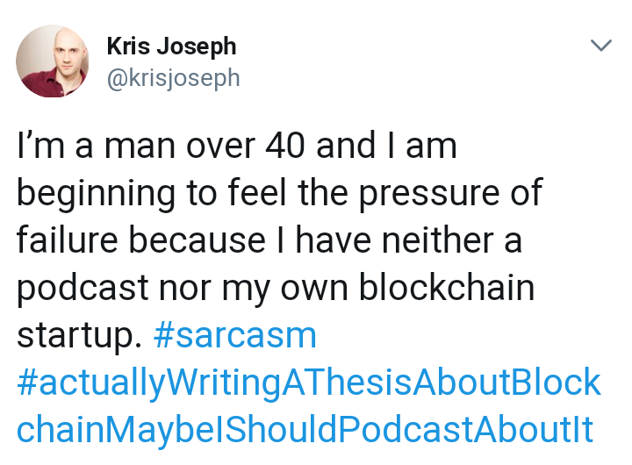
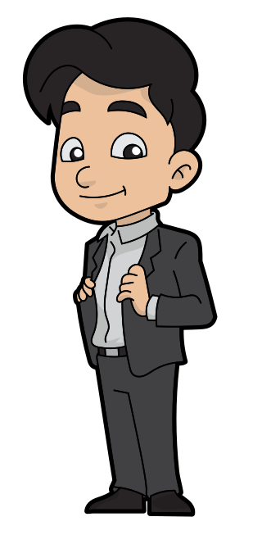

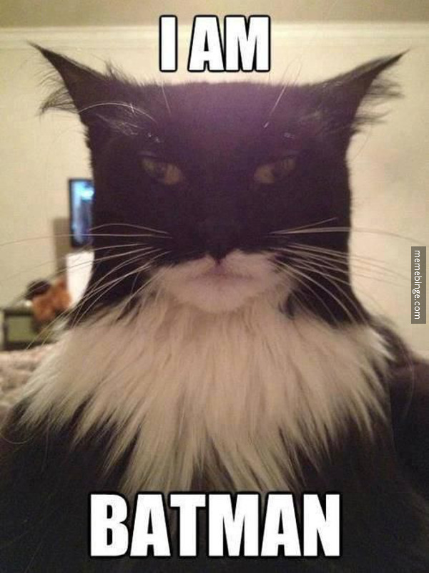
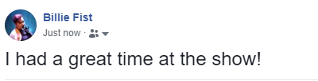
THIRD PARTY CONTENT
Bauer, G. R., & Hammond, R. (2015). Toward a broader conceptualization of trans women's sexual health. The Canadian Journal of Human Sexuality, 24(1), 1-11. doi:10.3138/cjhs.24.1-CO1
Notes:
Have you ever shared an image someone else created… maybe in a Tweet or a Facebook post? Or maybe you’ve quoted someone on a blog post or in an assignment? It’s natural to want to share things we find interesting and compelling. Communicating with others is at the core of what makes us human and sometimes the way someone else says something or captures it in an image is either better than we can do ourselves or enhances what we are trying to convey. Or let’s say that Sandy, here, would like to to share someone else’s work to analyze, criticize, or provide commentary on it.

Slide 3
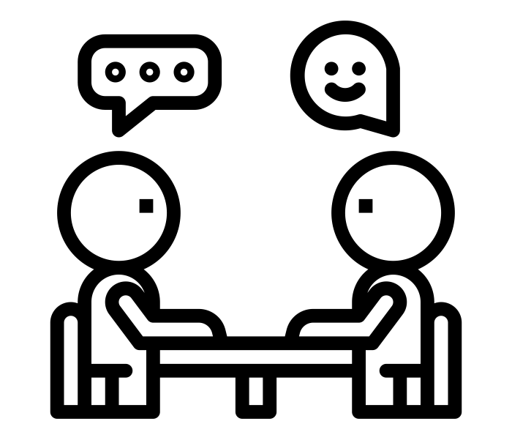

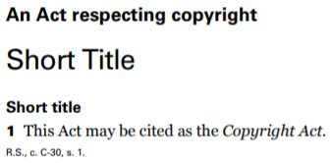
USING OTHER PEOPLE’S WORK
Terms of Use
Mike Huckabee Settles ‘Eye of the Tiger’ Lawsuit for $25,000
Former presidential hopeful must pay Survivor guitarist Frankie Sullivan
for unauthorized song use at Kim Davis rally
Kreps, D. (2016). Rolling Stone.
Notes:
3. Some of your uses of other people’s work might be permitted under the Copyright Act or allowed under the terms of use associated with the work in question. In some cases you might need to ask for permission to use a work. In other cases your intended use of another person’s work might be considered copyright infringement. This module will help you determine how and when to use works in which the copyright is held by others.
https://www.rollingstone.com/music/music-news/mike-huckabee-settles-eye-of-the-tiger-lawsuit-for-25000-72945/

Slide 4



THIRD-PARTY CONTENT
©
©
©
THIRD-PARTY CONTENT
Notes:
Third party content is the legal-sounding phrase often used to describe works in which you do not hold rights. In many cases, you will know when a work is owned by someone else… but not always. For example, Sandy’s employer might hold the rights to work they create in the course of employment. [H5P popout to s13, ownership] Or they might have transferred the copyright in a work they created to someone else via a publishing agreement or other type of contract. Sometimes it’s easy to figure out who owns the rights in a work, other times not so much.

Slide 5


QUESTIONS
1
Is the person or company who holds the rights to this content okay with my using it the way I plan to?
2
Does the Copyright Act permit my use of this content?
Notes:
There are two questions you should ask yourself when considering the use of third party content in your own work:
[c] Is the person or company who holds the rights to this content ok with my using it the way I plan to?
[c] Does the Copyright Act permit my use of this content?
If the answer to the first question is yes, you can use the third party content in your work (assuming that you also respect any terms of use defined by the rights holder). If the answer to both of these questions is, “no,” however, you should ask the rights holder directly for permission to use the work or, if practical, find a different work to use. For the rest of this module, though, we’ll focus on how to determine if the answer to either of these questions might be, “yes.”

Slide 6

THE FIRST QUESTION
1
Is the person or company who holds the rights to this content okay with my using it the way I plan to?
RE-USE
VIEW
SHARE
Notes:
Many rights-holders will make it clear how their works can be used, but others won’t. Some rights-holders only want people to *view* their work online, not re-use it. Others want their works to be widely shared and re-used.
More and more rights-holders want people to re-use their works and recognize the value of communicating this intention to users. One way they can do this is by assigning an open licence to the work, such as a Creative Commons licence. In many cases, it is ok to repost and share works with a CC licence.

Slide 7
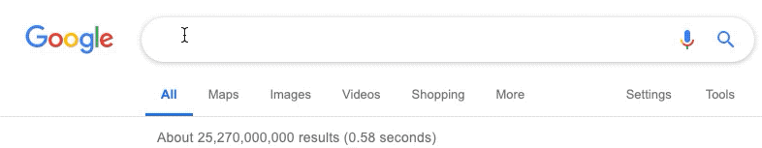
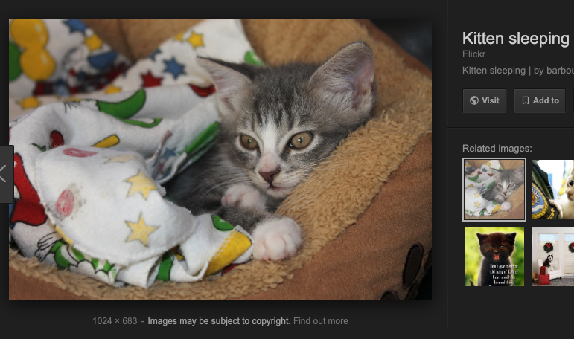
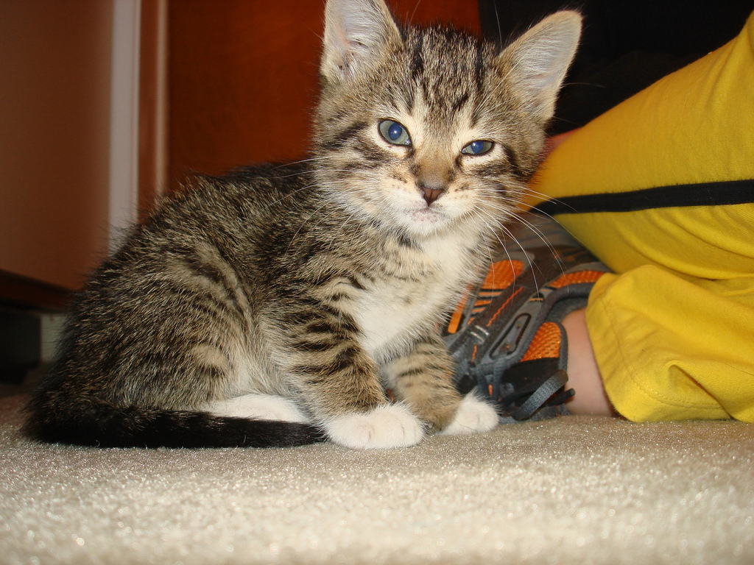
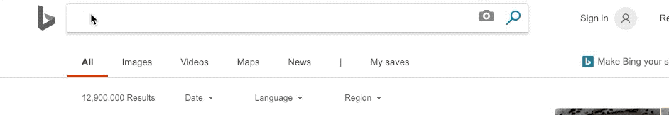
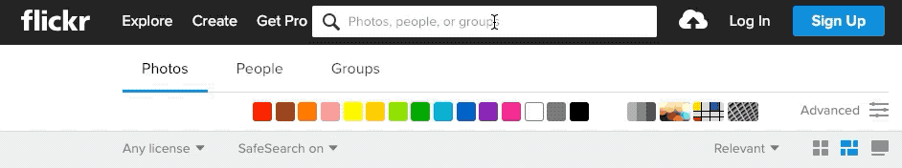
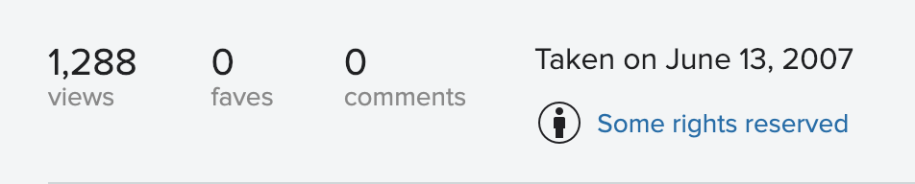
ADVANCED SEARCH
Google
Bing
Flickr
Notes:
Search engines such as Google and Bing, and photo sharing sites such as Flickr have search tools that allow you to filter by licence. Such options may be under buttons like [c]“Tools” and “Filter””
Don’t forget to confirm those terms of use at the image’s original source, as they might have changed or been mis-tagged by the service that is aggregating the images.
[c] In addition to providing a web search index and fairly decent mapping function, Google is also pretty good about informing its users about how they can and cannot re-use screen captures of search and map results. If you find content you want to re-use on a web site you trust, take a look at the terms of use associated with the site, normally linked under the headings, “copyright” or “terms of use.”

Slide 8


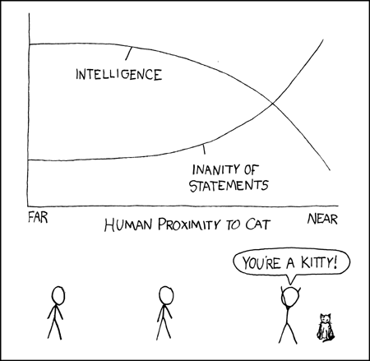

PUBLISHERS
©
Ehrlich, M. C. (2016). Taking animal news seriously: Cat tales in The New York Times. Journalism: Theory, Practice & Criticism, 17(3), 366–381.
Breed of kitten | Cuteness of kitten
Bengal | 10
Russian Blue | 7
Sphinx | 8
$
$
$
$
$
$
$
$
Notes:
Some companies make much of their revenue from the distribution and sales of other people’s work. Publishers are the traditional example, and they can often also be the rights-holder of the work you want to use. Some publishers, especially large academic publishers, make it relatively easy for graduate students and other researchers to re-use academic articles or the tables or graphs found within those articles for non-commercial purposes… often without requiring any payment. They do this by providing the user a licence that allows them to re-use the work. Sometimes the terms of these licences are reasonable, sometimes they aren’t.

Slide 9
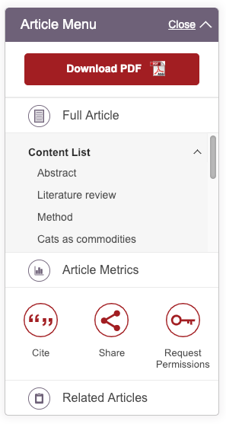

PUBLISHERS
Commercial
Reuse Licence
Notes:
As always, it’s up to you to read the fine print. Unlike the Creative Commons licences mentioned earlier, these licences are only between the publisher and one single, specified, user. To complicate things, many academic articles have both a Creative Commons licence to cover some types of re-use, often non-commercial uses, and the ability to obtain a secondary licence that allows for other types of re-use.
To explore these options for an academic article, look for the “reprints and permissions” link, usually near the top or bottom of the article.

Slide 10
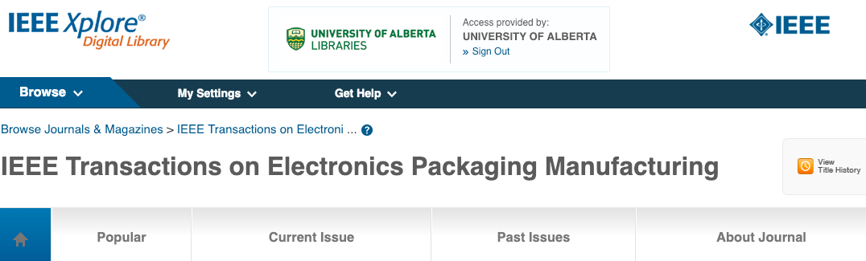
AFFILIATION
Notes:
In some cases you may also be affiliated with an institution that has purchased access to materials made available online. This would include databases, or journals like this one, accessible through your public or academic library. Again, learn about the terms of use for these materials before you copy, share or modify them.

Slide 11
THE SECOND QUESTION
1
Is the person or company who holds the rights to this content okay with my using it the way I plan to?
2
Does the Copyright Act permit my use of this content?
Notes:
Coming back to our two questions: if the rights holder is okay with your use of their work, you don’t need to think about the second question and can go ahead with your use. If they’re not, though, the second question you should ask yourself when using third party content is: Does the Copyright Act permit my use of this content?

Slide 12



USERS’ RIGHTS
Educational Institutions
Libraries,
Archives,
Museums
$
Exceptions to Infringement
Persons with Perceptual Disabilities
Non-commercial User-generated Content
Notes:
The Copyright Act includes exceptions to infringement, also known as users rights. These provisions set out limited and specific ways that Sandy can use third party content without the need to ask permission of the rights-holders or pay royalties. Fair dealing is the most well known and widely applicable of these exceptions, but there are also more narrowly defined exceptions specific to educational institutions,[c] libraries, archives, museums, and persons with perceptual disabilities. There is also a relatively new Non-commercial User-generated Content exception.

Slide 13
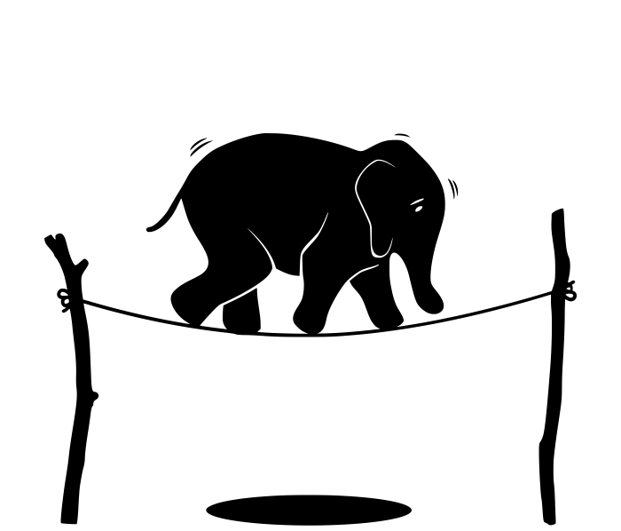
RISK ASSESSMENT
Hmmmm…
Is this
fair dealing?
Notes:
Only a court of law can determine if a use -- or dealing -- is fair. However, you can complete a fair dealing assessment on your own to get a better sense of whether or not the way you intend to use a work might be considered fair and therefore non-infringing. Since court determinations of fair dealing are made on a case by case basis, there is always some risk involved when you rely on your own fair dealing assessment.

Slide 14
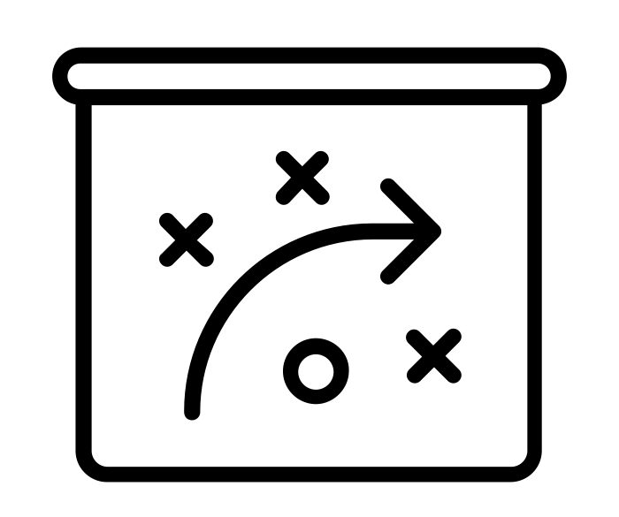
REQUESTING PERMISSION
BACKUP PLAN
X
$?
FAIR
DEALING
TERMS
OF USE
Notes:
If neither fair dealing nor the terms of use support your use of the work, you can ask the rights-holder for permission for the use. In some cases the rights-holder may want Sandy to pay for this permission. This is more likely if Sandy expects to make money from their re-use of the work. In other cases, however, the rights-holder might refuse the request to use the work at all. So it’s good to have a backup plan.

Slide 15


BACKUP PLAN
Hmmmm…
Notes:
Sandy’s backup plan could mean changing the way they use the work, with the intention of making the dealing more fair. For example, instead of making a course assignment that includes third party content available on the open web, Sandy could limit the distribution to their professor. Or it could mean choosing another work to use in the first place.

Slide 16
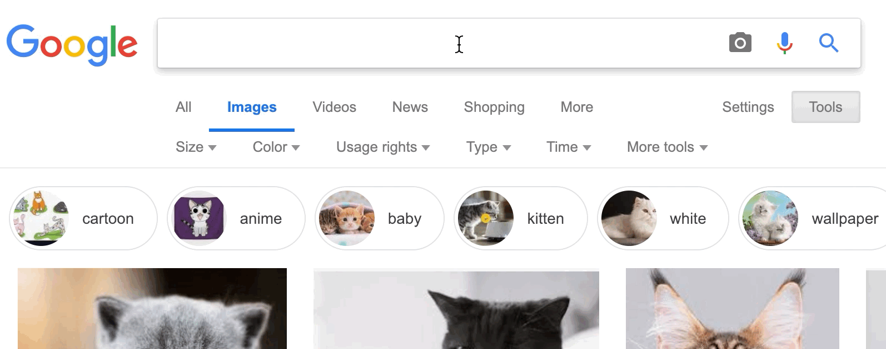

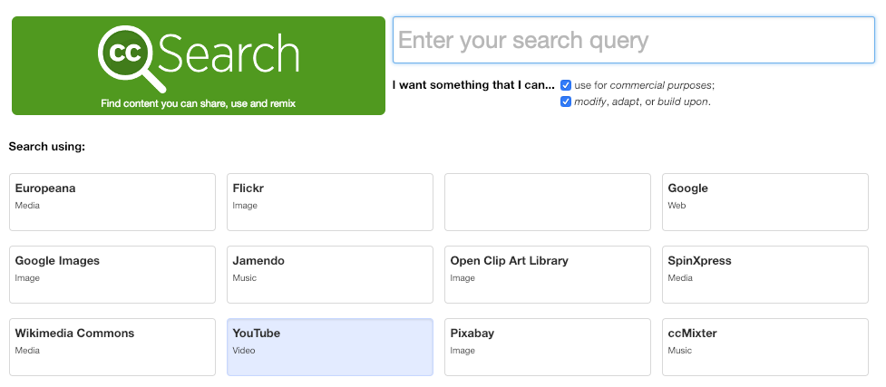
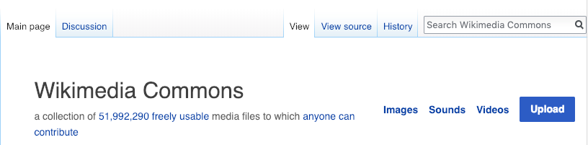
BACKUP PLAN
Notes:
We mentioned the advanced Google search a bit earlier. It’s only one of many ways to find images, music, and text-based works that are free for you to re-use. The Creative Commons search interface and exploring the free image databases listed on Wikimedia are other ways to find works that are openly available and re-usable

Slide 17

CONCLUSION
Terms of Use
Notes:
To sum up, sometimes it will make sense to use other people’s work as part of your own. Many rights-holders make this easy for you to do by assigning an open licence to their work. Others want or need to restrict re-use, sometimes to limit commercial exploitation of the work. The terms of use associated with a work, along with your willingness to rely on fair dealing or other possible exceptions to infringement will determine how and when you use third party content. Asking for permission from the rights-holder to use a work is also an option.

Slide 18
LEARNING OBJECTIVES
You should now be able to:
Outline the two key questions you should consider when determining how to incorporate third party content into your work
Locate and identify the licence terms or other terms of use for third party content you are interested in using
Determine how and when you may use works for which the copyright is held by others
Notes:
You should now be able to:
- Outline the two key questions you should consider when determining how to incorporate third party content into your work
- Locate and identify the licence terms or other terms of use for third party content you are interested in using
- Determine how and when you may use works for which the copyright is held by others

Slide 19

THANK YOU FOR YOUR ATTENTION
Notes:
This has been the opening up copyright module on Including Third Party Content in your work. Thank you for your attention

Slide 20
QUESTIONS
As long as you credit the creator, you can use anyone else’s work as part of your own.
a) True
b) False
If a rights holder does not want you to use their content as part of your own work, you can evaluate whether or not the use might be permitted…
a) …as fair dealing
b) …because it encourages market competition
c) …as long as you don’t make a profit
d) …if they never find out about it
Only a court of law can determine if your use of third party content is actually “fair dealing.”
a) True
b) False

Slide 21
QUESTIONS
Which of these is not one of the two key questions to consider when evaluating the use of third party content?
a) Does the Copyright Act permit my use of the work?
b) Is the rights holder okay with me using the work?
c) Does the original work appear in a Google search result?
You can use any content offered under any type of Creative Commons licence any way you like.
a) True
b) False
Notes:
Is the fig

Slide 22
QUESTIONS
The rights holder for a work is always the original author or creator.
a) True
b) False
Which of these is NOT considered an exception to copyright infringement (or “users’ right”)?
a) Certain uses by educational institutions
b) Conversion of text into Braille
c) Breaking a digital lock to improve accessibility to a work
d) Some user-generated content for non-commercial use
Notes:
Is the fig

Slide 23
IMAGE AND SOUND REFERENCES
GraphicMama-team. (2016) Arab girl. Pixabay. CC0 https://pixabay.com/en/arabian-arab-girl-female-ethnic-1456184/
Meme Binge. (2014). I am Batman. CC BY. https://www.flickr.com/photos/memebinge/14172428246
Supalerk laipawat. (n.d.) Interview. The Noun Project. CC0. https://thenounproject.com/icon/1962276
Amiryshakiel. (n.d.) Investigate. The Noun Project. CC0. .https://thenounproject.com/icon/1163976
Ghan Koon Lay. (n.d). Boss. The Noun Project. CC0. https://thenounproject.com/icon/1587076
Enshia. (n.d.). Book. The Noun Project. CC0. https://thenounproject.com/icon/1787402/
Vladimir Belochkin. (n.d). contract. The Noun Project. CC0. https://thenounproject.com/icon/869929
Fuzzy Gerdes. Kitten. Flickr. CC BY. https://www.flickr.com/photos/fuzzy/550450176

Slide 24
IMAGE AND SOUND REFERENCES
Ian Barbour. (2012). Kitten sleeping. Flickr. CC BY SA. https://www.flickr.com/photos/barbourians/7220144234
Michael Wohlwend. (n.d.) Gutenberg Press. The Noun Project. CC0. https://thenounproject.com/icon/86670
Xkcd. (n.d.) Cat Proximity. Xkcd. CC BY NC. https://imgs.xkcd.com/comics/cat_proximity.png
Mikicon. (n.d..) Accessibility. The Noun Project. CC BY. https://thenounproject.com/term/accessibility/975764
Rob Crosswell. (n.d.) Library. The Noun Project. CC BY. https://thenounproject.com/term/library/1122686
Tom Fricker. (n.d.) School. The Noun Project. CC BY. https://thenounproject.com/term/library/1122686
Lee Mette. (n.d.) Elephant. The Noun Project. CC BY. https://thenounproject.com/icon/163857
Wikimedia Commons Logo. (n.d.) Wikimedia Commons. Public Domain. https://en.wikipedia.org/wiki/File:Commons-logo.svg

Slide 25
IMAGE AND SOUND REFERENCES
PNG ALL. (n.d.) Copyright All Rights Reserved. PNG ALL. CC BY. http://www.pngall.com/copyright-all-rights-reserved-symbol-png
Clip Art by Vector Toons. (2018). Charming Cartoon Businessman. Wikimedia Commons. CC BY. https://commons.wikimedia.org/wiki/File:Charming_Cartoon_Businessman.svg
Chrystalelizabeth. (2014) Teacher-bookworm-glasses-professor. Pixabay. CC0. https://pixabay.com/illustrations/teacher-bookworm-glasses-professor-359311/
Unattributed materials are contributions from the Opening Up Copyright Project Team and placed in the Public Domain
Closing Slides Music: Rybak, Nazar. “Corporate Inspired.” HookSounds. n.d. http://www.hooksounds.com (used under a CC-BY 4.0 Licence)

Slide 26
LICENSING AND ATTRIBUTION
Suggested Citation:
  University of Alberta. 2018. “Third Party Content.” Opening Up Copyright Instructional Module. https://www.ualberta.ca/copyright/resources/opening-up-copyright-instructional-modules
For the project overview and complete list of modules please visit the project website at: https://www.ualberta.ca/copyright/resources/opening-up-copyright-instructional-modules
Questions, comments, and suggestions should be directed to the University of Alberta’s Copyright Office at: copyright@ualberta.ca
This module is made available and licensed under a Creative Commons Attribution 4.0 International Licence

