Slide 1
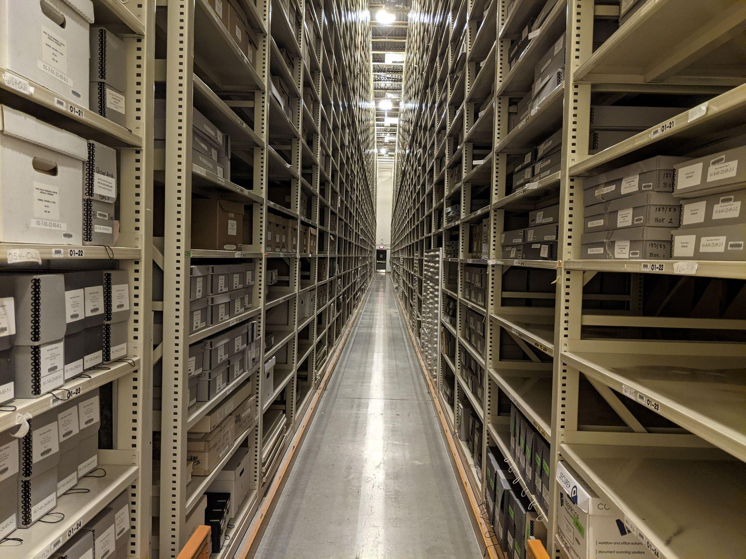
The Importance of Archives: where do unaffiliated polar organizations archive their records?
LAURA KISSEL BYRD POLAR and CLIMATE RESEARCH CENTER
ARCHIVAL PROGRAM
THE OHIO STATE UNIVERSITY
PETER LUND SCOTT POLAR RESEARCH INSTITUTE
UNIVERSITY OF CAMBRIDGE
SANDY CAMPBELL UNIVERSITY OF ALBERTA LIBRARY

Slide 2
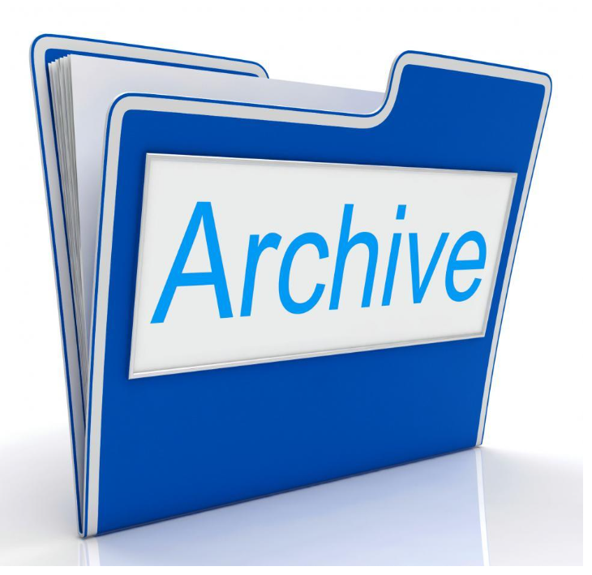
Background
1. Archiving DALAM records
2. Why the Internet Archive is not
a good choice
3. Mandate of traditional archives
Notes:
This paper/presentation idea came about when we discovered that there was no logical place to archive the DALAM records. Presenter note: this is the abstract

Slide 3
Introduction
Archives are usually designed to collect the records of the organization with which they are affiliated.
Notes:
Presenter note: Introduction

Slide 4

Archives and the Practice of Archiving
1. Archives are the ‘memory’ of an organization
2. Archives preserve primary source materials
3. Archives are used for research and for legal purposes.
Notes:
Presenter Note: Background: Archives and the Practice of Archiving

Slide 5
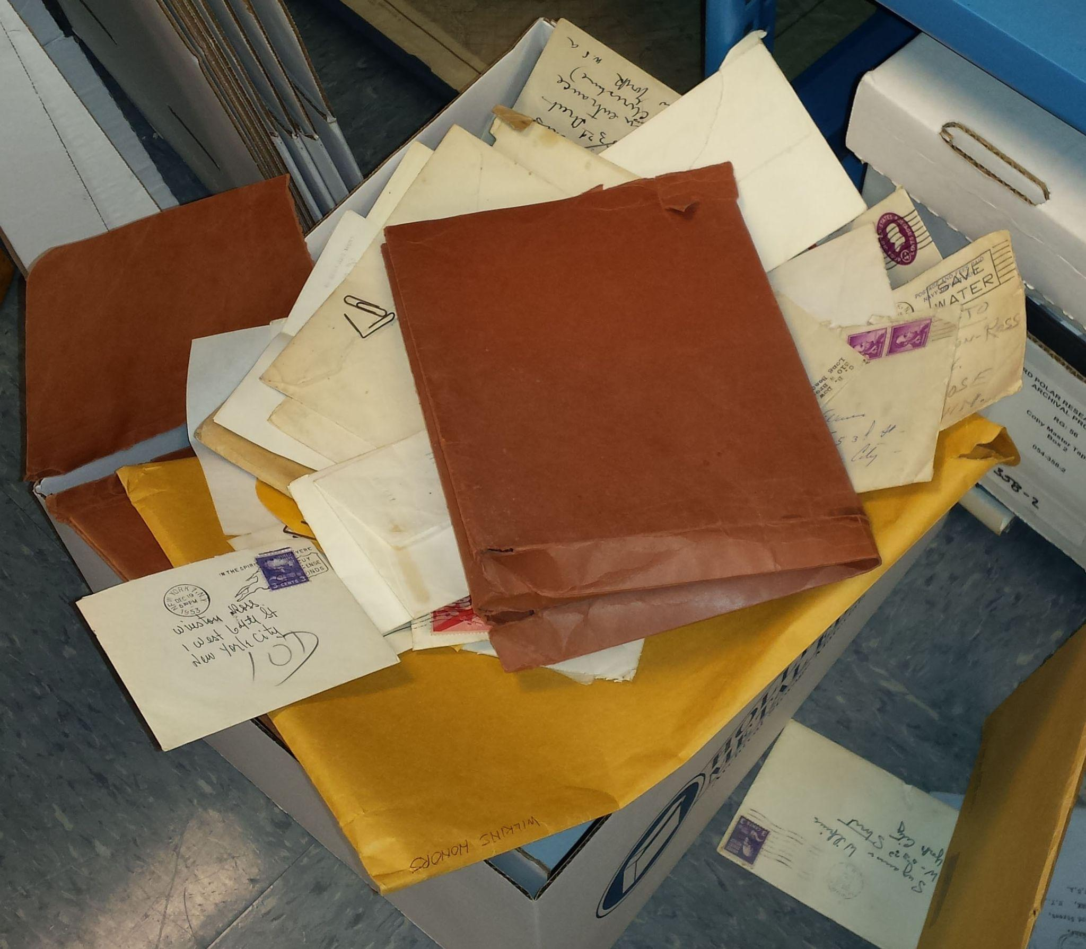
Archival Collections may include:
organizational records such as minutes of meetings
manuscript materials, such as writings and drafts
photographs
reports
diaries or journals
moving image film
data in any format
sound recordings
correspondence
newspaper clippings
scrapbooks
field notes
laboratory notebooks

Slide 6

Who are “Unaffiliated International Polar Organizations”?
Unaffiliated International Polar Organization (UIPO) is our term for an organization like the PLC or DALAM that is not tied to a particular university or government entity, and therefore has no logical place for depositing their archival materials.

Slide 7
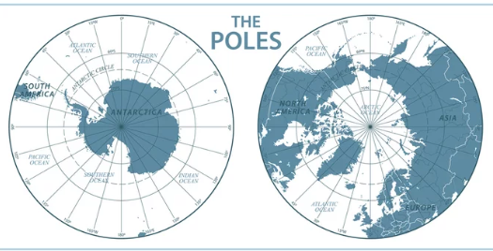
Why should UIPOs archive their records?
Both the Arctic and the Antarctic are geographically international arenas
At both poles, engagement among nations involved naturally gives rise to international polar organizations
Notes:
Presenter Note: Why is Archiving of records of UIPOs important?

Slide 8

Reasons why UIPOs might not archive yet
1. Don’t see the need to archive records.
  Organization still active – don’t need to archive now
  Don’t think anyone else would care about our records
2. No obvious connection with an archive
3. Don’t know who to ask.
4. Seems like too much work.
5. Don’t want to give up control of records
6. Don’t want to make records public.

Slide 9

Why ‘automatic’ electronic storage won’t work
1. If it has never been online, it can’t be captured
2. Definitions and functions of IRs are not consistent across organizations
3. IRs and online repositories lack the curatorial function of Archives

Slide 10
Solutions currently used by some unaffiliated organizations
1. Do nothing (broom closet solution)
2. Store on a local/personal server
3. Store on a commercial server
4. Store parts of the organization’s records on several servers
5. Find a friendly archive and deposit there
6. Archive with a member’s affiliated archive
Example: University of Alberta

Slide 11
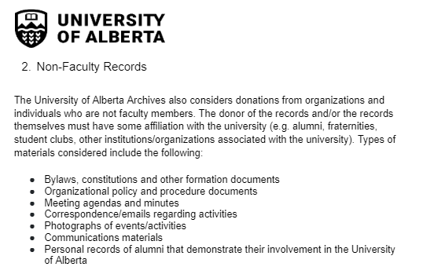
Archive with an affiliated organization

Slide 12
Decisions When Deciding to Archive
Domain | Choices
Location | Single or multiple locations
Staff | Dedicated in-house or rely on staff at other org
Space | Dedicated in-house or housed with another org
Control | Maintain ownership/transfer ownership
Privacy | Limited access or open to the public
Catalogue Access | Unique catalogue or integrate into consortial catalogue

Slide 13
Examples of how Three UIPOs Currently Archive their Records
1. PLC
2. DALAM
3. SCAR

Slide 14
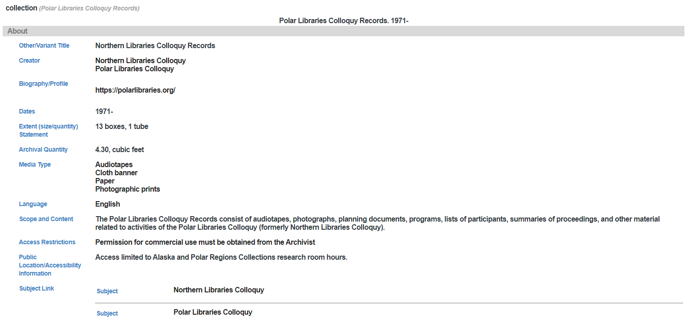
Notes:
This is the catalog record for the PLC Records at UAF. There are actually 10 accessions (11, if you include the materials I just sent) for the PLC.

Slide 15
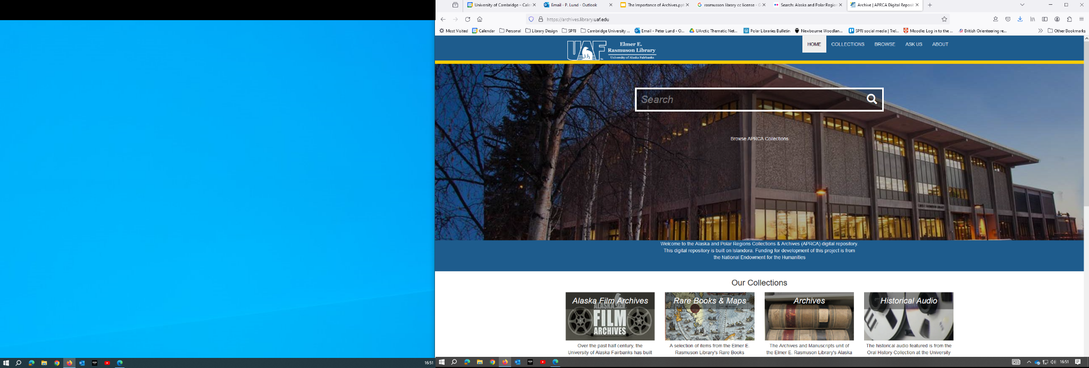
DALAM Records held at APRCA
An archival deposit was created for DALAM's records at the Alaska and Polar Regions Collections & Archives (APRCA) at University of Alaska Fairbanks. The records parallel those of the Polar Libraries Colloquy, which also reside at APRCA. DALAM records will be open to the public through this deposit. The initial deposit included DALAM's foundational documents and the first years' agendas and meeting notes.
Notes:
DALAM added to the PLC collection at UAF - but would never have been accepted w/o the PLC Records already archived there. Materials sent XXXX by Sandy. Not yet cataloged by UAF so does not appear in their online catalog.

Slide 16
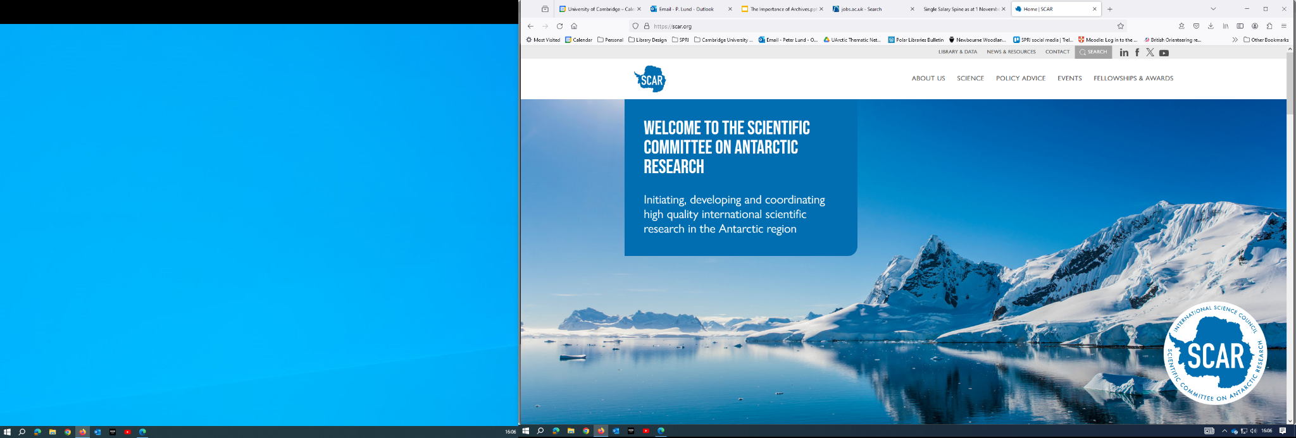

Scientific Committee on Antarctic Research (SCAR)
SCAR based at SPRI since 1958
Archive records first deposited on loan in 1982
Records returned to SCAR in 2007
Records now being prepared for archiving
Under a Memorandum of Understanding archived records are still owned by SCAR with access to them managed by SPRI’s full-time, professionally qualified Archivist
Archive is accredited by the UK’s National Archives

Slide 17
Next Steps: How can PLC help?
1. Identify archives willing to take records of Unaffiliated International Polar Organizations
2. Awareness campaign about the importance of archiving records
3. Pointing to good archival educational programs already available

Slide 18
Awareness Campaign
The PLC could create a statement or publicity material to help people understand the importance of archiving.
Encourage people to ask an archivist/librarian for help!

Slide 19
Future Research
PLC could document the locations of various UIPOs, as this can be difficult for researchers to find them.
Notes:
Example: American Polar Society Records are held by the Byrd Polar and Climate Research Center Archives

Slide 20
Create a web page with links to “how to create an archive”
Library of Congress. Your Personal Archiving Project: Where Do You Start? https://blogs.loc.gov/thesignal/2016/05/how-to-begin-a-personal-archiving-project/
Green, S. 20 Steps for Developing an Archives, 2005. Center for the Study of Upper Midwestern Cultures. University of Wisconsin - Madison, 2005. https://csumc.wisc.edu/common-folklore-archiving-issues-and-selected-resources/20-steps-for-developing-an-archives/
Notes:
Many examples exist online - we are presenting 2 here

Slide 21
Conclusions
Purpose of this study: to highlight the issues around the archiving of unaffiliated international polar organization’s records.
We conclude that:
UIPOs should be encouraged to recognize the historical and research value of their records
UIPOs should consider formally archiving appropriate records
UIPOs may have difficulty identifying an archive for their records
PLC has the experience and knowledge to be able to offer guidance and advice to UIPOs seeking archive their records.

Slide 22
Thank You

