Slide 1
Our Stories
sharing the Indigenous Edmonton experience

Slide 2

Create a digital public space for local Indigenous stories and content
With community.
By community.
For community.

Slide 3
Project Steps
Community Consultations
Hire a project facilitator and part-time assistant
Purchase, develop and launch a platform
Create and gather stories and content
  in-branch and outreach programs and workshops
  supporting community projects
Notes:
We have received funding to work with our communtiies to create a digital public space of Edmonton Indigenous stories. In collaboration with community, we will

Slide 4

A digital space is…
“An open resource of culture and knowledge, a wholly collaborative web through which anyone, anywhere, anytime can access, explore and create with digital content.”

Slide 5
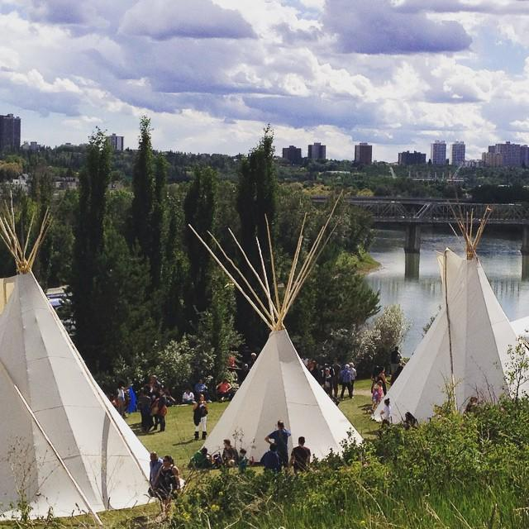
In other words…
“ A local, community knowledge gathering place.”

Slide 6
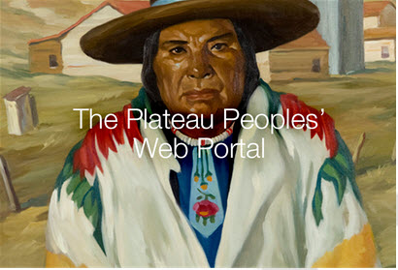

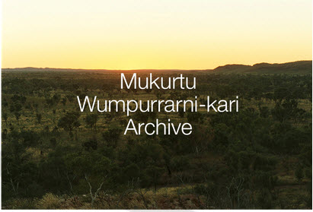
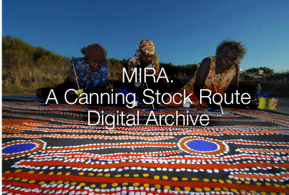
What about an Indigenous Public Space?

Slide 7
Our Stories…
Personal Stories
Oral Histories
Culture
Artworks
Language
Documents
Photographs
Music/Audio

Slide 8
Desired outcome…
Creating
Sharing
Discovering
Learning
Celebrating
Connecting
Understanding
Honouring
Remembering
Imagining

Slide 9
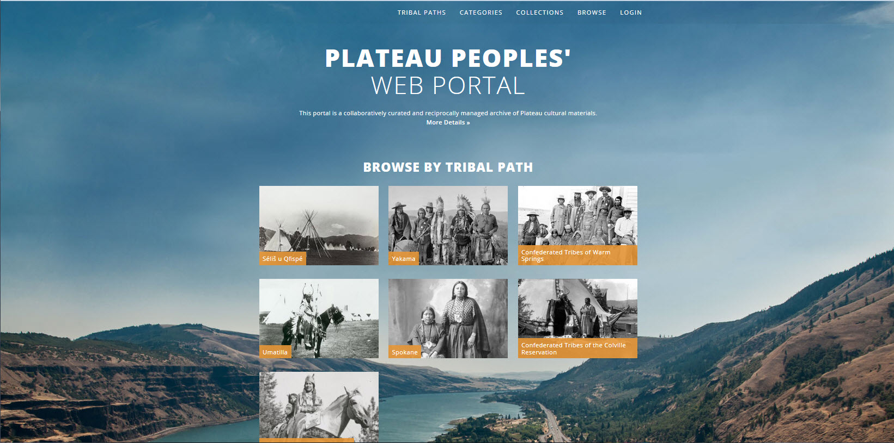
One example…
Notes:
This portal is a collaboratively curated and reciprocally managed archive of Plateau cultural materials.
TRIBAL PATHS
Each path allows viewers to directly access materials from one tribe. As a matter of sovereignty and respect, each tribal path follows the protocols of the tribes, allows for tribal curation of materials, and defines access based on cultural values.

Slide 10
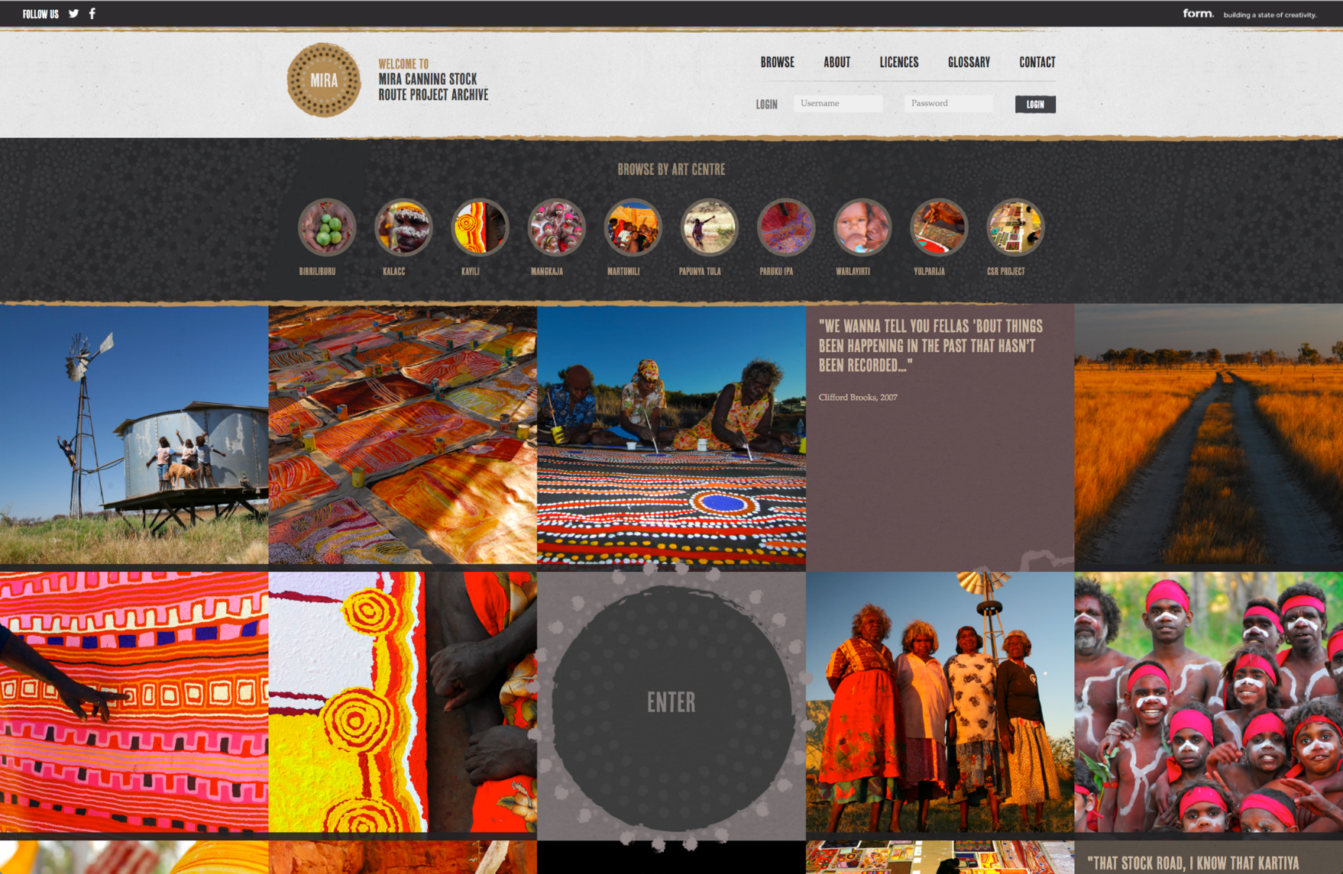
And another…
Notes:
Canning Stock Route Project, initiated in 2006 and has involved over 250 Aboriginal participants, over 100 Aboriginal artists and elders, approximately 100 non-Indigenous contributors, and a cross-cultural project team of curators, filmmakers, photographers and cultural advisors.
Their collective contributions have resulted in a vast archive of intangible cultural heritage, which the Project has been committed to returning to participating communities since its early days. With the astronomical growth of Project content between 2006 and 2013 amounting to over 40,000 unique cultural heritage items, the Project team has been focused on the development of innovative and sustainable digital solutions for the repatriation of this content to the 17 remote Aboriginal communities involved.
The Canning Stock Route Digital Futures Project enables intangible cultural heritage materials to be used, shared, viewed and enjoyed in communities via an online portal.

Slide 11
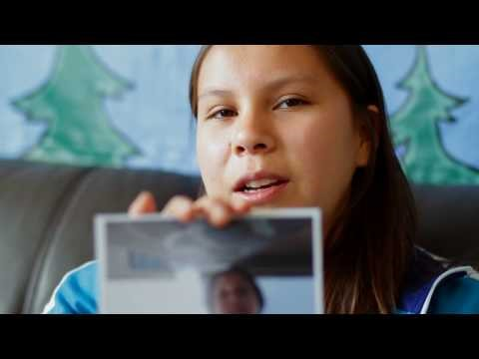
And one more.
In My Own Eyes – Nadia Chiblow
Notes:
Anyone can make a digital story. Here is an example from the In My Own Eyes project.
In My Own Eyes is a partnership between the Ontario Ministry of Aboriginal Affairs and Harbourfront Centre. This project gives Aboriginal youth a chance to share their stories with people across the province. They also learn the role photography can have in storytelling and social change.
Aboriginal youth, both on-reserve and urban, are mentored in their communities by an Aboriginal photographer. Over the course of three days, the mentors teach youth basic photographic history, theory, techniques and equipment. The participants learn that photography can be a new and slower way of seeing. They also learn how to use the mediums of colour, shape, pattern and texture to create a narrative. The youth use digital cameras in the local environment to try this new way of seeing and to tell their stories.

Slide 12
We want to hear from you!
What stories would you like to share?
What will it do?
What will it contain?
How can it be used?
Contact:
Lese Skidmore
lskidmore@epl.ca

