Slide 1
developing strong data roots in fertile library soil: e-science in canadian libraries
Geoff Harder
Canadian eResearch Community, CLA, 2013

Slide 2
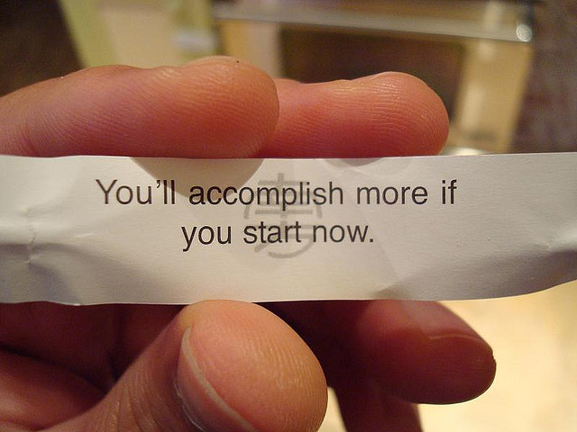
“A year from now you may wish you had started today.” - Karen Lamb
Image credit: numskullery/Flickr, Creative Commons licensed

Slide 3
The most important step is taking the first one. [have an agenda]
Goals and objective setting for e-science is important. We can’t afford BUSY work.
Articulate goals and act with purpose.
Planning and action *can* begin at the grassroots.
Assume there is no top down funding.
Take action: Environmental scan, requirements building, re-imagining services, tools, communications, education, training
Image Attribution: http://www.flickr.com/photos/badbodydoubletrouble/6333804376/sizes/o/in/photostream/

Slide 4
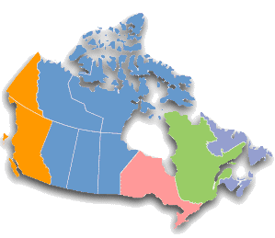
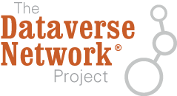
A few examples of collaborative e-science in action:

Slide 5
data.archivematica collaboration
What: Tools - Open source software stack to create and manage OAIS compliant AIPs; dashboard for monitoring and auditing preservation; ability to take action, e.g. file normalization
U of A/UBC/SFU: joint effort to make Archivematica research data friendly
Development includes: file normalization, LOCKSS, generic storage APIs, repository connectors
Momentum: Others looking to join/fund new components

Slide 6
collaboration
Create a Social Sciences and Humanities Private LOCKSS Network (PLN) - address gap
In discussion: UofA, UBC, SFU, Scholar’s Portal/OCUL
Goal: Preserve SSH data at risk; small data is vulnerable
Phase 1: dark archive
Phase 2: strategies to brighten data; develop value-added services

Slide 7
borrow and build
Canadian Polar Data Network - polardatanetwork.ca
UAL, OCUL/Scholar’s Portal, Canadian Cryospheric Information Network/Polar Data Catalogue UWaterloo – International Polar Year, CISTI, DFO
Data deposit agreement - http://polardatanetwork.ca/wp-content/uploads/DataDepositAgreementforCPDN.pdf
Governance - http://polardatanetwork.ca/?page_id=277
Metadata standards - http://polardatanetwork.ca/wp-content/uploads/CPDNBestPracticeForNapMetadata1.pdf

Slide 8
Several institutions looking at Dataverse – lightweight data management
OCUL: in production
UAL: testing; launch in fall 2013
UBC: testing
“…makes it easy for researchers to deposit data, create appropriate metadata, and version documents as you work. Access to data and supporting documentation can be controlled down to the file level, and researchers can choose to make content available publicly, only to select individuals, or to keep it completely locked. All data is hosted on Canadian servers, in a secure environment that conforms to industry best practices for maintaining data integrity and longevity.”

Slide 9
Source: M. Leggott, Goats in the Garden, APLA 2013
UPEI running VREs for 5 years
Open source project (Fedora + Drupal) growing in use – generic VRE service pack in late 2013
Domain specific solution packs for 2013 to include Digital Humanities, Chemistry, Biodiversity

Slide 10
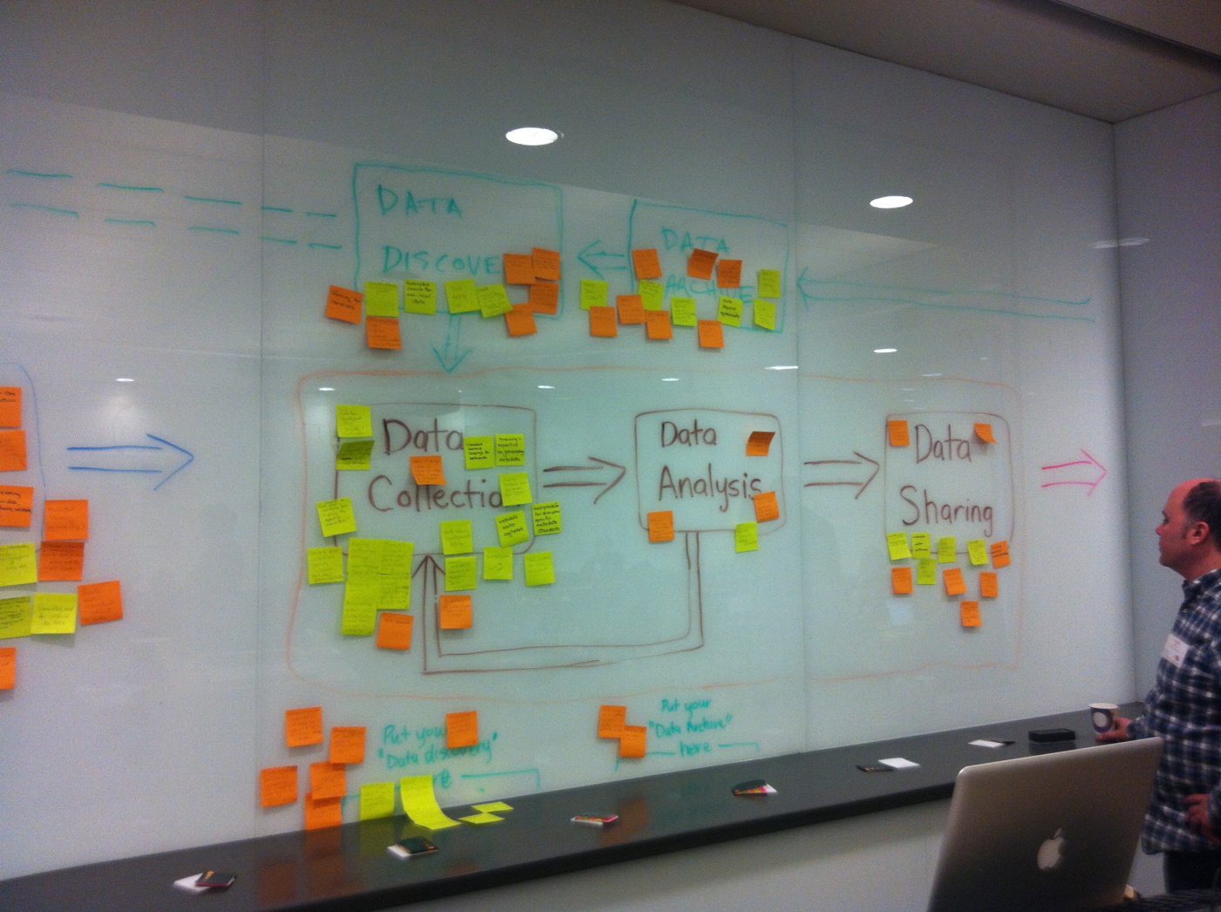
from the roots: action items
Things are happening!
Identify gaps
Leverage existing resources, partnerships, infrastructure
Do something today!
Image credit: http://thezeds.com/2013/02/06/carl-research-data-management-course-rdm/

